Slide 1
FORM 4
GEOGRAPHY
Lesson 34
Condensation
Notes:
Good morning, class, and welcome to our geography lesson. I am your geography teacher, Mr Kamdem. Today we are starting Lesson 34: Condensation.

Slide 2
CLASS INFO
Class, Chapter and Duration
Class | Form 4
Chapter | Module 3: Weather and Climate — Adaptation to Climatic Excesses
Duration | 50 minutes
Notes:
This lesson is for Form 4. It belongs to Module 3: Weather and Climate — Adaptation to Climatic Excesses. We shall need 50 minutes to cover it.

Slide 3
IDENTIFICATION
Lesson Identification
Topic | The Earth-Atmosphere System
Sub-topic | Forms of Condensation
Lesson | Lesson 34: Condensation
Notions / Concepts | Drizzle, precipitation, hail, cloud, fog, dew, mist.
Syllabus focus | Meaning of condensation; forms of condensation.
Competence | Learners are able to explain the drops of water that appear on cold objects, grass and windows, and to drive or walk carefully in fog.
Notes:
Our topic is The Earth-Atmosphere System, and the sub-topic is Forms of Condensation. The key notions we shall use today are: drizzle, precipitation, hail, cloud, fog, dew, mist. At the end, you should be able to do this: learners are able to explain the drops of water that appear on cold objects, grass and windows, and to drive or walk carefully in fog.

Slide 4

HOMEWORK CORRECTION
Correction of the Homework
Question (Lesson 33: Weather Elements: Humidity, Wind, Pressure and Sunshine):
Early tomorrow morning, look at the grass, leaves or cars near your house. Write down whether you see drops of water on them, and where you think the water came from.
Notes:
Before we start the new lesson, let us correct the homework I gave you at the end of Lesson 33: Weather Elements: Humidity, Wind, Pressure and Sunshine. The question was: Early tomorrow morning, look at the grass, leaves or cars near your house. Write down whether you see drops of water on them, and where you think the water came from. Take out your exercise books.

Slide 5
HOMEWORK CORRECTION
Correction: Possible Answer
Yes, there are drops of water (dew) on the grass and cars. The water came from water vapour in the air, which condensed when the air cooled during the night.
Notes:
Here is a good answer. Yes, there are drops of water (dew) on the grass and cars. The water came from water vapour in the air, which condensed when the air cooled during the night. Compare it with your own answer and correct your work in red.

Slide 6
LESSON PLAN
Lesson Plan
Correction of the homework
Objectives and recall
Real-life situation and action to take
Learning activities
Board summary
Evaluation, remediation and homework
Notes:
Here is the plan of our lesson today. First, we shall correct the homework. Then we shall look at the objectives and recall what you already know. After that, we shall study a situation from real life and the action to take, and do the learning activities. Finally, we shall copy the board summary, do the evaluation and the remediation, and I will give you the homework.

Slide 7
OBJECTIVES
Objectives
By the end of this lesson, you should be able to:
Define condensation, saturation and dew point.
State the conditions necessary for condensation.
Notes:
Take your time to copy this part; we will continue together.

Slide 8
OBJECTIVES
Objectives (continued)
Describe the forms of condensation near the ground and in the atmosphere.
Notes:
By the end of this lesson, you should be able to do three things. Number 1: define condensation, saturation and dew point. Number 2: state the conditions necessary for condensation. Number 3: describe the forms of condensation near the ground and in the atmosphere.

Slide 9
PREVIOUS KNOWLEDGE
Previous Knowledge
Humidity is the amount of water vapour in the air.
It is measured with a hygrometer and given in percent.
Warm air can hold more water vapour than cold air.
Notes:
Let us first remember what you already know. Humidity is the amount of water vapour in the air. It is measured with a hygrometer and given in percent. Warm air can hold more water vapour than cold air. Keep this in mind, because we shall build on it today.

Slide 10
REAL-LIFE SITUATION
Situation in Real Life
On a hot afternoon, Yaya takes a cold bottle out of the refrigerator. After a few minutes, drops of water cover the outside of the bottle. The bottle is closed.
Notes:
Listen carefully to this situation from real life. On a hot afternoon, Yaya takes a cold bottle out of the refrigerator. After a few minutes, drops of water cover the outside of the bottle. The bottle is closed. Think about it, because I am going to ask you some questions.

Slide 11
REAL-LIFE SITUATION
Situation: Question 1
What is the problem in the situation?
Notes:
Question 1: What is the problem in the situation? Think for a moment, then raise your hand to answer.

Slide 12
REAL-LIFE SITUATION
Answer
Yaya does not know where the drops come from.
Notes:
Good. Yaya does not know where the drops come from.

Slide 13
REAL-LIFE SITUATION
Situation: Question 2
Where is the water from?
Notes:
Question 2: Where is the water from? Think for a moment, then raise your hand to answer.

Slide 14
REAL-LIFE SITUATION
Answer
From the water vapour in the air.
Notes:
Good. From the water vapour in the air.

Slide 15
REAL-LIFE SITUATION
Situation: Question 3
What changed it into drops?
Notes:
Question 3: What changed it into drops? Think for a moment, then raise your hand to answer.

Slide 16
REAL-LIFE SITUATION
Possible Answer
The cold bottle cooled the air.
Notes:
Good. The cold bottle cooled the air.

Slide 17
ACTION TO TAKE
Action to Take
Drive carefully in fog and mist.
Notes:
From this situation, the action we are working towards in this lesson is the following: drive carefully in fog and mist.

Slide 18
JUSTIFICATION
Justification of the Lesson
This lesson helps us to understand how clouds, fog and dew form.
Notes:
Why is this lesson important for you? This lesson helps us to understand how clouds, fog and dew form.

Slide 19
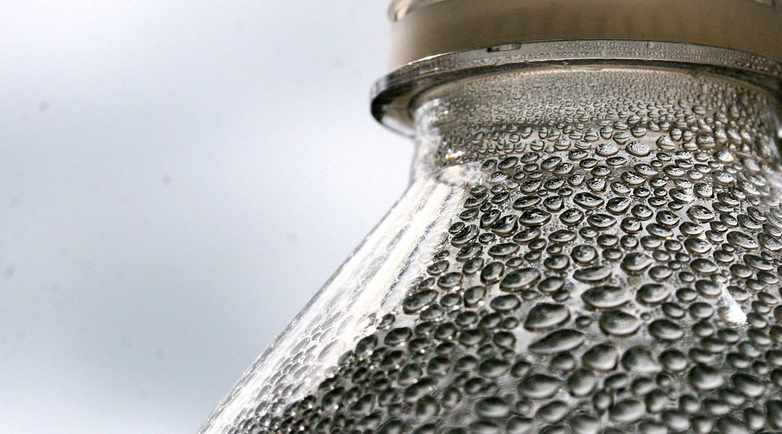
1. MEANING OF CONDENSATION
Activity 1
Drops of water on a cold bottle.
Notes:
Activity 1. Look carefully at this picture: drops of water on a cold bottle. Observe every detail before I ask the question.

Slide 20
1. MEANING OF CONDENSATION
Activity 1: Question
What do we call the change of water vapour into drops of water?
Notes:
Here is the question for Activity 1: What do we call the change of water vapour into drops of water? Take one minute to think and write your answer in your rough notebook.

Slide 21
1. MEANING OF CONDENSATION
Activity 1: Answer
Condensation.
Notes:
Let us check the answer together. Condensation.

Slide 22

2. FORMS OF CONDENSATION
Activity 2
Fog in the valleys in the morning.
Notes:
Activity 2. Look carefully at this picture: fog in the valleys in the morning. Observe every detail before I ask the question.

Slide 23
2. FORMS OF CONDENSATION
Activity 2: Question
What is fog?
Notes:
Here is the question for Activity 2: What is fog? Take one minute to think and write your answer in your rough notebook.

Slide 24
2. FORMS OF CONDENSATION
Activity 2: Answer
A cloud at ground level.
Notes:
Let us check the answer together. A cloud at ground level.

Slide 25

2. FORMS OF CONDENSATION
Activity 3
A very tall storm cloud.
Notes:
Activity 3. Look carefully at this picture: a very tall storm cloud. Observe every detail before I ask the question.

Slide 26
2. FORMS OF CONDENSATION
Activity 3: Question
This cloud brings heavy rain and thunder. What is it called?
Notes:
Here is the question for Activity 3: This cloud brings heavy rain and thunder. What is it called? Take one minute to think and write your answer in your rough notebook.

Slide 27
2. FORMS OF CONDENSATION
Activity 3: Answer
A cumulonimbus cloud.
Notes:
Let us check the answer together. A cumulonimbus cloud.

Slide 28
BOARD SUMMARY
Board Summary
Topic: The Earth-Atmosphere System
Sub-topic: Forms of Condensation
Lesson 34: Condensation
Notes:
Now we are going to copy the board summary. Write the title and the headings neatly in your notebooks. I will give you enough time for each slide, so do not rush.

Slide 29
BOARD SUMMARY
1. Meaning of Condensation
Condensation and its conditions are explained as follows:
Condensation: It is the change of water vapour into liquid water.
Dew point: It is the temperature at which the air is saturated and condensation starts.
Notes:
Let us copy Meaning of Condensation. Condensation and its conditions are explained as follows. On this slide we have Condensation and Dew point. Write each point on a new line, with the key term first, and explain it in your own words when we revise. When you finish, we go to the next slide.

Slide 30
BOARD SUMMARY
1. Meaning of Condensation (continued)
Conditions: Condensation needs moist air, cooling to the dew point and tiny particles of dust.
Notes:
We continue with Meaning of Condensation. On this slide we have Conditions. Write each point on a new line, with the key term first, and explain it in your own words when we revise.

Slide 31
BOARD SUMMARY
2. Forms of Condensation
Condensation takes the following forms:
Dew: It is drops of water formed on cold surfaces such as grass in the early morning.
Fog and mist: They are clouds formed at ground level.
Notes:
Let us copy Forms of Condensation. Condensation takes the following forms. On this slide we have Dew and Fog and mist. Write each point on a new line, with the key term first, and explain it in your own words when we revise. When you finish, we go to the next slide.

Slide 32
BOARD SUMMARY
2. Forms of Condensation (continued)
Clouds: They are masses of water droplets in the sky, such as cumulus, stratus, cirrus and cumulonimbus.
Frost: It is ice formed when the temperature falls below 0 °C.
Notes:
We continue with Forms of Condensation. On this slide we have Clouds and Frost. Write each point on a new line, with the key term first, and explain it in your own words when we revise.

Slide 33
FORMATIVE EVALUATION
Evaluation 1
What is condensation?
Notes:
Now let us check what you have understood. Question 1: What is condensation? Answer in your exercise book.

Slide 34
FORMATIVE EVALUATION
Expected Answer
The change of water vapour into water.
Notes:
The expected answer is: the change of water vapour into water. If you got it right, well done.

Slide 35
FORMATIVE EVALUATION
Evaluation 2
Which cloud brings thunderstorms?
Notes:
Now let us check what you have understood. Question 2: Which cloud brings thunderstorms? Answer in your exercise book.

Slide 36
FORMATIVE EVALUATION
Expected Answer
The cumulonimbus.
Notes:
The expected answer is: the cumulonimbus. If you got it right, well done.

Slide 37
REMEDIATION
Remediation
Fill in the blanks:
Water vapour becoming water is ______.
Drops on grass in the morning are ______.
A cloud at ground level is ______.
Notes:
For those who need more practice, fill in the blanks in your exercise book. The answers are: number 1, condensation; number 2, dew; number 3, fog.

Slide 38
HOMEWORK
Homework
During the next rain, put an empty tin with straight sides in an open place. After the rain, measure the depth of water in it with a ruler, in millimetres.
Notes:
For your homework: During the next rain, put an empty tin with straight sides in an open place. After the rain, measure the depth of water in it with a ruler, in millimetres. We shall correct it at the beginning of our next lesson.

Slide 39
NEXT LESSON
Next Lesson
Our next lesson will be on:
Lesson 35: Precipitation
Notes:
Our next lesson will be on Lesson 35: Precipitation. Thank you for your attention, and see you next time.

Slide 40
BILINGUAL GAME
Bilingual Game (Jeu Bilingue)
English | Français
Condensation | La condensation
Water vapour | La vapeur d'eau
Dew point | Le point de rosée
Dew | La rosée
Frost | Le givre
Fog | Le brouillard
Mist | La brume
Cloud | Le nuage
Notes:
Let us play the bilingual game. I say a word in English, and you give me the French word. Then we do the reverse.

Slide 41
LOGBOOK
Official Logbook (1/2)
Module / Topic | The Earth-Atmosphere System
Lesson Title | Lesson 34: Condensation
Expected Learning Outcomes | Define condensation, saturation and dew point. State the conditions necessary for condensation. Describe the forms of condensation near the ground and in the atmosphere.
Competence | Learners are able to explain the drops of water that appear on cold objects, grass and windows, and to drive or walk carefully in fog.
Notes:
I record this information in the official logbook of the class after the lesson.

Slide 42
LOGBOOK
Official Logbook (2/2)
Matter Taught | Meaning of Condensation; Forms of Condensation.
Evaluation | Formative evaluation and remediation exercise.
Homework | During the next rain, put an empty tin with straight sides in an open place. After the rain, measure the depth of water in it with a ruler, in millimetres.
Enrolment / Present / Absent | ____ / ____ / ____
Achievement | To be completed after the lesson.
Notes:
I complete the second page of the logbook: the matter taught, the evaluation, the homework and the attendance.

Slide 43
TEACHER'S NOTE
Teacher's Note
Timing: Homework correction, plan, objectives 4 min | Recall, situation, action 6 min | 3 activities 12 min | Board summary (copying) 15 min | Evaluation, remediation 5 min | Homework, next lesson 3 min | Logbook 5 min
Without the projector (Activity 1): bring a cold bottle to class.
Without the projector (Activity 2): describe a foggy morning on the Adamawa plateau.
Without the projector (Activity 3): draw a very tall cloud with a flat top.
Notes:
This slide is for me, the teacher: it gives the timing of the lesson and what to do if the projector is not available.

Slide 44
REFERENCES
References
National Geography Syllabus (MINESEC), Form 4 — Module 3: Weather and Climate.
Teacher's lesson notes (f4.docx), checked and corrected where necessary.
Photo, Activity 1: “water bottle” by Muffet, CC BY 2.0, via Flickr (https://www.flickr.com/photos/53133240@N00/542497582)
Photo, Activity 2: “Mist” by Art by MarkAC, CC BY-SA 2.0, via Flickr (https://www.flickr.com/photos/60580775@N08/40783321332)
Photo, Activity 3: “06172012 Sunday evening pulse storms/cumulonimbi” by StormRider93 | Into the Storm, CC BY-NC-ND 2.0, via Flickr (https://www.flickr.com/photos/65232104@N04/7395715628)
Diagrams and animations: drawn for this lesson (Geography Department).
Notes:
These are the references and picture credits used to prepare this lesson.

