Slide 1
FORM 4
GEOGRAPHY
Lesson 42
Water Scarcity
Notes:
Good morning, class, and welcome to our geography lesson. I am your geography teacher, Mr Kamdem. Today we are starting Lesson 42: Water Scarcity.

Slide 2
CLASS INFO
Class, Chapter and Duration
Class | Form 4
Chapter | Module 3: Weather and Climate — Adaptation to Climatic Excesses
Duration | 50 minutes
Notes:
This lesson is for Form 4. It belongs to Module 3: Weather and Climate — Adaptation to Climatic Excesses. We shall need 50 minutes to cover it.

Slide 3
IDENTIFICATION
Lesson Identification
Topic | Management of Climate and Hydrological Related Hazards
Sub-topic | Hydro-climatic Hazards
Lesson | Lesson 42: Water Scarcity
Notions / Concepts | Water stress, storage tanks, boreholes, dams, reservoirs.
Syllabus focus | Meaning; causes; effects; water conservation methods.
Competence | Learners are able to save water at home and at school, and to collect and store rainwater for the dry season.
Notes:
Our topic is Management of Climate and Hydrological Related Hazards, and the sub-topic is Hydro-climatic Hazards. The key notions we shall use today are: water stress, storage tanks, boreholes, dams, reservoirs. At the end, you should be able to do this: learners are able to save water at home and at school, and to collect and store rainwater for the dry season.

Slide 4

HOMEWORK CORRECTION
Correction of the Homework
Question (Lesson 41: Floods, Droughts and Desertification):
Count how many buckets (or litres) of water your family uses in one day, and list the main uses (drinking, cooking, washing).
Notes:
Before we start the new lesson, let us correct the homework I gave you at the end of Lesson 41: Floods, Droughts and Desertification. The question was: Count how many buckets (or litres) of water your family uses in one day, and list the main uses (drinking, cooking, washing). Take out your exercise books.

Slide 5
HOMEWORK CORRECTION
Correction: Possible Answer
Example: a family of 8 uses about 10 buckets (about 150 litres) a day: drinking 1, cooking 2, washing dishes 2, bathing 3, laundry and cleaning 2.
Notes:
Here is a good answer. Example: a family of 8 uses about 10 buckets (about 150 litres) a day: drinking 1, cooking 2, washing dishes 2, bathing 3, laundry and cleaning 2. Compare it with your own answer and correct your work in red.

Slide 6
LESSON PLAN
Lesson Plan
Correction of the homework
Objectives and recall
Real-life situation and action to take
Learning activities
Board summary
Evaluation, remediation and homework
Notes:
Here is the plan of our lesson today. First, we shall correct the homework. Then we shall look at the objectives and recall what you already know. After that, we shall study a situation from real life and the action to take, and do the learning activities. Finally, we shall copy the board summary, do the evaluation and the remediation, and I will give you the homework.

Slide 7
OBJECTIVES
Objectives
By the end of this lesson, you should be able to:
Define water scarcity and water stress.
Explain the causes of water scarcity.
Describe its effects.
Describe methods of water conservation.
Notes:
By the end of this lesson, you should be able to do three things. Number 1: define water scarcity and water stress. Number 2: explain the causes of water scarcity. Number 3: describe its effects. Number 4: describe methods of water conservation.

Slide 8
PREVIOUS KNOWLEDGE
Previous Knowledge
Floods cover dry land; droughts are long periods of low rainfall.
Desertification turns dry land into desert.
Storing water helps people to face droughts.
Notes:
Let us first remember what you already know. Floods cover dry land; droughts are long periods of low rainfall. Desertification turns dry land into desert. Storing water helps people to face droughts. Keep this in mind, because we shall build on it today.

Slide 9
REAL-LIFE SITUATION
Situation in Real Life
Every year in March, the taps in Aminatou's neighbourhood run dry for several days. Women and children queue for hours at the borehole, and water sellers raise their prices.
Notes:
Listen carefully to this situation from real life. Every year in March, the taps in Aminatou's neighbourhood run dry for several days. Women and children queue for hours at the borehole, and water sellers raise their prices. Think about it, because I am going to ask you some questions.

Slide 10
REAL-LIFE SITUATION
Situation: Question 1
What is the problem in the situation?
Notes:
Question 1: What is the problem in the situation? Think for a moment, then raise your hand to answer.

Slide 11
REAL-LIFE SITUATION
Answer
There is not enough water in March.
Notes:
Good. There is not enough water in March.

Slide 12
REAL-LIFE SITUATION
Situation: Question 2
What do the people do?
Notes:
Question 2: What do the people do? Think for a moment, then raise your hand to answer.

Slide 13
REAL-LIFE SITUATION
Answer
They queue at the borehole or buy water.
Notes:
Good. They queue at the borehole or buy water.

Slide 14
REAL-LIFE SITUATION
Situation: Question 3
What can families do?
Notes:
Question 3: What can families do? Think for a moment, then raise your hand to answer.

Slide 15
REAL-LIFE SITUATION
Possible Answer
Store rain water and save water.
Notes:
Good. Store rain water and save water.

Slide 16
ACTION TO TAKE
Action to Take
Close taps, repair leaks and collect rainwater.
Notes:
From this situation, the action we are working towards in this lesson is the following: close taps, repair leaks and collect rainwater.

Slide 17
JUSTIFICATION
Justification of the Lesson
This lesson helps us to understand water scarcity and how to save water.
Notes:
Why is this lesson important for you? This lesson helps us to understand water scarcity and how to save water.

Slide 18

1. MEANING OF WATER SCARCITY
Activity 1
Children fetch water at a hand pump.
Notes:
Activity 1. Look carefully at this picture: children fetch water at a hand pump. Observe every detail before I ask the question.

Slide 19
1. MEANING OF WATER SCARCITY
Activity 1: Question
There is not enough clean water for everyone. What is this situation called?
Notes:
Here is the question for Activity 1: There is not enough clean water for everyone. What is this situation called? Take one minute to think and write your answer in your rough notebook.

Slide 20
1. MEANING OF WATER SCARCITY
Activity 1: Answer
Water scarcity.
Notes:
Let us check the answer together. Water scarcity.

Slide 21
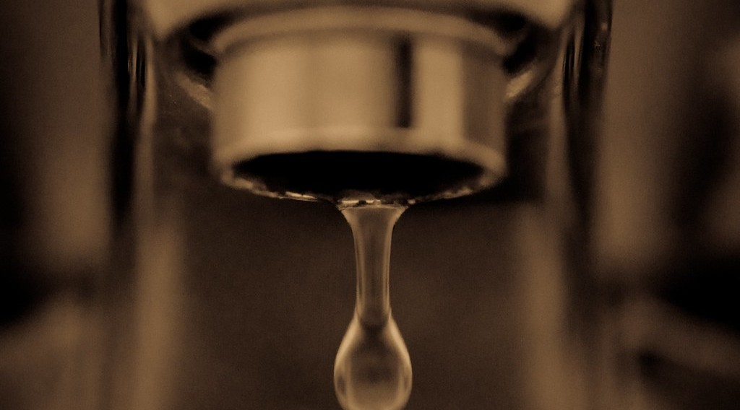
2. CAUSES
Activity 2
A tap that leaks.
Notes:
Activity 2. Look carefully at this picture: a tap that leaks. Observe every detail before I ask the question.

Slide 22
2. CAUSES
Activity 2: Question
Give one human cause of water scarcity.
Notes:
Here is the question for Activity 2: Give one human cause of water scarcity. Take one minute to think and write your answer in your rough notebook.

Slide 23
2. CAUSES
Activity 2: Answer
Wasting water (leaks) or too many people.
Notes:
Let us check the answer together. Wasting water (leaks) or too many people.

Slide 24
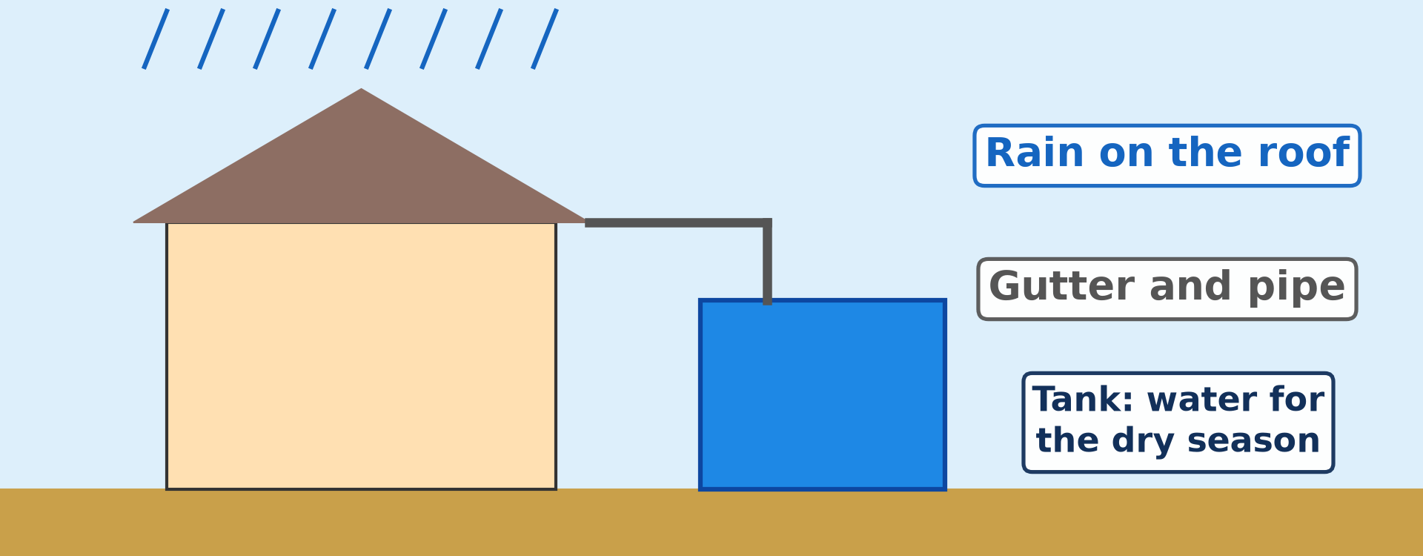
4. WATER CONSERVATION
Activity 3
Collecting rain water.
Notes:
Activity 3. Look carefully at this diagram: collecting rain water. Observe every detail before I ask the question.

Slide 25
4. WATER CONSERVATION
Activity 3: Question
How can a family keep water for the dry season?
Notes:
Here is the question for Activity 3: How can a family keep water for the dry season? Take one minute to think and write your answer in your rough notebook.

Slide 26
4. WATER CONSERVATION
Activity 3: Answer
Collect rain water from the roof in a tank.
Notes:
Let us check the answer together. Collect rain water from the roof in a tank.

Slide 27
BOARD SUMMARY
Board Summary
Topic: Management of Climate and Hydrological Related Hazards
Sub-topic: Hydro-climatic Hazards
Lesson 42: Water Scarcity
Notes:
Now we are going to copy the board summary. Write the title and the headings neatly in your notebooks. I will give you enough time for each slide, so do not rush.

Slide 28
BOARD SUMMARY
1. Meaning of Water Scarcity
Water scarcity is defined as follows:
Water scarcity: It is the lack of enough clean water to meet the needs of people.
Notes:
Let us copy Meaning of Water Scarcity. Water scarcity is defined as follows. On this slide we have Water scarcity. Write each point on a new line, with the key term first, and explain it in your own words when we revise.

Slide 29
BOARD SUMMARY
2. Causes of Water Scarcity
Water scarcity has the following causes:
Natural causes: A long dry season and droughts reduce water supply.
Human causes: Population growth, waste and pollution reduce clean water.
Notes:
Let us copy Causes of Water Scarcity. Water scarcity has the following causes. On this slide we have Natural causes and Human causes. Write each point on a new line, with the key term first, and explain it in your own words when we revise. When you finish, we go to the next slide.

Slide 30
BOARD SUMMARY
2. Causes of Water Scarcity (continued)
Poor networks: Old pipes and too few boreholes limit the supply of water.
Notes:
We continue with Causes of Water Scarcity. On this slide we have Poor networks. Write each point on a new line, with the key term first, and explain it in your own words when we revise.

Slide 31
BOARD SUMMARY
3. Effects of Water Scarcity
Water scarcity has the following effects:
Loss of time: People walk long distances and queue for water.
Diseases: Dirty water causes cholera and diarrhoea.
Notes:
Let us copy Effects of Water Scarcity. Water scarcity has the following effects. On this slide we have Loss of time and Diseases. Write each point on a new line, with the key term first, and explain it in your own words when we revise. When you finish, we go to the next slide.

Slide 32
BOARD SUMMARY
3. Effects of Water Scarcity (continued)
Cost and schooling: Water becomes expensive, and children miss classes to fetch it.
Notes:
We continue with Effects of Water Scarcity. On this slide we have Cost and schooling. Write each point on a new line, with the key term first, and explain it in your own words when we revise.

Slide 33
BOARD SUMMARY
4. Water Conservation Methods
Water can be conserved in the following ways:
At home: We should repair leaks and close taps.
Rainwater harvesting: Rainwater can be collected from roofs and stored in tanks.
Notes:
Let us copy Water Conservation Methods. Water can be conserved in the following ways. On this slide we have At home and Rainwater harvesting. Write each point on a new line, with the key term first, and explain it in your own words when we revise. When you finish, we go to the next slide.

Slide 34
BOARD SUMMARY
4. Water Conservation Methods (continued)
In farming: Drip irrigation gives water directly to the roots of plants.
Large projects: Dams and boreholes store and supply water.
Notes:
We continue with Water Conservation Methods. On this slide we have In farming and Large projects. Write each point on a new line, with the key term first, and explain it in your own words when we revise.

Slide 35
BOARD SUMMARY
4. Water Conservation Methods
Illustration: rainwater harvesting
Notes:
Now draw this illustration in your notebook: rainwater harvesting. Give it a title and label it clearly.

Slide 36
FORMATIVE EVALUATION
Evaluation 1
Give two effects of water scarcity.
Notes:
Now let us check what you have understood. Question 1: Give two effects of water scarcity. Answer in your exercise book.

Slide 37
FORMATIVE EVALUATION
Expected Answer
Long queues and diseases like cholera.
Notes:
The expected answer is: long queues and diseases like cholera. If you got it right, well done.

Slide 38
FORMATIVE EVALUATION
Evaluation 2
Give two ways of saving water at home.
Notes:
Now let us check what you have understood. Question 2: Give two ways of saving water at home. Answer in your exercise book.

Slide 39
FORMATIVE EVALUATION
Expected Answer
Repair leaks and close taps.
Notes:
The expected answer is: repair leaks and close taps. If you got it right, well done.

Slide 40
REMEDIATION
Remediation
Fill in the blanks:
Not enough clean water is water ______.
Using water carefully is water ______.
Rain water can be stored in a ______.
Notes:
For those who need more practice, fill in the blanks in your exercise book. The answers are: number 1, scarcity; number 2, conservation; number 3, tank.

Slide 41
HOMEWORK
Homework
Revise Lessons 30 to 42. Draw one diagram of your choice (layers of the atmosphere, Stevenson screen, types of rainfall, pressure belts or water cycle) and label it.
Notes:
For your homework: Revise Lessons 30 to 42. Draw one diagram of your choice (layers of the atmosphere, Stevenson screen, types of rainfall, pressure belts or water cycle) and label it. We shall correct it at the beginning of our next lesson.

Slide 42
BILINGUAL GAME
Bilingual Game (Jeu Bilingue)
English | Français
Water scarcity | La pénurie d'eau
Water stress | Le stress hydrique
Storage tank | La citerne
Borehole | Le forage
Dam | Le barrage
Reservoir | Le réservoir
Leak | La fuite
To save water | Économiser l'eau
Notes:
Let us play the bilingual game. I say a word in English, and you give me the French word. Then we do the reverse.

Slide 43
LOGBOOK
Official Logbook (1/2)
Module / Topic | Management of Climate and Hydrological Related Hazards
Lesson Title | Lesson 42: Water Scarcity
Expected Learning Outcomes | Define water scarcity and water stress. Explain the causes of water scarcity. Describe its effects. Describe methods of water conservation.
Competence | Learners are able to save water at home and at school, and to collect and store rainwater for the dry season.
Notes:
I record this information in the official logbook of the class after the lesson.

Slide 44
LOGBOOK
Official Logbook (2/2)
Matter Taught | Meaning of Water Scarcity; Causes of Water Scarcity; Effects of Water Scarcity; Water Conservation Methods.
Evaluation | Formative evaluation and remediation exercise.
Homework | Revise Lessons 30 to 42. Draw one diagram of your choice (layers of the atmosphere, Stevenson screen, types of rainfall, pressure belts or water cycle) and label it.
Enrolment / Present / Absent | ____ / ____ / ____
Achievement | To be completed after the lesson.
Notes:
I complete the second page of the logbook: the matter taught, the evaluation, the homework and the attendance.

Slide 45
TEACHER'S NOTE
Teacher's Note
Timing: Homework correction, plan, objectives 4 min | Recall, situation, action 6 min | 3 activities 12 min | Board summary (copying) 15 min | Evaluation, remediation 5 min | Homework, next lesson 3 min | Logbook 5 min
Without the projector (Activity 1): use the situation of Aminatou.
Without the projector (Activity 2): ask learners where water is wasted at school.
Without the projector (Activity 3): draw a house, a pipe and a tank.
Notes:
This slide is for me, the teacher: it gives the timing of the lesson and what to do if the projector is not available.

Slide 46
REFERENCES
References
National Geography Syllabus (MINESEC), Form 4 — Module 3: Weather and Climate.
Teacher's lesson notes (f4.docx), checked and corrected where necessary.
UN-Water: Water scarcity (Falkenmark indicator).
Photo, Activity 1: “i'll fight you for it...” by the apostrophe, CC BY-NC-SA 2.0, via Flickr (https://www.flickr.com/photos/66441426@N00/4019192363)
Photo, Activity 2: “Drip” by jronaldlee, CC BY 2.0, via Flickr (https://www.flickr.com/photos/37176760@N06/5996590138)
Diagrams and animations: drawn for this lesson (Geography Department).
Notes:
These are the references and picture credits used to prepare this lesson.

