Slide 1
FORM 1
GEOGRAPHY
Lesson 3
The Earth: A Planet Moving in Space
Notes:
Good morning, class, and welcome to our geography lesson. I am your geography teacher, Mr Kamdem. Today we are starting Lesson 3: The Earth: A Planet Moving in Space.

Slide 2
CLASS INFO
Class, Chapter and Duration
Class | Form 1
Chapter | Module 1: The Earth in the Universe
Duration | 2 periods (2 × 50 minutes)
Notes:
This lesson is for Form 1. It belongs to Module 1: The Earth in the Universe. We shall need 2 periods to cover it.

Slide 3
IDENTIFICATION
Lesson Identification
Topic | The Earth in the Universe
Sub-topic | The Earth: A Planet in the Solar System
Lesson | Lesson 3: The Earth: A Planet Moving in Space
Notions / Concepts | Rotation, revolution, time, solstice, equinox, time zones, GMT.
Syllabus focus | Rotation and revolution of the Earth and their consequences.
Competence | Learners are able to explain the movements of the Earth and their effects on daily life.
Notes:
Our topic is The Earth in the Universe, and the sub-topic is The Earth: A Planet in the Solar System. The key notions we shall use today are: rotation, revolution, time, solstice, equinox, time zones, GMT. At the end, you should be able to do this: learners are able to explain the movements of the Earth and their effects on daily life.

Slide 4

HOMEWORK CORRECTION
Correction of the Homework
Question (Practical Work 2: Locate a Place on a Map):
Name the two movements of the Earth.
Notes:
Before we start the new lesson, let us correct the homework I gave you at the end of Practical Work 2: Locate a Place on a Map. The question was: Name the two movements of the Earth. Take out your exercise books.

Slide 5
HOMEWORK CORRECTION
Correction: Possible Answer
Rotation and revolution.
Notes:
Here is a good answer. Rotation and revolution. Compare it with your own answer and correct your work in red.

Slide 6
LESSON PLAN
Lesson Plan
Correction of the homework
Objectives and recall
Real-life situation and action to take
Learning activities
Board summary
Evaluation, remediation and homework
Notes:
Here is the plan of our lesson today. First, we shall correct the homework. Then we shall look at the objectives and recall what you already know. After that, we shall study a situation from real life and the action to take, and do the learning activities. Finally, we shall copy the board summary, do the evaluation and the remediation, and I will give you the homework.

Slide 7
OBJECTIVES
Objectives
By the end of this lesson, you should be able to:
Define rotation and revolution.
Explain the consequences of rotation.
Explain the consequences of revolution.
Notes:
By the end of this lesson, you should be able to do three things. Number 1: define rotation and revolution. Number 2: explain the consequences of rotation. Number 3: explain the consequences of revolution.

Slide 8
PREVIOUS KNOWLEDGE
Previous Knowledge
The Earth is a planet that moves around the Sun.
The Earth has an axis from the North Pole to the South Pole.
Lines of longitude help to locate places.
Notes:
Let us first remember what you already know. The Earth is a planet that moves around the Sun. The Earth has an axis from the North Pole to the South Pole. Lines of longitude help to locate places. Keep this in mind, because we shall build on it today.

Slide 9
REAL-LIFE SITUATION
Situation in Real Life
One evening, Aïcha calls her uncle in Canada to wish him a happy birthday. It is already night in Garoua, but her uncle says that it is still the middle of the day there. Aïcha asks her mother: "How can it be night here and day in Canada at the same time?"
Notes:
Listen carefully to this situation from real life. One evening, Aïcha calls her uncle in Canada to wish him a happy birthday. It is already night in Garoua, but her uncle says that it is still the middle of the day there. Aïcha asks her mother: "How can it be night here and day in Canada at the same time?" Think about it, because I am going to ask you some questions.

Slide 10
REAL-LIFE SITUATION
Situation: Question 1
What is the problem in the situation?
Notes:
Question 1: What is the problem in the situation? Think for a moment, then raise your hand to answer.

Slide 11
REAL-LIFE SITUATION
Answer
Aïcha does not understand why it is night in Garoua and day in Canada at the same time.
Notes:
Good. Aïcha does not understand why it is night in Garoua and day in Canada at the same time.

Slide 12
REAL-LIFE SITUATION
Situation: Question 2
Which movement of the Earth causes day and night?
Notes:
Question 2: Which movement of the Earth causes day and night? Think for a moment, then raise your hand to answer.

Slide 13
REAL-LIFE SITUATION
Answer
Rotation.
Notes:
Good. Rotation.

Slide 14
REAL-LIFE SITUATION
Situation: Question 3
Why is it earlier in Canada?
Notes:
Question 3: Why is it earlier in Canada? Think for a moment, then raise your hand to answer.

Slide 15
REAL-LIFE SITUATION
Possible Answer
Canada is to the west, so it receives the Sun later.
Notes:
Good. Canada is to the west, so it receives the Sun later.

Slide 16
ACTION TO TAKE
Action to Take
Plan your activities according to the time of day and the seasons.
Notes:
From this situation, the action we are working towards in this lesson is the following: plan your activities according to the time of day and the seasons.

Slide 17
JUSTIFICATION
Justification of the Lesson
This lesson helps us to understand day and night, the time differences and the seasons.
Notes:
Why is this lesson important for you? This lesson helps us to understand day and night, the time differences and the seasons.

Slide 18
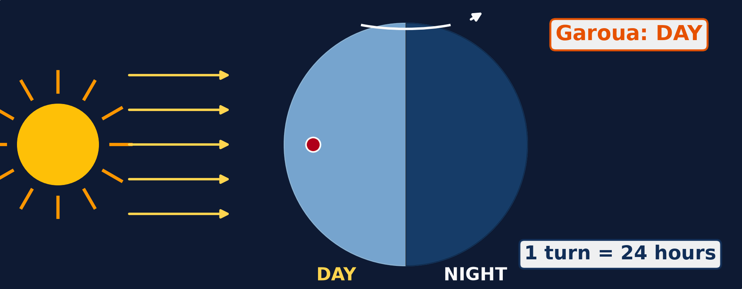
1. ROTATION
Activity 1
Animation: the Earth turns.
Notes:
Activity 1. Look carefully at this animation: animation: the Earth turns. Watch the animation to the end; it will play again.

Slide 19
1. ROTATION
Activity 1: Question 1
How long does the Earth take to make one full turn on its axis?
Notes:
Here is the question for Activity 1: How long does the Earth take to make one full turn on its axis? Take one minute to think and write your answer in your rough notebook.

Slide 20
1. ROTATION
Activity 1: Answer 1
24 hours (one day).
Notes:
Let us check the answer together. 24 hours (one day).

Slide 21
1. ROTATION
Activity 1: Question 2
In which direction does it turn?
Notes:
Here is the next question: In which direction does it turn? Take one minute to think and write your answer in your rough notebook.

Slide 22
1. ROTATION
Activity 1: Answer 2
From west to east.
Notes:
Let us check the answer together. From west to east.

Slide 23
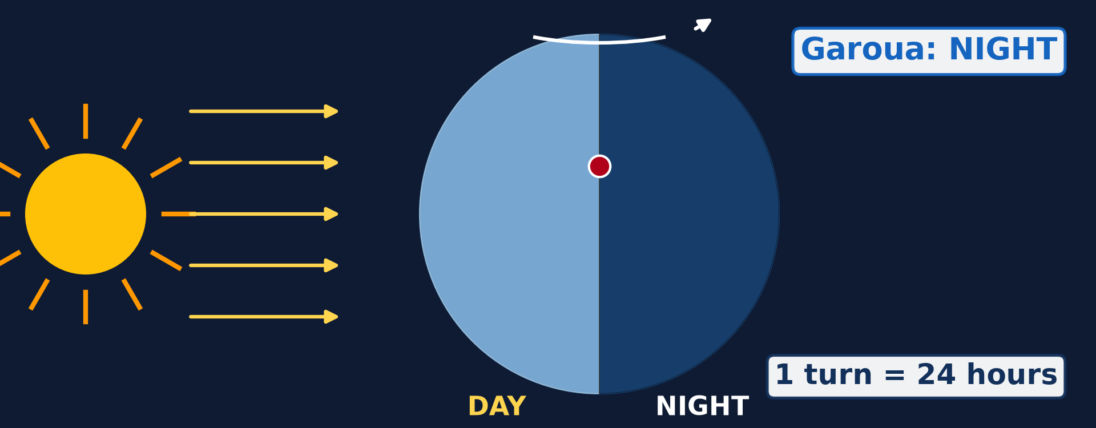
1. CONSEQUENCES OF ROTATION
Activity 2
The Earth facing the Sun.
Notes:
Activity 2. Look carefully at this picture: the Earth facing the Sun. Observe every detail before I ask the question.

Slide 24
1. CONSEQUENCES OF ROTATION
Activity 2: Question
Why is it day on one side of the Earth and night on the other?
Notes:
Here is the question for Activity 2: Why is it day on one side of the Earth and night on the other? Take one minute to think and write your answer in your rough notebook.

Slide 25
1. CONSEQUENCES OF ROTATION
Activity 2: Answer
Only the side facing the Sun receives light; the other side is in darkness.
Notes:
Let us check the answer together. Only the side facing the Sun receives light; the other side is in darkness.

Slide 26

1. CONSEQUENCES OF ROTATION
Activity 3
Time zones of the world.
Notes:
Activity 3. Look carefully at this diagram: time zones of the world. Observe every detail before I ask the question.

Slide 27
1. CONSEQUENCES OF ROTATION
Activity 3: Question
Why is the time different in different countries?
Notes:
Here is the question for Activity 3: Why is the time different in different countries? Take one minute to think and write your answer in your rough notebook.

Slide 28
1. CONSEQUENCES OF ROTATION
Activity 3: Answer
Places to the east see the Sun first, so they are ahead in time.
Notes:
Let us check the answer together. Places to the east see the Sun first, so they are ahead in time.

Slide 29

2. REVOLUTION
Activity 4
Animation: the Earth moves around the Sun.
Notes:
Activity 4. Look carefully at this animation: animation: the Earth moves around the Sun. Watch the animation to the end; it will play again.

Slide 30
2. REVOLUTION
Activity 4: Question
How long does the Earth take to go once around the Sun?
Notes:
Here is the question for Activity 4: How long does the Earth take to go once around the Sun? Take one minute to think and write your answer in your rough notebook.

Slide 31
2. REVOLUTION
Activity 4: Answer
365¼ days, which is one year.
Notes:
Let us check the answer together. 365¼ days, which is one year.

Slide 32

2. CONSEQUENCES OF REVOLUTION
Activity 5
The overhead Sun during the year.
Notes:
Activity 5. Look carefully at this diagram: the overhead Sun during the year. Observe every detail before I ask the question.

Slide 33
2. CONSEQUENCES OF REVOLUTION
Activity 5: Question
On which dates is the Sun overhead at the Equator?
Notes:
Here is the question for Activity 5: On which dates is the Sun overhead at the Equator? Take one minute to think and write your answer in your rough notebook.

Slide 34
2. CONSEQUENCES OF REVOLUTION
Activity 5: Answer
On 21 March and 23 September (the equinoxes).
Notes:
Let us check the answer together. On 21 March and 23 September (the equinoxes).

Slide 35
BOARD SUMMARY
Board Summary
Topic: The Earth in the Universe
Sub-topic: The Earth: A Planet in the Solar System
Lesson 3: The Earth: A Planet Moving in Space
Notes:
Now we are going to copy the board summary. Write the title and the headings neatly in your notebooks. I will give you enough time for each slide, so do not rush.

Slide 36
BOARD SUMMARY
DEFINITIONS
The key terms of this lesson are defined as follows:
Rotation: It is the turning of the Earth on its axis from west to east in 24 hours.
Revolution: It is the movement of the Earth around the Sun in 365¼ days.
Notes:
Let us copy the definitions. The key terms of this lesson are defined as follows. On this slide we have Rotation and Revolution. Write each point on a new line, with the key term first, and explain it in your own words when we revise. When you finish, we go to the next slide.

Slide 37
BOARD SUMMARY
DEFINITIONS (continued)
Axis: It is the imaginary line through the Earth from the North Pole to the South Pole.
Notes:
We continue with the definitions. On this slide we have Axis. Write each point on a new line, with the key term first, and explain it in your own words when we revise.

Slide 38
BOARD SUMMARY
1. Consequences of Rotation
The rotation of the Earth has the following consequences:
Day and night: The side of the Earth facing the Sun has day, and the other side has night.
Illustration: day and night
Notes:
Let us copy Consequences of Rotation. The rotation of the Earth has the following consequences. Copy the point on Day and night on the left, then draw the diagram on the right: day and night. Give it a title and label it clearly.

Slide 39

BOARD SUMMARY
1. Consequences of Rotation
Sunrise and sunset: The Sun seems to rise in the east and to set in the west.
Illustration: sunrise
Notes:
Copy the point on Sunrise and sunset on the left, then draw the diagram on the right: sunrise. Give it a title and label it clearly.

Slide 40
BOARD SUMMARY
1. Consequences of Rotation
Time differences: Places to the east are ahead in time: 1 hour for every 15° of longitude.
Illustration: time zones of the world
Notes:
Copy the point on Time differences on the left, then draw the diagram on the right: time zones of the world. Give it a title and label it clearly.

Slide 41
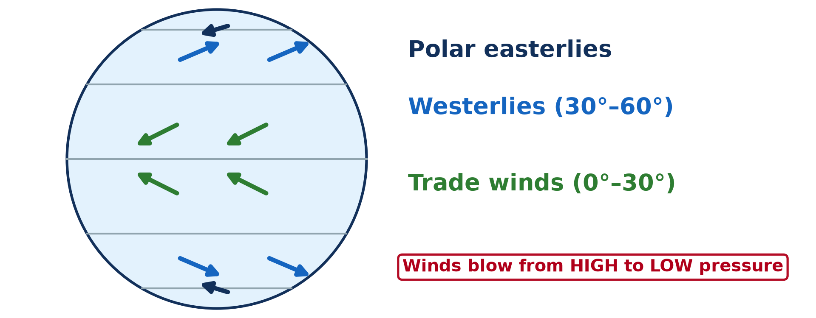
BOARD SUMMARY
1. Consequences of Rotation
Deflection of winds: Winds and ocean currents are turned to the right in the Northern Hemisphere and to the left in the Southern Hemisphere.
Illustration: planetary winds
Notes:
Copy the point on Deflection of winds on the left, then draw the diagram on the right: planetary winds. Give it a title and label it clearly.

Slide 42

BOARD SUMMARY
2. Consequences of Revolution
The revolution of the Earth has the following consequences:
Seasons: Revolution and the tilt of the axis cause the seasons of the year.
Illustration: the four seasons of temperate lands
Notes:
Let us copy Consequences of Revolution. The revolution of the Earth has the following consequences. Copy the point on Seasons on the left, then draw the diagram on the right: the four seasons of temperate lands. Give it a title and label it clearly.

Slide 43
BOARD SUMMARY
2. Consequences of Revolution
Equinoxes: On 21 March and 23 September, the Sun is overhead at the Equator. Day and night are equal everywhere.
Illustration: the overhead Sun during the year
Notes:
Copy the point on Equinoxes on the left, then draw the diagram on the right: the overhead Sun during the year. Give it a title and label it clearly.

Slide 44
BOARD SUMMARY
2. Consequences of Revolution
Solstices: On 21 June the Sun is overhead at the Tropic of Cancer. On 22 December it is overhead at the Tropic of Capricorn.
Length of day and night: Days are longer in summer and shorter in winter, except at the Equator.
Notes:
We continue with Consequences of Revolution. On this slide we have Solstices and Length of day and night. Write each point on a new line, with the key term first, and explain it in your own words when we revise. When you finish, we go to the next slide.

Slide 45
BOARD SUMMARY
2. Consequences of Revolution (continued)
Leap year: Every fourth year has 366 days to use the extra quarter days.
Notes:
We continue with Consequences of Revolution. On this slide we have Leap year. Write each point on a new line, with the key term first, and explain it in your own words when we revise.

Slide 46
FORMATIVE EVALUATION
Evaluation 1
Give two consequences of rotation.
Notes:
Now let us check what you have understood. Question 1: Give two consequences of rotation. Answer in your exercise book.

Slide 47
FORMATIVE EVALUATION
Expected Answer
Day and night; time differences between places.
Notes:
The expected answer is: day and night; time differences between places. If you got it right, well done.

Slide 48
FORMATIVE EVALUATION
Evaluation 2
What is an equinox?
Notes:
Now let us check what you have understood. Question 2: What is an equinox? Answer in your exercise book.

Slide 49
FORMATIVE EVALUATION
Expected Answer
A day when the Sun is overhead at the Equator and day and night are equal everywhere.
Notes:
The expected answer is: a day when the Sun is overhead at the Equator and day and night are equal everywhere. If you got it right, well done.

Slide 50
REMEDIATION
Remediation
Fill in the blanks:
The turning of the Earth on its axis is ______.
One revolution takes ______ days.
On 21 June the Sun is overhead at the Tropic of ______.
Notes:
For those who need more practice, fill in the blanks in your exercise book. The answers are: number 1, rotation; number 2, 365¼; number 3, Cancer.

Slide 51
HOMEWORK
Homework
State how many degrees the Earth turns in one hour.
Notes:
For your homework: State how many degrees the Earth turns in one hour. We shall correct it at the beginning of our next lesson.

Slide 52
NEXT LESSON
Next Lesson
Our next lesson will be on:
Practical Work 3: Calculation of Time
Notes:
Our next lesson will be on Practical Work 3: Calculation of Time. Thank you for your attention, and see you next time.

Slide 53
BILINGUAL GAME
Bilingual Game (Jeu Bilingue)
English | Français
Rotation | La rotation
Revolution | La révolution
Axis | L'axe
Season | La saison
Equinox | L'équinoxe
Solstice | Le solstice
Notes:
Let us play the bilingual game. I say a word in English, and you give me the French word. Then we do the reverse.

Slide 54
LOGBOOK
Official Logbook (1/2)
Module / Topic | The Earth in the Universe
Lesson Title | Lesson 3: The Earth: A Planet Moving in Space
Expected Learning Outcomes | Define rotation and revolution. Explain the consequences of rotation. Explain the consequences of revolution.
Competence | Learners are able to explain the movements of the Earth and their effects on daily life.
Notes:
I record this information in the official logbook of the class after the lesson.

Slide 55
LOGBOOK
Official Logbook (2/2)
Matter Taught | DEFINITIONS; Consequences of Rotation; Consequences of Revolution.
Evaluation | Formative evaluation and remediation exercise.
Homework | State how many degrees the Earth turns in one hour.
Enrolment / Present / Absent | ____ / ____ / ____
Achievement | To be completed after the lesson.
Notes:
I complete the second page of the logbook: the matter taught, the evaluation, the homework and the attendance.

Slide 56
TEACHER'S NOTE
Teacher's Note
Timing: Homework correction, plan, objectives 8 min | Recall, situation, action 10 min | 5 activities 30 min | Board summary (copying) 30 min | Evaluation, remediation 10 min | Homework, next lesson 5 min | Logbook 7 min
Activities 1 and 4 are animations (GIF): it plays automatically in slide-show mode.
Without the projector (Activity 1): turn a ball in front of a torch.
Without the projector (Activity 2): use a torch and a ball.
Without the projector (Activity 3): compare the time in Garoua and Paris.
Without the projector (Activity 4): walk around a chair holding a ball.
Without the projector (Activity 5): draw the tropics and the Equator.
Notes:
This slide is for me, the teacher: it gives the timing of the lesson and what to do if the projector is not available.

Slide 57
REFERENCES
References
Geography Syllabus, Forms I–V, MINESEC (2023) — Form 1, Module 1: The Earth in the Universe.
Photo, board summary (Sunrise and sunset): “African Sunrise, Amboseli National Park” by Ray in Manila, CC BY 2.0, via Flickr (https://www.flickr.com/photos/21186555@N07/30385097358)
Diagrams and animations: drawn for this lesson (Geography Department).
Notes:
These are the references and picture credits used to prepare this lesson.

