Slide 1
FORM 1
GEOGRAPHY
Practical Work 3
Calculation of Time
Notes:
Good morning, class, and welcome to our geography lesson. I am your geography teacher, Mr Kamdem. Today we are starting Practical Work 3: Calculation of Time.

Slide 2
CLASS INFO
Class, Chapter and Duration
Class | Form 1
Chapter | Module 1: The Earth in the Universe
Duration | 2 periods (2 × 50 minutes)
Notes:
This lesson is for Form 1. It belongs to Module 1: The Earth in the Universe. We shall need 2 periods to cover it.

Slide 3
IDENTIFICATION
Lesson Identification
Topic | The Earth in the Universe
Sub-topic | The Earth: A Planet in the Solar System
Lesson | Practical Work 3: Calculation of Time
Notions / Concepts | Local time, standard time, GMT, time zone, difference of longitude.
Syllabus focus | Theoretical basis: revision of local and standard time. Practical exercise: calculation of local time; calculation of the local time of a place from GMT; basis of carving out time zones. Contextualisation: establish Cameroon's standard time compared with other areas.
Competence | Learners are able to calculate the time of places using longitude and time zones.
Notes:
Our topic is The Earth in the Universe, and the sub-topic is The Earth: A Planet in the Solar System. The key notions we shall use today are: local time, standard time, GMT, time zone, difference of longitude. At the end, you should be able to do this: learners are able to calculate the time of places using longitude and time zones.

Slide 4

HOMEWORK CORRECTION
Correction of the Homework
Question (Lesson 3: The Earth: A Planet Moving in Space):
State how many degrees the Earth turns in one hour.
Notes:
Before we start the new lesson, let us correct the homework I gave you at the end of Lesson 3: The Earth: A Planet Moving in Space. The question was: State how many degrees the Earth turns in one hour. Take out your exercise books.

Slide 5
HOMEWORK CORRECTION
Correction: Possible Answer
15° (360° in 24 hours).
Notes:
Here is a good answer. 15° (360° in 24 hours). Compare it with your own answer and correct your work in red.

Slide 6
LESSON PLAN
Lesson Plan
Correction of the homework
Objectives and recall
Real-life situation and action to take
Learning activities
Board summary
Evaluation, remediation and homework
Notes:
Here is the plan of our lesson today. First, we shall correct the homework. Then we shall look at the objectives and recall what you already know. After that, we shall study a situation from real life and the action to take, and do the learning activities. Finally, we shall copy the board summary, do the evaluation and the remediation, and I will give you the homework.

Slide 7
OBJECTIVES
Objectives
By the end of this lesson, you should be able to:
Recall local time, standard time and GMT.
Calculate the local time of a place from its longitude or from GMT.
Notes:
Take your time to copy this part; we will continue together.

Slide 8
OBJECTIVES
Objectives (continued)
Compare the standard time of Cameroon with other countries.
Notes:
By the end of this lesson, you should be able to do three things. Number 1: recall local time, standard time and GMT. Number 2: calculate the local time of a place from its longitude or from GMT. Number 3: compare the standard time of Cameroon with other countries.

Slide 9
PREVIOUS KNOWLEDGE
Previous Knowledge
The Earth turns 360° in 24 hours.
Places to the east are ahead in time.
Cameroon uses GMT + 1.
Notes:
Let us first remember what you already know. The Earth turns 360° in 24 hours. Places to the east are ahead in time. Cameroon uses GMT + 1. Keep this in mind, because we shall build on it today.

Slide 10
REAL-LIFE SITUATION
Situation in Real Life
A football match starts at 18:00 in London. Moussa wants to watch it on television in Garoua. He asks his friends: "At what time will the match start in Cameroon?" None of them can calculate it.
Notes:
Listen carefully to this situation from real life. A football match starts at 18:00 in London. Moussa wants to watch it on television in Garoua. He asks his friends: "At what time will the match start in Cameroon?" None of them can calculate it. Think about it, because I am going to ask you some questions.

Slide 11
REAL-LIFE SITUATION
Situation: Question 1
What is the problem in the situation?
Notes:
Question 1: What is the problem in the situation? Think for a moment, then raise your hand to answer.

Slide 12
REAL-LIFE SITUATION
Answer
Moussa and his friends do not know how to calculate the time of the match in Cameroon.
Notes:
Good. Moussa and his friends do not know how to calculate the time of the match in Cameroon.

Slide 13
REAL-LIFE SITUATION
Situation: Question 2
Which information does he need?
Notes:
Question 2: Which information does he need? Think for a moment, then raise your hand to answer.

Slide 14
REAL-LIFE SITUATION
Answer
The time difference between London and Cameroon.
Notes:
Good. The time difference between London and Cameroon.

Slide 15
REAL-LIFE SITUATION
Situation: Question 3
How can he find it?
Notes:
Question 3: How can he find it? Think for a moment, then raise your hand to answer.

Slide 16
REAL-LIFE SITUATION
Possible Answer
By using the longitudes or the time zones.
Notes:
Good. By using the longitudes or the time zones.

Slide 17
ACTION TO TAKE
Action to Take
Check the time difference before calling or travelling to another country.
Notes:
From this situation, the action we are working towards in this lesson is the following: check the time difference before calling or travelling to another country.

Slide 18
JUSTIFICATION
Justification of the Lesson
This practical work helps us to calculate the time in other places of the world.
Notes:
Why is this lesson important for you? This practical work helps us to calculate the time in other places of the world.

Slide 19

1. REVISION
Activity 1
Time and longitude.
Notes:
Activity 1. Look carefully at this diagram: time and longitude. Observe every detail before I ask the question.

Slide 20
1. REVISION
Activity 1: Question
The Earth turns 360° in 24 hours. How many degrees does it turn in one hour?
Notes:
Here is the question for Activity 1: The Earth turns 360° in 24 hours. How many degrees does it turn in one hour? Take one minute to think and write your answer in your rough notebook.

Slide 21
1. REVISION
Activity 1: Answer
360 ÷ 24 = 15° per hour, so 1° takes 4 minutes.
Notes:
Let us check the answer together. 360 ÷ 24 = 15° per hour, so 1° takes 4 minutes.

Slide 22
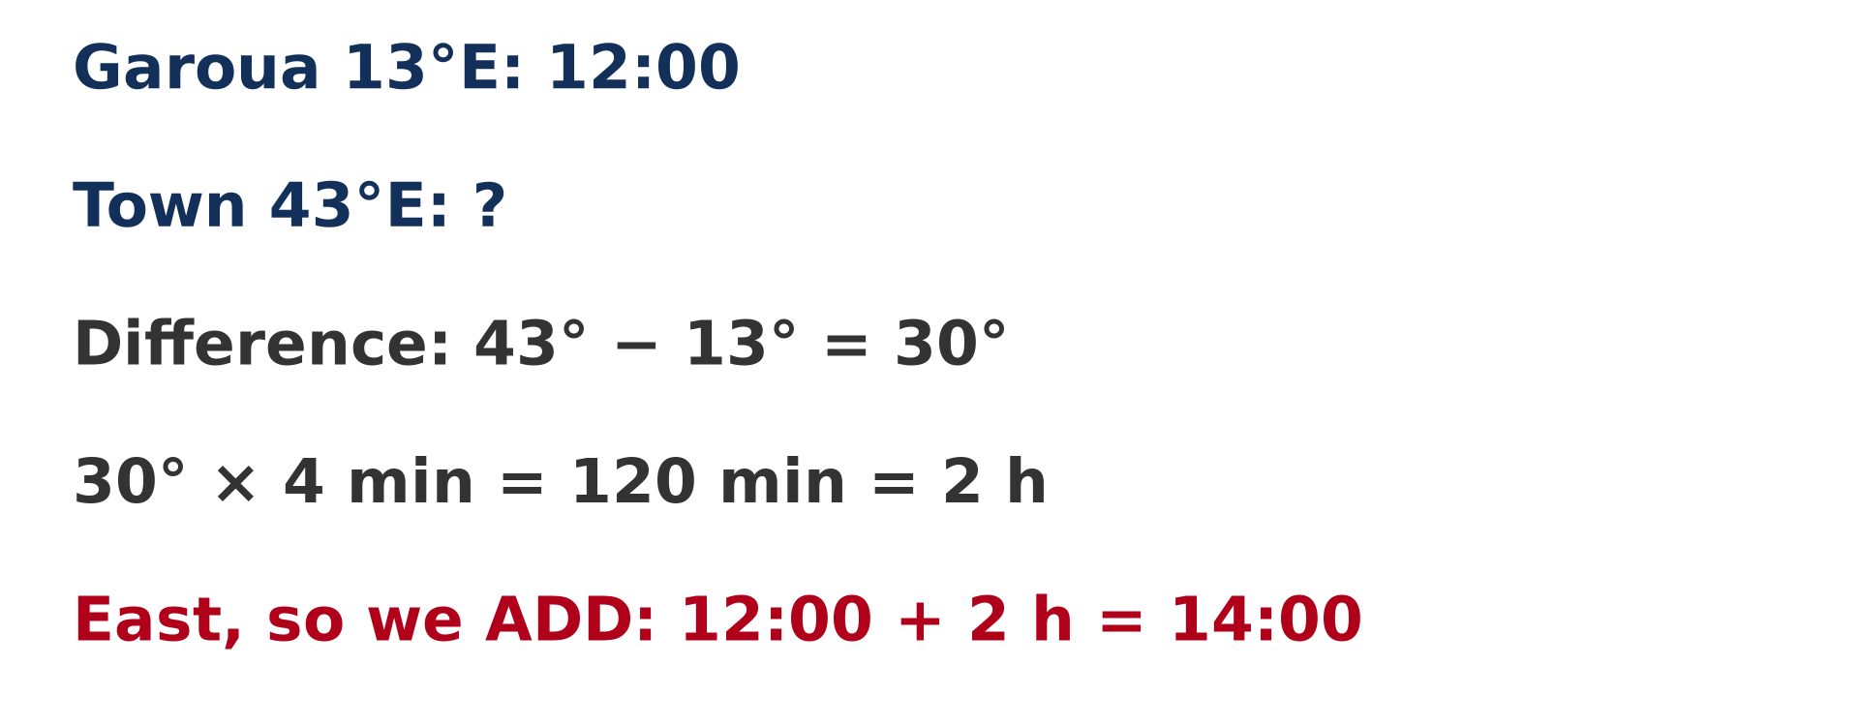
2. LOCAL TIME
Activity 2
A worked example.
Notes:
Activity 2. Look carefully at this diagram: a worked example. Observe every detail before I ask the question.

Slide 23
2. LOCAL TIME
Activity 2: Question
It is 12:00 at 0°. What is the local time at 30° E?
Notes:
Here is the question for Activity 2: It is 12:00 at 0°. What is the local time at 30° E? Take one minute to think and write your answer in your rough notebook.

Slide 24
2. LOCAL TIME
Activity 2: Answer
30 × 4 min = 120 min = 2 hours; the place is to the east, so 12:00 + 2 h = 14:00.
Notes:
Let us check the answer together. 30 × 4 min = 120 min = 2 hours; the place is to the east, so 12:00 + 2 h = 14:00.

Slide 25
2. LOCAL TIME FROM GMT
Activity 3
East is ahead, west is behind.
Notes:
Activity 3. Look carefully at this diagram: east is ahead, west is behind. Observe every detail before I ask the question.

Slide 26
2. LOCAL TIME FROM GMT
Activity 3: Question
It is 10:00 GMT. What is the local time at 45° W?
Notes:
Here is the question for Activity 3: It is 10:00 GMT. What is the local time at 45° W? Take one minute to think and write your answer in your rough notebook.

Slide 27
2. LOCAL TIME FROM GMT
Activity 3: Answer
45 × 4 = 180 min = 3 hours; the place is to the west, so 10:00 − 3 h = 07:00.
Notes:
Let us check the answer together. 45 × 4 = 180 min = 3 hours; the place is to the west, so 10:00 − 3 h = 07:00.

Slide 28

3. TIME ZONES
Activity 4
Time zones of the world.
Notes:
Activity 4. Look carefully at this diagram: time zones of the world. Observe every detail before I ask the question.

Slide 29
3. TIME ZONES
Activity 4: Question
Why was the world divided into time zones?
Notes:
Here is the question for Activity 4: Why was the world divided into time zones? Take one minute to think and write your answer in your rough notebook.

Slide 30
3. TIME ZONES
Activity 4: Answer
To avoid a different time in every town: each zone of about 15° uses the same standard time.
Notes:
Let us check the answer together. To avoid a different time in every town: each zone of about 15° uses the same standard time.

Slide 31
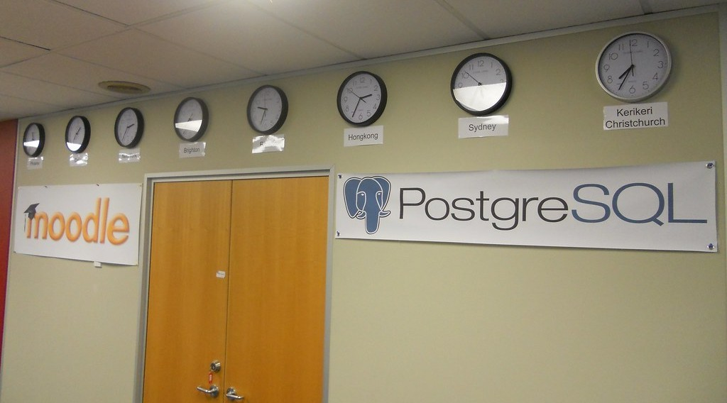
4. CAMEROON'S STANDARD TIME
Activity 5
Clocks showing the time in different cities.
Notes:
Activity 5. Look carefully at this picture: clocks showing the time in different cities. Observe every detail before I ask the question.

Slide 32
4. CAMEROON'S STANDARD TIME
Activity 5: Question
When it is 12:00 in Garoua (GMT + 1), what time is it in London (GMT)?
Notes:
Here is the question for Activity 5: When it is 12:00 in Garoua (GMT + 1), what time is it in London (GMT)? Take one minute to think and write your answer in your rough notebook.

Slide 33
4. CAMEROON'S STANDARD TIME
Activity 5: Answer
11:00.
Notes:
Let us check the answer together. 11:00.

Slide 34
BOARD SUMMARY
Board Summary
Topic: The Earth in the Universe
Sub-topic: The Earth: A Planet in the Solar System
Practical Work 3: Calculation of Time
Notes:
Now we are going to copy the board summary. Write the title and the headings neatly in your notebooks. I will give you enough time for each slide, so do not rush.

Slide 35
BOARD SUMMARY
DEFINITIONS
The key terms of this lesson are defined as follows:
Local time: It is the time of a place given by the position of the Sun.
Standard time: It is the official time used in a whole country or time zone.
Notes:
Let us copy the definitions. The key terms of this lesson are defined as follows. On this slide we have Local time and Standard time. Write each point on a new line, with the key term first, and explain it in your own words when we revise. When you finish, we go to the next slide.

Slide 36
BOARD SUMMARY
DEFINITIONS (continued)
GMT: It is Greenwich Mean Time, the local time of the Greenwich Meridian (0°).
Notes:
We continue with the definitions. On this slide we have GMT. Write each point on a new line, with the key term first, and explain it in your own words when we revise.

Slide 37
BOARD SUMMARY
1. Rules for Calculating Local Time
We calculate local time with the following rules:
Rule 1: The Earth turns 15° in one hour, so 1° of longitude equals 4 minutes.
Illustration: time and longitude
Notes:
Let us copy Rules for Calculating Local Time. We calculate local time with the following rules. Copy the point on Rule 1 on the left, then draw the diagram on the right: time and longitude. Give it a title and label it clearly.

Slide 38
BOARD SUMMARY
1. Rules for Calculating Local Time
Rule 2: We add time for places to the east and remove time for places to the west.
Rule 3: We find the difference of longitude, multiply it by 4 minutes and change it into hours.
Notes:
We continue with Rules for Calculating Local Time. On this slide we have Rule 2 and Rule 3. Write each point on a new line, with the key term first, and explain it in your own words when we revise.

Slide 39
BOARD SUMMARY
2. Calculating Local Time from GMT
We calculate local time from GMT as in the following examples:
Example to the east: It is 12:00 GMT. At 30° E, the difference is 30 × 4 = 120 min = 2 h, so the local time is 14:00.
Illustration: calculating local time
Notes:
Let us copy Calculating Local Time from GMT. We calculate local time from GMT as in the following examples. Copy the point on Example to the east on the left, then draw the diagram on the right: calculating local time. Give it a title and label it clearly.

Slide 40
BOARD SUMMARY
2. Calculating Local Time from GMT
Example to the west: It is 10:00 GMT. At 45° W, the difference is 45 × 4 = 180 min = 3 h, so the local time is 07:00.
Notes:
We continue with Calculating Local Time from GMT. On this slide we have Example to the west. Write each point on a new line, with the key term first, and explain it in your own words when we revise.

Slide 41
BOARD SUMMARY
3. Basis of Time Zones
Time zones are carved out as follows:
24 time zones: The world is divided into 24 time zones of about 15° each, one for each hour.
Illustration: time zones of the world
Notes:
Let us copy Basis of Time Zones. Time zones are carved out as follows. Copy the point on 24 time zones on the left, then draw the diagram on the right: time zones of the world. Give it a title and label it clearly.

Slide 42
BOARD SUMMARY
3. Basis of Time Zones
Standard time: All places in one zone use the same standard time.
Boundaries: The boundaries of the zones often follow the borders of countries.
Notes:
We continue with Basis of Time Zones. On this slide we have Standard time and Boundaries. Write each point on a new line, with the key term first, and explain it in your own words when we revise.

Slide 43
BOARD SUMMARY
4. Cameroon's Standard Time and Other Areas
When it is 12:00 in Cameroon (GMT + 1), the time elsewhere is the following:
London (GMT): It is 11:00.
Illustration: clocks in different cities
Notes:
Let us copy Cameroon's Standard Time and Other Areas. When it is 12:00 in Cameroon (GMT + 1), the time elsewhere is the following. Copy the point on London (GMT) on the left, then draw the diagram on the right: clocks in different cities. Give it a title and label it clearly.

Slide 44
BOARD SUMMARY
4. Cameroon's Standard Time and Other Areas
Nigeria and Chad (GMT + 1): It is 12:00, the same time as Cameroon.
Dubai (GMT + 4): It is 15:00.
New York (GMT − 5): It is 06:00.
Notes:
We continue with Cameroon's Standard Time and Other Areas. On this slide we have Nigeria and Chad (GMT + 1), Dubai (GMT + 4) and New York (GMT − 5). Write each point on a new line, with the key term first, and explain it in your own words when we revise.

Slide 45
FORMATIVE EVALUATION
Evaluation 1
It is 08:00 GMT. What is the local time at 60° E?
Notes:
Now let us check what you have understood. Question 1: It is 08:00 GMT. What is the local time at 60° E? Answer in your exercise book.

Slide 46
FORMATIVE EVALUATION
Expected Answer
60 × 4 = 240 min = 4 h; 08:00 + 4 h = 12:00.
Notes:
The expected answer is: 60 × 4 = 240 min = 4 h; 08:00 + 4 h = 12:00. If you got it right, well done.

Slide 47
FORMATIVE EVALUATION
Evaluation 2
A match starts at 18:00 in London (GMT). What time is it in Cameroon?
Notes:
Now let us check what you have understood. Question 2: A match starts at 18:00 in London (GMT). What time is it in Cameroon? Answer in your exercise book.

Slide 48
FORMATIVE EVALUATION
Expected Answer
19:00, because Cameroon is GMT + 1.
Notes:
The expected answer is: 19:00, because Cameroon is GMT + 1. If you got it right, well done.

Slide 49
REMEDIATION
Remediation
Fill in the blanks:
The Earth turns ______° in one hour.
1° of longitude equals ______ minutes.
Places to the ______ are ahead in time.
Notes:
For those who need more practice, fill in the blanks in your exercise book. The answers are: number 1, 15; number 2, 4; number 3, east.

Slide 50
HOMEWORK
Homework
List four components of the natural environment.
Notes:
For your homework: List four components of the natural environment. We shall correct it at the beginning of our next lesson.

Slide 51
NEXT LESSON
Next Lesson
Our next lesson will be on:
Lesson 4: The Notion of the Environment
Notes:
Our next lesson will be on Lesson 4: The Notion of the Environment. Thank you for your attention, and see you next time.

Slide 52
BILINGUAL GAME
Bilingual Game (Jeu Bilingue)
English | Français
Time | L'heure
Local time | L'heure locale
Time zone | Le fuseau horaire
Clock | L'horloge
East | L'est
West | L'ouest
Notes:
Let us play the bilingual game. I say a word in English, and you give me the French word. Then we do the reverse.

Slide 53
LOGBOOK
Official Logbook (1/2)
Module / Topic | The Earth in the Universe
Lesson Title | Practical Work 3: Calculation of Time
Expected Learning Outcomes | Recall local time, standard time and GMT. Calculate the local time of a place from its longitude or from GMT. Compare the standard time of Cameroon with other countries.
Competence | Learners are able to calculate the time of places using longitude and time zones.
Notes:
I record this information in the official logbook of the class after the lesson.

Slide 54
LOGBOOK
Official Logbook (2/2)
Matter Taught | DEFINITIONS; Rules for Calculating Local Time; Calculating Local Time from GMT; Basis of Time Zones; Cameroon's Standard Time and Other Areas.
Evaluation | Formative evaluation and remediation exercise.
Homework | List four components of the natural environment.
Enrolment / Present / Absent | ____ / ____ / ____
Achievement | To be completed after the lesson.
Notes:
I complete the second page of the logbook: the matter taught, the evaluation, the homework and the attendance.

Slide 55
TEACHER'S NOTE
Teacher's Note
Timing: Homework correction, plan, objectives 8 min | Recall, situation, action 10 min | 5 activities 30 min | Board summary (copying) 30 min | Evaluation, remediation 10 min | Homework, next lesson 5 min | Logbook 7 min
Without the projector (Activity 1): write the calculation on the board.
Without the projector (Activity 2): write the steps on the board.
Without the projector (Activity 3): draw a line with 0° in the middle.
Without the projector (Activity 4): show the zones on a world map.
Without the projector (Activity 5): draw two clocks on the board.
Notes:
This slide is for me, the teacher: it gives the timing of the lesson and what to do if the projector is not available.

Slide 56
REFERENCES
References
Geography Syllabus, Forms I–V, MINESEC (2023) — Form 1, Module 1: The Earth in the Universe.
Photo, Activity 5: “The world in our office - 2012-03-28” by 4nitsirk, CC BY-SA 2.0, via Flickr (https://www.flickr.com/photos/26223114@N02/7023309809)
Diagrams and animations: drawn for this lesson (Geography Department).
Notes:
These are the references and picture credits used to prepare this lesson.

