Slide 1
FORM 2
GEOGRAPHY
Lesson 1
A Rapid Growth of the World's Population
Notes:
Good morning, class, and welcome to our geography lesson. I am your geography teacher, Mr Kamdem. Today we are starting Lesson 1: A Rapid Growth of the World's Population.

Slide 2
CLASS INFO
Class, Chapter and Duration
Class | Form 2
Chapter | Module 1: Man in his Environment
Duration | 2 periods (2 × 50 minutes)
Notes:
This lesson is for Form 2. It belongs to Module 1: Man in his Environment. We shall need 2 periods to cover it.

Slide 3
IDENTIFICATION
Lesson Identification
Topic | Man in his Environment
Sub-topic | The World's Population
Lesson | Lesson 1: A Rapid Growth of the World's Population
Notions / Concepts | Population, natural population growth, resources.
Syllabus focus | Evolution of the world's population; factors of the population growth; implications of the rapid population growth on natural resources.
Competence | Learners are able to describe the growth of the world population and its effects on natural resources.
Notes:
Our topic is Man in his Environment, and the sub-topic is The World's Population. The key notions we shall use today are: population, natural population growth, resources. At the end, you should be able to do this: learners are able to describe the growth of the world population and its effects on natural resources.

Slide 4

LESSON PLAN
Lesson Plan
Objectives and recall
Real-life situation and action to take
Learning activities
Board summary
Evaluation, remediation and homework
Notes:
Here is the plan of our lesson today. First, we shall look at the objectives and recall what you already know. After that, we shall study a situation from real life and the action to take, and do the learning activities. Finally, we shall copy the board summary, do the evaluation and the remediation, and I will give you the homework.

Slide 5
OBJECTIVES
Objectives
By the end of this lesson, you should be able to:
Describe the evolution of the world's population.
Explain the factors of population growth.
Notes:
Take your time to copy this part; we will continue together.

Slide 6
OBJECTIVES
Objectives (continued)
Give the implications of rapid growth on natural resources.
Notes:
By the end of this lesson, you should be able to do three things. Number 1: describe the evolution of the world's population. Number 2: explain the factors of population growth. Number 3: give the implications of rapid growth on natural resources.

Slide 7
PREVIOUS KNOWLEDGE
Previous Knowledge
Many people live in towns and villages.
Families have children.
People use land, water and forests.
Notes:
Let us first remember what you already know. Many people live in towns and villages. Families have children. People use land, water and forests. Keep this in mind, because we shall build on it today.

Slide 8
REAL-LIFE SITUATION
Situation in Real Life
Grandmother Hawa says that when she was young, her village had only a few compounds and plenty of land. Today the village is crowded, the forest has disappeared and the farms are small. Her grandson asks: "Why are there so many more people today, and what will happen to our land?"
Notes:
Listen carefully to this situation from real life. Grandmother Hawa says that when she was young, her village had only a few compounds and plenty of land. Today the village is crowded, the forest has disappeared and the farms are small. Her grandson asks: "Why are there so many more people today, and what will happen to our land?" Think about it, because I am going to ask you some questions.

Slide 9
REAL-LIFE SITUATION
Situation: Question 1
What is the problem in the situation?
Notes:
Question 1: What is the problem in the situation? Think for a moment, then raise your hand to answer.

Slide 10
REAL-LIFE SITUATION
Answer
The grandson does not know why the population has grown so fast and what it means for the land.
Notes:
Good. The grandson does not know why the population has grown so fast and what it means for the land.

Slide 11
REAL-LIFE SITUATION
Situation: Question 2
What has happened to the forest?
Notes:
Question 2: What has happened to the forest? Think for a moment, then raise your hand to answer.

Slide 12
REAL-LIFE SITUATION
Answer
It has disappeared.
Notes:
Good. It has disappeared.

Slide 13
REAL-LIFE SITUATION
Situation: Question 3
Why are farms smaller today?
Notes:
Question 3: Why are farms smaller today? Think for a moment, then raise your hand to answer.

Slide 14
REAL-LIFE SITUATION
Possible Answer
More people share the same land.
Notes:
Good. More people share the same land.

Slide 15
ACTION TO TAKE
Action to Take
Use resources wisely and respect family planning advice.
Notes:
From this situation, the action we are working towards in this lesson is the following: use resources wisely and respect family planning advice.

Slide 16
JUSTIFICATION
Justification of the Lesson
This lesson helps us to understand population growth and its effects on our resources.
Notes:
Why is this lesson important for you? This lesson helps us to understand population growth and its effects on our resources.

Slide 17
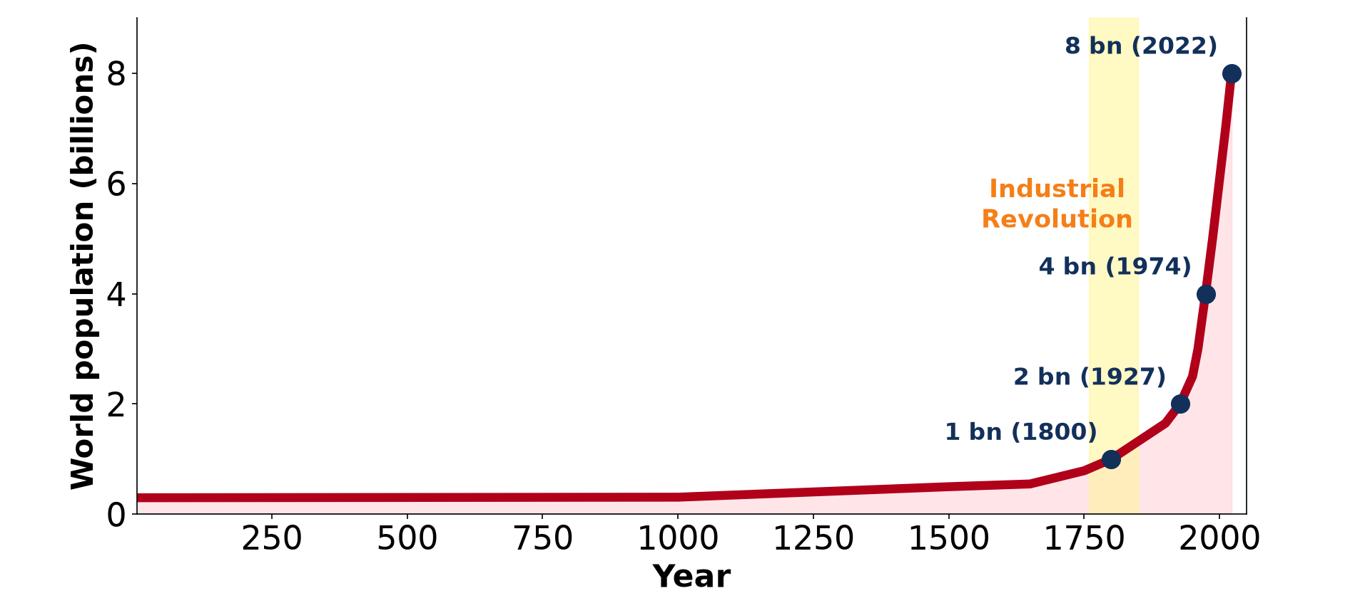
1. EVOLUTION OF THE WORLD POPULATION
Activity 1
World population over time.
Notes:
Activity 1. Look carefully at this diagram: world population over time. Observe every detail before I ask the question.

Slide 18
1. EVOLUTION OF THE WORLD POPULATION
Activity 1: Question
About how many people lived on the Earth in 1800?
Notes:
Here is the question for Activity 1: About how many people lived on the Earth in 1800? Take one minute to think and write your answer in your rough notebook.

Slide 19
1. EVOLUTION OF THE WORLD POPULATION
Activity 1: Answer
About 1 billion.
Notes:
Let us check the answer together. About 1 billion.

Slide 20
1. EVOLUTION OF THE WORLD POPULATION
Activity 2
World population over time.
Notes:
Activity 2. Look carefully at this diagram: world population over time. Observe every detail before I ask the question.

Slide 21
1. EVOLUTION OF THE WORLD POPULATION
Activity 2: Question
About how many people live on the Earth today?
Notes:
Here is the question for Activity 2: About how many people live on the Earth today? Take one minute to think and write your answer in your rough notebook.

Slide 22
1. EVOLUTION OF THE WORLD POPULATION
Activity 2: Answer
More than 8 billion: the population has grown very fast since 1950.
Notes:
Let us check the answer together. More than 8 billion: the population has grown very fast since 1950.

Slide 23

2. FACTORS OF GROWTH
Activity 3
A child is vaccinated.
Notes:
Activity 3. Look carefully at this picture: a child is vaccinated. Observe every detail before I ask the question.

Slide 24
2. FACTORS OF GROWTH
Activity 3: Question
How do vaccines and hospitals increase the population?
Notes:
Here is the question for Activity 3: How do vaccines and hospitals increase the population? Take one minute to think and write your answer in your rough notebook.

Slide 25
2. FACTORS OF GROWTH
Activity 3: Answer
They reduce deaths, especially of children, so more people survive.
Notes:
Let us check the answer together. They reduce deaths, especially of children, so more people survive.

Slide 26
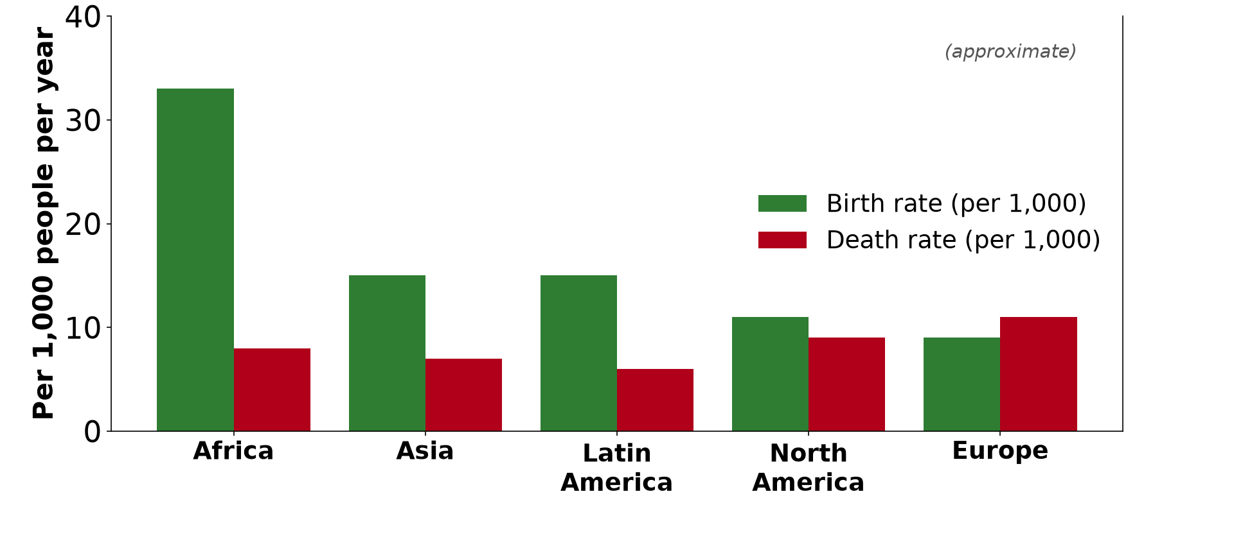
2. FACTORS OF GROWTH
Activity 4
Births and deaths.
Notes:
Activity 4. Look carefully at this diagram: births and deaths. Observe every detail before I ask the question.

Slide 27
2. FACTORS OF GROWTH
Activity 4: Question
What happens to the population when births are higher than deaths?
Notes:
Here is the question for Activity 4: What happens to the population when births are higher than deaths? Take one minute to think and write your answer in your rough notebook.

Slide 28
2. FACTORS OF GROWTH
Activity 4: Answer
The population grows: this is natural growth.
Notes:
Let us check the answer together. The population grows: this is natural growth.

Slide 29

3. IMPLICATIONS
Activity 5
Forest cleared for farms.
Notes:
Activity 5. Look carefully at this picture: forest cleared for farms. Observe every detail before I ask the question.

Slide 30
3. IMPLICATIONS
Activity 5: Question
Why is the forest cut when the population grows?
Notes:
Here is the question for Activity 5: Why is the forest cut when the population grows? Take one minute to think and write your answer in your rough notebook.

Slide 31
3. IMPLICATIONS
Activity 5: Answer
More people need more land for farms and more wood for fuel and houses.
Notes:
Let us check the answer together. More people need more land for farms and more wood for fuel and houses.

Slide 32
BOARD SUMMARY
Board Summary
Topic: Man in his Environment
Sub-topic: The World's Population
Lesson 1: A Rapid Growth of the World's Population
Notes:
Now we are going to copy the board summary. Write the title and the headings neatly in your notebooks. I will give you enough time for each slide, so do not rush.

Slide 33
BOARD SUMMARY
DEFINITIONS
The key terms of this lesson are defined as follows:
Population: It is the number of people living in a place at a given time.
Natural population growth: It is the difference between the number of births and the number of deaths.
Notes:
Let us copy the definitions. The key terms of this lesson are defined as follows. On this slide we have Population and Natural population growth. Write each point on a new line, with the key term first, and explain it in your own words when we revise. When you finish, we go to the next slide.

Slide 34
BOARD SUMMARY
DEFINITIONS (continued)
Resources: They are the useful things that people get from nature, such as land, water and forests.
Notes:
We continue with the definitions. On this slide we have Resources. Write each point on a new line, with the key term first, and explain it in your own words when we revise.

Slide 35
BOARD SUMMARY
1. Evolution of the World's Population
The world population has evolved as follows:
Slow growth: Until about 1800, the world had fewer than 1 billion people because many people died young.
Faster growth: The population reached about 2.5 billion in 1950.
Notes:
Let us copy Evolution of the World's Population. The world population has evolved as follows. On this slide we have Slow growth and Faster growth. Write each point on a new line, with the key term first, and explain it in your own words when we revise.

Slide 36
BOARD SUMMARY
1. Evolution of the World's Population
Rapid growth: It passed 8 billion in 2022, growing fastest in Africa and Asia.
Illustration: world population growth
Notes:
Copy the point on Rapid growth on the left, then draw the diagram on the right: world population growth. Give it a title and label it clearly.

Slide 37

BOARD SUMMARY
2. Factors of the Population Growth
The population grows for the following reasons:
High birth rate: Many children are born, especially in poor countries.
Illustration: children
Notes:
Let us copy Factors of the Population Growth. The population grows for the following reasons. Copy the point on High birth rate on the left, then draw the diagram on the right: children. Give it a title and label it clearly.

Slide 38
BOARD SUMMARY
2. Factors of the Population Growth
Falling death rate: Vaccines, hospitals and clean water reduce deaths.
Illustration: a vaccination
Notes:
Copy the point on Falling death rate on the left, then draw the diagram on the right: a vaccination. Give it a title and label it clearly.

Slide 39
BOARD SUMMARY
2. Factors of the Population Growth
Better food supply: More food allows more people to survive.
Early marriages and big families: In many places people marry young and want many children.
Notes:
We continue with Factors of the Population Growth. On this slide we have Better food supply and Early marriages and big families. Write each point on a new line, with the key term first, and explain it in your own words when we revise.

Slide 40
BOARD SUMMARY
3. Implications on Natural Resources
Rapid growth has the following effects on natural resources:
Land: Farmland becomes scarce, and farms become smaller.
Notes:
Let us copy Implications on Natural Resources. Rapid growth has the following effects on natural resources. On this slide we have Land. Write each point on a new line, with the key term first, and explain it in your own words when we revise.

Slide 41
BOARD SUMMARY
3. Implications on Natural Resources
Forests: Forests are cut for farms, firewood and building.
Illustration: forest cleared for farms
Notes:
Copy the point on Forests on the left, then draw the diagram on the right: forest cleared for farms. Give it a title and label it clearly.

Slide 42
BOARD SUMMARY
3. Implications on Natural Resources
Water: Clean water becomes scarce and polluted.
Soils: Soils are overused and lose their fertility.
Notes:
We continue with Implications on Natural Resources. On this slide we have Water and Soils. Write each point on a new line, with the key term first, and explain it in your own words when we revise.

Slide 43
FORMATIVE EVALUATION
Evaluation 1
Give two factors of rapid population growth.
Notes:
Now let us check what you have understood. Question 1: Give two factors of rapid population growth. Answer in your exercise book.

Slide 44
FORMATIVE EVALUATION
Expected Answer
A high birth rate and a falling death rate.
Notes:
The expected answer is: a high birth rate and a falling death rate. If you got it right, well done.

Slide 45
FORMATIVE EVALUATION
Evaluation 2
Give two effects on natural resources.
Notes:
Now let us check what you have understood. Question 2: Give two effects on natural resources. Answer in your exercise book.

Slide 46
FORMATIVE EVALUATION
Expected Answer
Deforestation and shortage of land.
Notes:
The expected answer is: deforestation and shortage of land. If you got it right, well done.

Slide 47
REMEDIATION
Remediation
Fill in the blanks:
The world population passed ______ billion in 2022.
Births minus deaths is natural ______.
Vaccines reduce the ______ rate.
Notes:
For those who need more practice, fill in the blanks in your exercise book. The answers are: number 1, 8; number 2, growth; number 3, death.

Slide 48
HOMEWORK
Homework
Write the formula of the birth rate.
Notes:
For your homework: Write the formula of the birth rate. We shall correct it at the beginning of our next lesson.

Slide 49
NEXT LESSON
Next Lesson
Our next lesson will be on:
Practical Work 1: Calculation of the Demographic Indices of Cameroon
Notes:
Our next lesson will be on Practical Work 1: Calculation of the Demographic Indices of Cameroon. Thank you for your attention, and see you next time.

Slide 50
BILINGUAL GAME
Bilingual Game (Jeu Bilingue)
English | Français
Population | La population
Birth | La naissance
Death | Le décès
Growth | La croissance
Resource | La ressource
Family | La famille
Notes:
Let us play the bilingual game. I say a word in English, and you give me the French word. Then we do the reverse.

Slide 51
LOGBOOK
Official Logbook (1/2)
Module / Topic | Man in his Environment
Lesson Title | Lesson 1: A Rapid Growth of the World's Population
Expected Learning Outcomes | Describe the evolution of the world's population. Explain the factors of population growth. Give the implications of rapid growth on natural resources.
Competence | Learners are able to describe the growth of the world population and its effects on natural resources.
Notes:
I record this information in the official logbook of the class after the lesson.

Slide 52
LOGBOOK
Official Logbook (2/2)
Matter Taught | DEFINITIONS; Evolution of the World's Population; Factors of the Population Growth; Implications on Natural Resources.
Evaluation | Formative evaluation and remediation exercise.
Homework | Write the formula of the birth rate.
Enrolment / Present / Absent | ____ / ____ / ____
Achievement | To be completed after the lesson.
Notes:
I complete the second page of the logbook: the matter taught, the evaluation, the homework and the attendance.

Slide 53
TEACHER'S NOTE
Teacher's Note
Timing: Homework correction, plan, objectives 8 min | Recall, situation, action 10 min | 5 activities 30 min | Board summary (copying) 30 min | Evaluation, remediation 10 min | Homework, next lesson 5 min | Logbook 7 min
Without the projector (Activity 1): write the numbers on the board.
Without the projector (Activity 2): draw a rising curve.
Without the projector (Activity 3): ask about vaccination campaigns.
Without the projector (Activity 4): draw two lines.
Without the projector (Activity 5): discuss the village of the situation.
Notes:
This slide is for me, the teacher: it gives the timing of the lesson and what to do if the projector is not available.

Slide 54
REFERENCES
References
Geography Syllabus, Forms I–V, MINESEC (2023) — Form 2, Module 1: Man in his Environment.
Photo, Activity 3: “Isatu gets a vaccination for her 5 week old son” by World Bank Photo Collection, CC BY-NC-ND 2.0, via Flickr (https://www.flickr.com/photos/10816734@N03/26372818523)
Photo, Activity 5: “Slash and burn agriculture in the Amazon” by Matt-Zimmerman, CC BY 2.0, via Flickr (https://www.flickr.com/photos/16725630@N00/1524189000)
Photo, board summary (High birth rate): “African school children” by World Resources, CC BY-NC-SA 2.0, via Flickr (https://www.flickr.com/photos/26107309@N05/2658469563)
Diagrams and animations: drawn for this lesson (Geography Department).
Notes:
These are the references and picture credits used to prepare this lesson.

