Slide 1
FORM 2
GEOGRAPHY
Further Study 4
Water Scarcity
Notes:
Good morning, class, and welcome to our geography lesson. I am your geography teacher, Mr Kamdem. Today we are starting Further Study 4: Water Scarcity.

Slide 2
CLASS INFO
Class, Chapter and Duration
Class | Form 2
Chapter | Module 1: Man in his Environment
Duration | 2 periods (2 × 50 minutes)
Notes:
This lesson is for Form 2. It belongs to Module 1: Man in his Environment. We shall need 2 periods to cover it.

Slide 3
IDENTIFICATION
Lesson Identification
Topic | Man in his Environment
Sub-topic | Exploitation of Resources in the Natural Environment
Lesson | Further Study 4: Water Scarcity
Notions / Concepts | Water scarcity, quantity, quality, water management, uses of water.
Syllabus focus | Enquiry on the problem of water scarcity (quantity, quality, management and uses).
Competence | Learners are able to investigate water scarcity in their area and propose ways to manage water.
Notes:
Our topic is Man in his Environment, and the sub-topic is Exploitation of Resources in the Natural Environment. The key notions we shall use today are: water scarcity, quantity, quality, water management, uses of water. At the end, you should be able to do this: learners are able to investigate water scarcity in their area and propose ways to manage water.

Slide 4

HOMEWORK CORRECTION
Correction of the Homework
Question (Lesson 5: Man in the Hot Desert Milieu):
Give two causes of water scarcity.
Notes:
Before we start the new lesson, let us correct the homework I gave you at the end of Lesson 5: Man in the Hot Desert Milieu. The question was: Give two causes of water scarcity. Take out your exercise books.

Slide 5
HOMEWORK CORRECTION
Correction: Possible Answer
Long dry seasons and population growth (also pollution and waste).
Notes:
Here is a good answer. Long dry seasons and population growth (also pollution and waste). Compare it with your own answer and correct your work in red.

Slide 6
LESSON PLAN
Lesson Plan
Correction of the homework
Objectives and recall
Real-life situation and action to take
Learning activities
Board summary
Evaluation, remediation and homework
Notes:
Here is the plan of our lesson today. First, we shall correct the homework. Then we shall look at the objectives and recall what you already know. After that, we shall study a situation from real life and the action to take, and do the learning activities. Finally, we shall copy the board summary, do the evaluation and the remediation, and I will give you the homework.

Slide 7
OBJECTIVES
Objectives
By the end of this lesson, you should be able to:
Define water scarcity.
Describe the problems of quantity and quality of water and its uses.
Propose ways to manage water well.
Notes:
By the end of this lesson, you should be able to do three things. Number 1: define water scarcity. Number 2: describe the problems of quantity and quality of water and its uses. Number 3: propose ways to manage water well.

Slide 8
PREVIOUS KNOWLEDGE
Previous Knowledge
People need water every day.
The dry season is long in the north.
Dirty water causes diseases.
Notes:
Let us first remember what you already know. People need water every day. The dry season is long in the north. Dirty water causes diseases. Keep this in mind, because we shall build on it today.

Slide 9
REAL-LIFE SITUATION
Situation in Real Life
In the dry season, the tap in Ali's quarter of Garoua runs only two days a week. His family buys water from sellers and sometimes drinks water from a well that is not clean. Ali asks: "Why is there not enough clean water, and what can we do?"
Notes:
Listen carefully to this situation from real life. In the dry season, the tap in Ali's quarter of Garoua runs only two days a week. His family buys water from sellers and sometimes drinks water from a well that is not clean. Ali asks: "Why is there not enough clean water, and what can we do?" Think about it, because I am going to ask you some questions.

Slide 10
REAL-LIFE SITUATION
Situation: Question 1
What is the problem in the situation?
Notes:
Question 1: What is the problem in the situation? Think for a moment, then raise your hand to answer.

Slide 11
REAL-LIFE SITUATION
Answer
There is not enough clean water, and Ali does not know what to do.
Notes:
Good. There is not enough clean water, and Ali does not know what to do.

Slide 12
REAL-LIFE SITUATION
Situation: Question 2
How does the family get water?
Notes:
Question 2: How does the family get water? Think for a moment, then raise your hand to answer.

Slide 13
REAL-LIFE SITUATION
Answer
From sellers and a well.
Notes:
Good. From sellers and a well.

Slide 14
REAL-LIFE SITUATION
Situation: Question 3
What danger does the well water bring?
Notes:
Question 3: What danger does the well water bring? Think for a moment, then raise your hand to answer.

Slide 15
REAL-LIFE SITUATION
Possible Answer
Diseases like cholera and typhoid.
Notes:
Good. Diseases like cholera and typhoid.

Slide 16
ACTION TO TAKE
Action to Take
Close taps, repair leaks, store rainwater and treat drinking water.
Notes:
From this situation, the action we are working towards in this lesson is the following: close taps, repair leaks, store rainwater and treat drinking water.

Slide 17
JUSTIFICATION
Justification of the Lesson
This further study helps us to understand water problems and use water wisely.
Notes:
Why is this lesson important for you? This further study helps us to understand water problems and use water wisely.

Slide 18

1. MEANING
Activity 1
Women fetching water.
Notes:
Activity 1. Look carefully at this picture: women fetching water. Observe every detail before I ask the question.

Slide 19
1. MEANING
Activity 1: Question
Why do these women carry water from far away?
Notes:
Here is the question for Activity 1: Why do these women carry water from far away? Take one minute to think and write your answer in your rough notebook.

Slide 20
1. MEANING
Activity 1: Answer
There is not enough clean water near their homes: this is water scarcity.
Notes:
Let us check the answer together. There is not enough clean water near their homes: this is water scarcity.

Slide 21
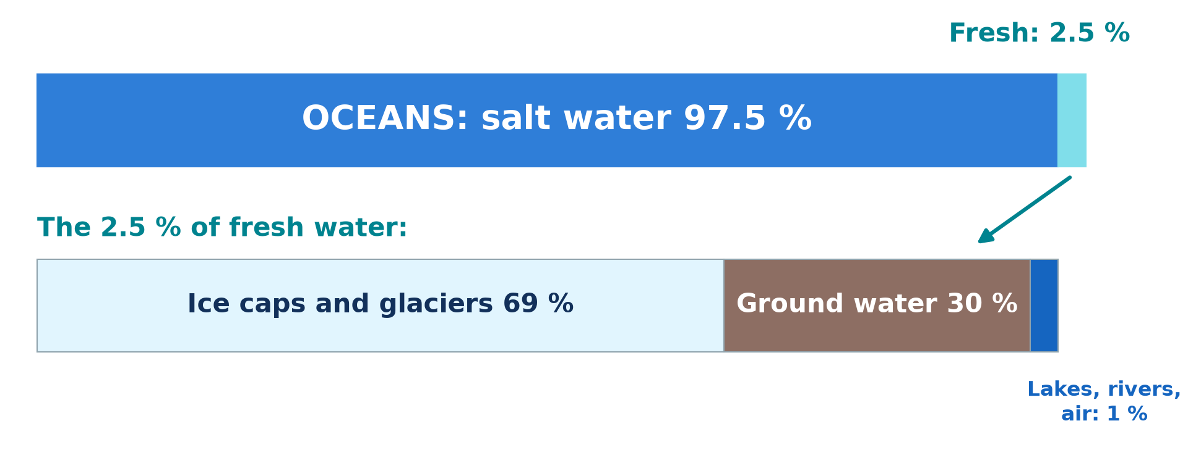
2. QUANTITY
Activity 2
Water on the Earth.
Notes:
Activity 2. Look carefully at this diagram: water on the Earth. Observe every detail before I ask the question.

Slide 22
2. QUANTITY
Activity 2: Question
What part of the Earth's water is fresh water?
Notes:
Here is the question for Activity 2: What part of the Earth's water is fresh water? Take one minute to think and write your answer in your rough notebook.

Slide 23
2. QUANTITY
Activity 2: Answer
Only about 2.5 %; most water is salty sea water.
Notes:
Let us check the answer together. Only about 2.5 %; most water is salty sea water.

Slide 24

3. QUALITY
Activity 3
A borehole.
Notes:
Activity 3. Look carefully at this picture: a borehole. Observe every detail before I ask the question.

Slide 25
3. QUALITY
Activity 3: Question
Why is borehole water safer than water from an open well?
Notes:
Here is the question for Activity 3: Why is borehole water safer than water from an open well? Take one minute to think and write your answer in your rough notebook.

Slide 26
3. QUALITY
Activity 3: Answer
It comes from deep underground and is protected from dirt.
Notes:
Let us check the answer together. It comes from deep underground and is protected from dirt.

Slide 27
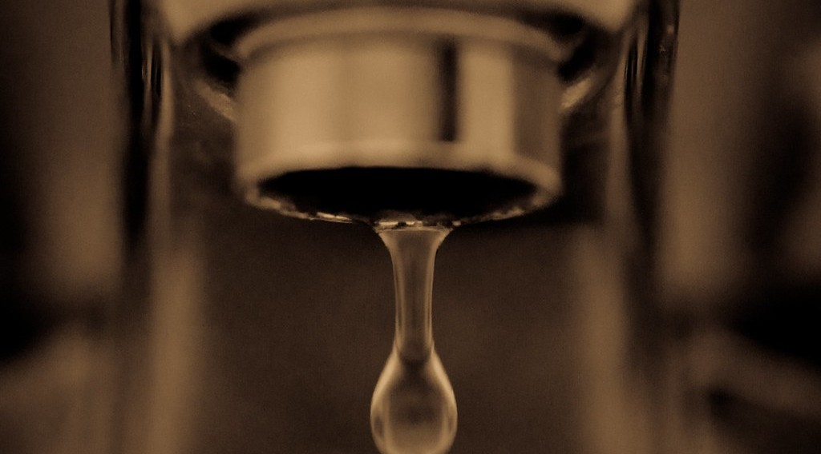
4. USES
Activity 4
A leaking tap.
Notes:
Activity 4. Look carefully at this picture: a leaking tap. Observe every detail before I ask the question.

Slide 28
4. USES
Activity 4: Question
How is water wasted in this picture?
Notes:
Here is the question for Activity 4: How is water wasted in this picture? Take one minute to think and write your answer in your rough notebook.

Slide 29
4. USES
Activity 4: Answer
The tap leaks, so clean water is lost.
Notes:
Let us check the answer together. The tap leaks, so clean water is lost.

Slide 30
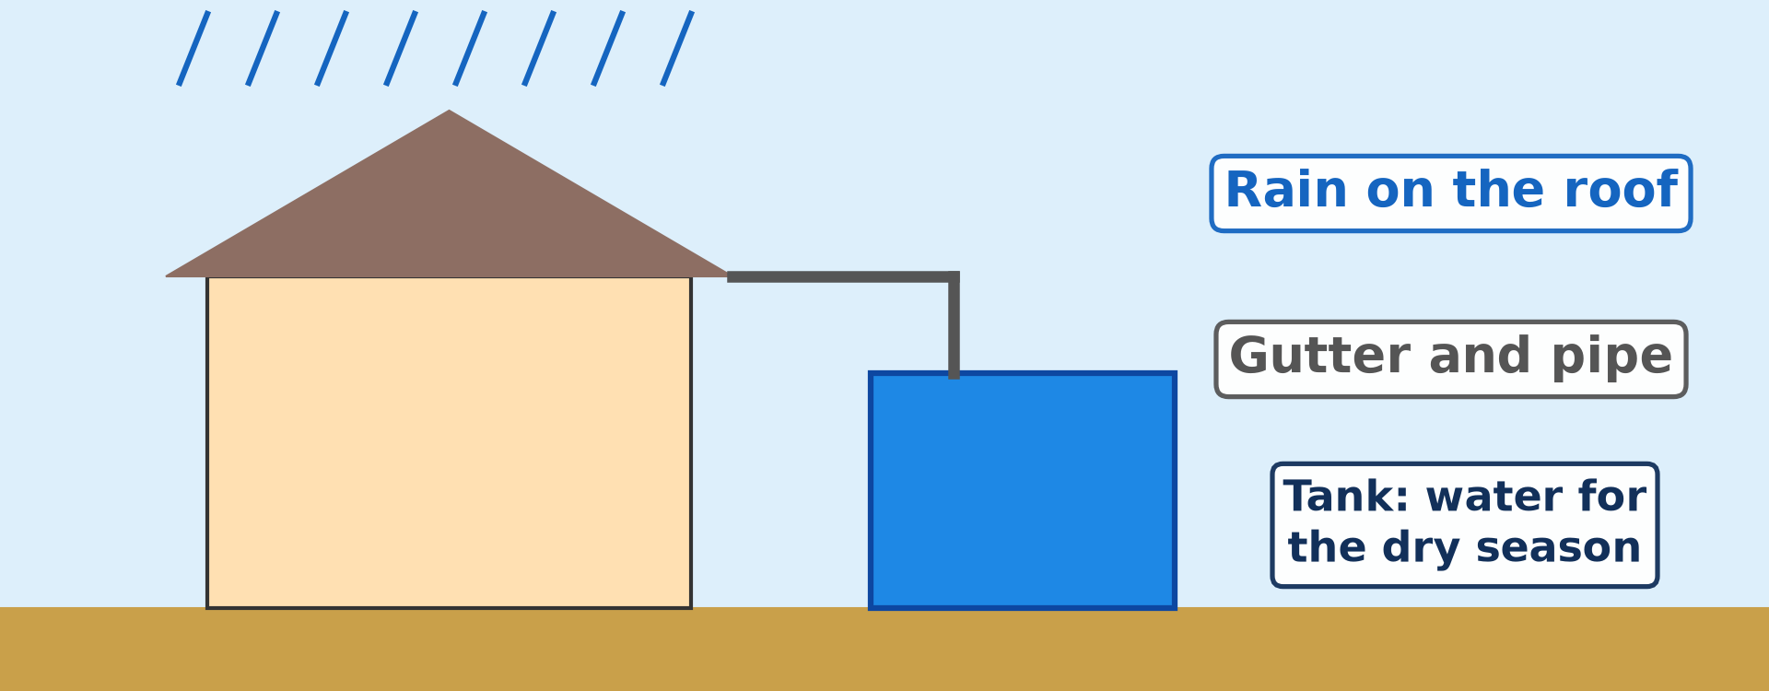
5. MANAGEMENT
Activity 5
Collecting rainwater.
Notes:
Activity 5. Look carefully at this diagram: collecting rainwater. Observe every detail before I ask the question.

Slide 31
5. MANAGEMENT
Activity 5: Question
How can a family keep water for the dry season?
Notes:
Here is the question for Activity 5: How can a family keep water for the dry season? Take one minute to think and write your answer in your rough notebook.

Slide 32
5. MANAGEMENT
Activity 5: Answer
By collecting rainwater from the roof in a tank.
Notes:
Let us check the answer together. By collecting rainwater from the roof in a tank.

Slide 33
BOARD SUMMARY
Board Summary
Topic: Man in his Environment
Sub-topic: Exploitation of Resources in the Natural Environment
Further Study 4: Water Scarcity
Notes:
Now we are going to copy the board summary. Write the title and the headings neatly in your notebooks. I will give you enough time for each slide, so do not rush.

Slide 34
BOARD SUMMARY
DEFINITIONS
The key terms of this lesson are defined as follows:
Water scarcity: It is a lack of enough clean water to meet people's needs.
Water management: It is the good use, storage and protection of water.
Notes:
Let us copy the definitions. The key terms of this lesson are defined as follows. On this slide we have Water scarcity and Water management. Write each point on a new line, with the key term first, and explain it in your own words when we revise.

Slide 35
BOARD SUMMARY
1. Quantity of Water
The quantity of water is limited for the following reasons:
Little fresh water: Only about 2.5 % of the water on the Earth is fresh.
Illustration: water on the Earth
Notes:
Let us copy Quantity of Water. The quantity of water is limited for the following reasons. Copy the point on Little fresh water on the left, then draw the diagram on the right: water on the Earth. Give it a title and label it clearly.

Slide 36
BOARD SUMMARY
1. Quantity of Water
Long dry seasons and droughts: Rivers and wells dry up in the north.
Population growth: More people need more water.
Notes:
We continue with Quantity of Water. On this slide we have Long dry seasons and droughts and Population growth. Write each point on a new line, with the key term first, and explain it in your own words when we revise.

Slide 37
BOARD SUMMARY
2. Quality of Water
The quality of water is explained as follows:
Open wells and rivers: Their water is often dirty and carries germs.
Diseases: Dirty water causes cholera, typhoid and diarrhoea.
Notes:
Let us copy Quality of Water. The quality of water is explained as follows. On this slide we have Open wells and rivers and Diseases. Write each point on a new line, with the key term first, and explain it in your own words when we revise.

Slide 38
BOARD SUMMARY
2. Quality of Water
Safe sources: Boreholes and treated tap water are safer.
Illustration: a borehole
Notes:
Copy the point on Safe sources on the left, then draw the diagram on the right: a borehole. Give it a title and label it clearly.

Slide 39
BOARD SUMMARY
3. Uses of Water
The uses of water and its waste are the following:
Domestic uses: We use water for drinking, cooking and washing.
Notes:
Let us copy Uses of Water. The uses of water and its waste are the following. On this slide we have Domestic uses. Write each point on a new line, with the key term first, and explain it in your own words when we revise.

Slide 40
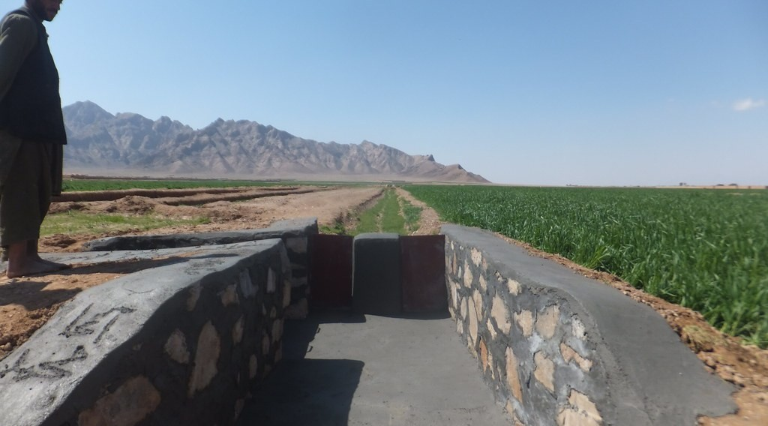
BOARD SUMMARY
3. Uses of Water
Farming and livestock: Farmers irrigate crops and herders water their animals.
Illustration: irrigation
Notes:
Copy the point on Farming and livestock on the left, then draw the diagram on the right: irrigation. Give it a title and label it clearly.

Slide 41
BOARD SUMMARY
3. Uses of Water
Industry and energy: Factories use water, and dams produce electricity.
Notes:
We continue with Uses of Water. On this slide we have Industry and energy. Write each point on a new line, with the key term first, and explain it in your own words when we revise.

Slide 42
BOARD SUMMARY
3. Uses of Water
Waste: Leaking taps and careless use waste water.
Illustration: a leaking tap
Notes:
Copy the point on Waste on the left, then draw the diagram on the right: a leaking tap. Give it a title and label it clearly.

Slide 43
BOARD SUMMARY
4. Management of Water
Water can be managed with the following measures:
Saving water: We close taps and repair leaks.
Notes:
Let us copy Management of Water. Water can be managed with the following measures. On this slide we have Saving water. Write each point on a new line, with the key term first, and explain it in your own words when we revise.

Slide 44
BOARD SUMMARY
4. Management of Water
Storing water: We collect rainwater in tanks and build dams.
Illustration: collecting rainwater
Notes:
Copy the point on Storing water on the left, then draw the diagram on the right: collecting rainwater. Give it a title and label it clearly.

Slide 45
BOARD SUMMARY
4. Management of Water
Clean water: We boil or filter water and build boreholes.
Protecting sources: We keep wells covered and do not throw rubbish in rivers.
Notes:
We continue with Management of Water. On this slide we have Clean water and Protecting sources. Write each point on a new line, with the key term first, and explain it in your own words when we revise.

Slide 46
FORMATIVE EVALUATION
Evaluation 1
What is water scarcity?
Notes:
Now let us check what you have understood. Question 1: What is water scarcity? Answer in your exercise book.

Slide 47
FORMATIVE EVALUATION
Expected Answer
A lack of enough clean water.
Notes:
The expected answer is: a lack of enough clean water. If you got it right, well done.

Slide 48
FORMATIVE EVALUATION
Evaluation 2
Give two ways to manage water.
Notes:
Now let us check what you have understood. Question 2: Give two ways to manage water. Answer in your exercise book.

Slide 49
FORMATIVE EVALUATION
Expected Answer
Store rainwater and repair leaks.
Notes:
The expected answer is: store rainwater and repair leaks. If you got it right, well done.

Slide 50
REMEDIATION
Remediation
Fill in the blanks:
Only about ______ % of the Earth's water is fresh.
A deep well dug with machines is a ______.
Dirty water causes ______.
Notes:
For those who need more practice, fill in the blanks in your exercise book. The answers are: number 1, ; number 2, 5; number 2, borehole; number 3, cholera (or typhoid).

Slide 51
HOMEWORK
Homework
Name three patterns of rural settlements.
Notes:
For your homework: Name three patterns of rural settlements. We shall correct it at the beginning of our next lesson.

Slide 52
NEXT LESSON
Next Lesson
Our next lesson will be on:
Lesson 6: Country Sides in Africa
Notes:
Our next lesson will be on Lesson 6: Country Sides in Africa. Thank you for your attention, and see you next time.

Slide 53
BILINGUAL GAME
Bilingual Game (Jeu Bilingue)
English | Français
Water | L'eau
Scarcity | La pénurie
Well | Le puits
Tap | Le robinet
Clean | Propre
Enquiry | L'enquête
Notes:
Let us play the bilingual game. I say a word in English, and you give me the French word. Then we do the reverse.

Slide 54
LOGBOOK
Official Logbook (1/2)
Module / Topic | Man in his Environment
Lesson Title | Further Study 4: Water Scarcity
Expected Learning Outcomes | Define water scarcity. Describe the problems of quantity and quality of water and its uses. Propose ways to manage water well.
Competence | Learners are able to investigate water scarcity in their area and propose ways to manage water.
Notes:
I record this information in the official logbook of the class after the lesson.

Slide 55
LOGBOOK
Official Logbook (2/2)
Matter Taught | DEFINITIONS; Quantity of Water; Quality of Water; Uses of Water; Management of Water.
Evaluation | Formative evaluation and remediation exercise.
Homework | Name three patterns of rural settlements.
Enrolment / Present / Absent | ____ / ____ / ____
Achievement | To be completed after the lesson.
Notes:
I complete the second page of the logbook: the matter taught, the evaluation, the homework and the attendance.

Slide 56
TEACHER'S NOTE
Teacher's Note
Timing: Homework correction, plan, objectives 8 min | Recall, situation, action 10 min | 5 activities 30 min | Board summary (copying) 30 min | Evaluation, remediation 10 min | Homework, next lesson 5 min | Logbook 7 min
Without the projector (Activity 1): ask where families get water.
Without the projector (Activity 2): draw a bar of 100 %.
Without the projector (Activity 3): describe water sources of the quarter.
Without the projector (Activity 4): list uses at home.
Without the projector (Activity 5): design a water plan for the school.
Notes:
This slide is for me, the teacher: it gives the timing of the lesson and what to do if the projector is not available.

Slide 57
REFERENCES
References
Geography Syllabus, Forms I–V, MINESEC (2023) — Form 2, Module 1: Man in his Environment.
Photo, Activity 1: “Women fetch water in Kilte-Awlaelo woreda, Tigray” by UNICEF Ethiopia, CC BY-NC-ND 2.0, via Flickr (https://www.flickr.com/photos/86783452@N02/14056445728)
Photo, Activity 3: “i'll fight you for it...” by the apostrophe, CC BY-NC-SA 2.0, via Flickr (https://www.flickr.com/photos/66441426@N00/4019192363)
Photo, Activity 4: “Drip” by jronaldlee, CC BY 2.0, via Flickr (https://www.flickr.com/photos/37176760@N06/5996590138)
Photo, board summary (Farming and livestock): “Irrigation Canals in Farah Province Afgahnistan” by USAID_IMAGES, CC BY-NC-ND 2.0, via Flickr (https://www.flickr.com/photos/46658241@N06/14784748647)
Diagrams and animations: drawn for this lesson (Geography Department).
Notes:
These are the references and picture credits used to prepare this lesson.

