Slide 1
FORM 2 TECHNICAL
GEOGRAPHY
Lesson 2 (Part 2)
The Tropical Grassland Region: Characteristics (Soils and Vegetation)
Notes:
Good morning, class, and welcome to our geography lesson. I am your geography teacher, Mr Kamdem. Today we are starting Lesson 2 (Part 2): The Tropical Grassland Region: Characteristics (Soils and Vegetation).

Slide 2
CLASS INFO
Class, Chapter and Duration
Class | Form 2 Technical
Chapter | Economic Geography — Natural Regions: 2. The Tropical Grassland Region
Duration | 2 periods (2 × 50 minutes)
Notes:
This lesson is for Form 2 Technical. It belongs to Economic Geography — Natural Regions: 2. The Tropical Grassland Region. We shall need 2 periods to cover it.

Slide 3
IDENTIFICATION
Lesson Identification
Topic | Man in His Environment
Sub-topic | Natural Regions
Lesson | Lesson 2 (Part 2): The Tropical Grassland Region: Characteristics (Soils and Vegetation)
Notions / Concepts | Savanna, deciduous, xerophyte, ferruginous soil, laterite, black cotton soil.
Syllabus focus | Characteristics of the soils and vegetation of the Tropical Grassland region.
Competence | Learners are able to recognise the trees and soils of the savanna around them and explain why some trees lose their leaves in the dry season.
Notes:
Our topic is Man in His Environment, and the sub-topic is Natural Regions. The key notions we shall use today are: savanna, deciduous, xerophyte, ferruginous soil, laterite, black cotton soil. At the end, you should be able to do this: learners are able to recognise the trees and soils of the savanna around them and explain why some trees lose their leaves in the dry season.

Slide 4

HOMEWORK CORRECTION
Correction of the Homework
Question (Lesson 2 (Part 1): The Tropical Grassland Region: Location and Characteristics (Climate)):
Name two trees of the savanna.
Notes:
Before we start the new lesson, let us correct the homework I gave you at the end of Lesson 2 (Part 1): The Tropical Grassland Region: Location and Characteristics (Climate). The question was: Name two trees of the savanna. Take out your exercise books.

Slide 5
HOMEWORK CORRECTION
Correction: Possible Answer
The baobab and the shea tree (also the acacia).
Notes:
Here is a good answer. The baobab and the shea tree (also the acacia). Compare it with your own answer and correct your work in red.

Slide 6
LESSON PLAN
Lesson Plan
Correction of the homework
Objectives and recall
Real-life situation and action to take
Learning activities
Board summary
Evaluation, remediation and homework
Notes:
Here is the plan of our lesson today. First, we shall correct the homework. Then we shall look at the objectives and recall what you already know. After that, we shall study a situation from real life and the action to take, and do the learning activities. Finally, we shall copy the board summary, do the evaluation and the remediation, and I will give you the homework.

Slide 7
OBJECTIVES
Objectives
By the end of this lesson, you should be able to:
Describe the vegetation of the Tropical Grassland region.
Explain how savanna plants are adapted to the dry season and to bush fires.
Notes:
Take your time to copy this part; we will continue together.

Slide 8
OBJECTIVES
Objectives (continued)
Describe the main soils of the Tropical Grassland region.
Notes:
By the end of this lesson, you should be able to do three things. Number 1: describe the vegetation of the Tropical Grassland region. Number 2: explain how savanna plants are adapted to the dry season and to bush fires. Number 3: describe the main soils of the Tropical Grassland region.

Slide 9
PREVIOUS KNOWLEDGE
Previous Knowledge
The Tropical Grassland lies between 5° and 15° north and south of the Equator.
It has a wet season and a dry season, with 500 to 1,500 mm of rain.
Garoua has a dry season from November to March.
Notes:
Let us first remember what you already know. The Tropical Grassland lies between 5° and 15° north and south of the Equator. It has a wet season and a dry season, with 500 to 1,500 mm of rain. Garoua has a dry season from November to March. Keep this in mind, because we shall build on it today.

Slide 10
REAL-LIFE SITUATION
Situation in Real Life
In January, Hawa travels from Garoua to Ngaoundéré. The grass is dry and yellow, and many trees have no leaves, but the shea tree still has leaves and its bark is not burnt. Hawa asks: "How do the plants of the savanna survive the long dry season and the bush fires?"
Notes:
Listen carefully to this situation from real life. In January, Hawa travels from Garoua to Ngaoundéré. The grass is dry and yellow, and many trees have no leaves, but the shea tree still has leaves and its bark is not burnt. Hawa asks: "How do the plants of the savanna survive the long dry season and the bush fires?" Think about it, because I am going to ask you some questions.

Slide 11
REAL-LIFE SITUATION
Situation: Question 1
What is the problem in the situation?
Notes:
Question 1: What is the problem in the situation? Think for a moment, then raise your hand to answer.

Slide 12
REAL-LIFE SITUATION
Answer
Hawa does not know how savanna plants survive the dry season and fires.
Notes:
Good. Hawa does not know how savanna plants survive the dry season and fires.

Slide 13
REAL-LIFE SITUATION
Situation: Question 2
What colour is the grass in January?
Notes:
Question 2: What colour is the grass in January? Think for a moment, then raise your hand to answer.

Slide 14
REAL-LIFE SITUATION
Answer
Yellow (dry).
Notes:
Good. Yellow (dry).

Slide 15
REAL-LIFE SITUATION
Situation: Question 3
Which tree still has leaves?
Notes:
Question 3: Which tree still has leaves? Think for a moment, then raise your hand to answer.

Slide 16
REAL-LIFE SITUATION
Possible Answer
The shea tree.
Notes:
Good. The shea tree.

Slide 17
ACTION TO TAKE
Action to Take
Avoid bush fires, which destroy plants and the humus of the soil.
Notes:
From this situation, the action we are working towards in this lesson is the following: avoid bush fires, which destroy plants and the humus of the soil.

Slide 18
JUSTIFICATION
Justification of the Lesson
This lesson helps us to know the plants and soils around us.
Notes:
Why is this lesson important for you? This lesson helps us to know the plants and soils around us.

Slide 19
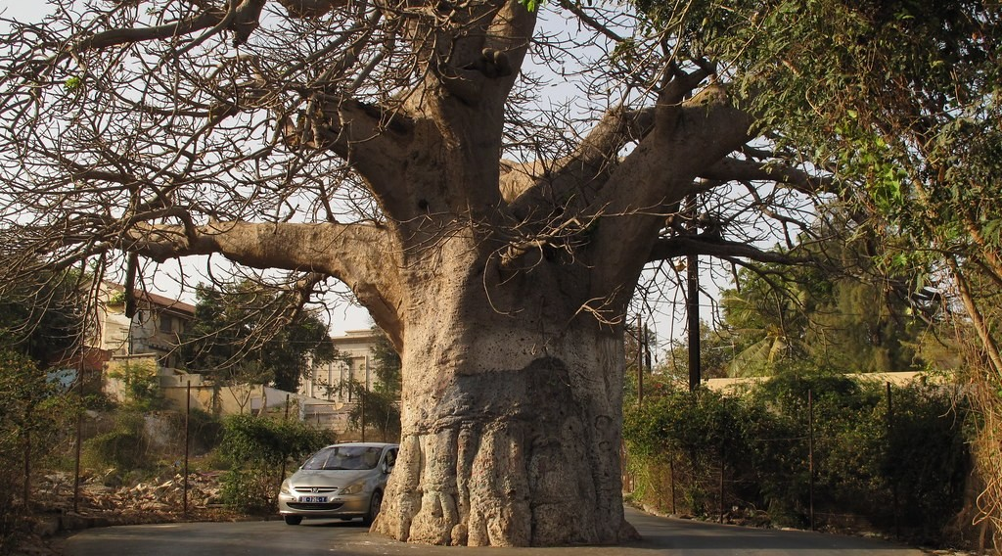
1. VEGETATION
Activity 1
A baobab.
Notes:
Activity 1. Look carefully at this picture: a baobab. Observe every detail before I ask the question.

Slide 20
1. VEGETATION
Activity 1: Question
How does the big trunk of the baobab help it in the dry season?
Notes:
Here is the question for Activity 1: How does the big trunk of the baobab help it in the dry season? Take one minute to think and write your answer in your rough notebook.

Slide 21
1. VEGETATION
Activity 1: Answer
It stores water.
Notes:
Let us check the answer together. It stores water.

Slide 22
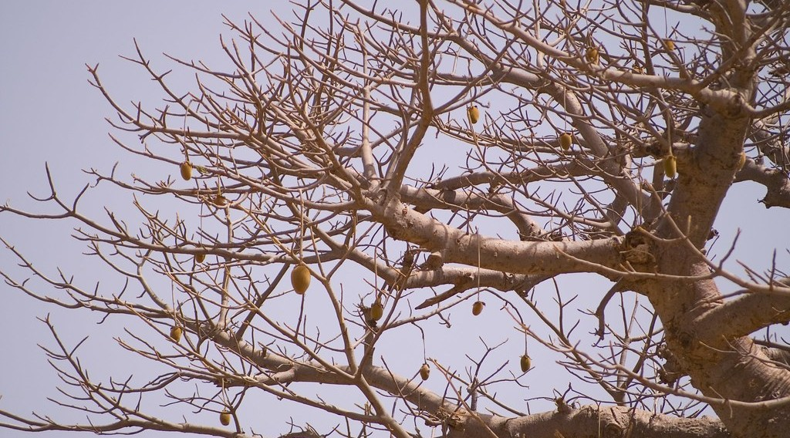
1. VEGETATION
Activity 2
Trees without leaves.
Notes:
Activity 2. Look carefully at this picture: trees without leaves. Observe every detail before I ask the question.

Slide 23
1. VEGETATION
Activity 2: Question
Why do many savanna trees lose their leaves in the dry season?
Notes:
Here is the question for Activity 2: Why do many savanna trees lose their leaves in the dry season? Take one minute to think and write your answer in your rough notebook.

Slide 24
1. VEGETATION
Activity 2: Answer
To lose less water.
Notes:
Let us check the answer together. To lose less water.

Slide 25

1. VEGETATION
Activity 3
A shea tree.
Notes:
Activity 3. Look carefully at this picture: a shea tree. Observe every detail before I ask the question.

Slide 26
1. VEGETATION
Activity 3: Question
How does the thick bark help the shea tree?
Notes:
Here is the question for Activity 3: How does the thick bark help the shea tree? Take one minute to think and write your answer in your rough notebook.

Slide 27
1. VEGETATION
Activity 3: Answer
It protects the tree from bush fires.
Notes:
Let us check the answer together. It protects the tree from bush fires.

Slide 28

2. SOILS
Activity 4
A red, hard soil.
Notes:
Activity 4. Look carefully at this picture: a red, hard soil. Observe every detail before I ask the question.

Slide 29
2. SOILS
Activity 4: Question
What is this red soil that becomes hard when it dries?
Notes:
Here is the question for Activity 4: What is this red soil that becomes hard when it dries? Take one minute to think and write your answer in your rough notebook.

Slide 30
2. SOILS
Activity 4: Answer
Laterite.
Notes:
Let us check the answer together. Laterite.

Slide 31

2. SOILS
Activity 5
A black soil that cracks.
Notes:
Activity 5. Look carefully at this picture: a black soil that cracks. Observe every detail before I ask the question.

Slide 32
2. SOILS
Activity 5: Question
Why do farmers like black cotton soils?
Notes:
Here is the question for Activity 5: Why do farmers like black cotton soils? Take one minute to think and write your answer in your rough notebook.

Slide 33
2. SOILS
Activity 5: Answer
They are fertile and keep water.
Notes:
Let us check the answer together. They are fertile and keep water.

Slide 34
BOARD SUMMARY
Board Summary
Topic: Man in His Environment
Sub-topic: Natural Regions
Lesson 2 (Part 2): The Tropical Grassland Region: Characteristics (Soils and Vegetation)
Notes:
Now we are going to copy the board summary. Write the title and the headings neatly in your notebooks. I will give you enough time for each slide, so do not rush.

Slide 35
BOARD SUMMARY
DEFINITIONS
The key terms of this lesson are defined as follows:
Savanna: It is a vegetation of tall grass with scattered trees.
Laterite: It is a red soil that becomes very hard when it dries.
Notes:
Let us copy the definitions. The key terms of this lesson are defined as follows. On this slide we have Savanna and Laterite. Write each point on a new line, with the key term first, and explain it in your own words when we revise.

Slide 36

BOARD SUMMARY
1. Vegetation
The savanna vegetation has the following characteristics:
Tall grass: Elephant grass grows up to 3 m high.
Illustration: the savanna
Notes:
Let us copy Vegetation. The savanna vegetation has the following characteristics. Copy the point on Tall grass on the left, then draw the diagram on the right: the savanna. Give it a title and label it clearly.

Slide 37
BOARD SUMMARY
1. Vegetation
Scattered trees: Baobab, acacia and shea trees.
Deciduous trees: Many trees lose their leaves in the dry season.
Notes:
We continue with Vegetation. On this slide we have Scattered trees and Deciduous trees. Write each point on a new line, with the key term first, and explain it in your own words when we revise.

Slide 38
BOARD SUMMARY
1. Vegetation
Water storage: The baobab stores water in its trunk.
Illustration: a baobab
Notes:
Copy the point on Water storage on the left, then draw the diagram on the right: a baobab. Give it a title and label it clearly.

Slide 39
BOARD SUMMARY
1. Vegetation
Protection: Thick bark protects trees from fire.
Notes:
We continue with Vegetation. On this slide we have Protection. Write each point on a new line, with the key term first, and explain it in your own words when we revise.

Slide 40
BOARD SUMMARY
2. Soils
The savanna soils have the following characteristics:
Ferruginous soils: Red soils rich in iron.
Notes:
Let us copy Soils. The savanna soils have the following characteristics. On this slide we have Ferruginous soils. Write each point on a new line, with the key term first, and explain it in your own words when we revise.

Slide 41
BOARD SUMMARY
2. Soils
Laterite: A hard red crust used for roads and bricks.
Illustration: laterite
Notes:
Copy the point on Laterite on the left, then draw the diagram on the right: laterite. Give it a title and label it clearly.

Slide 42
BOARD SUMMARY
2. Soils
Black cotton soils: Fertile clay soils that crack when dry.
Little humus: Bush fires burn dead plants.
Notes:
We continue with Soils. On this slide we have Black cotton soils and Little humus. Write each point on a new line, with the key term first, and explain it in your own words when we revise.

Slide 43
FORMATIVE EVALUATION
Evaluation 1
Give two ways savanna trees survive the dry season.
Notes:
Now let us check what you have understood. Question 1: Give two ways savanna trees survive the dry season. Answer in your exercise book.

Slide 44
FORMATIVE EVALUATION
Expected Answer
They lose their leaves; the baobab keeps water in its trunk.
Notes:
The expected answer is: they lose their leaves; the baobab keeps water in its trunk. If you got it right, well done.

Slide 45
FORMATIVE EVALUATION
Evaluation 2
What is laterite used for?
Notes:
Now let us check what you have understood. Question 2: What is laterite used for? Answer in your exercise book.

Slide 46
FORMATIVE EVALUATION
Expected Answer
For roads and bricks.
Notes:
The expected answer is: for roads and bricks. If you got it right, well done.

Slide 47
REMEDIATION
Remediation
Fill in the blanks:
Trees that lose their leaves are ______ trees.
The tree that keeps water in its trunk is the ______.
The hard red layer in the soil is ______.
Notes:
For those who need more practice, fill in the blanks in your exercise book. The answers are: number 1, deciduous; number 2, baobab; number 3, laterite.

Slide 48
HOMEWORK
Homework
Name three resources of the savanna.
Notes:
For your homework: Name three resources of the savanna. We shall correct it at the beginning of our next lesson.

Slide 49
NEXT LESSON
Next Lesson
Our next lesson will be on:
Lesson 2 (Part 3): The Tropical Grassland Region: Types of Resources and Methods of Exploitation
Notes:
Our next lesson will be on Lesson 2 (Part 3): The Tropical Grassland Region: Types of Resources and Methods of Exploitation. Thank you for your attention, and see you next time.

Slide 50
BILINGUAL GAME
Bilingual Game (Jeu Bilingue)
English | Français
Savanna | La savane
Grass | L'herbe
Deciduous tree | L'arbre à feuilles caduques
Bush fire | Le feu de brousse
Shea tree | Le karité
Baobab | Le baobab
Laterite | La latérite
Leaching | Le lessivage
Notes:
Let us play the bilingual game. I say a word in English, and you give me the French word. Then we do the reverse.

Slide 51
LOGBOOK
Official Logbook (1/2)
Module / Topic | Man in His Environment
Lesson Title | Lesson 2 (Part 2): The Tropical Grassland Region: Characteristics (Soils and Vegetation)
Expected Learning Outcomes | Describe the vegetation of the Tropical Grassland region. Explain how savanna plants are adapted to the dry season and to bush fires. Describe the main soils of the Tropical Grassland region.
Competence | Learners are able to recognise the trees and soils of the savanna around them and explain why some trees lose their leaves in the dry season.
Notes:
I record this information in the official logbook of the class after the lesson.

Slide 52
LOGBOOK
Official Logbook (2/2)
Matter Taught | DEFINITIONS; Vegetation; Soils.
Evaluation | Formative evaluation and remediation exercise.
Homework | Name three resources of the savanna.
Enrolment / Present / Absent | ____ / ____ / ____
Achievement | To be completed after the lesson.
Notes:
I complete the second page of the logbook: the matter taught, the evaluation, the homework and the attendance.

Slide 53
TEACHER'S NOTE
Teacher's Note
Timing: Homework correction, plan, objectives 8 min | Recall, situation, action 10 min | 5 activities 30 min | Board summary (copying) 30 min | Evaluation, remediation 10 min | Homework, next lesson 5 min | Logbook 7 min
Without the projector (Activity 1): describe a baobab.
Without the projector (Activity 2): look at the trees of the school.
Without the projector (Activity 3): touch the bark of a tree.
Without the projector (Activity 4): show a laterite road.
Without the projector (Activity 5): name crops grown on black soils.
Notes:
This slide is for me, the teacher: it gives the timing of the lesson and what to do if the projector is not available.

Slide 54
REFERENCES
References
Harmonised Progression Sheet, Economic Geography (5051), Form 2.
Class textbook: The major biomes of the world (tropical grassland).
Photo, Activity 1: “What happens if you let weeds grow in centre of road, Dakar, Senegal” by ambabheg, CC BY 2.0, via Flickr (https://www.flickr.com/photos/31518985@N04/5627872663)
Photo, Activity 2: “'Pain de singe' (monkey's bread) in a baobab, Senegal” by Milamber's portfolio, CC BY-NC-ND 2.0, via Flickr (https://www.flickr.com/photos/90956808@N00/420120264)
Photo, Activity 3: “Female shea tree (Vitellaria paradoxa) in full flower” by Joel Abroad, CC BY-NC-SA 2.0, via Flickr (https://www.flickr.com/photos/40295335@N00/5603751456)
Photo, Activity 4: “Laterite soil bricks in Richard Rebello's farm” by India Water Portal, CC BY-NC-SA 2.0, via Flickr (https://www.flickr.com/photos/21623815@N03/10720461943)
Photo, Activity 5: “Cracked Earth” by Aleatoric Consonance, CC BY 2.0, via Flickr (https://www.flickr.com/photos/93921318@N00/3772011444)
Notes:
Take your time to copy this part; we will continue together.

Slide 55
REFERENCES
References (continued)
Photo, board summary (Tall grass): “Blue Wildebeest in the Lowveld” by Martin_Heigan, CC BY-NC-ND 2.0, via Flickr (https://www.flickr.com/photos/97303475@N00/2089079933)
Diagrams and animations: drawn for this lesson (Geography Department).
Notes:
These are the references and picture credits used to prepare this lesson.

