Slide 1
FORM 2 TECHNICAL
GEOGRAPHY
Lesson 5 (Part 4)
The Sectors of the Economy: The Secondary Sector (Definition and Examples)
Notes:
Good morning, class, and welcome to our geography lesson. I am your geography teacher, Mr Kamdem. Today we are starting Lesson 5 (Part 4): The Sectors of the Economy: The Secondary Sector (Definition and Examples).

Slide 2
CLASS INFO
Class, Chapter and Duration
Class | Form 2 Technical
Chapter | Economic Geography — Sectors of the Economy
Duration | 2 periods (2 × 50 minutes)
Notes:
This lesson is for Form 2 Technical. It belongs to Economic Geography — Sectors of the Economy. We shall need 2 periods to cover it.

Slide 3
IDENTIFICATION
Lesson Identification
Topic | Economic Activities
Sub-topic | Sectors of the Economy
Lesson | Lesson 5 (Part 4): The Sectors of the Economy: The Secondary Sector (Definition and Examples)
Notions / Concepts | Secondary sector, industry, manufacturing, processing, construction, energy production.
Syllabus focus | Definition and examples of the secondary sector, with examples from Cameroon.
Competence | Learners are able to recognise the products of Cameroonian factories and explain why transforming raw materials creates jobs and wealth.
Notes:
Our topic is Economic Activities, and the sub-topic is Sectors of the Economy. The key notions we shall use today are: secondary sector, industry, manufacturing, processing, construction, energy production. At the end, you should be able to do this: learners are able to recognise the products of Cameroonian factories and explain why transforming raw materials creates jobs and wealth.

Slide 4

HOMEWORK CORRECTION
Correction of the Homework
Question (Lesson 5 (Part 3): The Sectors of the Economy: The Primary Sector (Definition and Examples)):
Name one factory of Garoua and its product.
Notes:
Before we start the new lesson, let us correct the homework I gave you at the end of Lesson 5 (Part 3): The Sectors of the Economy: The Primary Sector (Definition and Examples). The question was: Name one factory of Garoua and its product. Take out your exercise books.

Slide 5
HOMEWORK CORRECTION
Correction: Possible Answer
CICAM, which makes cloth.
Notes:
Here is a good answer. CICAM, which makes cloth. Compare it with your own answer and correct your work in red.

Slide 6
LESSON PLAN
Lesson Plan
Correction of the homework
Objectives and recall
Real-life situation and action to take
Learning activities
Board summary
Evaluation, remediation and homework
Notes:
Here is the plan of our lesson today. First, we shall correct the homework. Then we shall look at the objectives and recall what you already know. After that, we shall study a situation from real life and the action to take, and do the learning activities. Finally, we shall copy the board summary, do the evaluation and the remediation, and I will give you the homework.

Slide 7
OBJECTIVES
Objectives
By the end of this lesson, you should be able to:
Define the secondary sector.
Name the main secondary activities.
Give examples of industries in Cameroon and explain their importance.
Notes:
By the end of this lesson, you should be able to do three things. Number 1: define the secondary sector. Number 2: name the main secondary activities. Number 3: give examples of industries in Cameroon and explain their importance.

Slide 8
PREVIOUS KNOWLEDGE
Previous Knowledge
The primary sector takes raw materials from nature.
Its activities are agriculture, livestock rearing, fishing, forestry and mining.
Notes:
Let us first remember what you already know. The primary sector takes raw materials from nature. Its activities are agriculture, livestock rearing, fishing, forestry and mining. Keep this in mind, because we shall build on it today.

Slide 9
REAL-LIFE SITUATION
Situation in Real Life
Cameroon sells raw cotton and cocoa beans at low prices, and later buys back clothes and chocolate made from them at high prices. Djibrilla asks: "What do we call the work of changing raw materials into new goods, and why is it important?"
Notes:
Listen carefully to this situation from real life. Cameroon sells raw cotton and cocoa beans at low prices, and later buys back clothes and chocolate made from them at high prices. Djibrilla asks: "What do we call the work of changing raw materials into new goods, and why is it important?" Think about it, because I am going to ask you some questions.

Slide 10
REAL-LIFE SITUATION
Situation: Question 1
What is the problem in the situation?
Notes:
Question 1: What is the problem in the situation? Think for a moment, then raise your hand to answer.

Slide 11
REAL-LIFE SITUATION
Answer
Djibrilla does not know the sector that transforms raw materials.
Notes:
Good. Djibrilla does not know the sector that transforms raw materials.

Slide 12
REAL-LIFE SITUATION
Situation: Question 2
What does Cameroon sell?
Notes:
Question 2: What does Cameroon sell? Think for a moment, then raise your hand to answer.

Slide 13
REAL-LIFE SITUATION
Answer
Raw cotton and cocoa beans.
Notes:
Good. Raw cotton and cocoa beans.

Slide 14
REAL-LIFE SITUATION
Situation: Question 3
What does it buy back?
Notes:
Question 3: What does it buy back? Think for a moment, then raise your hand to answer.

Slide 15
REAL-LIFE SITUATION
Possible Answer
Clothes and chocolate.
Notes:
Good. Clothes and chocolate.

Slide 16
ACTION TO TAKE
Action to Take
Buy goods made in Cameroon to support our industries.
Notes:
From this situation, the action we are working towards in this lesson is the following: buy goods made in Cameroon to support our industries.

Slide 17
JUSTIFICATION
Justification of the Lesson
This lesson helps us to know the jobs that make goods.
Notes:
Why is this lesson important for you? This lesson helps us to know the jobs that make goods.

Slide 18

DEFINITION
Activity 1
A textile factory.
Notes:
Activity 1. Look carefully at this picture: a textile factory. Observe every detail before I ask the question.

Slide 19
DEFINITION
Activity 1: Question
This factory turns cotton into cloth. Which sector is this?
Notes:
Here is the question for Activity 1: This factory turns cotton into cloth. Which sector is this? Take one minute to think and write your answer in your rough notebook.

Slide 20
DEFINITION
Activity 1: Answer
The secondary sector.
Notes:
Let us check the answer together. The secondary sector.

Slide 21

EXAMPLES
Activity 2
A drinks factory.
Notes:
Activity 2. Look carefully at this picture: a drinks factory. Observe every detail before I ask the question.

Slide 22
EXAMPLES
Activity 2: Question
Name one factory of North Cameroon.
Notes:
Here is the question for Activity 2: Name one factory of North Cameroon. Take one minute to think and write your answer in your rough notebook.

Slide 23
EXAMPLES
Activity 2: Answer
CICAM (cloth) or SODECOTON (cotton oil).
Notes:
Let us check the answer together. CICAM (cloth) or SODECOTON (cotton oil).

Slide 24
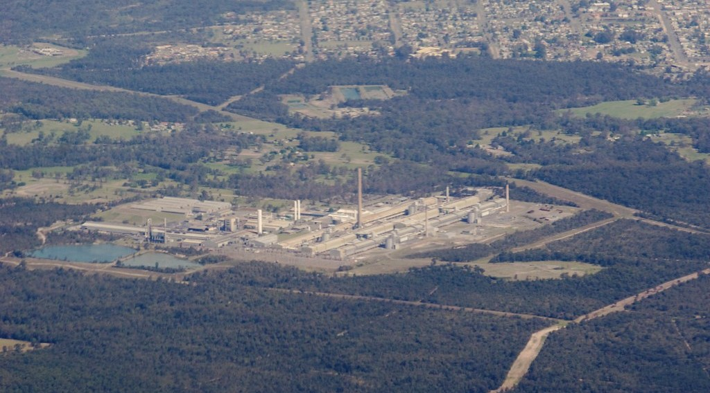
EXAMPLES
Activity 3
An aluminium factory.
Notes:
Activity 3. Look carefully at this picture: an aluminium factory. Observe every detail before I ask the question.

Slide 25
EXAMPLES
Activity 3: Question
What does Alucam in Edéa make?
Notes:
Here is the question for Activity 3: What does Alucam in Edéa make? Take one minute to think and write your answer in your rough notebook.

Slide 26
EXAMPLES
Activity 3: Answer
Aluminium.
Notes:
Let us check the answer together. Aluminium.

Slide 27

EXAMPLES
Activity 4
Builders at work.
Notes:
Activity 4. Look carefully at this picture: builders at work. Observe every detail before I ask the question.

Slide 28
EXAMPLES
Activity 4: Question
Is building houses part of the secondary sector?
Notes:
Here is the question for Activity 4: Is building houses part of the secondary sector? Take one minute to think and write your answer in your rough notebook.

Slide 29
EXAMPLES
Activity 4: Answer
Yes: builders make new things from cement, sand and iron.
Notes:
Let us check the answer together. Yes: builders make new things from cement, sand and iron.

Slide 30
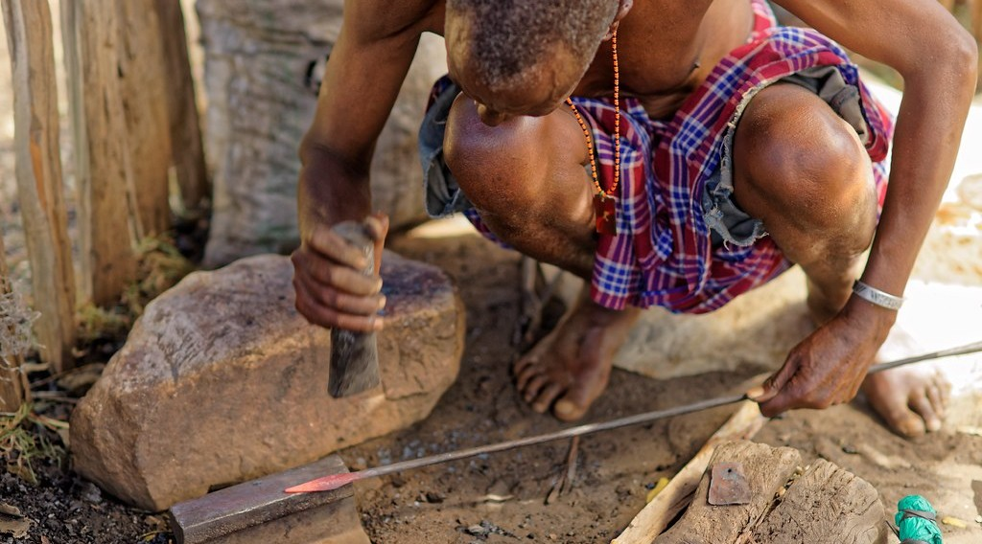
EXAMPLES
Activity 5
A blacksmith.
Notes:
Activity 5. Look carefully at this picture: a blacksmith. Observe every detail before I ask the question.

Slide 31
EXAMPLES
Activity 5: Question
What do we call making tools by hand?
Notes:
Here is the question for Activity 5: What do we call making tools by hand? Take one minute to think and write your answer in your rough notebook.

Slide 32
EXAMPLES
Activity 5: Answer
Crafts (handicraft).
Notes:
Let us check the answer together. Crafts (handicraft).

Slide 33
BOARD SUMMARY
Board Summary
Topic: Economic Activities
Sub-topic: Sectors of the Economy
Lesson 5 (Part 4): The Sectors of the Economy: The Secondary Sector (Definition and Examples)
Notes:
Now we are going to copy the board summary. Write the title and the headings neatly in your notebooks. I will give you enough time for each slide, so do not rush.

Slide 34
BOARD SUMMARY
DEFINITIONS
The key terms of this lesson are defined as follows:
Secondary sector: It is made of activities that transform raw materials into new goods.
Industry: It is a place or activity where goods are made.
Notes:
Let us copy the definitions. The key terms of this lesson are defined as follows. On this slide we have Secondary sector and Industry. Write each point on a new line, with the key term first, and explain it in your own words when we revise.

Slide 35
BOARD SUMMARY
Examples of Secondary Activities
The secondary sector includes the following activities:
Light industries: Cloth (CICAM), drinks (SABC) and cotton oil (SODECOTON).
Illustration: a textile factory
Notes:
Let us copy Examples of Secondary Activities. The secondary sector includes the following activities. Copy the point on Light industries on the left, then draw the diagram on the right: a textile factory. Give it a title and label it clearly.

Slide 36
BOARD SUMMARY
Examples of Secondary Activities
Heavy industries: Aluminium (Alucam at Edéa) and cement (CIMENCAM at Figuil).
Illustration: an aluminium factory
Notes:
Copy the point on Heavy industries on the left, then draw the diagram on the right: an aluminium factory. Give it a title and label it clearly.

Slide 37
BOARD SUMMARY
Examples of Secondary Activities
Building and public works: Houses, roads and bridges.
Notes:
We continue with Examples of Secondary Activities. On this slide we have Building and public works. Write each point on a new line, with the key term first, and explain it in your own words when we revise.

Slide 38
BOARD SUMMARY
Examples of Secondary Activities
Crafts: Blacksmiths, potters, weavers and carpenters.
Illustration: a blacksmith
Notes:
Copy the point on Crafts on the left, then draw the diagram on the right: a blacksmith. Give it a title and label it clearly.

Slide 39
BOARD SUMMARY
Examples of Secondary Activities
Energy production: Electricity from dams such as Lagdo.
Notes:
We continue with Examples of Secondary Activities. On this slide we have Energy production. Write each point on a new line, with the key term first, and explain it in your own words when we revise.

Slide 40
FORMATIVE EVALUATION
Evaluation 1
What is the secondary sector?
Notes:
Now let us check what you have understood. Question 1: What is the secondary sector? Answer in your exercise book.

Slide 41
FORMATIVE EVALUATION
Expected Answer
The sector that turns raw materials into goods.
Notes:
The expected answer is: the sector that turns raw materials into goods. If you got it right, well done.

Slide 42
FORMATIVE EVALUATION
Evaluation 2
Give two examples of industries in Cameroon.
Notes:
Now let us check what you have understood. Question 2: Give two examples of industries in Cameroon. Answer in your exercise book.

Slide 43
FORMATIVE EVALUATION
Expected Answer
CICAM (cloth) and Alucam (aluminium).
Notes:
The expected answer is: cICAM (cloth) and Alucam (aluminium). If you got it right, well done.

Slide 44
REMEDIATION
Remediation
Fill in the blanks:
Turning raw materials into goods is the ______ sector.
CICAM turns cotton into ______.
Alucam at Edéa makes ______.
Notes:
For those who need more practice, fill in the blanks in your exercise book. The answers are: number 1, secondary; number 2, cloth; number 3, aluminium.

Slide 45
HOMEWORK
Homework
Give three services used every day.
Notes:
For your homework: Give three services used every day. We shall correct it at the beginning of our next lesson.

Slide 46
NEXT LESSON
Next Lesson
Our next lesson will be on:
Lesson 5 (Part 5): The Sectors of the Economy: The Tertiary Sector (Definition and Examples)
Notes:
Our next lesson will be on Lesson 5 (Part 5): The Sectors of the Economy: The Tertiary Sector (Definition and Examples). Thank you for your attention, and see you next time.

Slide 47
BILINGUAL GAME
Bilingual Game (Jeu Bilingue)
English | Français
Industry | L'industrie
Factory | L'usine
Finished good | Le produit fini
Construction | Le bâtiment (la construction)
Energy | L'énergie
Refinery | La raffinerie
Craftsman | L'artisan
Cement | Le ciment
Notes:
Let us play the bilingual game. I say a word in English, and you give me the French word. Then we do the reverse.

Slide 48
LOGBOOK
Official Logbook (1/2)
Module / Topic | Economic Activities
Lesson Title | Lesson 5 (Part 4): The Sectors of the Economy: The Secondary Sector (Definition and Examples)
Expected Learning Outcomes | Define the secondary sector. Name the main secondary activities. Give examples of industries in Cameroon and explain their importance.
Competence | Learners are able to recognise the products of Cameroonian factories and explain why transforming raw materials creates jobs and wealth.
Notes:
I record this information in the official logbook of the class after the lesson.

Slide 49
LOGBOOK
Official Logbook (2/2)
Matter Taught | DEFINITIONS; Examples of Secondary Activities.
Evaluation | Formative evaluation and remediation exercise.
Homework | Give three services used every day.
Enrolment / Present / Absent | ____ / ____ / ____
Achievement | To be completed after the lesson.
Notes:
I complete the second page of the logbook: the matter taught, the evaluation, the homework and the attendance.

Slide 50
TEACHER'S NOTE
Teacher's Note
Timing: Homework correction, plan, objectives 8 min | Recall, situation, action 10 min | 5 activities 30 min | Board summary (copying) 30 min | Evaluation, remediation 10 min | Homework, next lesson 5 min | Logbook 7 min
Without the projector (Activity 1): show cloth.
Without the projector (Activity 2): name factories of Garoua.
Without the projector (Activity 3): show an aluminium pot.
Without the projector (Activity 4): describe a building site.
Without the projector (Activity 5): name craftsmen.
Notes:
This slide is for me, the teacher: it gives the timing of the lesson and what to do if the projector is not available.

Slide 51
REFERENCES
References
Harmonised Progression Sheet, Economic Geography (5051), Form 2.
Photo, Activity 1: “Lowell Massachusetts - Boott Cotton Mills Museum Weave Room” by Onasill ~ Bill- 81M views, CC BY-NC-SA 2.0, via Flickr (https://www.flickr.com/photos/7156765@N05/43677799854)
Photo, Activity 2: “Interior of Winston-Salem Chero-Cola Bottling Company, Winston-Salem, ” by unclibraries_commons, Public domain 1.0, via Flickr (https://www.flickr.com/photos/122654055@N06/22680169228)
Photo, Activity 3: “Kurri Kurri aluminium” by yewenyi, CC BY-NC 2.0, via Flickr (https://www.flickr.com/photos/30265340@N00/2971223932)
Photo, Activity 4: “Cementing Ethiopia's progress” by DFID - UK Department for International Development, CC BY 2.0, via Flickr (https://www.flickr.com/photos/14214150@N02/8757865770)
Photo, Activity 5: “Forging a new spear tip” by www.j-pics.info, CC BY-NC-SA 2.0, via Flickr (https://www.flickr.com/photos/33979630@N07/16024814824)
Diagrams and animations: drawn for this lesson (Geography Department).
Notes:
These are the references and picture credits used to prepare this lesson.

