Slide 1
FORM 2 TECHNICAL
GEOGRAPHY
Lesson 5 (Part 6)
The Sectors of the Economy: The Quaternary Sector (Definition and Examples)
Notes:
Good morning, class, and welcome to our geography lesson. I am your geography teacher, Mr Kamdem. Today we are starting Lesson 5 (Part 6): The Sectors of the Economy: The Quaternary Sector (Definition and Examples).

Slide 2
CLASS INFO
Class, Chapter and Duration
Class | Form 2 Technical
Chapter | Economic Geography — Sectors of the Economy
Duration | 2 periods (2 × 50 minutes)
Notes:
This lesson is for Form 2 Technical. It belongs to Economic Geography — Sectors of the Economy. We shall need 2 periods to cover it.

Slide 3
IDENTIFICATION
Lesson Identification
Topic | Economic Activities
Sub-topic | Sectors of the Economy
Lesson | Lesson 5 (Part 6): The Sectors of the Economy: The Quaternary Sector (Definition and Examples)
Notions / Concepts | Quaternary sector, research, information and communication technology (ICT), knowledge economy.
Syllabus focus | Definition and examples of the quaternary sector.
Competence | Learners are able to explain how research and digital tools improve daily life and farming, and to use them responsibly.
Notes:
Our topic is Economic Activities, and the sub-topic is Sectors of the Economy. The key notions we shall use today are: quaternary sector, research, information and communication technology (ICT), knowledge economy. At the end, you should be able to do this: learners are able to explain how research and digital tools improve daily life and farming, and to use them responsibly.

Slide 4

HOMEWORK CORRECTION
Correction of the Homework
Question (Lesson 5 (Part 5): The Sectors of the Economy: The Tertiary Sector (Definition and Examples)):
Name one research centre in Cameroon.
Notes:
Before we start the new lesson, let us correct the homework I gave you at the end of Lesson 5 (Part 5): The Sectors of the Economy: The Tertiary Sector (Definition and Examples). The question was: Name one research centre in Cameroon. Take out your exercise books.

Slide 5
HOMEWORK CORRECTION
Correction: Possible Answer
IRAD.
Notes:
Here is a good answer. IRAD. Compare it with your own answer and correct your work in red.

Slide 6
LESSON PLAN
Lesson Plan
Correction of the homework
Objectives and recall
Real-life situation and action to take
Learning activities
Board summary
Evaluation, remediation and homework
Notes:
Here is the plan of our lesson today. First, we shall correct the homework. Then we shall look at the objectives and recall what you already know. After that, we shall study a situation from real life and the action to take, and do the learning activities. Finally, we shall copy the board summary, do the evaluation and the remediation, and I will give you the homework.

Slide 7
OBJECTIVES
Objectives
By the end of this lesson, you should be able to:
Define the quaternary sector.
Name the main quaternary activities.
Explain the importance of the quaternary sector for development.
Notes:
By the end of this lesson, you should be able to do three things. Number 1: define the quaternary sector. Number 2: name the main quaternary activities. Number 3: explain the importance of the quaternary sector for development.

Slide 8
PREVIOUS KNOWLEDGE
Previous Knowledge
The tertiary sector provides services: trade, transport, banking, social services and tourism.
Services link producers to consumers.
Notes:
Let us first remember what you already know. The tertiary sector provides services: trade, transport, banking, social services and tourism. Services link producers to consumers. Keep this in mind, because we shall build on it today.

Slide 9
REAL-LIFE SITUATION
Situation in Real Life
For many years, drought destroyed the maize of farmers near Garoua. Then researchers created a new maize that grows fast and needs less water, and now the harvests are better. A farmer asks: "What is the work of these researchers called, and how does it help us?"
Notes:
Listen carefully to this situation from real life. For many years, drought destroyed the maize of farmers near Garoua. Then researchers created a new maize that grows fast and needs less water, and now the harvests are better. A farmer asks: "What is the work of these researchers called, and how does it help us?" Think about it, because I am going to ask you some questions.

Slide 10
REAL-LIFE SITUATION
Situation: Question 1
What is the problem in the situation?
Notes:
Question 1: What is the problem in the situation? Think for a moment, then raise your hand to answer.

Slide 11
REAL-LIFE SITUATION
Answer
The farmer does not know the sector of research and its importance.
Notes:
Good. The farmer does not know the sector of research and its importance.

Slide 12
REAL-LIFE SITUATION
Situation: Question 2
What destroyed the maize?
Notes:
Question 2: What destroyed the maize? Think for a moment, then raise your hand to answer.

Slide 13
REAL-LIFE SITUATION
Answer
Drought.
Notes:
Good. Drought.

Slide 14
REAL-LIFE SITUATION
Situation: Question 3
What did the researchers create?
Notes:
Question 3: What did the researchers create? Think for a moment, then raise your hand to answer.

Slide 15
REAL-LIFE SITUATION
Possible Answer
A new maize that needs less water.
Notes:
Good. A new maize that needs less water.

Slide 16
ACTION TO TAKE
Action to Take
Study hard and use ICT to create new knowledge.
Notes:
From this situation, the action we are working towards in this lesson is the following: study hard and use ICT to create new knowledge.

Slide 17
JUSTIFICATION
Justification of the Lesson
This lesson helps us to know the jobs of knowledge and research.
Notes:
Why is this lesson important for you? This lesson helps us to know the jobs of knowledge and research.

Slide 18
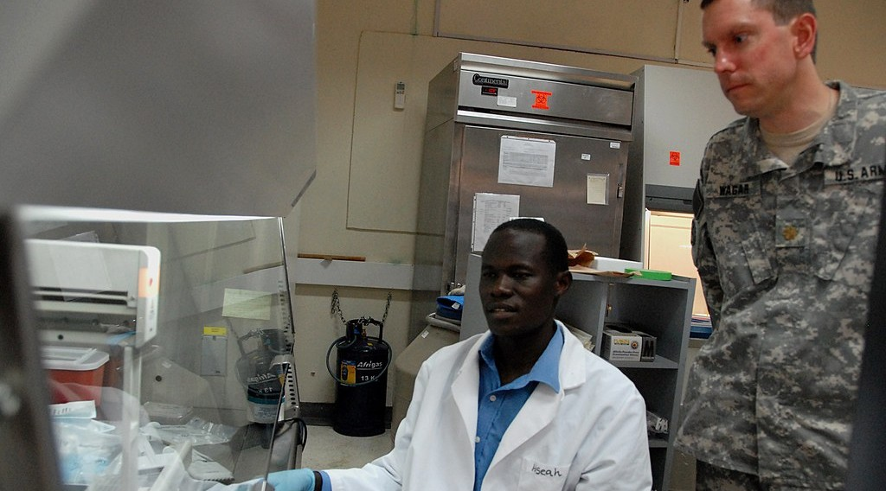
DEFINITION
Activity 1
A researcher.
Notes:
Activity 1. Look carefully at this picture: a researcher. Observe every detail before I ask the question.

Slide 19
DEFINITION
Activity 1: Question
Researchers create new knowledge. Which sector is this?
Notes:
Here is the question for Activity 1: Researchers create new knowledge. Which sector is this? Take one minute to think and write your answer in your rough notebook.

Slide 20
DEFINITION
Activity 1: Answer
The quaternary sector.
Notes:
Let us check the answer together. The quaternary sector.

Slide 21

EXAMPLES
Activity 2
A research field.
Notes:
Activity 2. Look carefully at this picture: a research field. Observe every detail before I ask the question.

Slide 22
EXAMPLES
Activity 2: Question
Name one research centre in Cameroon.
Notes:
Here is the question for Activity 2: Name one research centre in Cameroon. Take one minute to think and write your answer in your rough notebook.

Slide 23
EXAMPLES
Activity 2: Answer
IRAD (also the universities).
Notes:
Let us check the answer together. IRAD (also the universities).

Slide 24

EXAMPLES
Activity 3
A farmer with a phone.
Notes:
Activity 3. Look carefully at this picture: a farmer with a phone. Observe every detail before I ask the question.

Slide 25
EXAMPLES
Activity 3: Question
How does the phone help farmers?
Notes:
Here is the question for Activity 3: How does the phone help farmers? Take one minute to think and write your answer in your rough notebook.

Slide 26
EXAMPLES
Activity 3: Answer
They get prices and weather news.
Notes:
Let us check the answer together. They get prices and weather news.

Slide 27
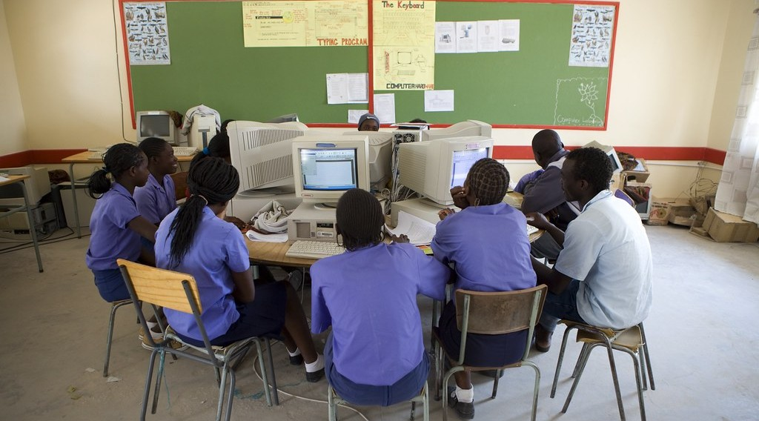
EXAMPLES
Activity 4
A computer class.
Notes:
Activity 4. Look carefully at this picture: a computer class. Observe every detail before I ask the question.

Slide 28
EXAMPLES
Activity 4: Question
Name one job of information technology.
Notes:
Here is the question for Activity 4: Name one job of information technology. Take one minute to think and write your answer in your rough notebook.

Slide 29
EXAMPLES
Activity 4: Answer
Making software, websites or phone apps.
Notes:
Let us check the answer together. Making software, websites or phone apps.

Slide 30
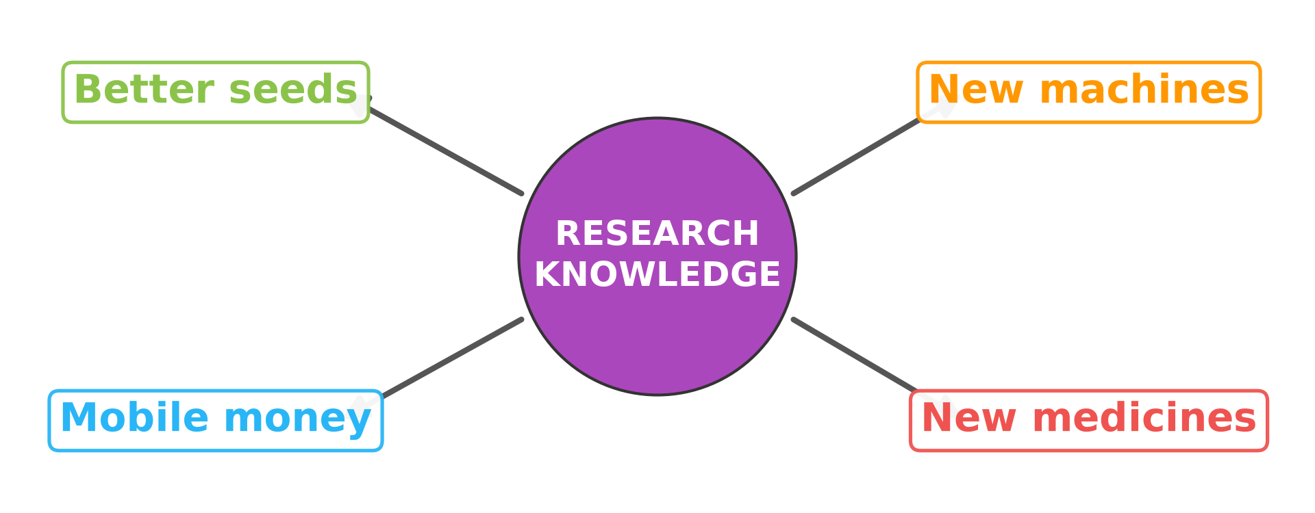
EXAMPLES
Activity 5
Research helps the other sectors.
Notes:
Activity 5. Look carefully at this diagram: research helps the other sectors. Observe every detail before I ask the question.

Slide 31
EXAMPLES
Activity 5: Question
How does research help farming?
Notes:
Here is the question for Activity 5: How does research help farming? Take one minute to think and write your answer in your rough notebook.

Slide 32
EXAMPLES
Activity 5: Answer
It gives better seeds and new methods.
Notes:
Let us check the answer together. It gives better seeds and new methods.

Slide 33
BOARD SUMMARY
Board Summary
Topic: Economic Activities
Sub-topic: Sectors of the Economy
Lesson 5 (Part 6): The Sectors of the Economy: The Quaternary Sector (Definition and Examples)
Notes:
Now we are going to copy the board summary. Write the title and the headings neatly in your notebooks. I will give you enough time for each slide, so do not rush.

Slide 34
BOARD SUMMARY
DEFINITIONS
The key terms of this lesson are defined as follows:
Quaternary sector: It is made of activities based on knowledge, research and information.
Notes:
Let us copy the definitions. The key terms of this lesson are defined as follows. On this slide we have Quaternary sector. Write each point on a new line, with the key term first, and explain it in your own words when we revise.

Slide 35
BOARD SUMMARY
Examples of Quaternary Activities
A) Activities
The main quaternary activities are the following:
Research: IRAD creates better seeds and animal breeds.
Illustration: a research field
Notes:
Let us copy Activities. The main quaternary activities are the following. Copy the point on Research on the left, then draw the diagram on the right: a research field. Give it a title and label it clearly.

Slide 36
BOARD SUMMARY
Examples of Quaternary Activities
A) Activities
Universities: Teaching and research, as at the University of Garoua.
Notes:
We continue with Activities. On this slide we have Universities. Write each point on a new line, with the key term first, and explain it in your own words when we revise.

Slide 37
BOARD SUMMARY
Examples of Quaternary Activities
A) Activities
Information technology: Software, websites and phone apps.
Illustration: a computer class
Notes:
Copy the point on Information technology on the left, then draw the diagram on the right: a computer class. Give it a title and label it clearly.

Slide 38
BOARD SUMMARY
Examples of Quaternary Activities
A) Activities
Consulting and planning: Experts give advice to companies and the state.
Notes:
We continue with Activities. On this slide we have Consulting and planning. Write each point on a new line, with the key term first, and explain it in your own words when we revise.

Slide 39
BOARD SUMMARY
Examples of Quaternary Activities
B) Importance
The quaternary sector is important for the following reasons:
New seeds: Farmers get better harvests.
Illustration: research helps the other sectors
Notes:
Let us copy Importance. The quaternary sector is important for the following reasons. Copy the point on New seeds on the left, then draw the diagram on the right: research helps the other sectors. Give it a title and label it clearly.

Slide 40
BOARD SUMMARY
Examples of Quaternary Activities
B) Importance
New machines: Industries produce more and faster.
New medicines: Doctors treat more diseases.
Notes:
We continue with Importance. On this slide we have New machines and New medicines. Write each point on a new line, with the key term first, and explain it in your own words when we revise.

Slide 41
FORMATIVE EVALUATION
Evaluation 1
What is the quaternary sector?
Notes:
Now let us check what you have understood. Question 1: What is the quaternary sector? Answer in your exercise book.

Slide 42
FORMATIVE EVALUATION
Expected Answer
The sector of knowledge and research.
Notes:
The expected answer is: the sector of knowledge and research. If you got it right, well done.

Slide 43
FORMATIVE EVALUATION
Evaluation 2
Give one example of how research helps farmers.
Notes:
Now let us check what you have understood. Question 2: Give one example of how research helps farmers. Answer in your exercise book.

Slide 44
FORMATIVE EVALUATION
Expected Answer
It gives better seeds that resist drought.
Notes:
The expected answer is: it gives better seeds that resist drought. If you got it right, well done.

Slide 45
REMEDIATION
Remediation
Fill in the blanks:
The sector of knowledge and research is the ______ sector.
The research centre for farming in Cameroon is ______.
Notes:
Take your time to copy this part; we will continue together.

Slide 46
REMEDIATION
Remediation (continued)
Computers, phones and the internet are called ______.
Notes:
For those who need more practice, fill in the blanks in your exercise book. The answers are: number 1, quaternary; number 2, IRAD; number 3, ICT.

Slide 47
HOMEWORK
Homework
Name the four oceans and seas around Africa.
Notes:
For your homework: Name the four oceans and seas around Africa. We shall correct it at the beginning of our next lesson.

Slide 48
NEXT LESSON
Next Lesson
Our next lesson will be on:
Lesson 6 (Part 1): Africa: Introduction (Location and Physical Characteristics)
Notes:
Our next lesson will be on Lesson 6 (Part 1): Africa: Introduction (Location and Physical Characteristics). Thank you for your attention, and see you next time.

Slide 49
BILINGUAL GAME
Bilingual Game (Jeu Bilingue)
English | Français
Research | La recherche
Researcher | Le chercheur
Knowledge | La connaissance
Information | L'information
Software | Le logiciel
Internet | L'internet
Expert | L'expert
Innovation | L'innovation
Notes:
Let us play the bilingual game. I say a word in English, and you give me the French word. Then we do the reverse.

Slide 50
LOGBOOK
Official Logbook (1/2)
Module / Topic | Economic Activities
Lesson Title | Lesson 5 (Part 6): The Sectors of the Economy: The Quaternary Sector (Definition and Examples)
Expected Learning Outcomes | Define the quaternary sector. Name the main quaternary activities. Explain the importance of the quaternary sector for development.
Competence | Learners are able to explain how research and digital tools improve daily life and farming, and to use them responsibly.
Notes:
I record this information in the official logbook of the class after the lesson.

Slide 51
LOGBOOK
Official Logbook (2/2)
Matter Taught | DEFINITIONS; Activities; Importance.
Evaluation | Formative evaluation and remediation exercise.
Homework | Name the four oceans and seas around Africa.
Enrolment / Present / Absent | ____ / ____ / ____
Achievement | To be completed after the lesson.
Notes:
I complete the second page of the logbook: the matter taught, the evaluation, the homework and the attendance.

Slide 52
TEACHER'S NOTE
Teacher's Note
Timing: Homework correction, plan, objectives 8 min | Recall, situation, action 10 min | 5 activities 30 min | Board summary (copying) 30 min | Evaluation, remediation 10 min | Homework, next lesson 5 min | Logbook 7 min
IRAD: Institut de Recherche Agricole pour le Développement, with a regional centre at Garoua.
Without the projector (Activity 1): describe a laboratory.
Without the projector (Activity 2): name IRAD in Garoua.
Without the projector (Activity 3): ask who uses a phone for work.
Without the projector (Activity 4): name apps.
Without the projector (Activity 5): draw arrows.
Notes:
This slide is for me, the teacher: it gives the timing of the lesson and what to do if the projector is not available.

Slide 53
REFERENCES
References
Harmonised Progression Sheet, Economic Geography (5051), Form 2.
IRAD: Institut de Recherche Agricole pour le Développement (Cameroon).
Photo, Activity 1: “U.S. Army research unit marks four decades in Kenya, Africa - USAMRU-K” by US Army Africa, CC BY 2.0, via Flickr (https://www.flickr.com/photos/36281822@N08/4074611177)
Photo, Activity 2: “CIMMYT international wheat nurseries growing in Ecuador” by CIMMYT, CC BY-NC-SA 2.0, via Flickr (https://www.flickr.com/photos/44760652@N05/5958068839)
Photo, Activity 3: “Using mobile technology to give feedback about the crop trials” by Bioversity International, CC BY-NC-ND 2.0, via Flickr (https://www.flickr.com/photos/50383637@N07/15019002626)
Photo, Activity 4: “The Oneputa Combined School goes from Grade 1 through to Grade 10” by World Bank Photo Collection, CC BY-NC-ND 2.0, via Flickr (https://www.flickr.com/photos/10816734@N03/5321464442)
Diagrams and animations: drawn for this lesson (Geography Department).
Notes:
These are the references and picture credits used to prepare this lesson.

