Slide 1
FORM 4
GEOGRAPHY
Lesson 19
Indicators of Development
Notes:
Good morning, class, and welcome to our geography lesson. I am your geography teacher, Mr Kamdem. Today we are starting Lesson 19: Indicators of Development.

Slide 2
CLASS INFO
Class, Chapter and Duration
Class | Form 4
Chapter | Module II: Development and the Management of Primary Resources
Duration | 2 periods (2 × 50 minutes)
Notes:
This lesson is for Form 4. It belongs to Module II: Development and the Management of Primary Resources. We shall need 2 periods to cover it.

Slide 3
IDENTIFICATION
Lesson Identification
Topic | The Process of Development
Sub-topic | The Concept of Development
Lesson | Lesson 19: Indicators of Development
Notions / Concepts | Life expectancy, literacy, per capita income, Human Development Index (HDI).
Syllabus focus | Traditional indicators; the HDI.
Competence | Learners are able to use indicators to compare the development of countries.
Notes:
Our topic is The Process of Development, and the sub-topic is The Concept of Development. The key notions we shall use today are: life expectancy, literacy, per capita income, Human Development Index (HDI). At the end, you should be able to do this: learners are able to use indicators to compare the development of countries.

Slide 4

HOMEWORK CORRECTION
Correction of the Homework
Question (Lesson 18: The Notion of Development):
Give three examples of sustainable actions in your community.
Notes:
Before we start the new lesson, let us correct the homework I gave you at the end of Lesson 18: The Notion of Development. The question was: Give three examples of sustainable actions in your community. Take out your exercise books.

Slide 5
HOMEWORK CORRECTION
Correction: Possible Answer
Planting trees; sorting waste for compost; sending all children, including girls, to school.
Notes:
Here is a good answer. Planting trees; sorting waste for compost; sending all children, including girls, to school. Compare it with your own answer and correct your work in red.

Slide 6
LESSON PLAN
Lesson Plan
Correction of the homework
Objectives and recall
Real-life situation and action to take
Learning activities
Board summary
Evaluation, remediation and homework
Notes:
Here is the plan of our lesson today. First, we shall correct the homework. Then we shall look at the objectives and recall what you already know. After that, we shall study a situation from real life and the action to take, and do the learning activities. Finally, we shall copy the board summary, do the evaluation and the remediation, and I will give you the homework.

Slide 7
OBJECTIVES
Objectives
By the end of this lesson, you should be able to:
Identify traditional indicators of development.
Explain the HDI.
Compare countries using indicators.
Notes:
By the end of this lesson, you should be able to do three things. Number 1: identify traditional indicators of development. Number 2: explain the HDI. Number 3: compare countries using indicators.

Slide 8
PREVIOUS KNOWLEDGE
Previous Knowledge
Some countries are richer than others.
Health and education improve lives.
Income is the money people earn.
Notes:
Let us first remember what you already know. Some countries are richer than others. Health and education improve lives. Income is the money people earn. Keep this in mind, because we shall build on it today.

Slide 9
REAL-LIFE SITUATION
Situation in Real Life
A report says that people in Japan live on average 84 years, while in Chad they live about 53 years. Most adults in Japan can read, but many in Chad cannot.
Notes:
Listen carefully to this situation from real life. A report says that people in Japan live on average 84 years, while in Chad they live about 53 years. Most adults in Japan can read, but many in Chad cannot. Think about it, because I am going to ask you some questions.

Slide 10
REAL-LIFE SITUATION
Situation: Question 1
What is the problem in the situation?
Notes:
Question 1: What is the problem in the situation? Think for a moment, then raise your hand to answer.

Slide 11
REAL-LIFE SITUATION
Answer
We must measure the differences in development.
Notes:
Good. We must measure the differences in development.

Slide 12
REAL-LIFE SITUATION
Situation: Question 2
Which indicator is about how long people live?
Notes:
Question 2: Which indicator is about how long people live? Think for a moment, then raise your hand to answer.

Slide 13
REAL-LIFE SITUATION
Answer
Life expectancy.
Notes:
Good. Life expectancy.

Slide 14
REAL-LIFE SITUATION
Situation: Question 3
Which indicator is about reading?
Notes:
Question 3: Which indicator is about reading? Think for a moment, then raise your hand to answer.

Slide 15
REAL-LIFE SITUATION
Possible Answer
Literacy rate.
Notes:
Good. Literacy rate.

Slide 16
ACTION TO TAKE
Action to Take
Read and compare development figures of Cameroon and other countries.
Notes:
From this situation, the action we are working towards in this lesson is the following: read and compare development figures of Cameroon and other countries.

Slide 17
JUSTIFICATION
Justification of the Lesson
This lesson helps us to measure and compare development.
Notes:
Why is this lesson important for you? This lesson helps us to measure and compare development.

Slide 18
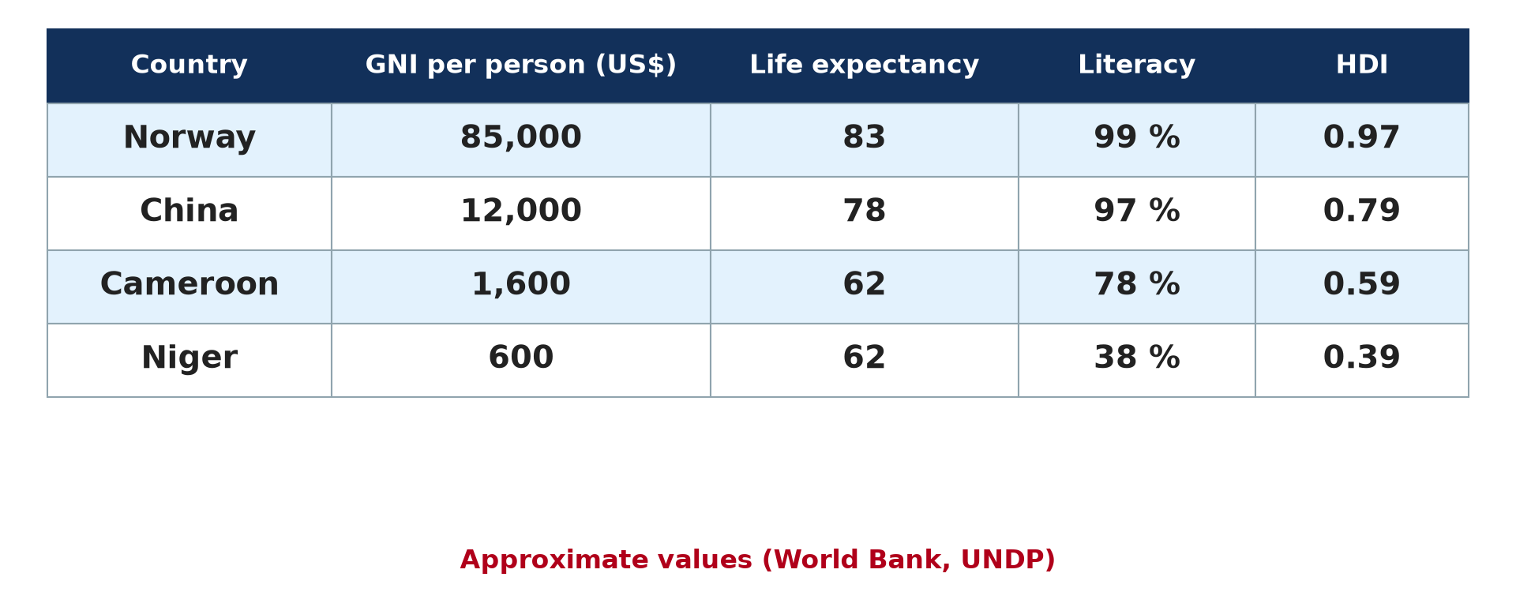
1. ECONOMIC INDICATORS
Activity 1
Development indicators (approximate).
Notes:
Activity 1. Look carefully at this diagram: development indicators (approximate). Observe every detail before I ask the question.

Slide 19
1. ECONOMIC INDICATORS
Activity 1: Question
What is per capita income?
Notes:
Here is the question for Activity 1: What is per capita income? Take one minute to think and write your answer in your rough notebook.

Slide 20
1. ECONOMIC INDICATORS
Activity 1: Answer
The total income of a country divided by its population.
Notes:
Let us check the answer together. The total income of a country divided by its population.

Slide 21
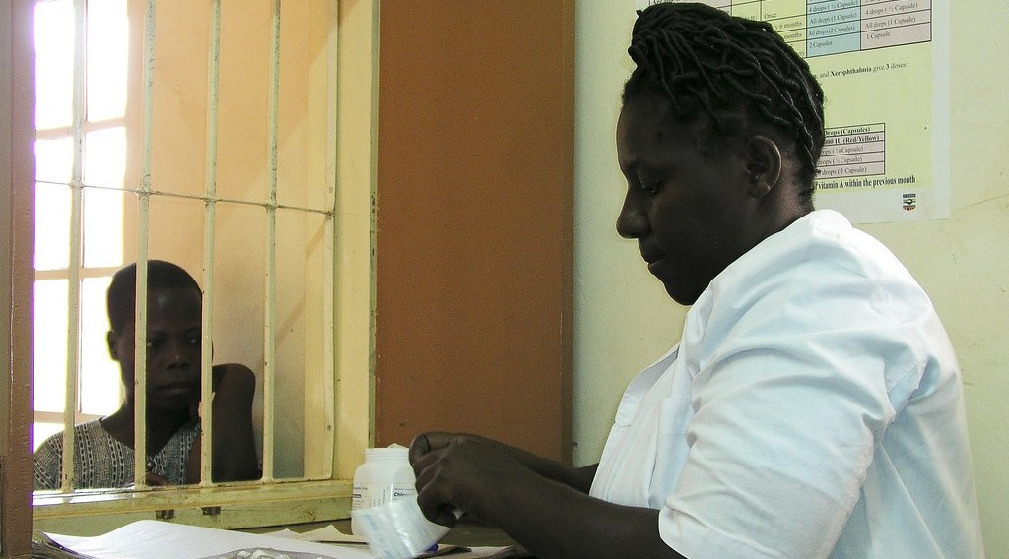
1. SOCIAL INDICATORS
Activity 2
A health centre.
Notes:
Activity 2. Look carefully at this picture: a health centre. Observe every detail before I ask the question.

Slide 22
1. SOCIAL INDICATORS
Activity 2: Question
Give two social indicators of development.
Notes:
Here is the question for Activity 2: Give two social indicators of development. Take one minute to think and write your answer in your rough notebook.

Slide 23
1. SOCIAL INDICATORS
Activity 2: Answer
Life expectancy and literacy rate (also doctors per person, infant mortality).
Notes:
Let us check the answer together. Life expectancy and literacy rate (also doctors per person, infant mortality).

Slide 24

1. SOCIAL INDICATORS
Activity 3
Girls at school.
Notes:
Activity 3. Look carefully at this picture: girls at school. Observe every detail before I ask the question.

Slide 25
1. SOCIAL INDICATORS
Activity 3: Question
Why is the literacy rate an indicator of development?
Notes:
Here is the question for Activity 3: Why is the literacy rate an indicator of development? Take one minute to think and write your answer in your rough notebook.

Slide 26
1. SOCIAL INDICATORS
Activity 3: Answer
Educated people can get better jobs and improve their lives.
Notes:
Let us check the answer together. Educated people can get better jobs and improve their lives.

Slide 27
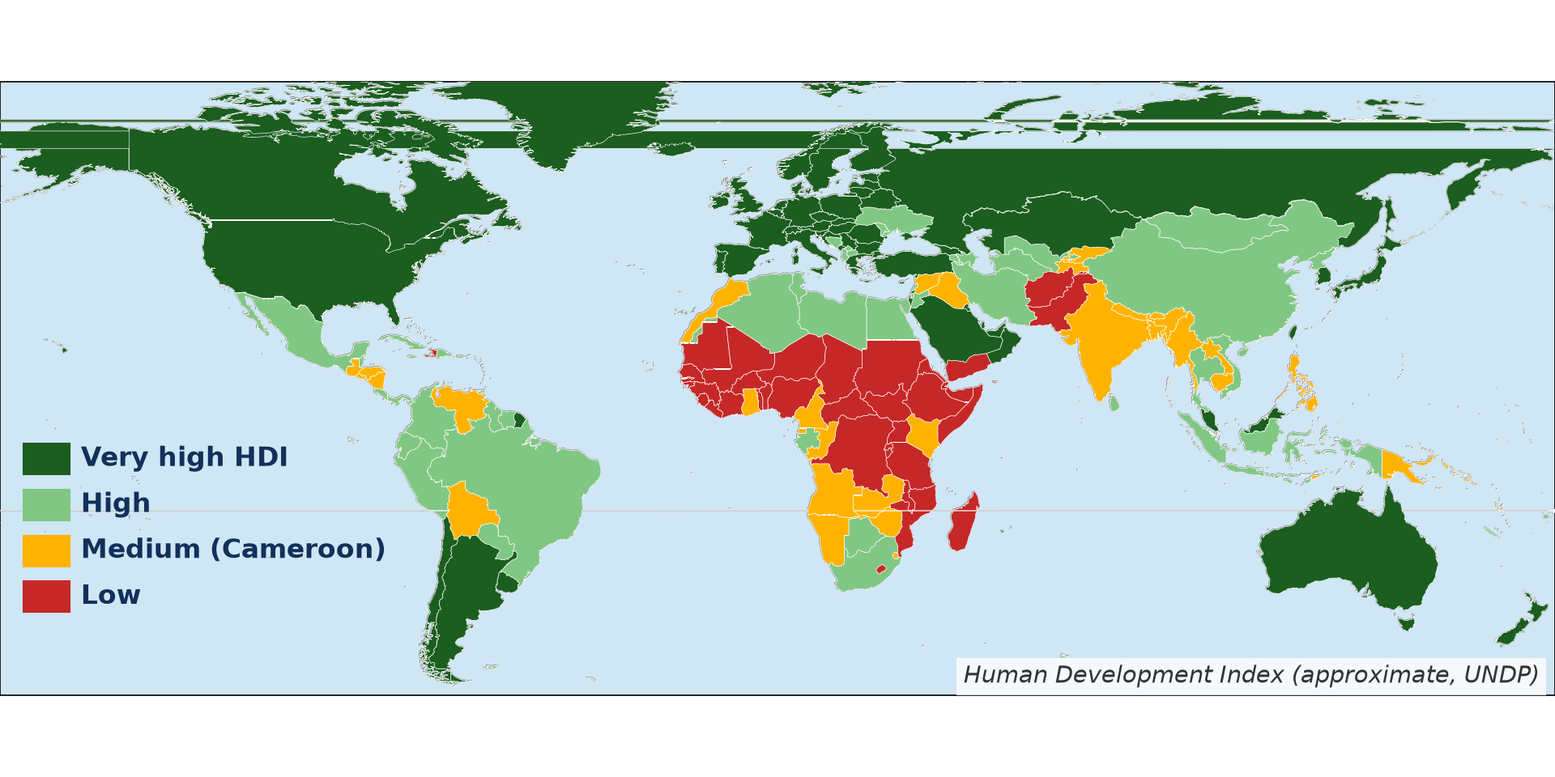
2. THE HDI
Activity 4
Human Development Index (approximate).
Notes:
Activity 4. Look carefully at this diagram: human Development Index (approximate). Observe every detail before I ask the question.

Slide 28
2. THE HDI
Activity 4: Question
What three things does the HDI combine?
Notes:
Here is the question for Activity 4: What three things does the HDI combine? Take one minute to think and write your answer in your rough notebook.

Slide 29
2. THE HDI
Activity 4: Answer
Income, health (life expectancy) and education.
Notes:
Let us check the answer together. Income, health (life expectancy) and education.

Slide 30
2. THE HDI
Activity 5
HDI around the world.
Notes:
Activity 5. Look carefully at this diagram: hDI around the world. Observe every detail before I ask the question.

Slide 31
2. THE HDI
Activity 5: Question
Which region has the lowest HDI values?
Notes:
Here is the question for Activity 5: Which region has the lowest HDI values? Take one minute to think and write your answer in your rough notebook.

Slide 32
2. THE HDI
Activity 5: Answer
Sub-Saharan Africa.
Notes:
Let us check the answer together. Sub-Saharan Africa.

Slide 33
BOARD SUMMARY
Board Summary
Topic: The Process of Development
Sub-topic: The Concept of Development
Lesson 19: Indicators of Development
Notes:
Now we are going to copy the board summary. Write the title and the headings neatly in your notebooks. I will give you enough time for each slide, so do not rush.

Slide 34
BOARD SUMMARY
DEFINITIONS
The key terms of this lesson are defined as follows:
Indicator of development: It is a measure used to show the level of development of a country.
Notes:
Let us copy the definitions. The key terms of this lesson are defined as follows. On this slide we have Indicator of development. Write each point on a new line, with the key term first, and explain it in your own words when we revise.

Slide 35
BOARD SUMMARY
1. Traditional Indicators
Development is measured with the following traditional indicators:
Per capita income: It is the income of a country divided by its population.
Life expectancy: It is the average number of years a person is expected to live.
Notes:
Let us copy Traditional Indicators. Development is measured with the following traditional indicators. On this slide we have Per capita income and Life expectancy. Write each point on a new line, with the key term first, and explain it in your own words when we revise. When you finish, we go to the next slide.

Slide 36
BOARD SUMMARY
1. Traditional Indicators (continued)
Literacy rate: It is the percentage of adults who can read and write.
Other indicators: Infant mortality, doctors per person and access to water are also used.
Notes:
We continue with Traditional Indicators. On this slide we have Literacy rate and Other indicators. Write each point on a new line, with the key term first, and explain it in your own words when we revise.

Slide 37
BOARD SUMMARY
1. Traditional Indicators
Illustration: development indicators
Notes:
Now draw this illustration in your notebook: development indicators. Give it a title and label it clearly.

Slide 38
BOARD SUMMARY
2. The Human Development Index
The HDI is explained as follows:
Meaning: The HDI combines income, life expectancy and education on a scale from 0 to 1.
Use: Countries near 1 are very developed and countries below 0.55 have low development.
Notes:
Let us copy The Human Development Index. The HDI is explained as follows. On this slide we have Meaning and Use. Write each point on a new line, with the key term first, and explain it in your own words when we revise. When you finish, we go to the next slide.

Slide 39
BOARD SUMMARY
2. The Human Development Index (continued)
Cameroon: Cameroon has a medium HDI of about 0.59.
Notes:
We continue with The Human Development Index. On this slide we have Cameroon. Write each point on a new line, with the key term first, and explain it in your own words when we revise.

Slide 40
FORMATIVE EVALUATION
Evaluation 1
Give three indicators of development.
Notes:
Now let us check what you have understood. Question 1: Give three indicators of development. Answer in your exercise book.

Slide 41
FORMATIVE EVALUATION
Expected Answer
Per capita income, life expectancy and literacy rate.
Notes:
The expected answer is: per capita income, life expectancy and literacy rate. If you got it right, well done.

Slide 42
FORMATIVE EVALUATION
Evaluation 2
What does the HDI combine?
Notes:
Now let us check what you have understood. Question 2: What does the HDI combine? Answer in your exercise book.

Slide 43
FORMATIVE EVALUATION
Expected Answer
Income, health and education.
Notes:
The expected answer is: income, health and education. If you got it right, well done.

Slide 44
REMEDIATION
Remediation
Fill in the blanks:
The average years a person lives is life ______.
The HDI ranges from 0 to ______.
The percentage of adults who can read is the ______ rate.
Notes:
For those who need more practice, fill in the blanks in your exercise book. The answers are: number 1, expectancy; number 2, 1; number 3, literacy.

Slide 45
HOMEWORK
Homework
Compare Cameroon and one developed country using two indicators.
Notes:
For your homework: Compare Cameroon and one developed country using two indicators. We shall correct it at the beginning of our next lesson.

Slide 46
NEXT LESSON
Next Lesson
Our next lesson will be on:
Lesson 20: Classification of Countries in Terms of Development Levels
Notes:
Our next lesson will be on Lesson 20: Classification of Countries in Terms of Development Levels. Thank you for your attention, and see you next time.

Slide 47
BILINGUAL GAME
Bilingual Game (Jeu Bilingue)
English | Français
Indicator | L'indicateur
Income | Le revenu
Life expectancy | L'espérance de vie
Literacy | L'alphabétisation
Index | L'indice
Health | La santé
Notes:
Let us play the bilingual game. I say a word in English, and you give me the French word. Then we do the reverse.

Slide 48
LOGBOOK
Official Logbook (1/2)
Module / Topic | The Process of Development
Lesson Title | Lesson 19: Indicators of Development
Expected Learning Outcomes | Identify traditional indicators of development. Explain the HDI. Compare countries using indicators.
Competence | Learners are able to use indicators to compare the development of countries.
Notes:
I record this information in the official logbook of the class after the lesson.

Slide 49
LOGBOOK
Official Logbook (2/2)
Matter Taught | DEFINITIONS; Traditional Indicators; The Human Development Index.
Evaluation | Formative evaluation and remediation exercise.
Homework | Compare Cameroon and one developed country using two indicators.
Enrolment / Present / Absent | ____ / ____ / ____
Achievement | To be completed after the lesson.
Notes:
I complete the second page of the logbook: the matter taught, the evaluation, the homework and the attendance.

Slide 50
TEACHER'S NOTE
Teacher's Note
Timing: Homework correction, plan, objectives 8 min | Recall, situation, action 10 min | 5 activities 30 min | Board summary (copying) 30 min | Evaluation, remediation 10 min | Homework, next lesson 5 min | Logbook 7 min
Without the projector (Activity 1): write the formula.
Without the projector (Activity 2): list indicators.
Without the projector (Activity 3): discuss schooling.
Without the projector (Activity 4): draw three boxes.
Without the projector (Activity 5): compare regions.
Notes:
This slide is for me, the teacher: it gives the timing of the lesson and what to do if the projector is not available.

Slide 51
REFERENCES
References
Geography Syllabus, Forms I–V, MINESEC (2023) — Form 4, Module II: Development and the Management of Primary Resources.
Photo, Activity 2: “Waiting at the dispensary” by World Bank Photo Collection, CC BY-NC-ND 2.0, via Flickr (https://www.flickr.com/photos/10816734@N03/7556643920)
Photo, Activity 3: “Students in Primary Seven at Zanaki Primary School” by World Bank Photo Collection, CC BY-NC-ND 2.0, via Flickr (https://www.flickr.com/photos/10816734@N03/33423887921)
Diagrams and animations: drawn for this lesson (Geography Department).
Notes:
These are the references and picture credits used to prepare this lesson.

