Slide 1
FORM 4
GEOGRAPHY
Lesson 32
Climate-Smart Agriculture
Notes:
Good morning, class, and welcome to our geography lesson. I am your geography teacher, Mr Kamdem. Today we are starting Lesson 32: Climate-Smart Agriculture.

Slide 2
CLASS INFO
Class, Chapter and Duration
Class | Form 4
Chapter | Module II: Development and the Management of Primary Resources
Duration | 2 periods (2 × 50 minutes)
Notes:
This lesson is for Form 4. It belongs to Module II: Development and the Management of Primary Resources. We shall need 2 periods to cover it.

Slide 3
IDENTIFICATION
Lesson Identification
Topic | Managing Resources for Development through Economic Activities
Sub-topic | Agriculture as an Economic Activity of the Primary Sector
Lesson | Lesson 32: Climate-Smart Agriculture
Notions / Concepts | Climate-smart agriculture, mulching, water management, shade house, intercropping, improved grazing.
Syllabus focus | Meaning; aims (main pillars); practical techniques.
Competence | Learners are able to explain climate-smart agriculture and apply its techniques.
Notes:
Our topic is Managing Resources for Development through Economic Activities, and the sub-topic is Agriculture as an Economic Activity of the Primary Sector. The key notions we shall use today are: climate-smart agriculture, mulching, water management, shade house, intercropping, improved grazing. At the end, you should be able to do this: learners are able to explain climate-smart agriculture and apply its techniques.

Slide 4

HOMEWORK CORRECTION
Correction of the Homework
Question (Lesson 31: Sustainable Agriculture):
Propose a crop rotation plan for three years on a farm in your area.
Notes:
Before we start the new lesson, let us correct the homework I gave you at the end of Lesson 31: Sustainable Agriculture. The question was: Propose a crop rotation plan for three years on a farm in your area. Take out your exercise books.

Slide 5
HOMEWORK CORRECTION
Correction: Possible Answer
Example: year 1 – maize; year 2 – groundnuts or beans (which enrich the soil); year 3 – cotton or sorghum; then start again.
Notes:
Here is a good answer. Example: year 1 – maize; year 2 – groundnuts or beans (which enrich the soil); year 3 – cotton or sorghum; then start again. Compare it with your own answer and correct your work in red.

Slide 6
LESSON PLAN
Lesson Plan
Correction of the homework
Objectives and recall
Real-life situation and action to take
Learning activities
Board summary
Evaluation, remediation and homework
Notes:
Here is the plan of our lesson today. First, we shall correct the homework. Then we shall look at the objectives and recall what you already know. After that, we shall study a situation from real life and the action to take, and do the learning activities. Finally, we shall copy the board summary, do the evaluation and the remediation, and I will give you the homework.

Slide 7
OBJECTIVES
Objectives
By the end of this lesson, you should be able to:
Define climate-smart agriculture.
State its three pillars.
Describe its practical techniques.
Notes:
By the end of this lesson, you should be able to do three things. Number 1: define climate-smart agriculture. Number 2: state its three pillars. Number 3: describe its practical techniques.

Slide 8
PREVIOUS KNOWLEDGE
Previous Knowledge
The climate is changing.
Rains are irregular in the north.
Sustainable agriculture protects the soil.
Notes:
Let us first remember what you already know. The climate is changing. Rains are irregular in the north. Sustainable agriculture protects the soil. Keep this in mind, because we shall build on it today.

Slide 9
REAL-LIFE SITUATION
Situation in Real Life
Because the rains now start late in the Far North, some farmers dig zaï pits, cover the soil with straw and plant drought-resistant sorghum. Their harvests are better than their neighbours'.
Notes:
Listen carefully to this situation from real life. Because the rains now start late in the Far North, some farmers dig zaï pits, cover the soil with straw and plant drought-resistant sorghum. Their harvests are better than their neighbours'. Think about it, because I am going to ask you some questions.

Slide 10
REAL-LIFE SITUATION
Situation: Question 1
What is the problem in the situation?
Notes:
Question 1: What is the problem in the situation? Think for a moment, then raise your hand to answer.

Slide 11
REAL-LIFE SITUATION
Answer
Farmers must adapt to irregular rains.
Notes:
Good. Farmers must adapt to irregular rains.

Slide 12
REAL-LIFE SITUATION
Situation: Question 2
Name two techniques they use.
Notes:
Question 2: Name two techniques they use. Think for a moment, then raise your hand to answer.

Slide 13
REAL-LIFE SITUATION
Answer
Zaï pits and mulching (also drought-resistant seeds).
Notes:
Good. Zaï pits and mulching (also drought-resistant seeds).

Slide 14
REAL-LIFE SITUATION
Situation: Question 3
What is the result?
Notes:
Question 3: What is the result? Think for a moment, then raise your hand to answer.

Slide 15
REAL-LIFE SITUATION
Possible Answer
Better harvests.
Notes:
Good. Better harvests.

Slide 16
ACTION TO TAKE
Action to Take
Use mulching, water harvesting and resistant seeds on farms.
Notes:
From this situation, the action we are working towards in this lesson is the following: use mulching, water harvesting and resistant seeds on farms.

Slide 17
JUSTIFICATION
Justification of the Lesson
This lesson helps farmers to adapt to climate change.
Notes:
Why is this lesson important for you? This lesson helps farmers to adapt to climate change.

Slide 18

1. MEANING
Activity 1
Farmers digging zaï pits.
Notes:
Activity 1. Look carefully at this picture: farmers digging zaï pits. Observe every detail before I ask the question.

Slide 19
1. MEANING
Activity 1: Question
What is climate-smart agriculture?
Notes:
Here is the question for Activity 1: What is climate-smart agriculture? Take one minute to think and write your answer in your rough notebook.

Slide 20
1. MEANING
Activity 1: Answer
Farming that increases production, adapts to climate change and reduces greenhouse gases.
Notes:
Let us check the answer together. Farming that increases production, adapts to climate change and reduces greenhouse gases.

Slide 21
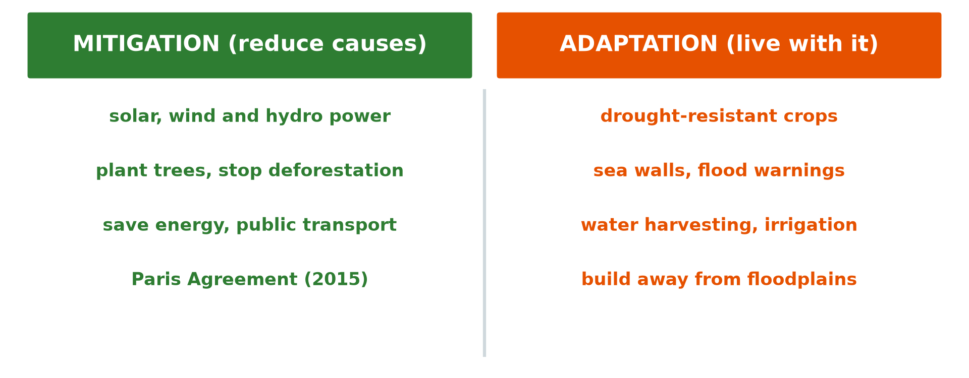
2. PILLARS
Activity 2
Mitigation and adaptation.
Notes:
Activity 2. Look carefully at this diagram: mitigation and adaptation. Observe every detail before I ask the question.

Slide 22
2. PILLARS
Activity 2: Question
Name the three pillars of climate-smart agriculture.
Notes:
Here is the question for Activity 2: Name the three pillars of climate-smart agriculture. Take one minute to think and write your answer in your rough notebook.

Slide 23
2. PILLARS
Activity 2: Answer
Increase productivity, adapt to climate change and reduce emissions (mitigation).
Notes:
Let us check the answer together. Increase productivity, adapt to climate change and reduce emissions (mitigation).

Slide 24

3. MULCHING AND WATER
Activity 3
Mulch covering the soil.
Notes:
Activity 3. Look carefully at this picture: mulch covering the soil. Observe every detail before I ask the question.

Slide 25
3. MULCHING AND WATER
Activity 3: Question
How do mulching and water harvesting help?
Notes:
Here is the question for Activity 3: How do mulching and water harvesting help? Take one minute to think and write your answer in your rough notebook.

Slide 26
3. MULCHING AND WATER
Activity 3: Answer
They keep moisture in the soil and save water.
Notes:
Let us check the answer together. They keep moisture in the soil and save water.

Slide 27
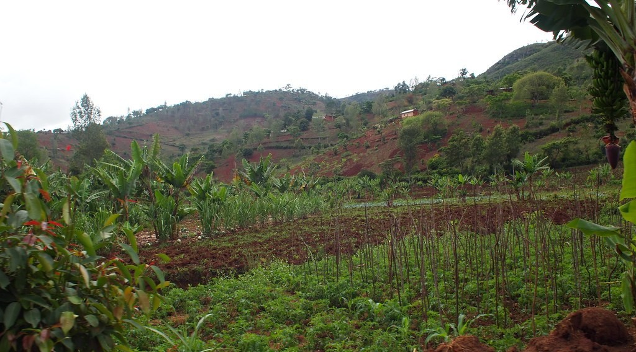
3. INTERCROPPING
Activity 4
Mixed crops.
Notes:
Activity 4. Look carefully at this picture: mixed crops. Observe every detail before I ask the question.

Slide 28
3. INTERCROPPING
Activity 4: Question
What is intercropping and why is it smart?
Notes:
Here is the question for Activity 4: What is intercropping and why is it smart? Take one minute to think and write your answer in your rough notebook.

Slide 29
3. INTERCROPPING
Activity 4: Answer
Growing two or more crops together; it reduces risk and covers the soil.
Notes:
Let us check the answer together. Growing two or more crops together; it reduces risk and covers the soil.

Slide 30
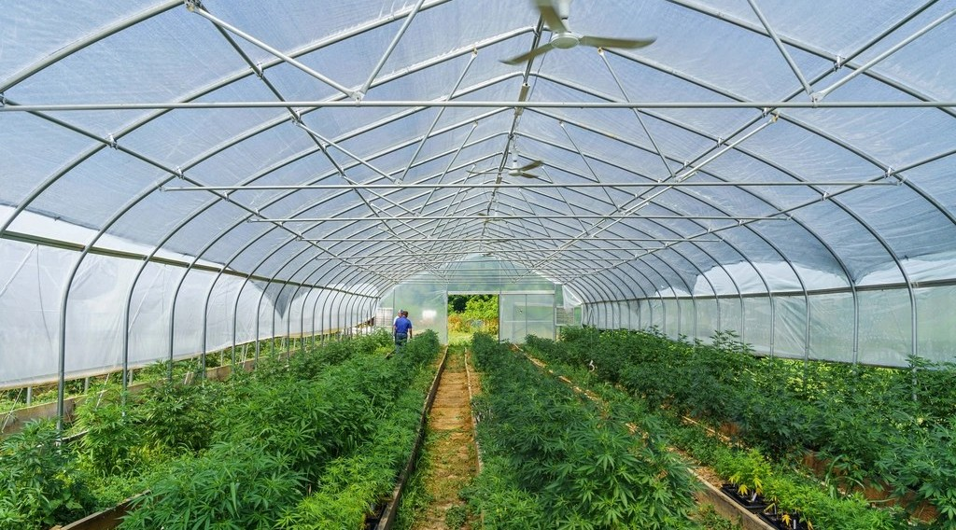
3. SHADE HOUSES AND GRAZING
Activity 5
A covered garden.
Notes:
Activity 5. Look carefully at this picture: a covered garden. Observe every detail before I ask the question.

Slide 31
3. SHADE HOUSES AND GRAZING
Activity 5: Question
How do shade houses and improved grazing help?
Notes:
Here is the question for Activity 5: How do shade houses and improved grazing help? Take one minute to think and write your answer in your rough notebook.

Slide 32
3. SHADE HOUSES AND GRAZING
Activity 5: Answer
Shade houses protect plants from heat; improved grazing keeps pastures healthy.
Notes:
Let us check the answer together. Shade houses protect plants from heat; improved grazing keeps pastures healthy.

Slide 33
BOARD SUMMARY
Board Summary
Topic: Managing Resources for Development through Economic Activities
Sub-topic: Agriculture as an Economic Activity of the Primary Sector
Lesson 32: Climate-Smart Agriculture
Notes:
Now we are going to copy the board summary. Write the title and the headings neatly in your notebooks. I will give you enough time for each slide, so do not rush.

Slide 34
BOARD SUMMARY
DEFINITIONS
The key terms of this lesson are defined as follows:
Climate-smart agriculture: It is farming that raises production, adapts to climate change and reduces greenhouse gases.
Notes:
Let us copy the definitions. The key terms of this lesson are defined as follows. On this slide we have Climate-smart agriculture. Write each point on a new line, with the key term first, and explain it in your own words when we revise.

Slide 35
BOARD SUMMARY
1. Aims (Main Pillars)
Climate-smart agriculture has three pillars:
Productivity: It increases yields and farmers' incomes.
Adaptation: It helps farms resist droughts, floods and heat.
Notes:
Let us copy Aims (Main Pillars). Climate-smart agriculture has three pillars. On this slide we have Productivity and Adaptation. Write each point on a new line, with the key term first, and explain it in your own words when we revise. When you finish, we go to the next slide.

Slide 36
BOARD SUMMARY
1. Aims (Main Pillars) (continued)
Mitigation: It reduces greenhouse gas emissions from farming.
Notes:
We continue with Aims (Main Pillars). On this slide we have Mitigation. Write each point on a new line, with the key term first, and explain it in your own words when we revise.

Slide 37
BOARD SUMMARY
2. Practical Techniques
Farmers use the following techniques:
Mulching: Covering the soil keeps it moist and cool.
Water management: Zaï pits, water harvesting and drip irrigation save water.
Notes:
Let us copy Practical Techniques. Farmers use the following techniques. On this slide we have Mulching and Water management. Write each point on a new line, with the key term first, and explain it in your own words when we revise. When you finish, we go to the next slide.

Slide 38
BOARD SUMMARY
2. Practical Techniques (continued)
Intercropping and resistant seeds: Mixed crops and drought-resistant varieties reduce risk.
Shade houses and improved grazing: They protect plants from heat and keep pastures healthy.
Notes:
We continue with Practical Techniques. On this slide we have Intercropping and resistant seeds and Shade houses and improved grazing. Write each point on a new line, with the key term first, and explain it in your own words when we revise.

Slide 39
BOARD SUMMARY
2. Practical Techniques
Illustration: adaptation and mitigation
Notes:
Now draw this illustration in your notebook: adaptation and mitigation. Give it a title and label it clearly.

Slide 40
FORMATIVE EVALUATION
Evaluation 1
Name the three pillars of climate-smart agriculture.
Notes:
Now let us check what you have understood. Question 1: Name the three pillars of climate-smart agriculture. Answer in your exercise book.

Slide 41
FORMATIVE EVALUATION
Expected Answer
Productivity, adaptation and mitigation.
Notes:
The expected answer is: productivity, adaptation and mitigation. If you got it right, well done.

Slide 42
FORMATIVE EVALUATION
Evaluation 2
Give two techniques.
Notes:
Now let us check what you have understood. Question 2: Give two techniques. Answer in your exercise book.

Slide 43
FORMATIVE EVALUATION
Expected Answer
Mulching and zaï pits.
Notes:
The expected answer is: mulching and zaï pits. If you got it right, well done.

Slide 44
REMEDIATION
Remediation
Fill in the blanks:
Covering the soil with straw is ______.
Growing crops together is ______.
Reducing greenhouse gases is ______.
Notes:
For those who need more practice, fill in the blanks in your exercise book. The answers are: number 1, mulching; number 2, intercropping; number 3, mitigation.

Slide 45
HOMEWORK
Homework
Propose three climate-smart techniques for a farm near Garoua.
Notes:
For your homework: Propose three climate-smart techniques for a farm near Garoua. We shall correct it at the beginning of our next lesson.

Slide 46
NEXT LESSON
Next Lesson
Our next lesson will be on:
Lesson 33: Spatial Patterns of Agriculture: Von Thünen's Model of Agricultural Land Use
Notes:
Our next lesson will be on Lesson 33: Spatial Patterns of Agriculture: Von Thünen's Model of Agricultural Land Use. Thank you for your attention, and see you next time.

Slide 47
BILINGUAL GAME
Bilingual Game (Jeu Bilingue)
English | Français
Climate | Le climat
Drought | La sécheresse
Mulch | Le paillis
Water harvesting | La collecte de l'eau
Adaptation | L'adaptation
Resistant | Résistant
Notes:
Let us play the bilingual game. I say a word in English, and you give me the French word. Then we do the reverse.

Slide 48
LOGBOOK
Official Logbook (1/2)
Module / Topic | Managing Resources for Development through Economic Activities
Lesson Title | Lesson 32: Climate-Smart Agriculture
Expected Learning Outcomes | Define climate-smart agriculture. State its three pillars. Describe its practical techniques.
Competence | Learners are able to explain climate-smart agriculture and apply its techniques.
Notes:
I record this information in the official logbook of the class after the lesson.

Slide 49
LOGBOOK
Official Logbook (2/2)
Matter Taught | DEFINITIONS; Aims (Main Pillars); Practical Techniques.
Evaluation | Formative evaluation and remediation exercise.
Homework | Propose three climate-smart techniques for a farm near Garoua.
Enrolment / Present / Absent | ____ / ____ / ____
Achievement | To be completed after the lesson.
Notes:
I complete the second page of the logbook: the matter taught, the evaluation, the homework and the attendance.

Slide 50
TEACHER'S NOTE
Teacher's Note
Timing: Homework correction, plan, objectives 8 min | Recall, situation, action 10 min | 5 activities 30 min | Board summary (copying) 30 min | Evaluation, remediation 10 min | Homework, next lesson 5 min | Logbook 7 min
Without the projector (Activity 1): discuss.
Without the projector (Activity 2): draw three pillars.
Without the projector (Activity 3): mulch a garden bed.
Without the projector (Activity 4): describe mixed fields.
Without the projector (Activity 5): discuss.
Notes:
This slide is for me, the teacher: it gives the timing of the lesson and what to do if the projector is not available.

Slide 51
REFERENCES
References
Geography Syllabus, Forms I–V, MINESEC (2023) — Form 4, Module II: Development and the Management of Primary Resources.
Photo, Activity 1: “Women sowing okra in zai holes” by abossuet, CC BY-NC 2.0, via Flickr (https://www.flickr.com/photos/30450178@N07/7175750825)
Photo, Activity 3: “Heavily earthworm-infested soil” by esagor, CC BY-NC 2.0, via Flickr (https://www.flickr.com/photos/7357861@N03/1993224477)
Photo, Activity 4: “Workshop in Lushoto, Tanzania” by CGIAR Climate, CC BY-NC-SA 2.0, via Flickr (https://www.flickr.com/photos/55227776@N04/8551480688)
Photo, Activity 5: “Organic farming, vegetable patch” by U.S. Department of Agriculture, CC0 1.0, via rawpixel (https://www.rawpixel.com/image/10995692/organic-farming-vegetable-patch)
Diagrams and animations: drawn for this lesson (Geography Department).
Notes:
These are the references and picture credits used to prepare this lesson.

