Slide 1
FORM 4
GEOGRAPHY
Lesson 35
Pastoral Agriculture in Cameroon
Notes:
Good morning, class, and welcome to our geography lesson. I am your geography teacher, Mr Kamdem. Today we are starting Lesson 35: Pastoral Agriculture in Cameroon.

Slide 2
CLASS INFO
Class, Chapter and Duration
Class | Form 4
Chapter | Module II: Development and the Management of Primary Resources
Duration | 2 periods (2 × 50 minutes)
Notes:
This lesson is for Form 4. It belongs to Module II: Development and the Management of Primary Resources. We shall need 2 periods to cover it.

Slide 3
IDENTIFICATION
Lesson Identification
Topic | Managing Resources for Development through Economic Activities
Sub-topic | The Economic Development Potentials of Cameroon in the Primary Sector: Agriculture
Lesson | Lesson 35: Pastoral Agriculture in Cameroon
Notions / Concepts | Pastoral farming, pastoral nomadism, transhumance, ranching.
Syllabus focus | Pastoral nomadism; ranching.
Competence | Learners are able to describe pastoral farming in Cameroon.
Notes:
Our topic is Managing Resources for Development through Economic Activities, and the sub-topic is The Economic Development Potentials of Cameroon in the Primary Sector: Agriculture. The key notions we shall use today are: pastoral farming, pastoral nomadism, transhumance, ranching. At the end, you should be able to do this: learners are able to describe pastoral farming in Cameroon.

Slide 4

HOMEWORK CORRECTION
Correction of the Homework
Question (Lesson 34: Arable Agriculture in Cameroon):
List the food crops and cash crops grown in your region.
Notes:
Before we start the new lesson, let us correct the homework I gave you at the end of Lesson 34: Arable Agriculture in Cameroon. The question was: List the food crops and cash crops grown in your region. Take out your exercise books.

Slide 5
HOMEWORK CORRECTION
Correction: Possible Answer
North Region: food crops – maize, sorghum, millet, groundnuts, onions; cash crops – cotton (also rice and onions sold).
Notes:
Here is a good answer. North Region: food crops – maize, sorghum, millet, groundnuts, onions; cash crops – cotton (also rice and onions sold). Compare it with your own answer and correct your work in red.

Slide 6
LESSON PLAN
Lesson Plan
Correction of the homework
Objectives and recall
Real-life situation and action to take
Learning activities
Board summary
Evaluation, remediation and homework
Notes:
Here is the plan of our lesson today. First, we shall correct the homework. Then we shall look at the objectives and recall what you already know. After that, we shall study a situation from real life and the action to take, and do the learning activities. Finally, we shall copy the board summary, do the evaluation and the remediation, and I will give you the homework.

Slide 7
OBJECTIVES
Objectives
By the end of this lesson, you should be able to:
Describe pastoral nomadism and transhumance in Cameroon.
Describe ranching in Cameroon.
Explain the problems of pastoral farming.
Notes:
By the end of this lesson, you should be able to do three things. Number 1: describe pastoral nomadism and transhumance in Cameroon. Number 2: describe ranching in Cameroon. Number 3: explain the problems of pastoral farming.

Slide 8
PREVIOUS KNOWLEDGE
Previous Knowledge
Herders rear cattle in the North.
Nomads move with animals.
The Adamawa Plateau has good pasture.
Notes:
Let us first remember what you already know. Herders rear cattle in the North. Nomads move with animals. The Adamawa Plateau has good pasture. Keep this in mind, because we shall build on it today.

Slide 9
REAL-LIFE SITUATION
Situation in Real Life
In the dry season, Mbororo herders leave the Far North with their cattle and walk south towards the Benue valley. On the Adamawa Plateau, the SODEPA ranch keeps cattle in fenced pastures.
Notes:
Listen carefully to this situation from real life. In the dry season, Mbororo herders leave the Far North with their cattle and walk south towards the Benue valley. On the Adamawa Plateau, the SODEPA ranch keeps cattle in fenced pastures. Think about it, because I am going to ask you some questions.

Slide 10
REAL-LIFE SITUATION
Situation: Question 1
What is the problem in the situation?
Notes:
Question 1: What is the problem in the situation? Think for a moment, then raise your hand to answer.

Slide 11
REAL-LIFE SITUATION
Answer
We want to know how cattle are reared in Cameroon.
Notes:
Good. We want to know how cattle are reared in Cameroon.

Slide 12
REAL-LIFE SITUATION
Situation: Question 2
Why do herders move south in the dry season?
Notes:
Question 2: Why do herders move south in the dry season? Think for a moment, then raise your hand to answer.

Slide 13
REAL-LIFE SITUATION
Answer
To find grass and water.
Notes:
Good. To find grass and water.

Slide 14
REAL-LIFE SITUATION
Situation: Question 3
What is a ranch?
Notes:
Question 3: What is a ranch? Think for a moment, then raise your hand to answer.

Slide 15
REAL-LIFE SITUATION
Possible Answer
A large fenced farm for rearing animals.
Notes:
Good. A large fenced farm for rearing animals.

Slide 16
ACTION TO TAKE
Action to Take
Respect grazing corridors and farm boundaries.
Notes:
From this situation, the action we are working towards in this lesson is the following: respect grazing corridors and farm boundaries.

Slide 17
JUSTIFICATION
Justification of the Lesson
This lesson helps us to understand livestock farming in northern Cameroon.
Notes:
Why is this lesson important for you? This lesson helps us to understand livestock farming in northern Cameroon.

Slide 18

1. PASTORAL NOMADISM
Activity 1
A nomadic camp.
Notes:
Activity 1. Look carefully at this picture: a nomadic camp. Observe every detail before I ask the question.

Slide 19
1. PASTORAL NOMADISM
Activity 1: Question
What is pastoral nomadism?
Notes:
Here is the question for Activity 1: What is pastoral nomadism? Take one minute to think and write your answer in your rough notebook.

Slide 20
1. PASTORAL NOMADISM
Activity 1: Answer
Moving with animals from place to place to find grass and water.
Notes:
Let us check the answer together. Moving with animals from place to place to find grass and water.

Slide 21
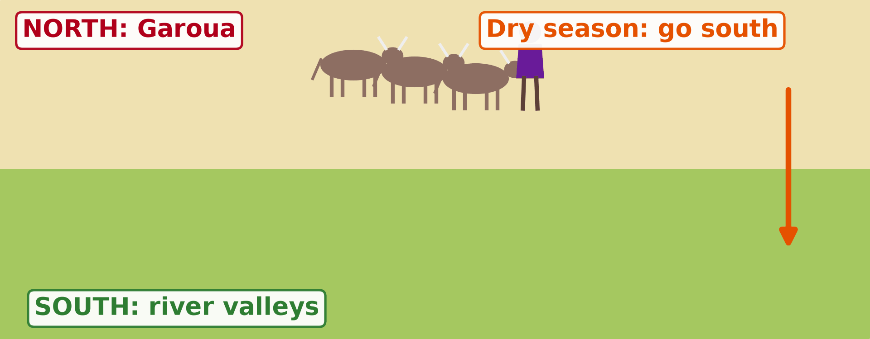
1. TRANSHUMANCE
Activity 2
Animation: seasonal movement of herds.
Notes:
Activity 2. Look carefully at this animation: animation: seasonal movement of herds. Watch the animation to the end; it will play again.

Slide 22
1. TRANSHUMANCE
Activity 2: Question
What is transhumance?
Notes:
Here is the question for Activity 2: What is transhumance? Take one minute to think and write your answer in your rough notebook.

Slide 23
1. TRANSHUMANCE
Activity 2: Answer
Seasonal movement of herds between dry-season and wet-season pastures.
Notes:
Let us check the answer together. Seasonal movement of herds between dry-season and wet-season pastures.

Slide 24
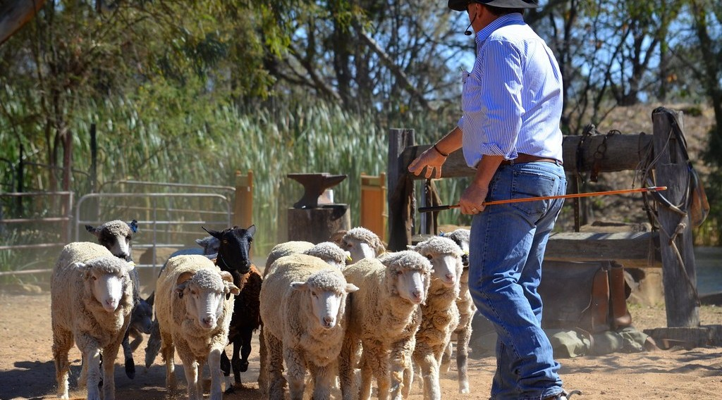
2. RANCHING
Activity 3
Cattle on a ranch.
Notes:
Activity 3. Look carefully at this picture: cattle on a ranch. Observe every detail before I ask the question.

Slide 25
2. RANCHING
Activity 3: Question
What is ranching? Where is it practised in Cameroon?
Notes:
Here is the question for Activity 3: What is ranching? Where is it practised in Cameroon? Take one minute to think and write your answer in your rough notebook.

Slide 26
2. RANCHING
Activity 3: Answer
Rearing animals on a large fenced farm; on the Adamawa Plateau (SODEPA ranches).
Notes:
Let us check the answer together. Rearing animals on a large fenced farm; on the Adamawa Plateau (SODEPA ranches).

Slide 27

3. IMPORTANCE
Activity 4
A cattle market.
Notes:
Activity 4. Look carefully at this picture: a cattle market. Observe every detail before I ask the question.

Slide 28
3. IMPORTANCE
Activity 4: Question
Give two importance of livestock farming.
Notes:
Here is the question for Activity 4: Give two importance of livestock farming. Take one minute to think and write your answer in your rough notebook.

Slide 29
3. IMPORTANCE
Activity 4: Answer
Meat and milk for people, and income from sales to towns and neighbouring countries.
Notes:
Let us check the answer together. Meat and milk for people, and income from sales to towns and neighbouring countries.

Slide 30

3. PROBLEMS
Activity 5
Cattle near farms.
Notes:
Activity 5. Look carefully at this picture: cattle near farms. Observe every detail before I ask the question.

Slide 31
3. PROBLEMS
Activity 5: Question
Give two problems of pastoral farming.
Notes:
Here is the question for Activity 5: Give two problems of pastoral farming. Take one minute to think and write your answer in your rough notebook.

Slide 32
3. PROBLEMS
Activity 5: Answer
Farmer–herder conflicts and animal diseases (also drought, cattle theft).
Notes:
Let us check the answer together. Farmer–herder conflicts and animal diseases (also drought, cattle theft).

Slide 33
BOARD SUMMARY
Board Summary
Topic: Managing Resources for Development through Economic Activities
Sub-topic: The Economic Development Potentials of Cameroon in the Primary Sector: Agriculture
Lesson 35: Pastoral Agriculture in Cameroon
Notes:
Now we are going to copy the board summary. Write the title and the headings neatly in your notebooks. I will give you enough time for each slide, so do not rush.

Slide 34
BOARD SUMMARY
DEFINITIONS
The key terms of this lesson are defined as follows:
Pastoral farming: It is the rearing of animals such as cattle, sheep and goats.
Notes:
Let us copy the definitions. The key terms of this lesson are defined as follows. On this slide we have Pastoral farming. Write each point on a new line, with the key term first, and explain it in your own words when we revise.

Slide 35
BOARD SUMMARY
1. Pastoral Nomadism and Transhumance
Traditional herding in Cameroon is organised as follows:
Nomadism: Herders such as the Mbororo move with their animals to find grass and water.
Transhumance: Herds move south to river valleys in the dry season and return north in the rainy season.
Notes:
Let us copy Pastoral Nomadism and Transhumance. Traditional herding in Cameroon is organised as follows. On this slide we have Nomadism and Transhumance. Write each point on a new line, with the key term first, and explain it in your own words when we revise.

Slide 36
BOARD SUMMARY
2. Ranching
The location and characteristics of modern ranching in Cameroon are the following:
Location: Ranches are found on the Adamawa Plateau and in the North-West.
Methods: Animals are kept in fenced pastures, vaccinated and fed improved grass.
Notes:
Let us copy Ranching. The location and characteristics of modern ranching in Cameroon are the following. On this slide we have Location and Methods. Write each point on a new line, with the key term first, and explain it in your own words when we revise.

Slide 37
BOARD SUMMARY
3. Importance and Problems
A) Importance
Pastoral farming is important for the following reasons:
Food: It gives meat and milk.
Hides and skins: They are used to make leather.
Notes:
Let us copy Importance. Pastoral farming is important for the following reasons. On this slide we have Food and Hides and skins. Write each point on a new line, with the key term first, and explain it in your own words when we revise. When you finish, we go to the next slide.

Slide 38
BOARD SUMMARY
3. Importance and Problems
A) Importance (continued)
Income and exports: Cattle are sold in Cameroon and to Nigeria and Gabon.
Notes:
We continue with Importance. On this slide we have Income and exports. Write each point on a new line, with the key term first, and explain it in your own words when we revise.

Slide 39
BOARD SUMMARY
3. Importance and Problems
B) Problems
Pastoral farming faces the following problems:
Drought: Grass and water become scarce.
Animal diseases: Diseases kill many animals.
Cattle theft: Thieves steal herds.
Notes:
Let us copy Problems. Pastoral farming faces the following problems. On this slide we have Drought, Animal diseases and Cattle theft. Write each point on a new line, with the key term first, and explain it in your own words when we revise. When you finish, we go to the next slide.

Slide 40
BOARD SUMMARY
3. Importance and Problems
B) Problems (continued)
Farmer–herder conflicts: Animals destroy crops, and fights break out.
Notes:
We continue with Problems. On this slide we have Farmer–herder conflicts. Write each point on a new line, with the key term first, and explain it in your own words when we revise.

Slide 41
FORMATIVE EVALUATION
Evaluation 1
Distinguish nomadism and ranching.
Notes:
Now let us check what you have understood. Question 1: Distinguish nomadism and ranching. Answer in your exercise book.

Slide 42
FORMATIVE EVALUATION
Expected Answer
Nomadism moves with herds; ranching keeps them on fenced farms.
Notes:
The expected answer is: nomadism moves with herds; ranching keeps them on fenced farms. If you got it right, well done.

Slide 43
FORMATIVE EVALUATION
Evaluation 2
Give two problems of pastoral farming.
Notes:
Now let us check what you have understood. Question 2: Give two problems of pastoral farming. Answer in your exercise book.

Slide 44
FORMATIVE EVALUATION
Expected Answer
Diseases and farmer–herder conflicts.
Notes:
The expected answer is: diseases and farmer–herder conflicts. If you got it right, well done.

Slide 45
REMEDIATION
Remediation
Fill in the blanks:
Seasonal movement of herds is ______.
A large fenced farm for animals is a ______.
Ranches are found on the ______ Plateau.
Notes:
For those who need more practice, fill in the blanks in your exercise book. The answers are: number 1, transhumance; number 2, ranch; number 3, Adamawa.

Slide 46
HOMEWORK
Homework
Propose two solutions to farmer–herder conflicts in the North.
Notes:
For your homework: Propose two solutions to farmer–herder conflicts in the North. We shall correct it at the beginning of our next lesson.

Slide 47
NEXT LESSON
Next Lesson
Our next lesson will be on:
Lesson 36: The Impact of Agriculture on the Economy of Cameroon
Notes:
Our next lesson will be on Lesson 36: The Impact of Agriculture on the Economy of Cameroon. Thank you for your attention, and see you next time.

Slide 48
BILINGUAL GAME
Bilingual Game (Jeu Bilingue)
English | Français
Herder | L'éleveur
Cattle | Le bétail
Ranch | Le ranch
Pasture | Le pâturage
Transhumance | La transhumance
Conflict | Le conflit
Notes:
Let us play the bilingual game. I say a word in English, and you give me the French word. Then we do the reverse.

Slide 49
LOGBOOK
Official Logbook (1/2)
Module / Topic | Managing Resources for Development through Economic Activities
Lesson Title | Lesson 35: Pastoral Agriculture in Cameroon
Expected Learning Outcomes | Describe pastoral nomadism and transhumance in Cameroon. Describe ranching in Cameroon. Explain the problems of pastoral farming.
Competence | Learners are able to describe pastoral farming in Cameroon.
Notes:
I record this information in the official logbook of the class after the lesson.

Slide 50
LOGBOOK
Official Logbook (2/2)
Matter Taught | DEFINITIONS; Pastoral Nomadism and Transhumance; Ranching; Importance; Problems.
Evaluation | Formative evaluation and remediation exercise.
Homework | Propose two solutions to farmer–herder conflicts in the North.
Enrolment / Present / Absent | ____ / ____ / ____
Achievement | To be completed after the lesson.
Notes:
I complete the second page of the logbook: the matter taught, the evaluation, the homework and the attendance.

Slide 51
TEACHER'S NOTE
Teacher's Note
Timing: Homework correction, plan, objectives 8 min | Recall, situation, action 10 min | 5 activities 30 min | Board summary (copying) 30 min | Evaluation, remediation 10 min | Homework, next lesson 5 min | Logbook 7 min
Activity 2 is an animation (GIF): it plays automatically in slide-show mode.
Without the projector (Activity 1): describe nomads.
Without the projector (Activity 2): draw the route.
Without the projector (Activity 3): describe a ranch.
Without the projector (Activity 4): describe the cattle market.
Without the projector (Activity 5): discuss conflicts.
Notes:
This slide is for me, the teacher: it gives the timing of the lesson and what to do if the projector is not available.

Slide 52
REFERENCES
References
Geography Syllabus, Forms I–V, MINESEC (2023) — Form 4, Module II: Development and the Management of Primary Resources.
Photo, Activity 1: “A roadside stop for souvenirs & exploring dry wells, Northern Sahara, ” by ali eminov, CC BY-NC 2.0, via Flickr (https://www.flickr.com/photos/27435717@N00/3437516165)
Photo, Activity 3: “The Flock” by seefit, CC BY 2.0, via Flickr (https://www.flickr.com/photos/76574551@N00/20928299362)
Photo, Activity 4: “Discussing the price” by 10b travelling / Carsten ten Brink, CC BY-NC-ND 2.0, via Flickr (https://www.flickr.com/photos/77334245@N00/7313656038)
Photo, Activity 5: “Acacia Tree” by D-Stanley, CC BY 2.0, via Flickr (https://www.flickr.com/photos/79721788@N00/11527335486)
Diagrams and animations: drawn for this lesson (Geography Department).
Notes:
These are the references and picture credits used to prepare this lesson.

