Slide 1
FORM 4
GEOGRAPHY
Lesson 36
The Impact of Agriculture on the Economy of Cameroon
Notes:
Good morning, class, and welcome to our geography lesson. I am your geography teacher, Mr Kamdem. Today we are starting Lesson 36: The Impact of Agriculture on the Economy of Cameroon.

Slide 2
CLASS INFO
Class, Chapter and Duration
Class | Form 4
Chapter | Module II: Development and the Management of Primary Resources
Duration | 2 periods (2 × 50 minutes)
Notes:
This lesson is for Form 4. It belongs to Module II: Development and the Management of Primary Resources. We shall need 2 periods to cover it.

Slide 3
IDENTIFICATION
Lesson Identification
Topic | Managing Resources for Development through Economic Activities
Sub-topic | The Economic Development Potentials of Cameroon in the Primary Sector: Agriculture
Lesson | Lesson 36: The Impact of Agriculture on the Economy of Cameroon
Notions / Concepts | Short-term effects, long-term effects, GDP, exports.
Syllabus focus | Short-term effects; long-term effects.
Competence | Learners are able to explain the importance of agriculture for the economy of Cameroon.
Notes:
Our topic is Managing Resources for Development through Economic Activities, and the sub-topic is The Economic Development Potentials of Cameroon in the Primary Sector: Agriculture. The key notions we shall use today are: short-term effects, long-term effects, GDP, exports. At the end, you should be able to do this: learners are able to explain the importance of agriculture for the economy of Cameroon.

Slide 4

HOMEWORK CORRECTION
Correction of the Homework
Question (Lesson 35: Pastoral Agriculture in Cameroon):
Propose two solutions to farmer–herder conflicts in the North.
Notes:
Before we start the new lesson, let us correct the homework I gave you at the end of Lesson 35: Pastoral Agriculture in Cameroon. The question was: Propose two solutions to farmer–herder conflicts in the North. Take out your exercise books.

Slide 5
HOMEWORK CORRECTION
Correction: Possible Answer
Create and mark grazing corridors and zones; set up local committees of farmers and herders to settle disputes.
Notes:
Here is a good answer. Create and mark grazing corridors and zones; set up local committees of farmers and herders to settle disputes. Compare it with your own answer and correct your work in red.

Slide 6
LESSON PLAN
Lesson Plan
Correction of the homework
Objectives and recall
Real-life situation and action to take
Learning activities
Board summary
Evaluation, remediation and homework
Notes:
Here is the plan of our lesson today. First, we shall correct the homework. Then we shall look at the objectives and recall what you already know. After that, we shall study a situation from real life and the action to take, and do the learning activities. Finally, we shall copy the board summary, do the evaluation and the remediation, and I will give you the homework.

Slide 7
OBJECTIVES
Objectives
By the end of this lesson, you should be able to:
Explain the short-term effects of agriculture on the economy.
Explain its long-term effects.
Propose ways to increase its benefits.
Notes:
By the end of this lesson, you should be able to do three things. Number 1: explain the short-term effects of agriculture on the economy. Number 2: explain its long-term effects. Number 3: propose ways to increase its benefits.

Slide 8
PREVIOUS KNOWLEDGE
Previous Knowledge
Agriculture employs most Cameroonians.
Cameroon exports cocoa, coffee and cotton.
Agro-industries use farm products.
Notes:
Let us first remember what you already know. Agriculture employs most Cameroonians. Cameroon exports cocoa, coffee and cotton. Agro-industries use farm products. Keep this in mind, because we shall build on it today.

Slide 9
REAL-LIFE SITUATION
Situation in Real Life
When the price of cocoa rose, cocoa farmers in the Centre built houses and sent their children to school. When it fell, many could not pay school fees.
Notes:
Listen carefully to this situation from real life. When the price of cocoa rose, cocoa farmers in the Centre built houses and sent their children to school. When it fell, many could not pay school fees. Think about it, because I am going to ask you some questions.

Slide 10
REAL-LIFE SITUATION
Situation: Question 1
What is the problem in the situation?
Notes:
Question 1: What is the problem in the situation? Think for a moment, then raise your hand to answer.

Slide 11
REAL-LIFE SITUATION
Answer
Farm incomes depend on world prices.
Notes:
Good. Farm incomes depend on world prices.

Slide 12
REAL-LIFE SITUATION
Situation: Question 2
What happened when the price rose?
Notes:
Question 2: What happened when the price rose? Think for a moment, then raise your hand to answer.

Slide 13
REAL-LIFE SITUATION
Answer
Farmers built houses and paid school fees.
Notes:
Good. Farmers built houses and paid school fees.

Slide 14
REAL-LIFE SITUATION
Situation: Question 3
What happened when it fell?
Notes:
Question 3: What happened when it fell? Think for a moment, then raise your hand to answer.

Slide 15
REAL-LIFE SITUATION
Possible Answer
Many could not pay school fees.
Notes:
Good. Many could not pay school fees.

Slide 16
ACTION TO TAKE
Action to Take
Support the local processing of farm products.
Notes:
From this situation, the action we are working towards in this lesson is the following: support the local processing of farm products.

Slide 17
JUSTIFICATION
Justification of the Lesson
This lesson helps us to see how agriculture drives the economy of Cameroon.
Notes:
Why is this lesson important for you? This lesson helps us to see how agriculture drives the economy of Cameroon.

Slide 18

1. SHORT-TERM EFFECTS
Activity 1
A food market.
Notes:
Activity 1. Look carefully at this picture: a food market. Observe every detail before I ask the question.

Slide 19
1. SHORT-TERM EFFECTS
Activity 1: Question
Give two short-term effects of agriculture on the economy.
Notes:
Here is the question for Activity 1: Give two short-term effects of agriculture on the economy. Take one minute to think and write your answer in your rough notebook.

Slide 20
1. SHORT-TERM EFFECTS
Activity 1: Answer
It feeds the population and gives daily income to farmers and traders.
Notes:
Let us check the answer together. It feeds the population and gives daily income to farmers and traders.

Slide 21
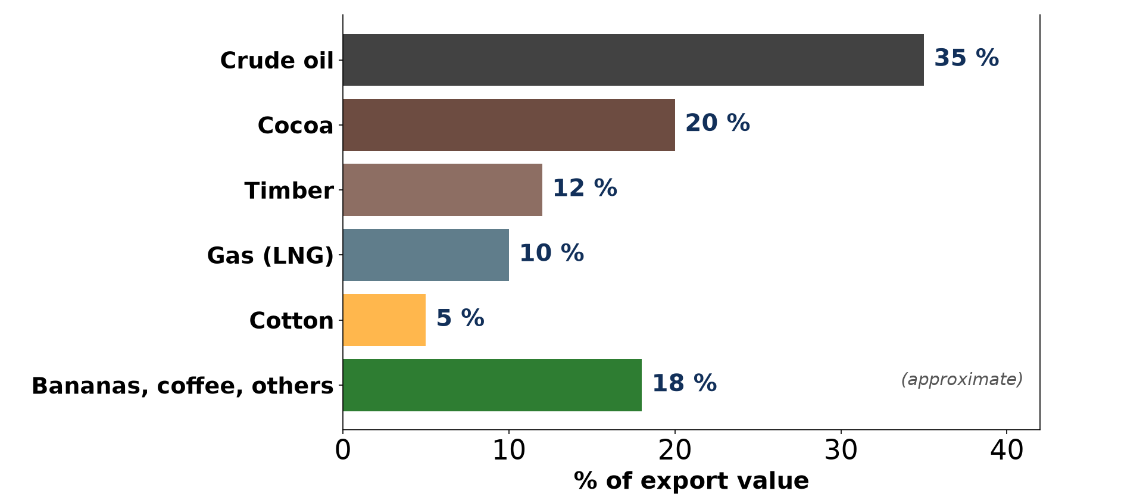
1. SHORT-TERM EFFECTS
Activity 2
Exports of Cameroon.
Notes:
Activity 2. Look carefully at this diagram: exports of Cameroon. Observe every detail before I ask the question.

Slide 22
1. SHORT-TERM EFFECTS
Activity 2: Question
Which farm products does Cameroon export?
Notes:
Here is the question for Activity 2: Which farm products does Cameroon export? Take one minute to think and write your answer in your rough notebook.

Slide 23
1. SHORT-TERM EFFECTS
Activity 2: Answer
Cocoa, coffee, cotton, bananas and timber.
Notes:
Let us check the answer together. Cocoa, coffee, cotton, bananas and timber.

Slide 24

2. LONG-TERM EFFECTS
Activity 3
A factory.
Notes:
Activity 3. Look carefully at this picture: a factory. Observe every detail before I ask the question.

Slide 25
2. LONG-TERM EFFECTS
Activity 3: Question
How does agriculture help industry in the long term?
Notes:
Here is the question for Activity 3: How does agriculture help industry in the long term? Take one minute to think and write your answer in your rough notebook.

Slide 26
2. LONG-TERM EFFECTS
Activity 3: Answer
It supplies raw materials to agro-industries such as textiles, breweries and oil mills.
Notes:
Let us check the answer together. It supplies raw materials to agro-industries such as textiles, breweries and oil mills.

Slide 27

2. LONG-TERM EFFECTS
Activity 4
A rural road.
Notes:
Activity 4. Look carefully at this picture: a rural road. Observe every detail before I ask the question.

Slide 28
2. LONG-TERM EFFECTS
Activity 4: Question
How does agriculture help rural development?
Notes:
Here is the question for Activity 4: How does agriculture help rural development? Take one minute to think and write your answer in your rough notebook.

Slide 29
2. LONG-TERM EFFECTS
Activity 4: Answer
Farm incomes and agro-industries lead to roads, schools and health centres.
Notes:
Let us check the answer together. Farm incomes and agro-industries lead to roads, schools and health centres.

Slide 30
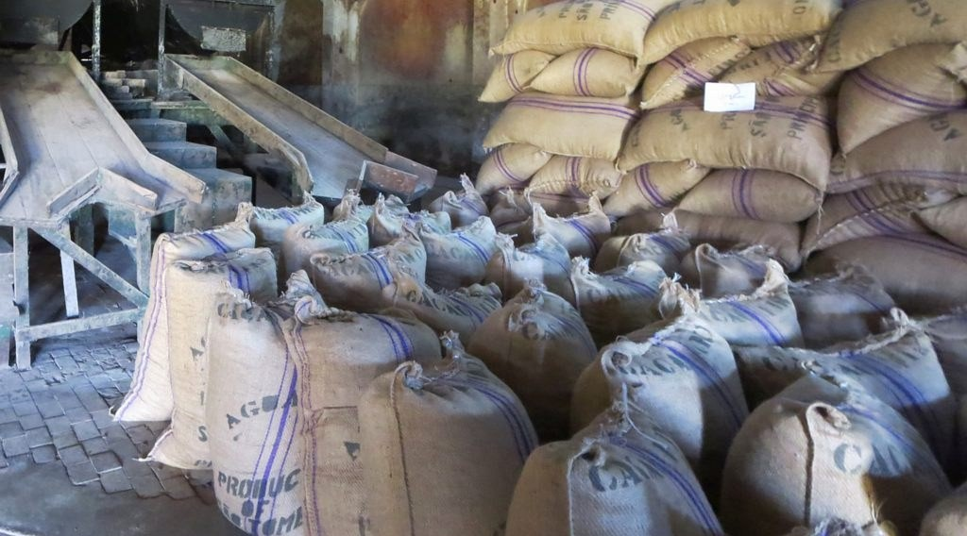
3. LIMITS
Activity 5
Sacks of raw cocoa.
Notes:
Activity 5. Look carefully at this picture: sacks of raw cocoa. Observe every detail before I ask the question.

Slide 31
3. LIMITS
Activity 5: Question
Why is dependence on raw exports a problem?
Notes:
Here is the question for Activity 5: Why is dependence on raw exports a problem? Take one minute to think and write your answer in your rough notebook.

Slide 32
3. LIMITS
Activity 5: Answer
World prices change often, so farmers' incomes are unstable.
Notes:
Let us check the answer together. World prices change often, so farmers' incomes are unstable.

Slide 33
BOARD SUMMARY
Board Summary
Topic: Managing Resources for Development through Economic Activities
Sub-topic: The Economic Development Potentials of Cameroon in the Primary Sector: Agriculture
Lesson 36: The Impact of Agriculture on the Economy of Cameroon
Notes:
Now we are going to copy the board summary. Write the title and the headings neatly in your notebooks. I will give you enough time for each slide, so do not rush.

Slide 34
BOARD SUMMARY
1. Short-term Effects
Agriculture has the following short-term effects on the economy:
Food supply: It feeds the population and reduces food imports.
Income and jobs: It gives jobs and daily income to most rural people.
Notes:
Let us copy Short-term Effects. Agriculture has the following short-term effects on the economy. On this slide we have Food supply and Income and jobs. Write each point on a new line, with the key term first, and explain it in your own words when we revise. When you finish, we go to the next slide.

Slide 35
BOARD SUMMARY
1. Short-term Effects (continued)
Exports: Cocoa, coffee, cotton and bananas bring foreign currency.
Notes:
We continue with Short-term Effects. On this slide we have Exports. Write each point on a new line, with the key term first, and explain it in your own words when we revise.

Slide 36
BOARD SUMMARY
1. Short-term Effects
Illustration: exports of Cameroon
Notes:
Now draw this illustration in your notebook: exports of Cameroon. Give it a title and label it clearly.

Slide 37
BOARD SUMMARY
2. Long-term Effects
Agriculture has the following long-term effects:
Industrialisation: It supplies raw materials to agro-industries.
Rural development: It helps to build roads, schools and health centres.
Notes:
Let us copy Long-term Effects. Agriculture has the following long-term effects. On this slide we have Industrialisation and Rural development. Write each point on a new line, with the key term first, and explain it in your own words when we revise. When you finish, we go to the next slide.

Slide 38
BOARD SUMMARY
2. Long-term Effects (continued)
Limits: Dependence on raw exports makes incomes unstable when world prices fall.
Notes:
We continue with Long-term Effects. On this slide we have Limits. Write each point on a new line, with the key term first, and explain it in your own words when we revise.

Slide 39
FORMATIVE EVALUATION
Evaluation 1
Give two short-term effects of agriculture on the economy.
Notes:
Now let us check what you have understood. Question 1: Give two short-term effects of agriculture on the economy. Answer in your exercise book.

Slide 40
FORMATIVE EVALUATION
Expected Answer
Food supply and income.
Notes:
The expected answer is: food supply and income. If you got it right, well done.

Slide 41
FORMATIVE EVALUATION
Evaluation 2
Give one long-term effect.
Notes:
Now let us check what you have understood. Question 2: Give one long-term effect. Answer in your exercise book.

Slide 42
FORMATIVE EVALUATION
Expected Answer
Raw materials for agro-industries.
Notes:
The expected answer is: raw materials for agro-industries. If you got it right, well done.

Slide 43
REMEDIATION
Remediation
Fill in the blanks:
Money from exports is foreign ______.
Factories that process farm products are ______.
Cocoa prices depend on the ______ market.
Notes:
For those who need more practice, fill in the blanks in your exercise book. The answers are: number 1, currency; number 2, agro-industries; number 3, world.

Slide 44
HOMEWORK
Homework
Name three factories in Cameroon that use farm products and their raw materials.
Notes:
For your homework: Name three factories in Cameroon that use farm products and their raw materials. We shall correct it at the beginning of our next lesson.

Slide 45
NEXT LESSON
Next Lesson
Our next lesson will be on:
Lesson 37: Food Loss and Food Waste
Notes:
Our next lesson will be on Lesson 37: Food Loss and Food Waste. Thank you for your attention, and see you next time.

Slide 46
BILINGUAL GAME
Bilingual Game (Jeu Bilingue)
English | Français
Economy | L'économie
Export | L'exportation
Price | Le prix
Agro-industry | L'agro-industrie
Income | Le revenu
Development | Le développement
Notes:
Let us play the bilingual game. I say a word in English, and you give me the French word. Then we do the reverse.

Slide 47
LOGBOOK
Official Logbook (1/2)
Module / Topic | Managing Resources for Development through Economic Activities
Lesson Title | Lesson 36: The Impact of Agriculture on the Economy of Cameroon
Expected Learning Outcomes | Explain the short-term effects of agriculture on the economy. Explain its long-term effects. Propose ways to increase its benefits.
Competence | Learners are able to explain the importance of agriculture for the economy of Cameroon.
Notes:
I record this information in the official logbook of the class after the lesson.

Slide 48
LOGBOOK
Official Logbook (2/2)
Matter Taught | Short-term Effects; Long-term Effects.
Evaluation | Formative evaluation and remediation exercise.
Homework | Name three factories in Cameroon that use farm products and their raw materials.
Enrolment / Present / Absent | ____ / ____ / ____
Achievement | To be completed after the lesson.
Notes:
I complete the second page of the logbook: the matter taught, the evaluation, the homework and the attendance.

Slide 49
TEACHER'S NOTE
Teacher's Note
Timing: Homework correction, plan, objectives 8 min | Recall, situation, action 10 min | 5 activities 30 min | Board summary (copying) 30 min | Evaluation, remediation 10 min | Homework, next lesson 5 min | Logbook 7 min
Without the projector (Activity 1): discuss.
Without the projector (Activity 2): read the chart.
Without the projector (Activity 3): name agro-industries.
Without the projector (Activity 4): discuss.
Without the projector (Activity 5): discuss price changes.
Notes:
This slide is for me, the teacher: it gives the timing of the lesson and what to do if the projector is not available.

Slide 50
REFERENCES
References
Geography Syllabus, Forms I–V, MINESEC (2023) — Form 4, Module II: Development and the Management of Primary Resources.
Photo, Activity 1: “Sandga Market in Douala, Cameroon” by The Advocacy Project, CC BY-NC-SA 2.0, via Flickr (https://www.flickr.com/photos/42487558@N00/3636438732)
Photo, Activity 3: “Interior of Winston-Salem Chero-Cola Bottling Company, Winston-Salem, ” by unclibraries_commons, Public domain 1.0, via Flickr (https://www.flickr.com/photos/122654055@N06/22680169228)
Photo, Activity 4: “Cameroon - UN Women's Gender Road Project” by UN Women Gallery, CC BY-NC-ND 2.0, via Flickr (https://www.flickr.com/photos/51431730@N04/40672356003)
Photo, Activity 5: “Sacks of Cocoa Beans” by D-Stanley, CC BY 2.0, via Flickr (https://www.flickr.com/photos/79721788@N00/20795057229)
Diagrams and animations: drawn for this lesson (Geography Department).
Notes:
These are the references and picture credits used to prepare this lesson.

