Slide 1
FORM 5
GEOGRAPHY
Lesson 3
Industrialisation in the Least Industrialised Countries
Notes:
Good morning, class, and welcome to our geography lesson. I am your geography teacher, Mr Kamdem. Today we are starting Lesson 3: Industrialisation in the Least Industrialised Countries.

Slide 2
CLASS INFO
Class, Chapter and Duration
Class | Form 5
Chapter | Module I: Management of Manufacturing and Tertiary Activities
Duration | 2 periods (2 × 50 minutes)
Notes:
This lesson is for Form 5. It belongs to Module I: Management of Manufacturing and Tertiary Activities. We shall need 2 periods to cover it.

Slide 3
IDENTIFICATION
Lesson Identification
Topic | Managing Resources for Development through Economic Activities
Sub-topic | Manufacturing as an Economic Activity of the Secondary Sector
Lesson | Lesson 3: Industrialisation in the Least Industrialised Countries
Notions / Concepts | Industrialisation, food processing industries, import substitution.
Syllabus focus | Characteristics; reasons for low level of industrialisation.
Competence | Learners are able to describe industry in LICs and explain its low level.
Notes:
Our topic is Managing Resources for Development through Economic Activities, and the sub-topic is Manufacturing as an Economic Activity of the Secondary Sector. The key notions we shall use today are: industrialisation, food processing industries, import substitution. At the end, you should be able to do this: learners are able to describe industry in LICs and explain its low level.

Slide 4

HOMEWORK CORRECTION
Correction of the Homework
Question (Lesson 2: The Agglomeration of Industries):
Name the industrial area of your town and two factories found there.
Notes:
Before we start the new lesson, let us correct the homework I gave you at the end of Lesson 2: The Agglomeration of Industries. The question was: Name the industrial area of your town and two factories found there. Take out your exercise books.

Slide 5
HOMEWORK CORRECTION
Correction: Possible Answer
Example for Garoua: the industrial zone near the port area and the Benue, with CICAM (textiles) and a SODECOTON cotton ginnery (also a brewery).
Notes:
Here is a good answer. Example for Garoua: the industrial zone near the port area and the Benue, with CICAM (textiles) and a SODECOTON cotton ginnery (also a brewery). Compare it with your own answer and correct your work in red.

Slide 6
LESSON PLAN
Lesson Plan
Correction of the homework
Objectives and recall
Real-life situation and action to take
Learning activities
Board summary
Evaluation, remediation and homework
Notes:
Here is the plan of our lesson today. First, we shall correct the homework. Then we shall look at the objectives and recall what you already know. After that, we shall study a situation from real life and the action to take, and do the learning activities. Finally, we shall copy the board summary, do the evaluation and the remediation, and I will give you the homework.

Slide 7
OBJECTIVES
Objectives
By the end of this lesson, you should be able to:
Describe the characteristics of industry in LICs.
Explain the reasons for the low level of industrialisation.
Notes:
Take your time to copy this part; we will continue together.

Slide 8
OBJECTIVES
Objectives (continued)
Propose solutions.
Notes:
By the end of this lesson, you should be able to do three things. Number 1: describe the characteristics of industry in LICs. Number 2: explain the reasons for the low level of industrialisation. Number 3: propose solutions.

Slide 9
PREVIOUS KNOWLEDGE
Previous Knowledge
LICs export raw materials.
Industry needs capital and energy.
Cameroon has some factories.
Notes:
Let us first remember what you already know. LICs export raw materials. Industry needs capital and energy. Cameroon has some factories. Keep this in mind, because we shall build on it today.

Slide 10
REAL-LIFE SITUATION
Situation in Real Life
Chad produces cotton but has very few factories. Most of its cotton is exported raw and clothes are imported from Asia.
Notes:
Listen carefully to this situation from real life. Chad produces cotton but has very few factories. Most of its cotton is exported raw and clothes are imported from Asia. Think about it, because I am going to ask you some questions.

Slide 11
REAL-LIFE SITUATION
Situation: Question 1
What is the problem in the situation?
Notes:
Question 1: What is the problem in the situation? Think for a moment, then raise your hand to answer.

Slide 12
REAL-LIFE SITUATION
Answer
Chad has little industry.
Notes:
Good. Chad has little industry.

Slide 13
REAL-LIFE SITUATION
Situation: Question 2
What does Chad export?
Notes:
Question 2: What does Chad export? Think for a moment, then raise your hand to answer.

Slide 14
REAL-LIFE SITUATION
Answer
Raw cotton.
Notes:
Good. Raw cotton.

Slide 15
REAL-LIFE SITUATION
Situation: Question 3
What does it import?
Notes:
Question 3: What does it import? Think for a moment, then raise your hand to answer.

Slide 16
REAL-LIFE SITUATION
Possible Answer
Clothes.
Notes:
Good. Clothes.

Slide 17
ACTION TO TAKE
Action to Take
Support local transformation of raw materials.
Notes:
From this situation, the action we are working towards in this lesson is the following: support local transformation of raw materials.

Slide 18
JUSTIFICATION
Justification of the Lesson
This lesson helps us to understand why industry is weak in poor countries.
Notes:
Why is this lesson important for you? This lesson helps us to understand why industry is weak in poor countries.

Slide 19
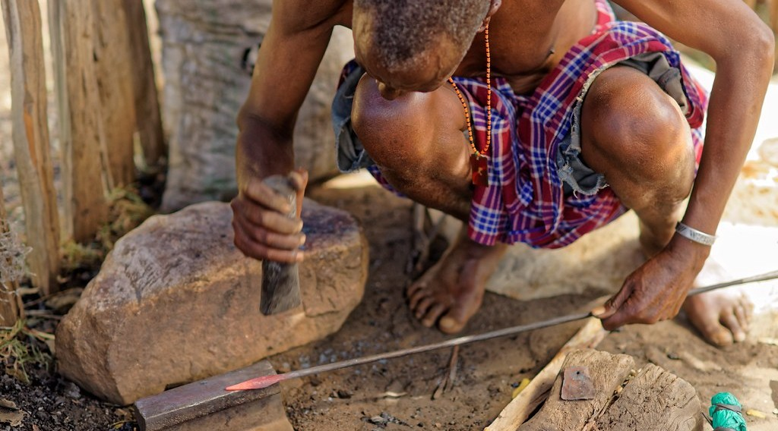
1. CHARACTERISTICS
Activity 1
A craftsman.
Notes:
Activity 1. Look carefully at this picture: a craftsman. Observe every detail before I ask the question.

Slide 20
1. CHARACTERISTICS
Activity 1: Question
Give two characteristics of industry in LICs.
Notes:
Here is the question for Activity 1: Give two characteristics of industry in LICs. Take one minute to think and write your answer in your rough notebook.

Slide 21
1. CHARACTERISTICS
Activity 1: Answer
Small, light industries such as food processing and many crafts.
Notes:
Let us check the answer together. Small, light industries such as food processing and many crafts.

Slide 22

1. CHARACTERISTICS
Activity 2
A food and drinks factory.
Notes:
Activity 2. Look carefully at this picture: a food and drinks factory. Observe every detail before I ask the question.

Slide 23
1. CHARACTERISTICS
Activity 2: Question
Why are food processing industries common in LICs?
Notes:
Here is the question for Activity 2: Why are food processing industries common in LICs? Take one minute to think and write your answer in your rough notebook.

Slide 24
1. CHARACTERISTICS
Activity 2: Answer
Farm raw materials are available and the local market needs food and drinks.
Notes:
Let us check the answer together. Farm raw materials are available and the local market needs food and drinks.

Slide 25
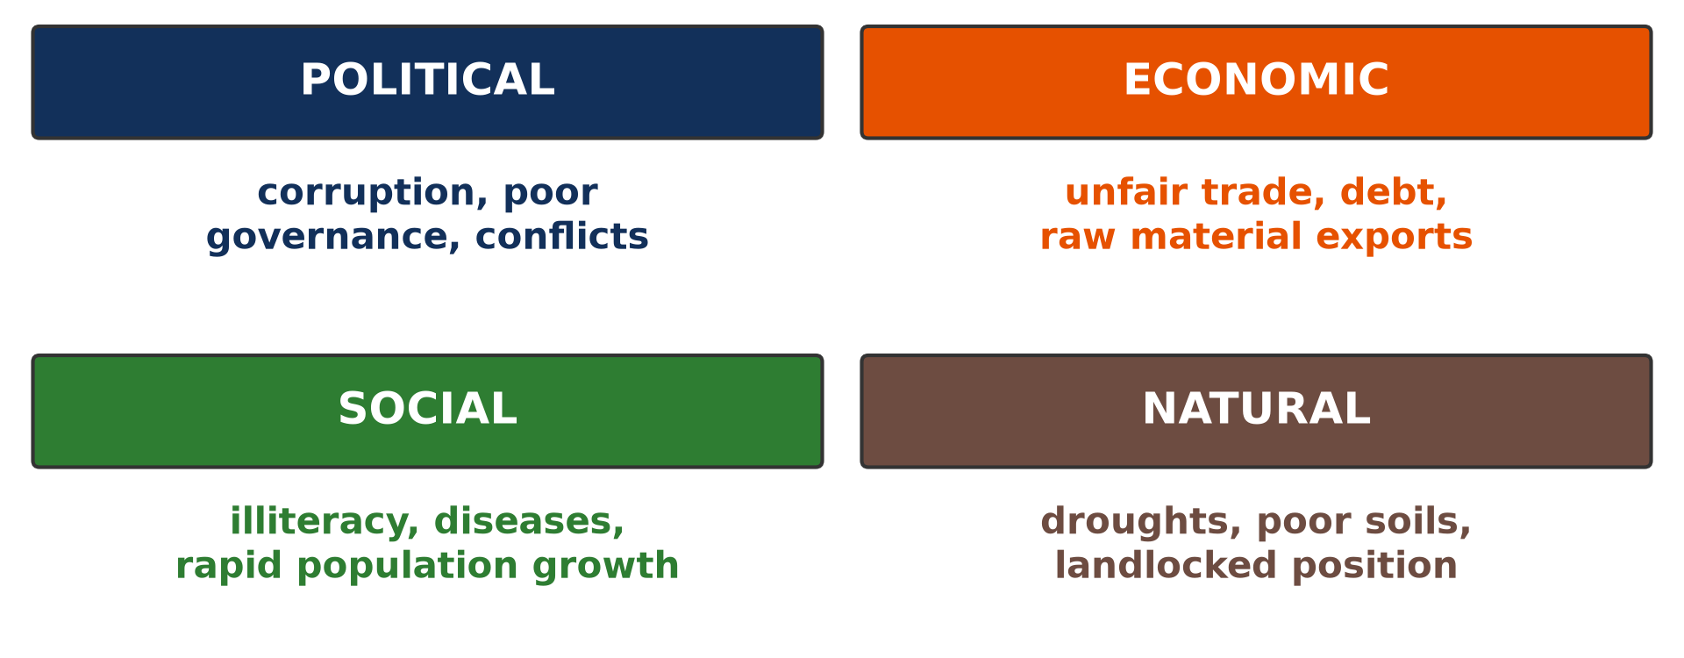
2. REASONS: CAPITAL AND TECHNOLOGY
Activity 3
Causes of underdevelopment.
Notes:
Activity 3. Look carefully at this diagram: causes of underdevelopment. Observe every detail before I ask the question.

Slide 26
2. REASONS: CAPITAL AND TECHNOLOGY
Activity 3: Question
Give two reasons for low industrialisation.
Notes:
Here is the question for Activity 3: Give two reasons for low industrialisation. Take one minute to think and write your answer in your rough notebook.

Slide 27
2. REASONS: CAPITAL AND TECHNOLOGY
Activity 3: Answer
Lack of capital and technology (also skilled labour).
Notes:
Let us check the answer together. Lack of capital and technology (also skilled labour).

Slide 28

2. REASONS: ENERGY AND MARKET
Activity 4
A bad road.
Notes:
Activity 4. Look carefully at this picture: a bad road. Observe every detail before I ask the question.

Slide 29
2. REASONS: ENERGY AND MARKET
Activity 4: Question
How do energy, transport and markets limit industry?
Notes:
Here is the question for Activity 4: How do energy, transport and markets limit industry? Take one minute to think and write your answer in your rough notebook.

Slide 30
2. REASONS: ENERGY AND MARKET
Activity 4: Answer
Power cuts, bad roads and small, poor markets raise costs.
Notes:
Let us check the answer together. Power cuts, bad roads and small, poor markets raise costs.

Slide 31

3. SOLUTIONS
Activity 5
A textile factory.
Notes:
Activity 5. Look carefully at this picture: a textile factory. Observe every detail before I ask the question.

Slide 32
3. SOLUTIONS
Activity 5: Question
Give two solutions.
Notes:
Here is the question for Activity 5: Give two solutions. Take one minute to think and write your answer in your rough notebook.

Slide 33
3. SOLUTIONS
Activity 5: Answer
Attract investors and build energy and transport infrastructure (also train workers).
Notes:
Let us check the answer together. Attract investors and build energy and transport infrastructure (also train workers).

Slide 34
BOARD SUMMARY
Board Summary
Topic: Managing Resources for Development through Economic Activities
Sub-topic: Manufacturing as an Economic Activity of the Secondary Sector
Lesson 3: Industrialisation in the Least Industrialised Countries
Notes:
Now we are going to copy the board summary. Write the title and the headings neatly in your notebooks. I will give you enough time for each slide, so do not rush.

Slide 35
BOARD SUMMARY
1. Characteristics of Industry in LICs
Industry in LICs has the following characteristics:
Light industries: Most factories are small and make food, drinks, soap and clothes.
Raw material processing: Many industries only partly process exports such as cotton or timber.
Notes:
Let us copy Characteristics of Industry in LICs. Industry in LICs has the following characteristics. On this slide we have Light industries and Raw material processing. Write each point on a new line, with the key term first, and explain it in your own words when we revise. When you finish, we go to the next slide.

Slide 36
BOARD SUMMARY
1. Characteristics of Industry in LICs (continued)
Foreign ownership and crafts: Many big factories are foreign-owned, and crafts are important.
Notes:
We continue with Characteristics of Industry in LICs. On this slide we have Foreign ownership and crafts. Write each point on a new line, with the key term first, and explain it in your own words when we revise.

Slide 37
BOARD SUMMARY
2. Reasons for the Low Level of Industrialisation
Industry is weak in LICs for the following reasons:
Capital and technology: There is little money to invest and little modern technology.
Energy and transport: Power cuts and poor roads raise production costs.
Notes:
Let us copy Reasons for the Low Level of Industrialisation. Industry is weak in LICs for the following reasons. On this slide we have Capital and technology and Energy and transport. Write each point on a new line, with the key term first, and explain it in your own words when we revise. When you finish, we go to the next slide.

Slide 38
BOARD SUMMARY
2. Reasons for the Low Level of Industrialisation (continued)
Market and labour: Local markets are small and poor, and skilled workers are few.
Competition: Cheap imported goods compete with local products.
Notes:
We continue with Reasons for the Low Level of Industrialisation. On this slide we have Market and labour and Competition. Write each point on a new line, with the key term first, and explain it in your own words when we revise.

Slide 39
BOARD SUMMARY
2. Reasons for the Low Level of Industrialisation
Illustration: causes of underdevelopment
Notes:
Now draw this illustration in your notebook: causes of underdevelopment. Give it a title and label it clearly.

Slide 40
FORMATIVE EVALUATION
Evaluation 1
Give two characteristics of industry in LICs.
Notes:
Now let us check what you have understood. Question 1: Give two characteristics of industry in LICs. Answer in your exercise book.

Slide 41
FORMATIVE EVALUATION
Expected Answer
Light industries and processing of raw materials.
Notes:
The expected answer is: light industries and processing of raw materials. If you got it right, well done.

Slide 42
FORMATIVE EVALUATION
Evaluation 2
Give three reasons for low industrialisation.
Notes:
Now let us check what you have understood. Question 2: Give three reasons for low industrialisation. Answer in your exercise book.

Slide 43
FORMATIVE EVALUATION
Expected Answer
Lack of capital, poor energy and small markets.
Notes:
The expected answer is: lack of capital, poor energy and small markets. If you got it right, well done.

Slide 44
REMEDIATION
Remediation
Fill in the blanks:
Most industries in LICs are ______ industries.
Industries that transform farm products are ______ industries.
Lack of money to invest is lack of ______.
Notes:
For those who need more practice, fill in the blanks in your exercise book. The answers are: number 1, light; number 2, agro- (food processing); number 3, capital.

Slide 45
HOMEWORK
Homework
Give three reasons why cotton from the North of Cameroon is not all made into cloth locally.
Notes:
For your homework: Give three reasons why cotton from the North of Cameroon is not all made into cloth locally. We shall correct it at the beginning of our next lesson.

Slide 46
NEXT LESSON
Next Lesson
Our next lesson will be on:
Lesson 4: Industrialisation in the Advanced Industrialised Countries
Notes:
Our next lesson will be on Lesson 4: Industrialisation in the Advanced Industrialised Countries. Thank you for your attention, and see you next time.

Slide 47
BILINGUAL GAME
Bilingual Game (Jeu Bilingue)
English | Français
Industrialisation | L'industrialisation
Capital | Le capital
Technology | La technologie
Import | L'importation
Competition | La concurrence
Processing | La transformation
Notes:
Let us play the bilingual game. I say a word in English, and you give me the French word. Then we do the reverse.

Slide 48
LOGBOOK
Official Logbook (1/2)
Module / Topic | Managing Resources for Development through Economic Activities
Lesson Title | Lesson 3: Industrialisation in the Least Industrialised Countries
Expected Learning Outcomes | Describe the characteristics of industry in LICs. Explain the reasons for the low level of industrialisation. Propose solutions.
Competence | Learners are able to describe industry in LICs and explain its low level.
Notes:
I record this information in the official logbook of the class after the lesson.

Slide 49
LOGBOOK
Official Logbook (2/2)
Matter Taught | Characteristics of Industry in LICs; Reasons for the Low Level of Industrialisation.
Evaluation | Formative evaluation and remediation exercise.
Homework | Give three reasons why cotton from the North of Cameroon is not all made into cloth locally.
Enrolment / Present / Absent | ____ / ____ / ____
Achievement | To be completed after the lesson.
Notes:
I complete the second page of the logbook: the matter taught, the evaluation, the homework and the attendance.

Slide 50
TEACHER'S NOTE
Teacher's Note
Timing: Homework correction, plan, objectives 8 min | Recall, situation, action 10 min | 5 activities 30 min | Board summary (copying) 30 min | Evaluation, remediation 10 min | Homework, next lesson 5 min | Logbook 7 min
Without the projector (Activity 1): list local industries.
Without the projector (Activity 2): name food factories.
Without the projector (Activity 3): discuss.
Without the projector (Activity 4): discuss.
Without the projector (Activity 5): list solutions.
Notes:
This slide is for me, the teacher: it gives the timing of the lesson and what to do if the projector is not available.

Slide 51
REFERENCES
References
Geography Syllabus, Forms I–V, MINESEC (2023) — Form 5, Module I: Management of Manufacturing and Tertiary Activities.
Photo, Activity 1: “Forging a new spear tip” by www.j-pics.info, CC BY-NC-SA 2.0, via Flickr (https://www.flickr.com/photos/33979630@N07/16024814824)
Photo, Activity 2: “Interior of Winston-Salem Chero-Cola Bottling Company, Winston-Salem, ” by unclibraries_commons, Public domain 1.0, via Flickr (https://www.flickr.com/photos/122654055@N06/22680169228)
Photo, Activity 4: “Cameroon - UN Women's Gender Road Project” by UN Women Gallery, CC BY-NC-ND 2.0, via Flickr (https://www.flickr.com/photos/51431730@N04/40672356003)
Photo, Activity 5: “Lowell Massachusetts - Boott Cotton Mills Museum Weave Room” by Onasill ~ Bill- 81M views, CC BY-NC-SA 2.0, via Flickr (https://www.flickr.com/photos/7156765@N05/43677799854)
Diagrams and animations: drawn for this lesson (Geography Department).
Notes:
These are the references and picture credits used to prepare this lesson.

