Slide 1
FORM 5
GEOGRAPHY
Practical Work 2
Communication on Maps
Notes:
Good morning, class, and welcome to our geography lesson. I am your geography teacher, Mr Kamdem. Today we are starting Practical Work 2: Communication on Maps.

Slide 2
CLASS INFO
Class, Chapter and Duration
Class | Form 5
Chapter | Module I: Management of Manufacturing and Tertiary Activities
Duration | 2 periods (2 × 50 minutes)
Notes:
This lesson is for Form 5. It belongs to Module I: Management of Manufacturing and Tertiary Activities. We shall need 2 periods to cover it.

Slide 3
IDENTIFICATION
Lesson Identification
Topic | Initiation to Map Analysis
Sub-topic | Map Interpretation
Lesson | Practical Work 2: Communication on Maps
Notions / Concepts | Transport forms, telecommunication, map symbols, distribution pattern.
Syllabus focus | Identification of types of transport forms on the map; identify forms of telecommunication; description of distribution; explanation for distribution patterns.
Competence | Learners are able to identify, describe and explain communication networks on a map.
Notes:
Our topic is Initiation to Map Analysis, and the sub-topic is Map Interpretation. The key notions we shall use today are: transport forms, telecommunication, map symbols, distribution pattern. At the end, you should be able to do this: learners are able to identify, describe and explain communication networks on a map.

Slide 4

HOMEWORK CORRECTION
Correction of the Homework
Question (Lesson 16: Transport Development in Cameroon):
Draw a sketch map of Cameroon showing the main roads, railways, ports and airports.
Notes:
Before we start the new lesson, let us correct the homework I gave you at the end of Lesson 16: Transport Development in Cameroon. The question was: Draw a sketch map of Cameroon showing the main roads, railways, ports and airports. Take out your exercise books.

Slide 5
HOMEWORK CORRECTION
Correction: Possible Answer
A framed sketch with Douala, Kribi and Limbe ports, the Transcam to Ngaoundéré, the main roads to Garoua, Bamenda and Bertoua, and the airports, with a key and north arrow.
Notes:
Here is a good answer. A framed sketch with Douala, Kribi and Limbe ports, the Transcam to Ngaoundéré, the main roads to Garoua, Bamenda and Bertoua, and the airports, with a key and north arrow. Compare it with your own answer and correct your work in red.

Slide 6
LESSON PLAN
Lesson Plan
Correction of the homework
Objectives and recall
Real-life situation and action to take
Learning activities
Board summary
Evaluation, remediation and homework
Notes:
Here is the plan of our lesson today. First, we shall correct the homework. Then we shall look at the objectives and recall what you already know. After that, we shall study a situation from real life and the action to take, and do the learning activities. Finally, we shall copy the board summary, do the evaluation and the remediation, and I will give you the homework.

Slide 7
OBJECTIVES
Objectives
By the end of this lesson, you should be able to:
Identify transport and telecommunication forms on a map.
Describe their distribution.
Explain their distribution patterns.
Notes:
By the end of this lesson, you should be able to do three things. Number 1: identify transport and telecommunication forms on a map. Number 2: describe their distribution. Number 3: explain their distribution patterns.

Slide 8
PREVIOUS KNOWLEDGE
Previous Knowledge
Maps use symbols and a key.
Roads follow valleys and gentle slopes.
A sketch map needs a frame, title and key.
Notes:
Let us first remember what you already know. Maps use symbols and a key. Roads follow valleys and gentle slopes. A sketch map needs a frame, title and key. Keep this in mind, because we shall build on it today.

Slide 9
REAL-LIFE SITUATION
Situation in Real Life
On a map extract, the class sees a main road, a railway, a footpath, a telephone line and an airstrip. They must describe and explain their distribution.
Notes:
Listen carefully to this situation from real life. On a map extract, the class sees a main road, a railway, a footpath, a telephone line and an airstrip. They must describe and explain their distribution. Think about it, because I am going to ask you some questions.

Slide 10
REAL-LIFE SITUATION
Situation: Question 1
What is the problem in the situation?
Notes:
Question 1: What is the problem in the situation? Think for a moment, then raise your hand to answer.

Slide 11
REAL-LIFE SITUATION
Answer
The class must interpret communication on a map.
Notes:
Good. The class must interpret communication on a map.

Slide 12
REAL-LIFE SITUATION
Situation: Question 2
Name two transport forms on the map.
Notes:
Question 2: Name two transport forms on the map. Think for a moment, then raise your hand to answer.

Slide 13
REAL-LIFE SITUATION
Answer
A main road and a railway.
Notes:
Good. A main road and a railway.

Slide 14
REAL-LIFE SITUATION
Situation: Question 3
Name one telecommunication form.
Notes:
Question 3: Name one telecommunication form. Think for a moment, then raise your hand to answer.

Slide 15
REAL-LIFE SITUATION
Possible Answer
A telephone line.
Notes:
Good. A telephone line.

Slide 16
ACTION TO TAKE
Action to Take
Always support map descriptions with evidence from the map.
Notes:
From this situation, the action we are working towards in this lesson is the following: always support map descriptions with evidence from the map.

Slide 17
JUSTIFICATION
Justification of the Lesson
This practical work helps us to read communication networks on maps.
Notes:
Why is this lesson important for you? This practical work helps us to read communication networks on maps.

Slide 18
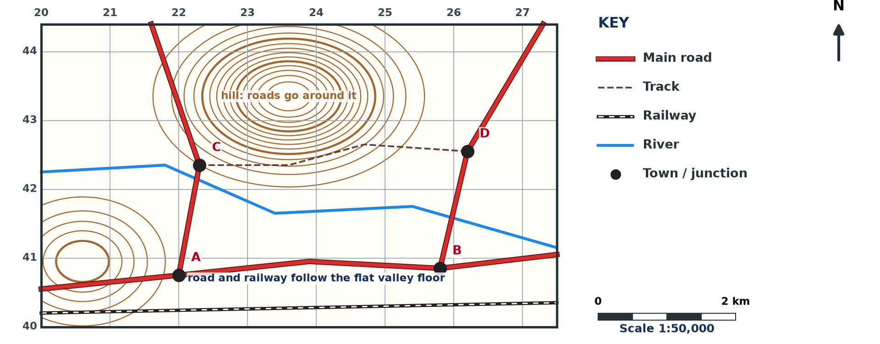
1. TRANSPORT FORMS
Activity 1
Transport on a map (invented).
Notes:
Activity 1. Look carefully at this diagram: transport on a map (invented). Observe every detail before I ask the question.

Slide 19
1. TRANSPORT FORMS
Activity 1: Question
Name three transport forms on the extract.
Notes:
Here is the question for Activity 1: Name three transport forms on the extract. Take one minute to think and write your answer in your rough notebook.

Slide 20
1. TRANSPORT FORMS
Activity 1: Answer
Main road, railway and footpath (also airstrip and river).
Notes:
Let us check the answer together. Main road, railway and footpath (also airstrip and river).

Slide 21

2. TELECOMMUNICATION FORMS
Activity 2
Conventional signs.
Notes:
Activity 2. Look carefully at this diagram: conventional signs. Observe every detail before I ask the question.

Slide 22
2. TELECOMMUNICATION FORMS
Activity 2: Question
Name two forms of telecommunication shown on maps.
Notes:
Here is the question for Activity 2: Name two forms of telecommunication shown on maps. Take one minute to think and write your answer in your rough notebook.

Slide 23
2. TELECOMMUNICATION FORMS
Activity 2: Answer
Telephone lines and telecommunication masts (also post offices).
Notes:
Let us check the answer together. Telephone lines and telecommunication masts (also post offices).

Slide 24
3. DESCRIPTION OF DISTRIBUTION
Activity 3
Describing distribution.
Notes:
Activity 3. Look carefully at this diagram: describing distribution. Observe every detail before I ask the question.

Slide 25
3. DESCRIPTION OF DISTRIBUTION
Activity 3: Question
Describe the distribution of roads on the extract.
Notes:
Here is the question for Activity 3: Describe the distribution of roads on the extract. Take one minute to think and write your answer in your rough notebook.

Slide 26
3. DESCRIPTION OF DISTRIBUTION
Activity 3: Answer
Roads are dense near the town and in the lowland, and few on the hills.
Notes:
Let us check the answer together. Roads are dense near the town and in the lowland, and few on the hills.

Slide 27
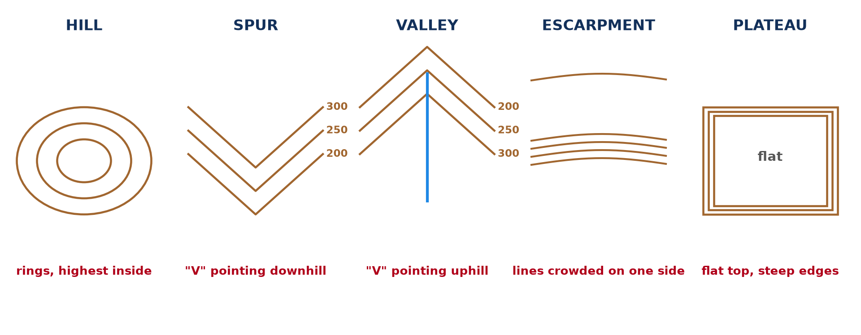
4. EXPLANATION
Activity 4
Relief forms.
Notes:
Activity 4. Look carefully at this diagram: relief forms. Observe every detail before I ask the question.

Slide 28
4. EXPLANATION
Activity 4: Question
Why do roads and railways follow valleys?
Notes:
Here is the question for Activity 4: Why do roads and railways follow valleys? Take one minute to think and write your answer in your rough notebook.

Slide 29
4. EXPLANATION
Activity 4: Answer
Valleys have gentle slopes that make building and travel easier.
Notes:
Let us check the answer together. Valleys have gentle slopes that make building and travel easier.

Slide 30

4. EXPLANATION
Activity 5
A transport network.
Notes:
Activity 5. Look carefully at this diagram: a transport network. Observe every detail before I ask the question.

Slide 31
4. EXPLANATION
Activity 5: Question
Why do routes meet at the town?
Notes:
Here is the question for Activity 5: Why do routes meet at the town? Take one minute to think and write your answer in your rough notebook.

Slide 32
4. EXPLANATION
Activity 5: Answer
The town is a market and service centre (a route centre).
Notes:
Let us check the answer together. The town is a market and service centre (a route centre).

Slide 33
BOARD SUMMARY
Board Summary
Topic: Initiation to Map Analysis
Sub-topic: Map Interpretation
Practical Work 2: Communication on Maps
Notes:
Now we are going to copy the board summary. Write the title and the headings neatly in your notebooks. I will give you enough time for each slide, so do not rush.

Slide 34
BOARD SUMMARY
1. Identification
Communication forms are identified on a map as follows:
Transport forms: Roads, tracks, footpaths, railways, airstrips and navigable rivers are shown by symbols.
Telecommunication forms: Telephone lines, masts and post offices are shown by symbols.
Notes:
Let us copy Identification. Communication forms are identified on a map as follows. On this slide we have Transport forms and Telecommunication forms. Write each point on a new line, with the key term first, and explain it in your own words when we revise. When you finish, we go to the next slide.

Slide 35
BOARD SUMMARY
1. Identification (continued)
Evidence: We use the key, names and grid references.
Notes:
We continue with Identification. On this slide we have Evidence. Write each point on a new line, with the key term first, and explain it in your own words when we revise.

Slide 36
BOARD SUMMARY
1. Identification
Illustration: transport on a map
Notes:
Now draw this illustration in your notebook: transport on a map. Give it a title and label it clearly.

Slide 37
BOARD SUMMARY
2. Description and Explanation of Distribution
The distribution of communication is described and explained as follows:
Description: Routes may be dense, sparse, radial or linear along valleys.
Relief: Routes follow valleys, gentle slopes and gaps and avoid steep slopes.
Notes:
Let us copy Description and Explanation of Distribution. The distribution of communication is described and explained as follows. On this slide we have Description and Relief. Write each point on a new line, with the key term first, and explain it in your own words when we revise. When you finish, we go to the next slide.

Slide 38
BOARD SUMMARY
2. Description and Explanation of Distribution (continued)
Drainage: Routes avoid swamps and cross rivers at bridges.
Settlements: Routes meet at towns, which become route centres.
Notes:
We continue with Description and Explanation of Distribution. On this slide we have Drainage and Settlements. Write each point on a new line, with the key term first, and explain it in your own words when we revise.

Slide 39
FORMATIVE EVALUATION
Evaluation 1
Name two transport forms and one telecommunication form on maps.
Notes:
Now let us check what you have understood. Question 1: Name two transport forms and one telecommunication form on maps. Answer in your exercise book.

Slide 40
FORMATIVE EVALUATION
Expected Answer
Road and railway; telephone line.
Notes:
The expected answer is: road and railway; telephone line. If you got it right, well done.

Slide 41
FORMATIVE EVALUATION
Evaluation 2
Explain why routes avoid steep slopes.
Notes:
Now let us check what you have understood. Question 2: Explain why routes avoid steep slopes. Answer in your exercise book.

Slide 42
FORMATIVE EVALUATION
Expected Answer
Building and travel are difficult and costly.
Notes:
The expected answer is: building and travel are difficult and costly. If you got it right, well done.

Slide 43
REMEDIATION
Remediation
Fill in the blanks:
A town where many routes meet is a route ______.
Roads usually follow ______.
Routes avoid ______ areas.
Notes:
For those who need more practice, fill in the blanks in your exercise book. The answers are: number 1, centre; number 2, valleys; number 3, swampy (steep).

Slide 44
HOMEWORK
Homework
Draw a sketch map of the communication network of a map extract.
Notes:
For your homework: Draw a sketch map of the communication network of a map extract. We shall correct it at the beginning of our next lesson.

Slide 45
NEXT LESSON
Next Lesson
Our next lesson will be on:
Lesson 17: Volume of Trade
Notes:
Our next lesson will be on Lesson 17: Volume of Trade. Thank you for your attention, and see you next time.

Slide 46
BILINGUAL GAME
Bilingual Game (Jeu Bilingue)
English | Français
Footpath | Le sentier
Railway | La voie ferrée
Airstrip | La piste d'atterrissage
Telephone line | La ligne téléphonique
Route centre | Le carrefour de routes
Distribution | La répartition
Notes:
Let us play the bilingual game. I say a word in English, and you give me the French word. Then we do the reverse.

Slide 47
LOGBOOK
Official Logbook (1/2)
Module / Topic | Initiation to Map Analysis
Lesson Title | Practical Work 2: Communication on Maps
Expected Learning Outcomes | Identify transport and telecommunication forms on a map. Describe their distribution. Explain their distribution patterns.
Competence | Learners are able to identify, describe and explain communication networks on a map.
Notes:
I record this information in the official logbook of the class after the lesson.

Slide 48
LOGBOOK
Official Logbook (2/2)
Matter Taught | Identification; Description and Explanation of Distribution.
Evaluation | Formative evaluation and remediation exercise.
Homework | Draw a sketch map of the communication network of a map extract.
Enrolment / Present / Absent | ____ / ____ / ____
Achievement | To be completed after the lesson.
Notes:
I complete the second page of the logbook: the matter taught, the evaluation, the homework and the attendance.

Slide 49
TEACHER'S NOTE
Teacher's Note
Timing: Homework correction, plan, objectives 8 min | Recall, situation, action 10 min | 5 activities 30 min | Board summary (copying) 30 min | Evaluation, remediation 10 min | Homework, next lesson 5 min | Logbook 7 min
Without the projector (Activity 1): use a map.
Without the projector (Activity 2): use the key.
Without the projector (Activity 3): describe.
Without the projector (Activity 4): discuss.
Without the projector (Activity 5): discuss.
Notes:
This slide is for me, the teacher: it gives the timing of the lesson and what to do if the projector is not available.

Slide 50
REFERENCES
References
Geography Syllabus, Forms I–V, MINESEC (2023) — Form 5, Module I: Management of Manufacturing and Tertiary Activities.
Diagrams and animations: drawn for this lesson (Geography Department).
Notes:
These are the references and picture credits used to prepare this lesson.

