Slide 1
FORM 5
GEOGRAPHY
Lesson 26
Problems of Waste Management
Notes:
Good morning, class, and welcome to our geography lesson. I am your geography teacher, Mr Kamdem. Today we are starting Lesson 26: Problems of Waste Management.

Slide 2
CLASS INFO
Class, Chapter and Duration
Class | Form 5
Chapter | Module II: Preservation of the Natural Environment
Duration | 2 periods (2 × 50 minutes)
Notes:
This lesson is for Form 5. It belongs to Module II: Preservation of the Natural Environment. We shall need 2 periods to cover it.

Slide 3
IDENTIFICATION
Lesson Identification
Topic | Development Projects and Environmental Management
Sub-topic | Environmental Degradation
Lesson | Lesson 26: Problems of Waste Management
Notions / Concepts | Waste, waste management, landfill, recycling, pollution.
Syllabus focus | Definition; causes; consequences; solutions.
Competence | Learners are able to explain the problems of waste management and propose solutions.
Notes:
Our topic is Development Projects and Environmental Management, and the sub-topic is Environmental Degradation. The key notions we shall use today are: waste, waste management, landfill, recycling, pollution. At the end, you should be able to do this: learners are able to explain the problems of waste management and propose solutions.

Slide 4

HOMEWORK CORRECTION
Correction of the Homework
Question (Lesson 25: Multipurpose River Development Project in Cameroon):
Explain how the Lagdo dam affects the life of the people of Garoua.
Notes:
Before we start the new lesson, let us correct the homework I gave you at the end of Lesson 25: Multipurpose River Development Project in Cameroon. The question was: Explain how the Lagdo dam affects the life of the people of Garoua. Take out your exercise books.

Slide 5
HOMEWORK CORRECTION
Correction: Possible Answer
It gives electricity for homes and industries, fish and irrigated food, but power cuts occur and floods can affect the riverside areas.
Notes:
Here is a good answer. It gives electricity for homes and industries, fish and irrigated food, but power cuts occur and floods can affect the riverside areas. Compare it with your own answer and correct your work in red.

Slide 6
LESSON PLAN
Lesson Plan
Correction of the homework
Objectives and recall
Real-life situation and action to take
Learning activities
Board summary
Evaluation, remediation and homework
Notes:
Here is the plan of our lesson today. First, we shall correct the homework. Then we shall look at the objectives and recall what you already know. After that, we shall study a situation from real life and the action to take, and do the learning activities. Finally, we shall copy the board summary, do the evaluation and the remediation, and I will give you the homework.

Slide 7
OBJECTIVES
Objectives
By the end of this lesson, you should be able to:
Define waste and waste management.
Explain the causes and consequences of poor waste management.
Propose solutions.
Notes:
By the end of this lesson, you should be able to do three things. Number 1: define waste and waste management. Number 2: explain the causes and consequences of poor waste management. Number 3: propose solutions.

Slide 8
PREVIOUS KNOWLEDGE
Previous Knowledge
Towns produce much waste.
Plastic bags block drains.
Dirty water causes diseases.
Notes:
Let us first remember what you already know. Towns produce much waste. Plastic bags block drains. Dirty water causes diseases. Keep this in mind, because we shall build on it today.

Slide 9
REAL-LIFE SITUATION
Situation in Real Life
In a quarter of Garoua, people throw waste into the gutters and the river. In the rainy season, the gutters overflow and many children suffer from cholera.
Notes:
Listen carefully to this situation from real life. In a quarter of Garoua, people throw waste into the gutters and the river. In the rainy season, the gutters overflow and many children suffer from cholera. Think about it, because I am going to ask you some questions.

Slide 10
REAL-LIFE SITUATION
Situation: Question 1
What is the problem in the situation?
Notes:
Question 1: What is the problem in the situation? Think for a moment, then raise your hand to answer.

Slide 11
REAL-LIFE SITUATION
Answer
Poor waste management.
Notes:
Good. Poor waste management.

Slide 12
REAL-LIFE SITUATION
Situation: Question 2
Where is the waste thrown?
Notes:
Question 2: Where is the waste thrown? Think for a moment, then raise your hand to answer.

Slide 13
REAL-LIFE SITUATION
Answer
Into gutters and the river.
Notes:
Good. Into gutters and the river.

Slide 14
REAL-LIFE SITUATION
Situation: Question 3
What are the consequences?
Notes:
Question 3: What are the consequences? Think for a moment, then raise your hand to answer.

Slide 15
REAL-LIFE SITUATION
Possible Answer
Floods and cholera.
Notes:
Good. Floods and cholera.

Slide 16
ACTION TO TAKE
Action to Take
Sort your waste, use bins and denounce the dumping of waste into streams.
Notes:
From this situation, the action we are working towards in this lesson is the following: sort your waste, use bins and denounce the dumping of waste into streams.

Slide 17
JUSTIFICATION
Justification of the Lesson
This lesson helps us to keep our environment clean and healthy.
Notes:
Why is this lesson important for you? This lesson helps us to keep our environment clean and healthy.

Slide 18
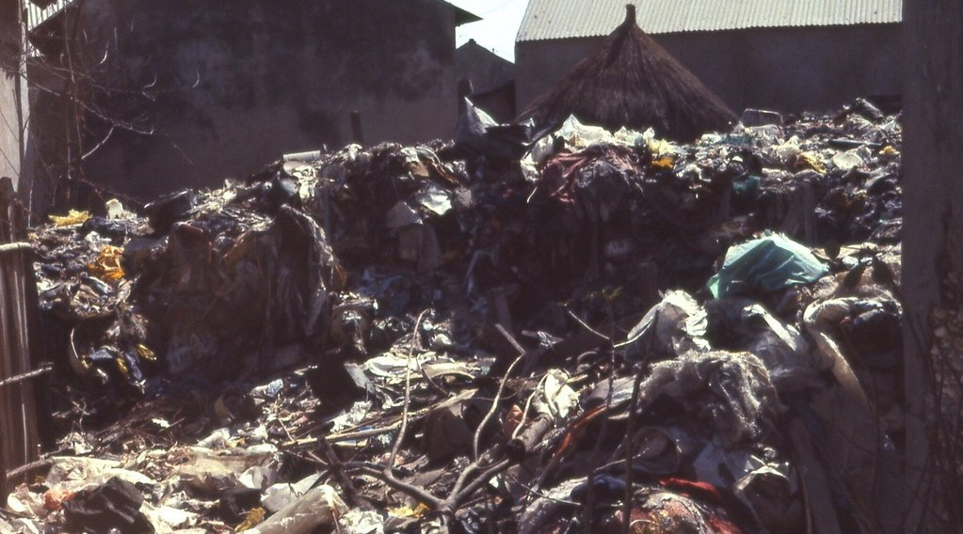
1. DEFINITION
Activity 1
A waste dump.
Notes:
Activity 1. Look carefully at this picture: a waste dump. Observe every detail before I ask the question.

Slide 19
1. DEFINITION
Activity 1: Question
What is waste management?
Notes:
Here is the question for Activity 1: What is waste management? Take one minute to think and write your answer in your rough notebook.

Slide 20
1. DEFINITION
Activity 1: Answer
The collection, transport, treatment and disposal of waste.
Notes:
Let us check the answer together. The collection, transport, treatment and disposal of waste.

Slide 21
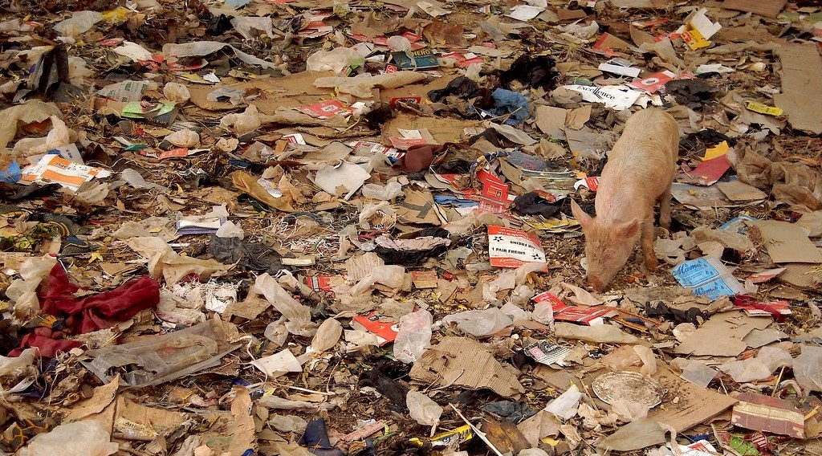
2. CAUSES
Activity 2
Litter.
Notes:
Activity 2. Look carefully at this picture: litter. Observe every detail before I ask the question.

Slide 22
2. CAUSES
Activity 2: Question
Give three causes of poor waste management.
Notes:
Here is the question for Activity 2: Give three causes of poor waste management. Take one minute to think and write your answer in your rough notebook.

Slide 23
2. CAUSES
Activity 2: Answer
Rapid urban growth, few bins and trucks, and bad habits of people.
Notes:
Let us check the answer together. Rapid urban growth, few bins and trucks, and bad habits of people.

Slide 24
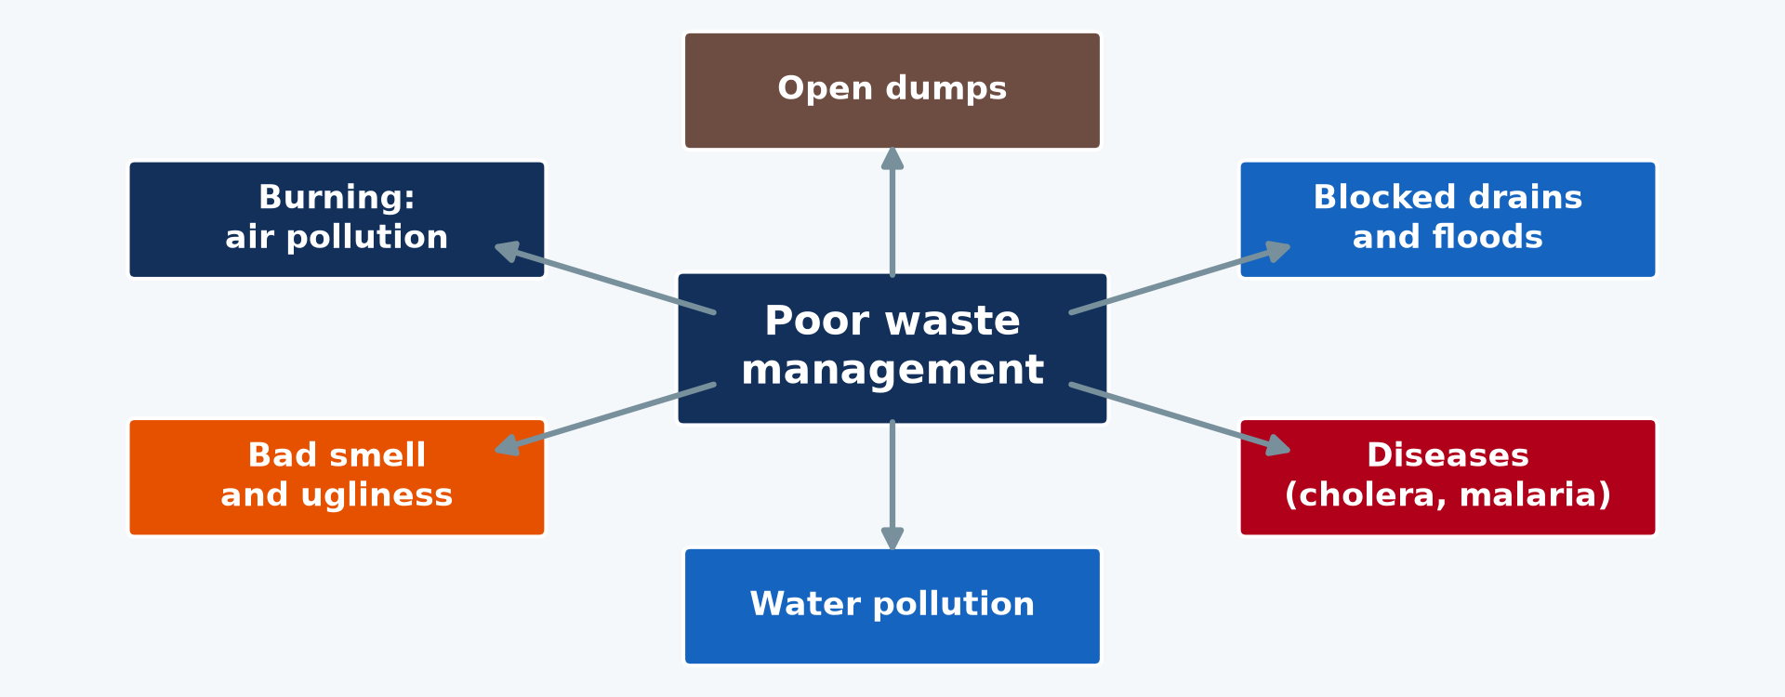
3. CONSEQUENCES
Activity 3
Consequences of poor waste management.
Notes:
Activity 3. Look carefully at this diagram: consequences of poor waste management. Observe every detail before I ask the question.

Slide 25
3. CONSEQUENCES
Activity 3: Question
Give three consequences.
Notes:
Here is the question for Activity 3: Give three consequences. Take one minute to think and write your answer in your rough notebook.

Slide 26
3. CONSEQUENCES
Activity 3: Answer
Diseases, floods from blocked drains and water pollution.
Notes:
Let us check the answer together. Diseases, floods from blocked drains and water pollution.

Slide 27
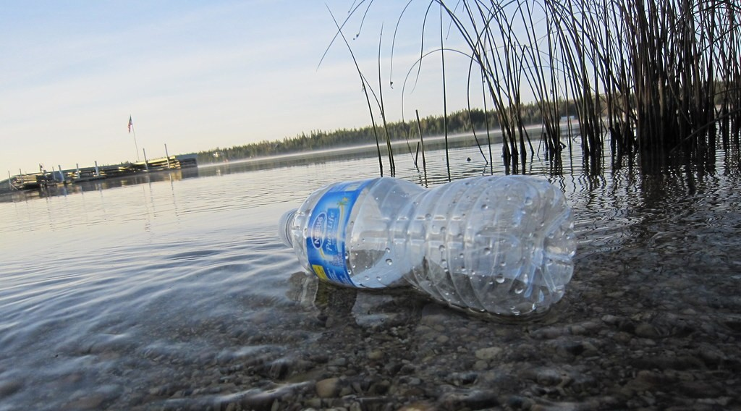
3. CONSEQUENCES
Activity 4
Plastic waste in water.
Notes:
Activity 4. Look carefully at this picture: plastic waste in water. Observe every detail before I ask the question.

Slide 28
3. CONSEQUENCES
Activity 4: Question
Why is plastic waste dangerous?
Notes:
Here is the question for Activity 4: Why is plastic waste dangerous? Take one minute to think and write your answer in your rough notebook.

Slide 29
3. CONSEQUENCES
Activity 4: Answer
It lasts a long time, blocks drains and kills animals.
Notes:
Let us check the answer together. It lasts a long time, blocks drains and kills animals.

Slide 30
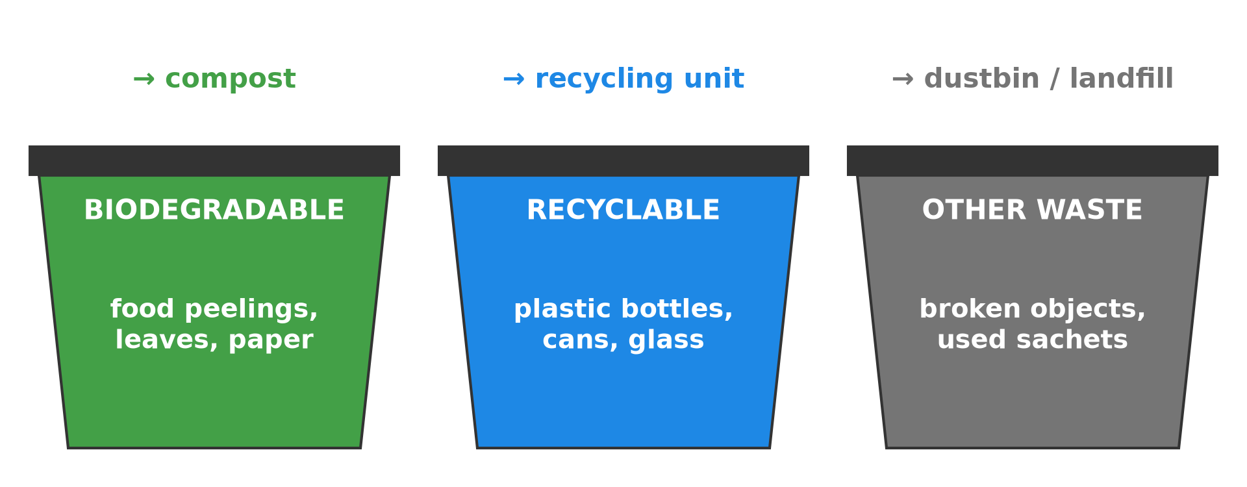
4. SOLUTIONS
Activity 5
Sorting waste.
Notes:
Activity 5. Look carefully at this diagram: sorting waste. Observe every detail before I ask the question.

Slide 31
4. SOLUTIONS
Activity 5: Question
Give three solutions.
Notes:
Here is the question for Activity 5: Give three solutions. Take one minute to think and write your answer in your rough notebook.

Slide 32
4. SOLUTIONS
Activity 5: Answer
Sorting and recycling, sanitary landfills and education of the population.
Notes:
Let us check the answer together. Sorting and recycling, sanitary landfills and education of the population.

Slide 33
BOARD SUMMARY
Board Summary
Topic: Development Projects and Environmental Management
Sub-topic: Environmental Degradation
Lesson 26: Problems of Waste Management
Notes:
Now we are going to copy the board summary. Write the title and the headings neatly in your notebooks. I will give you enough time for each slide, so do not rush.

Slide 34
BOARD SUMMARY
DEFINITIONS
The key terms of this lesson are defined as follows:
Waste: It is any material that is thrown away because it is no longer useful.
Waste management: It is the collection, transport, treatment and disposal of waste.
Notes:
Let us copy the definitions. The key terms of this lesson are defined as follows. On this slide we have Waste and Waste management. Write each point on a new line, with the key term first, and explain it in your own words when we revise.

Slide 35
BOARD SUMMARY
1. Causes of Poor Waste Management
Poor waste management has the following causes:
Urban growth: Fast-growing towns produce more waste than can be collected.
Lack of means: Councils lack bins, trucks and landfills.
Notes:
Let us copy Causes of Poor Waste Management. Poor waste management has the following causes. On this slide we have Urban growth and Lack of means. Write each point on a new line, with the key term first, and explain it in your own words when we revise. When you finish, we go to the next slide.

Slide 36
BOARD SUMMARY
1. Causes of Poor Waste Management (continued)
Bad habits: People throw waste into streets, gutters and rivers.
Notes:
We continue with Causes of Poor Waste Management. On this slide we have Bad habits. Write each point on a new line, with the key term first, and explain it in your own words when we revise.

Slide 37
BOARD SUMMARY
2. Consequences
Poor waste management has the following consequences:
Health: Flies, mosquitoes and dirty water spread cholera, typhoid and malaria.
Floods: Waste blocks drains and causes floods.
Notes:
Let us copy Consequences. Poor waste management has the following consequences. On this slide we have Health and Floods. Write each point on a new line, with the key term first, and explain it in your own words when we revise. When you finish, we go to the next slide.

Slide 38
BOARD SUMMARY
2. Consequences (continued)
Pollution: Burning and dumping pollute the air, soil and water.
Notes:
We continue with Consequences. On this slide we have Pollution. Write each point on a new line, with the key term first, and explain it in your own words when we revise.

Slide 39
BOARD SUMMARY
2. Consequences
Illustration: consequences of poor waste management
Notes:
Now draw this illustration in your notebook: consequences of poor waste management. Give it a title and label it clearly.

Slide 40
BOARD SUMMARY
3. Solutions
Waste can be better managed in the following ways:
Reduce, reuse and recycle: Waste should be sorted and reused or recycled.
Infrastructure: Bins, collection trucks and sanitary landfills should be provided.
Notes:
Let us copy Solutions. Waste can be better managed in the following ways. On this slide we have Reduce, reuse and recycle and Infrastructure. Write each point on a new line, with the key term first, and explain it in your own words when we revise. When you finish, we go to the next slide.

Slide 41
BOARD SUMMARY
3. Solutions (continued)
Education and laws: People should be sensitised and dumping should be punished.
Notes:
We continue with Solutions. On this slide we have Education and laws. Write each point on a new line, with the key term first, and explain it in your own words when we revise.

Slide 42
FORMATIVE EVALUATION
Evaluation 1
Define waste management.
Notes:
Now let us check what you have understood. Question 1: Define waste management. Answer in your exercise book.

Slide 43
FORMATIVE EVALUATION
Expected Answer
The collection, transport, treatment and disposal of waste.
Notes:
The expected answer is: the collection, transport, treatment and disposal of waste. If you got it right, well done.

Slide 44
FORMATIVE EVALUATION
Evaluation 2
Give two consequences and two solutions.
Notes:
Now let us check what you have understood. Question 2: Give two consequences and two solutions. Answer in your exercise book.

Slide 45
FORMATIVE EVALUATION
Expected Answer
Diseases and floods; recycling and landfills.
Notes:
The expected answer is: diseases and floods; recycling and landfills. If you got it right, well done.

Slide 46
REMEDIATION
Remediation
Fill in the blanks:
A controlled site for burying waste is a sanitary ______.
Making new products from waste is ______.
Waste in gutters causes ______.
Notes:
For those who need more practice, fill in the blanks in your exercise book. The answers are: number 1, landfill; number 2, recycling; number 3, floods.

Slide 47
HOMEWORK
Homework
Describe how waste is managed in your quarter and propose three improvements.
Notes:
For your homework: Describe how waste is managed in your quarter and propose three improvements. We shall correct it at the beginning of our next lesson.

Slide 48
NEXT LESSON
Next Lesson
Our next lesson will be on:
Lesson 27: Pollution
Notes:
Our next lesson will be on Lesson 27: Pollution. Thank you for your attention, and see you next time.

Slide 49
BILINGUAL GAME
Bilingual Game (Jeu Bilingue)
English | Français
Waste | Les déchets
Bin | La poubelle
Recycling | Le recyclage
Landfill | La décharge
Gutter | Le caniveau
Cholera | Le choléra
Notes:
Let us play the bilingual game. I say a word in English, and you give me the French word. Then we do the reverse.

Slide 50
LOGBOOK
Official Logbook (1/2)
Module / Topic | Development Projects and Environmental Management
Lesson Title | Lesson 26: Problems of Waste Management
Expected Learning Outcomes | Define waste and waste management. Explain the causes and consequences of poor waste management. Propose solutions.
Competence | Learners are able to explain the problems of waste management and propose solutions.
Notes:
I record this information in the official logbook of the class after the lesson.

Slide 51
LOGBOOK
Official Logbook (2/2)
Matter Taught | DEFINITIONS; Causes of Poor Waste Management; Consequences; Solutions.
Evaluation | Formative evaluation and remediation exercise.
Homework | Describe how waste is managed in your quarter and propose three improvements.
Enrolment / Present / Absent | ____ / ____ / ____
Achievement | To be completed after the lesson.
Notes:
I complete the second page of the logbook: the matter taught, the evaluation, the homework and the attendance.

Slide 52
TEACHER'S NOTE
Teacher's Note
Timing: Homework correction, plan, objectives 8 min | Recall, situation, action 10 min | 5 activities 30 min | Board summary (copying) 30 min | Evaluation, remediation 10 min | Homework, next lesson 5 min | Logbook 7 min
Without the projector (Activity 1): discuss.
Without the projector (Activity 2): discuss.
Without the projector (Activity 3): list.
Without the projector (Activity 4): discuss.
Without the projector (Activity 5): list.
Notes:
This slide is for me, the teacher: it gives the timing of the lesson and what to do if the projector is not available.

Slide 53
REFERENCES
References
Geography Syllabus, Forms I–V, MINESEC (2023) — Form 5, Module II: Preservation of the Natural Environment.
Photo, Activity 1: “Garbage dump at Fadiouth, Senegal (West Africa)” by gbaku, CC BY-SA 2.0, via Flickr (https://www.flickr.com/photos/72105154@N00/906659197)
Photo, Activity 2: “Do the evolution” by Marco Bellucci, CC BY 2.0, via Flickr (https://www.flickr.com/photos/50451886@N00/3382099741)
Photo, Activity 4: “Thank God men cannot fly, and lay waste the sky as well as the earth. ” by katerha, CC BY 2.0, via Flickr (https://www.flickr.com/photos/8489692@N03/5107788414)
Diagrams and animations: drawn for this lesson (Geography Department).
Notes:
These are the references and picture credits used to prepare this lesson.

