Slide 1
FORM 5
GEOGRAPHY
Lesson 33
Population Growth
Notes:
Good morning, class, and welcome to our geography lesson. I am your geography teacher, Mr Kamdem. Today we are starting Lesson 33: Population Growth.

Slide 2
CLASS INFO
Class, Chapter and Duration
Class | Form 5
Chapter | Module III: Management of Population Growth and Space Colonisation
Duration | 2 periods (2 × 50 minutes)
Notes:
This lesson is for Form 5. It belongs to Module III: Management of Population Growth and Space Colonisation. We shall need 2 periods to cover it.

Slide 3
IDENTIFICATION
Lesson Identification
Topic | The Dynamics of Population and Implications
Sub-topic | Population Change in Time (Population Growth)
Lesson | Lesson 33: Population Growth
Notions / Concepts | Birth rate, death rate, natural increase, growth rate.
Syllabus focus | Meaning; determinants; measurement of population growth.
Competence | Learners are able to explain and measure population growth.
Notes:
Our topic is The Dynamics of Population and Implications, and the sub-topic is Population Change in Time (Population Growth). The key notions we shall use today are: birth rate, death rate, natural increase, growth rate. At the end, you should be able to do this: learners are able to explain and measure population growth.

Slide 4

HOMEWORK CORRECTION
Correction of the Homework
Question (Lesson 32: Basic Types of Age-Sex Pyramids):
Draw the three types of age-sex pyramids and give one example of a country for each.
Notes:
Before we start the new lesson, let us correct the homework I gave you at the end of Lesson 32: Basic Types of Age-Sex Pyramids. The question was: Draw the three types of age-sex pyramids and give one example of a country for each. Take out your exercise books.

Slide 5
HOMEWORK CORRECTION
Correction: Possible Answer
Progressive (Cameroon), stationary (USA), regressive (Japan), each with age groups on the vertical axis, males left and females right.
Notes:
Here is a good answer. Progressive (Cameroon), stationary (USA), regressive (Japan), each with age groups on the vertical axis, males left and females right. Compare it with your own answer and correct your work in red.

Slide 6
LESSON PLAN
Lesson Plan
Correction of the homework
Objectives and recall
Real-life situation and action to take
Learning activities
Board summary
Evaluation, remediation and homework
Notes:
Here is the plan of our lesson today. First, we shall correct the homework. Then we shall look at the objectives and recall what you already know. After that, we shall study a situation from real life and the action to take, and do the learning activities. Finally, we shall copy the board summary, do the evaluation and the remediation, and I will give you the homework.

Slide 7
OBJECTIVES
Objectives
By the end of this lesson, you should be able to:
Define population growth.
Explain its determinants.
Calculate the birth rate, death rate and natural increase.
Notes:
By the end of this lesson, you should be able to do three things. Number 1: define population growth. Number 2: explain its determinants. Number 3: calculate the birth rate, death rate and natural increase.

Slide 8
PREVIOUS KNOWLEDGE
Previous Knowledge
Babies are born every day.
People die.
People move in and out of countries.
Notes:
Let us first remember what you already know. Babies are born every day. People die. People move in and out of countries. Keep this in mind, because we shall build on it today.

Slide 9
REAL-LIFE SITUATION
Situation in Real Life
In a village of 2,000 people, 80 babies are born and 20 people die in one year. The chief wants to know how fast the village is growing.
Notes:
Listen carefully to this situation from real life. In a village of 2,000 people, 80 babies are born and 20 people die in one year. The chief wants to know how fast the village is growing. Think about it, because I am going to ask you some questions.

Slide 10
REAL-LIFE SITUATION
Situation: Question 1
What is the problem in the situation?
Notes:
Question 1: What is the problem in the situation? Think for a moment, then raise your hand to answer.

Slide 11
REAL-LIFE SITUATION
Answer
We want to measure population growth.
Notes:
Good. We want to measure population growth.

Slide 12
REAL-LIFE SITUATION
Situation: Question 2
How many births are there?
Notes:
Question 2: How many births are there? Think for a moment, then raise your hand to answer.

Slide 13
REAL-LIFE SITUATION
Answer
80.
Notes:
Good. 80.

Slide 14
REAL-LIFE SITUATION
Situation: Question 3
How many deaths are there?
Notes:
Question 3: How many deaths are there? Think for a moment, then raise your hand to answer.

Slide 15
REAL-LIFE SITUATION
Possible Answer
20.
Notes:
Good. 20.

Slide 16
ACTION TO TAKE
Action to Take
Acquire sex education and respect birth control advice.
Notes:
From this situation, the action we are working towards in this lesson is the following: acquire sex education and respect birth control advice.

Slide 17
JUSTIFICATION
Justification of the Lesson
This lesson helps us to measure the growth of population.
Notes:
Why is this lesson important for you? This lesson helps us to measure the growth of population.

Slide 18
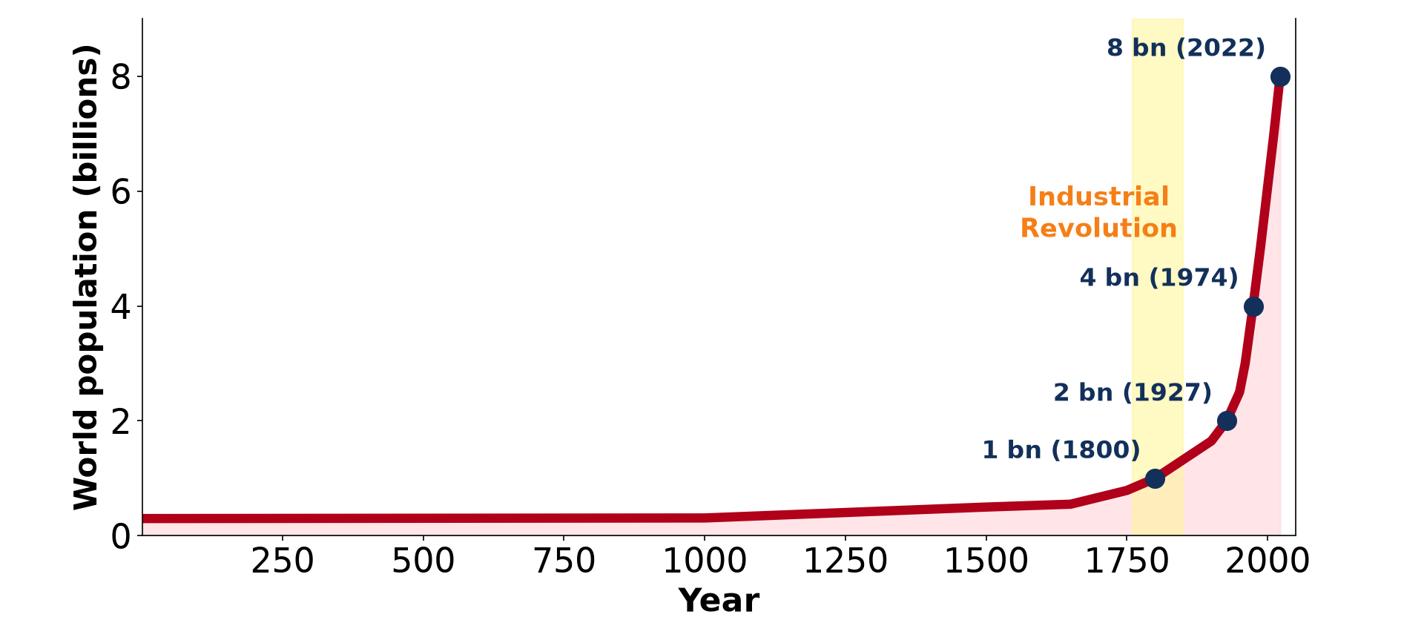
1. MEANING
Activity 1
World population growth.
Notes:
Activity 1. Look carefully at this diagram: world population growth. Observe every detail before I ask the question.

Slide 19
1. MEANING
Activity 1: Question
What is population growth?
Notes:
Here is the question for Activity 1: What is population growth? Take one minute to think and write your answer in your rough notebook.

Slide 20
1. MEANING
Activity 1: Answer
The change in the number of people in an area over time.
Notes:
Let us check the answer together. The change in the number of people in an area over time.

Slide 21
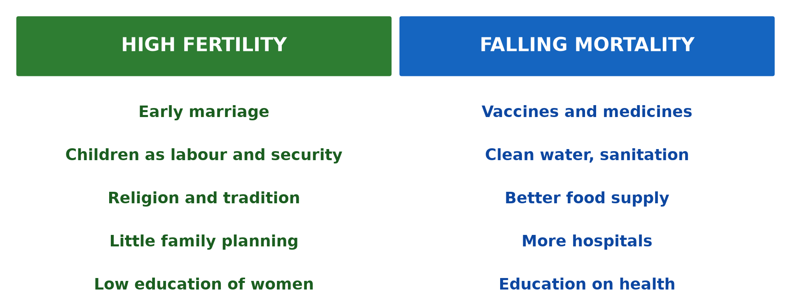
2. DETERMINANTS
Activity 2
Factors of growth.
Notes:
Activity 2. Look carefully at this diagram: factors of growth. Observe every detail before I ask the question.

Slide 22
2. DETERMINANTS
Activity 2: Question
Name the three determinants of population growth.
Notes:
Here is the question for Activity 2: Name the three determinants of population growth. Take one minute to think and write your answer in your rough notebook.

Slide 23
2. DETERMINANTS
Activity 2: Answer
Births, deaths and migration.
Notes:
Let us check the answer together. Births, deaths and migration.

Slide 24
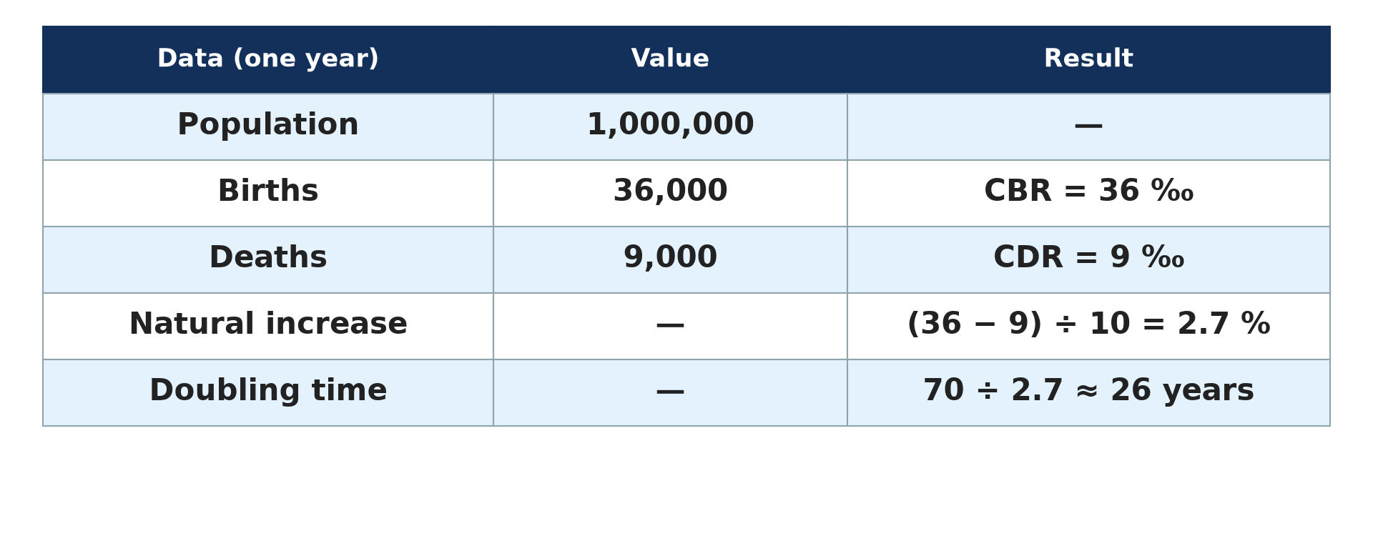
3. MEASUREMENT: BIRTH RATE
Activity 3
Calculating indices.
Notes:
Activity 3. Look carefully at this diagram: calculating indices. Observe every detail before I ask the question.

Slide 25
3. MEASUREMENT: BIRTH RATE
Activity 3: Question
Calculate the birth rate of the village.
Notes:
Here is the question for Activity 3: Calculate the birth rate of the village. Take one minute to think and write your answer in your rough notebook.

Slide 26
3. MEASUREMENT: BIRTH RATE
Activity 3: Answer
80 ÷ 2,000 × 1,000 = 40 per thousand.
Notes:
Let us check the answer together. 80 ÷ 2,000 × 1,000 = 40 per thousand.

Slide 27
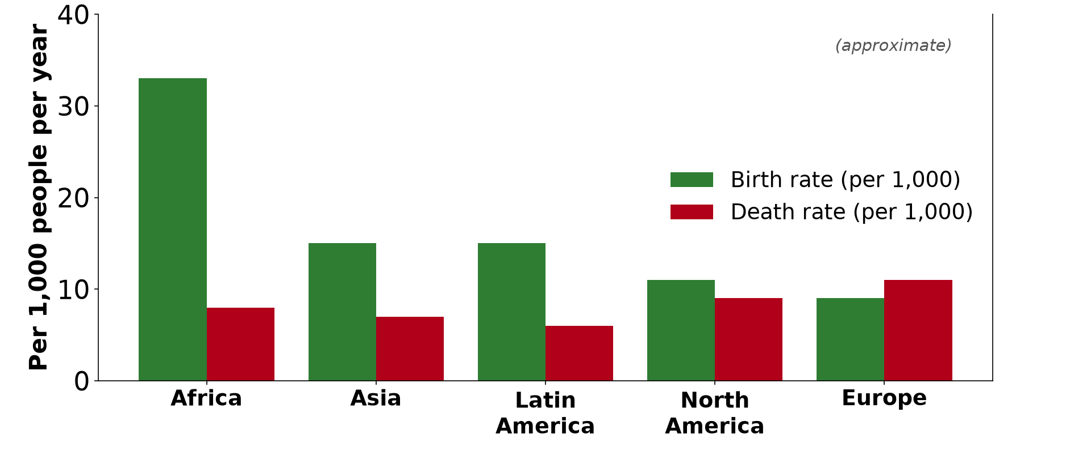
3. MEASUREMENT: DEATH RATE
Activity 4
Birth and death rates.
Notes:
Activity 4. Look carefully at this diagram: birth and death rates. Observe every detail before I ask the question.

Slide 28
3. MEASUREMENT: DEATH RATE
Activity 4: Question
Calculate the death rate of the village.
Notes:
Here is the question for Activity 4: Calculate the death rate of the village. Take one minute to think and write your answer in your rough notebook.

Slide 29
3. MEASUREMENT: DEATH RATE
Activity 4: Answer
20 ÷ 2,000 × 1,000 = 10 per thousand.
Notes:
Let us check the answer together. 20 ÷ 2,000 × 1,000 = 10 per thousand.

Slide 30
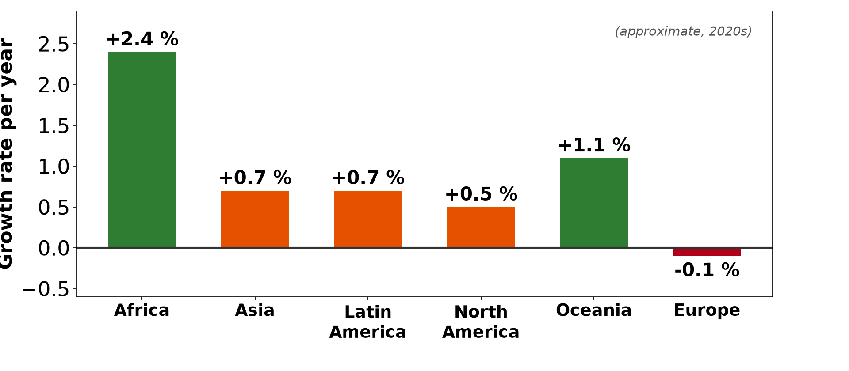
3. MEASUREMENT: NATURAL INCREASE
Activity 5
Growth rates.
Notes:
Activity 5. Look carefully at this diagram: growth rates. Observe every detail before I ask the question.

Slide 31
3. MEASUREMENT: NATURAL INCREASE
Activity 5: Question
Calculate the natural increase rate.
Notes:
Here is the question for Activity 5: Calculate the natural increase rate. Take one minute to think and write your answer in your rough notebook.

Slide 32
3. MEASUREMENT: NATURAL INCREASE
Activity 5: Answer
(40 − 10) ÷ 10 = 3 percent.
Notes:
Let us check the answer together. (40 − 10) ÷ 10 = 3 percent.

Slide 33
BOARD SUMMARY
Board Summary
Topic: The Dynamics of Population and Implications
Sub-topic: Population Change in Time (Population Growth)
Lesson 33: Population Growth
Notes:
Now we are going to copy the board summary. Write the title and the headings neatly in your notebooks. I will give you enough time for each slide, so do not rush.

Slide 34
BOARD SUMMARY
DEFINITIONS
The key terms of this lesson are defined as follows:
Population growth: It is the change in the number of people in an area over a period.
Notes:
Let us copy the definitions. The key terms of this lesson are defined as follows. On this slide we have Population growth. Write each point on a new line, with the key term first, and explain it in your own words when we revise.

Slide 35
BOARD SUMMARY
1. Determinants of Population Growth
Population growth depends on the following:
Births: They add people to the population.
Deaths: They remove people from the population.
Migration: Immigrants add people and emigrants remove people.
Notes:
Let us copy Determinants of Population Growth. Population growth depends on the following. On this slide we have Births, Deaths and Migration. Write each point on a new line, with the key term first, and explain it in your own words when we revise.

Slide 36
BOARD SUMMARY
1. Determinants of Population Growth
Illustration: factors of population growth
Notes:
Now draw this illustration in your notebook: factors of population growth. Give it a title and label it clearly.

Slide 37
BOARD SUMMARY
2. Measurement of Population Growth
Population growth is measured with the following indices:
Birth rate: It is births divided by population times 1,000, in per thousand.
Death rate: It is deaths divided by population times 1,000, in per thousand.
Notes:
Let us copy Measurement of Population Growth. Population growth is measured with the following indices. On this slide we have Birth rate and Death rate. Write each point on a new line, with the key term first, and explain it in your own words when we revise. When you finish, we go to the next slide.

Slide 38
BOARD SUMMARY
2. Measurement of Population Growth (continued)
Natural increase rate: It is birth rate minus death rate, divided by 10, in percent.
Growth rate: It adds net migration to the natural increase.
Notes:
We continue with Measurement of Population Growth. On this slide we have Natural increase rate and Growth rate. Write each point on a new line, with the key term first, and explain it in your own words when we revise.

Slide 39
FORMATIVE EVALUATION
Evaluation 1
Name the determinants of population growth.
Notes:
Now let us check what you have understood. Question 1: Name the determinants of population growth. Answer in your exercise book.

Slide 40
FORMATIVE EVALUATION
Expected Answer
Births, deaths and migration.
Notes:
The expected answer is: births, deaths and migration. If you got it right, well done.

Slide 41
FORMATIVE EVALUATION
Evaluation 2
A town of 10,000 has 350 births and 100 deaths. Calculate the natural increase rate.
Notes:
Now let us check what you have understood. Question 2: A town of 10,000 has 350 births and 100 deaths. Calculate the natural increase rate. Answer in your exercise book.

Slide 42
FORMATIVE EVALUATION
Expected Answer
BR 35‰, DR 10‰, NIR = 2.5 %.
Notes:
The expected answer is: bR 35‰, DR 10‰, NIR = 2.5 %. If you got it right, well done.

Slide 43
REMEDIATION
Remediation
Fill in the blanks:
Births per 1,000 people is the ______ rate.
Birth rate minus death rate gives the natural ______.
People who leave a country are ______.
Notes:
For those who need more practice, fill in the blanks in your exercise book. The answers are: number 1, birth; number 2, increase; number 3, emigrants.

Slide 44
HOMEWORK
Homework
A town of 50,000 people has 1,900 births and 450 deaths in a year. Calculate the birth rate, death rate and natural increase rate.
Notes:
For your homework: A town of 50,000 people has 1,900 births and 450 deaths in a year. Calculate the birth rate, death rate and natural increase rate. We shall correct it at the beginning of our next lesson.

Slide 45
NEXT LESSON
Next Lesson
Our next lesson will be on:
Lesson 34: The Demographic Transition Model (DTM)
Notes:
Our next lesson will be on Lesson 34: The Demographic Transition Model (DTM). Thank you for your attention, and see you next time.

Slide 46
BILINGUAL GAME
Bilingual Game (Jeu Bilingue)
English | Français
Birth rate | Le taux de natalité
Death rate | Le taux de mortalité
Natural increase | L'accroissement naturel
Migration | La migration
Per thousand | Pour mille
Growth rate | Le taux de croissance
Notes:
Let us play the bilingual game. I say a word in English, and you give me the French word. Then we do the reverse.

Slide 47
LOGBOOK
Official Logbook (1/2)
Module / Topic | The Dynamics of Population and Implications
Lesson Title | Lesson 33: Population Growth
Expected Learning Outcomes | Define population growth. Explain its determinants. Calculate the birth rate, death rate and natural increase.
Competence | Learners are able to explain and measure population growth.
Notes:
I record this information in the official logbook of the class after the lesson.

Slide 48
LOGBOOK
Official Logbook (2/2)
Matter Taught | DEFINITIONS; Determinants of Population Growth; Measurement of Population Growth.
Evaluation | Formative evaluation and remediation exercise.
Homework | A town of 50,000 people has 1,900 births and 450 deaths in a year. Calculate the birth rate, death rate and natural increase rate.
Enrolment / Present / Absent | ____ / ____ / ____
Achievement | To be completed after the lesson.
Notes:
I complete the second page of the logbook: the matter taught, the evaluation, the homework and the attendance.

Slide 49
TEACHER'S NOTE
Teacher's Note
Timing: Homework correction, plan, objectives 8 min | Recall, situation, action 10 min | 5 activities 30 min | Board summary (copying) 30 min | Evaluation, remediation 10 min | Homework, next lesson 5 min | Logbook 7 min
Without the projector (Activity 1): discuss.
Without the projector (Activity 2): list.
Without the projector (Activity 3): calculate.
Without the projector (Activity 4): calculate.
Without the projector (Activity 5): calculate.
Notes:
This slide is for me, the teacher: it gives the timing of the lesson and what to do if the projector is not available.

Slide 50
REFERENCES
References
Geography Syllabus, Forms I–V, MINESEC (2023) — Form 5, Module III: Management of Population Growth and Space Colonisation.
Diagrams and animations: drawn for this lesson (Geography Department).
Notes:
These are the references and picture credits used to prepare this lesson.

