Slide 1
FORM 5
GEOGRAPHY
Lesson 38
Population and Resource Model (Malthus)
Notes:
Good morning, class, and welcome to our geography lesson. I am your geography teacher, Mr Kamdem. Today we are starting Lesson 38: Population and Resource Model (Malthus).

Slide 2
CLASS INFO
Class, Chapter and Duration
Class | Form 5
Chapter | Module III: Management of Population Growth and Space Colonisation
Duration | 2 periods (2 × 50 minutes)
Notes:
This lesson is for Form 5. It belongs to Module III: Management of Population Growth and Space Colonisation. We shall need 2 periods to cover it.

Slide 3
IDENTIFICATION
Lesson Identification
Topic | The Dynamics of Population and Implications
Sub-topic | Population and Resources
Lesson | Lesson 38: Population and Resource Model (Malthus)
Notions / Concepts | Carrying capacity, standards of living, geometric and arithmetic growth.
Syllabus focus | Principles; conclusions.
Competence | Learners are able to explain Malthus's theory and assess it.
Notes:
Our topic is The Dynamics of Population and Implications, and the sub-topic is Population and Resources. The key notions we shall use today are: carrying capacity, standards of living, geometric and arithmetic growth. At the end, you should be able to do this: learners are able to explain Malthus's theory and assess it.

Slide 4

HOMEWORK CORRECTION
Correction of the Homework
Question (Lesson 37: Notions on Optimum Population, Over-population and Under-population):
Is the East Region of Cameroon over-populated or under-populated? Justify your answer.
Notes:
Before we start the new lesson, let us correct the homework I gave you at the end of Lesson 37: Notions on Optimum Population, Over-population and Under-population. The question was: Is the East Region of Cameroon over-populated or under-populated? Justify your answer. Take out your exercise books.

Slide 5
HOMEWORK CORRECTION
Correction: Possible Answer
Under-populated: about 11 people per km², large forests, minerals and farmland not fully used, and labour shortages.
Notes:
Here is a good answer. Under-populated: about 11 people per km², large forests, minerals and farmland not fully used, and labour shortages. Compare it with your own answer and correct your work in red.

Slide 6
LESSON PLAN
Lesson Plan
Correction of the homework
Objectives and recall
Real-life situation and action to take
Learning activities
Board summary
Evaluation, remediation and homework
Notes:
Here is the plan of our lesson today. First, we shall correct the homework. Then we shall look at the objectives and recall what you already know. After that, we shall study a situation from real life and the action to take, and do the learning activities. Finally, we shall copy the board summary, do the evaluation and the remediation, and I will give you the homework.

Slide 7
OBJECTIVES
Objectives
By the end of this lesson, you should be able to:
State the principles of Malthus's theory.
Draw the Malthus graph.
Give the conclusions and criticisms.
Notes:
By the end of this lesson, you should be able to do three things. Number 1: state the principles of Malthus's theory. Number 2: draw the Malthus graph. Number 3: give the conclusions and criticisms.

Slide 8
PREVIOUS KNOWLEDGE
Previous Knowledge
Population needs food.
Food shortages cause famine.
Population can grow fast.
Notes:
Let us first remember what you already know. Population needs food. Food shortages cause famine. Population can grow fast. Keep this in mind, because we shall build on it today.

Slide 9
REAL-LIFE SITUATION
Situation in Real Life
In 1798, an English priest, Thomas Malthus, predicted that population would grow faster than food and cause famine, wars and diseases.
Notes:
Listen carefully to this situation from real life. In 1798, an English priest, Thomas Malthus, predicted that population would grow faster than food and cause famine, wars and diseases. Think about it, because I am going to ask you some questions.

Slide 10
REAL-LIFE SITUATION
Situation: Question 1
What is the problem in the situation?
Notes:
Question 1: What is the problem in the situation? Think for a moment, then raise your hand to answer.

Slide 11
REAL-LIFE SITUATION
Answer
We want to understand Malthus's theory.
Notes:
Good. We want to understand Malthus's theory.

Slide 12
REAL-LIFE SITUATION
Situation: Question 2
Who was Malthus?
Notes:
Question 2: Who was Malthus? Think for a moment, then raise your hand to answer.

Slide 13
REAL-LIFE SITUATION
Answer
An English priest and economist.
Notes:
Good. An English priest and economist.

Slide 14
REAL-LIFE SITUATION
Situation: Question 3
What did he predict?
Notes:
Question 3: What did he predict? Think for a moment, then raise your hand to answer.

Slide 15
REAL-LIFE SITUATION
Possible Answer
Population would grow faster than food.
Notes:
Good. Population would grow faster than food.

Slide 16
ACTION TO TAKE
Action to Take
Support both birth control and food production.
Notes:
From this situation, the action we are working towards in this lesson is the following: support both birth control and food production.

Slide 17
JUSTIFICATION
Justification of the Lesson
This lesson helps us to reflect on the balance between population and food.
Notes:
Why is this lesson important for you? This lesson helps us to reflect on the balance between population and food.

Slide 18
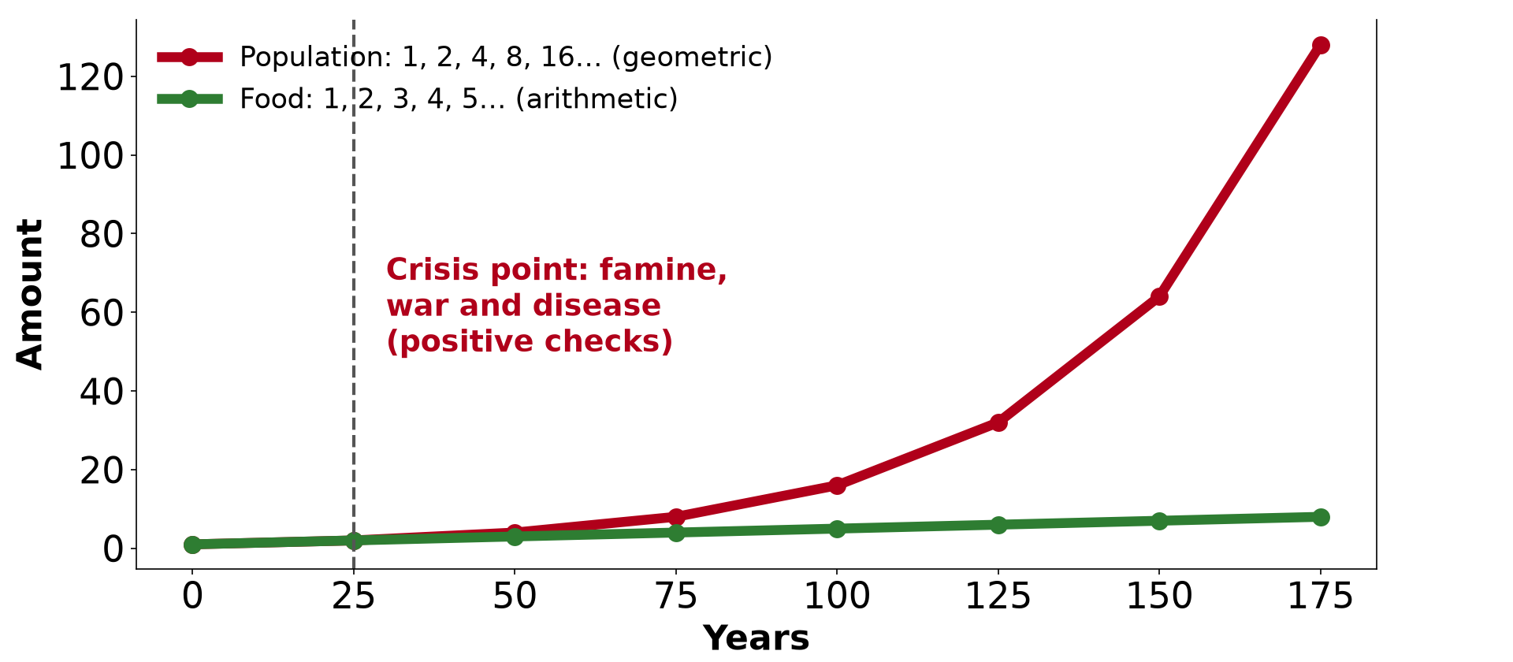
1. PRINCIPLES
Activity 1
The Malthus model.
Notes:
Activity 1. Look carefully at this diagram: the Malthus model. Observe every detail before I ask the question.

Slide 19
1. PRINCIPLES
Activity 1: Question
How did Malthus say population and food grow?
Notes:
Here is the question for Activity 1: How did Malthus say population and food grow? Take one minute to think and write your answer in your rough notebook.

Slide 20
1. PRINCIPLES
Activity 1: Answer
Population grows geometrically (1, 2, 4, 8) and food arithmetically (1, 2, 3, 4).
Notes:
Let us check the answer together. Population grows geometrically (1, 2, 4, 8) and food arithmetically (1, 2, 3, 4).

Slide 21
1. PRINCIPLES
Activity 2
The crisis point.
Notes:
Activity 2. Look carefully at this diagram: the crisis point. Observe every detail before I ask the question.

Slide 22
1. PRINCIPLES
Activity 2: Question
What happens when population passes food supply?
Notes:
Here is the question for Activity 2: What happens when population passes food supply? Take one minute to think and write your answer in your rough notebook.

Slide 23
1. PRINCIPLES
Activity 2: Answer
A crisis occurs: famine, diseases and wars.
Notes:
Let us check the answer together. A crisis occurs: famine, diseases and wars.

Slide 24

2. CHECKS
Activity 3
Famine relief.
Notes:
Activity 3. Look carefully at this picture: famine relief. Observe every detail before I ask the question.

Slide 25
2. CHECKS
Activity 3: Question
Distinguish positive and preventive checks.
Notes:
Here is the question for Activity 3: Distinguish positive and preventive checks. Take one minute to think and write your answer in your rough notebook.

Slide 26
2. CHECKS
Activity 3: Answer
Positive checks raise deaths (famine, war); preventive checks reduce births (late marriage).
Notes:
Let us check the answer together. Positive checks raise deaths (famine, war); preventive checks reduce births (late marriage).

Slide 27
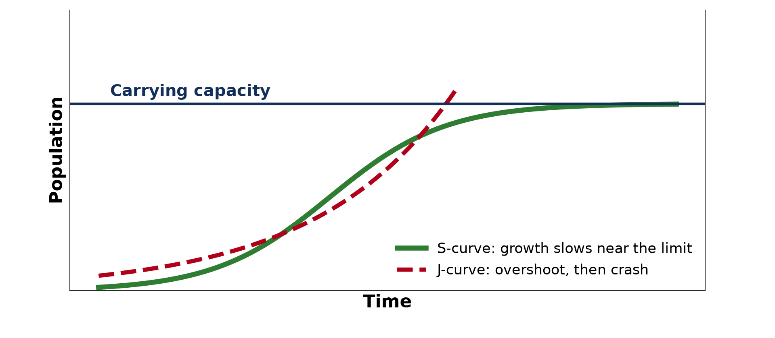
3. CONCLUSIONS
Activity 4
Carrying capacity.
Notes:
Activity 4. Look carefully at this diagram: carrying capacity. Observe every detail before I ask the question.

Slide 28
3. CONCLUSIONS
Activity 4: Question
What did Malthus conclude?
Notes:
Here is the question for Activity 4: What did Malthus conclude? Take one minute to think and write your answer in your rough notebook.

Slide 29
3. CONCLUSIONS
Activity 4: Answer
Population must be controlled to avoid misery.
Notes:
Let us check the answer together. Population must be controlled to avoid misery.

Slide 30
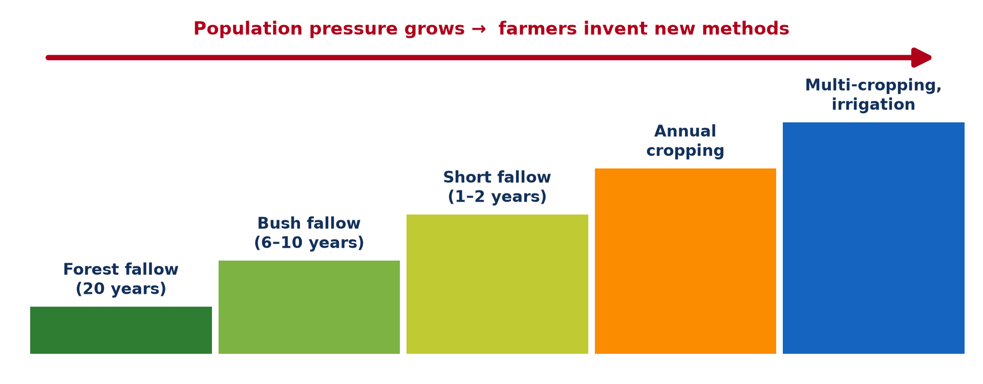
3. CRITICISMS
Activity 5
Boserup's view.
Notes:
Activity 5. Look carefully at this diagram: boserup's view. Observe every detail before I ask the question.

Slide 31
3. CRITICISMS
Activity 5: Question
Give one criticism of Malthus.
Notes:
Here is the question for Activity 5: Give one criticism of Malthus. Take one minute to think and write your answer in your rough notebook.

Slide 32
3. CRITICISMS
Activity 5: Answer
Technology such as the Green Revolution increased food faster than he expected.
Notes:
Let us check the answer together. Technology such as the Green Revolution increased food faster than he expected.

Slide 33
BOARD SUMMARY
Board Summary
Topic: The Dynamics of Population and Implications
Sub-topic: Population and Resources
Lesson 38: Population and Resource Model (Malthus)
Notes:
Now we are going to copy the board summary. Write the title and the headings neatly in your notebooks. I will give you enough time for each slide, so do not rush.

Slide 34
BOARD SUMMARY
1. Principles of the Malthus Model
Malthus stated the following principles in 1798:
Population growth: Population grows geometrically, as 1, 2, 4, 8, 16.
Food growth: Food supply grows arithmetically, as 1, 2, 3, 4, 5.
Notes:
Let us copy Principles of the Malthus Model. Malthus stated the following principles in 1798. On this slide we have Population growth and Food growth. Write each point on a new line, with the key term first, and explain it in your own words when we revise. When you finish, we go to the next slide.

Slide 35
BOARD SUMMARY
1. Principles of the Malthus Model (continued)
Crisis: When population passes food supply, famine, diseases and wars occur.
Notes:
We continue with Principles of the Malthus Model. On this slide we have Crisis. Write each point on a new line, with the key term first, and explain it in your own words when we revise.

Slide 36
BOARD SUMMARY
1. Principles of the Malthus Model
Illustration: the Malthus model
Notes:
Now draw this illustration in your notebook: the Malthus model. Give it a title and label it clearly.

Slide 37
BOARD SUMMARY
2. Conclusions and Criticisms
A) Conclusions
Malthus concluded that population is limited by the following checks:
Positive checks: Famine, diseases and wars raise death rates.
Preventive checks: Late marriage and moral restraint reduce birth rates.
Notes:
Let us copy Conclusions. Malthus concluded that population is limited by the following checks. On this slide we have Positive checks and Preventive checks. Write each point on a new line, with the key term first, and explain it in your own words when we revise.

Slide 38
BOARD SUMMARY
2. Conclusions and Criticisms
B) Criticisms and Relevance
The theory of Malthus is judged as follows:
Technology: New methods increased food production.
Trade: Countries can buy food from abroad.
Relevance: Famines in some LICs show that his ideas are still discussed.
Notes:
Let us copy Criticisms and Relevance. The theory of Malthus is judged as follows. On this slide we have Technology, Trade and Relevance. Write each point on a new line, with the key term first, and explain it in your own words when we revise.

Slide 39
FORMATIVE EVALUATION
Evaluation 1
State the two principles of Malthus.
Notes:
Now let us check what you have understood. Question 1: State the two principles of Malthus. Answer in your exercise book.

Slide 40
FORMATIVE EVALUATION
Expected Answer
Population grows geometrically and food arithmetically.
Notes:
The expected answer is: population grows geometrically and food arithmetically. If you got it right, well done.

Slide 41
FORMATIVE EVALUATION
Evaluation 2
Give one criticism.
Notes:
Now let us check what you have understood. Question 2: Give one criticism. Answer in your exercise book.

Slide 42
FORMATIVE EVALUATION
Expected Answer
Technology increased food production.
Notes:
The expected answer is: technology increased food production. If you got it right, well done.

Slide 43
REMEDIATION
Remediation
Fill in the blanks:
Malthus published his theory in ______.
Famine and war are ______ checks.
Late marriage is a ______ check.
Notes:
For those who need more practice, fill in the blanks in your exercise book. The answers are: number 1, 1798; number 2, positive; number 3, preventive.

Slide 44
HOMEWORK
Homework
Is Malthus's theory relevant to Cameroon today? Give two arguments.
Notes:
For your homework: Is Malthus's theory relevant to Cameroon today? Give two arguments. We shall correct it at the beginning of our next lesson.

Slide 45
NEXT LESSON
Next Lesson
Our next lesson will be on:
Lesson 39: Population in Cameroon
Notes:
Our next lesson will be on Lesson 39: Population in Cameroon. Thank you for your attention, and see you next time.

Slide 46
BILINGUAL GAME
Bilingual Game (Jeu Bilingue)
English | Français
Theory | La théorie
Famine | La famine
Food supply | L'approvisionnement alimentaire
Check | Le frein
Geometric | Géométrique
Arithmetic | Arithmétique
Notes:
Let us play the bilingual game. I say a word in English, and you give me the French word. Then we do the reverse.

Slide 47
LOGBOOK
Official Logbook (1/2)
Module / Topic | The Dynamics of Population and Implications
Lesson Title | Lesson 38: Population and Resource Model (Malthus)
Expected Learning Outcomes | State the principles of Malthus's theory. Draw the Malthus graph. Give the conclusions and criticisms.
Competence | Learners are able to explain Malthus's theory and assess it.
Notes:
I record this information in the official logbook of the class after the lesson.

Slide 48
LOGBOOK
Official Logbook (2/2)
Matter Taught | Principles of the Malthus Model; Conclusions; Criticisms and Relevance.
Evaluation | Formative evaluation and remediation exercise.
Homework | Is Malthus's theory relevant to Cameroon today? Give two arguments.
Enrolment / Present / Absent | ____ / ____ / ____
Achievement | To be completed after the lesson.
Notes:
I complete the second page of the logbook: the matter taught, the evaluation, the homework and the attendance.

Slide 49
TEACHER'S NOTE
Teacher's Note
Timing: Homework correction, plan, objectives 8 min | Recall, situation, action 10 min | 5 activities 30 min | Board summary (copying) 30 min | Evaluation, remediation 10 min | Homework, next lesson 5 min | Logbook 7 min
Without the projector (Activity 1): draw.
Without the projector (Activity 2): discuss.
Without the projector (Activity 3): define.
Without the projector (Activity 4): discuss.
Without the projector (Activity 5): discuss.
Notes:
This slide is for me, the teacher: it gives the timing of the lesson and what to do if the projector is not available.

Slide 50
REFERENCES
References
Geography Syllabus, Forms I–V, MINESEC (2023) — Form 5, Module III: Management of Population Growth and Space Colonisation.
Photo, Activity 3: “WFP food distribution” by UNAMID Photo, CC BY-NC-ND 2.0, via Flickr (https://www.flickr.com/photos/58538810@N03/12495227734)
Diagrams and animations: drawn for this lesson (Geography Department).
Notes:
These are the references and picture credits used to prepare this lesson.

