Slide 1
FORM 5
GEOGRAPHY
Practical Work 4
Calculation of the Determinants of Population Growth (Indices)
Notes:
Good morning, class, and welcome to our geography lesson. I am your geography teacher, Mr Kamdem. Today we are starting Practical Work 4: Calculation of the Determinants of Population Growth (Indices).

Slide 2
CLASS INFO
Class, Chapter and Duration
Class | Form 5
Chapter | Module III: Management of Population Growth and Space Colonisation
Duration | 2 periods (2 × 50 minutes)
Notes:
This lesson is for Form 5. It belongs to Module III: Management of Population Growth and Space Colonisation. We shall need 2 periods to cover it.

Slide 3
IDENTIFICATION
Lesson Identification
Topic | The Dynamics of Population and Implications
Sub-topic | Population of Cameroon
Lesson | Practical Work 4: Calculation of the Determinants of Population Growth (Indices)
Notions / Concepts | Birth rate, death rate, natural increase, growth rate.
Syllabus focus | Theoretical basis (definitions of birth rate, death rate, natural growth rate and population growth); calculation of birth rate, death rate, natural population increase and population growth rate, using concrete data on the population of Cameroon.
Competence | Learners are able to calculate the indices of population growth with data on Cameroon.
Notes:
Our topic is The Dynamics of Population and Implications, and the sub-topic is Population of Cameroon. The key notions we shall use today are: birth rate, death rate, natural increase, growth rate. At the end, you should be able to do this: learners are able to calculate the indices of population growth with data on Cameroon.

Slide 4

HOMEWORK CORRECTION
Correction of the Homework
Question (Lesson 40: Migration Patterns in Cameroon):
Propose three actions to reduce rural exodus in your region.
Notes:
Before we start the new lesson, let us correct the homework I gave you at the end of Lesson 40: Migration Patterns in Cameroon. The question was: Propose three actions to reduce rural exodus in your region. Take out your exercise books.

Slide 5
HOMEWORK CORRECTION
Correction: Possible Answer
Bring electricity, water and schools to villages; create farms, cooperatives and small industries; and organise cultural festivals.
Notes:
Here is a good answer. Bring electricity, water and schools to villages; create farms, cooperatives and small industries; and organise cultural festivals. Compare it with your own answer and correct your work in red.

Slide 6
LESSON PLAN
Lesson Plan
Correction of the homework
Objectives and recall
Real-life situation and action to take
Learning activities
Board summary
Evaluation, remediation and homework
Notes:
Here is the plan of our lesson today. First, we shall correct the homework. Then we shall look at the objectives and recall what you already know. After that, we shall study a situation from real life and the action to take, and do the learning activities. Finally, we shall copy the board summary, do the evaluation and the remediation, and I will give you the homework.

Slide 7
OBJECTIVES
Objectives
By the end of this lesson, you should be able to:
Recall the definitions and formulas of the indices.
Calculate the indices with data on Cameroon.
Notes:
Take your time to copy this part; we will continue together.

Slide 8
OBJECTIVES
Objectives (continued)
Interpret the results.
Notes:
By the end of this lesson, you should be able to do three things. Number 1: recall the definitions and formulas of the indices. Number 2: calculate the indices with data on Cameroon. Number 3: interpret the results.

Slide 9
PREVIOUS KNOWLEDGE
Previous Knowledge
Birth rate is in per thousand.
Natural increase is birth rate minus death rate.
Migration also changes population.
Notes:
Let us first remember what you already know. Birth rate is in per thousand. Natural increase is birth rate minus death rate. Migration also changes population. Keep this in mind, because we shall build on it today.

Slide 10
REAL-LIFE SITUATION
Situation in Real Life
The teacher gives the class approximate data on the population of Cameroon for one year. The class must calculate the growth indices and interpret them.
Notes:
Listen carefully to this situation from real life. The teacher gives the class approximate data on the population of Cameroon for one year. The class must calculate the growth indices and interpret them. Think about it, because I am going to ask you some questions.

Slide 11
REAL-LIFE SITUATION
Situation: Question 1
What is the problem in the situation?
Notes:
Question 1: What is the problem in the situation? Think for a moment, then raise your hand to answer.

Slide 12
REAL-LIFE SITUATION
Answer
The class must calculate population indices.
Notes:
Good. The class must calculate population indices.

Slide 13
REAL-LIFE SITUATION
Situation: Question 2
What data are given?
Notes:
Question 2: What data are given? Think for a moment, then raise your hand to answer.

Slide 14
REAL-LIFE SITUATION
Answer
Population, births, deaths and migrants.
Notes:
Good. Population, births, deaths and migrants.

Slide 15
REAL-LIFE SITUATION
Situation: Question 3
What is the unit of the birth rate?
Notes:
Question 3: What is the unit of the birth rate? Think for a moment, then raise your hand to answer.

Slide 16
REAL-LIFE SITUATION
Possible Answer
Per thousand.
Notes:
Good. Per thousand.

Slide 17
ACTION TO TAKE
Action to Take
Show all formulas and steps in calculations.
Notes:
From this situation, the action we are working towards in this lesson is the following: show all formulas and steps in calculations.

Slide 18
JUSTIFICATION
Justification of the Lesson
This practical work helps us to use numbers to understand population growth.
Notes:
Why is this lesson important for you? This practical work helps us to use numbers to understand population growth.

Slide 19
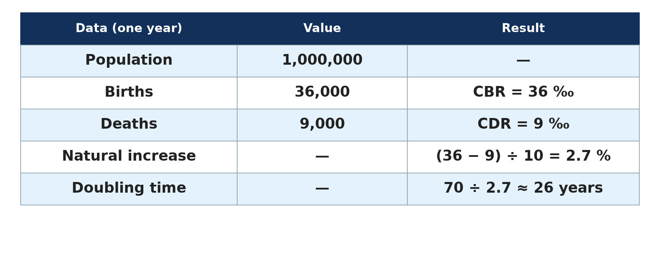
1. THEORETICAL BASIS
Activity 1
Formulas.
Notes:
Activity 1. Look carefully at this diagram: formulas. Observe every detail before I ask the question.

Slide 20
1. THEORETICAL BASIS
Activity 1: Question
Give the formula of the birth rate.
Notes:
Here is the question for Activity 1: Give the formula of the birth rate. Take one minute to think and write your answer in your rough notebook.

Slide 21
1. THEORETICAL BASIS
Activity 1: Answer
Births ÷ total population × 1,000.
Notes:
Let us check the answer together. Births ÷ total population × 1,000.

Slide 22
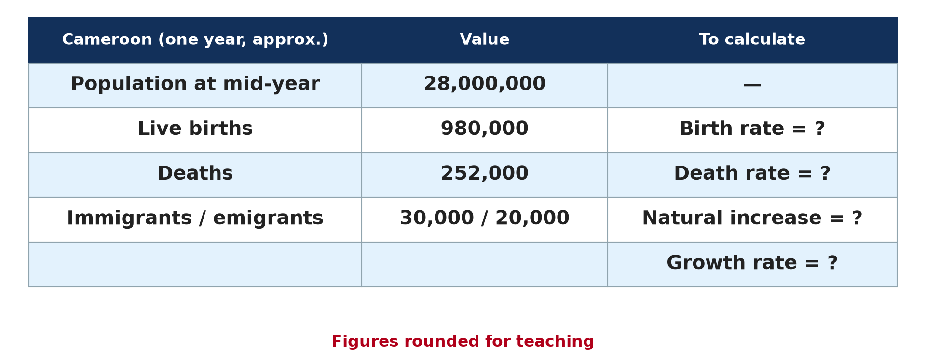
2. BIRTH RATE
Activity 2
Data on Cameroon (approximate).
Notes:
Activity 2. Look carefully at this diagram: data on Cameroon (approximate). Observe every detail before I ask the question.

Slide 23
2. BIRTH RATE
Activity 2: Question
Calculate the birth rate of Cameroon.
Notes:
Here is the question for Activity 2: Calculate the birth rate of Cameroon. Take one minute to think and write your answer in your rough notebook.

Slide 24
2. BIRTH RATE
Activity 2: Answer
980,000 ÷ 28,000,000 × 1,000 = 35 per thousand.
Notes:
Let us check the answer together. 980,000 ÷ 28,000,000 × 1,000 = 35 per thousand.

Slide 25
3. DEATH RATE
Activity 3
Data on Cameroon (approximate).
Notes:
Activity 3. Look carefully at this diagram: data on Cameroon (approximate). Observe every detail before I ask the question.

Slide 26
3. DEATH RATE
Activity 3: Question
Calculate the death rate.
Notes:
Here is the question for Activity 3: Calculate the death rate. Take one minute to think and write your answer in your rough notebook.

Slide 27
3. DEATH RATE
Activity 3: Answer
252,000 ÷ 28,000,000 × 1,000 = 9 per thousand.
Notes:
Let us check the answer together. 252,000 ÷ 28,000,000 × 1,000 = 9 per thousand.

Slide 28
4. NATURAL INCREASE
Activity 4
Data on Cameroon (approximate).
Notes:
Activity 4. Look carefully at this diagram: data on Cameroon (approximate). Observe every detail before I ask the question.

Slide 29
4. NATURAL INCREASE
Activity 4: Question
Calculate the natural increase rate.
Notes:
Here is the question for Activity 4: Calculate the natural increase rate. Take one minute to think and write your answer in your rough notebook.

Slide 30
4. NATURAL INCREASE
Activity 4: Answer
(35 − 9) ÷ 10 = 2.6 percent.
Notes:
Let us check the answer together. (35 − 9) ÷ 10 = 2.6 percent.

Slide 31
5. GROWTH RATE
Activity 5
Data on Cameroon (approximate).
Notes:
Activity 5. Look carefully at this diagram: data on Cameroon (approximate). Observe every detail before I ask the question.

Slide 32
5. GROWTH RATE
Activity 5: Question
Calculate the growth rate with migration.
Notes:
Here is the question for Activity 5: Calculate the growth rate with migration. Take one minute to think and write your answer in your rough notebook.

Slide 33
5. GROWTH RATE
Activity 5: Answer
(980,000 − 252,000 + 30,000 − 20,000) ÷ 28,000,000 × 100 ≈ 2.64 percent.
Notes:
Let us check the answer together. (980,000 − 252,000 + 30,000 − 20,000) ÷ 28,000,000 × 100 ≈ 2.64 percent.

Slide 34
BOARD SUMMARY
Board Summary
Topic: The Dynamics of Population and Implications
Sub-topic: Population of Cameroon
Practical Work 4: Calculation of the Determinants of Population Growth (Indices)
Notes:
Now we are going to copy the board summary. Write the title and the headings neatly in your notebooks. I will give you enough time for each slide, so do not rush.

Slide 35
BOARD SUMMARY
1. Theoretical Basis
The indices of population growth are calculated as follows:
Birth rate: It is births divided by population times 1,000.
Death rate: It is deaths divided by population times 1,000.
Notes:
Let us copy Theoretical Basis. The indices of population growth are calculated as follows. On this slide we have Birth rate and Death rate. Write each point on a new line, with the key term first, and explain it in your own words when we revise. When you finish, we go to the next slide.

Slide 36
BOARD SUMMARY
1. Theoretical Basis (continued)
Natural increase rate: It is birth rate minus death rate, divided by 10, in percent.
Growth rate: It is natural increase plus net migration, divided by population, times 100.
Notes:
We continue with Theoretical Basis. On this slide we have Natural increase rate and Growth rate. Write each point on a new line, with the key term first, and explain it in your own words when we revise.

Slide 37
BOARD SUMMARY
1. Theoretical Basis
Illustration: formulas and example
Notes:
Now draw this illustration in your notebook: formulas and example. Give it a title and label it clearly.

Slide 38
BOARD SUMMARY
2. Application to Cameroon
With the data of Cameroon, the results are the following:
Birth rate: It is 980,000 ÷ 28,000,000 × 1,000, which equals 35 per thousand.
Death rate: It is 252,000 ÷ 28,000,000 × 1,000, which equals 9 per thousand.
Notes:
Let us copy Application to Cameroon. With the data of Cameroon, the results are the following. On this slide we have Birth rate and Death rate. Write each point on a new line, with the key term first, and explain it in your own words when we revise. When you finish, we go to the next slide.

Slide 39
BOARD SUMMARY
2. Application to Cameroon (continued)
Natural increase: It is (35 − 9) ÷ 10, which equals 2.6 percent.
Interpretation: Cameroon grows fast and its population may double in about 27 years.
Notes:
We continue with Application to Cameroon. On this slide we have Natural increase and Interpretation. Write each point on a new line, with the key term first, and explain it in your own words when we revise.

Slide 40
BOARD SUMMARY
2. Application to Cameroon
Illustration: data on Cameroon
Notes:
Now draw this illustration in your notebook: data on Cameroon. Give it a title and label it clearly.

Slide 41
FORMATIVE EVALUATION
Evaluation 1
A country of 10 million has 400,000 births and 100,000 deaths. Calculate BR, DR and NIR.
Notes:
Now let us check what you have understood. Question 1: A country of 10 million has 400,000 births and 100,000 deaths. Calculate BR, DR and NIR. Answer in your exercise book.

Slide 42
FORMATIVE EVALUATION
Expected Answer
BR 40‰, DR 10‰, NIR 3 %.
Notes:
The expected answer is: bR 40‰, DR 10‰, NIR 3 %. If you got it right, well done.

Slide 43
FORMATIVE EVALUATION
Evaluation 2
What does a natural increase of 2.6 percent mean?
Notes:
Now let us check what you have understood. Question 2: What does a natural increase of 2.6 percent mean? Answer in your exercise book.

Slide 44
FORMATIVE EVALUATION
Expected Answer
The population grows fast and doubles in about 27 years.
Notes:
The expected answer is: the population grows fast and doubles in about 27 years. If you got it right, well done.

Slide 45
REMEDIATION
Remediation
Fill in the blanks:
Birth rate is expressed in per ______.
Natural increase is expressed in ______.
Doubling time is about 70 ÷ growth ______.
Notes:
For those who need more practice, fill in the blanks in your exercise book. The answers are: number 1, thousand; number 2, percent; number 3, rate.

Slide 46
HOMEWORK
Homework
A town of 400,000 people has 14,000 births, 3,600 deaths, 5,000 immigrants and 1,000 emigrants in a year. Calculate all the indices.
Notes:
For your homework: A town of 400,000 people has 14,000 births, 3,600 deaths, 5,000 immigrants and 1,000 emigrants in a year. Calculate all the indices. We shall correct it at the beginning of our next lesson.

Slide 47
NEXT LESSON
Next Lesson
Our next lesson will be on:
Lesson 41: Settlement
Notes:
Our next lesson will be on Lesson 41: Settlement. Thank you for your attention, and see you next time.

Slide 48
BILINGUAL GAME
Bilingual Game (Jeu Bilingue)
English | Français
Index | L'indice
Formula | La formule
Birth | La naissance
Death | Le décès
Immigrant | L'immigrant
Doubling time | Le temps de doublement
Notes:
Let us play the bilingual game. I say a word in English, and you give me the French word. Then we do the reverse.

Slide 49
LOGBOOK
Official Logbook (1/2)
Module / Topic | The Dynamics of Population and Implications
Lesson Title | Practical Work 4: Calculation of the Determinants of Population Growth (Indices)
Expected Learning Outcomes | Recall the definitions and formulas of the indices. Calculate the indices with data on Cameroon. Interpret the results.
Competence | Learners are able to calculate the indices of population growth with data on Cameroon.
Notes:
I record this information in the official logbook of the class after the lesson.

Slide 50
LOGBOOK
Official Logbook (2/2)
Matter Taught | Theoretical Basis; Application to Cameroon.
Evaluation | Formative evaluation and remediation exercise.
Homework | A town of 400,000 people has 14,000 births, 3,600 deaths, 5,000 immigrants and 1,000 emigrants in a year. Calculate all the indices.
Enrolment / Present / Absent | ____ / ____ / ____
Achievement | To be completed after the lesson.
Notes:
I complete the second page of the logbook: the matter taught, the evaluation, the homework and the attendance.

Slide 51
TEACHER'S NOTE
Teacher's Note
Timing: Homework correction, plan, objectives 8 min | Recall, situation, action 10 min | 5 activities 30 min | Board summary (copying) 30 min | Evaluation, remediation 10 min | Homework, next lesson 5 min | Logbook 7 min
Without the projector (Activity 1): write the formulas.
Without the projector (Activity 2): calculate.
Without the projector (Activity 3): calculate.
Without the projector (Activity 4): calculate.
Without the projector (Activity 5): calculate.
Notes:
This slide is for me, the teacher: it gives the timing of the lesson and what to do if the projector is not available.

Slide 52
REFERENCES
References
Geography Syllabus, Forms I–V, MINESEC (2023) — Form 5, Module III: Management of Population Growth and Space Colonisation.
Diagrams and animations: drawn for this lesson (Geography Department).
Notes:
These are the references and picture credits used to prepare this lesson.

