Slide 1
FORM 5
GEOGRAPHY
Lesson 42
Location of Settlements
Notes:
Good morning, class, and welcome to our geography lesson. I am your geography teacher, Mr Kamdem. Today we are starting Lesson 42: Location of Settlements.

Slide 2
CLASS INFO
Class, Chapter and Duration
Class | Form 5
Chapter | Module III: Management of Population Growth and Space Colonisation
Duration | 2 periods (2 × 50 minutes)
Notes:
This lesson is for Form 5. It belongs to Module III: Management of Population Growth and Space Colonisation. We shall need 2 periods to cover it.

Slide 3
IDENTIFICATION
Lesson Identification
Topic | The Development of Settlements and their Implications
Sub-topic | Rural Settlements, their Morphology and Implications on the Environment
Lesson | Lesson 42: Location of Settlements
Notions / Concepts | Location, site, situation.
Syllabus focus | Meaning; notion of site and situation; factors of location.
Competence | Learners are able to explain the site, situation and factors of location of settlements.
Notes:
Our topic is The Development of Settlements and their Implications, and the sub-topic is Rural Settlements, their Morphology and Implications on the Environment. The key notions we shall use today are: location, site, situation. At the end, you should be able to do this: learners are able to explain the site, situation and factors of location of settlements.

Slide 4

HOMEWORK CORRECTION
Correction of the Homework
Question (Lesson 41: Settlement):
Compare your village or quarter with a big town in five points.
Notes:
Before we start the new lesson, let us correct the homework I gave you at the end of Lesson 41: Settlement. The question was: Compare your village or quarter with a big town in five points. Take out your exercise books.

Slide 5
HOMEWORK CORRECTION
Correction: Possible Answer
Population size, main activities, type of houses, services available and way of life.
Notes:
Here is a good answer. Population size, main activities, type of houses, services available and way of life. Compare it with your own answer and correct your work in red.

Slide 6
LESSON PLAN
Lesson Plan
Correction of the homework
Objectives and recall
Real-life situation and action to take
Learning activities
Board summary
Evaluation, remediation and homework
Notes:
Here is the plan of our lesson today. First, we shall correct the homework. Then we shall look at the objectives and recall what you already know. After that, we shall study a situation from real life and the action to take, and do the learning activities. Finally, we shall copy the board summary, do the evaluation and the remediation, and I will give you the homework.

Slide 7
OBJECTIVES
Objectives
By the end of this lesson, you should be able to:
Distinguish site and situation.
Identify types of sites.
Explain the factors of location of settlements.
Notes:
By the end of this lesson, you should be able to do three things. Number 1: distinguish site and situation. Number 2: identify types of sites. Number 3: explain the factors of location of settlements.

Slide 8
PREVIOUS KNOWLEDGE
Previous Knowledge
People need water.
Some villages are on hills.
Towns grow near roads and rivers.
Notes:
Let us first remember what you already know. People need water. Some villages are on hills. Towns grow near roads and rivers. Keep this in mind, because we shall build on it today.

Slide 9
REAL-LIFE SITUATION
Situation in Real Life
Garoua was built on the Benue River, where people found water and could travel by boat. Today, roads link it to Maroua, Ngaoundéré and Chad.
Notes:
Listen carefully to this situation from real life. Garoua was built on the Benue River, where people found water and could travel by boat. Today, roads link it to Maroua, Ngaoundéré and Chad. Think about it, because I am going to ask you some questions.

Slide 10
REAL-LIFE SITUATION
Situation: Question 1
What is the problem in the situation?
Notes:
Question 1: What is the problem in the situation? Think for a moment, then raise your hand to answer.

Slide 11
REAL-LIFE SITUATION
Answer
We want to know why settlements are located where they are.
Notes:
Good. We want to know why settlements are located where they are.

Slide 12
REAL-LIFE SITUATION
Situation: Question 2
Why was Garoua built on the Benue?
Notes:
Question 2: Why was Garoua built on the Benue? Think for a moment, then raise your hand to answer.

Slide 13
REAL-LIFE SITUATION
Answer
For water and river transport.
Notes:
Good. For water and river transport.

Slide 14
REAL-LIFE SITUATION
Situation: Question 3
What links Garoua to other towns?
Notes:
Question 3: What links Garoua to other towns? Think for a moment, then raise your hand to answer.

Slide 15
REAL-LIFE SITUATION
Possible Answer
Roads.
Notes:
Good. Roads.

Slide 16
ACTION TO TAKE
Action to Take
Avoid building in flood zones and on unstable slopes.
Notes:
From this situation, the action we are working towards in this lesson is the following: avoid building in flood zones and on unstable slopes.

Slide 17
JUSTIFICATION
Justification of the Lesson
This lesson helps us to understand why settlements grow in some places.
Notes:
Why is this lesson important for you? This lesson helps us to understand why settlements grow in some places.

Slide 18
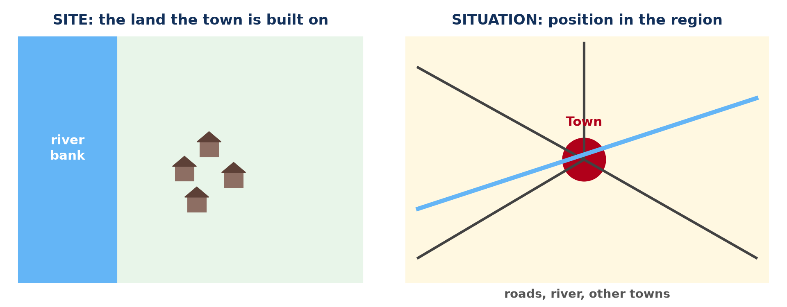
1. SITE AND SITUATION
Activity 1
Site and situation.
Notes:
Activity 1. Look carefully at this diagram: site and situation. Observe every detail before I ask the question.

Slide 19
1. SITE AND SITUATION
Activity 1: Question
Distinguish site and situation.
Notes:
Here is the question for Activity 1: Distinguish site and situation. Take one minute to think and write your answer in your rough notebook.

Slide 20
1. SITE AND SITUATION
Activity 1: Answer
Site is the land a settlement is built on; situation is its position in relation to the surrounding area.
Notes:
Let us check the answer together. Site is the land a settlement is built on; situation is its position in relation to the surrounding area.

Slide 21
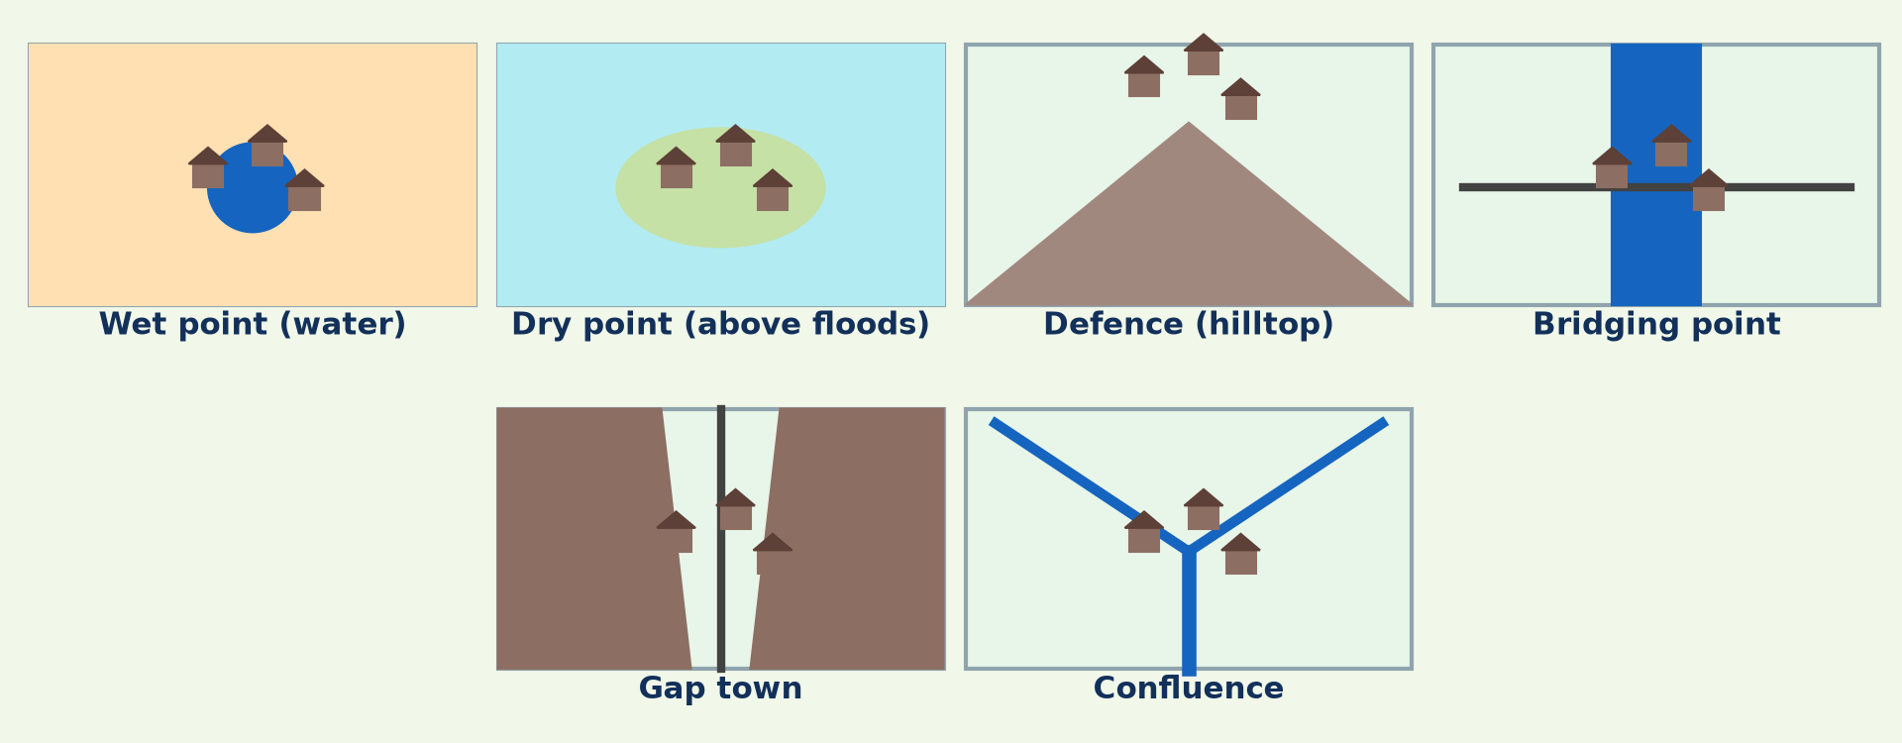
2. TYPES OF SITES
Activity 2
Types of sites.
Notes:
Activity 2. Look carefully at this diagram: types of sites. Observe every detail before I ask the question.

Slide 22
2. TYPES OF SITES
Activity 2: Question
Name four types of sites.
Notes:
Here is the question for Activity 2: Name four types of sites. Take one minute to think and write your answer in your rough notebook.

Slide 23
2. TYPES OF SITES
Activity 2: Answer
Wet point, dry point, defence site and bridging point (also gap and confluence).
Notes:
Let us check the answer together. Wet point, dry point, defence site and bridging point (also gap and confluence).

Slide 24

3. PHYSICAL FACTORS
Activity 3
Fetching water.
Notes:
Activity 3. Look carefully at this picture: fetching water. Observe every detail before I ask the question.

Slide 25
3. PHYSICAL FACTORS
Activity 3: Question
Give three physical factors of location.
Notes:
Here is the question for Activity 3: Give three physical factors of location. Take one minute to think and write your answer in your rough notebook.

Slide 26
3. PHYSICAL FACTORS
Activity 3: Answer
Water supply, flat land and fertile soil (also safety from floods).
Notes:
Let us check the answer together. Water supply, flat land and fertile soil (also safety from floods).

Slide 27

3. HUMAN FACTORS
Activity 4
A hilltop town.
Notes:
Activity 4. Look carefully at this picture: a hilltop town. Observe every detail before I ask the question.

Slide 28
3. HUMAN FACTORS
Activity 4: Question
Give two human factors of location.
Notes:
Here is the question for Activity 4: Give two human factors of location. Take one minute to think and write your answer in your rough notebook.

Slide 29
3. HUMAN FACTORS
Activity 4: Answer
Defence and routes (also trade and mining).
Notes:
Let us check the answer together. Defence and routes (also trade and mining).

Slide 30
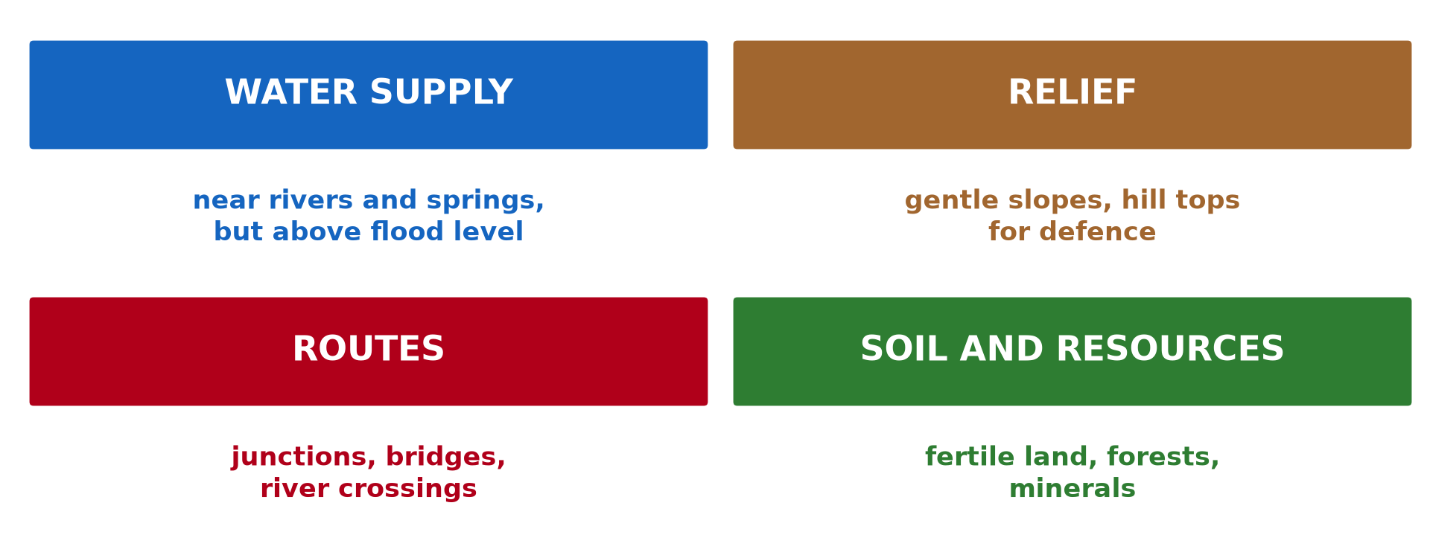
3. FACTORS
Activity 5
Site factors.
Notes:
Activity 5. Look carefully at this diagram: site factors. Observe every detail before I ask the question.

Slide 31
3. FACTORS
Activity 5: Question
Why do people avoid swamps and steep slopes?
Notes:
Here is the question for Activity 5: Why do people avoid swamps and steep slopes? Take one minute to think and write your answer in your rough notebook.

Slide 32
3. FACTORS
Activity 5: Answer
They are unhealthy, flood-prone or difficult to build on.
Notes:
Let us check the answer together. They are unhealthy, flood-prone or difficult to build on.

Slide 33
BOARD SUMMARY
Board Summary
Topic: The Development of Settlements and their Implications
Sub-topic: Rural Settlements, their Morphology and Implications on the Environment
Lesson 42: Location of Settlements
Notes:
Now we are going to copy the board summary. Write the title and the headings neatly in your notebooks. I will give you enough time for each slide, so do not rush.

Slide 34
BOARD SUMMARY
DEFINITIONS
The key terms of this lesson are defined as follows:
Site: It is the land on which a settlement is built.
Situation: It is the position of a settlement in relation to its surroundings.
Notes:
Let us copy the definitions. The key terms of this lesson are defined as follows. On this slide we have Site and Situation. Write each point on a new line, with the key term first, and explain it in your own words when we revise.

Slide 35
BOARD SUMMARY
1. Types of Sites
The main types of sites are the following:
Wet point: The settlement is near a reliable water supply.
Dry point: The settlement is on raised land above floods.
Notes:
Let us copy Types of Sites. The main types of sites are the following. On this slide we have Wet point and Dry point. Write each point on a new line, with the key term first, and explain it in your own words when we revise. When you finish, we go to the next slide.

Slide 36
BOARD SUMMARY
1. Types of Sites (continued)
Defence site: The settlement is on a hill or in a river bend.
Bridging point and gap: The settlement is where a river can be crossed or a valley cuts through hills.
Notes:
We continue with Types of Sites. On this slide we have Defence site and Bridging point and gap. Write each point on a new line, with the key term first, and explain it in your own words when we revise.

Slide 37
BOARD SUMMARY
1. Types of Sites
Illustration: types of sites
Notes:
Now draw this illustration in your notebook: types of sites. Give it a title and label it clearly.

Slide 38
BOARD SUMMARY
2. Factors of Location
Settlements are located according to the following factors:
Physical factors: Water, flat land, fertile soil and a healthy climate attract settlement.
Human factors: Defence, routes, trade, mining and religion also attract settlement.
Notes:
Let us copy Factors of Location. Settlements are located according to the following factors. On this slide we have Physical factors and Human factors. Write each point on a new line, with the key term first, and explain it in your own words when we revise.

Slide 39
FORMATIVE EVALUATION
Evaluation 1
Distinguish site and situation.
Notes:
Now let us check what you have understood. Question 1: Distinguish site and situation. Answer in your exercise book.

Slide 40
FORMATIVE EVALUATION
Expected Answer
Site is the land; situation is the position in the region.
Notes:
The expected answer is: site is the land; situation is the position in the region. If you got it right, well done.

Slide 41
FORMATIVE EVALUATION
Evaluation 2
Give two physical factors of location.
Notes:
Now let us check what you have understood. Question 2: Give two physical factors of location. Answer in your exercise book.

Slide 42
FORMATIVE EVALUATION
Expected Answer
Water supply and flat land.
Notes:
The expected answer is: water supply and flat land. If you got it right, well done.

Slide 43
REMEDIATION
Remediation
Fill in the blanks:
The land a town is built on is its ______.
A settlement near water is a ______ point.
A town where a river is crossed is a ______ point.
Notes:
For those who need more practice, fill in the blanks in your exercise book. The answers are: number 1, site; number 2, wet; number 3, bridging.

Slide 44
HOMEWORK
Homework
Describe the site and situation of your town.
Notes:
For your homework: Describe the site and situation of your town. We shall correct it at the beginning of our next lesson.

Slide 45
NEXT LESSON
Next Lesson
Our next lesson will be on:
Lesson 43: Concept of Rural Settlement
Notes:
Our next lesson will be on Lesson 43: Concept of Rural Settlement. Thank you for your attention, and see you next time.

Slide 46
BILINGUAL GAME
Bilingual Game (Jeu Bilingue)
English | Français
Location | L'emplacement
Site | Le site
Situation | La situation
Bridge | Le pont
Defence | La défense
Water supply | L'approvisionnement en eau
Notes:
Let us play the bilingual game. I say a word in English, and you give me the French word. Then we do the reverse.

Slide 47
LOGBOOK
Official Logbook (1/2)
Module / Topic | The Development of Settlements and their Implications
Lesson Title | Lesson 42: Location of Settlements
Expected Learning Outcomes | Distinguish site and situation. Identify types of sites. Explain the factors of location of settlements.
Competence | Learners are able to explain the site, situation and factors of location of settlements.
Notes:
I record this information in the official logbook of the class after the lesson.

Slide 48
LOGBOOK
Official Logbook (2/2)
Matter Taught | DEFINITIONS; Types of Sites; Factors of Location.
Evaluation | Formative evaluation and remediation exercise.
Homework | Describe the site and situation of your town.
Enrolment / Present / Absent | ____ / ____ / ____
Achievement | To be completed after the lesson.
Notes:
I complete the second page of the logbook: the matter taught, the evaluation, the homework and the attendance.

Slide 49
TEACHER'S NOTE
Teacher's Note
Timing: Homework correction, plan, objectives 8 min | Recall, situation, action 10 min | 5 activities 30 min | Board summary (copying) 30 min | Evaluation, remediation 10 min | Homework, next lesson 5 min | Logbook 7 min
Without the projector (Activity 1): define.
Without the projector (Activity 2): list.
Without the projector (Activity 3): discuss.
Without the projector (Activity 4): discuss.
Without the projector (Activity 5): discuss.
Notes:
This slide is for me, the teacher: it gives the timing of the lesson and what to do if the projector is not available.

Slide 50
REFERENCES
References
Geography Syllabus, Forms I–V, MINESEC (2023) — Form 5, Module III: Management of Population Growth and Space Colonisation.
Photo, Activity 3: “Women fetch water in Kilte-Awlaelo woreda, Tigray” by UNICEF Ethiopia, CC BY-NC-ND 2.0, via Flickr (https://www.flickr.com/photos/86783452@N02/14056445728)
Photo, Activity 4: “Piazza Roma, Monteriggioni, Tuscany” by Ray in Manila, CC BY 2.0, via Flickr (https://www.flickr.com/photos/21186555@N07/27053980373)
Diagrams and animations: drawn for this lesson (Geography Department).
Notes:
These are the references and picture credits used to prepare this lesson.

