Slide 1
FORM 5
GEOGRAPHY
Lesson 43
Concept of Rural Settlement
Notes:
Good morning, class, and welcome to our geography lesson. I am your geography teacher, Mr Kamdem. Today we are starting Lesson 43: Concept of Rural Settlement.

Slide 2
CLASS INFO
Class, Chapter and Duration
Class | Form 5
Chapter | Module III: Management of Population Growth and Space Colonisation
Duration | 2 periods (2 × 50 minutes)
Notes:
This lesson is for Form 5. It belongs to Module III: Management of Population Growth and Space Colonisation. We shall need 2 periods to cover it.

Slide 3
IDENTIFICATION
Lesson Identification
Topic | The Development of Settlements and their Implications
Sub-topic | Rural Settlements, their Morphology and Implications on the Environment
Lesson | Lesson 43: Concept of Rural Settlement
Notions / Concepts | Farmstead, hamlet, village.
Syllabus focus | Meaning; types (farmstead, hamlet, village).
Competence | Learners are able to define rural settlement and identify its types.
Notes:
Our topic is The Development of Settlements and their Implications, and the sub-topic is Rural Settlements, their Morphology and Implications on the Environment. The key notions we shall use today are: farmstead, hamlet, village. At the end, you should be able to do this: learners are able to define rural settlement and identify its types.

Slide 4

HOMEWORK CORRECTION
Correction of the Homework
Question (Lesson 42: Location of Settlements):
Describe the site and situation of your town.
Notes:
Before we start the new lesson, let us correct the homework I gave you at the end of Lesson 42: Location of Settlements. The question was: Describe the site and situation of your town. Take out your exercise books.

Slide 5
HOMEWORK CORRECTION
Correction: Possible Answer
Example Garoua: site on the right bank of the Benue on flat land; situation on the Ngaoundéré–Maroua road near Nigeria and Chad.
Notes:
Here is a good answer. Example Garoua: site on the right bank of the Benue on flat land; situation on the Ngaoundéré–Maroua road near Nigeria and Chad. Compare it with your own answer and correct your work in red.

Slide 6
LESSON PLAN
Lesson Plan
Correction of the homework
Objectives and recall
Real-life situation and action to take
Learning activities
Board summary
Evaluation, remediation and homework
Notes:
Here is the plan of our lesson today. First, we shall correct the homework. Then we shall look at the objectives and recall what you already know. After that, we shall study a situation from real life and the action to take, and do the learning activities. Finally, we shall copy the board summary, do the evaluation and the remediation, and I will give you the homework.

Slide 7
OBJECTIVES
Objectives
By the end of this lesson, you should be able to:
Define rural settlement.
Identify the types of rural settlements.
Give the characteristics of each type.
Notes:
By the end of this lesson, you should be able to do three things. Number 1: define rural settlement. Number 2: identify the types of rural settlements. Number 3: give the characteristics of each type.

Slide 8
PREVIOUS KNOWLEDGE
Previous Knowledge
Rural people are mostly farmers.
Villages have a chief.
Some farmers live alone on their farms.
Notes:
Let us first remember what you already know. Rural people are mostly farmers. Villages have a chief. Some farmers live alone on their farms. Keep this in mind, because we shall build on it today.

Slide 9
REAL-LIFE SITUATION
Situation in Real Life
A herder lives with his family alone near his cattle, five families live together near a stream, and a large village has a market, a school and a chief.
Notes:
Listen carefully to this situation from real life. A herder lives with his family alone near his cattle, five families live together near a stream, and a large village has a market, a school and a chief. Think about it, because I am going to ask you some questions.

Slide 10
REAL-LIFE SITUATION
Situation: Question 1
What is the problem in the situation?
Notes:
Question 1: What is the problem in the situation? Think for a moment, then raise your hand to answer.

Slide 11
REAL-LIFE SITUATION
Answer
We want to classify rural settlements.
Notes:
Good. We want to classify rural settlements.

Slide 12
REAL-LIFE SITUATION
Situation: Question 2
What is the herder's home?
Notes:
Question 2: What is the herder's home? Think for a moment, then raise your hand to answer.

Slide 13
REAL-LIFE SITUATION
Answer
A farmstead (isolated dwelling).
Notes:
Good. A farmstead (isolated dwelling).

Slide 14
REAL-LIFE SITUATION
Situation: Question 3
What is the large settlement?
Notes:
Question 3: What is the large settlement? Think for a moment, then raise your hand to answer.

Slide 15
REAL-LIFE SITUATION
Possible Answer
A village.
Notes:
Good. A village.

Slide 16
ACTION TO TAKE
Action to Take
Create social amenities in rural areas.
Notes:
From this situation, the action we are working towards in this lesson is the following: create social amenities in rural areas.

Slide 17
JUSTIFICATION
Justification of the Lesson
This lesson helps us to understand the rural world where many Cameroonians live.
Notes:
Why is this lesson important for you? This lesson helps us to understand the rural world where many Cameroonians live.

Slide 18

1. MEANING
Activity 1
A village.
Notes:
Activity 1. Look carefully at this picture: a village. Observe every detail before I ask the question.

Slide 19
1. MEANING
Activity 1: Question
What is a rural settlement?
Notes:
Here is the question for Activity 1: What is a rural settlement? Take one minute to think and write your answer in your rough notebook.

Slide 20
1. MEANING
Activity 1: Answer
A settlement in the countryside where most people farm, fish or herd.
Notes:
Let us check the answer together. A settlement in the countryside where most people farm, fish or herd.

Slide 21
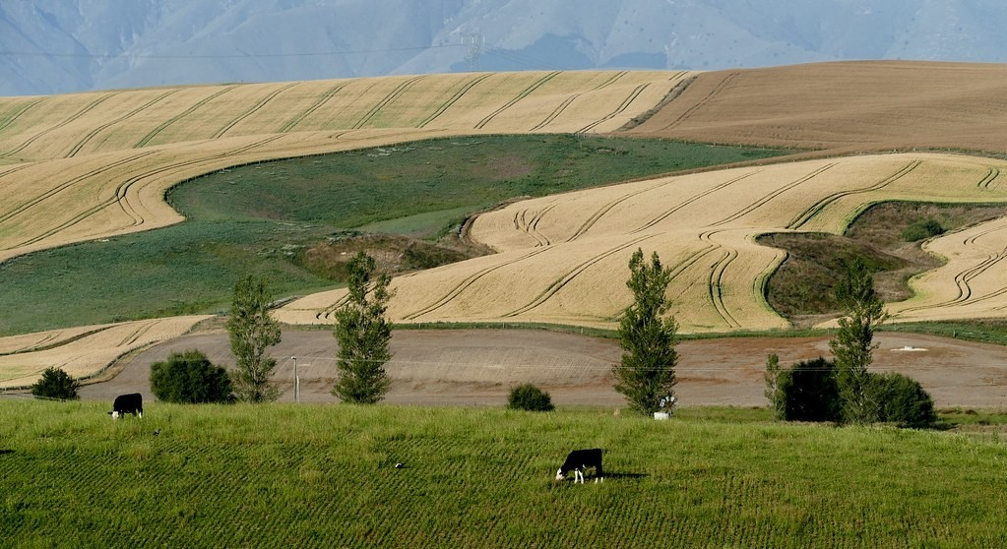
2. FARMSTEAD
Activity 2
A farmstead.
Notes:
Activity 2. Look carefully at this picture: a farmstead. Observe every detail before I ask the question.

Slide 22
2. FARMSTEAD
Activity 2: Question
What is a farmstead?
Notes:
Here is the question for Activity 2: What is a farmstead? Take one minute to think and write your answer in your rough notebook.

Slide 23
2. FARMSTEAD
Activity 2: Answer
An isolated farm house with its outbuildings.
Notes:
Let us check the answer together. An isolated farm house with its outbuildings.

Slide 24

2. HAMLET
Activity 3
Settlement hierarchy.
Notes:
Activity 3. Look carefully at this diagram: settlement hierarchy. Observe every detail before I ask the question.

Slide 25
2. HAMLET
Activity 3: Question
What is a hamlet?
Notes:
Here is the question for Activity 3: What is a hamlet? Take one minute to think and write your answer in your rough notebook.

Slide 26
2. HAMLET
Activity 3: Answer
A small group of houses with few or no services.
Notes:
Let us check the answer together. A small group of houses with few or no services.

Slide 27

2. VILLAGE
Activity 4
A village and farms.
Notes:
Activity 4. Look carefully at this picture: a village and farms. Observe every detail before I ask the question.

Slide 28
2. VILLAGE
Activity 4: Question
What is a village?
Notes:
Here is the question for Activity 4: What is a village? Take one minute to think and write your answer in your rough notebook.

Slide 29
2. VILLAGE
Activity 4: Answer
A larger rural settlement with some services such as a school, a market and a church or mosque.
Notes:
Let us check the answer together. A larger rural settlement with some services such as a school, a market and a church or mosque.

Slide 30

3. CHARACTERISTICS
Activity 5
A nomadic camp.
Notes:
Activity 5. Look carefully at this picture: a nomadic camp. Observe every detail before I ask the question.

Slide 31
3. CHARACTERISTICS
Activity 5: Question
Why do nomadic herders have temporary settlements?
Notes:
Here is the question for Activity 5: Why do nomadic herders have temporary settlements? Take one minute to think and write your answer in your rough notebook.

Slide 32
3. CHARACTERISTICS
Activity 5: Answer
They move with their animals in search of pasture and water.
Notes:
Let us check the answer together. They move with their animals in search of pasture and water.

Slide 33
BOARD SUMMARY
Board Summary
Topic: The Development of Settlements and their Implications
Sub-topic: Rural Settlements, their Morphology and Implications on the Environment
Lesson 43: Concept of Rural Settlement
Notes:
Now we are going to copy the board summary. Write the title and the headings neatly in your notebooks. I will give you enough time for each slide, so do not rush.

Slide 34
BOARD SUMMARY
DEFINITIONS
The key terms of this lesson are defined as follows:
Rural settlement: It is a settlement in the countryside where most people farm, fish or herd.
Notes:
Let us copy the definitions. The key terms of this lesson are defined as follows. On this slide we have Rural settlement. Write each point on a new line, with the key term first, and explain it in your own words when we revise.

Slide 35
BOARD SUMMARY
Types of Rural Settlements
The types of rural settlements are the following:
Farmstead: It is an isolated farm house with its stores and animal pens.
Hamlet: It is a small group of houses with few or no services.
Notes:
Let us copy Types of Rural Settlements. The types of rural settlements are the following. On this slide we have Farmstead and Hamlet. Write each point on a new line, with the key term first, and explain it in your own words when we revise. When you finish, we go to the next slide.

Slide 36
BOARD SUMMARY
Types of Rural Settlements (continued)
Village: It is a larger group of houses with a school, a market and a place of worship.
Temporary settlement: Nomadic herders build camps that they leave when they move.
Notes:
We continue with Types of Rural Settlements. On this slide we have Village and Temporary settlement. Write each point on a new line, with the key term first, and explain it in your own words when we revise.

Slide 37
BOARD SUMMARY
Types of Rural Settlements
Illustration: settlement hierarchy
Notes:
Now draw this illustration in your notebook: settlement hierarchy. Give it a title and label it clearly.

Slide 38
FORMATIVE EVALUATION
Evaluation 1
Define a hamlet.
Notes:
Now let us check what you have understood. Question 1: Define a hamlet. Answer in your exercise book.

Slide 39
FORMATIVE EVALUATION
Expected Answer
A small group of houses with few services.
Notes:
The expected answer is: a small group of houses with few services. If you got it right, well done.

Slide 40
FORMATIVE EVALUATION
Evaluation 2
Give two services found in a village.
Notes:
Now let us check what you have understood. Question 2: Give two services found in a village. Answer in your exercise book.

Slide 41
FORMATIVE EVALUATION
Expected Answer
A school and a market.
Notes:
The expected answer is: a school and a market. If you got it right, well done.

Slide 42
REMEDIATION
Remediation
Fill in the blanks:
An isolated farm house is a ______.
A small group of houses is a ______.
Nomads live in ______ settlements.
Notes:
For those who need more practice, fill in the blanks in your exercise book. The answers are: number 1, farmstead; number 2, hamlet; number 3, temporary.

Slide 43
HOMEWORK
Homework
Describe a village you know and list its services.
Notes:
For your homework: Describe a village you know and list its services. We shall correct it at the beginning of our next lesson.

Slide 44
NEXT LESSON
Next Lesson
Our next lesson will be on:
Lesson 44: Rural Settlement Form
Notes:
Our next lesson will be on Lesson 44: Rural Settlement Form. Thank you for your attention, and see you next time.

Slide 45
BILINGUAL GAME
Bilingual Game (Jeu Bilingue)
English | Français
Farmstead | La ferme isolée
Hamlet | Le hameau
Village | Le village
Chief | Le chef
Camp | Le campement
Countryside | La campagne
Notes:
Let us play the bilingual game. I say a word in English, and you give me the French word. Then we do the reverse.

Slide 46
LOGBOOK
Official Logbook (1/2)
Module / Topic | The Development of Settlements and their Implications
Lesson Title | Lesson 43: Concept of Rural Settlement
Expected Learning Outcomes | Define rural settlement. Identify the types of rural settlements. Give the characteristics of each type.
Competence | Learners are able to define rural settlement and identify its types.
Notes:
I record this information in the official logbook of the class after the lesson.

Slide 47
LOGBOOK
Official Logbook (2/2)
Matter Taught | DEFINITIONS; Types of Rural Settlements.
Evaluation | Formative evaluation and remediation exercise.
Homework | Describe a village you know and list its services.
Enrolment / Present / Absent | ____ / ____ / ____
Achievement | To be completed after the lesson.
Notes:
I complete the second page of the logbook: the matter taught, the evaluation, the homework and the attendance.

Slide 48
TEACHER'S NOTE
Teacher's Note
Timing: Homework correction, plan, objectives 8 min | Recall, situation, action 10 min | 5 activities 30 min | Board summary (copying) 30 min | Evaluation, remediation 10 min | Homework, next lesson 5 min | Logbook 7 min
Without the projector (Activity 1): describe.
Without the projector (Activity 2): define.
Without the projector (Activity 3): define.
Without the projector (Activity 4): define.
Without the projector (Activity 5): discuss.
Notes:
This slide is for me, the teacher: it gives the timing of the lesson and what to do if the projector is not available.

Slide 49
REFERENCES
References
Geography Syllabus, Forms I–V, MINESEC (2023) — Form 5, Module III: Management of Population Growth and Space Colonisation.
Photo, Activity 1: “Village built into the hillside” by 10b travelling / Carsten ten Brink, CC BY-NC-ND 2.0, via Flickr (https://www.flickr.com/photos/77334245@N00/5677301357)
Photo, Activity 2: “Wheat fields. New Zealand.” by Bernard Spragg, CC0 1.0, via Flickr (https://www.flickr.com/photos/88123769@N02/24607172362)
Photo, Activity 4: “Cameroon - UN Women's Gender Road Project” by UN Women Gallery, CC BY-NC-ND 2.0, via Flickr (https://www.flickr.com/photos/51431730@N04/46914753474)
Photo, Activity 5: “A roadside stop for souvenirs & exploring dry wells, Northern Sahara, ” by ali eminov, CC BY-NC 2.0, via Flickr (https://www.flickr.com/photos/27435717@N00/3437516165)
Diagrams and animations: drawn for this lesson (Geography Department).
Notes:
These are the references and picture credits used to prepare this lesson.

