Slide 1
FORM 2
GEOGRAPHY
Lesson 6
Country Sides in Africa
Notes:
Good morning, class, and welcome to our geography lesson. I am your geography teacher, Mr Kamdem. Today we are starting Lesson 6: Country Sides in Africa.

Slide 2
CLASS INFO
Class, Chapter and Duration
Class | Form 2
Chapter | Module 2: Space Occupation
Duration | 2 periods (2 × 50 minutes)
Notes:
This lesson is for Form 2. It belongs to Module 2: Space Occupation. We shall need 2 periods to cover it.

Slide 3
IDENTIFICATION
Lesson Identification
Topic | Space Occupation
Sub-topic | Country Sides and Towns of Africa
Lesson | Lesson 6: Country Sides in Africa
Notions / Concepts | Rural landscape, agricultural landscape, rural settlement, land.
Syllabus focus | Agricultural landscape; rural settlements; attractive and repulsive aspects of rural areas (emphasis on the attractive aspects).
Competence | Learners are able to describe rural areas of Africa and appreciate their attractive aspects.
Notes:
Our topic is Space Occupation, and the sub-topic is Country Sides and Towns of Africa. The key notions we shall use today are: rural landscape, agricultural landscape, rural settlement, land. At the end, you should be able to do this: learners are able to describe rural areas of Africa and appreciate their attractive aspects.

Slide 4

HOMEWORK CORRECTION
Correction of the Homework
Question (Further Study 4: Water Scarcity):
Carry out a small enquiry: ask three families where they get water and what problems they have.
Notes:
Before we start the new lesson, let us correct the homework I gave you at the end of Further Study 4: Water Scarcity. The question was: Carry out a small enquiry: ask three families where they get water and what problems they have. Take out your exercise books.

Slide 5
HOMEWORK CORRECTION
Correction: Possible Answer
Answers vary. Typical results: tap water that runs irregularly, buying water from sellers, wells that dry up in the dry season, and fear of dirty water.
Notes:
Here is a good answer. Answers vary. Typical results: tap water that runs irregularly, buying water from sellers, wells that dry up in the dry season, and fear of dirty water. Compare it with your own answer and correct your work in red.

Slide 6
LESSON PLAN
Lesson Plan
Correction of the homework
Objectives and recall
Real-life situation and action to take
Learning activities
Board summary
Evaluation, remediation and homework
Notes:
Here is the plan of our lesson today. First, we shall correct the homework. Then we shall look at the objectives and recall what you already know. After that, we shall study a situation from real life and the action to take, and do the learning activities. Finally, we shall copy the board summary, do the evaluation and the remediation, and I will give you the homework.

Slide 7
OBJECTIVES
Objectives
By the end of this lesson, you should be able to:
Describe the agricultural landscape of African country sides.
Describe the building materials, types, forms and patterns of rural settlements.
Notes:
Take your time to copy this part; we will continue together.

Slide 8
OBJECTIVES
Objectives (continued)
Identify the attractive and repulsive aspects of rural areas.
Notes:
By the end of this lesson, you should be able to do three things. Number 1: describe the agricultural landscape of African country sides. Number 2: describe the building materials, types, forms and patterns of rural settlements. Number 3: identify the attractive and repulsive aspects of rural areas.

Slide 9
PREVIOUS KNOWLEDGE
Previous Knowledge
Most Africans live in villages.
Villagers are mostly farmers.
Villages have fewer services than towns.
Notes:
Let us first remember what you already know. Most Africans live in villages. Villagers are mostly farmers. Villages have fewer services than towns. Keep this in mind, because we shall build on it today.

Slide 10
REAL-LIFE SITUATION
Situation in Real Life
Awa's cousin in Yaoundé says that village life is boring and poor.
Awa, who lives in a village near Guider, answers that the village has fresh food, clean air and solidarity.
"
Notes:
Listen carefully to this situation from real life. Awa's cousin in Yaoundé says that village life is boring and poor. Awa, who lives in a village near Guider, answers that the village has fresh food, clean air and solidarity. Their teacher asks the class: "Who is right: is the country side only a place of problems, or does it also have good sides?" Think about it, because I am going to ask you some questions.

Slide 11
REAL-LIFE SITUATION
Situation: Question 1
What is the problem in the situation?
Notes:
Question 1: What is the problem in the situation? Think for a moment, then raise your hand to answer.

Slide 12
REAL-LIFE SITUATION
Answer
The two girls disagree: we must find out whether the country side has only problems or also attractive aspects.
Notes:
Good. The two girls disagree: we must find out whether the country side has only problems or also attractive aspects.

Slide 13
REAL-LIFE SITUATION
Situation: Question 2
Give one negative view of the village.
Notes:
Question 2: Give one negative view of the village. Think for a moment, then raise your hand to answer.

Slide 14
REAL-LIFE SITUATION
Answer
It is boring and poor.
Notes:
Good. It is boring and poor.

Slide 15
REAL-LIFE SITUATION
Situation: Question 3
Give two attractive aspects of the village.
Notes:
Question 3: Give two attractive aspects of the village. Think for a moment, then raise your hand to answer.

Slide 16
REAL-LIFE SITUATION
Possible Answer
Fresh food and solidarity (also clean air).
Notes:
Good. Fresh food and solidarity (also clean air).

Slide 17
ACTION TO TAKE
Action to Take
Value village life and contribute to the development of your village.
Notes:
From this situation, the action we are working towards in this lesson is the following: value village life and contribute to the development of your village.

Slide 18
JUSTIFICATION
Justification of the Lesson
This lesson helps us to know and appreciate the country sides of Africa.
Notes:
Why is this lesson important for you? This lesson helps us to know and appreciate the country sides of Africa.

Slide 19

1. AGRICULTURAL LANDSCAPE
Activity 1
A cotton field near Garoua.
Notes:
Activity 1. Look carefully at this picture: a cotton field near Garoua. Observe every detail before I ask the question.

Slide 20
1. AGRICULTURAL LANDSCAPE
Activity 1: Question
What covers most of the land in this rural landscape?
Notes:
Here is the question for Activity 1: What covers most of the land in this rural landscape? Take one minute to think and write your answer in your rough notebook.

Slide 21
1. AGRICULTURAL LANDSCAPE
Activity 1: Answer
Fields of crops: here, cotton.
Notes:
Let us check the answer together. Fields of crops: here, cotton.

Slide 22

2. RURAL SETTLEMENTS
Activity 2
A village of round huts.
Notes:
Activity 2. Look carefully at this picture: a village of round huts. Observe every detail before I ask the question.

Slide 23
2. RURAL SETTLEMENTS
Activity 2: Question 1
What shape are the houses of this village?
Notes:
Here is the question for Activity 2: What shape are the houses of this village? Take one minute to think and write your answer in your rough notebook.

Slide 24
2. RURAL SETTLEMENTS
Activity 2: Answer 1
They are round huts.
Notes:
Let us check the answer together. They are round huts.

Slide 25
2. RURAL SETTLEMENTS
Activity 2: Question 2
With what materials are they built?
Notes:
Here is the next question: With what materials are they built? Take one minute to think and write your answer in your rough notebook.

Slide 26
2. RURAL SETTLEMENTS
Activity 2: Answer 2
Mud walls and grass (thatched) roofs.
Notes:
Let us check the answer together. Mud walls and grass (thatched) roofs.

Slide 27

2. RURAL SETTLEMENTS
Activity 3
Patterns of rural settlements.
Notes:
Activity 3. Look carefully at this diagram: patterns of rural settlements. Observe every detail before I ask the question.

Slide 28
2. RURAL SETTLEMENTS
Activity 3: Question
In which pattern are the houses grouped closely together?
Notes:
Here is the question for Activity 3: In which pattern are the houses grouped closely together? Take one minute to think and write your answer in your rough notebook.

Slide 29
2. RURAL SETTLEMENTS
Activity 3: Answer
The nucleated (grouped) pattern.
Notes:
Let us check the answer together. The nucleated (grouped) pattern.

Slide 30

3. ATTRACTIVE ASPECTS
Activity 4
A chiefdom in the West of Cameroon.
Notes:
Activity 4. Look carefully at this picture: a chiefdom in the West of Cameroon. Observe every detail before I ask the question.

Slide 31
3. ATTRACTIVE ASPECTS
Activity 4: Question
What can attract a town dweller to a village like this?
Notes:
Here is the question for Activity 4: What can attract a town dweller to a village like this? Take one minute to think and write your answer in your rough notebook.

Slide 32
3. ATTRACTIVE ASPECTS
Activity 4: Answer
Its traditions and culture, its calm life, fresh food and solidarity.
Notes:
Let us check the answer together. Its traditions and culture, its calm life, fresh food and solidarity.

Slide 33

3. REPULSIVE ASPECTS
Activity 5
A bad rural road.
Notes:
Activity 5. Look carefully at this picture: a bad rural road. Observe every detail before I ask the question.

Slide 34
3. REPULSIVE ASPECTS
Activity 5: Question
Why does this road push young people away from the village?
Notes:
Here is the question for Activity 5: Why does this road push young people away from the village? Take one minute to think and write your answer in your rough notebook.

Slide 35
3. REPULSIVE ASPECTS
Activity 5: Answer
It makes travel and trade difficult; villages also lack jobs, hospitals and electricity.
Notes:
Let us check the answer together. It makes travel and trade difficult; villages also lack jobs, hospitals and electricity.

Slide 36
BOARD SUMMARY
Board Summary
Topic: Space Occupation
Sub-topic: Country Sides and Towns of Africa
Lesson 6: Country Sides in Africa
Notes:
Now we are going to copy the board summary. Write the title and the headings neatly in your notebooks. I will give you enough time for each slide, so do not rush.

Slide 37
BOARD SUMMARY
DEFINITIONS
The key terms of this lesson are defined as follows:
Country side: It is the rural area outside towns, where most people live from farming, herding or fishing.
Notes:
Let us copy the definitions. The key terms of this lesson are defined as follows. On this slide we have Country side. Write each point on a new line, with the key term first, and explain it in your own words when we revise. When you finish, we go to the next slide.

Slide 38
BOARD SUMMARY
DEFINITIONS (continued)
Rural landscape: It is the appearance of the country side, made of fields, pastures, bush and villages.
Rural settlement: It is a group of dwellings in the country side, such as a village or a hamlet.
Notes:
We continue with the definitions. On this slide we have Rural landscape and Rural settlement. Write each point on a new line, with the key term first, and explain it in your own words when we revise.

Slide 39
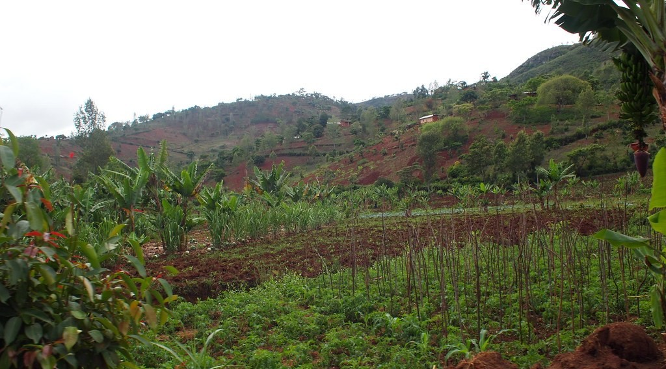
BOARD SUMMARY
1. The Agricultural Landscape
The agricultural landscape of African country sides is made of the following elements:
Food crop fields: Fields of maize, millet, sorghum, cassava and groundnuts surround the villages.
Illustration: a cassava farm
Notes:
Let us copy The Agricultural Landscape. The agricultural landscape of African country sides is made of the following elements. Copy the point on Food crop fields on the left, then draw the diagram on the right: a cassava farm. Give it a title and label it clearly.

Slide 40
BOARD SUMMARY
1. The Agricultural Landscape
Cash crop fields and plantations: Cotton, cocoa, coffee and oil palm are grown for sale, on small farms or on large plantations.
Illustration: a cotton field
Notes:
Copy the point on Cash crop fields and plantations on the left, then draw the diagram on the right: a cotton field. Give it a title and label it clearly.

Slide 41

BOARD SUMMARY
1. The Agricultural Landscape
Pastures: Herders graze cattle, sheep and goats on grassland, especially in the savanna.
Illustration: herders and cattle
Notes:
Copy the point on Pastures on the left, then draw the diagram on the right: herders and cattle. Give it a title and label it clearly.

Slide 42
BOARD SUMMARY
1. The Agricultural Landscape
Fallow land and bush: Some land is left to rest to recover its fertility, and bush and forest remain between the fields.
Open and enclosed fields: In the savanna, fields are usually open, while in the Western Highlands they are often enclosed by hedges.
Notes:
We continue with The Agricultural Landscape. On this slide we have Fallow land and bush and Open and enclosed fields. Write each point on a new line, with the key term first, and explain it in your own words when we revise.

Slide 43
BOARD SUMMARY
2. Rural Settlements
A) Building Materials
Rural houses are built with the following local materials:
Mud (earth): Mud or mud bricks are used for the walls of most rural houses.
Illustration: mud huts with grass roofs
Notes:
Let us copy Building Materials. Rural houses are built with the following local materials. Copy the point on Mud (earth) on the left, then draw the diagram on the right: mud huts with grass roofs. Give it a title and label it clearly.

Slide 44
BOARD SUMMARY
2. Rural Settlements
A) Building Materials
Grass (thatch): Dry grass is used for roofs, especially in the savanna.
Wood, bamboo and raffia: They are used for walls and roofs in forest areas.
Stone: Stones are used for walls in mountain areas such as the Mandara Mountains.
Notes:
We continue with Building Materials. On this slide we have Grass (thatch), Wood, bamboo and raffia and Stone. Write each point on a new line, with the key term first, and explain it in your own words when we revise. When you finish, we go to the next slide.

Slide 45
BOARD SUMMARY
2. Rural Settlements
A) Building Materials (continued)
Modern materials: Cement blocks and zinc sheets are more and more used in villages.
Notes:
We continue with Building Materials. On this slide we have Modern materials. Write each point on a new line, with the key term first, and explain it in your own words when we revise.

Slide 46
BOARD SUMMARY
2. Rural Settlements
B) Types of Rural Dwellings
The main types of rural dwellings are the following:
Round huts: They have a circular mud wall and a conical grass roof, as in the North of Cameroon.
Notes:
Let us copy Types of Rural Dwellings. The main types of rural dwellings are the following. On this slide we have Round huts. Write each point on a new line, with the key term first, and explain it in your own words when we revise. When you finish, we go to the next slide.

Slide 47
BOARD SUMMARY
2. Rural Settlements
B) Types of Rural Dwellings (continued)
Rectangular houses: They have straight walls and a roof of thatch or zinc, as in the forest South.
Compounds (saré): Several huts of one family are grouped inside a fence or wall.
Notes:
We continue with Types of Rural Dwellings. On this slide we have Rectangular houses and Compounds (saré). Write each point on a new line, with the key term first, and explain it in your own words when we revise.

Slide 48
BOARD SUMMARY
2. Rural Settlements
B) Types of Rural Dwellings
Square houses with high roofs: They are typical of the chiefdoms of the Western Highlands.
Illustration: a chiefdom of the West
Notes:
Copy the point on Square houses with high roofs on the left, then draw the diagram on the right: a chiefdom of the West. Give it a title and label it clearly.

Slide 49
BOARD SUMMARY
2. Rural Settlements
C) Patterns of Rural Settlements
Rural settlements are spread over the land in the following patterns:
Nucleated (grouped) pattern: The houses are grouped closely together, often around a chief's compound, a water point or a market.
Illustration: patterns of rural settlements
Notes:
Let us copy Patterns of Rural Settlements. Rural settlements are spread over the land in the following patterns. Copy the point on Nucleated (grouped) pattern on the left, then draw the diagram on the right: patterns of rural settlements. Give it a title and label it clearly.

Slide 50
BOARD SUMMARY
2. Rural Settlements
C) Patterns of Rural Settlements
Dispersed (scattered) pattern: The houses are far from one another, each one on its farm.
Linear pattern: The houses are built in a line along a road, a river or a valley.
Notes:
We continue with Patterns of Rural Settlements. On this slide we have Dispersed (scattered) pattern and Linear pattern. Write each point on a new line, with the key term first, and explain it in your own words when we revise. When you finish, we go to the next slide.

Slide 51
BOARD SUMMARY
2. Rural Settlements
C) Patterns of Rural Settlements (continued)
Regular (planned) pattern: The houses are placed at equal distances, as in planned villages.
Notes:
We continue with Patterns of Rural Settlements. On this slide we have Regular (planned) pattern. Write each point on a new line, with the key term first, and explain it in your own words when we revise.

Slide 52
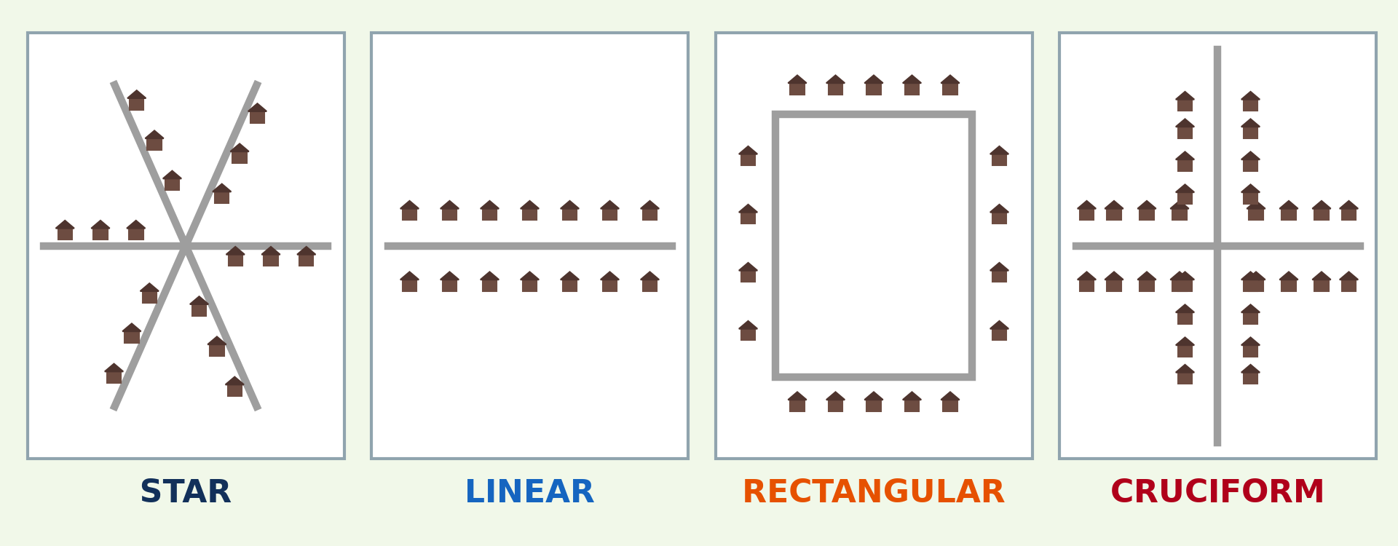
BOARD SUMMARY
2. Rural Settlements
D) Forms of Rural Settlements
The main forms of rural settlements are the following:
Star form: The houses spread along several roads that meet at one point.
Illustration: forms of rural settlements
Notes:
Let us copy Forms of Rural Settlements. The main forms of rural settlements are the following. Copy the point on Star form on the left, then draw the diagram on the right: forms of rural settlements. Give it a title and label it clearly.

Slide 53
BOARD SUMMARY
2. Rural Settlements
D) Forms of Rural Settlements
Linear form: The houses form one line along a single road.
Rectangular form: The houses are built around a square or an open space.
Cruciform form: The houses are built along two roads that cross each other.
Notes:
We continue with Forms of Rural Settlements. On this slide we have Linear form, Rectangular form and Cruciform form. Write each point on a new line, with the key term first, and explain it in your own words when we revise.

Slide 54

BOARD SUMMARY
3. Attractive and Repulsive Aspects
A) Attractive Aspects
Rural areas attract people for the following reasons:
Fresh and cheap food: Food comes directly from the farms and costs little.
Illustration: a rural market
Notes:
Let us copy Attractive Aspects. Rural areas attract people for the following reasons. Copy the point on Fresh and cheap food on the left, then draw the diagram on the right: a rural market. Give it a title and label it clearly.

Slide 55
BOARD SUMMARY
3. Attractive and Repulsive Aspects
A) Attractive Aspects
Clean air and a calm life: There is little noise, pollution and traffic.
Solidarity: People know one another and help one another at work, in sickness and at funerals.
Notes:
We continue with Attractive Aspects. On this slide we have Clean air and a calm life and Solidarity. Write each point on a new line, with the key term first, and explain it in your own words when we revise.

Slide 56
BOARD SUMMARY
3. Attractive and Repulsive Aspects
A) Attractive Aspects
Traditions and culture: Chiefdoms, festivals, dances and crafts keep culture alive.
Illustration: a traditional chiefdom
Notes:
Copy the point on Traditions and culture on the left, then draw the diagram on the right: a traditional chiefdom. Give it a title and label it clearly.

Slide 57
BOARD SUMMARY
3. Attractive and Repulsive Aspects
A) Attractive Aspects
Available land: Land is available for farming, herding and building a house.
Notes:
We continue with Attractive Aspects. On this slide we have Available land. Write each point on a new line, with the key term first, and explain it in your own words when we revise.

Slide 58
BOARD SUMMARY
3. Attractive and Repulsive Aspects
B) Repulsive Aspects
Rural areas push people away for the following reasons:
Bad roads: Many roads are muddy in the rainy season, so travel and trade are difficult.
Illustration: a bad rural road
Notes:
Let us copy Repulsive Aspects. Rural areas push people away for the following reasons. Copy the point on Bad roads on the left, then draw the diagram on the right: a bad rural road. Give it a title and label it clearly.

Slide 59
BOARD SUMMARY
3. Attractive and Repulsive Aspects
B) Repulsive Aspects
Lack of social amenities: Hospitals, schools, electricity and pipe-borne water are scarce.
Unemployment and poverty: There are few paid jobs apart from farming, and incomes are low.
Notes:
We continue with Repulsive Aspects. On this slide we have Lack of social amenities and Unemployment and poverty. Write each point on a new line, with the key term first, and explain it in your own words when we revise. When you finish, we go to the next slide.

Slide 60
BOARD SUMMARY
3. Attractive and Repulsive Aspects
B) Repulsive Aspects (continued)
Hard work: Farming with hoes and cutlasses is tiring and gives low yields.
Notes:
We continue with Repulsive Aspects. On this slide we have Hard work. Write each point on a new line, with the key term first, and explain it in your own words when we revise.

Slide 61
FORMATIVE EVALUATION
Evaluation 1
Name three patterns of rural settlements.
Notes:
Now let us check what you have understood. Question 1: Name three patterns of rural settlements. Answer in your exercise book.

Slide 62
FORMATIVE EVALUATION
Expected Answer
Nucleated, dispersed and linear (also regular).
Notes:
The expected answer is: nucleated, dispersed and linear (also regular). If you got it right, well done.

Slide 63
FORMATIVE EVALUATION
Evaluation 2
Give two attractive aspects of rural areas.
Notes:
Now let us check what you have understood. Question 2: Give two attractive aspects of rural areas. Answer in your exercise book.

Slide 64
FORMATIVE EVALUATION
Expected Answer
Fresh food and solidarity.
Notes:
The expected answer is: fresh food and solidarity. If you got it right, well done.

Slide 65
REMEDIATION
Remediation
Fill in the blanks:
Houses grouped together form a ______ settlement.
Houses along a road form a ______ settlement.
Notes:
Take your time to copy this part; we will continue together.

Slide 66
REMEDIATION
Remediation (continued)
The roof of a round hut is often made of ______.
Notes:
For those who need more practice, fill in the blanks in your exercise book. The answers are: number 1, nucleated; number 2, linear; number 3, grass (thatch).

Slide 67
HOMEWORK
Homework
Describe your village or a village you know: its fields, its houses and two attractive aspects.
Notes:
For your homework: Describe your village or a village you know: its fields, its houses and two attractive aspects. We shall correct it at the beginning of our next lesson.

Slide 68
NEXT LESSON
Next Lesson
Our next lesson will be on:
Lesson 7: Towns in Africa
Notes:
Our next lesson will be on Lesson 7: Towns in Africa. Thank you for your attention, and see you next time.

Slide 69
BILINGUAL GAME
Bilingual Game (Jeu Bilingue)
English | Français
Village | Le village
Countryside | La campagne
Farmer | L'agriculteur
Hut | La case
Field | Le champ
Solidarity | La solidarité
Notes:
Let us play the bilingual game. I say a word in English, and you give me the French word. Then we do the reverse.

Slide 70
LOGBOOK
Official Logbook (1/2)
Module / Topic | Space Occupation
Lesson Title | Lesson 6: Country Sides in Africa
Expected Learning Outcomes | Describe the agricultural landscape of African country sides. Describe the building materials, types, forms and patterns of rural settlements. Identify the attractive and repulsive aspects of rural areas.
Competence | Learners are able to describe rural areas of Africa and appreciate their attractive aspects.
Notes:
I record this information in the official logbook of the class after the lesson.

Slide 71
LOGBOOK
Official Logbook (2/2)
Matter Taught | DEFINITIONS; The Agricultural Landscape; Building Materials; Types of Rural Dwellings; Patterns of Rural Settlements; Forms of Rural Settlements; Attractive Aspects; Repulsive Aspects.
Evaluation | Formative evaluation and remediation exercise.
Homework | Describe your village or a village you know: its fields, its houses and two attractive aspects.
Enrolment / Present / Absent | ____ / ____ / ____
Achievement | To be completed after the lesson.
Notes:
I complete the second page of the logbook: the matter taught, the evaluation, the homework and the attendance.

Slide 72
TEACHER'S NOTE
Teacher's Note
Timing: Homework correction, plan, objectives 8 min | Recall, situation, action 10 min | 5 activities 30 min | Board summary (copying) 30 min | Evaluation, remediation 10 min | Homework, next lesson 5 min | Logbook 7 min
Without the projector (Activity 1): describe farms around the village.
Without the projector (Activity 2): describe houses in your village.
Without the projector (Activity 3): draw the patterns on the board.
Without the projector (Activity 4): list what learners like in villages.
Without the projector (Activity 5): discuss problems of villages.
Notes:
This slide is for me, the teacher: it gives the timing of the lesson and what to do if the projector is not available.

Slide 73
REFERENCES
References
Geography Syllabus, Forms I–V, MINESEC (2023) — Form 2, Module 2: Space Occupation.
Photo, Activity 1: “Cotton Fields, U.S. 65, Tensas Parish, Louisiana (4)” by Ken Lund, CC BY-SA 2.0, via Flickr (https://www.flickr.com/photos/75683070@N00/3934873451)
Photo, Activity 2: “Village built into the hillside” by 10b travelling / Carsten ten Brink, CC BY-NC-ND 2.0, via Flickr (https://www.flickr.com/photos/77334245@N00/5677301357)
Photo, Activity 4: “Bandjoun's chefferie: I - the approach past the royal quarters” by 10b travelling / Carsten ten Brink, CC BY-NC-ND 2.0, via Flickr (https://www.flickr.com/photos/77334245@N00/7326237514)
Photo, Activity 5: “Cameroon - UN Women's Gender Road Project” by UN Women Gallery, CC BY-NC-ND 2.0, via Flickr (https://www.flickr.com/photos/51431730@N04/40672356003)
Photo, board summary (Food crop fields): “Workshop in Lushoto, Tanzania” by CGIAR Climate, CC BY-NC-SA 2.0, via Flickr (https://www.flickr.com/photos/55227776@N04/8551480688)
Photo, board summary (Pastures): “Young cattle herders in Sénégal (West Africa)” by gbaku, CC BY-SA 2.0, via Flickr (https://www.flickr.com/photos/72105154@N00/525185172)
Notes:
Take your time to copy this part; we will continue together.

Slide 74
REFERENCES
References (continued)
Photo, board summary (Fresh and cheap food): “Sandga Market in Douala, Cameroon” by The Advocacy Project, CC BY-NC-SA 2.0, via Flickr (https://www.flickr.com/photos/42487558@N00/3636438732)
Diagrams and animations: drawn for this lesson (Geography Department).
Notes:
These are the references and picture credits used to prepare this lesson.

