Slide 1
FORM 1
GEOGRAPHY
Practical Work 5
Solid Waste Management
Notes:
Good morning, class, and welcome to our geography lesson. I am your geography teacher, Mr Kamdem. Today we are starting Practical Work 5: Solid Waste Management.

Slide 2
CLASS INFO
Class, Chapter and Duration
Class | Form 1
Chapter | Module 2: Preservation of the Environment
Duration | 2 periods (2 × 50 minutes)
Notes:
This lesson is for Form 1. It belongs to Module 2: Preservation of the Environment. We shall need 2 periods to cover it.

Slide 3
IDENTIFICATION
Lesson Identification
Topic | Let's Preserve our Environment
Sub-topic | Natural Regions (Bio-climatic Zones) and their Degradation
Lesson | Practical Work 5: Solid Waste Management
Notions / Concepts | Waste, biodegradable, non-biodegradable, compost, recycling, disposal.
Syllabus focus | Theoretical basis: recall and define waste, types and sources. Practical exercise (within the school environment): collect waste around the school campus; sort it into biodegradable and non-biodegradable; dispose of it at the indicated sites (compost; burning of papers; recycling or burying of plastics, glass and metals).
Competence | Learners are able to collect, sort and dispose of solid waste correctly.
Notes:
Our topic is Let's Preserve our Environment, and the sub-topic is Natural Regions (Bio-climatic Zones) and their Degradation. The key notions we shall use today are: waste, biodegradable, non-biodegradable, compost, recycling, disposal. At the end, you should be able to do this: learners are able to collect, sort and dispose of solid waste correctly.

Slide 4

HOMEWORK CORRECTION
Correction of the Homework
Question (Guided Work 1: Degradation of the Natural Environment of the School):
Write a short report (five lines) on the damage you observed around the school and your solutions.
Notes:
Before we start the new lesson, let us correct the homework I gave you at the end of Guided Work 1: Degradation of the Natural Environment of the School. The question was: Write a short report (five lines) on the damage you observed around the school and your solutions. Take out your exercise books.

Slide 5
HOMEWORK CORRECTION
Correction: Possible Answer
A good report names each damaged place, describes the damage, gives its cause and proposes a solution, for example: "Behind the classrooms there is rubbish; students throw it there; we need dustbins."
Notes:
Here is a good answer. A good report names each damaged place, describes the damage, gives its cause and proposes a solution, for example: "Behind the classrooms there is rubbish; students throw it there; we need dustbins.". Compare it with your own answer and correct your work in red.

Slide 6
LESSON PLAN
Lesson Plan
Correction of the homework
Objectives and recall
Real-life situation and action to take
Learning activities
Board summary
Evaluation, remediation and homework
Notes:
Here is the plan of our lesson today. First, we shall correct the homework. Then we shall look at the objectives and recall what you already know. After that, we shall study a situation from real life and the action to take, and do the learning activities. Finally, we shall copy the board summary, do the evaluation and the remediation, and I will give you the homework.

Slide 7
OBJECTIVES
Objectives
By the end of this lesson, you should be able to:
Define waste and give its types and sources.
Sort waste into biodegradable and non-biodegradable.
Notes:
Take your time to copy this part; we will continue together.

Slide 8
OBJECTIVES
Objectives (continued)
Dispose of each type of waste at the right site.
Notes:
By the end of this lesson, you should be able to do three things. Number 1: define waste and give its types and sources. Number 2: sort waste into biodegradable and non-biodegradable. Number 3: dispose of each type of waste at the right site.

Slide 9
PREVIOUS KNOWLEDGE
Previous Knowledge
Rubbish pollutes the environment.
Pollution causes diseases.
Dustbins help to keep places clean.
Notes:
Let us first remember what you already know. Rubbish pollutes the environment. Pollution causes diseases. Dustbins help to keep places clean. Keep this in mind, because we shall build on it today.

Slide 10
REAL-LIFE SITUATION
Situation in Real Life
After break time, the school yard is full of plastic sachets, paper, bottles and food remains. The teacher asks the class to clean the yard. Aïssatou asks: "Should we put everything in the same hole, or is there a better way to get rid of each type of waste?"
Notes:
Listen carefully to this situation from real life. After break time, the school yard is full of plastic sachets, paper, bottles and food remains. The teacher asks the class to clean the yard. Aïssatou asks: "Should we put everything in the same hole, or is there a better way to get rid of each type of waste?" Think about it, because I am going to ask you some questions.

Slide 11
REAL-LIFE SITUATION
Situation: Question 1
What is the problem in the situation?
Notes:
Question 1: What is the problem in the situation? Think for a moment, then raise your hand to answer.

Slide 12
REAL-LIFE SITUATION
Answer
The class does not know how to get rid of each type of waste correctly.
Notes:
Good. The class does not know how to get rid of each type of waste correctly.

Slide 13
REAL-LIFE SITUATION
Situation: Question 2
Name two types of waste in the yard.
Notes:
Question 2: Name two types of waste in the yard. Think for a moment, then raise your hand to answer.

Slide 14
REAL-LIFE SITUATION
Answer
Plastic sachets and food remains (also paper and bottles).
Notes:
Good. Plastic sachets and food remains (also paper and bottles).

Slide 15
REAL-LIFE SITUATION
Situation: Question 3
Should all the waste go to the same place?
Notes:
Question 3: Should all the waste go to the same place? Think for a moment, then raise your hand to answer.

Slide 16
REAL-LIFE SITUATION
Possible Answer
No, it must be sorted.
Notes:
Good. No, it must be sorted.

Slide 17
ACTION TO TAKE
Action to Take
Sort your waste: food remains for compost, plastics and metals for recycling.
Notes:
From this situation, the action we are working towards in this lesson is the following: sort your waste: food remains for compost, plastics and metals for recycling.

Slide 18
JUSTIFICATION
Justification of the Lesson
This practical work helps us to manage waste and keep our environment clean and healthy.
Notes:
Why is this lesson important for you? This practical work helps us to manage waste and keep our environment clean and healthy.

Slide 19
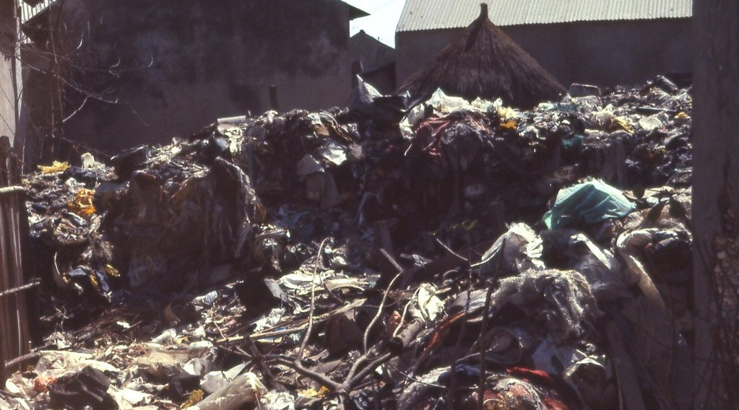
1. MEANING AND SOURCES
Activity 1
A rubbish dump.
Notes:
Activity 1. Look carefully at this picture: a rubbish dump. Observe every detail before I ask the question.

Slide 20
1. MEANING AND SOURCES
Activity 1: Question
Where does all this waste come from?
Notes:
Here is the question for Activity 1: Where does all this waste come from? Take one minute to think and write your answer in your rough notebook.

Slide 21
1. MEANING AND SOURCES
Activity 1: Answer
From homes, markets, schools and factories.
Notes:
Let us check the answer together. From homes, markets, schools and factories.

Slide 22
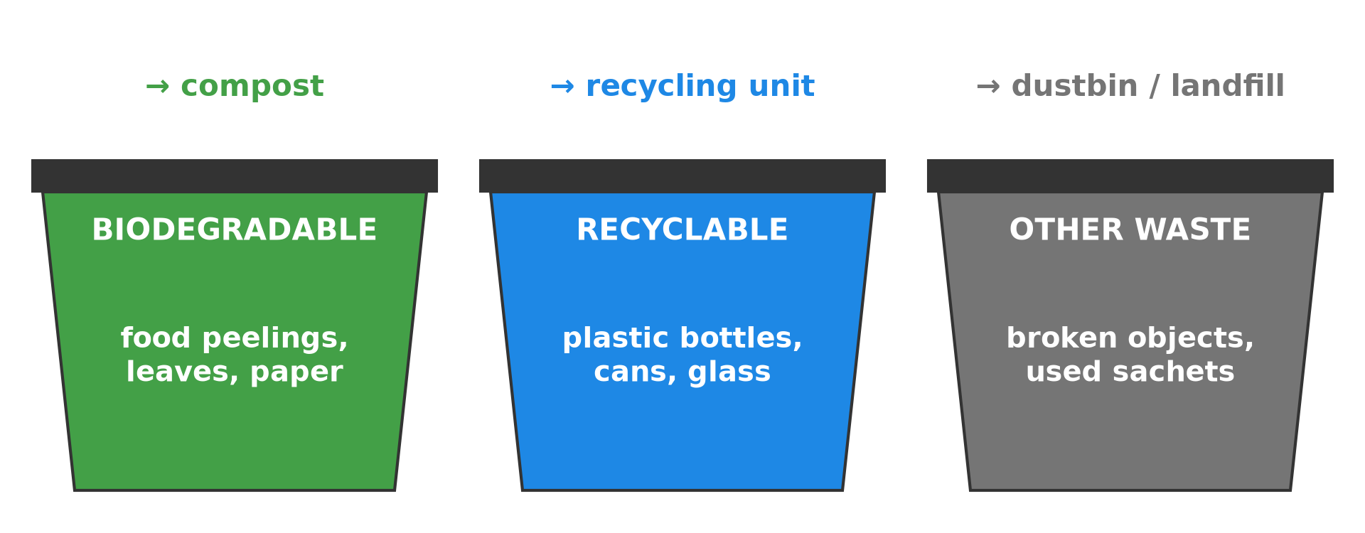
2. TYPES OF WASTE
Activity 2
Two groups of waste.
Notes:
Activity 2. Look carefully at this diagram: two groups of waste. Observe every detail before I ask the question.

Slide 23
2. TYPES OF WASTE
Activity 2: Question
Which of these wastes rot naturally?
Notes:
Here is the question for Activity 2: Which of these wastes rot naturally? Take one minute to think and write your answer in your rough notebook.

Slide 24
2. TYPES OF WASTE
Activity 2: Answer
Food remains, leaves and paper: they are biodegradable.
Notes:
Let us check the answer together. Food remains, leaves and paper: they are biodegradable.

Slide 25
2. TYPES OF WASTE
Activity 3
Two groups of waste.
Notes:
Activity 3. Look carefully at this diagram: two groups of waste. Observe every detail before I ask the question.

Slide 26
2. TYPES OF WASTE
Activity 3: Question
Which wastes do not rot easily?
Notes:
Here is the question for Activity 3: Which wastes do not rot easily? Take one minute to think and write your answer in your rough notebook.

Slide 27
2. TYPES OF WASTE
Activity 3: Answer
Plastics, glass and metals: they are non-biodegradable.
Notes:
Let us check the answer together. Plastics, glass and metals: they are non-biodegradable.

Slide 28
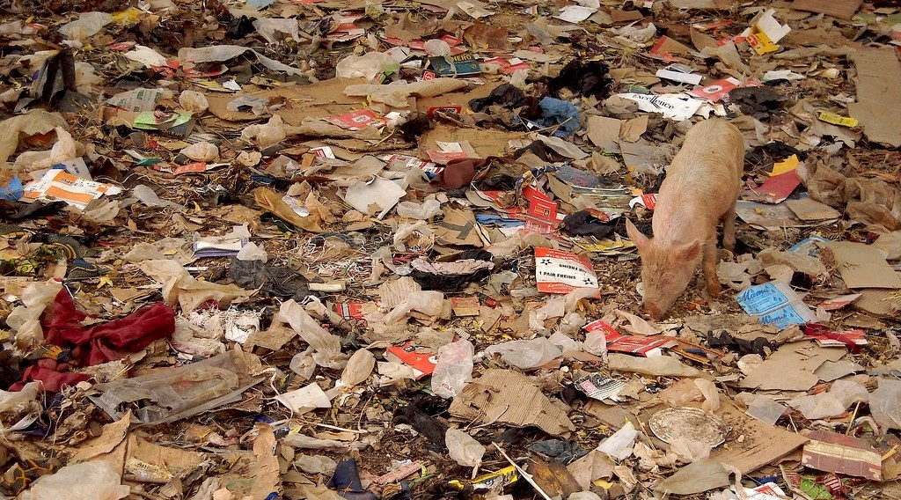
3. COLLECTION
Activity 4
Litter on the ground.
Notes:
Activity 4. Look carefully at this picture: litter on the ground. Observe every detail before I ask the question.

Slide 29
3. COLLECTION
Activity 4: Question
What must we use when we collect waste?
Notes:
Here is the question for Activity 4: What must we use when we collect waste? Take one minute to think and write your answer in your rough notebook.

Slide 30
3. COLLECTION
Activity 4: Answer
Gloves or plastic bags and bins, and we wash our hands after.
Notes:
Let us check the answer together. Gloves or plastic bags and bins, and we wash our hands after.

Slide 31

4. DISPOSAL
Activity 5
A farm.
Notes:
Activity 5. Look carefully at this picture: a farm. Observe every detail before I ask the question.

Slide 32
4. DISPOSAL
Activity 5: Question
How can food remains help this farmer?
Notes:
Here is the question for Activity 5: How can food remains help this farmer? Take one minute to think and write your answer in your rough notebook.

Slide 33
4. DISPOSAL
Activity 5: Answer
They can be turned into compost, a natural manure that makes the soil fertile.
Notes:
Let us check the answer together. They can be turned into compost, a natural manure that makes the soil fertile.

Slide 34
BOARD SUMMARY
Board Summary
Topic: Let's Preserve our Environment
Sub-topic: Natural Regions (Bio-climatic Zones) and their Degradation
Practical Work 5: Solid Waste Management
Notes:
Now we are going to copy the board summary. Write the title and the headings neatly in your notebooks. I will give you enough time for each slide, so do not rush.

Slide 35
BOARD SUMMARY
DEFINITIONS
The key terms of this lesson are defined as follows:
Waste: It is anything we throw away because it is no longer useful.
Biodegradable waste: It is waste that rots naturally.
Notes:
Let us copy the definitions. The key terms of this lesson are defined as follows. On this slide we have Waste and Biodegradable waste. Write each point on a new line, with the key term first, and explain it in your own words when we revise. When you finish, we go to the next slide.

Slide 36
BOARD SUMMARY
DEFINITIONS (continued)
Non-biodegradable waste: It is waste that does not rot easily.
Notes:
We continue with the definitions. On this slide we have Non-biodegradable waste. Write each point on a new line, with the key term first, and explain it in your own words when we revise.

Slide 37
BOARD SUMMARY
1. Types and Sources of Waste
A) Types of Waste
Biodegradable waste: Examples are food remains, peelings, leaves and paper.
Illustration: sorting waste
Notes:
Let us copy Types of Waste. Copy the point on Biodegradable waste on the left, then draw the diagram on the right: sorting waste. Give it a title and label it clearly.

Slide 38
BOARD SUMMARY
1. Types and Sources of Waste
A) Types of Waste
Non-biodegradable waste: Examples are plastic sachets and bottles, glass and metal tins.
Illustration: plastic litter
Notes:
Copy the point on Non-biodegradable waste on the left, then draw the diagram on the right: plastic litter. Give it a title and label it clearly.

Slide 39
BOARD SUMMARY
1. Types and Sources of Waste
B) Sources of Waste
Homes: They produce food remains, packaging and old objects.
Markets: They produce rotten fruits and vegetables, sachets and boxes.
Schools: They produce paper, sachets and bottles.
Notes:
Let us copy Sources of Waste. On this slide we have Homes, Markets and Schools. Write each point on a new line, with the key term first, and explain it in your own words when we revise. When you finish, we go to the next slide.

Slide 40
BOARD SUMMARY
1. Types and Sources of Waste
B) Sources of Waste (continued)
Factories and workshops: They produce metal, plastic and chemical waste.
Notes:
We continue with Sources of Waste. On this slide we have Factories and workshops. Write each point on a new line, with the key term first, and explain it in your own words when we revise.

Slide 41
BOARD SUMMARY
2. Managing Waste at School
We manage solid waste in the following steps:
Collection: We collect the waste around the school campus with gloves and bags.
Illustration: waste to collect
Notes:
Let us copy Managing Waste at School. We manage solid waste in the following steps. Copy the point on Collection on the left, then draw the diagram on the right: waste to collect. Give it a title and label it clearly.

Slide 42
BOARD SUMMARY
2. Managing Waste at School
Sorting: We separate biodegradable waste from non-biodegradable waste.
Illustration: sorting waste
Notes:
Copy the point on Sorting on the left, then draw the diagram on the right: sorting waste. Give it a title and label it clearly.

Slide 43
BOARD SUMMARY
2. Managing Waste at School
Disposal site 1 (compost): We put food remains and leaves in a compost pit to make manure.
Illustration: compost is used on farms
Notes:
Copy the point on Disposal site 1 (compost) on the left, then draw the diagram on the right: compost is used on farms. Give it a title and label it clearly.

Slide 44
BOARD SUMMARY
2. Managing Waste at School
Disposal site 2 (burning): We burn old papers in a safe place.
Disposal site 3 (recycling or burying): We send plastics, glass and metals to a recycling unit, or we bury them if there is none.
Notes:
We continue with Managing Waste at School. On this slide we have Disposal site 2 (burning) and Disposal site 3 (recycling or burying). Write each point on a new line, with the key term first, and explain it in your own words when we revise.

Slide 45
FORMATIVE EVALUATION
Evaluation 1
Give two examples of biodegradable and two of non-biodegradable waste.
Notes:
Now let us check what you have understood. Question 1: Give two examples of biodegradable and two of non-biodegradable waste. Answer in your exercise book.

Slide 46
FORMATIVE EVALUATION
Expected Answer
Biodegradable: food remains, leaves. Non-biodegradable: plastic bottles, glass.
Notes:
The expected answer is: biodegradable: food remains, leaves. Non-biodegradable: plastic bottles, glass. If you got it right, well done.

Slide 47
FORMATIVE EVALUATION
Evaluation 2
What is compost used for?
Notes:
Now let us check what you have understood. Question 2: What is compost used for? Answer in your exercise book.

Slide 48
FORMATIVE EVALUATION
Expected Answer
To make the soil fertile.
Notes:
The expected answer is: to make the soil fertile. If you got it right, well done.

Slide 49
REMEDIATION
Remediation
Fill in the blanks:
Waste that rots naturally is ______.
Plastics are ______ waste.
Manure made from rotten waste is ______.
Notes:
For those who need more practice, fill in the blanks in your exercise book. The answers are: number 1, biodegradable; number 2, non-biodegradable; number 3, compost.

Slide 50
HOMEWORK
Homework
At home, sort the waste of one day into two groups and write what you found in each group.
Notes:
For your homework: At home, sort the waste of one day into two groups and write what you found in each group. We shall correct it at the beginning of our next lesson.

Slide 51
NEXT LESSON
Next Lesson
Our next lesson will be on:
Lesson 7: The Atmosphere
Notes:
Our next lesson will be on Lesson 7: The Atmosphere. Thank you for your attention, and see you next time.

Slide 52
BILINGUAL GAME
Bilingual Game (Jeu Bilingue)
English | Français
Waste | Les déchets
Recycling | Le recyclage
Compost | Le compost
Plastic | Le plastique
Sorting | Le tri
Dustbin | La poubelle
Notes:
Let us play the bilingual game. I say a word in English, and you give me the French word. Then we do the reverse.

Slide 53
LOGBOOK
Official Logbook (1/2)
Module / Topic | Let's Preserve our Environment
Lesson Title | Practical Work 5: Solid Waste Management
Expected Learning Outcomes | Define waste and give its types and sources. Sort waste into biodegradable and non-biodegradable. Dispose of each type of waste at the right site.
Competence | Learners are able to collect, sort and dispose of solid waste correctly.
Notes:
I record this information in the official logbook of the class after the lesson.

Slide 54
LOGBOOK
Official Logbook (2/2)
Matter Taught | DEFINITIONS; Types of Waste; Sources of Waste; Managing Waste at School.
Evaluation | Formative evaluation and remediation exercise.
Homework | At home, sort the waste of one day into two groups and write what you found in each group.
Enrolment / Present / Absent | ____ / ____ / ____
Achievement | To be completed after the lesson.
Notes:
I complete the second page of the logbook: the matter taught, the evaluation, the homework and the attendance.

Slide 55
TEACHER'S NOTE
Teacher's Note
Timing: Homework correction, plan, objectives 8 min | Recall, situation, action 10 min | 5 activities 30 min | Board summary (copying) 30 min | Evaluation, remediation 10 min | Homework, next lesson 5 min | Logbook 7 min
Without the projector (Activity 1): list the waste found in class.
Without the projector (Activity 2): sort objects into two groups.
Without the projector (Activity 3): show a plastic bottle.
Without the projector (Activity 4): organise groups for the yard.
Without the projector (Activity 5): describe a compost pit.
Notes:
This slide is for me, the teacher: it gives the timing of the lesson and what to do if the projector is not available.

Slide 56
REFERENCES
References
Geography Syllabus, Forms I–V, MINESEC (2023) — Form 1, Module 2: Preservation of the Environment.
Photo, Activity 1: “Garbage dump at Fadiouth, Senegal (West Africa)” by gbaku, CC BY-SA 2.0, via Flickr (https://www.flickr.com/photos/72105154@N00/906659197)
Photo, Activity 4: “Do the evolution” by Marco Bellucci, CC BY 2.0, via Flickr (https://www.flickr.com/photos/50451886@N00/3382099741)
Photo, Activity 5: “Timid” by tricky (rick harrison), CC BY-NC-SA 2.0, via Flickr (https://www.flickr.com/photos/81851211@N00/205287304)
Diagrams and animations: drawn for this lesson (Geography Department).
Notes:
These are the references and picture credits used to prepare this lesson.

