Slide 1
FORM 1
GEOGRAPHY
Lesson 9
Atmospheric Disturbances
Notes:
Good morning, class, and welcome to our geography lesson. I am your geography teacher, Mr Kamdem. Today we are starting Lesson 9: Atmospheric Disturbances.

Slide 2
CLASS INFO
Class, Chapter and Duration
Class | Form 1
Chapter | Module 3: Protection from the Wrath of Nature
Duration | 2 periods (2 × 50 minutes)
Notes:
This lesson is for Form 1. It belongs to Module 3: Protection from the Wrath of Nature. We shall need 2 periods to cover it.

Slide 3
IDENTIFICATION
Lesson Identification
Topic | Protection against the Wrath of Nature
Sub-topic | Climatic Disturbances
Lesson | Lesson 9: Atmospheric Disturbances
Notions / Concepts | Atmospheric disturbances, wind, precipitation, fronts, windward, leeward.
Syllabus focus | Definition; types of clouds; types of disturbances (thunderstorms, cyclones, dust storms, torrential rain, drizzle); location of the main areas; consequences.
Competence | Learners are able to identify atmospheric disturbances, locate where they occur and adopt safe behaviour.
Notes:
Our topic is Protection against the Wrath of Nature, and the sub-topic is Climatic Disturbances. The key notions we shall use today are: atmospheric disturbances, wind, precipitation, fronts, windward, leeward. At the end, you should be able to do this: learners are able to identify atmospheric disturbances, locate where they occur and adopt safe behaviour.

Slide 4

HOMEWORK CORRECTION
Correction of the Homework
Question (Lesson 8: Atmospheric Circulation):
Observe the wind for three days and write its direction and whether it is dry or moist.
Notes:
Before we start the new lesson, let us correct the homework I gave you at the end of Lesson 8: Atmospheric Circulation. The question was: Observe the wind for three days and write its direction and whether it is dry or moist. Take out your exercise books.

Slide 5
HOMEWORK CORRECTION
Correction: Possible Answer
In the dry season the wind blows from the north-east and is dry and dusty (Harmattan); in the rainy season it blows from the south-west and is moist.
Notes:
Here is a good answer. In the dry season the wind blows from the north-east and is dry and dusty (Harmattan); in the rainy season it blows from the south-west and is moist. Compare it with your own answer and correct your work in red.

Slide 6
LESSON PLAN
Lesson Plan
Correction of the homework
Objectives and recall
Real-life situation and action to take
Learning activities
Board summary
Evaluation, remediation and homework
Notes:
Here is the plan of our lesson today. First, we shall correct the homework. Then we shall look at the objectives and recall what you already know. After that, we shall study a situation from real life and the action to take, and do the learning activities. Finally, we shall copy the board summary, do the evaluation and the remediation, and I will give you the homework.

Slide 7
OBJECTIVES
Objectives
By the end of this lesson, you should be able to:
Define an atmospheric disturbance.
Identify the main types of clouds and disturbances and locate their main areas.
Give their consequences.
Notes:
By the end of this lesson, you should be able to do three things. Number 1: define an atmospheric disturbance. Number 2: identify the main types of clouds and disturbances and locate their main areas. Number 3: give their consequences.

Slide 8
PREVIOUS KNOWLEDGE
Previous Knowledge
Weather occurs in the troposphere.
Winds blow from high to low pressure.
Clouds give rain.
Notes:
Let us first remember what you already know. Weather occurs in the troposphere. Winds blow from high to low pressure. Clouds give rain. Keep this in mind, because we shall build on it today.

Slide 9
REAL-LIFE SITUATION
Situation in Real Life
In June, a violent storm with lightning and strong winds hits Garoua. Roofs are blown off and a tree falls on a house. The next day, Ali asks his father: "What caused such a storm, and are there other dangerous kinds of weather?"
Notes:
Listen carefully to this situation from real life. In June, a violent storm with lightning and strong winds hits Garoua. Roofs are blown off and a tree falls on a house. The next day, Ali asks his father: "What caused such a storm, and are there other dangerous kinds of weather?" Think about it, because I am going to ask you some questions.

Slide 10
REAL-LIFE SITUATION
Situation: Question 1
What is the problem in the situation?
Notes:
Question 1: What is the problem in the situation? Think for a moment, then raise your hand to answer.

Slide 11
REAL-LIFE SITUATION
Answer
Ali does not know what causes violent storms and what other dangerous weather exists.
Notes:
Good. Ali does not know what causes violent storms and what other dangerous weather exists.

Slide 12
REAL-LIFE SITUATION
Situation: Question 2
Name two effects of the storm.
Notes:
Question 2: Name two effects of the storm. Think for a moment, then raise your hand to answer.

Slide 13
REAL-LIFE SITUATION
Answer
Roofs are blown off and a tree falls on a house.
Notes:
Good. Roofs are blown off and a tree falls on a house.

Slide 14
REAL-LIFE SITUATION
Situation: Question 3
Is it safe to shelter under a tree during a storm?
Notes:
Question 3: Is it safe to shelter under a tree during a storm? Think for a moment, then raise your hand to answer.

Slide 15
REAL-LIFE SITUATION
Possible Answer
No, lightning can strike tall trees.
Notes:
Good. No, lightning can strike tall trees.

Slide 16
ACTION TO TAKE
Action to Take
During a storm, stay inside a building, away from trees and metal objects.
Notes:
From this situation, the action we are working towards in this lesson is the following: during a storm, stay inside a building, away from trees and metal objects.

Slide 17
JUSTIFICATION
Justification of the Lesson
This lesson helps us to know dangerous weather and how to protect ourselves.
Notes:
Why is this lesson important for you? This lesson helps us to know dangerous weather and how to protect ourselves.

Slide 18
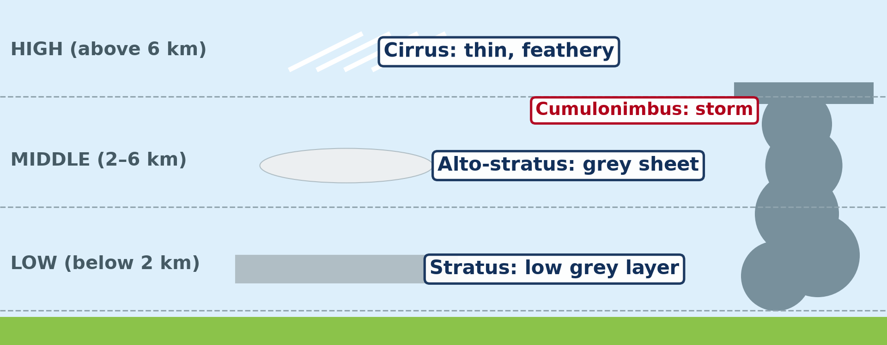
1. TYPES OF CLOUDS
Activity 1
Clouds of different shapes.
Notes:
Activity 1. Look carefully at this diagram: clouds of different shapes. Observe every detail before I ask the question.

Slide 19
1. TYPES OF CLOUDS
Activity 1: Question
Are all clouds the same shape and height?
Notes:
Here is the question for Activity 1: Are all clouds the same shape and height? Take one minute to think and write your answer in your rough notebook.

Slide 20
1. TYPES OF CLOUDS
Activity 1: Answer
No, they have different shapes and heights: cumulus, stratus, cirrus and cumulonimbus.
Notes:
Let us check the answer together. No, they have different shapes and heights: cumulus, stratus, cirrus and cumulonimbus.

Slide 21

2. THUNDERSTORMS
Activity 2
A tall, dark cloud.
Notes:
Activity 2. Look carefully at this picture: a tall, dark cloud. Observe every detail before I ask the question.

Slide 22
2. THUNDERSTORMS
Activity 2: Question
What kind of weather does this tall, dark cloud bring?
Notes:
Here is the question for Activity 2: What kind of weather does this tall, dark cloud bring? Take one minute to think and write your answer in your rough notebook.

Slide 23
2. THUNDERSTORMS
Activity 2: Answer
A thunderstorm, with lightning, thunder, strong winds and heavy rain.
Notes:
Let us check the answer together. A thunderstorm, with lightning, thunder, strong winds and heavy rain.

Slide 24

2. CYCLONES
Activity 3
A huge storm seen from space.
Notes:
Activity 3. Look carefully at this picture: a huge storm seen from space. Observe every detail before I ask the question.

Slide 25
2. CYCLONES
Activity 3: Question
Over which areas do such huge storms form?
Notes:
Here is the question for Activity 3: Over which areas do such huge storms form? Take one minute to think and write your answer in your rough notebook.

Slide 26
2. CYCLONES
Activity 3: Answer
Over warm tropical oceans, such as the Caribbean Sea and the Indian Ocean: they are cyclones.
Notes:
Let us check the answer together. Over warm tropical oceans, such as the Caribbean Sea and the Indian Ocean: they are cyclones.

Slide 27

2. DUST STORMS
Activity 4
A cloud of dust.
Notes:
Activity 4. Look carefully at this picture: a cloud of dust. Observe every detail before I ask the question.

Slide 28
2. DUST STORMS
Activity 4: Question
In which season do dust storms occur in the north of Cameroon?
Notes:
Here is the question for Activity 4: In which season do dust storms occur in the north of Cameroon? Take one minute to think and write your answer in your rough notebook.

Slide 29
2. DUST STORMS
Activity 4: Answer
In the dry season.
Notes:
Let us check the answer together. In the dry season.

Slide 30

4. CONSEQUENCES
Activity 5
A street after very heavy rain.
Notes:
Activity 5. Look carefully at this picture: a street after very heavy rain. Observe every detail before I ask the question.

Slide 31
4. CONSEQUENCES
Activity 5: Question
What happens in towns after very heavy rain?
Notes:
Here is the question for Activity 5: What happens in towns after very heavy rain? Take one minute to think and write your answer in your rough notebook.

Slide 32
4. CONSEQUENCES
Activity 5: Answer
Streets and houses are flooded, and roads and bridges can be destroyed.
Notes:
Let us check the answer together. Streets and houses are flooded, and roads and bridges can be destroyed.

Slide 33
BOARD SUMMARY
Board Summary
Topic: Protection against the Wrath of Nature
Sub-topic: Climatic Disturbances
Lesson 9: Atmospheric Disturbances
Notes:
Now we are going to copy the board summary. Write the title and the headings neatly in your notebooks. I will give you enough time for each slide, so do not rush.

Slide 34
BOARD SUMMARY
DEFINITIONS
The key terms of this lesson are defined as follows:
Atmospheric disturbance: It is a sudden and violent change in the weather.
Cloud: It is a mass of tiny water drops or ice floating in the air.
Notes:
Let us copy the definitions. The key terms of this lesson are defined as follows. On this slide we have Atmospheric disturbance and Cloud. Write each point on a new line, with the key term first, and explain it in your own words when we revise. When you finish, we go to the next slide.

Slide 35
BOARD SUMMARY
DEFINITIONS (continued)
Precipitation: It is water that falls from clouds as rain, drizzle, snow or hail.
Notes:
We continue with the definitions. On this slide we have Precipitation. Write each point on a new line, with the key term first, and explain it in your own words when we revise.

Slide 36
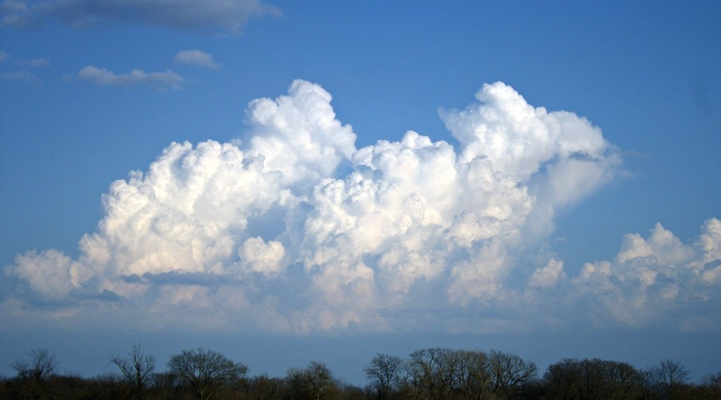
BOARD SUMMARY
1. Types of Clouds
The main types of clouds are the following:
Cumulus: They are white, puffy clouds of fine weather.
Illustration: cumulus clouds
Notes:
Let us copy Types of Clouds. The main types of clouds are the following. Copy the point on Cumulus on the left, then draw the diagram on the right: cumulus clouds. Give it a title and label it clearly.

Slide 37
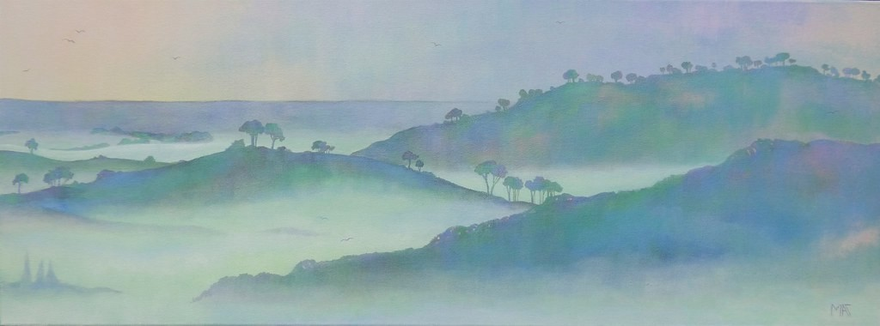
BOARD SUMMARY
1. Types of Clouds
Stratus: They are grey layers of low cloud that give drizzle.
Illustration: low stratus and fog
Notes:
Copy the point on Stratus on the left, then draw the diagram on the right: low stratus and fog. Give it a title and label it clearly.

Slide 38
BOARD SUMMARY
1. Types of Clouds
Cirrus: They are thin, high clouds made of ice crystals.
Illustration: types of clouds
Notes:
Copy the point on Cirrus on the left, then draw the diagram on the right: types of clouds. Give it a title and label it clearly.

Slide 39
BOARD SUMMARY
1. Types of Clouds
Cumulonimbus: They are tall, dark clouds that give thunderstorms.
Illustration: a cumulonimbus cloud
Notes:
Copy the point on Cumulonimbus on the left, then draw the diagram on the right: a cumulonimbus cloud. Give it a title and label it clearly.

Slide 40
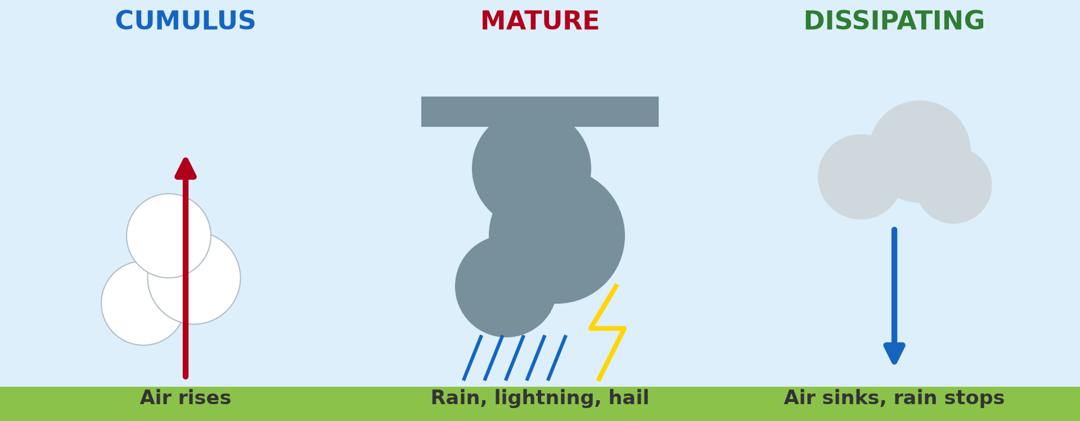
BOARD SUMMARY
2. Types of Disturbances
The main atmospheric disturbances are the following:
Thunderstorm: It is a storm with lightning, thunder, strong wind and heavy rain.
Illustration: the formation of a thunderstorm
Notes:
Let us copy Types of Disturbances. The main atmospheric disturbances are the following. Copy the point on Thunderstorm on the left, then draw the diagram on the right: the formation of a thunderstorm. Give it a title and label it clearly.

Slide 41
BOARD SUMMARY
2. Types of Disturbances
Cyclone: It is a very violent storm with strong winds and heavy rain that forms over warm tropical oceans.
Illustration: a cyclone seen from space
Notes:
Copy the point on Cyclone on the left, then draw the diagram on the right: a cyclone seen from space. Give it a title and label it clearly.

Slide 42
BOARD SUMMARY
2. Types of Disturbances
Dust storm: It is a strong wind carrying dust and sand in dry areas.
Illustration: a dust storm
Notes:
Copy the point on Dust storm on the left, then draw the diagram on the right: a dust storm. Give it a title and label it clearly.

Slide 43

BOARD SUMMARY
2. Types of Disturbances
Torrential rain: It is very heavy rain that falls in a short time.
Illustration: torrential rain
Notes:
Copy the point on Torrential rain on the left, then draw the diagram on the right: torrential rain. Give it a title and label it clearly.

Slide 44
BOARD SUMMARY
2. Types of Disturbances
Drizzle: It is very light rain with tiny drops, falling from stratus clouds.
Notes:
We continue with Types of Disturbances. On this slide we have Drizzle. Write each point on a new line, with the key term first, and explain it in your own words when we revise.

Slide 45
BOARD SUMMARY
3. Main Areas of Disturbances
Disturbances occur mainly in the following areas:
Thunderstorms: They are common in the equatorial and tropical regions, including Cameroon in the rainy season.
Notes:
Let us copy Main Areas of Disturbances. Disturbances occur mainly in the following areas. On this slide we have Thunderstorms. Write each point on a new line, with the key term first, and explain it in your own words when we revise.

Slide 46
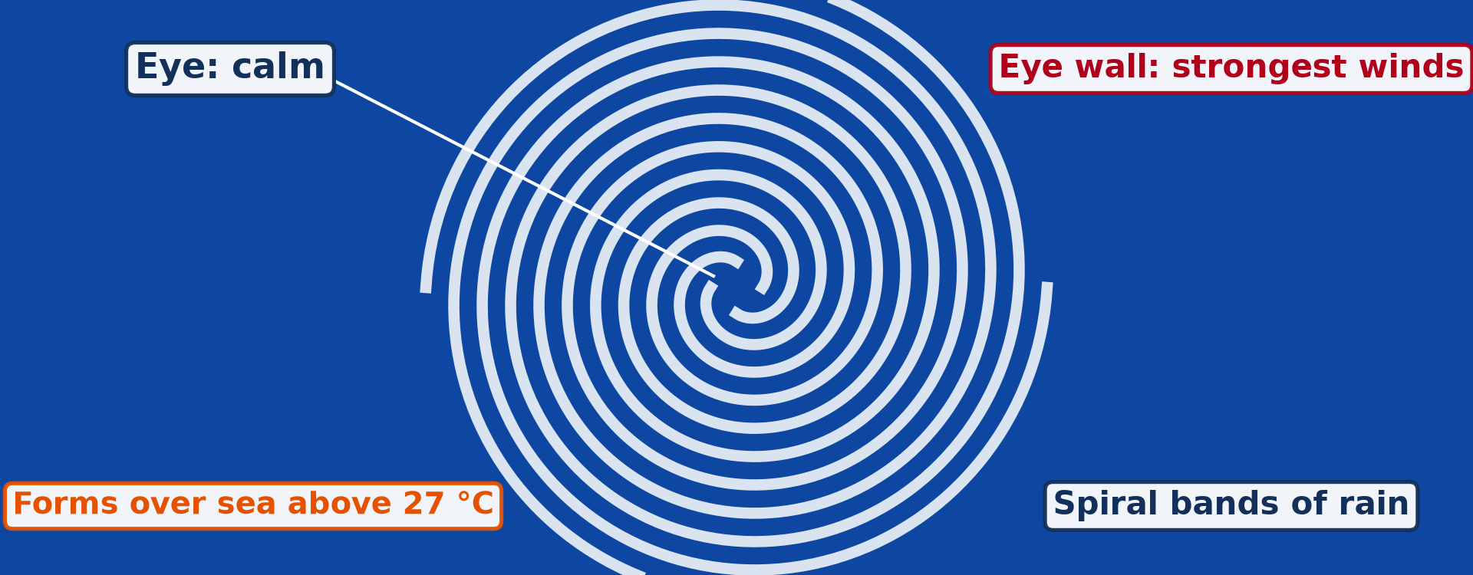
BOARD SUMMARY
3. Main Areas of Disturbances
Cyclones: They occur over the Caribbean Sea, the Indian Ocean and the western Pacific Ocean.
Illustration: a cyclone
Notes:
Copy the point on Cyclones on the left, then draw the diagram on the right: a cyclone. Give it a title and label it clearly.

Slide 47
BOARD SUMMARY
3. Main Areas of Disturbances
Dust storms: They occur in the Sahara, the Sahel and the north of Cameroon.
Torrential rain: It falls in equatorial regions and in monsoon lands such as India.
Notes:
We continue with Main Areas of Disturbances. On this slide we have Dust storms and Torrential rain. Write each point on a new line, with the key term first, and explain it in your own words when we revise.

Slide 48
BOARD SUMMARY
4. Consequences
Atmospheric disturbances have the following consequences:
Floods: Heavy rain floods streets, houses and farms.
Illustration: a flooded street
Notes:
Let us copy Consequences. Atmospheric disturbances have the following consequences. Copy the point on Floods on the left, then draw the diagram on the right: a flooded street. Give it a title and label it clearly.

Slide 49
BOARD SUMMARY
4. Consequences
Destruction: Strong winds blow off roofs and pull down trees and electric poles.
Loss of life: Lightning, floods and cyclones kill people and animals.
Diseases: Dust causes breathing diseases, and floods spread cholera.
Notes:
We continue with Consequences. On this slide we have Destruction, Loss of life and Diseases. Write each point on a new line, with the key term first, and explain it in your own words when we revise.

Slide 50
FORMATIVE EVALUATION
Evaluation 1
Name three atmospheric disturbances.
Notes:
Now let us check what you have understood. Question 1: Name three atmospheric disturbances. Answer in your exercise book.

Slide 51
FORMATIVE EVALUATION
Expected Answer
Thunderstorm, cyclone and dust storm.
Notes:
The expected answer is: thunderstorm, cyclone and dust storm. If you got it right, well done.

Slide 52
FORMATIVE EVALUATION
Evaluation 2
Give one safety rule during a thunderstorm.
Notes:
Now let us check what you have understood. Question 2: Give one safety rule during a thunderstorm. Answer in your exercise book.

Slide 53
FORMATIVE EVALUATION
Expected Answer
Stay inside a building, away from trees.
Notes:
The expected answer is: stay inside a building, away from trees. If you got it right, well done.

Slide 54
REMEDIATION
Remediation
Fill in the blanks:
The cloud that gives thunderstorms is the ______.
A violent storm over warm oceans is a ______.
Very light rain is ______.
Notes:
For those who need more practice, fill in the blanks in your exercise book. The answers are: number 1, cumulonimbus; number 2, cyclone; number 3, drizzle.

Slide 55
HOMEWORK
Homework
Write three safety rules for your family during a thunderstorm.
Notes:
For your homework: Write three safety rules for your family during a thunderstorm. We shall correct it at the beginning of our next lesson.

Slide 56
NEXT LESSON
Next Lesson
Our next lesson will be on:
Further Study 1: Atmospheric Disturbances in Cameroon
Notes:
Our next lesson will be on Further Study 1: Atmospheric Disturbances in Cameroon. Thank you for your attention, and see you next time.

Slide 57
BILINGUAL GAME
Bilingual Game (Jeu Bilingue)
English | Français
Storm | L'orage
Lightning | L'éclair
Thunder | Le tonnerre
Cyclone | Le cyclone
Dust storm | La tempête de poussière
Drizzle | La bruine
Notes:
Let us play the bilingual game. I say a word in English, and you give me the French word. Then we do the reverse.

Slide 58
LOGBOOK
Official Logbook (1/2)
Module / Topic | Protection against the Wrath of Nature
Lesson Title | Lesson 9: Atmospheric Disturbances
Expected Learning Outcomes | Define an atmospheric disturbance. Identify the main types of clouds and disturbances and locate their main areas. Give their consequences.
Competence | Learners are able to identify atmospheric disturbances, locate where they occur and adopt safe behaviour.
Notes:
I record this information in the official logbook of the class after the lesson.

Slide 59
LOGBOOK
Official Logbook (2/2)
Matter Taught | DEFINITIONS; Types of Clouds; Types of Disturbances; Main Areas of Disturbances; Consequences.
Evaluation | Formative evaluation and remediation exercise.
Homework | Write three safety rules for your family during a thunderstorm.
Enrolment / Present / Absent | ____ / ____ / ____
Achievement | To be completed after the lesson.
Notes:
I complete the second page of the logbook: the matter taught, the evaluation, the homework and the attendance.

Slide 60
TEACHER'S NOTE
Teacher's Note
Timing: Homework correction, plan, objectives 8 min | Recall, situation, action 10 min | 5 activities 30 min | Board summary (copying) 30 min | Evaluation, remediation 10 min | Homework, next lesson 5 min | Logbook 7 min
Without the projector (Activity 1): draw the clouds on the board.
Without the projector (Activity 2): describe a storm cloud.
Without the projector (Activity 3): point to the oceans on a map.
Without the projector (Activity 4): describe a dusty day.
Without the projector (Activity 5): list the damage of a storm.
Notes:
This slide is for me, the teacher: it gives the timing of the lesson and what to do if the projector is not available.

Slide 61
REFERENCES
References
Geography Syllabus, Forms I–V, MINESEC (2023) — Form 1, Module 3: Protection from the Wrath of Nature.
Photo, Activity 2: “06172012 Sunday evening pulse storms/cumulonimbi” by StormRider93 | Into the Storm, CC BY-NC-ND 2.0, via Flickr (https://www.flickr.com/photos/65232104@N04/7395715628)
Photo, Activity 3: “NASA's Aqua Satellite Captures Hurricane Danielle” by NASA Goddard Photo and Video, CC BY 2.0, via nasa (https://www.flickr.com/photos/24662369@N07/4931591817)
Photo, Activity 4: “Sandstorm at Camp Bastion, Afghanistan” by Defence Images, CC BY-NC 2.0, via Flickr (https://www.flickr.com/photos/48399297@N04/10343833885)
Photo, Activity 5: “Vicenza flooding Nov.1, 2010” by US Army Africa, CC BY 2.0, via Flickr (https://www.flickr.com/photos/36281822@N08/5157191333)
Photo, board summary (Cumulus): “Epic Cloud (Explored)” by Christina Ann VanMeter, CC BY-NC 2.0, via Flickr (https://www.flickr.com/photos/54129831@N02/6984912657)
Photo, board summary (Stratus): “Mist” by Art by MarkAC, CC BY-SA 2.0, via Flickr (https://www.flickr.com/photos/60580775@N08/40783321332)
Notes:
Take your time to copy this part; we will continue together.

Slide 62
REFERENCES
References (continued)
Photo, board summary (Torrential rain): “Heavy rain. Johannesburg, South Africa” by varfolomeev, CC BY-NC 2.0, via Flickr (https://www.flickr.com/photos/45427632@N02/49745935146)
Diagrams and animations: drawn for this lesson (Geography Department).
Notes:
These are the references and picture credits used to prepare this lesson.

