Slide 1
FORM 1
GEOGRAPHY
Lesson 10
Climate Change and its Consequences
Notes:
Good morning, class, and welcome to our geography lesson. I am your geography teacher, Mr Kamdem. Today we are starting Lesson 10: Climate Change and its Consequences.

Slide 2
CLASS INFO
Class, Chapter and Duration
Class | Form 1
Chapter | Module 3: Protection from the Wrath of Nature
Duration | 2 periods (2 × 50 minutes)
Notes:
This lesson is for Form 1. It belongs to Module 3: Protection from the Wrath of Nature. We shall need 2 periods to cover it.

Slide 3
IDENTIFICATION
Lesson Identification
Topic | Protection against the Wrath of Nature
Sub-topic | Climatic Disturbances
Lesson | Lesson 10: Climate Change and its Consequences
Notions / Concepts | Global warming, greenhouse gases.
Syllabus focus | General causes; manifestations; consequences; adaptation; mitigation.
Competence | Learners are able to explain climate change and adopt behaviour that reduces it.
Notes:
Our topic is Protection against the Wrath of Nature, and the sub-topic is Climatic Disturbances. The key notions we shall use today are: global warming, greenhouse gases. At the end, you should be able to do this: learners are able to explain climate change and adopt behaviour that reduces it.

Slide 4

HOMEWORK CORRECTION
Correction of the Homework
Question (Practical Work 6: Mechanisms of Rain Formation):
Draw and label the mechanism of relief rainfall on Mount Cameroon.
Notes:
Before we start the new lesson, let us correct the homework I gave you at the end of Practical Work 6: Mechanisms of Rain Formation. The question was: Draw and label the mechanism of relief rainfall on Mount Cameroon. Take out your exercise books.

Slide 5
HOMEWORK CORRECTION
Correction: Possible Answer
The drawing shows the sea, moist wind arrows rising up the windward slope, clouds and rain on that slope, and dry descending air on the leeward slope (rain shadow).
Notes:
Here is a good answer. The drawing shows the sea, moist wind arrows rising up the windward slope, clouds and rain on that slope, and dry descending air on the leeward slope (rain shadow). Compare it with your own answer and correct your work in red.

Slide 6
LESSON PLAN
Lesson Plan
Correction of the homework
Objectives and recall
Real-life situation and action to take
Learning activities
Board summary
Evaluation, remediation and homework
Notes:
Here is the plan of our lesson today. First, we shall correct the homework. Then we shall look at the objectives and recall what you already know. After that, we shall study a situation from real life and the action to take, and do the learning activities. Finally, we shall copy the board summary, do the evaluation and the remediation, and I will give you the homework.

Slide 7
OBJECTIVES
Objectives
By the end of this lesson, you should be able to:
Give the general causes of climate change.
Describe its manifestations and consequences.
Notes:
Take your time to copy this part; we will continue together.

Slide 8
OBJECTIVES
Objectives (continued)
Propose adaptation and mitigation measures.
Notes:
By the end of this lesson, you should be able to do three things. Number 1: give the general causes of climate change. Number 2: describe its manifestations and consequences. Number 3: propose adaptation and mitigation measures.

Slide 9
PREVIOUS KNOWLEDGE
Previous Knowledge
The atmosphere contains carbon dioxide.
Burning fuel gives smoke.
Trees take in carbon dioxide.
Notes:
Let us first remember what you already know. The atmosphere contains carbon dioxide. Burning fuel gives smoke. Trees take in carbon dioxide. Keep this in mind, because we shall build on it today.

Slide 10
REAL-LIFE SITUATION
Situation in Real Life
Grandfather Oumarou says that when he was young, the rains in Garoua started in April and were regular. Today they start late and stop suddenly, and the heat is stronger. He asks his grandson: "What is happening to our climate, and what can we do about it?"
Notes:
Listen carefully to this situation from real life. Grandfather Oumarou says that when he was young, the rains in Garoua started in April and were regular. Today they start late and stop suddenly, and the heat is stronger. He asks his grandson: "What is happening to our climate, and what can we do about it?" Think about it, because I am going to ask you some questions.

Slide 11
REAL-LIFE SITUATION
Situation: Question 1
What is the problem in the situation?
Notes:
Question 1: What is the problem in the situation? Think for a moment, then raise your hand to answer.

Slide 12
REAL-LIFE SITUATION
Answer
The grandfather does not understand why the climate of Garoua is changing and what to do.
Notes:
Good. The grandfather does not understand why the climate of Garoua is changing and what to do.

Slide 13
REAL-LIFE SITUATION
Situation: Question 2
Give two changes the grandfather notices.
Notes:
Question 2: Give two changes the grandfather notices. Think for a moment, then raise your hand to answer.

Slide 14
REAL-LIFE SITUATION
Answer
The rains start late, and the heat is stronger.
Notes:
Good. The rains start late, and the heat is stronger.

Slide 15
REAL-LIFE SITUATION
Situation: Question 3
What is this phenomenon called?
Notes:
Question 3: What is this phenomenon called? Think for a moment, then raise your hand to answer.

Slide 16
REAL-LIFE SITUATION
Possible Answer
Climate change.
Notes:
Good. Climate change.

Slide 17
ACTION TO TAKE
Action to Take
Plant trees, save energy and avoid burning waste.
Notes:
From this situation, the action we are working towards in this lesson is the following: plant trees, save energy and avoid burning waste.

Slide 18
JUSTIFICATION
Justification of the Lesson
This lesson helps us to understand climate change and how to fight it.
Notes:
Why is this lesson important for you? This lesson helps us to understand climate change and how to fight it.

Slide 19

1. GENERAL CAUSES
Activity 1
Smoke from an exhaust pipe.
Notes:
Activity 1. Look carefully at this picture: smoke from an exhaust pipe. Observe every detail before I ask the question.

Slide 20
1. GENERAL CAUSES
Activity 1: Question
Which gas comes out when petrol or wood is burnt?
Notes:
Here is the question for Activity 1: Which gas comes out when petrol or wood is burnt? Take one minute to think and write your answer in your rough notebook.

Slide 21
1. GENERAL CAUSES
Activity 1: Answer
Carbon dioxide, a greenhouse gas.
Notes:
Let us check the answer together. Carbon dioxide, a greenhouse gas.

Slide 22

1. GENERAL CAUSES
Activity 2
Gases around the Earth.
Notes:
Activity 2. Look carefully at this diagram: gases around the Earth. Observe every detail before I ask the question.

Slide 23
1. GENERAL CAUSES
Activity 2: Question
How do these gases warm the Earth?
Notes:
Here is the question for Activity 2: How do these gases warm the Earth? Take one minute to think and write your answer in your rough notebook.

Slide 24
1. GENERAL CAUSES
Activity 2: Answer
They trap the heat of the Sun in the atmosphere, like the glass of a greenhouse.
Notes:
Let us check the answer together. They trap the heat of the Sun in the atmosphere, like the glass of a greenhouse.

Slide 25
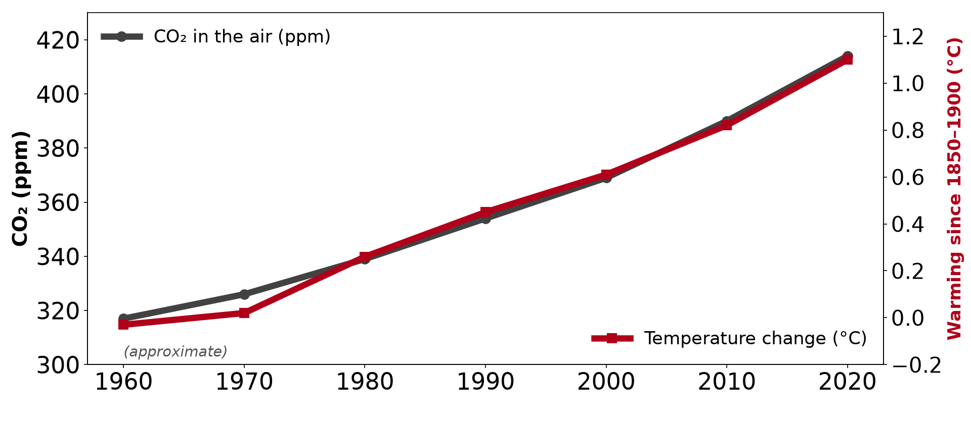
2. MANIFESTATIONS
Activity 3
Carbon dioxide and temperature.
Notes:
Activity 3. Look carefully at this diagram: carbon dioxide and temperature. Observe every detail before I ask the question.

Slide 26
2. MANIFESTATIONS
Activity 3: Question
What happens to the temperature of the Earth as carbon dioxide increases?
Notes:
Here is the question for Activity 3: What happens to the temperature of the Earth as carbon dioxide increases? Take one minute to think and write your answer in your rough notebook.

Slide 27
2. MANIFESTATIONS
Activity 3: Answer
The temperature rises: this is global warming.
Notes:
Let us check the answer together. The temperature rises: this is global warming.

Slide 28

3. CONSEQUENCES
Activity 4
Dry, cracked soil.
Notes:
Activity 4. Look carefully at this picture: dry, cracked soil. Observe every detail before I ask the question.

Slide 29
3. CONSEQUENCES
Activity 4: Question
How does climate change affect farmers in the north?
Notes:
Here is the question for Activity 4: How does climate change affect farmers in the north? Take one minute to think and write your answer in your rough notebook.

Slide 30
3. CONSEQUENCES
Activity 4: Answer
Rains are irregular, droughts and floods are more frequent, and harvests are poor.
Notes:
Let us check the answer together. Rains are irregular, droughts and floods are more frequent, and harvests are poor.

Slide 31

5. MITIGATION
Activity 5
A solar panel.
Notes:
Activity 5. Look carefully at this picture: a solar panel. Observe every detail before I ask the question.

Slide 32
5. MITIGATION
Activity 5: Question
How does solar energy help to fight climate change?
Notes:
Here is the question for Activity 5: How does solar energy help to fight climate change? Take one minute to think and write your answer in your rough notebook.

Slide 33
5. MITIGATION
Activity 5: Answer
It gives electricity without burning fuel, so it releases no carbon dioxide.
Notes:
Let us check the answer together. It gives electricity without burning fuel, so it releases no carbon dioxide.

Slide 34
BOARD SUMMARY
Board Summary
Topic: Protection against the Wrath of Nature
Sub-topic: Climatic Disturbances
Lesson 10: Climate Change and its Consequences
Notes:
Now we are going to copy the board summary. Write the title and the headings neatly in your notebooks. I will give you enough time for each slide, so do not rush.

Slide 35
BOARD SUMMARY
DEFINITIONS
The key terms of this lesson are defined as follows:
Climate change: It is a long-term change in the average climate of a place or of the world.
Global warming: It is the rise of the average temperature of the Earth.
Notes:
Let us copy the definitions. The key terms of this lesson are defined as follows. On this slide we have Climate change and Global warming. Write each point on a new line, with the key term first, and explain it in your own words when we revise. When you finish, we go to the next slide.

Slide 36
BOARD SUMMARY
DEFINITIONS (continued)
Greenhouse gases: They are gases, such as carbon dioxide and methane, that trap heat in the atmosphere.
Notes:
We continue with the definitions. On this slide we have Greenhouse gases. Write each point on a new line, with the key term first, and explain it in your own words when we revise.

Slide 37
BOARD SUMMARY
1. General Causes
Climate change has the following causes:
Burning fuels: Burning petrol, coal, gas and wood releases carbon dioxide.
Illustration: smoke from burning fuel
Notes:
Let us copy General Causes. Climate change has the following causes. Copy the point on Burning fuels on the left, then draw the diagram on the right: smoke from burning fuel. Give it a title and label it clearly.

Slide 38

BOARD SUMMARY
1. General Causes
Deforestation: Cutting trees leaves fewer plants to absorb carbon dioxide.
Illustration: a cleared forest
Notes:
Copy the point on Deforestation on the left, then draw the diagram on the right: a cleared forest. Give it a title and label it clearly.

Slide 39

BOARD SUMMARY
1. General Causes
Farming and livestock: Cattle and rice fields release methane, another greenhouse gas.
Illustration: cattle
Notes:
Copy the point on Farming and livestock on the left, then draw the diagram on the right: cattle. Give it a title and label it clearly.

Slide 40
BOARD SUMMARY
1. General Causes
Greenhouse effect: These gases trap the heat of the Sun and warm the Earth.
Illustration: the greenhouse effect
Notes:
Copy the point on Greenhouse effect on the left, then draw the diagram on the right: the greenhouse effect. Give it a title and label it clearly.

Slide 41
BOARD SUMMARY
1. General Causes
Natural causes: Volcanic eruptions and changes in the Sun also change the climate.
Notes:
We continue with General Causes. On this slide we have Natural causes. Write each point on a new line, with the key term first, and explain it in your own words when we revise.

Slide 42
BOARD SUMMARY
2. Manifestations
Climate change shows itself in the following ways:
Rising temperatures: The average temperature of the Earth is rising.
Illustration: carbon dioxide and temperature
Notes:
Let us copy Manifestations. Climate change shows itself in the following ways. Copy the point on Rising temperatures on the left, then draw the diagram on the right: carbon dioxide and temperature. Give it a title and label it clearly.

Slide 43
BOARD SUMMARY
2. Manifestations
Irregular rains: Rains start late, stop early or fall too heavily.
Notes:
We continue with Manifestations. On this slide we have Irregular rains. Write each point on a new line, with the key term first, and explain it in your own words when we revise.

Slide 44
BOARD SUMMARY
2. Manifestations
Droughts and floods: Long dry periods and violent floods are more frequent.
Illustration: drought
Notes:
Copy the point on Droughts and floods on the left, then draw the diagram on the right: drought. Give it a title and label it clearly.

Slide 45
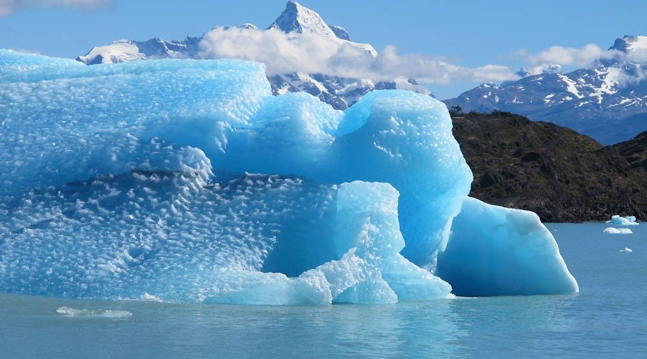
BOARD SUMMARY
2. Manifestations
Melting ice: Glaciers and polar ice melt, and the sea level rises.
Illustration: a melting glacier
Notes:
Copy the point on Melting ice on the left, then draw the diagram on the right: a melting glacier. Give it a title and label it clearly.

Slide 46
BOARD SUMMARY
3. Consequences
Climate change has the following consequences:
Poor harvests: Crops fail because of drought, floods and heat.
Water shortage: Rivers, lakes such as Lake Chad and wells dry up.
Notes:
Let us copy Consequences. Climate change has the following consequences. On this slide we have Poor harvests and Water shortage. Write each point on a new line, with the key term first, and explain it in your own words when we revise. When you finish, we go to the next slide.

Slide 47
BOARD SUMMARY
3. Consequences (continued)
Diseases: Heat and floods increase malaria, cholera and meningitis.
Migration: Some people leave their land to find water and food.
Notes:
We continue with Consequences. On this slide we have Diseases and Migration. Write each point on a new line, with the key term first, and explain it in your own words when we revise.

Slide 48
BOARD SUMMARY
4. Adaptation
People adapt to climate change in the following ways:
Resistant seeds: Farmers grow crops that resist drought.
Notes:
Let us copy Adaptation. People adapt to climate change in the following ways. On this slide we have Resistant seeds. Write each point on a new line, with the key term first, and explain it in your own words when we revise.

Slide 49
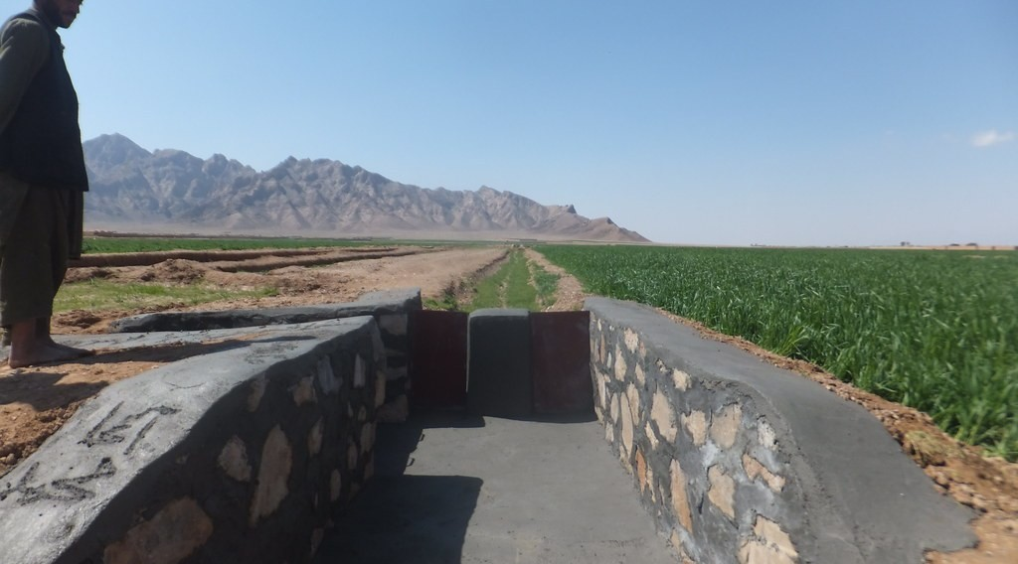
BOARD SUMMARY
4. Adaptation
Water storage: People dig wells and store rain water for dry periods.
Illustration: irrigation canals
Notes:
Copy the point on Water storage on the left, then draw the diagram on the right: irrigation canals. Give it a title and label it clearly.

Slide 50
BOARD SUMMARY
4. Adaptation
New farming calendar: Farmers change the dates of planting according to the rains.
Notes:
We continue with Adaptation. On this slide we have New farming calendar. Write each point on a new line, with the key term first, and explain it in your own words when we revise.

Slide 51

BOARD SUMMARY
5. Mitigation
People reduce climate change in the following ways:
Planting trees: Trees absorb carbon dioxide.
Illustration: planting a tree
Notes:
Let us copy Mitigation. People reduce climate change in the following ways. Copy the point on Planting trees on the left, then draw the diagram on the right: planting a tree. Give it a title and label it clearly.

Slide 52
BOARD SUMMARY
5. Mitigation
Clean energy: Solar, wind and water energy replace fuels that give smoke.
Illustration: a solar panel
Notes:
Copy the point on Clean energy on the left, then draw the diagram on the right: a solar panel. Give it a title and label it clearly.

Slide 53
BOARD SUMMARY
5. Mitigation
Saving energy: We switch off lights and use improved stoves that need less wood.
Stopping bush fires and waste burning: Less burning means less carbon dioxide.
Notes:
We continue with Mitigation. On this slide we have Saving energy and Stopping bush fires and waste burning. Write each point on a new line, with the key term first, and explain it in your own words when we revise.

Slide 54
FORMATIVE EVALUATION
Evaluation 1
Give two causes of climate change.
Notes:
Now let us check what you have understood. Question 1: Give two causes of climate change. Answer in your exercise book.

Slide 55
FORMATIVE EVALUATION
Expected Answer
Burning fuels and deforestation.
Notes:
The expected answer is: burning fuels and deforestation. If you got it right, well done.

Slide 56
FORMATIVE EVALUATION
Evaluation 2
Distinguish mitigation and adaptation.
Notes:
Now let us check what you have understood. Question 2: Distinguish mitigation and adaptation. Answer in your exercise book.

Slide 57
FORMATIVE EVALUATION
Expected Answer
Mitigation reduces the causes; adaptation adjusts to the effects.
Notes:
The expected answer is: mitigation reduces the causes; adaptation adjusts to the effects. If you got it right, well done.

Slide 58
REMEDIATION
Remediation
Fill in the blanks:
The rise of the Earth's temperature is global ______.
Carbon dioxide is a ______ gas.
Planting trees is a ______ measure.
Notes:
For those who need more practice, fill in the blanks in your exercise book. The answers are: number 1, warming; number 2, greenhouse; number 3, mitigation.

Slide 59
HOMEWORK
Homework
Propose three actions your family can take against climate change.
Notes:
For your homework: Propose three actions your family can take against climate change. We shall correct it at the beginning of our next lesson.

Slide 60
NEXT LESSON
Next Lesson
Our next lesson will be on:
Lesson 11: The Internal Structure of the Earth
Notes:
Our next lesson will be on Lesson 11: The Internal Structure of the Earth. Thank you for your attention, and see you next time.

Slide 61
BILINGUAL GAME
Bilingual Game (Jeu Bilingue)
English | Français
Climate change | Le changement climatique
Global warming | Le réchauffement climatique
Greenhouse gas | Le gaz à effet de serre
Drought | La sécheresse
Adaptation | L'adaptation
Mitigation | L'atténuation
Notes:
Let us play the bilingual game. I say a word in English, and you give me the French word. Then we do the reverse.

Slide 62
LOGBOOK
Official Logbook (1/2)
Module / Topic | Protection against the Wrath of Nature
Lesson Title | Lesson 10: Climate Change and its Consequences
Expected Learning Outcomes | Give the general causes of climate change. Describe its manifestations and consequences. Propose adaptation and mitigation measures.
Competence | Learners are able to explain climate change and adopt behaviour that reduces it.
Notes:
I record this information in the official logbook of the class after the lesson.

Slide 63
LOGBOOK
Official Logbook (2/2)
Matter Taught | DEFINITIONS; General Causes; Manifestations; Consequences; Adaptation; Mitigation.
Evaluation | Formative evaluation and remediation exercise.
Homework | Propose three actions your family can take against climate change.
Enrolment / Present / Absent | ____ / ____ / ____
Achievement | To be completed after the lesson.
Notes:
I complete the second page of the logbook: the matter taught, the evaluation, the homework and the attendance.

Slide 64
TEACHER'S NOTE
Teacher's Note
Timing: Homework correction, plan, objectives 8 min | Recall, situation, action 10 min | 5 activities 30 min | Board summary (copying) 30 min | Evaluation, remediation 10 min | Homework, next lesson 5 min | Logbook 7 min
Without the projector (Activity 1): list sources of smoke in town.
Without the projector (Activity 2): compare with a closed car in the sun.
Without the projector (Activity 3): draw a rising line on the board.
Without the projector (Activity 4): ask farmers' children.
Without the projector (Activity 5): list actions for the school.
Notes:
This slide is for me, the teacher: it gives the timing of the lesson and what to do if the projector is not available.

Slide 65
REFERENCES
References
Geography Syllabus, Forms I–V, MINESEC (2023) — Form 1, Module 3: Protection from the Wrath of Nature.
Photo, Activity 1: “image replaced (thanks Anne :) )” by why 137, CC BY 2.0, via Flickr (https://www.flickr.com/photos/78752351@N03/8464430910)
Photo, Activity 4: “Imagine a world without trees” by aloshbennett, CC BY 2.0, via Flickr (https://www.flickr.com/photos/13203757@N00/3480223314)
Photo, Activity 5: “Noor Ouarzazate III Solar Plant” by Richard Allaway, CC BY 2.0, via Flickr (https://www.flickr.com/photos/16287002@N00/52769922684)
Photo, board summary (Deforestation): “Managed Destruction” by Harlz_, CC BY-NC 2.0, via Flickr (https://www.flickr.com/photos/35169553@N06/4295797661)
Photo, board summary (Farming and livestock): “Fulani cattle breed of West Africa” by International Livestock Research Institute, CC BY-NC-SA 2.0, via Flickr (https://www.flickr.com/photos/7155605@N03/48125675226)
Notes:
Take your time to copy this part; we will continue together.

Slide 66
REFERENCES
References (continued)
Photo, board summary (Melting ice): “Glaciers and Sea Level Rise” by NASA Goddard Photo and Video, CC BY 2.0, via nasa (https://www.flickr.com/photos/24662369@N07/8742463970)
Photo, board summary (Water storage): “Irrigation Canals in Farah Province Afgahnistan” by USAID_IMAGES, CC BY-NC-ND 2.0, via Flickr (https://www.flickr.com/photos/46658241@N06/14784748647)
Photo, board summary (Planting trees): “Haitian Students Breathe New Life into Depleted Pine Forest” by United Nations Photo, CC BY-NC-ND 2.0, via Flickr (https://www.flickr.com/photos/35483578@N03/5860275159)
Diagrams and animations: drawn for this lesson (Geography Department).
Notes:
These are the references and picture credits used to prepare this lesson.

