Slide 1
FORM 2
GEOGRAPHY
Further Study 3
Products Gathered from the Wild in Cameroon
Notes:
Good morning, class, and welcome to our geography lesson. I am your geography teacher, Mr Kamdem. Today we are starting Further Study 3: Products Gathered from the Wild in Cameroon.

Slide 2
CLASS INFO
Class, Chapter and Duration
Class | Form 2
Chapter | Module 1: Man in his Environment
Duration | 2 periods (2 × 50 minutes)
Notes:
This lesson is for Form 2. It belongs to Module 1: Man in his Environment. We shall need 2 periods to cover it.

Slide 3
IDENTIFICATION
Lesson Identification
Topic | Man in his Environment
Sub-topic | Exploitation of Resources in the Natural Environment
Lesson | Further Study 3: Products Gathered from the Wild in Cameroon
Notions / Concepts | Non-timber forest products, gathering.
Syllabus focus | Identification of various products (njangsa, eru, bush mango, bitter cola, etc.); methods of collection and processing; the socio-cultural and economic importance of these products.
Competence | Learners are able to identify wild products of Cameroon and explain their importance.
Notes:
Our topic is Man in his Environment, and the sub-topic is Exploitation of Resources in the Natural Environment. The key notions we shall use today are: non-timber forest products, gathering. At the end, you should be able to do this: learners are able to identify wild products of Cameroon and explain their importance.

Slide 4

HOMEWORK CORRECTION
Correction of the Homework
Question (Further Study 2: The Firewood Crisis):
Ask your family how much they spend on firewood or charcoal each week.
Notes:
Before we start the new lesson, let us correct the homework I gave you at the end of Further Study 2: The Firewood Crisis. The question was: Ask your family how much they spend on firewood or charcoal each week. Take out your exercise books.

Slide 5
HOMEWORK CORRECTION
Correction: Possible Answer
Answers vary. Example: about 3,000 to 5,000 FCFA a week for firewood or a bag of charcoal.
Notes:
Here is a good answer. Answers vary. Example: about 3,000 to 5,000 FCFA a week for firewood or a bag of charcoal. Compare it with your own answer and correct your work in red.

Slide 6
LESSON PLAN
Lesson Plan
Correction of the homework
Objectives and recall
Real-life situation and action to take
Learning activities
Board summary
Evaluation, remediation and homework
Notes:
Here is the plan of our lesson today. First, we shall correct the homework. Then we shall look at the objectives and recall what you already know. After that, we shall study a situation from real life and the action to take, and do the learning activities. Finally, we shall copy the board summary, do the evaluation and the remediation, and I will give you the homework.

Slide 7
OBJECTIVES
Objectives
By the end of this lesson, you should be able to:
Identify products gathered from the wild in Cameroon.
Describe the methods of collection and processing.
Notes:
Take your time to copy this part; we will continue together.

Slide 8
OBJECTIVES
Objectives (continued)
Explain their socio-cultural and economic importance.
Notes:
By the end of this lesson, you should be able to do three things. Number 1: identify products gathered from the wild in Cameroon. Number 2: describe the methods of collection and processing. Number 3: explain their socio-cultural and economic importance.

Slide 9
PREVIOUS KNOWLEDGE
Previous Knowledge
The forest gives timber.
People gather fruits and leaves.
Markets sell many forest products.
Notes:
Let us first remember what you already know. The forest gives timber. People gather fruits and leaves. Markets sell many forest products. Keep this in mind, because we shall build on it today.

Slide 10
REAL-LIFE SITUATION
Situation in Real Life
In the market of Garoua, Aïcha sees eru leaves, njangsa seeds, bush mango, honey and bitter cola. The trader says that she earns her living from these products. Aïcha asks: "Where do these products come from, and why are they so important?"
Notes:
Listen carefully to this situation from real life. In the market of Garoua, Aïcha sees eru leaves, njangsa seeds, bush mango, honey and bitter cola. The trader says that she earns her living from these products. Aïcha asks: "Where do these products come from, and why are they so important?" Think about it, because I am going to ask you some questions.

Slide 11
REAL-LIFE SITUATION
Situation: Question 1
What is the problem in the situation?
Notes:
Question 1: What is the problem in the situation? Think for a moment, then raise your hand to answer.

Slide 12
REAL-LIFE SITUATION
Answer
Aïcha does not know where these products come from and why they are important.
Notes:
Good. Aïcha does not know where these products come from and why they are important.

Slide 13
REAL-LIFE SITUATION
Situation: Question 2
Name three products she sees.
Notes:
Question 2: Name three products she sees. Think for a moment, then raise your hand to answer.

Slide 14
REAL-LIFE SITUATION
Answer
Eru, njangsa and bush mango (also bitter cola and honey).
Notes:
Good. Eru, njangsa and bush mango (also bitter cola and honey).

Slide 15
REAL-LIFE SITUATION
Situation: Question 3
Why are they important to the trader?
Notes:
Question 3: Why are they important to the trader? Think for a moment, then raise your hand to answer.

Slide 16
REAL-LIFE SITUATION
Possible Answer
They give her an income.
Notes:
Good. They give her an income.

Slide 17
ACTION TO TAKE
Action to Take
Harvest wild products without destroying the plants.
Notes:
From this situation, the action we are working towards in this lesson is the following: harvest wild products without destroying the plants.

Slide 18
JUSTIFICATION
Justification of the Lesson
This further study helps us to know the value of wild products and protect them.
Notes:
Why is this lesson important for you? This further study helps us to know the value of wild products and protect them.

Slide 19
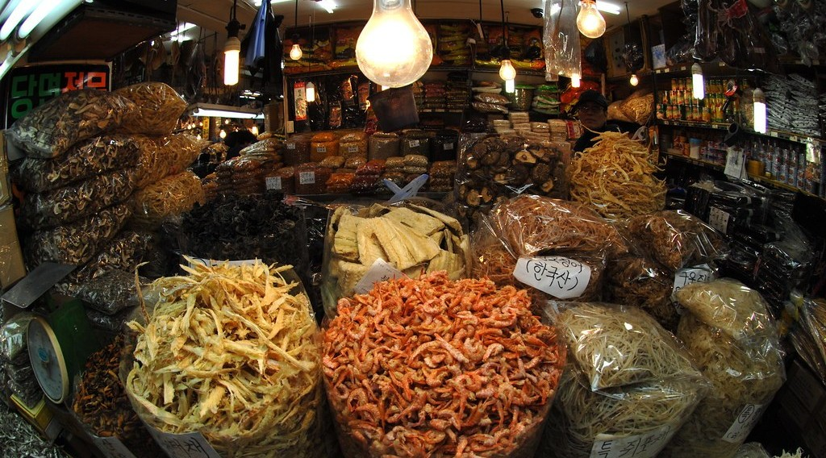
1. IDENTIFICATION
Activity 1
Products in a market.
Notes:
Activity 1. Look carefully at this picture: products in a market. Observe every detail before I ask the question.

Slide 20
1. IDENTIFICATION
Activity 1: Question
Were these products planted by farmers?
Notes:
Here is the question for Activity 1: Were these products planted by farmers? Take one minute to think and write your answer in your rough notebook.

Slide 21
1. IDENTIFICATION
Activity 1: Answer
No, they are gathered from the wild: eru, njangsa, bush mango and bitter cola.
Notes:
Let us check the answer together. No, they are gathered from the wild: eru, njangsa, bush mango and bitter cola.

Slide 22

1. IDENTIFICATION
Activity 2
A tree of the northern savanna.
Notes:
Activity 2. Look carefully at this picture: a tree of the northern savanna. Observe every detail before I ask the question.

Slide 23
1. IDENTIFICATION
Activity 2: Question
Which product of the North is made from the nuts of this tree?
Notes:
Here is the question for Activity 2: Which product of the North is made from the nuts of this tree? Take one minute to think and write your answer in your rough notebook.

Slide 24
1. IDENTIFICATION
Activity 2: Answer
Shea butter.
Notes:
Let us check the answer together. Shea butter.

Slide 25
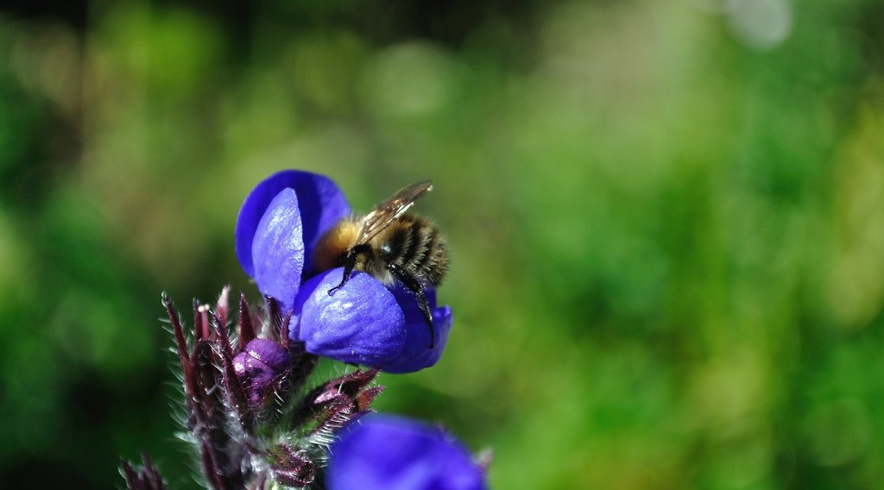
2. COLLECTION
Activity 3
A bee.
Notes:
Activity 3. Look carefully at this picture: a bee. Observe every detail before I ask the question.

Slide 26
2. COLLECTION
Activity 3: Question
Where do people find wild honey?
Notes:
Here is the question for Activity 3: Where do people find wild honey? Take one minute to think and write your answer in your rough notebook.

Slide 27
2. COLLECTION
Activity 3: Answer
In hives of wild bees in trees and rocks.
Notes:
Let us check the answer together. In hives of wild bees in trees and rocks.

Slide 28

3. ECONOMIC IMPORTANCE
Activity 4
A market.
Notes:
Activity 4. Look carefully at this picture: a market. Observe every detail before I ask the question.

Slide 29
3. ECONOMIC IMPORTANCE
Activity 4: Question
How do wild products help the families that sell them?
Notes:
Here is the question for Activity 4: How do wild products help the families that sell them? Take one minute to think and write your answer in your rough notebook.

Slide 30
3. ECONOMIC IMPORTANCE
Activity 4: Answer
They give them money to buy food and pay school fees.
Notes:
Let us check the answer together. They give them money to buy food and pay school fees.

Slide 31

3. SOCIO-CULTURAL IMPORTANCE
Activity 5
The forest.
Notes:
Activity 5. Look carefully at this picture: the forest. Observe every detail before I ask the question.

Slide 32
3. SOCIO-CULTURAL IMPORTANCE
Activity 5: Question
When are cola nuts and bitter cola shared?
Notes:
Here is the question for Activity 5: When are cola nuts and bitter cola shared? Take one minute to think and write your answer in your rough notebook.

Slide 33
3. SOCIO-CULTURAL IMPORTANCE
Activity 5: Answer
At ceremonies such as weddings and funerals.
Notes:
Let us check the answer together. At ceremonies such as weddings and funerals.

Slide 34
BOARD SUMMARY
Board Summary
Topic: Man in his Environment
Sub-topic: Exploitation of Resources in the Natural Environment
Further Study 3: Products Gathered from the Wild in Cameroon
Notes:
Now we are going to copy the board summary. Write the title and the headings neatly in your notebooks. I will give you enough time for each slide, so do not rush.

Slide 35
BOARD SUMMARY
DEFINITIONS
The key terms of this lesson are defined as follows:
Wild product: It is a plant or animal product collected from nature without being cultivated.
Gathering: It is the collection of wild products.
Notes:
Let us copy the definitions. The key terms of this lesson are defined as follows. On this slide we have Wild product and Gathering. Write each point on a new line, with the key term first, and explain it in your own words when we revise.

Slide 36
BOARD SUMMARY
1. Identification of the Products
Cameroon has the following wild products:
Eru and njangsa: Eru is a forest leaf eaten as a vegetable, and njangsa seeds are used to make sauces.
Illustration: wild products in a market
Notes:
Let us copy Identification of the Products. Cameroon has the following wild products. Copy the point on Eru and njangsa on the left, then draw the diagram on the right: wild products in a market. Give it a title and label it clearly.

Slide 37
BOARD SUMMARY
1. Identification of the Products
Bush mango and bitter cola: Bush mango seeds thicken sauces, and bitter cola nuts are chewed.
Notes:
We continue with Identification of the Products. On this slide we have Bush mango and bitter cola. Write each point on a new line, with the key term first, and explain it in your own words when we revise.

Slide 38
BOARD SUMMARY
1. Identification of the Products
Shea nuts: They come from the shea tree of the savanna and give shea butter.
Illustration: a shea tree
Notes:
Copy the point on Shea nuts on the left, then draw the diagram on the right: a shea tree. Give it a title and label it clearly.

Slide 39
BOARD SUMMARY
1. Identification of the Products
Honey and medicinal plants: Honey, mushrooms, barks and roots are also gathered.
Illustration: a bee
Notes:
Copy the point on Honey and medicinal plants on the left, then draw the diagram on the right: a bee. Give it a title and label it clearly.

Slide 40
BOARD SUMMARY
2. Methods of Collection and Processing
Wild products are collected and processed in the following ways:
Picking: Fruits, nuts and leaves are picked from trees or from the ground.
Harvesting honey: Honey is taken from wild hives, often with smoke.
Notes:
Let us copy Methods of Collection and Processing. Wild products are collected and processed in the following ways. On this slide we have Picking and Harvesting honey. Write each point on a new line, with the key term first, and explain it in your own words when we revise. When you finish, we go to the next slide.

Slide 41
BOARD SUMMARY
2. Methods of Collection and Processing (continued)
Drying and cracking: Seeds and nuts are dried and cracked to remove the kernels.
Pressing and boiling: Shea nuts are crushed and boiled to make butter.
Notes:
We continue with Methods of Collection and Processing. On this slide we have Drying and cracking and Pressing and boiling. Write each point on a new line, with the key term first, and explain it in your own words when we revise.

Slide 42
BOARD SUMMARY
3. Socio-cultural and Economic Importance
Wild products are important in the following ways:
Income: They give money to gatherers and traders.
Illustration: a market
Notes:
Let us copy Socio-cultural and Economic Importance. Wild products are important in the following ways. Copy the point on Income on the left, then draw the diagram on the right: a market. Give it a title and label it clearly.

Slide 43
BOARD SUMMARY
3. Socio-cultural and Economic Importance
Exports: Eru and other products are exported to Nigeria and Europe.
Food: They make local dishes rich and nutritious.
Ceremonies and medicine: Cola nuts are shared at ceremonies, and many plants are used as traditional medicine.
Notes:
We continue with Socio-cultural and Economic Importance. On this slide we have Exports, Food and Ceremonies and medicine. Write each point on a new line, with the key term first, and explain it in your own words when we revise.

Slide 44
FORMATIVE EVALUATION
Evaluation 1
Name four wild products of Cameroon.
Notes:
Now let us check what you have understood. Question 1: Name four wild products of Cameroon. Answer in your exercise book.

Slide 45
FORMATIVE EVALUATION
Expected Answer
Eru, njangsa, bush mango and bitter cola.
Notes:
The expected answer is: eru, njangsa, bush mango and bitter cola. If you got it right, well done.

Slide 46
FORMATIVE EVALUATION
Evaluation 2
Give one economic importance.
Notes:
Now let us check what you have understood. Question 2: Give one economic importance. Answer in your exercise book.

Slide 47
FORMATIVE EVALUATION
Expected Answer
They give income to families.
Notes:
The expected answer is: they give income to families. If you got it right, well done.

Slide 48
REMEDIATION
Remediation
Fill in the blanks:
Shea butter comes from the ______ tree.
A leaf vegetable gathered in the forest is ______.
Wild products are used as traditional ______.
Notes:
For those who need more practice, fill in the blanks in your exercise book. The answers are: number 1, shea; number 2, eru; number 3, medicine.

Slide 49
HOMEWORK
Homework
Visit the market and write the price of three wild products.
Notes:
For your homework: Visit the market and write the price of three wild products. We shall correct it at the beginning of our next lesson.

Slide 50
NEXT LESSON
Next Lesson
Our next lesson will be on:
Practical Work 3: Identification of the Biological Resources of Cameroon
Notes:
Our next lesson will be on Practical Work 3: Identification of the Biological Resources of Cameroon. Thank you for your attention, and see you next time.

Slide 51
BILINGUAL GAME
Bilingual Game (Jeu Bilingue)
English | Français
Gathering | La cueillette
Honey | Le miel
Nut | La noix
Leaf | La feuille
Market | Le marché
Medicine | Le médicament
Notes:
Let us play the bilingual game. I say a word in English, and you give me the French word. Then we do the reverse.

Slide 52
LOGBOOK
Official Logbook (1/2)
Module / Topic | Man in his Environment
Lesson Title | Further Study 3: Products Gathered from the Wild in Cameroon
Expected Learning Outcomes | Identify products gathered from the wild in Cameroon. Describe the methods of collection and processing. Explain their socio-cultural and economic importance.
Competence | Learners are able to identify wild products of Cameroon and explain their importance.
Notes:
I record this information in the official logbook of the class after the lesson.

Slide 53
LOGBOOK
Official Logbook (2/2)
Matter Taught | DEFINITIONS; Identification of the Products; Methods of Collection and Processing; Socio-cultural and Economic Importance.
Evaluation | Formative evaluation and remediation exercise.
Homework | Visit the market and write the price of three wild products.
Enrolment / Present / Absent | ____ / ____ / ____
Achievement | To be completed after the lesson.
Notes:
I complete the second page of the logbook: the matter taught, the evaluation, the homework and the attendance.

Slide 54
TEACHER'S NOTE
Teacher's Note
Timing: Homework correction, plan, objectives 8 min | Recall, situation, action 10 min | 5 activities 30 min | Board summary (copying) 30 min | Evaluation, remediation 10 min | Homework, next lesson 5 min | Logbook 7 min
Without the projector (Activity 1): bring examples from the market.
Without the projector (Activity 2): describe shea butter.
Without the projector (Activity 3): describe harvesting.
Without the projector (Activity 4): list prices in the market.
Without the projector (Activity 5): ask about cola nuts at ceremonies.
Notes:
This slide is for me, the teacher: it gives the timing of the lesson and what to do if the projector is not available.

Slide 55
REFERENCES
References
Geography Syllabus, Forms I–V, MINESEC (2023) — Form 2, Module 1: Man in his Environment.
Photo, Activity 1: “MEDICINE MARKET - SEOUL” by U.S. Army Korea (Historical Image Archive), CC BY-NC-ND 2.0, via Flickr (https://www.flickr.com/photos/28486074@N08/2920744660)
Photo, Activity 2: “Female shea tree (Vitellaria paradoxa) in full flower” by Joel Abroad, CC BY-NC-SA 2.0, via Flickr (https://www.flickr.com/photos/40295335@N00/5603751456)
Photo, Activity 3: “Bee pollinating flower” by tombayly13, CC BY-SA 2.0, via Flickr (https://www.flickr.com/photos/60174932@N05/5797724005)
Photo, Activity 4: “Sandga Market in Douala, Cameroon” by The Advocacy Project, CC BY-NC-SA 2.0, via Flickr (https://www.flickr.com/photos/42487558@N00/3636438732)
Photo, Activity 5: “Amazon 11” by CIAT International Center for Tropical Agriculture, CC BY-SA 2.0, via Flickr (https://www.flickr.com/photos/38476503@N08/5641587148)
Diagrams and animations: drawn for this lesson (Geography Department).
Notes:
These are the references and picture credits used to prepare this lesson.

