Slide 1
FORM 2
GEOGRAPHY
Lesson 5
Man in the Hot Desert Milieu
Notes:
Good morning, class, and welcome to our geography lesson. I am your geography teacher, Mr Kamdem. Today we are starting Lesson 5: Man in the Hot Desert Milieu.

Slide 2
CLASS INFO
Class, Chapter and Duration
Class | Form 2
Chapter | Module 1: Man in his Environment
Duration | 2 periods (2 × 50 minutes)
Notes:
This lesson is for Form 2. It belongs to Module 1: Man in his Environment. We shall need 2 periods to cover it.

Slide 3
IDENTIFICATION
Lesson Identification
Topic | Man in his Environment
Sub-topic | Exploitation of Resources in the Natural Environment
Lesson | Lesson 5: Man in the Hot Desert Milieu
Notions / Concepts | Oasis, irrigation, pastoral nomadism.
Syllabus focus | Location; brief presentation of the climatic characteristics and resources; traditional methods of exploitation of resources; problems faced; proposed solutions.
Competence | Learners are able to describe how people live in hot deserts and solve their problems.
Notes:
Our topic is Man in his Environment, and the sub-topic is Exploitation of Resources in the Natural Environment. The key notions we shall use today are: oasis, irrigation, pastoral nomadism. At the end, you should be able to do this: learners are able to describe how people live in hot deserts and solve their problems.

Slide 4

HOMEWORK CORRECTION
Correction of the Homework
Question (Practical Work 3: Identification of the Biological Resources of Cameroon):
List three plants and three animals of your region and one use of each.
Notes:
Before we start the new lesson, let us correct the homework I gave you at the end of Practical Work 3: Identification of the Biological Resources of Cameroon. The question was: List three plants and three animals of your region and one use of each. Take out your exercise books.

Slide 5
HOMEWORK CORRECTION
Correction: Possible Answer
Plants: shea tree (butter), baobab (leaves), acacia (gum). Animals: cattle (meat, milk), goats (meat), bees (honey).
Notes:
Here is a good answer. Plants: shea tree (butter), baobab (leaves), acacia (gum). Animals: cattle (meat, milk), goats (meat), bees (honey). Compare it with your own answer and correct your work in red.

Slide 6
LESSON PLAN
Lesson Plan
Correction of the homework
Objectives and recall
Real-life situation and action to take
Learning activities
Board summary
Evaluation, remediation and homework
Notes:
Here is the plan of our lesson today. First, we shall correct the homework. Then we shall look at the objectives and recall what you already know. After that, we shall study a situation from real life and the action to take, and do the learning activities. Finally, we shall copy the board summary, do the evaluation and the remediation, and I will give you the homework.

Slide 7
OBJECTIVES
Objectives
By the end of this lesson, you should be able to:
Locate the hot deserts and describe their climate and resources.
Describe the traditional methods of exploitation.
Notes:
Take your time to copy this part; we will continue together.

Slide 8
OBJECTIVES
Objectives (continued)
Explain the problems faced and propose solutions.
Notes:
By the end of this lesson, you should be able to do three things. Number 1: locate the hot deserts and describe their climate and resources. Number 2: describe the traditional methods of exploitation. Number 3: explain the problems faced and propose solutions.

Slide 9
PREVIOUS KNOWLEDGE
Previous Knowledge
The Sahara is north of Cameroon.
Deserts receive very little rain.
The Harmattan comes from the Sahara.
Notes:
Let us first remember what you already know. The Sahara is north of Cameroon. Deserts receive very little rain. The Harmattan comes from the Sahara. Keep this in mind, because we shall build on it today.

Slide 10
REAL-LIFE SITUATION
Situation in Real Life
A Tuareg family moves with its camels across the Sahara from one well to another. At an oasis, farmers grow dates under palm trees with water from a well. A pupil asks: "How can people live and farm in a place with almost no rain?"
Notes:
Listen carefully to this situation from real life. A Tuareg family moves with its camels across the Sahara from one well to another. At an oasis, farmers grow dates under palm trees with water from a well. A pupil asks: "How can people live and farm in a place with almost no rain?" Think about it, because I am going to ask you some questions.

Slide 11
REAL-LIFE SITUATION
Situation: Question 1
What is the problem in the situation?
Notes:
Question 1: What is the problem in the situation? Think for a moment, then raise your hand to answer.

Slide 12
REAL-LIFE SITUATION
Answer
The pupil does not know how people survive and farm in the desert.
Notes:
Good. The pupil does not know how people survive and farm in the desert.

Slide 13
REAL-LIFE SITUATION
Situation: Question 2
Which animal carries the family?
Notes:
Question 2: Which animal carries the family? Think for a moment, then raise your hand to answer.

Slide 14
REAL-LIFE SITUATION
Answer
The camel.
Notes:
Good. The camel.

Slide 15
REAL-LIFE SITUATION
Situation: Question 3
Where do farmers grow dates?
Notes:
Question 3: Where do farmers grow dates? Think for a moment, then raise your hand to answer.

Slide 16
REAL-LIFE SITUATION
Possible Answer
At an oasis.
Notes:
Good. At an oasis.

Slide 17
ACTION TO TAKE
Action to Take
Save water every day, as desert peoples do.
Notes:
From this situation, the action we are working towards in this lesson is the following: save water every day, as desert peoples do.

Slide 18
JUSTIFICATION
Justification of the Lesson
This lesson helps us to understand how people survive in hot deserts.
Notes:
Why is this lesson important for you? This lesson helps us to understand how people survive in hot deserts.

Slide 19

1. LOCATION
Activity 1
Dry regions of the world.
Notes:
Activity 1. Look carefully at this diagram: dry regions of the world. Observe every detail before I ask the question.

Slide 20
1. LOCATION
Activity 1: Question
Which is the largest hot desert of the world?
Notes:
Here is the question for Activity 1: Which is the largest hot desert of the world? Take one minute to think and write your answer in your rough notebook.

Slide 21
1. LOCATION
Activity 1: Answer
The Sahara, north of Cameroon.
Notes:
Let us check the answer together. The Sahara, north of Cameroon.

Slide 22

1. CLIMATE
Activity 2
A sandy desert.
Notes:
Activity 2. Look carefully at this picture: a sandy desert. Observe every detail before I ask the question.

Slide 23
1. CLIMATE
Activity 2: Question
Why are there no trees here?
Notes:
Here is the question for Activity 2: Why are there no trees here? Take one minute to think and write your answer in your rough notebook.

Slide 24
1. CLIMATE
Activity 2: Answer
There is very little rain (less than 250 mm a year) and it is very hot.
Notes:
Let us check the answer together. There is very little rain (less than 250 mm a year) and it is very hot.

Slide 25
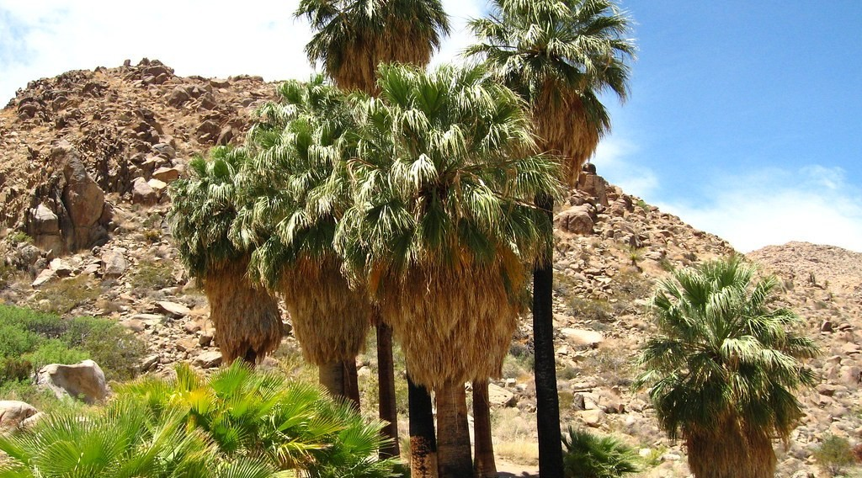
2. OASIS FARMING
Activity 3
A green place in the desert.
Notes:
Activity 3. Look carefully at this picture: a green place in the desert. Observe every detail before I ask the question.

Slide 26
2. OASIS FARMING
Activity 3: Question
Why can people farm at this place?
Notes:
Here is the question for Activity 3: Why can people farm at this place? Take one minute to think and write your answer in your rough notebook.

Slide 27
2. OASIS FARMING
Activity 3: Answer
There is water from a spring or a well: it is an oasis.
Notes:
Let us check the answer together. There is water from a spring or a well: it is an oasis.

Slide 28
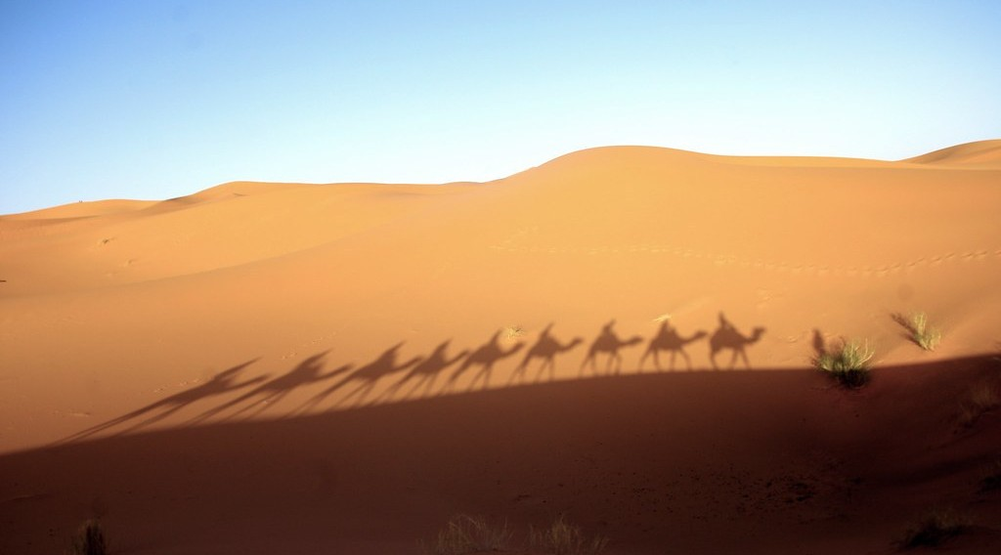
2. PASTORAL NOMADISM
Activity 4
Camels in the desert.
Notes:
Activity 4. Look carefully at this picture: camels in the desert. Observe every detail before I ask the question.

Slide 29
2. PASTORAL NOMADISM
Activity 4: Question
Why is the camel useful in the desert?
Notes:
Here is the question for Activity 4: Why is the camel useful in the desert? Take one minute to think and write your answer in your rough notebook.

Slide 30
2. PASTORAL NOMADISM
Activity 4: Answer
It can walk for days without water and carries people and goods.
Notes:
Let us check the answer together. It can walk for days without water and carries people and goods.

Slide 31

3. PROBLEMS
Activity 5
A sandstorm.
Notes:
Activity 5. Look carefully at this picture: a sandstorm. Observe every detail before I ask the question.

Slide 32
3. PROBLEMS
Activity 5: Question
What problems do sandstorms cause?
Notes:
Here is the question for Activity 5: What problems do sandstorms cause? Take one minute to think and write your answer in your rough notebook.

Slide 33
3. PROBLEMS
Activity 5: Answer
They bury wells and fields and make breathing difficult.
Notes:
Let us check the answer together. They bury wells and fields and make breathing difficult.

Slide 34
BOARD SUMMARY
Board Summary
Topic: Man in his Environment
Sub-topic: Exploitation of Resources in the Natural Environment
Lesson 5: Man in the Hot Desert Milieu
Notes:
Now we are going to copy the board summary. Write the title and the headings neatly in your notebooks. I will give you enough time for each slide, so do not rush.

Slide 35
BOARD SUMMARY
DEFINITIONS
The key terms of this lesson are defined as follows:
Hot desert: It is a very dry and hot area that receives less than 250 mm of rain a year.
Oasis: It is a green place in the desert with water from a spring or a well.
Notes:
Let us copy the definitions. The key terms of this lesson are defined as follows. On this slide we have Hot desert and Oasis. Write each point on a new line, with the key term first, and explain it in your own words when we revise. When you finish, we go to the next slide.

Slide 36
BOARD SUMMARY
DEFINITIONS (continued)
Irrigation: It is bringing water to fields to grow crops.
Notes:
We continue with the definitions. On this slide we have Irrigation. Write each point on a new line, with the key term first, and explain it in your own words when we revise.

Slide 37
BOARD SUMMARY
1. Brief Presentation of Hot Deserts
Hot deserts are presented as follows:
Location: Hot deserts lie near the tropics, like the Sahara, the Kalahari and the Arabian Desert.
Illustration: hot deserts of the world
Notes:
Let us copy Brief Presentation of Hot Deserts. Hot deserts are presented as follows. Copy the point on Location on the left, then draw the diagram on the right: hot deserts of the world. Give it a title and label it clearly.

Slide 38
BOARD SUMMARY
1. Brief Presentation of Hot Deserts
Climate: They receive less than 250 mm of rain, with very hot days and cold nights.
Illustration: a sandy desert
Notes:
Copy the point on Climate on the left, then draw the diagram on the right: a sandy desert. Give it a title and label it clearly.

Slide 39
BOARD SUMMARY
1. Brief Presentation of Hot Deserts
Resources: They have oases, underground water, oil, gas, minerals and sunshine.
Notes:
We continue with Brief Presentation of Hot Deserts. On this slide we have Resources. Write each point on a new line, with the key term first, and explain it in your own words when we revise.

Slide 40
BOARD SUMMARY
2. Traditional Methods of Exploitation
People use the desert in the following traditional ways:
Pastoral nomadism: Nomads such as the Tuareg move with camels, goats and sheep from well to well.
Illustration: camels
Notes:
Let us copy Traditional Methods of Exploitation. People use the desert in the following traditional ways. Copy the point on Pastoral nomadism on the left, then draw the diagram on the right: camels. Give it a title and label it clearly.

Slide 41
BOARD SUMMARY
2. Traditional Methods of Exploitation
Oasis farming: Farmers grow dates, vegetables and cereals under palm trees.
Illustration: an oasis
Notes:
Copy the point on Oasis farming on the left, then draw the diagram on the right: an oasis. Give it a title and label it clearly.

Slide 42
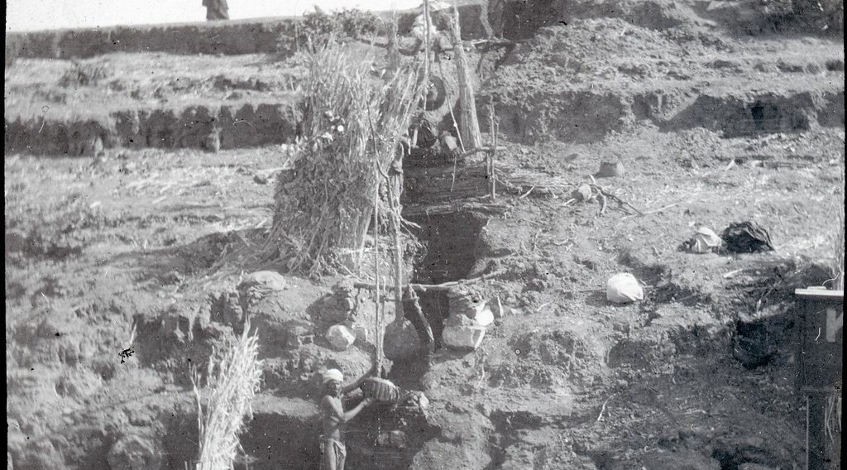
BOARD SUMMARY
2. Traditional Methods of Exploitation
Traditional irrigation: Farmers lift water from wells with tools such as the shaduf.
Illustration: a shaduf
Notes:
Copy the point on Traditional irrigation on the left, then draw the diagram on the right: a shaduf. Give it a title and label it clearly.

Slide 43
BOARD SUMMARY
2. Traditional Methods of Exploitation
Trade: Camel caravans carry salt and goods across the desert.
Notes:
We continue with Traditional Methods of Exploitation. On this slide we have Trade. Write each point on a new line, with the key term first, and explain it in your own words when we revise.

Slide 44

BOARD SUMMARY
3. Problems Faced
People face the following problems:
Lack of water: Wells dry up and water is scarce.
Illustration: a desert well
Notes:
Let us copy Problems Faced. People face the following problems. Copy the point on Lack of water on the left, then draw the diagram on the right: a desert well. Give it a title and label it clearly.

Slide 45
BOARD SUMMARY
3. Problems Faced
Heat and cold: Days are very hot and nights are cold.
Sandstorms: Wind buries wells, fields and roads.
Poor soils: Sand and salt make farming difficult.
Notes:
We continue with Problems Faced. On this slide we have Heat and cold, Sandstorms and Poor soils. Write each point on a new line, with the key term first, and explain it in your own words when we revise.

Slide 46
BOARD SUMMARY
4. Proposed Solutions
The following solutions help people:
Deep wells and boreholes: They bring underground water to the surface.
Notes:
Let us copy Proposed Solutions. The following solutions help people. On this slide we have Deep wells and boreholes. Write each point on a new line, with the key term first, and explain it in your own words when we revise.

Slide 47

BOARD SUMMARY
4. Proposed Solutions
Modern irrigation: Pumps and sprinklers water large fields.
Illustration: modern irrigation
Notes:
Copy the point on Modern irrigation on the left, then draw the diagram on the right: modern irrigation. Give it a title and label it clearly.

Slide 48
BOARD SUMMARY
4. Proposed Solutions
Tree planting: Trees stop moving sand.
Solar energy: Sunshine gives electricity for pumps and homes.
Notes:
We continue with Proposed Solutions. On this slide we have Tree planting and Solar energy. Write each point on a new line, with the key term first, and explain it in your own words when we revise.

Slide 49
FORMATIVE EVALUATION
Evaluation 1
Give two resources of hot deserts.
Notes:
Now let us check what you have understood. Question 1: Give two resources of hot deserts. Answer in your exercise book.

Slide 50
FORMATIVE EVALUATION
Expected Answer
Water at oases and oil.
Notes:
The expected answer is: water at oases and oil. If you got it right, well done.

Slide 51
FORMATIVE EVALUATION
Evaluation 2
Give two problems of the desert.
Notes:
Now let us check what you have understood. Question 2: Give two problems of the desert. Answer in your exercise book.

Slide 52
FORMATIVE EVALUATION
Expected Answer
Lack of water and sandstorms.
Notes:
The expected answer is: lack of water and sandstorms. If you got it right, well done.

Slide 53
REMEDIATION
Remediation
Fill in the blanks:
A green place in the desert with water is an ______.
The animal of the desert is the ______.
Bringing water to fields is ______.
Notes:
For those who need more practice, fill in the blanks in your exercise book. The answers are: number 1, oasis; number 2, camel; number 3, irrigation.

Slide 54
HOMEWORK
Homework
Write three ways people in the Far North of Cameroon save water.
Notes:
For your homework: Write three ways people in the Far North of Cameroon save water. We shall correct it at the beginning of our next lesson.

Slide 55
NEXT LESSON
Next Lesson
Our next lesson will be on:
Further Study 4: Water Scarcity
Notes:
Our next lesson will be on Further Study 4: Water Scarcity. Thank you for your attention, and see you next time.

Slide 56
BILINGUAL GAME
Bilingual Game (Jeu Bilingue)
English | Français
Desert | Le désert
Oasis | L'oasis
Camel | Le chameau
Well | Le puits
Nomad | Le nomade
Sand | Le sable
Notes:
Let us play the bilingual game. I say a word in English, and you give me the French word. Then we do the reverse.

Slide 57
LOGBOOK
Official Logbook (1/2)
Module / Topic | Man in his Environment
Lesson Title | Lesson 5: Man in the Hot Desert Milieu
Expected Learning Outcomes | Locate the hot deserts and describe their climate and resources. Describe the traditional methods of exploitation. Explain the problems faced and propose solutions.
Competence | Learners are able to describe how people live in hot deserts and solve their problems.
Notes:
I record this information in the official logbook of the class after the lesson.

Slide 58
LOGBOOK
Official Logbook (2/2)
Matter Taught | DEFINITIONS; Brief Presentation of Hot Deserts; Traditional Methods of Exploitation; Problems Faced; Proposed Solutions.
Evaluation | Formative evaluation and remediation exercise.
Homework | Write three ways people in the Far North of Cameroon save water.
Enrolment / Present / Absent | ____ / ____ / ____
Achievement | To be completed after the lesson.
Notes:
I complete the second page of the logbook: the matter taught, the evaluation, the homework and the attendance.

Slide 59
TEACHER'S NOTE
Teacher's Note
Timing: Homework correction, plan, objectives 8 min | Recall, situation, action 10 min | 5 activities 30 min | Board summary (copying) 30 min | Evaluation, remediation 10 min | Homework, next lesson 5 min | Logbook 7 min
Without the projector (Activity 1): use the atlas.
Without the projector (Activity 2): compare with Garoua.
Without the projector (Activity 3): list desert resources.
Without the projector (Activity 4): describe nomads of the Far North.
Without the projector (Activity 5): discuss water problems.
Notes:
This slide is for me, the teacher: it gives the timing of the lesson and what to do if the projector is not available.

Slide 60
REFERENCES
References
Geography Syllabus, Forms I–V, MINESEC (2023) — Form 2, Module 1: Man in his Environment.
Photo, Activity 2: “Desert trekking in Merzouga” by Antonio Cinotti , CC BY-NC-ND 2.0, via Flickr (https://www.flickr.com/photos/46378751@N02/15331399979)
Photo, Activity 3: “49 Palms Oasis; Twentynine Palms, CA” by Joshua Tree National Park, Public domain 1.0, via Flickr (https://www.flickr.com/photos/115357548@N08/12525367563)
Photo, Activity 4: “Merzouga desert, Morocco” by Mycroyance, CC BY-ND 2.0, via Flickr (https://www.flickr.com/photos/91155980@N07/13157027505)
Photo, Activity 5: “Sandstorm at Camp Bastion, Afghanistan” by Defence Images, CC BY-NC 2.0, via Flickr (https://www.flickr.com/photos/48399297@N04/10343833885)
Photo, board summary (Traditional irrigation): “A Shadoof” by 10b travelling / Carsten ten Brink, CC BY-NC-ND 2.0, via Flickr (https://www.flickr.com/photos/77334245@N00/5908489998)
Photo, board summary (Lack of water): “Well in the desert” by Focx Photography, CC BY-SA 2.0, via Flickr (https://www.flickr.com/photos/30780900@N02/4117141154)
Notes:
Take your time to copy this part; we will continue together.

Slide 61
REFERENCES
References (continued)
Photo, board summary (Modern irrigation): “Mid-West Agriculture” by Djof, CC BY-NC-SA 2.0, via Flickr (https://www.flickr.com/photos/10787942@N00/147222315)
Diagrams and animations: drawn for this lesson (Geography Department).
Notes:
These are the references and picture credits used to prepare this lesson.

