Slide 1
FORM 2
GEOGRAPHY
Lesson 7
Towns in Africa
Notes:
Good morning, class, and welcome to our geography lesson. I am your geography teacher, Mr Kamdem. Today we are starting Lesson 7: Towns in Africa.

Slide 2
CLASS INFO
Class, Chapter and Duration
Class | Form 2
Chapter | Module 2: Space Occupation
Duration | 2 periods (2 × 50 minutes)
Notes:
This lesson is for Form 2. It belongs to Module 2: Space Occupation. We shall need 2 periods to cover it.

Slide 3
IDENTIFICATION
Lesson Identification
Topic | Space Occupation
Sub-topic | Towns and Country Sides of Africa
Lesson | Lesson 7: Towns in Africa
Notions / Concepts | Town, urban landscape, city, informal sector, megalopolis.
Syllabus focus | Urban landscapes; informal activities; problems of African towns and cities.
Competence | Learners are able to identify, classify and describe African towns, their activities and their problems.
Notes:
Our topic is Space Occupation, and the sub-topic is Towns and Country Sides of Africa. The key notions we shall use today are: town, urban landscape, city, informal sector, megalopolis. At the end, you should be able to do this: learners are able to identify, classify and describe African towns, their activities and their problems.

Slide 4

HOMEWORK CORRECTION
Correction of the Homework
Question (Lesson 6: Country Sides in Africa):
Describe your village or a village you know: its fields, its houses and two attractive aspects.
Notes:
Before we start the new lesson, let us correct the homework I gave you at the end of Lesson 6: Country Sides in Africa. The question was: Describe your village or a village you know: its fields, its houses and two attractive aspects. Take out your exercise books.

Slide 5
HOMEWORK CORRECTION
Correction: Possible Answer
Answers vary. Example: fields of maize and cotton around the village; round mud houses with grass roofs grouped around the chief's compound; fresh food and solidarity at harvest time.
Notes:
Here is a good answer. Answers vary. Example: fields of maize and cotton around the village; round mud houses with grass roofs grouped around the chief's compound; fresh food and solidarity at harvest time. Compare it with your own answer and correct your work in red.

Slide 6
LESSON PLAN
Lesson Plan
Correction of the homework
Objectives and recall
Real-life situation and action to take
Learning activities
Board summary
Evaluation, remediation and homework
Notes:
Here is the plan of our lesson today. First, we shall correct the homework. Then we shall look at the objectives and recall what you already know. After that, we shall study a situation from real life and the action to take, and do the learning activities. Finally, we shall copy the board summary, do the evaluation and the remediation, and I will give you the homework.

Slide 7
OBJECTIVES
Objectives
By the end of this lesson, you should be able to:
Describe the urban landscape of African towns and classify towns.
Identify informal activities in towns.
Notes:
Take your time to copy this part; we will continue together.

Slide 8
OBJECTIVES
Objectives (continued)
Explain the problems of African towns and cities.
Notes:
By the end of this lesson, you should be able to do three things. Number 1: describe the urban landscape of African towns and classify towns. Number 2: identify informal activities in towns. Number 3: explain the problems of African towns and cities.

Slide 9
PREVIOUS KNOWLEDGE
Previous Knowledge
Towns have many people and buildings.
Douala and Yaoundé are big cities.
Many young people move to towns.
Notes:
Let us first remember what you already know. Towns have many people and buildings. Douala and Yaoundé are big cities. Many young people move to towns. Keep this in mind, because we shall build on it today.

Slide 10
REAL-LIFE SITUATION
Situation in Real Life
Ibrahim visits Douala for the first time. He admires the tall buildings and the busy port, but he also sees street sellers everywhere, traffic jams and quarters with poor houses and dirty gutters. He asks his uncle: "Why does such a rich town also have so many problems?"
Notes:
Listen carefully to this situation from real life. Ibrahim visits Douala for the first time. He admires the tall buildings and the busy port, but he also sees street sellers everywhere, traffic jams and quarters with poor houses and dirty gutters. He asks his uncle: "Why does such a rich town also have so many problems?" Think about it, because I am going to ask you some questions.

Slide 11
REAL-LIFE SITUATION
Situation: Question 1
What is the problem in the situation?
Notes:
Question 1: What is the problem in the situation? Think for a moment, then raise your hand to answer.

Slide 12
REAL-LIFE SITUATION
Answer
Ibrahim does not understand why a big, rich town also has many problems.
Notes:
Good. Ibrahim does not understand why a big, rich town also has many problems.

Slide 13
REAL-LIFE SITUATION
Situation: Question 2
Name two things he admires.
Notes:
Question 2: Name two things he admires. Think for a moment, then raise your hand to answer.

Slide 14
REAL-LIFE SITUATION
Answer
Tall buildings and the busy port.
Notes:
Good. Tall buildings and the busy port.

Slide 15
REAL-LIFE SITUATION
Situation: Question 3
Name two problems of the town.
Notes:
Question 3: Name two problems of the town. Think for a moment, then raise your hand to answer.

Slide 16
REAL-LIFE SITUATION
Possible Answer
Traffic jams and poor quarters with dirty gutters.
Notes:
Good. Traffic jams and poor quarters with dirty gutters.

Slide 17
ACTION TO TAKE
Action to Take
Keep your town clean and respect traffic rules.
Notes:
From this situation, the action we are working towards in this lesson is the following: keep your town clean and respect traffic rules.

Slide 18
JUSTIFICATION
Justification of the Lesson
This lesson helps us to understand life and problems in African towns.
Notes:
Why is this lesson important for you? This lesson helps us to understand life and problems in African towns.

Slide 19

1. URBAN LANDSCAPE
Activity 1
Yaoundé.
Notes:
Activity 1. Look carefully at this picture: yaoundé. Observe every detail before I ask the question.

Slide 20
1. URBAN LANDSCAPE
Activity 1: Question
What shows that this place is a town and not a village?
Notes:
Here is the question for Activity 1: What shows that this place is a town and not a village? Take one minute to think and write your answer in your rough notebook.

Slide 21
1. URBAN LANDSCAPE
Activity 1: Answer
Tall buildings, many roads and cars, and dense housing.
Notes:
Let us check the answer together. Tall buildings, many roads and cars, and dense housing.

Slide 22

1. URBAN LANDSCAPE
Activity 2
The main towns of Cameroon.
Notes:
Activity 2. Look carefully at this diagram: the main towns of Cameroon. Observe every detail before I ask the question.

Slide 23
1. URBAN LANDSCAPE
Activity 2: Question 1
Which are the two largest towns of Cameroon?
Notes:
Here is the question for Activity 2: Which are the two largest towns of Cameroon? Take one minute to think and write your answer in your rough notebook.

Slide 24
1. URBAN LANDSCAPE
Activity 2: Answer 1
Douala and Yaoundé.
Notes:
Let us check the answer together. Douala and Yaoundé.

Slide 25
1. URBAN LANDSCAPE
Activity 2: Question 2
Is Garoua bigger or smaller than them?
Notes:
Here is the next question: Is Garoua bigger or smaller than them? Take one minute to think and write your answer in your rough notebook.

Slide 26
1. URBAN LANDSCAPE
Activity 2: Answer 2
Smaller: it is a medium-sized town.
Notes:
Let us check the answer together. Smaller: it is a medium-sized town.

Slide 27

2. INFORMAL ACTIVITIES
Activity 3
A street seller roasting maize.
Notes:
Activity 3. Look carefully at this picture: a street seller roasting maize. Observe every detail before I ask the question.

Slide 28
2. INFORMAL ACTIVITIES
Activity 3: Question
Does this seller have a shop, a contract or a registered business?
Notes:
Here is the question for Activity 3: Does this seller have a shop, a contract or a registered business? Take one minute to think and write your answer in your rough notebook.

Slide 29
2. INFORMAL ACTIVITIES
Activity 3: Answer
No: he works on the street without registration; this is an informal activity.
Notes:
Let us check the answer together. No: he works on the street without registration; this is an informal activity.

Slide 30

3. PROBLEMS
Activity 4
A traffic jam.
Notes:
Activity 4. Look carefully at this picture: a traffic jam. Observe every detail before I ask the question.

Slide 31
3. PROBLEMS
Activity 4: Question
Why are there traffic jams in big African towns?
Notes:
Here is the question for Activity 4: Why are there traffic jams in big African towns? Take one minute to think and write your answer in your rough notebook.

Slide 32
3. PROBLEMS
Activity 4: Answer
There are too many vehicles for narrow and badly maintained roads.
Notes:
Let us check the answer together. There are too many vehicles for narrow and badly maintained roads.

Slide 33

3. PROBLEMS
Activity 5
A crowded poor quarter.
Notes:
Activity 5. Look carefully at this picture: a crowded poor quarter. Observe every detail before I ask the question.

Slide 34
3. PROBLEMS
Activity 5: Question
What problem of African towns does this picture show?
Notes:
Here is the question for Activity 5: What problem of African towns does this picture show? Take one minute to think and write your answer in your rough notebook.

Slide 35
3. PROBLEMS
Activity 5: Answer
Poor housing: a slum, crowded and without services.
Notes:
Let us check the answer together. Poor housing: a slum, crowded and without services.

Slide 36
BOARD SUMMARY
Board Summary
Topic: Space Occupation
Sub-topic: Towns and Country Sides of Africa
Lesson 7: Towns in Africa
Notes:
Now we are going to copy the board summary. Write the title and the headings neatly in your notebooks. I will give you enough time for each slide, so do not rush.

Slide 37
BOARD SUMMARY
DEFINITIONS
The key terms of this lesson are defined as follows:
Town: It is a large, dense settlement where most people work in trade, industry and services.
City: It is a large and important town.
Notes:
Let us copy the definitions. The key terms of this lesson are defined as follows. On this slide we have Town and City. Write each point on a new line, with the key term first, and explain it in your own words when we revise. When you finish, we go to the next slide.

Slide 38
BOARD SUMMARY
DEFINITIONS (continued)
Megalopolis: It is a very large urban region formed when several big cities grow and join together.
Informal sector: It is all the small economic activities that are not registered and do not pay taxes regularly.
Notes:
We continue with the definitions. On this slide we have Megalopolis and Informal sector. Write each point on a new line, with the key term first, and explain it in your own words when we revise.

Slide 39
BOARD SUMMARY
1. Urban Landscapes
A) Elements of the Urban Landscape
An African town has the following parts:
The centre (Central Business District): It has offices, banks, big shops and tall buildings.
Illustration: the centre of Yaoundé
Notes:
Let us copy Elements of the Urban Landscape. An African town has the following parts. Copy the point on The centre (Central Business District) on the left, then draw the diagram on the right: the centre of Yaoundé. Give it a title and label it clearly.

Slide 40

BOARD SUMMARY
1. Urban Landscapes
A) Elements of the Urban Landscape
Rich residential quarters: They have large houses, gardens, tarred roads and all services.
Illustration: a rich residential quarter
Notes:
Copy the point on Rich residential quarters on the left, then draw the diagram on the right: a rich residential quarter. Give it a title and label it clearly.

Slide 41
BOARD SUMMARY
1. Urban Landscapes
A) Elements of the Urban Landscape
Poor quarters (slums): They are crowded, with poor houses and few roads, drains or water points.
Illustration: a poor quarter
Notes:
Copy the point on Poor quarters (slums) on the left, then draw the diagram on the right: a poor quarter. Give it a title and label it clearly.

Slide 42
BOARD SUMMARY
1. Urban Landscapes
A) Elements of the Urban Landscape
Industrial zones and ports: Factories, warehouses and ports are found near railways, rivers or the sea, as in Douala.
Notes:
We continue with Elements of the Urban Landscape. On this slide we have Industrial zones and ports. Write each point on a new line, with the key term first, and explain it in your own words when we revise.

Slide 43

BOARD SUMMARY
1. Urban Landscapes
A) Elements of the Urban Landscape
Markets and transport areas: Big markets, bus stations and motor parks are crowded at all times.
Illustration: a bus station
Notes:
Copy the point on Markets and transport areas on the left, then draw the diagram on the right: a bus station. Give it a title and label it clearly.

Slide 44
BOARD SUMMARY
1. Urban Landscapes
B) Classification of Towns by Size
Towns can be classified by their size as follows:
Small towns: They have a few thousand to about 50,000 people, such as Poli and Tcholliré.
Notes:
Let us copy Classification of Towns by Size. Towns can be classified by their size as follows. On this slide we have Small towns. Write each point on a new line, with the key term first, and explain it in your own words when we revise. When you finish, we go to the next slide.

Slide 45
BOARD SUMMARY
1. Urban Landscapes
B) Classification of Towns by Size (continued)
Medium-sized towns: They have about 50,000 to 1 million people, such as Garoua, Maroua and Bamenda.
Notes:
We continue with Classification of Towns by Size. On this slide we have Medium-sized towns. Write each point on a new line, with the key term first, and explain it in your own words when we revise.

Slide 46
BOARD SUMMARY
1. Urban Landscapes
B) Classification of Towns by Size
Millionaire cities: They have more than 1 million people, such as Douala, Yaoundé and Kinshasa.
Illustration: the main towns of Cameroon
Notes:
Copy the point on Millionaire cities on the left, then draw the diagram on the right: the main towns of Cameroon. Give it a title and label it clearly.

Slide 47
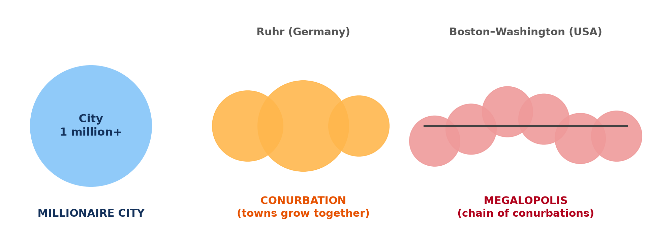
BOARD SUMMARY
1. Urban Landscapes
B) Classification of Towns by Size
Megalopolises: They are chains of big cities joined together, such as the Lagos–Ibadan area in Nigeria.
Illustration: city, conurbation and megalopolis
Notes:
Copy the point on Megalopolises on the left, then draw the diagram on the right: city, conurbation and megalopolis. Give it a title and label it clearly.

Slide 48
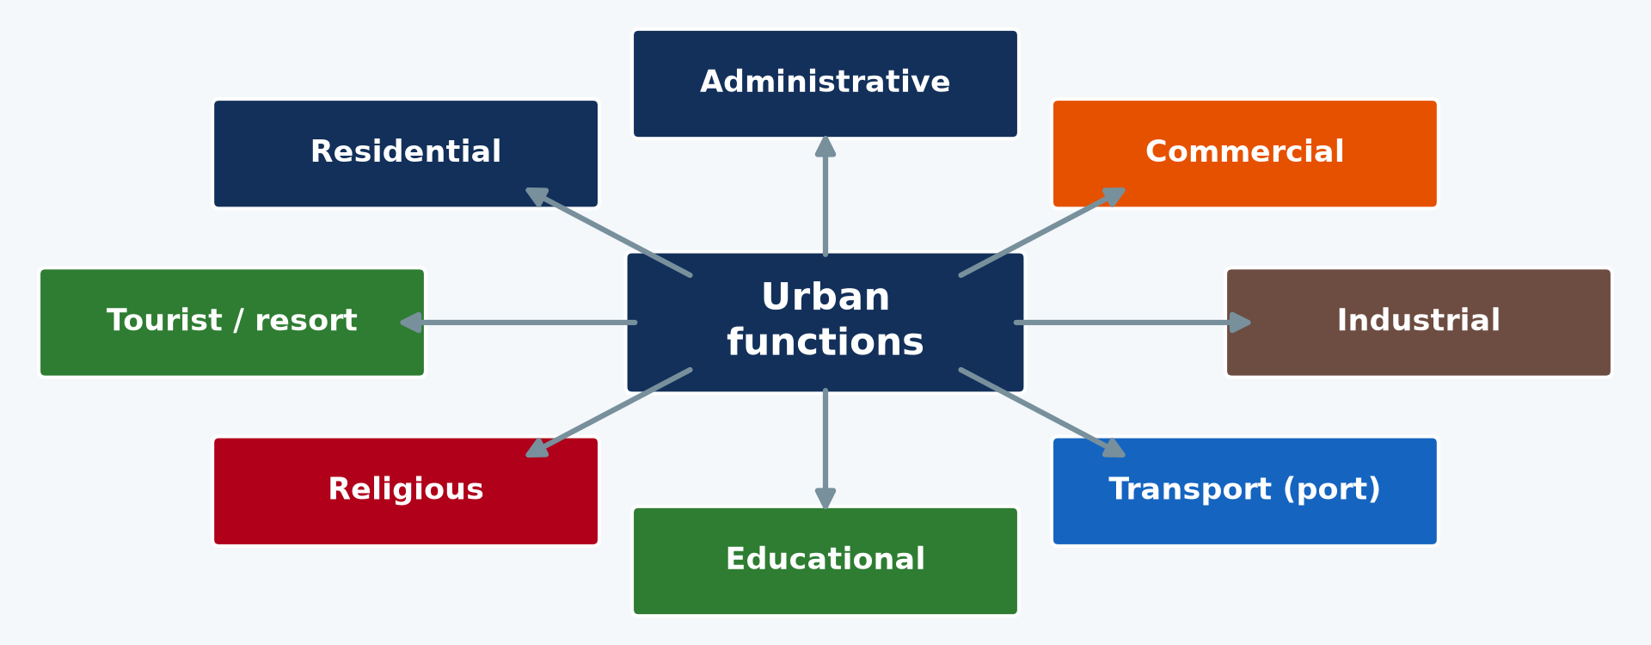
BOARD SUMMARY
1. Urban Landscapes
C) Classification of Towns by Function
Towns can also be classified by their main function:
Administrative towns: They are seats of government, such as Yaoundé, the political capital.
Illustration: urban functions
Notes:
Let us copy Classification of Towns by Function. Towns can also be classified by their main function. Copy the point on Administrative towns on the left, then draw the diagram on the right: urban functions. Give it a title and label it clearly.

Slide 49
BOARD SUMMARY
1. Urban Landscapes
C) Classification of Towns by Function
Commercial and port towns: They live from trade and ports, such as Douala and Kribi.
Industrial towns: They have many factories, such as Edéa with its aluminium plant.
Notes:
We continue with Classification of Towns by Function. On this slide we have Commercial and port towns and Industrial towns. Write each point on a new line, with the key term first, and explain it in your own words when we revise. When you finish, we go to the next slide.

Slide 50
BOARD SUMMARY
1. Urban Landscapes
C) Classification of Towns by Function (continued)
Educational and religious towns: They have universities or religious centres, such as Buea, Dschang and Ngaoundéré.
Notes:
We continue with Classification of Towns by Function. On this slide we have Educational and religious towns. Write each point on a new line, with the key term first, and explain it in your own words when we revise.

Slide 51
BOARD SUMMARY
2. Informal Activities
Many town dwellers work in the following informal activities:
Street trade: Sellers of food, fruits, clothes and phone credit work on the streets and in markets.
Illustration: a street seller
Notes:
Let us copy Informal Activities. Many town dwellers work in the following informal activities. Copy the point on Street trade on the left, then draw the diagram on the right: a street seller. Give it a title and label it clearly.

Slide 52

BOARD SUMMARY
2. Informal Activities
Transport: Moto-taxis and clandestine taxis carry people across the town.
Illustration: moto-taxis
Notes:
Copy the point on Transport on the left, then draw the diagram on the right: moto-taxis. Give it a title and label it clearly.

Slide 53
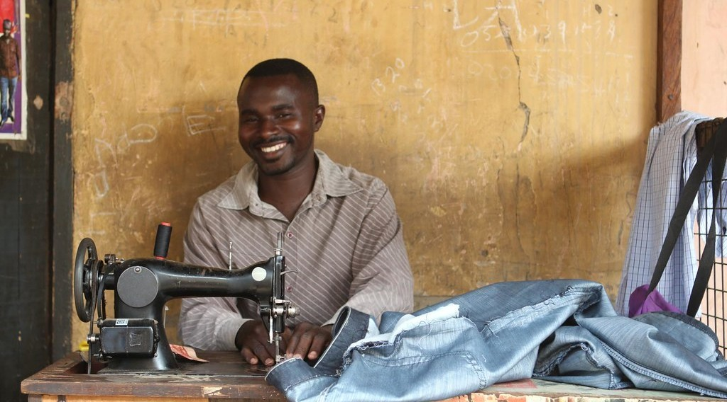
BOARD SUMMARY
2. Informal Activities
Crafts: Tailors, carpenters, blacksmiths and hairdressers work in small workshops.
Illustration: a tailor
Notes:
Copy the point on Crafts on the left, then draw the diagram on the right: a tailor. Give it a title and label it clearly.

Slide 54
BOARD SUMMARY
2. Informal Activities
Repairs and services: Mechanics, shoe repairers, phone repairers and mobile money agents serve the population.
Notes:
We continue with Informal Activities. On this slide we have Repairs and services. Write each point on a new line, with the key term first, and explain it in your own words when we revise.

Slide 55
BOARD SUMMARY
3. Problems of African Towns and Cities
African towns and cities face the following problems:
Unemployment: There are not enough jobs for the many young people who arrive from villages.
Notes:
Let us copy Problems of African Towns and Cities. African towns and cities face the following problems. On this slide we have Unemployment. Write each point on a new line, with the key term first, and explain it in your own words when we revise.

Slide 56
BOARD SUMMARY
3. Problems of African Towns and Cities
Poor housing (slums): Many people live in crowded quarters without water, drains or electricity.
Illustration: a slum
Notes:
Copy the point on Poor housing (slums) on the left, then draw the diagram on the right: a slum. Give it a title and label it clearly.

Slide 57
BOARD SUMMARY
3. Problems of African Towns and Cities
Traffic jams: Roads are too narrow for the growing number of vehicles.
Illustration: a traffic jam
Notes:
Copy the point on Traffic jams on the left, then draw the diagram on the right: a traffic jam. Give it a title and label it clearly.

Slide 58

BOARD SUMMARY
3. Problems of African Towns and Cities
Waste and floods: Rubbish blocks the gutters, and quarters are flooded after heavy rain.
Illustration: a flooded street
Notes:
Copy the point on Waste and floods on the left, then draw the diagram on the right: a flooded street. Give it a title and label it clearly.

Slide 59
BOARD SUMMARY
3. Problems of African Towns and Cities
Insecurity: Poverty and unemployment favour theft and aggression.
Lack of social amenities: Schools, hospitals, water and electricity are not enough for everybody.
Notes:
We continue with Problems of African Towns and Cities. On this slide we have Insecurity and Lack of social amenities. Write each point on a new line, with the key term first, and explain it in your own words when we revise.

Slide 60
FORMATIVE EVALUATION
Evaluation 1
Give two informal activities.
Notes:
Now let us check what you have understood. Question 1: Give two informal activities. Answer in your exercise book.

Slide 61
FORMATIVE EVALUATION
Expected Answer
Street selling and moto-taxi driving.
Notes:
The expected answer is: street selling and moto-taxi driving. If you got it right, well done.

Slide 62
FORMATIVE EVALUATION
Evaluation 2
Give three problems of African towns.
Notes:
Now let us check what you have understood. Question 2: Give three problems of African towns. Answer in your exercise book.

Slide 63
FORMATIVE EVALUATION
Expected Answer
Traffic jams, unemployment and slums.
Notes:
The expected answer is: traffic jams, unemployment and slums. If you got it right, well done.

Slide 64
REMEDIATION
Remediation
Fill in the blanks:
Small unregistered jobs form the ______ sector.
A crowded poor quarter is a ______.
A town of more than one million people is a ______ city.
Notes:
For those who need more practice, fill in the blanks in your exercise book. The answers are: number 1, informal; number 2, slum; number 3, millionaire.

Slide 65
HOMEWORK
Homework
List five informal activities you see on your way to school.
Notes:
For your homework: List five informal activities you see on your way to school. We shall correct it at the beginning of our next lesson.

Slide 66
NEXT LESSON
Next Lesson
Our next lesson will be on:
Further Study 5: Informal Sector Activities in African Cities
Notes:
Our next lesson will be on Further Study 5: Informal Sector Activities in African Cities. Thank you for your attention, and see you next time.

Slide 67
BILINGUAL GAME
Bilingual Game (Jeu Bilingue)
English | Français
Town | La ville
City | La grande ville
Traffic jam | L'embouteillage
Slum | Le bidonville
Street seller | Le vendeur ambulant
Unemployment | Le chômage
Notes:
Let us play the bilingual game. I say a word in English, and you give me the French word. Then we do the reverse.

Slide 68
LOGBOOK
Official Logbook (1/2)
Module / Topic | Space Occupation
Lesson Title | Lesson 7: Towns in Africa
Expected Learning Outcomes | Describe the urban landscape of African towns and classify towns. Identify informal activities in towns. Explain the problems of African towns and cities.
Competence | Learners are able to identify, classify and describe African towns, their activities and their problems.
Notes:
I record this information in the official logbook of the class after the lesson.

Slide 69
LOGBOOK
Official Logbook (2/2)
Matter Taught | DEFINITIONS; Elements of the Urban Landscape; Classification of Towns by Size; Classification of Towns by Function; Informal Activities; Problems of African Towns and Cities.
Evaluation | Formative evaluation and remediation exercise.
Homework | List five informal activities you see on your way to school.
Enrolment / Present / Absent | ____ / ____ / ____
Achievement | To be completed after the lesson.
Notes:
I complete the second page of the logbook: the matter taught, the evaluation, the homework and the attendance.

Slide 70
TEACHER'S NOTE
Teacher's Note
Timing: Homework correction, plan, objectives 8 min | Recall, situation, action 10 min | 5 activities 30 min | Board summary (copying) 30 min | Evaluation, remediation 10 min | Homework, next lesson 5 min | Logbook 7 min
Without the projector (Activity 1): describe the centre of Garoua.
Without the projector (Activity 2): use the atlas.
Without the projector (Activity 3): list small jobs in town.
Without the projector (Activity 4): describe rush hour in town.
Without the projector (Activity 5): discuss poor quarters of Garoua.
Notes:
This slide is for me, the teacher: it gives the timing of the lesson and what to do if the projector is not available.

Slide 71
REFERENCES
References
Geography Syllabus, Forms I–V, MINESEC (2023) — Form 2, Module 2: Space Occupation.
Photo, Activity 1: “Yaoundé” by wili_hybrid, CC BY-NC 2.0, via Flickr (https://www.flickr.com/photos/62223880@N00/5677034246)
Photo, Activity 3: “Roadside vendor roasts maize cobs for sale in Timau” by CIMMYT, CC BY-NC 2.0, via Flickr (https://www.flickr.com/photos/44760652@N05/25375356457)
Photo, Activity 4: “Nairobi Traffic Jam” by rogiro, CC BY-NC 2.0, via Flickr (https://www.flickr.com/photos/43132185@N00/48712135)
Photo, Activity 5: “Mathare” by Book Aid International, CC BY-NC-ND 2.0, via Flickr (https://www.flickr.com/photos/45024905@N07/4135561707)
Photo, board summary (Rich residential quarters): “Chicago suburbs from the air” by Scorpions and Centaurs, CC BY-NC-SA 2.0, via Flickr (https://www.flickr.com/photos/62736719@N00/2912708983)
Photo, board summary (Markets and transport areas): “Wadi Halfa Bus Station” by D-Stanley, CC BY 2.0, via Flickr (https://www.flickr.com/photos/79721788@N00/8651154444)
Notes:
Take your time to copy this part; we will continue together.

Slide 72
REFERENCES
References (continued)
Photo, board summary (Transport): “Cameroon - UN Women's Gender Road Project” by UN Women Gallery, CC BY-NC-ND 2.0, via Flickr (https://www.flickr.com/photos/51431730@N04/47586053052)
Photo, board summary (Crafts): “A tailor of Wa” by 10b travelling / Carsten ten Brink, CC BY-NC-ND 2.0, via Flickr (https://www.flickr.com/photos/77334245@N00/8154947468)
Photo, board summary (Waste and floods): “Vicenza flooding Nov.1, 2010” by US Army Africa, CC BY 2.0, via Flickr (https://www.flickr.com/photos/36281822@N08/5157191333)
Diagrams and animations: drawn for this lesson (Geography Department).
Notes:
These are the references and picture credits used to prepare this lesson.

