Slide 1
FORM 4
GEOGRAPHY
Lesson 1
Our Planet, the Earth: Size, Shape and Proofs
Notes:
Good morning, class, and welcome to our geography lesson. I am your geography teacher, Mr Kamdem. Today we are starting Lesson 1: Our Planet, the Earth: Size, Shape and Proofs.

Slide 2
CLASS INFO
Class, Chapter and Duration
Class | Form 4
Chapter | The Earth as a Planet in the Solar System — The Earth as a Planet of the Solar System
Duration | 50 minutes
Notes:
This lesson is for Form 4. It belongs to The Earth as a Planet in the Solar System — The Earth as a Planet of the Solar System. We shall need 50 minutes to cover it.

Slide 3
IDENTIFICATION
Lesson Identification
Topic | The Earth as a Planet in the Solar System
Sub-topic | The Earth as a Planet of the Solar System
Lesson | Lesson 1: Our Planet, the Earth: Size, Shape and Proofs
Notions / Concepts | Sphere, oblate spheroid, circumference, diameter, horizon.
Syllabus focus | Size of the Earth; shape of the Earth; proofs of the shape of the Earth.
Competence | Learners are able to explain, with everyday observations, why the Earth is round and to give its main measurements.
Notes:
Our topic is The Earth as a Planet in the Solar System, and the sub-topic is The Earth as a Planet of the Solar System. The key notions we shall use today are: sphere, oblate spheroid, circumference, diameter, horizon. At the end, you should be able to do this: learners are able to explain, with everyday observations, why the Earth is round and to give its main measurements.

Slide 4

LESSON PLAN
Lesson Plan
Objectives and recall
Real-life situation and action to take
Learning activities
Board summary
Evaluation, remediation and homework
Notes:
Here is the plan of our lesson today. First, we shall look at the objectives and recall what you already know. After that, we shall study a situation from real life and the action to take, and do the learning activities. Finally, we shall copy the board summary, do the evaluation and the remediation, and I will give you the homework.

Slide 5
OBJECTIVES
Objectives
By the end of this lesson, you should be able to:
Give the size of the Earth: its circumferences and diameters.
Describe the true shape of the Earth (an oblate spheroid).
Notes:
Take your time to copy this part; we will continue together.

Slide 6
OBJECTIVES
Objectives (continued)
Explain at least four proofs that the Earth is round.
Notes:
By the end of this lesson, you should be able to do three things. Number 1: give the size of the Earth: its circumferences and diameters. Number 2: describe the true shape of the Earth (an oblate spheroid). Number 3: explain at least four proofs that the Earth is round.

Slide 7
PREVIOUS KNOWLEDGE
Previous Knowledge
The Earth is one of the eight planets of the solar system.
The Earth moves around the Sun.
We live on the surface of the Earth, which is made of land and water.
Notes:
Let us first remember what you already know. The Earth is one of the eight planets of the solar system. The Earth moves around the Sun. We live on the surface of the Earth, which is made of land and water. Keep this in mind, because we shall build on it today.

Slide 8
REAL-LIFE SITUATION
Situation in Real Life
On a long, straight road, Aïcha sees a lorry coming from far away: first she sees only its top, then the whole lorry. Her brother says that the Earth is flat. Aïcha asks: "If the Earth is flat, why did I see the top of the lorry first?"
Notes:
Listen carefully to this situation from real life. On a long, straight road, Aïcha sees a lorry coming from far away: first she sees only its top, then the whole lorry. Her brother says that the Earth is flat. Aïcha asks: "If the Earth is flat, why did I see the top of the lorry first?" Think about it, because I am going to ask you some questions.

Slide 9
REAL-LIFE SITUATION
Situation: Question 1
What is the problem in the situation?
Notes:
Question 1: What is the problem in the situation? Think for a moment, then raise your hand to answer.

Slide 10
REAL-LIFE SITUATION
Answer
Aïcha cannot explain why she saw the top of the lorry first, and her brother thinks that the Earth is flat.
Notes:
Good. Aïcha cannot explain why she saw the top of the lorry first, and her brother thinks that the Earth is flat.

Slide 11
REAL-LIFE SITUATION
Situation: Question 2
Which part of the lorry did she see first?
Notes:
Question 2: Which part of the lorry did she see first? Think for a moment, then raise your hand to answer.

Slide 12
REAL-LIFE SITUATION
Answer
She saw the top of the lorry first.
Notes:
Good. She saw the top of the lorry first.

Slide 13
REAL-LIFE SITUATION
Situation: Question 3
What does this show about the shape of the Earth?
Notes:
Question 3: What does this show about the shape of the Earth? Think for a moment, then raise your hand to answer.

Slide 14
REAL-LIFE SITUATION
Possible Answer
It shows that the surface of the Earth is curved: the Earth is round.
Notes:
Good. It shows that the surface of the Earth is curved: the Earth is round.

Slide 15
ACTION TO TAKE
Action to Take
Use everyday observations to show that the Earth is round.
Notes:
From this situation, the action we are working towards in this lesson is the following: use everyday observations to show that the Earth is round.

Slide 16
JUSTIFICATION
Justification of the Lesson
This lesson helps us to know the size and the shape of our planet.
Notes:
Why is this lesson important for you? This lesson helps us to know the size and the shape of our planet.

Slide 17

2. SHAPE OF THE EARTH
Activity 1
The Earth seen from space.
Notes:
Activity 1. Look carefully at this picture: the Earth seen from space. Observe every detail before I ask the question.

Slide 18
2. SHAPE OF THE EARTH
Activity 1: Question
What is the shape of the Earth on this photo?
Notes:
Here is the question for Activity 1: What is the shape of the Earth on this photo? Take one minute to think and write your answer in your rough notebook.

Slide 19
2. SHAPE OF THE EARTH
Activity 1: Answer
It is round, like a ball.
Notes:
Let us check the answer together. It is round, like a ball.

Slide 20
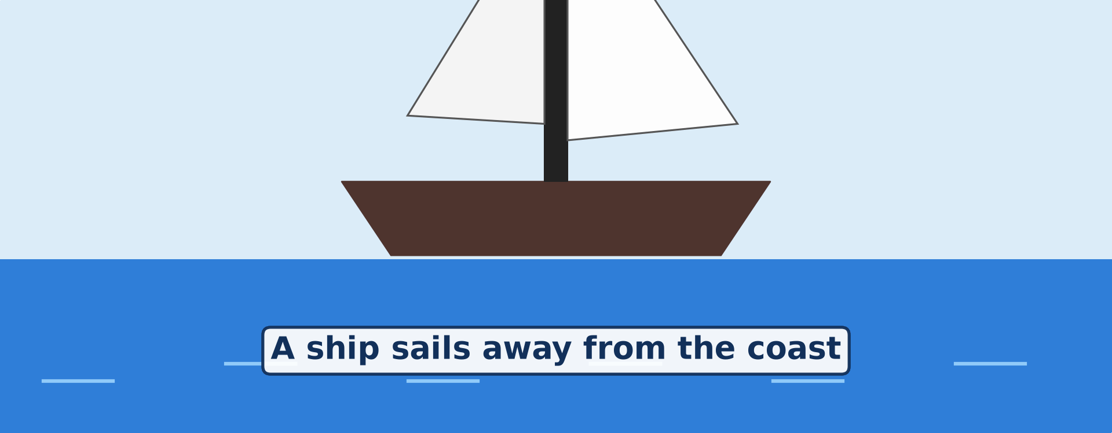
3. PROOFS OF THE SHAPE
Activity 2
Animation: a ship sails away from the coast.
Notes:
Activity 2. Look carefully at this animation: animation: a ship sails away from the coast. Watch the animation to the end; it will play again.

Slide 21
3. PROOFS OF THE SHAPE
Activity 2: Question 1
Which part of the ship disappears first?
Notes:
Here is the question for Activity 2: Which part of the ship disappears first? Take one minute to think and write your answer in your rough notebook.

Slide 22
3. PROOFS OF THE SHAPE
Activity 2: Answer 1
The bottom of the ship.
Notes:
Let us check the answer together. The bottom of the ship.

Slide 23
3. PROOFS OF THE SHAPE
Activity 2: Question 2
Why does it disappear first?
Notes:
Here is the next question: Why does it disappear first? Take one minute to think and write your answer in your rough notebook.

Slide 24
3. PROOFS OF THE SHAPE
Activity 2: Answer 2
The ship goes down behind the curve of the Earth.
Notes:
Let us check the answer together. The ship goes down behind the curve of the Earth.

Slide 25
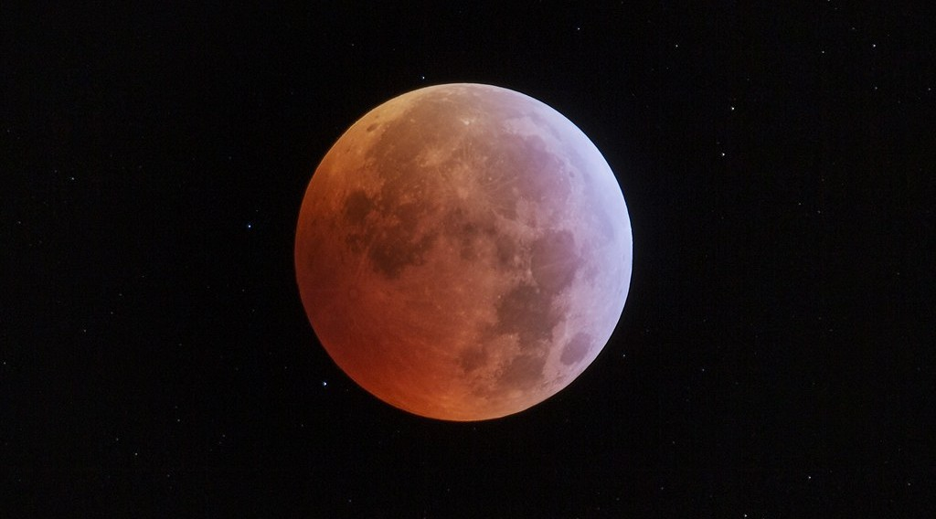
3. PROOFS OF THE SHAPE
Activity 3
An eclipse of the Moon.
Notes:
Activity 3. Look carefully at this picture: an eclipse of the Moon. Observe every detail before I ask the question.

Slide 26
3. PROOFS OF THE SHAPE
Activity 3: Question
The shadow of the Earth on the Moon is always curved. What does this prove?
Notes:
Here is the question for Activity 3: The shadow of the Earth on the Moon is always curved. What does this prove? Take one minute to think and write your answer in your rough notebook.

Slide 27
3. PROOFS OF THE SHAPE
Activity 3: Answer
The Earth is round: only a round object always gives a round shadow.
Notes:
Let us check the answer together. The Earth is round: only a round object always gives a round shadow.

Slide 28
BOARD SUMMARY
Board Summary
Topic: The Earth as a Planet in the Solar System
Sub-topic: The Earth as a Planet of the Solar System
Lesson 1: Our Planet, the Earth: Size, Shape and Proofs
Notes:
Now we are going to copy the board summary. Write the title and the headings neatly in your notebooks. I will give you enough time for each slide, so do not rush.

Slide 29
BOARD SUMMARY
DEFINITIONS
The key terms of this lesson are defined as follows:
Planet: It is a large round body that moves around the Sun.
Circumference: It is the distance around a circle or a sphere.
Notes:
Let us copy the definitions. The key terms of this lesson are defined as follows. On this slide we have Planet and Circumference. Write each point on a new line, with the key term first, and explain it in your own words when we revise. When you finish, we go to the next slide.

Slide 30
BOARD SUMMARY
DEFINITIONS (continued)
Diameter: It is the distance from one side of a sphere to the other, through its centre.
Oblate spheroid: It is a ball that is flattened at the poles and bulging at the Equator.
Notes:
We continue with the definitions. On this slide we have Diameter and Oblate spheroid. Write each point on a new line, with the key term first, and explain it in your own words when we revise.

Slide 31
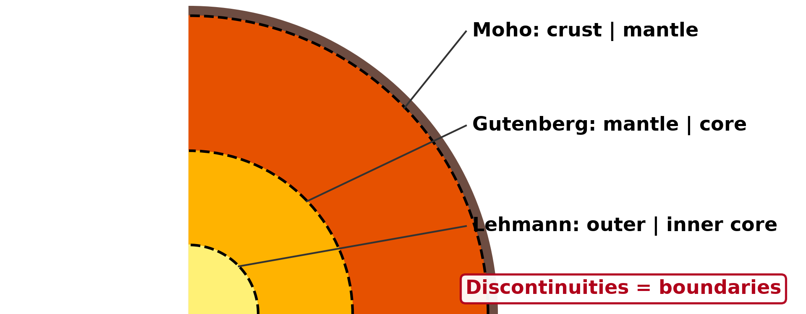
BOARD SUMMARY
1. The Size of the Earth
The main measurements of the Earth are the following:
Equatorial circumference: The distance around the Earth at the Equator is about 40,075 km.
Illustration: the Earth
Notes:
Let us copy The Size of the Earth. The main measurements of the Earth are the following. Copy the point on Equatorial circumference on the left, then draw the diagram on the right: the Earth. Give it a title and label it clearly.

Slide 32
BOARD SUMMARY
1. The Size of the Earth
Polar circumference: The distance around the Earth through the poles is about 40,008 km.
Equatorial diameter: The diameter of the Earth at the Equator is about 12,756 km.
Polar diameter: The diameter of the Earth from pole to pole is about 12,714 km.
Notes:
We continue with The Size of the Earth. On this slide we have Polar circumference, Equatorial diameter and Polar diameter. Write each point on a new line, with the key term first, and explain it in your own words when we revise. When you finish, we go to the next slide.

Slide 33
BOARD SUMMARY
1. The Size of the Earth (continued)
Surface area: The total surface of the Earth is about 510 million km².
Notes:
We continue with The Size of the Earth. On this slide we have Surface area. Write each point on a new line, with the key term first, and explain it in your own words when we revise.

Slide 34
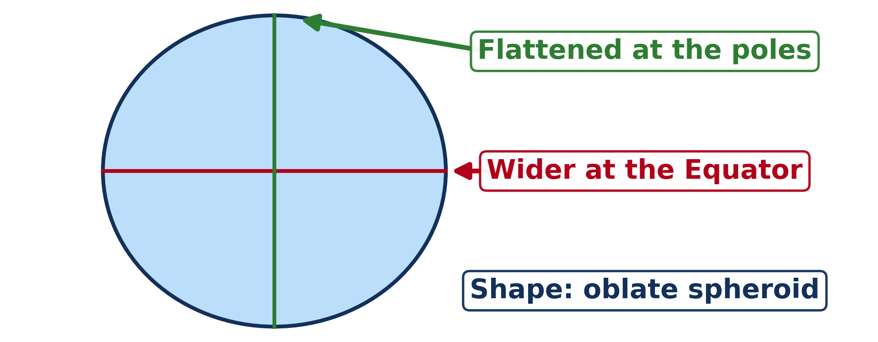
BOARD SUMMARY
2. The Shape of the Earth
The shape of the Earth is described as follows:
Oblate spheroid: The Earth is round, slightly flattened at the poles and bulging at the Equator.
Illustration: the shape of the Earth
Notes:
Let us copy The Shape of the Earth. The shape of the Earth is described as follows. Copy the point on Oblate spheroid on the left, then draw the diagram on the right: the shape of the Earth. Give it a title and label it clearly.

Slide 35
BOARD SUMMARY
2. The Shape of the Earth
Evidence from the measurements: The equatorial diameter is about 42 km longer than the polar diameter.
Notes:
We continue with The Shape of the Earth. On this slide we have Evidence from the measurements. Write each point on a new line, with the key term first, and explain it in your own words when we revise.

Slide 36
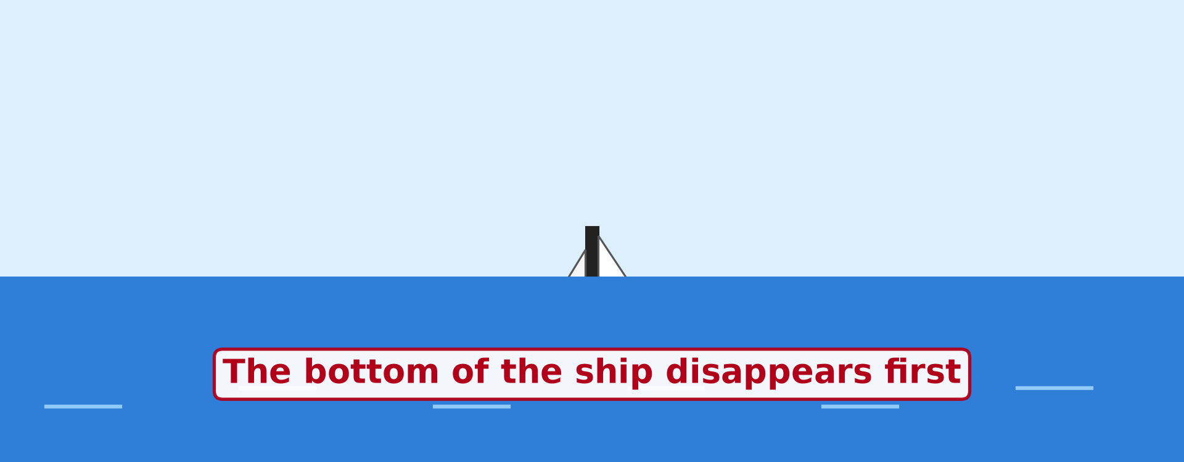
BOARD SUMMARY
3. Proofs that the Earth Is Spherical
The following observations prove that the Earth is round:
The ship at sea: When a ship sails away, its bottom disappears first and its top last.
Illustration: the ship at sea
Notes:
Let us copy Proofs that the Earth Is Spherical. The following observations prove that the Earth is round. Copy the point on The ship at sea on the left, then draw the diagram on the right: the ship at sea. Give it a title and label it clearly.

Slide 37
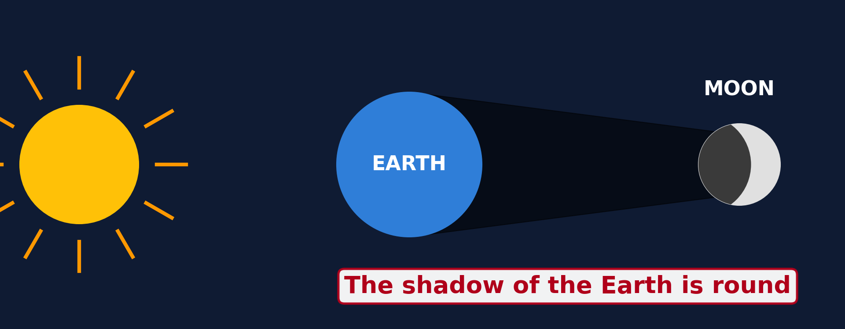
BOARD SUMMARY
3. Proofs that the Earth Is Spherical
The eclipse of the Moon: The shadow of the Earth on the Moon is always curved.
Illustration: an eclipse of the Moon
Notes:
Copy the point on The eclipse of the Moon on the left, then draw the diagram on the right: an eclipse of the Moon. Give it a title and label it clearly.

Slide 38
BOARD SUMMARY
3. Proofs that the Earth Is Spherical
Photos from space: Photos taken from satellites and spacecraft show a round Earth.
Illustration: the Earth seen from space
Notes:
Copy the point on Photos from space on the left, then draw the diagram on the right: the Earth seen from space. Give it a title and label it clearly.

Slide 39
BOARD SUMMARY
3. Proofs that the Earth Is Spherical
Travel around the world: A traveller who goes always in one direction comes back to the starting point.
The circular horizon: From a high place, the horizon is always a circle, and it widens as we go higher.
Notes:
We continue with Proofs that the Earth Is Spherical. On this slide we have Travel around the world and The circular horizon. Write each point on a new line, with the key term first, and explain it in your own words when we revise. When you finish, we go to the next slide.

Slide 40
BOARD SUMMARY
3. Proofs that the Earth Is Spherical (continued)
Sunrise at different times: The Sun rises earlier in the east than in the west, because the surface is curved.
Notes:
We continue with Proofs that the Earth Is Spherical. On this slide we have Sunrise at different times. Write each point on a new line, with the key term first, and explain it in your own words when we revise.

Slide 41
FORMATIVE EVALUATION
Evaluation 1
What is the shape of the Earth?
Notes:
Now let us check what you have understood. Question 1: What is the shape of the Earth? Answer in your exercise book.

Slide 42
FORMATIVE EVALUATION
Expected Answer
It is an oblate spheroid.
Notes:
The expected answer is: it is an oblate spheroid. If you got it right, well done.

Slide 43
FORMATIVE EVALUATION
Evaluation 2
Give two proofs that the Earth is round.
Notes:
Now let us check what you have understood. Question 2: Give two proofs that the Earth is round. Answer in your exercise book.

Slide 44
FORMATIVE EVALUATION
Expected Answer
The ship at sea and the round shadow of the Earth on the Moon.
Notes:
The expected answer is: the ship at sea and the round shadow of the Earth on the Moon. If you got it right, well done.

Slide 45
REMEDIATION
Remediation
Fill in the blanks:
The Earth is flat at the ______.
The Earth is wider at the ______.
The shadow of the Earth on the Moon is ______.
Notes:
For those who need more practice, fill in the blanks in your exercise book. The answers are: number 1, poles; number 2, Equator; number 3, round.

Slide 46
HOMEWORK
Homework
Look at the Moon on three different evenings this week. Draw its shape each time and write the date under each drawing.
Notes:
For your homework: Look at the Moon on three different evenings this week. Draw its shape each time and write the date under each drawing. We shall correct it at the beginning of our next lesson.

Slide 47
NEXT LESSON
Next Lesson
Our next lesson will be on:
Further Study 1: The Universe and the Moon
Notes:
Our next lesson will be on Further Study 1: The Universe and the Moon. Thank you for your attention, and see you next time.

Slide 48
BILINGUAL GAME
Bilingual Game (Jeu Bilingue)
English | Français
Planet | La planète
Shape | La forme
Size | La taille
Sphere | La sphère
Circumference | La circonférence
Diameter | Le diamètre
Horizon | L'horizon
Proof | La preuve
Notes:
Let us play the bilingual game. I say a word in English, and you give me the French word. Then we do the reverse.

Slide 49
LOGBOOK
Official Logbook (1/2)
Module / Topic | The Earth as a Planet in the Solar System
Lesson Title | Lesson 1: Our Planet, the Earth: Size, Shape and Proofs
Expected Learning Outcomes | Give the size of the Earth: its circumferences and diameters. Describe the true shape of the Earth (an oblate spheroid). Explain at least four proofs that the Earth is round.
Competence | Learners are able to explain, with everyday observations, why the Earth is round and to give its main measurements.
Notes:
I record this information in the official logbook of the class after the lesson.

Slide 50
LOGBOOK
Official Logbook (2/2)
Matter Taught | DEFINITIONS; The Size of the Earth; The Shape of the Earth; Proofs that the Earth Is Spherical.
Evaluation | Formative evaluation and remediation exercise.
Homework | Look at the Moon on three different evenings this week. Draw its shape each time and write the date under each drawing.
Enrolment / Present / Absent | ____ / ____ / ____
Achievement | To be completed after the lesson.
Notes:
I complete the second page of the logbook: the matter taught, the evaluation, the homework and the attendance.

Slide 51
TEACHER'S NOTE
Teacher's Note
Timing: Homework correction, plan, objectives 4 min | Recall, situation, action 6 min | 3 activities 12 min | Board summary (copying) 15 min | Evaluation, remediation 5 min | Homework, next lesson 3 min | Logbook 5 min
Figures: equatorial circumference 40,075 km; polar 40,008 km; equatorial diameter 12,756 km; polar 12,714 km.
Activity 2 is an animation (GIF): it plays automatically in slide-show mode.
Without the projector (Activity 1): show a globe or a ball.
Without the projector (Activity 2): draw three ships going down behind a curved line.
Without the projector (Activity 3): hold a ball in front of a torch: its shadow on the wall is round.
Notes:
This slide is for me, the teacher: it gives the timing of the lesson and what to do if the projector is not available.

Slide 52
REFERENCES
References
National Geography Syllabus (MINESEC), Form 4 — The Earth as a Planet in the Solar System.
Teacher's lesson notes (Form 4), checked and corrected where necessary.
Photo, Activity 1: “Blue Marble, Eastern Hemisphere March 2014” by NASA Goddard Photo and Video, CC BY 2.0, via nasa (https://www.flickr.com/photos/24662369@N07/14990033062)
Photo, Activity 3: “Medio de la totalidad eclipse Luna 21 enero 2019” by StarryEarth, CC BY-NC 2.0, via Flickr (https://www.flickr.com/photos/65131760@N06/46777562672)
Diagrams and animations: drawn for this lesson (Geography Department).
Notes:
These are the references and picture credits used to prepare this lesson.

