Slide 1
FORM 4
GEOGRAPHY
Lesson 8
Rocks
Notes:
Good morning, class, and welcome to our geography lesson. I am your geography teacher, Mr Kamdem. Today we are starting Lesson 8: Rocks.

Slide 2
CLASS INFO
Class, Chapter and Duration
Class | Form 4
Chapter | The Structure of the Earth: Building Processes and Impacts on Man — Internal Structure of the Earth
Duration | 50 minutes
Notes:
This lesson is for Form 4. It belongs to The Structure of the Earth: Building Processes and Impacts on Man — Internal Structure of the Earth. We shall need 50 minutes to cover it.

Slide 3
IDENTIFICATION
Lesson Identification
Topic | The Structure of the Earth: Building Processes and Impacts on Man
Sub-topic | Internal Structure of the Earth
Lesson | Lesson 8: Rocks
Notions / Concepts | Igneous rock, sedimentary rock, metamorphic rock.
Syllabus focus | Definition; classification according to origin (igneous, sedimentary, metamorphic): characteristics and main examples of each type; the rock cycle (illustration only).
Competence | Learners are able to recognise the main types of rocks around them and to choose suitable rocks for building.
Notes:
Our topic is The Structure of the Earth: Building Processes and Impacts on Man, and the sub-topic is Internal Structure of the Earth. The key notions we shall use today are: igneous rock, sedimentary rock, metamorphic rock. At the end, you should be able to do this: learners are able to recognise the main types of rocks around them and to choose suitable rocks for building.

Slide 4

HOMEWORK CORRECTION
Correction of the Homework
Question (Lesson 7: The Internal Structure of the Earth):
Collect three different stones or building materials (for example a piece of granite, a sandstone block and a piece of marble or tile). Write where you found each one.
Notes:
Before we start the new lesson, let us correct the homework I gave you at the end of Lesson 7: The Internal Structure of the Earth. The question was: Collect three different stones or building materials (for example a piece of granite, a sandstone block and a piece of marble or tile). Write where you found each one. Take out your exercise books.

Slide 5
HOMEWORK CORRECTION
Correction: Possible Answer
Examples: granite from a hill or a quarry; a sandstone block from a building site; marble tiles from a shop. Each should be named with where it was found.
Notes:
Here is a good answer. Examples: granite from a hill or a quarry; a sandstone block from a building site; marble tiles from a shop. Each should be named with where it was found. Compare it with your own answer and correct your work in red.

Slide 6
LESSON PLAN
Lesson Plan
Correction of the homework
Objectives and recall
Real-life situation and action to take
Learning activities
Board summary
Evaluation, remediation and homework
Notes:
Here is the plan of our lesson today. First, we shall correct the homework. Then we shall look at the objectives and recall what you already know. After that, we shall study a situation from real life and the action to take, and do the learning activities. Finally, we shall copy the board summary, do the evaluation and the remediation, and I will give you the homework.

Slide 7
OBJECTIVES
Objectives
By the end of this lesson, you should be able to:
Define a rock.
Classify rocks according to their origin.
Give the characteristics and examples of each type of rock.
Notes:
Take your time to copy this part; we will continue together.

Slide 8
OBJECTIVES
Objectives (continued)
Draw the rock cycle.
Notes:
By the end of this lesson, you should be able to do four things. Number 1: define a rock. Number 2: classify rocks according to their origin. Number 3: give the characteristics and examples of each type of rock. Number 4: draw the rock cycle.

Slide 9
PREVIOUS KNOWLEDGE
Previous Knowledge
The crust is the solid outer layer of the Earth.
The mantle is very hot rock that flows slowly.
Magma is molten rock under the ground.
Notes:
Let us first remember what you already know. The crust is the solid outer layer of the Earth. The mantle is very hot rock that flows slowly. Magma is molten rock under the ground. Keep this in mind, because we shall build on it today.

Slide 10
REAL-LIFE SITUATION
Situation in Real Life
In Garoua, a new mosque is built on hard grey stones with small crystals, while some walls are made of blocks with thin layers, and the floor is covered with shiny marble. Kadidja asks: "Why are these stones so different, and how were they formed?"
Notes:
Listen carefully to this situation from real life. In Garoua, a new mosque is built on hard grey stones with small crystals, while some walls are made of blocks with thin layers, and the floor is covered with shiny marble. Kadidja asks: "Why are these stones so different, and how were they formed?" Think about it, because I am going to ask you some questions.

Slide 11
REAL-LIFE SITUATION
Situation: Question 1
What is the problem in the situation?
Notes:
Question 1: What is the problem in the situation? Think for a moment, then raise your hand to answer.

Slide 12
REAL-LIFE SITUATION
Answer
Kadidja does not know why rocks are different and how they were formed.
Notes:
Good. Kadidja does not know why rocks are different and how they were formed.

Slide 13
REAL-LIFE SITUATION
Situation: Question 2
Describe two kinds of stones in the situation.
Notes:
Question 2: Describe two kinds of stones in the situation. Think for a moment, then raise your hand to answer.

Slide 14
REAL-LIFE SITUATION
Answer
Hard grey stones with crystals, and blocks with thin layers.
Notes:
Good. Hard grey stones with crystals, and blocks with thin layers.

Slide 15
REAL-LIFE SITUATION
Situation: Question 3
How are rocks grouped?
Notes:
Question 3: How are rocks grouped? Think for a moment, then raise your hand to answer.

Slide 16
REAL-LIFE SITUATION
Possible Answer
By their origin: igneous, sedimentary and metamorphic rocks.
Notes:
Good. By their origin: igneous, sedimentary and metamorphic rocks.

Slide 17
ACTION TO TAKE
Action to Take
Recognise the rocks around us and use them wisely for building.
Notes:
From this situation, the action we are working towards in this lesson is the following: recognise the rocks around us and use them wisely for building.

Slide 18
JUSTIFICATION
Justification of the Lesson
This lesson helps us to know the rocks around us.
Notes:
Why is this lesson important for you? This lesson helps us to know the rocks around us.

Slide 19

1. IGNEOUS ROCKS
Activity 1
Big granite rocks.
Notes:
Activity 1. Look carefully at this picture: big granite rocks. Observe every detail before I ask the question.

Slide 20
1. IGNEOUS ROCKS
Activity 1: Question
Granite has crystals. How was it formed?
Notes:
Here is the question for Activity 1: Granite has crystals. How was it formed? Take one minute to think and write your answer in your rough notebook.

Slide 21
1. IGNEOUS ROCKS
Activity 1: Answer
Hot magma cooled slowly and became hard: it is an igneous rock.
Notes:
Let us check the answer together. Hot magma cooled slowly and became hard: it is an igneous rock.

Slide 22
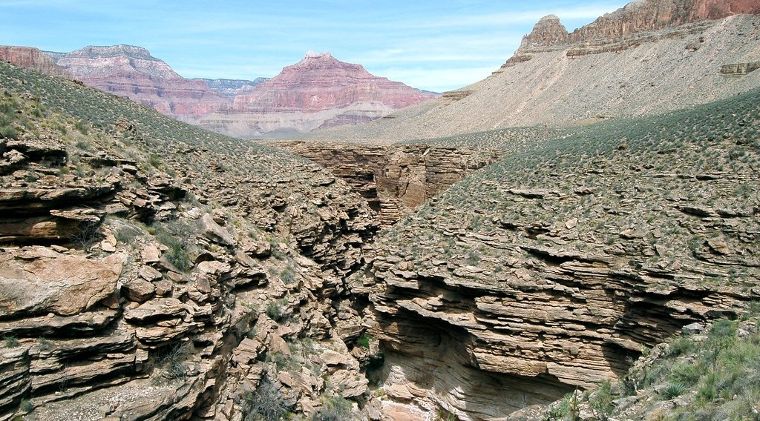
1. SEDIMENTARY ROCKS
Activity 2
A rock with layers.
Notes:
Activity 2. Look carefully at this picture: a rock with layers. Observe every detail before I ask the question.

Slide 23
1. SEDIMENTARY ROCKS
Activity 2: Question
This rock has layers. How was it formed?
Notes:
Here is the question for Activity 2: This rock has layers. How was it formed? Take one minute to think and write your answer in your rough notebook.

Slide 24
1. SEDIMENTARY ROCKS
Activity 2: Answer
Layers of sand and mud were pressed together: it is a sedimentary rock.
Notes:
Let us check the answer together. Layers of sand and mud were pressed together: it is a sedimentary rock.

Slide 25
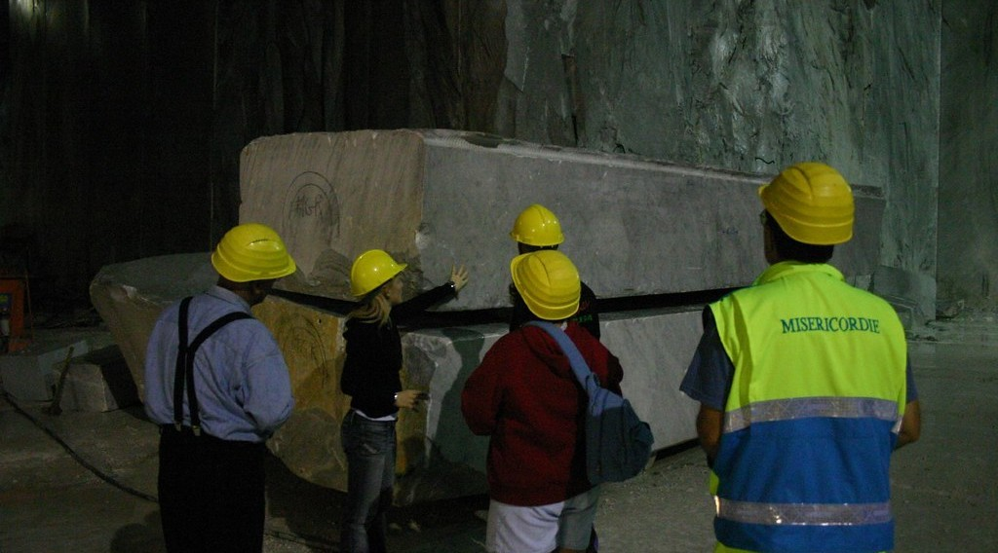
1. METAMORPHIC ROCKS
Activity 3
A block of marble in a quarry.
Notes:
Activity 3. Look carefully at this picture: a block of marble in a quarry. Observe every detail before I ask the question.

Slide 26
1. METAMORPHIC ROCKS
Activity 3: Question
Marble was once limestone. What changed it?
Notes:
Here is the question for Activity 3: Marble was once limestone. What changed it? Take one minute to think and write your answer in your rough notebook.

Slide 27
1. METAMORPHIC ROCKS
Activity 3: Answer
Great heat and pressure: it is a metamorphic rock.
Notes:
Let us check the answer together. Great heat and pressure: it is a metamorphic rock.

Slide 28
BOARD SUMMARY
Board Summary
Topic: The Structure of the Earth: Building Processes and Impacts on Man
Sub-topic: Internal Structure of the Earth
Lesson 8: Rocks
Notes:
Now we are going to copy the board summary. Write the title and the headings neatly in your notebooks. I will give you enough time for each slide, so do not rush.

Slide 29
BOARD SUMMARY
DEFINITIONS
The key terms of this lesson are defined as follows:
Rock: It is a hard, natural material made of one or more minerals, which forms the crust of the Earth.
Magma: It is melted rock found under the ground.
Notes:
Let us copy the definitions. The key terms of this lesson are defined as follows. On this slide we have Rock and Magma. Write each point on a new line, with the key term first, and explain it in your own words when we revise. When you finish, we go to the next slide.

Slide 30
BOARD SUMMARY
DEFINITIONS (continued)
Sediments: They are small pieces of rock, sand, mud and remains of living things laid down by water, wind or ice.
Notes:
We continue with the definitions. On this slide we have Sediments. Write each point on a new line, with the key term first, and explain it in your own words when we revise.

Slide 31
BOARD SUMMARY
1. Classification of Rocks according to Origin
A) Igneous Rocks
Igneous rocks have the following characteristics and examples:
Formation: They are formed when magma or lava cools and hardens.
Illustration: granite, an igneous rock
Notes:
Let us copy Igneous Rocks. Igneous rocks have the following characteristics and examples. Copy the point on Formation on the left, then draw the diagram on the right: granite, an igneous rock. Give it a title and label it clearly.

Slide 32
BOARD SUMMARY
1. Classification of Rocks according to Origin
A) Igneous Rocks
Crystals: They are made of crystals, large when magma cools slowly underground and small when lava cools quickly.
Hardness: They are hard, have no layers and contain no fossils.
Notes:
We continue with Igneous Rocks. On this slide we have Crystals and Hardness. Write each point on a new line, with the key term first, and explain it in your own words when we revise. When you finish, we go to the next slide.

Slide 33
BOARD SUMMARY
1. Classification of Rocks according to Origin
A) Igneous Rocks (continued)
Intrusive examples: Granite and gabbro cooled inside the crust.
Notes:
We continue with Igneous Rocks. On this slide we have Intrusive examples. Write each point on a new line, with the key term first, and explain it in your own words when we revise.

Slide 34
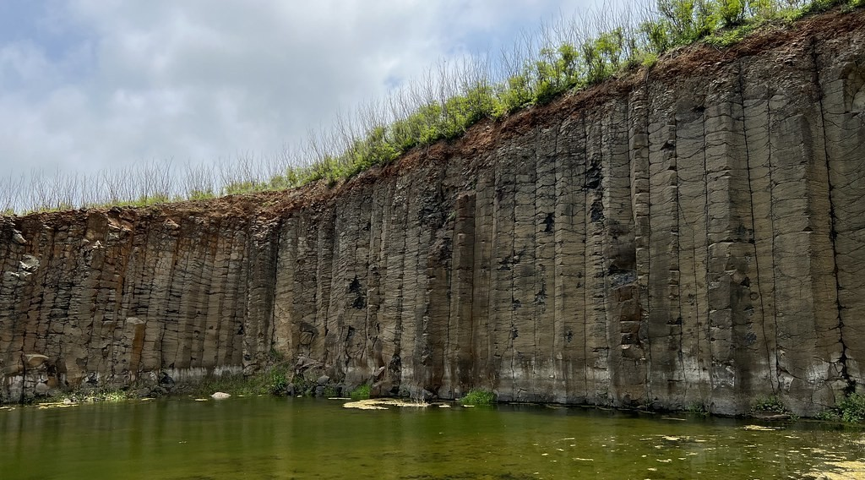
BOARD SUMMARY
1. Classification of Rocks according to Origin
A) Igneous Rocks
Extrusive examples: Basalt and pumice cooled on the surface.
Illustration: basalt
Notes:
Copy the point on Extrusive examples on the left, then draw the diagram on the right: basalt. Give it a title and label it clearly.

Slide 35
BOARD SUMMARY
1. Classification of Rocks according to Origin
B) Sedimentary Rocks
Sedimentary rocks have the following characteristics and examples:
Formation: They are formed from sediments laid down in layers and pressed together over a long time.
Illustration: sandstone, a sedimentary rock
Notes:
Let us copy Sedimentary Rocks. Sedimentary rocks have the following characteristics and examples. Copy the point on Formation on the left, then draw the diagram on the right: sandstone, a sedimentary rock. Give it a title and label it clearly.

Slide 36
BOARD SUMMARY
1. Classification of Rocks according to Origin
B) Sedimentary Rocks
Layers: They are arranged in layers called strata.
Notes:
We continue with Sedimentary Rocks. On this slide we have Layers. Write each point on a new line, with the key term first, and explain it in your own words when we revise.

Slide 37

BOARD SUMMARY
1. Classification of Rocks according to Origin
B) Sedimentary Rocks
Fossils: They often contain fossils of plants and animals.
Illustration: a fossil in rock
Notes:
Copy the point on Fossils on the left, then draw the diagram on the right: a fossil in rock. Give it a title and label it clearly.

Slide 38
BOARD SUMMARY
1. Classification of Rocks according to Origin
B) Sedimentary Rocks
Mechanically formed examples: Sandstone, clay and conglomerate are made of rock fragments.
Organically and chemically formed examples: Limestone, coal and rock salt come from living things or from chemical deposits.
Notes:
We continue with Sedimentary Rocks. On this slide we have Mechanically formed examples and Organically and chemically formed examples. Write each point on a new line, with the key term first, and explain it in your own words when we revise.

Slide 39
BOARD SUMMARY
1. Classification of Rocks according to Origin
C) Metamorphic Rocks
Metamorphic rocks have the following characteristics and examples:
Formation: They are formed when igneous or sedimentary rocks are changed by great heat and pressure.
Illustration: marble, a metamorphic rock
Notes:
Let us copy Metamorphic Rocks. Metamorphic rocks have the following characteristics and examples. Copy the point on Formation on the left, then draw the diagram on the right: marble, a metamorphic rock. Give it a title and label it clearly.

Slide 40
BOARD SUMMARY
1. Classification of Rocks according to Origin
C) Metamorphic Rocks
Hardness: They are usually harder and more compact than the original rock.
Bands: Many of them show bands or thin sheets.
Notes:
We continue with Metamorphic Rocks. On this slide we have Hardness and Bands. Write each point on a new line, with the key term first, and explain it in your own words when we revise. When you finish, we go to the next slide.

Slide 41
BOARD SUMMARY
1. Classification of Rocks according to Origin
C) Metamorphic Rocks (continued)
Examples: Limestone becomes marble, clay becomes slate, sandstone becomes quartzite and granite becomes gneiss.
Notes:
We continue with Metamorphic Rocks. On this slide we have Examples. Write each point on a new line, with the key term first, and explain it in your own words when we revise.

Slide 42
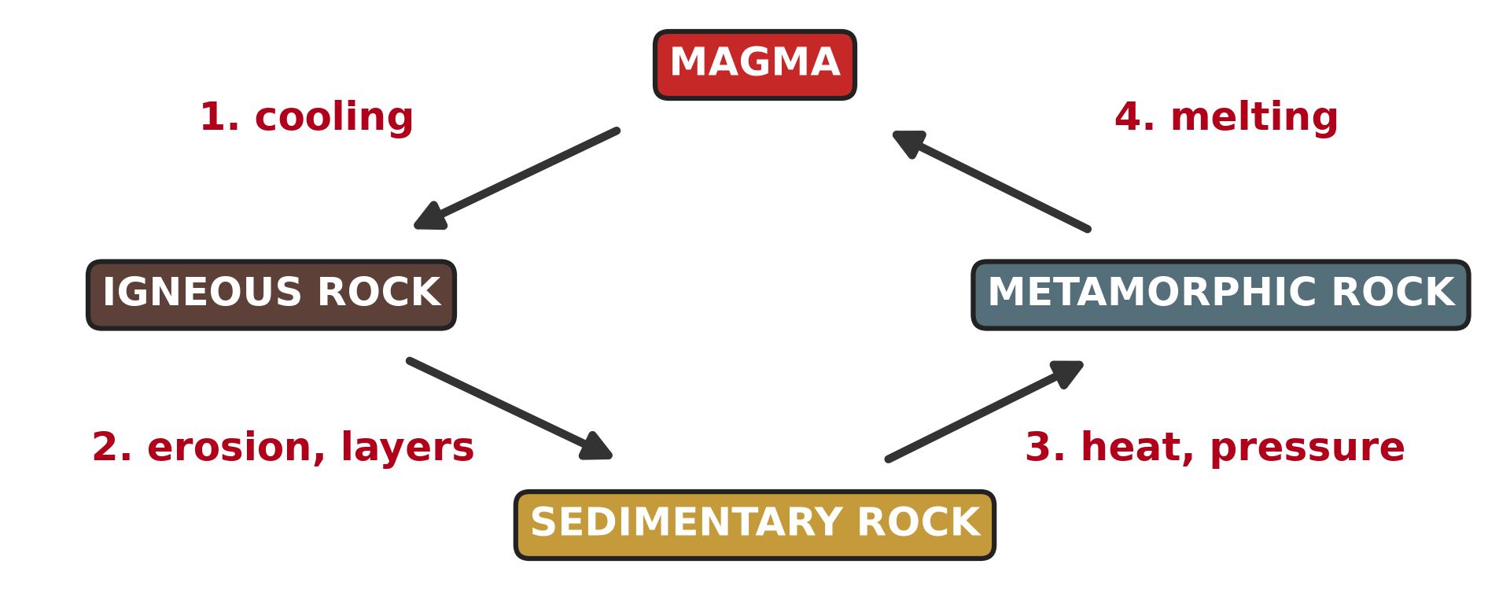
BOARD SUMMARY
2. The Rock Cycle
The rock cycle is illustrated as follows:
Rock cycle: It is the slow process by which one type of rock changes into another type.
Illustration: the rock cycle
Notes:
Let us copy The Rock Cycle. The rock cycle is illustrated as follows. Copy the point on Rock cycle on the left, then draw the diagram on the right: the rock cycle. Give it a title and label it clearly.

Slide 43
FORMATIVE EVALUATION
Evaluation 1
How are igneous rocks formed?
Notes:
Now let us check what you have understood. Question 1: How are igneous rocks formed? Answer in your exercise book.

Slide 44
FORMATIVE EVALUATION
Expected Answer
When magma or lava cools and becomes hard.
Notes:
The expected answer is: when magma or lava cools and becomes hard. If you got it right, well done.

Slide 45
FORMATIVE EVALUATION
Evaluation 2
Give one example of a metamorphic rock.
Notes:
Now let us check what you have understood. Question 2: Give one example of a metamorphic rock. Answer in your exercise book.

Slide 46
FORMATIVE EVALUATION
Expected Answer
Marble (or slate, gneiss).
Notes:
The expected answer is: marble (or slate, gneiss). If you got it right, well done.

Slide 47
REMEDIATION
Remediation
Fill in the blanks:
Granite is an ______ rock.
Rocks formed from layers are ______ rocks.
Heat and pressure make ______ rocks.
Notes:
For those who need more practice, fill in the blanks in your exercise book. The answers are: number 1, igneous; number 2, sedimentary; number 3, metamorphic.

Slide 48
HOMEWORK
Homework
Look at a map of the world. Cut out, or trace, Africa and South America and try to fit their coasts together. Write what you notice.
Notes:
For your homework: Look at a map of the world. Cut out, or trace, Africa and South America and try to fit their coasts together. Write what you notice. We shall correct it at the beginning of our next lesson.

Slide 49
NEXT LESSON
Next Lesson
Our next lesson will be on:
Lesson 9: The Theories of the Earth's Structure: Continental Drift
Notes:
Our next lesson will be on Lesson 9: The Theories of the Earth's Structure: Continental Drift. Thank you for your attention, and see you next time.

Slide 50
BILINGUAL GAME
Bilingual Game (Jeu Bilingue)
English | Français
Rock | La roche
Mineral | Le minéral
Igneous rock | La roche magmatique
Sedimentary rock | La roche sédimentaire
Metamorphic rock | La roche métamorphique
Fossil | Le fossile
Layer | La couche / la strate
Rock cycle | Le cycle des roches
Notes:
Let us play the bilingual game. I say a word in English, and you give me the French word. Then we do the reverse.

Slide 51
LOGBOOK
Official Logbook (1/2)
Module / Topic | The Structure of the Earth: Building Processes and Impacts on Man
Lesson Title | Lesson 8: Rocks
Expected Learning Outcomes | Define a rock. Classify rocks according to their origin. Give the characteristics and examples of each type of rock. Draw the rock cycle.
Competence | Learners are able to recognise the main types of rocks around them and to choose suitable rocks for building.
Notes:
I record this information in the official logbook of the class after the lesson.

Slide 52
LOGBOOK
Official Logbook (2/2)
Matter Taught | DEFINITIONS; Igneous Rocks; Sedimentary Rocks; Metamorphic Rocks; The Rock Cycle.
Evaluation | Formative evaluation and remediation exercise.
Homework | Look at a map of the world. Cut out, or trace, Africa and South America and try to fit their coasts together. Write what you notice.
Enrolment / Present / Absent | ____ / ____ / ____
Achievement | To be completed after the lesson.
Notes:
I complete the second page of the logbook: the matter taught, the evaluation, the homework and the attendance.

Slide 53
TEACHER'S NOTE
Teacher's Note
Timing: Homework correction, plan, objectives 4 min | Recall, situation, action 6 min | 3 activities 12 min | Board summary (copying) 15 min | Evaluation, remediation 5 min | Homework, next lesson 3 min | Logbook 5 min
Without the projector (Activity 1): show a piece of granite from the school yard.
Without the projector (Activity 2): show layers in a cut road bank.
Without the projector (Activity 3): show a marble tile.
Notes:
This slide is for me, the teacher: it gives the timing of the lesson and what to do if the projector is not available.

Slide 54
REFERENCES
References
National Geography Syllabus (MINESEC), Form 4 — The Structure of the Earth: Building Processes and Impacts on Man.
Teacher's lesson notes (Form 4), checked and corrected where necessary.
Photo, Activity 1: “Sunset over Pyramid Rock” by Mark Wassell, CC BY-NC-ND 2.0, via Flickr (https://www.flickr.com/photos/61520356@N07/6515411027)
Photo, Activity 2: “Grand Canyon: Tapeats Sandstone 0283” by Grand Canyon NPS, CC BY 2.0, via Flickr (https://www.flickr.com/photos/50693818@N08/8238057843)
Photo, Activity 3: “Marble quarry, Carrara” by Russell Carman, CC BY-NC-SA 2.0, via Flickr (https://www.flickr.com/photos/11328254@N02/2095886412)
Photo, board summary (Extrusive examples): “Snapshot, Daguoye Columnar Basalt, Penghu, Taiwan, 隨拍, 池東大菓葉玄武岩, 大菓葉柱狀” by bryan..., CC BY-SA 2.0, via Flickr (https://www.flickr.com/photos/91049143@N00/52316527525)
Photo, board summary (Fossils): “Marble Skin Fish Fossil” by Bold Frontiers, CC BY 2.0, via Flickr (https://www.flickr.com/photos/82955120@N05/14091612527)
Notes:
Take your time to copy this part; we will continue together.

Slide 55
REFERENCES
References (continued)
Diagrams and animations: drawn for this lesson (Geography Department).
Notes:
These are the references and picture credits used to prepare this lesson.

