Slide 1
FORM 4
GEOGRAPHY
Lesson 23
Wave Action in Coastal Areas
Notes:
Good morning, class, and welcome to our geography lesson. I am your geography teacher, Mr Kamdem. Today we are starting Lesson 23: Wave Action in Coastal Areas.

Slide 2
CLASS INFO
Class, Chapter and Duration
Class | Form 4
Chapter | Denudation Processes, Landforms and Impacts on Man — Wave Action along the Coast and Impacts on Man
Duration | 50 minutes
Notes:
This lesson is for Form 4. It belongs to Denudation Processes, Landforms and Impacts on Man — Wave Action along the Coast and Impacts on Man. We shall need 50 minutes to cover it.

Slide 3
IDENTIFICATION
Lesson Identification
Topic | Denudation Processes, Landforms and Impacts on Man
Sub-topic | Wave Action along the Coast and Impacts on Man
Lesson | Lesson 23: Wave Action in Coastal Areas
Notions / Concepts | Wave, fetch, swash, backwash, longshore drift.
Syllabus focus | Meaning of waves; types of waves (constructive and destructive).
Competence | Learners are able to explain how waves form and to recognise dangerous waves on a beach, for example at Kribi or Limbe.
Notes:
Our topic is Denudation Processes, Landforms and Impacts on Man, and the sub-topic is Wave Action along the Coast and Impacts on Man. The key notions we shall use today are: wave, fetch, swash, backwash, longshore drift. At the end, you should be able to do this: learners are able to explain how waves form and to recognise dangerous waves on a beach, for example at Kribi or Limbe.

Slide 4

HOMEWORK CORRECTION
Correction of the Homework
Question (Lesson 22: Man and Floodplain Interactions):
Watch the wind blowing on the water of the Benue or of a big basin of water. Write how the waves form and in which direction they move.
Notes:
Before we start the new lesson, let us correct the homework I gave you at the end of Lesson 22: Man and Floodplain Interactions. The question was: Watch the wind blowing on the water of the Benue or of a big basin of water. Write how the waves form and in which direction they move. Take out your exercise books.

Slide 5
HOMEWORK CORRECTION
Correction: Possible Answer
The wind blows over the water and pushes it into small waves (ripples). The waves move in the direction the wind is blowing; a stronger wind gives bigger waves.
Notes:
Here is a good answer. The wind blows over the water and pushes it into small waves (ripples). The waves move in the direction the wind is blowing; a stronger wind gives bigger waves. Compare it with your own answer and correct your work in red.

Slide 6
LESSON PLAN
Lesson Plan
Correction of the homework
Objectives and recall
Real-life situation and action to take
Learning activities
Board summary
Evaluation, remediation and homework
Notes:
Here is the plan of our lesson today. First, we shall correct the homework. Then we shall look at the objectives and recall what you already know. After that, we shall study a situation from real life and the action to take, and do the learning activities. Finally, we shall copy the board summary, do the evaluation and the remediation, and I will give you the homework.

Slide 7
OBJECTIVES
Objectives
By the end of this lesson, you should be able to:
Define a wave and explain its cause.
Explain the factors of the strength of waves.
Notes:
Take your time to copy this part; we will continue together.

Slide 8
OBJECTIVES
Objectives (continued)
Distinguish constructive and destructive waves.
Notes:
By the end of this lesson, you should be able to do three things. Number 1: define a wave and explain its cause. Number 2: explain the factors of the strength of waves. Number 3: distinguish constructive and destructive waves.

Slide 9
PREVIOUS KNOWLEDGE
Previous Knowledge
Rivers erode, transport and deposit.
Rivers drop their load where they lose energy.
Waves are an agent of denudation along the coast.
Notes:
Let us first remember what you already know. Rivers erode, transport and deposit. Rivers drop their load where they lose energy. Waves are an agent of denudation along the coast. Keep this in mind, because we shall build on it today.

Slide 10
REAL-LIFE SITUATION
Situation in Real Life
On a windy day, Moussa sees small waves on the Benue. His cousin in Kribi says that the waves of the Atlantic Ocean are much bigger, and that some of them bring sand to the beach while others take it away. Moussa asks: "What makes waves, and why are they not all the same?"
Notes:
Listen carefully to this situation from real life. On a windy day, Moussa sees small waves on the Benue. His cousin in Kribi says that the waves of the Atlantic Ocean are much bigger, and that some of them bring sand to the beach while others take it away. Moussa asks: "What makes waves, and why are they not all the same?" Think about it, because I am going to ask you some questions.

Slide 11
REAL-LIFE SITUATION
Situation: Question 1
What is the problem in the situation?
Notes:
Question 1: What is the problem in the situation? Think for a moment, then raise your hand to answer.

Slide 12
REAL-LIFE SITUATION
Answer
Moussa does not know what causes waves and why some build beaches while others destroy them.
Notes:
Good. Moussa does not know what causes waves and why some build beaches while others destroy them.

Slide 13
REAL-LIFE SITUATION
Situation: Question 2
Where are the waves bigger: on the Benue or on the Atlantic?
Notes:
Question 2: Where are the waves bigger: on the Benue or on the Atlantic? Think for a moment, then raise your hand to answer.

Slide 14
REAL-LIFE SITUATION
Answer
On the Atlantic Ocean.
Notes:
Good. On the Atlantic Ocean.

Slide 15
REAL-LIFE SITUATION
Situation: Question 3
What causes most waves?
Notes:
Question 3: What causes most waves? Think for a moment, then raise your hand to answer.

Slide 16
REAL-LIFE SITUATION
Possible Answer
The wind blowing over the water.
Notes:
Good. The wind blowing over the water.

Slide 17
ACTION TO TAKE
Action to Take
Respect warnings about big waves when swimming or fishing.
Notes:
From this situation, the action we are working towards in this lesson is the following: respect warnings about big waves when swimming or fishing.

Slide 18
JUSTIFICATION
Justification of the Lesson
This lesson helps us to understand waves and their work on the coast.
Notes:
Why is this lesson important for you? This lesson helps us to understand waves and their work on the coast.

Slide 19

1. MEANING OF WAVES
Activity 1
Waves on the sea.
Notes:
Activity 1. Look carefully at this picture: waves on the sea. Observe every detail before I ask the question.

Slide 20
1. MEANING OF WAVES
Activity 1: Question
What causes most waves?
Notes:
Here is the question for Activity 1: What causes most waves? Take one minute to think and write your answer in your rough notebook.

Slide 21
1. MEANING OF WAVES
Activity 1: Answer
The wind blowing over the surface of the sea.
Notes:
Let us check the answer together. The wind blowing over the surface of the sea.

Slide 22
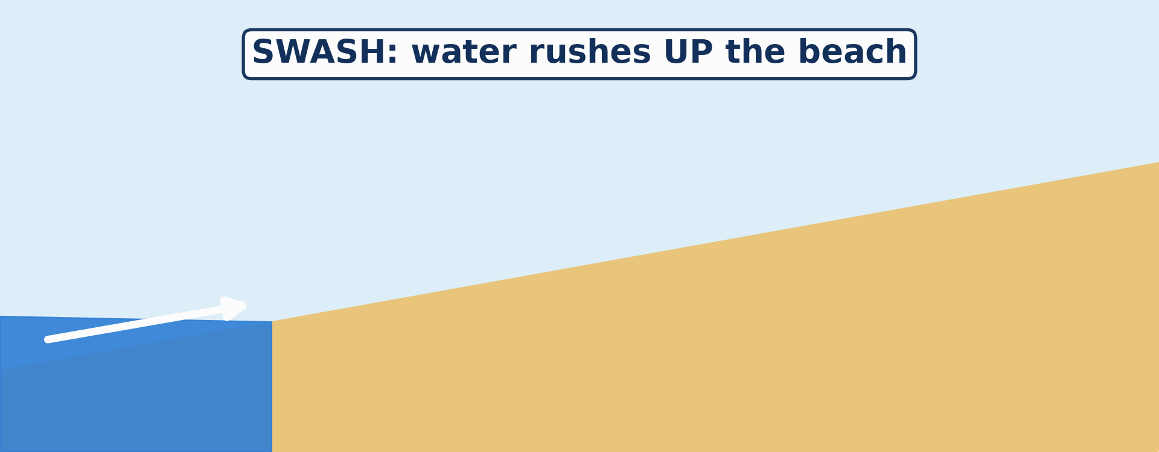
1. MEANING OF WAVES
Activity 2
Animation: a wave breaks on the beach.
Notes:
Activity 2. Look carefully at this animation: animation: a wave breaks on the beach. Watch the animation to the end; it will play again.

Slide 23
1. MEANING OF WAVES
Activity 2: Question 1
What do we call the water that rushes up the beach?
Notes:
Here is the question for Activity 2: What do we call the water that rushes up the beach? Take one minute to think and write your answer in your rough notebook.

Slide 24
1. MEANING OF WAVES
Activity 2: Answer 1
The swash.
Notes:
Let us check the answer together. The swash.

Slide 25
1. MEANING OF WAVES
Activity 2: Question 2
What do we call the water that flows back?
Notes:
Here is the next question: What do we call the water that flows back? Take one minute to think and write your answer in your rough notebook.

Slide 26
1. MEANING OF WAVES
Activity 2: Answer 2
The backwash.
Notes:
Let us check the answer together. The backwash.

Slide 27

2. TYPES OF WAVES
Activity 3
High waves on a beach.
Notes:
Activity 3. Look carefully at this picture: high waves on a beach. Observe every detail before I ask the question.

Slide 28
2. TYPES OF WAVES
Activity 3: Question
These high waves take sand away from the beach. What type of waves are they?
Notes:
Here is the question for Activity 3: These high waves take sand away from the beach. What type of waves are they? Take one minute to think and write your answer in your rough notebook.

Slide 29
2. TYPES OF WAVES
Activity 3: Answer
Destructive waves.
Notes:
Let us check the answer together. Destructive waves.

Slide 30
BOARD SUMMARY
Board Summary
Topic: Denudation Processes, Landforms and Impacts on Man
Sub-topic: Wave Action along the Coast and Impacts on Man
Lesson 23: Wave Action in Coastal Areas
Notes:
Now we are going to copy the board summary. Write the title and the headings neatly in your notebooks. I will give you enough time for each slide, so do not rush.

Slide 31
BOARD SUMMARY
DEFINITIONS
The key terms of this lesson are defined as follows:
Wave: It is an up-and-down movement of the surface water of the sea, caused mainly by the wind.
Swash: It is the water that rushes up the beach after a wave breaks.
Notes:
Let us copy the definitions. The key terms of this lesson are defined as follows. On this slide we have Wave and Swash. Write each point on a new line, with the key term first, and explain it in your own words when we revise. When you finish, we go to the next slide.

Slide 32
BOARD SUMMARY
DEFINITIONS (continued)
Backwash: It is the water that flows back down the beach to the sea.
Fetch: It is the distance of open sea over which the wind blows.
Notes:
We continue with the definitions. On this slide we have Backwash and Fetch. Write each point on a new line, with the key term first, and explain it in your own words when we revise.

Slide 33
BOARD SUMMARY
1. Meaning of Waves
A) Formation of Waves
Waves are formed as follows:
Wind friction: The wind blowing over the sea drags the surface water and makes it rise and fall.
Illustration: waves on the sea
Notes:
Let us copy Formation of Waves. Waves are formed as follows. Copy the point on Wind friction on the left, then draw the diagram on the right: waves on the sea. Give it a title and label it clearly.

Slide 34
BOARD SUMMARY
1. Meaning of Waves
A) Formation of Waves
Breaking: Near the coast the water becomes shallow, the bottom of the wave slows down, and the top falls forward: the wave breaks.
Notes:
We continue with Formation of Waves. On this slide we have Breaking. Write each point on a new line, with the key term first, and explain it in your own words when we revise.

Slide 35
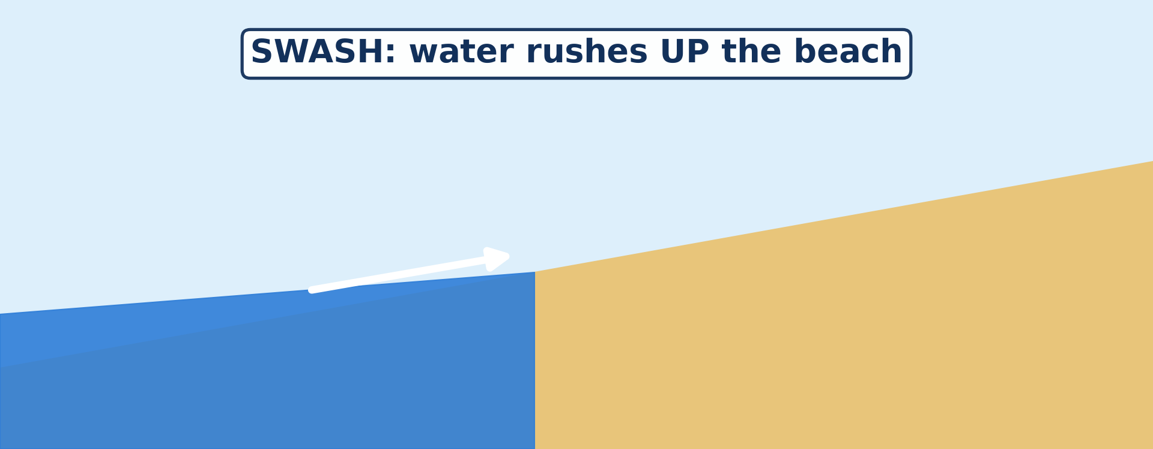
BOARD SUMMARY
1. Meaning of Waves
A) Formation of Waves
Swash and backwash: The broken wave rushes up the beach as swash and returns as backwash.
Illustration: the swash
Notes:
Copy the point on Swash and backwash on the left, then draw the diagram on the right: the swash. Give it a title and label it clearly.

Slide 36
BOARD SUMMARY
1. Meaning of Waves
B) Factors of the Strength of Waves
The strength of waves depends on the following factors:
Wind speed: A stronger wind makes bigger waves.
Duration of the wind: The longer the wind blows, the bigger the waves.
Notes:
Let us copy Factors of the Strength of Waves. The strength of waves depends on the following factors. On this slide we have Wind speed and Duration of the wind. Write each point on a new line, with the key term first, and explain it in your own words when we revise. When you finish, we go to the next slide.

Slide 37
BOARD SUMMARY
1. Meaning of Waves
B) Factors of the Strength of Waves (continued)
Length of the fetch: A long fetch over the open ocean gives big, powerful waves.
Depth of the sea: Waves break more strongly on steep coasts with deep water close to the shore.
Notes:
We continue with Factors of the Strength of Waves. On this slide we have Length of the fetch and Depth of the sea. Write each point on a new line, with the key term first, and explain it in your own words when we revise.

Slide 38
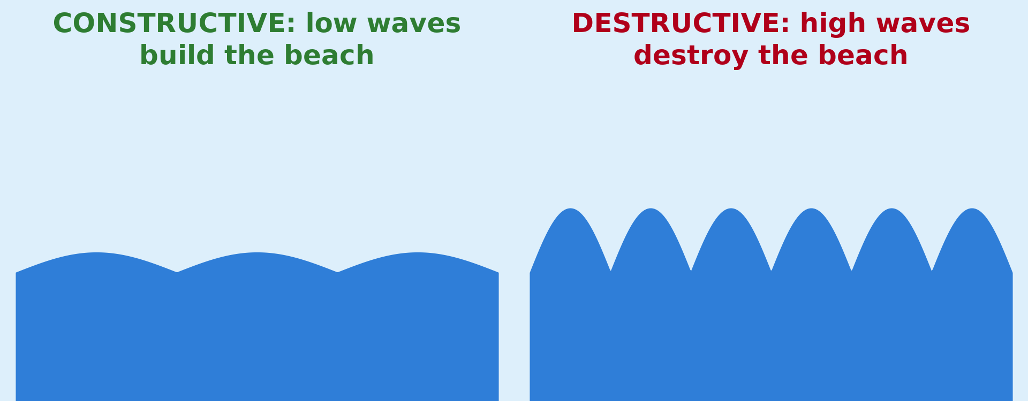
BOARD SUMMARY
2. Types of Waves
There are two types of waves:
Constructive waves: They are low, gentle waves that break far apart. Their swash is stronger than their backwash, so they build up beaches.
Illustration: constructive and destructive waves
Notes:
Let us copy Types of Waves. There are two types of waves. Copy the point on Constructive waves on the left, then draw the diagram on the right: constructive and destructive waves. Give it a title and label it clearly.

Slide 39
BOARD SUMMARY
2. Types of Waves
Destructive waves: They are high, steep waves that break close together. Their backwash is stronger than their swash, so they erode beaches.
Illustration: high waves
Notes:
Copy the point on Destructive waves on the left, then draw the diagram on the right: high waves. Give it a title and label it clearly.

Slide 40
FORMATIVE EVALUATION
Evaluation 1
What is the swash?
Notes:
Now let us check what you have understood. Question 1: What is the swash? Answer in your exercise book.

Slide 41
FORMATIVE EVALUATION
Expected Answer
The water that goes up the beach.
Notes:
The expected answer is: the water that goes up the beach. If you got it right, well done.

Slide 42
FORMATIVE EVALUATION
Evaluation 2
Give one difference between constructive and destructive waves.
Notes:
Now let us check what you have understood. Question 2: Give one difference between constructive and destructive waves. Answer in your exercise book.

Slide 43
FORMATIVE EVALUATION
Expected Answer
Constructive waves build the beach; destructive waves destroy it.
Notes:
The expected answer is: constructive waves build the beach; destructive waves destroy it. If you got it right, well done.

Slide 44
REMEDIATION
Remediation
Fill in the blanks:
Most waves are caused by the ______.
Water going back to the sea is the ______.
High waves that destroy the beach are ______ waves.
Notes:
For those who need more practice, fill in the blanks in your exercise book. The answers are: number 1, wind; number 2, backwash; number 3, destructive.

Slide 45
HOMEWORK
Homework
Look at photos of the coast of Limbe or Kribi. Draw a rocky part of the coast and name any holes, arches or rocks in the sea that you see.
Notes:
For your homework: Look at photos of the coast of Limbe or Kribi. Draw a rocky part of the coast and name any holes, arches or rocks in the sea that you see. We shall correct it at the beginning of our next lesson.

Slide 46
NEXT LESSON
Next Lesson
Our next lesson will be on:
Lesson 24: Main Erosional Processes and Features of Wave Action
Notes:
Our next lesson will be on Lesson 24: Main Erosional Processes and Features of Wave Action. Thank you for your attention, and see you next time.

Slide 47
BILINGUAL GAME
Bilingual Game (Jeu Bilingue)
English | Français
Wave | La vague
Coast | La côte
Beach | La plage
Swash | Le jet de rive
Backwash | La nappe de retrait / le ressac
Fetch | Le fetch
Storm | La tempête
Current | Le courant
Notes:
Let us play the bilingual game. I say a word in English, and you give me the French word. Then we do the reverse.

Slide 48
LOGBOOK
Official Logbook (1/2)
Module / Topic | Denudation Processes, Landforms and Impacts on Man
Lesson Title | Lesson 23: Wave Action in Coastal Areas
Expected Learning Outcomes | Define a wave and explain its cause. Explain the factors of the strength of waves. Distinguish constructive and destructive waves.
Competence | Learners are able to explain how waves form and to recognise dangerous waves on a beach, for example at Kribi or Limbe.
Notes:
I record this information in the official logbook of the class after the lesson.

Slide 49
LOGBOOK
Official Logbook (2/2)
Matter Taught | DEFINITIONS; Formation of Waves; Factors of the Strength of Waves; Types of Waves.
Evaluation | Formative evaluation and remediation exercise.
Homework | Look at photos of the coast of Limbe or Kribi. Draw a rocky part of the coast and name any holes, arches or rocks in the sea that you see.
Enrolment / Present / Absent | ____ / ____ / ____
Achievement | To be completed after the lesson.
Notes:
I complete the second page of the logbook: the matter taught, the evaluation, the homework and the attendance.

Slide 50
TEACHER'S NOTE
Teacher's Note
Timing: Homework correction, plan, objectives 4 min | Recall, situation, action 6 min | 3 activities 12 min | Board summary (copying) 15 min | Evaluation, remediation 5 min | Homework, next lesson 3 min | Logbook 5 min
Activity 2 is an animation (GIF): it plays automatically in slide-show mode.
Without the projector (Activity 1): blow over a basin of water.
Without the projector (Activity 2): draw a beach with two arrows.
Without the projector (Activity 3): describe the sea at Kribi in the rainy season.
Notes:
This slide is for me, the teacher: it gives the timing of the lesson and what to do if the projector is not available.

Slide 51
REFERENCES
References
National Geography Syllabus (MINESEC), Form 4 — Denudation Processes, Landforms and Impacts on Man.
Teacher's lesson notes (Form 4), checked and corrected where necessary.
Photo, Activity 1: “Carpinteria Bluffs, California (5)” by Ken Lund, CC BY-SA 2.0, via Flickr (https://www.flickr.com/photos/75683070@N00/4063056130)
Photo, Activity 3: “Wave Explosion, Monterey Bay, California” by John William Hammond, CC BY-NC-SA 2.0, via Flickr (https://www.flickr.com/photos/8398907@N02/16328053911)
Diagrams and animations: drawn for this lesson (Geography Department).
Notes:
These are the references and picture credits used to prepare this lesson.

