Slide 1
FORM 4
GEOGRAPHY
Lesson 26
Impact of Wave Action on Human Development along Coastal Areas
Notes:
Good morning, class, and welcome to our geography lesson. I am your geography teacher, Mr Kamdem. Today we are starting Lesson 26: Impact of Wave Action on Human Development along Coastal Areas.

Slide 2
CLASS INFO
Class, Chapter and Duration
Class | Form 4
Chapter | Denudation Processes, Landforms and Impacts on Man — Wave Action along the Coast and Impacts on Man
Duration | 50 minutes
Notes:
This lesson is for Form 4. It belongs to Denudation Processes, Landforms and Impacts on Man — Wave Action along the Coast and Impacts on Man. We shall need 50 minutes to cover it.

Slide 3
IDENTIFICATION
Lesson Identification
Topic | Denudation Processes, Landforms and Impacts on Man
Sub-topic | Wave Action along the Coast and Impacts on Man
Lesson | Lesson 26: Impact of Wave Action on Human Development along Coastal Areas
Notions / Concepts | Resource, hazard, coastal management.
Syllabus focus | Importance of coasts (resources); coastal hazards; coastal management strategies.
Competence | Learners are able to explain why coasts are important for Cameroon, and to suggest simple ways to protect them.
Notes:
Our topic is Denudation Processes, Landforms and Impacts on Man, and the sub-topic is Wave Action along the Coast and Impacts on Man. The key notions we shall use today are: resource, hazard, coastal management. At the end, you should be able to do this: learners are able to explain why coasts are important for Cameroon, and to suggest simple ways to protect them.

Slide 4

HOMEWORK CORRECTION
Correction of the Homework
Question (Lesson 25: Main Depositional Features of Wave Action):
List five goods sold in the market of Garoua that come from abroad. Ask a trader through which port they entered Cameroon.
Notes:
Before we start the new lesson, let us correct the homework I gave you at the end of Lesson 25: Main Depositional Features of Wave Action. The question was: List five goods sold in the market of Garoua that come from abroad. Ask a trader through which port they entered Cameroon. Take out your exercise books.

Slide 5
HOMEWORK CORRECTION
Correction: Possible Answer
Examples: rice, frozen fish, second-hand clothes, cars, phones and cement clinker. Traders say they entered through the port of Douala (some through Kribi).
Notes:
Here is a good answer. Examples: rice, frozen fish, second-hand clothes, cars, phones and cement clinker. Traders say they entered through the port of Douala (some through Kribi). Compare it with your own answer and correct your work in red.

Slide 6
LESSON PLAN
Lesson Plan
Correction of the homework
Objectives and recall
Real-life situation and action to take
Learning activities
Board summary
Evaluation, remediation and homework
Notes:
Here is the plan of our lesson today. First, we shall correct the homework. Then we shall look at the objectives and recall what you already know. After that, we shall study a situation from real life and the action to take, and do the learning activities. Finally, we shall copy the board summary, do the evaluation and the remediation, and I will give you the homework.

Slide 7
OBJECTIVES
Objectives
By the end of this lesson, you should be able to:
Explain the importance of coasts.
Describe the main coastal hazards.
Explain coastal management strategies.
Notes:
By the end of this lesson, you should be able to do three things. Number 1: explain the importance of coasts. Number 2: describe the main coastal hazards. Number 3: explain coastal management strategies.

Slide 8
PREVIOUS KNOWLEDGE
Previous Knowledge
Longshore drift moves sand along the coast.
Beaches, spits and bars are built by wave deposition.
Destructive waves erode the coast.
Notes:
Let us first remember what you already know. Longshore drift moves sand along the coast. Beaches, spits and bars are built by wave deposition. Destructive waves erode the coast. Keep this in mind, because we shall build on it today.

Slide 9
REAL-LIFE SITUATION
Situation in Real Life
In the market of Garoua, Idrissa sees phones, cloth and rice that came by ship to Douala or Kribi.
His uncle in Douala says that the sea brings trade and fish, but that strong waves also destroy beaches and houses.
"
Notes:
Listen carefully to this situation from real life. In the market of Garoua, Idrissa sees phones, cloth and rice that came by ship to Douala or Kribi. His uncle in Douala says that the sea brings trade and fish, but that strong waves also destroy beaches and houses. Idrissa asks: "Is the coast a blessing or a danger, and how can it be protected?" Think about it, because I am going to ask you some questions.

Slide 10
REAL-LIFE SITUATION
Situation: Question 1
What is the problem in the situation?
Notes:
Question 1: What is the problem in the situation? Think for a moment, then raise your hand to answer.

Slide 11
REAL-LIFE SITUATION
Answer
Idrissa does not know whether the coast is more useful or more dangerous, and how it can be protected.
Notes:
Good. Idrissa does not know whether the coast is more useful or more dangerous, and how it can be protected.

Slide 12
REAL-LIFE SITUATION
Situation: Question 2
How did the goods reach Cameroon?
Notes:
Question 2: How did the goods reach Cameroon? Think for a moment, then raise your hand to answer.

Slide 13
REAL-LIFE SITUATION
Answer
By ship, through the ports of Douala or Kribi.
Notes:
Good. By ship, through the ports of Douala or Kribi.

Slide 14
REAL-LIFE SITUATION
Situation: Question 3
Give one danger of the sea.
Notes:
Question 3: Give one danger of the sea. Think for a moment, then raise your hand to answer.

Slide 15
REAL-LIFE SITUATION
Possible Answer
Strong waves destroy beaches and houses.
Notes:
Good. Strong waves destroy beaches and houses.

Slide 16
ACTION TO TAKE
Action to Take
Protect mangroves and keep beaches clean.
Notes:
From this situation, the action we are working towards in this lesson is the following: protect mangroves and keep beaches clean.

Slide 17
JUSTIFICATION
Justification of the Lesson
This lesson helps us to know the importance and the dangers of the coast.
Notes:
Why is this lesson important for you? This lesson helps us to know the importance and the dangers of the coast.

Slide 18

1. IMPORTANCE OF COASTS
Activity 1
A container ship in a port.
Notes:
Activity 1. Look carefully at this picture: a container ship in a port. Observe every detail before I ask the question.

Slide 19
1. IMPORTANCE OF COASTS
Activity 1: Question
Why are ports important for Cameroon?
Notes:
Here is the question for Activity 1: Why are ports important for Cameroon? Take one minute to think and write your answer in your rough notebook.

Slide 20
1. IMPORTANCE OF COASTS
Activity 1: Answer
Ships bring in and take out goods: they carry most of the country's trade.
Notes:
Let us check the answer together. Ships bring in and take out goods: they carry most of the country's trade.

Slide 21

2. COASTAL HAZARDS
Activity 2
High waves on a beach.
Notes:
Activity 2. Look carefully at this picture: high waves on a beach. Observe every detail before I ask the question.

Slide 22
2. COASTAL HAZARDS
Activity 2: Question
What can such waves do to houses built near the beach?
Notes:
Here is the question for Activity 2: What can such waves do to houses built near the beach? Take one minute to think and write your answer in your rough notebook.

Slide 23
2. COASTAL HAZARDS
Activity 2: Answer
They erode the beach and can destroy the houses.
Notes:
Let us check the answer together. They erode the beach and can destroy the houses.

Slide 24
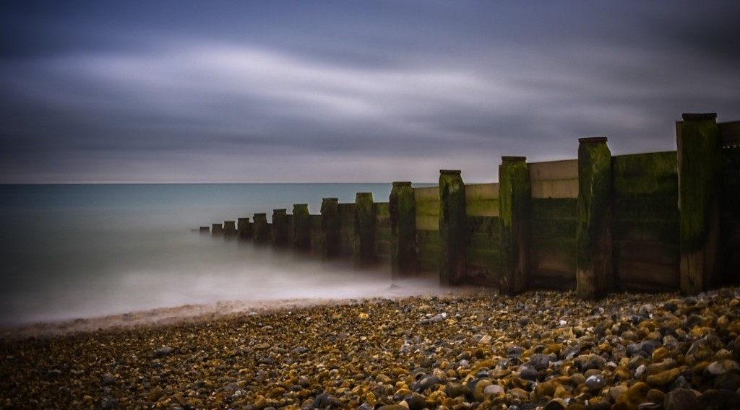
3. COASTAL MANAGEMENT
Activity 3
Low walls across a beach.
Notes:
Activity 3. Look carefully at this picture: low walls across a beach. Observe every detail before I ask the question.

Slide 25
3. COASTAL MANAGEMENT
Activity 3: Question
How do these low walls protect the beach?
Notes:
Here is the question for Activity 3: How do these low walls protect the beach? Take one minute to think and write your answer in your rough notebook.

Slide 26
3. COASTAL MANAGEMENT
Activity 3: Answer
They trap the sand and stop longshore drift from carrying it away.
Notes:
Let us check the answer together. They trap the sand and stop longshore drift from carrying it away.

Slide 27
BOARD SUMMARY
Board Summary
Topic: Denudation Processes, Landforms and Impacts on Man
Sub-topic: Wave Action along the Coast and Impacts on Man
Lesson 26: Impact of Wave Action on Human Development along Coastal Areas
Notes:
Now we are going to copy the board summary. Write the title and the headings neatly in your notebooks. I will give you enough time for each slide, so do not rush.

Slide 28
BOARD SUMMARY
DEFINITIONS
The key terms of this lesson are defined as follows:
Resource: It is anything in nature that people can use.
Coastal hazard: It is a danger that threatens people and property along the coast.
Notes:
Let us copy the definitions. The key terms of this lesson are defined as follows. On this slide we have Resource and Coastal hazard. Write each point on a new line, with the key term first, and explain it in your own words when we revise. When you finish, we go to the next slide.

Slide 29
BOARD SUMMARY
DEFINITIONS (continued)
Coastal management: It is the set of measures used to protect the coast and use it wisely.
Notes:
We continue with the definitions. On this slide we have Coastal management. Write each point on a new line, with the key term first, and explain it in your own words when we revise.

Slide 30
BOARD SUMMARY
1. Importance of Coasts (Resources)
Coasts provide the following resources:
Ports and trade: Ports such as Douala and Kribi handle the trade of Cameroon, Chad and the Central African Republic.
Illustration: a port
Notes:
Let us copy Importance of Coasts (Resources). Coasts provide the following resources. Copy the point on Ports and trade on the left, then draw the diagram on the right: a port. Give it a title and label it clearly.

Slide 31
BOARD SUMMARY
1. Importance of Coasts (Resources)
Fishing: Coastal waters and mangroves provide fish, shrimps and crabs.
Notes:
We continue with Importance of Coasts (Resources). On this slide we have Fishing. Write each point on a new line, with the key term first, and explain it in your own words when we revise.

Slide 32
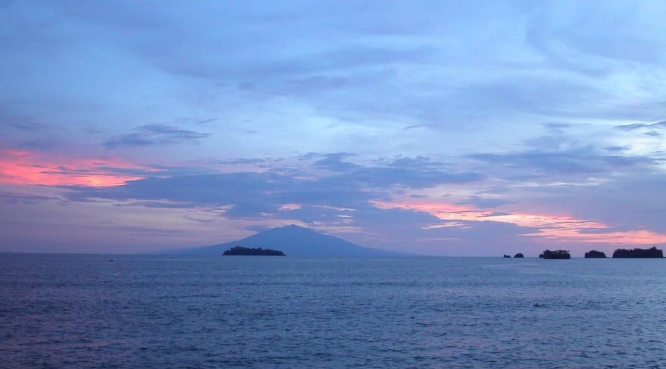
BOARD SUMMARY
1. Importance of Coasts (Resources)
Tourism: The beaches of Kribi and Limbe attract tourists.
Illustration: the coast at Limbe
Notes:
Copy the point on Tourism on the left, then draw the diagram on the right: the coast at Limbe. Give it a title and label it clearly.

Slide 33
BOARD SUMMARY
1. Importance of Coasts (Resources)
Oil and gas: Oil and gas are extracted under the sea near Limbe and Kribi.
Industry and settlement: Flat coastal land attracts towns, factories and plantations.
Notes:
We continue with Importance of Coasts (Resources). On this slide we have Oil and gas and Industry and settlement. Write each point on a new line, with the key term first, and explain it in your own words when we revise.

Slide 34
BOARD SUMMARY
2. Coastal Hazards
People on the coast face the following hazards:
Coastal erosion: Destructive waves wear away beaches and destroy roads and houses.
Illustration: high waves
Notes:
Let us copy Coastal Hazards. People on the coast face the following hazards. Copy the point on Coastal erosion on the left, then draw the diagram on the right: high waves. Give it a title and label it clearly.

Slide 35
BOARD SUMMARY
2. Coastal Hazards
Floods: The sea covers low-lying land during storms and high tides.
Salt-water incursion: Sea water enters wells and rivers and makes the water salty.
Sea-level rise: Rising sea levels threaten low coastal towns such as Douala.
Notes:
We continue with Coastal Hazards. On this slide we have Floods, Salt-water incursion and Sea-level rise. Write each point on a new line, with the key term first, and explain it in your own words when we revise. When you finish, we go to the next slide.

Slide 36
BOARD SUMMARY
2. Coastal Hazards (continued)
Pollution: Oil spills and rubbish pollute beaches and kill fish.
Notes:
We continue with Coastal Hazards. On this slide we have Pollution. Write each point on a new line, with the key term first, and explain it in your own words when we revise.

Slide 37
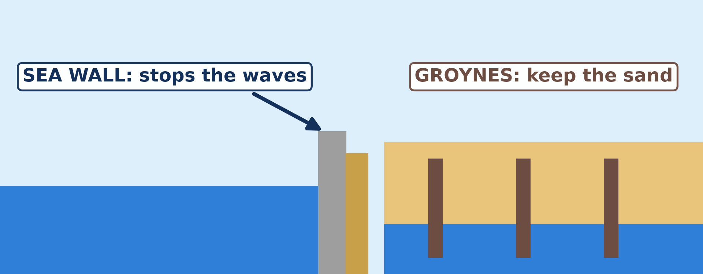
BOARD SUMMARY
3. Coastal Management Strategies
Coasts are protected with the following strategies:
Sea walls: They are strong walls that stop waves from reaching the land.
Illustration: a sea wall and groynes
Notes:
Let us copy Coastal Management Strategies. Coasts are protected with the following strategies. Copy the point on Sea walls on the left, then draw the diagram on the right: a sea wall and groynes. Give it a title and label it clearly.

Slide 38
BOARD SUMMARY
3. Coastal Management Strategies
Groynes: They are low walls built across a beach to trap the sand moved by longshore drift.
Illustration: groynes
Notes:
Copy the point on Groynes on the left, then draw the diagram on the right: groynes. Give it a title and label it clearly.

Slide 39
BOARD SUMMARY
3. Coastal Management Strategies
Rock armour and sandbanks: Large rocks and banks of sand are placed in front of the coast to break the waves.
Notes:
We continue with Coastal Management Strategies. On this slide we have Rock armour and sandbanks. Write each point on a new line, with the key term first, and explain it in your own words when we revise.

Slide 40

BOARD SUMMARY
3. Coastal Management Strategies
Mangroves and trees: Mangroves and trees reduce the force of waves and hold the soil.
Illustration: mangroves
Notes:
Copy the point on Mangroves and trees on the left, then draw the diagram on the right: mangroves. Give it a title and label it clearly.

Slide 41
BOARD SUMMARY
3. Coastal Management Strategies
Regulations: Houses must be built far from the shore, and sand must not be removed from beaches.
Notes:
We continue with Coastal Management Strategies. On this slide we have Regulations. Write each point on a new line, with the key term first, and explain it in your own words when we revise.

Slide 42
FORMATIVE EVALUATION
Evaluation 1
Name two ports of Cameroon.
Notes:
Now let us check what you have understood. Question 1: Name two ports of Cameroon. Answer in your exercise book.

Slide 43
FORMATIVE EVALUATION
Expected Answer
Douala and Kribi.
Notes:
The expected answer is: douala and Kribi. If you got it right, well done.

Slide 44
FORMATIVE EVALUATION
Evaluation 2
Give two ways to protect the coast.
Notes:
Now let us check what you have understood. Question 2: Give two ways to protect the coast. Answer in your exercise book.

Slide 45
FORMATIVE EVALUATION
Expected Answer
Sea walls and groynes (also mangroves).
Notes:
The expected answer is: sea walls and groynes (also mangroves). If you got it right, well done.

Slide 46
REMEDIATION
Remediation
Fill in the blanks:
A place where ships load goods is a ______.
A low wall across a beach is a ______.
The wearing away of the coast is coastal ______.
Notes:
For those who need more practice, fill in the blanks in your exercise book. The answers are: number 1, port; number 2, groyne; number 3, erosion.

Slide 47
HOMEWORK
Homework
On a map of Africa in your atlas, find the Sahara, the Sahel and the Kalahari. Write in which part of Africa each one is located.
Notes:
For your homework: On a map of Africa in your atlas, find the Sahara, the Sahel and the Kalahari. Write in which part of Africa each one is located. We shall correct it at the beginning of our next lesson.

Slide 48
NEXT LESSON
Next Lesson
Our next lesson will be on:
Lesson 27: Semi-Arid and Desert Landscapes
Notes:
Our next lesson will be on Lesson 27: Semi-Arid and Desert Landscapes. Thank you for your attention, and see you next time.

Slide 49
BILINGUAL GAME
Bilingual Game (Jeu Bilingue)
English | Français
Port | Le port
Coastal erosion | L'érosion côtière
Sea wall | La digue / le mur de protection
Groyne | L'épi
Mangrove | La mangrove
Sea-level rise | L'élévation du niveau de la mer
Estuary | L'estuaire
Pollution | La pollution
Notes:
Let us play the bilingual game. I say a word in English, and you give me the French word. Then we do the reverse.

Slide 50
LOGBOOK
Official Logbook (1/2)
Module / Topic | Denudation Processes, Landforms and Impacts on Man
Lesson Title | Lesson 26: Impact of Wave Action on Human Development along Coastal Areas
Expected Learning Outcomes | Explain the importance of coasts. Describe the main coastal hazards. Explain coastal management strategies.
Competence | Learners are able to explain why coasts are important for Cameroon, and to suggest simple ways to protect them.
Notes:
I record this information in the official logbook of the class after the lesson.

Slide 51
LOGBOOK
Official Logbook (2/2)
Matter Taught | DEFINITIONS; Importance of Coasts (Resources); Coastal Hazards; Coastal Management Strategies.
Evaluation | Formative evaluation and remediation exercise.
Homework | On a map of Africa in your atlas, find the Sahara, the Sahel and the Kalahari. Write in which part of Africa each one is located.
Enrolment / Present / Absent | ____ / ____ / ____
Achievement | To be completed after the lesson.
Notes:
I complete the second page of the logbook: the matter taught, the evaluation, the homework and the attendance.

Slide 52
TEACHER'S NOTE
Teacher's Note
Timing: Homework correction, plan, objectives 4 min | Recall, situation, action 6 min | 3 activities 12 min | Board summary (copying) 15 min | Evaluation, remediation 5 min | Homework, next lesson 3 min | Logbook 5 min
Without the projector (Activity 1): name goods that come through Douala.
Without the projector (Activity 2): describe coastal erosion at Kribi.
Without the projector (Activity 3): draw a beach with groynes.
Notes:
This slide is for me, the teacher: it gives the timing of the lesson and what to do if the projector is not available.

Slide 53
REFERENCES
References
National Geography Syllabus (MINESEC), Form 4 — Denudation Processes, Landforms and Impacts on Man.
Teacher's lesson notes (Form 4), checked and corrected where necessary.
Photo, Activity 1: “JAXPORT Welcomes Largest Container Ship To Date” by JAXPORT, CC BY-NC 2.0, via Flickr (https://www.flickr.com/photos/24847875@N05/17069054628)
Photo, Activity 2: “Wave Explosion, Monterey Bay, California” by John William Hammond, CC BY-NC-SA 2.0, via Flickr (https://www.flickr.com/photos/8398907@N02/16328053911)
Photo, Activity 3: “Wooden groynes” by aevarg, CC BY 2.0, via Flickr (https://www.flickr.com/photos/25999920@N00/17139000460)
Photo, board summary (Tourism): “Sunset in Limbe” by visulogik, CC BY 2.0, via Flickr (https://www.flickr.com/photos/55671677@N00/2202334428)
Photo, board summary (Mangroves and trees): “Pitchavaram waterway - Mangrove forest” by Balaji.B Photography, CC BY 2.0, via Flickr (https://www.flickr.com/photos/81073027@N00/1745978833)
Notes:
Take your time to copy this part; we will continue together.

Slide 54
REFERENCES
References (continued)
Diagrams and animations: drawn for this lesson (Geography Department).
Notes:
These are the references and picture credits used to prepare this lesson.

