Slide 1
LOWER SIXTH ARTS
GEOGRAPHY
Lesson 4
Landforms at Constructive or Divergent Margins
Notes:
Good morning, class, and welcome to our geography lesson. I am your geography teacher, Mr Kamdem. Today we are starting Lesson 4: Landforms at Constructive or Divergent Margins.

Slide 2
CLASS INFO
Class, Chapter and Duration
Class | Lower Sixth Arts
Chapter | Module 2: Understanding and managing physical landscapes, geomorphological processes and hazards across the world in general and Cameroon in particular
Duration | 2 periods (2 × 50 minutes)
Notes:
This lesson is for Lower Sixth Arts. It belongs to Module 2: Understanding and managing physical landscapes, geomorphological processes and hazards across the world in general and Cameroon in particular. We shall need 2 periods to cover it.

Slide 3
IDENTIFICATION
Lesson Identification
Topic | The Development of the Earth's Structure
Sub-topic | Theories of Earth Structure and Resultant Landforms
Lesson | Lesson 4: Landforms at Constructive or Divergent Margins
Notions / Concepts | Divergence, tension, fault, rift valley (graben), block mountain (horst), escarpment, basin and range, mid-ocean ridge, shield volcano.
Syllabus focus | Divergence and faulting; landforms of continental rifting (rift valley, horst, escarpment, basin and range, the Benue Trough); landforms of oceanic spreading (ridges, shield volcanoes); associated hazards.
Competence | Learners are able to explain the formation of rift valleys, block mountains and ridges and relate them to the Benue Trough.
Notes:
Our topic is The Development of the Earth's Structure, and the sub-topic is Theories of Earth Structure and Resultant Landforms. The key notions we shall use today are: divergence, tension, fault, rift valley (graben), block mountain (horst), escarpment, basin and range, mid-ocean ridge, shield volcano. At the end, you should be able to do this: learners are able to explain the formation of rift valleys, block mountains and ridges and relate them to the Benue Trough.

Slide 4

HOMEWORK CORRECTION
Correction of the Homework
Question (Lesson 3: Theory of Plate Tectonics):
Define a fault.
Notes:
Before we start the new lesson, let us correct the homework I gave you at the end of Lesson 3: Theory of Plate Tectonics. The question was: Define a fault. Take out your exercise books.

Slide 5
HOMEWORK CORRECTION
Correction: Possible Answer
A fault is a crack in the crust along which rocks have moved.
Notes:
Here is a good answer. A fault is a crack in the crust along which rocks have moved. Compare it with your own answer and correct your work in red.

Slide 6
LESSON PLAN
Lesson Plan
Correction of the homework
Objectives and recall
Real-life situation and action to take
Learning activities
Board summary
Evaluation, remediation and homework
Notes:
Here is the plan of our lesson today. First, we shall correct the homework. Then we shall look at the objectives and recall what you already know. After that, we shall study a situation from real life and the action to take, and do the learning activities. Finally, we shall copy the board summary, do the evaluation and the remediation, and I will give you the homework.

Slide 7
OBJECTIVES
Objectives
By the end of this lesson, you should be able to:
Explain how tension creates faults.
Explain the formation of rift valleys and block mountains.
Notes:
Take your time to copy this part; we will continue together.

Slide 8
OBJECTIVES
Objectives (continued)
Describe the landforms of oceanic spreading.
Describe the hazards of divergent margins.
Notes:
By the end of this lesson, you should be able to do four things. Number 1: explain how tension creates faults. Number 2: explain the formation of rift valleys and block mountains. Number 3: describe the landforms of oceanic spreading. Number 4: describe the hazards of divergent margins.

Slide 9
PREVIOUS KNOWLEDGE
Previous Knowledge
At a divergent margin, plates move apart.
A fault is a crack along which rocks have moved.
Mid-ocean ridges are made of basalt.
Notes:
Let us first remember what you already know. At a divergent margin, plates move apart. A fault is a crack along which rocks have moved. Mid-ocean ridges are made of basalt. Keep this in mind, because we shall build on it today.

Slide 10
REAL-LIFE SITUATION
Situation in Real Life
You travel by bus from Garoua to Ngaoundéré.
After the wide, flat plain of the Benue, the road climbs a long, steep slope.
From the top, you look back and see the vast low valley stretching for kilometres, as if a huge piece of land had sunk between two higher blocks.
Notes:
Take your time to copy this part; we will continue together.

Slide 11
REAL-LIFE SITUATION
Situation in Real Life (continued)
You ask: "Why is the landscape arranged like this, with a sunken basin next to high, steep-sided land?"
Notes:
Listen carefully to this situation from real life. You travel by bus from Garoua to Ngaoundéré. After the wide, flat plain of the Benue, the road climbs a long, steep slope. From the top, you look back and see the vast low valley stretching for kilometres, as if a huge piece of land had sunk between two higher blocks. You ask: "Why is the landscape arranged like this, with a sunken basin next to high, steep-sided land?" Think about it, because I am going to ask you some questions.

Slide 12
REAL-LIFE SITUATION
Situation: Question 1
What is the problem in the situation?
Notes:
Question 1: What is the problem in the situation? Think for a moment, then raise your hand to answer.

Slide 13
REAL-LIFE SITUATION
Answer
The learner does not know how land sinks and rises along faults at divergent margins.
Notes:
Good. The learner does not know how land sinks and rises along faults at divergent margins.

Slide 14
REAL-LIFE SITUATION
Situation: Question 2
What happens to the crust when it is stretched?
Notes:
Question 2: What happens to the crust when it is stretched? Think for a moment, then raise your hand to answer.

Slide 15
REAL-LIFE SITUATION
Answer
It cracks along faults.
Notes:
Good. It cracks along faults.

Slide 16
REAL-LIFE SITUATION
Situation: Question 3
What do we call a block of land that has sunk between two faults?
Notes:
Question 3: What do we call a block of land that has sunk between two faults? Think for a moment, then raise your hand to answer.

Slide 17
REAL-LIFE SITUATION
Possible Answer
A rift valley (graben).
Notes:
Good. A rift valley (graben).

Slide 18
ACTION TO TAKE
Action to Take
Recognise fault landforms such as escarpments and valleys in the relief of Cameroon.
Notes:
From this situation, the action we are working towards in this lesson is the following: recognise fault landforms such as escarpments and valleys in the relief of Cameroon.

Slide 19
JUSTIFICATION
Justification of the Lesson
This lesson explains the formation of major landforms of Africa and Cameroon, such as the Rift Valley and the Benue Trough.
Notes:
Why is this lesson important for you? This lesson explains the formation of major landforms of Africa and Cameroon, such as the Rift Valley and the Benue Trough.

Slide 20
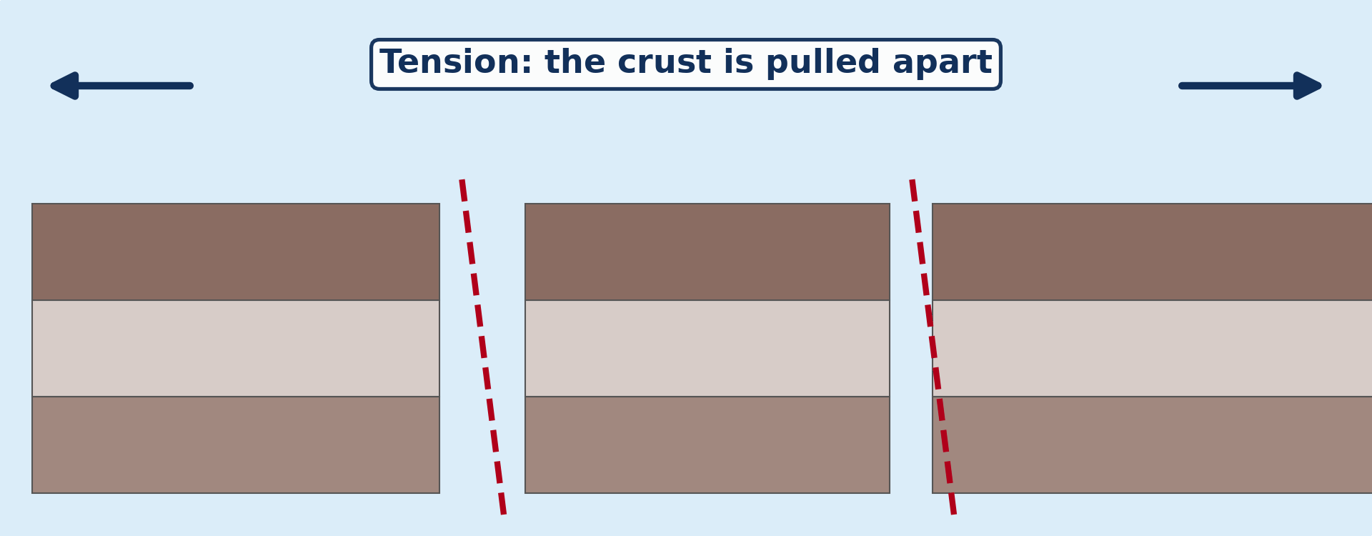
1. FAULTING
Activity 1
Animation: a rift valley forms.
Notes:
Activity 1. Look carefully at this animation: animation: a rift valley forms. Watch the animation to the end; it will play again.

Slide 21
1. FAULTING
Activity 1: Question
Which force pulls the crust apart at a divergent margin?
Notes:
Here is the question for Activity 1: Which force pulls the crust apart at a divergent margin? Take one minute to think and write your answer in your rough notebook.

Slide 22
1. FAULTING
Activity 1: Answer
Tension.
Notes:
Let us check the answer together. Tension.

Slide 23
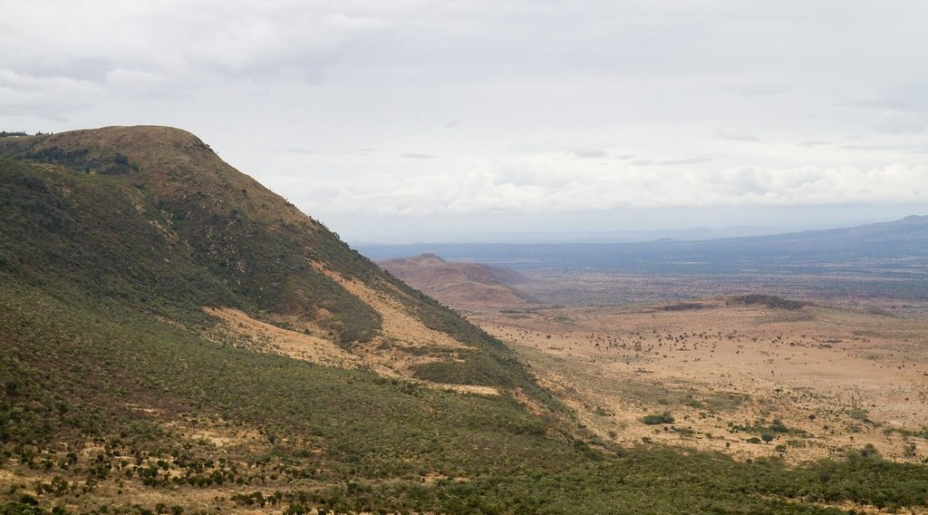
2. CONTINENTAL RIFTING
Activity 2
The Great Rift Valley.
Notes:
Activity 2. Look carefully at this picture: the Great Rift Valley. Observe every detail before I ask the question.

Slide 24
2. CONTINENTAL RIFTING
Activity 2: Question
What is the sunken block of a rift valley called?
Notes:
Here is the question for Activity 2: What is the sunken block of a rift valley called? Take one minute to think and write your answer in your rough notebook.

Slide 25
2. CONTINENTAL RIFTING
Activity 2: Answer
The graben.
Notes:
Let us check the answer together. The graben.

Slide 26
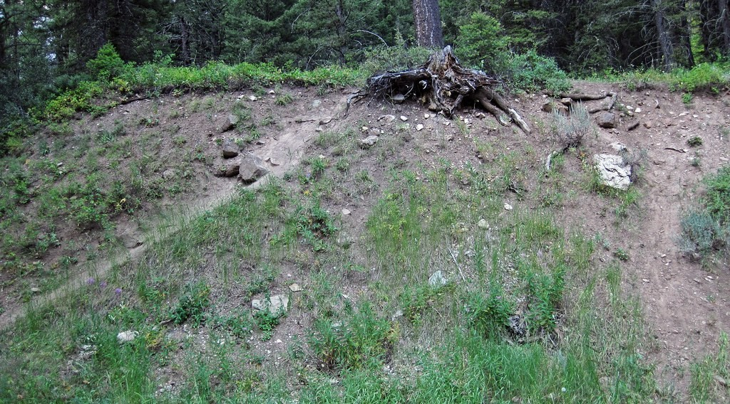
2. CONTINENTAL RIFTING
Activity 3
An escarpment.
Notes:
Activity 3. Look carefully at this picture: an escarpment. Observe every detail before I ask the question.

Slide 27
2. CONTINENTAL RIFTING
Activity 3: Question
What is the steep slope at the edge of a horst called?
Notes:
Here is the question for Activity 3: What is the steep slope at the edge of a horst called? Take one minute to think and write your answer in your rough notebook.

Slide 28
2. CONTINENTAL RIFTING
Activity 3: Answer
An escarpment (fault scarp).
Notes:
Let us check the answer together. An escarpment (fault scarp).

Slide 29
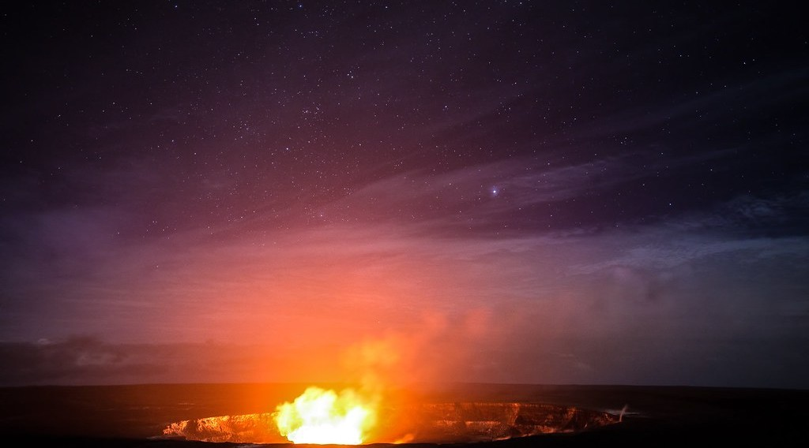
3. OCEANIC SPREADING
Activity 4
A shield volcano.
Notes:
Activity 4. Look carefully at this picture: a shield volcano. Observe every detail before I ask the question.

Slide 30
3. OCEANIC SPREADING
Activity 4: Question
Why are shield volcanoes wide with gentle slopes?
Notes:
Here is the question for Activity 4: Why are shield volcanoes wide with gentle slopes? Take one minute to think and write your answer in your rough notebook.

Slide 31
3. OCEANIC SPREADING
Activity 4: Answer
Their runny basic lava flows far before cooling.
Notes:
Let us check the answer together. Their runny basic lava flows far before cooling.

Slide 32

4. HAZARDS
Activity 5
A rift in Iceland.
Notes:
Activity 5. Look carefully at this picture: a rift in Iceland. Observe every detail before I ask the question.

Slide 33
4. HAZARDS
Activity 5: Question
Are earthquakes at divergent margins usually strong or weak?
Notes:
Here is the question for Activity 5: Are earthquakes at divergent margins usually strong or weak? Take one minute to think and write your answer in your rough notebook.

Slide 34
4. HAZARDS
Activity 5: Answer
Usually frequent but shallow and weak.
Notes:
Let us check the answer together. Usually frequent but shallow and weak.

Slide 35
BOARD SUMMARY
Board Summary
Topic: The Development of the Earth's Structure
Sub-topic: Theories of Earth Structure and Resultant Landforms
Lesson 4: Landforms at Constructive or Divergent Margins
Notes:
Now we are going to copy the board summary. Write the title and the headings neatly in your notebooks. I will give you enough time for each slide, so do not rush.

Slide 36
BOARD SUMMARY
DEFINITIONS
The key terms of this lesson are defined as follows:
Fault: It is a fracture in the crust along which rocks have moved.
Rift valley (graben): It is a long valley formed when a block of land sinks between two parallel faults.
Notes:
Let us copy the definitions. The key terms of this lesson are defined as follows. On this slide we have Fault and Rift valley (graben). Write each point on a new line, with the key term first, and explain it in your own words when we revise. When you finish, we go to the next slide.

Slide 37
BOARD SUMMARY
DEFINITIONS (continued)
Block mountain (horst): It is a block of land left standing high between faults.
Escarpment: It is a steep slope marking the edge of a horst or of a plateau.
Notes:
We continue with the definitions. On this slide we have Block mountain (horst) and Escarpment. Write each point on a new line, with the key term first, and explain it in your own words when we revise.

Slide 38
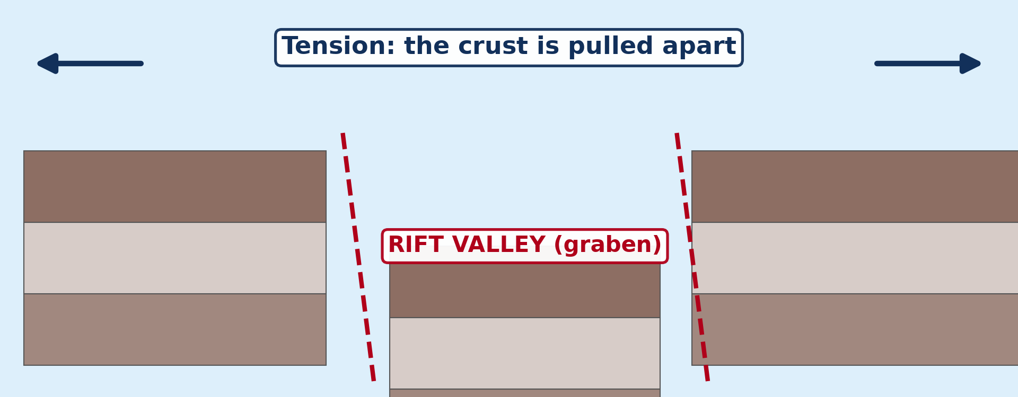
BOARD SUMMARY
1. Divergence and Faulting
Divergence and faulting are presented as follows:
Tension: At a constructive margin, tension pulls the crust apart.
Illustration: a rift valley
Notes:
Let us copy Divergence and Faulting. Divergence and faulting are presented as follows. Copy the point on Tension on the left, then draw the diagram on the right: a rift valley. Give it a title and label it clearly.

Slide 39
BOARD SUMMARY
1. Divergence and Faulting
Faulting: The brittle crust breaks along faults, and blocks move up or down along them.
Result: Faulting creates rift valleys, block mountains and escarpments on continents, and ridges on the ocean floor.
Notes:
We continue with Divergence and Faulting. On this slide we have Faulting and Result. Write each point on a new line, with the key term first, and explain it in your own words when we revise.

Slide 40
BOARD SUMMARY
2. Landforms of Continental Rifting
Continental rifting creates the following landforms:
Rift valley (graben): A long block sinks between two parallel faults, like the Great Rift Valley of East Africa.
Illustration: the Great Rift Valley
Notes:
Let us copy Landforms of Continental Rifting. Continental rifting creates the following landforms. Copy the point on Rift valley (graben) on the left, then draw the diagram on the right: the Great Rift Valley. Give it a title and label it clearly.

Slide 41
BOARD SUMMARY
2. Landforms of Continental Rifting
The Benue Trough: It is a rift formed when Africa and South America separated; the Benue flows in it past Garoua.
Block mountains (horsts): Blocks left standing high on each side of a graben, often with flat tops, like the Ruwenzori.
Notes:
We continue with Landforms of Continental Rifting. On this slide we have The Benue Trough and Block mountains (horsts). Write each point on a new line, with the key term first, and explain it in your own words when we revise.

Slide 42
BOARD SUMMARY
2. Landforms of Continental Rifting
Escarpment: The steep slope at the edge of a horst, which shows the fault line.
Illustration: an escarpment
Notes:
Copy the point on Escarpment on the left, then draw the diagram on the right: an escarpment. Give it a title and label it clearly.

Slide 43
BOARD SUMMARY
2. Landforms of Continental Rifting
Basin and range: Many parallel faults create alternating horsts and grabens, as in Nevada (USA).
Notes:
We continue with Landforms of Continental Rifting. On this slide we have Basin and range. Write each point on a new line, with the key term first, and explain it in your own words when we revise.

Slide 44
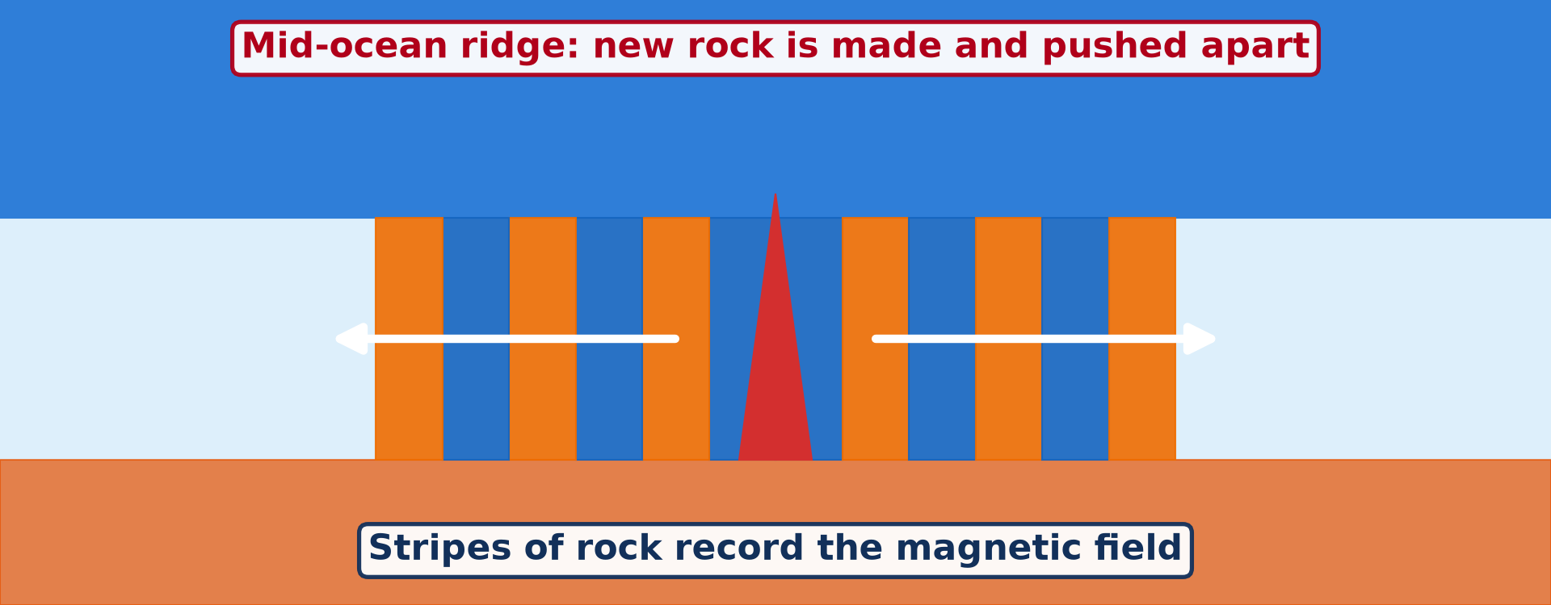
BOARD SUMMARY
3. Landforms of Oceanic Spreading
Oceanic spreading creates the following landforms:
Mid-ocean ridges: Long underwater mountain chains built by rising magma, like the Mid-Atlantic Ridge.
Illustration: a mid-ocean ridge
Notes:
Let us copy Landforms of Oceanic Spreading. Oceanic spreading creates the following landforms. Copy the point on Mid-ocean ridges on the left, then draw the diagram on the right: a mid-ocean ridge. Give it a title and label it clearly.

Slide 45
BOARD SUMMARY
3. Landforms of Oceanic Spreading
Shield volcanoes: Runny basaltic lava flows far and builds broad volcanoes with gentle slopes, as in Iceland.
Illustration: a shield volcano
Notes:
Copy the point on Shield volcanoes on the left, then draw the diagram on the right: a shield volcano. Give it a title and label it clearly.

Slide 46
BOARD SUMMARY
3. Landforms of Oceanic Spreading
Effusive eruptions: Eruptions are gentle: lava flows out rather than exploding.
Notes:
We continue with Landforms of Oceanic Spreading. On this slide we have Effusive eruptions. Write each point on a new line, with the key term first, and explain it in your own words when we revise.

Slide 47
BOARD SUMMARY
4. Associated Hazards
The hazards of divergent margins are the following:
Earthquakes: Movements along faults cause frequent earthquakes, usually shallow and weaker than at other margins.
Notes:
Let us copy Associated Hazards. The hazards of divergent margins are the following. On this slide we have Earthquakes. Write each point on a new line, with the key term first, and explain it in your own words when we revise.

Slide 48
BOARD SUMMARY
4. Associated Hazards
Lava flows: Non-explosive eruptions destroy property but usually give people time to escape.
Illustration: a rift in Iceland
Notes:
Copy the point on Lava flows on the left, then draw the diagram on the right: a rift in Iceland. Give it a title and label it clearly.

Slide 49
FORMATIVE EVALUATION
Evaluation 1
Explain the formation of a rift valley.
Notes:
Now let us check what you have understood. Question 1: Explain the formation of a rift valley. Answer in your exercise book.

Slide 50
FORMATIVE EVALUATION
Expected Answer
Tension pulls the crust apart; faults form and the block between two parallel faults sinks to form a graben.
Notes:
The expected answer is: tension pulls the crust apart; faults form and the block between two parallel faults sinks to form a graben. If you got it right, well done.

Slide 51
FORMATIVE EVALUATION
Evaluation 2
How was the Benue Trough formed?
Notes:
Now let us check what you have understood. Question 2: How was the Benue Trough formed? Answer in your exercise book.

Slide 52
FORMATIVE EVALUATION
Expected Answer
By rifting when Africa separated from South America, which made a block of crust sink.
Notes:
The expected answer is: by rifting when Africa separated from South America, which made a block of crust sink. If you got it right, well done.

Slide 53
REMEDIATION
Remediation
Fill in the blanks:
A sunken block between two faults is a ______.
A block left standing high is a ______.
Shield volcanoes are built by ______ lava.
Notes:
For those who need more practice, fill in the blanks in your exercise book. The answers are: number 1, graben (rift valley); number 2, horst (block mountain); number 3, basic (runny).

Slide 54
HOMEWORK
Homework
Name one range of fold mountains.
Notes:
For your homework: Name one range of fold mountains. We shall correct it at the beginning of our next lesson.

Slide 55
NEXT LESSON
Next Lesson
Our next lesson will be on:
Lesson 5: Landforms at Destructive and Conservative Margins
Notes:
Our next lesson will be on Lesson 5: Landforms at Destructive and Conservative Margins. Thank you for your attention, and see you next time.

Slide 56
BILINGUAL GAME
Bilingual Game (Jeu Bilingue)
English | Français
Rift valley | Le fossé d'effondrement
Fault | La faille
Block mountain | Le horst
Escarpment | L'escarpement
Volcano | Le volcan
Ridge | La dorsale
Notes:
Let us play the bilingual game. I say a word in English, and you give me the French word. Then we do the reverse.

Slide 57
LOGBOOK
Official Logbook (1/2)
Module / Topic | The Development of the Earth's Structure
Lesson Title | Lesson 4: Landforms at Constructive or Divergent Margins
Expected Learning Outcomes | Explain how tension creates faults. Explain the formation of rift valleys and block mountains. Describe the landforms of oceanic spreading. Describe the hazards of divergent margins.
Competence | Learners are able to explain the formation of rift valleys, block mountains and ridges and relate them to the Benue Trough.
Notes:
I record this information in the official logbook of the class after the lesson.

Slide 58
LOGBOOK
Official Logbook (2/2)
Matter Taught | DEFINITIONS; Divergence and Faulting; Landforms of Continental Rifting; Landforms of Oceanic Spreading; Associated Hazards.
Evaluation | Formative evaluation and remediation exercise.
Homework | Name one range of fold mountains.
Enrolment / Present / Absent | ____ / ____ / ____
Achievement | To be completed after the lesson.
Notes:
I complete the second page of the logbook: the matter taught, the evaluation, the homework and the attendance.

Slide 59
TEACHER'S NOTE
Teacher's Note
Timing: Homework correction, plan, objectives 8 min | Recall, situation, action 10 min | 5 activities 30 min | Board summary (copying) 30 min | Evaluation, remediation 10 min | Homework, next lesson 5 min | Logbook 7 min
Activity 1 is an animation (GIF): it plays automatically in slide-show mode.
Without the projector (Activity 1): pull a slab of clay apart.
Without the projector (Activity 2): draw a graben between two faults.
Without the projector (Activity 3): describe the Adamawa escarpment.
Without the projector (Activity 4): pour honey and thick porridge to compare.
Without the projector (Activity 5): compare with destructive margins.
Notes:
This slide is for me, the teacher: it gives the timing of the lesson and what to do if the projector is not available.

Slide 60
REFERENCES
References
Geography Syllabus for Sixth Forms (Lower and Upper Sixth), MINESEC, 2019 — Module 2 (Geomorphology).
Teacher's course notes: Mr KAMDEM E., Geomorphology (LSA), GBHS Garoua, 2026.
Photo, Activity 2: “Great Rift Valley” by GSAPP_SIDL, CC BY-NC-ND 2.0, via Flickr (https://www.flickr.com/photos/77974798@N04/7341392488)
Photo, Activity 3: “1959 Hebgen Lake Earthquake fault scarp (Cabin Creek, Gallatin County,” by James St. John, CC BY 2.0, via Flickr (https://www.flickr.com/photos/47445767@N05/45610123392)
Photo, Activity 4: “Fire and Stars” by howardignatius, CC BY-NC-ND 2.0, via Flickr (https://www.flickr.com/photos/25659032@N07/39966052052)
Photo, Activity 5: “Silfra Fissure” by Daveography.ca, CC BY-NC-SA 2.0, via Flickr (https://www.flickr.com/photos/71482738@N00/32857247053)
Diagrams and animations: drawn for this lesson (Geography Department).
Notes:
These are the references and picture credits used to prepare this lesson.

