Slide 1
LOWER SIXTH ARTS
GEOGRAPHY
Lesson 14
Erosional Processes and the Fluvial System
Notes:
Good morning, class, and welcome to our geography lesson. I am your geography teacher, Mr Kamdem. Today we are starting Lesson 14: Erosional Processes and the Fluvial System.

Slide 2
CLASS INFO
Class, Chapter and Duration
Class | Lower Sixth Arts
Chapter | Module 2: Understanding and managing physical landscapes, geomorphological processes and hazards across the world in general and Cameroon in particular
Duration | 2 periods (2 × 50 minutes)
Notes:
This lesson is for Lower Sixth Arts. It belongs to Module 2: Understanding and managing physical landscapes, geomorphological processes and hazards across the world in general and Cameroon in particular. We shall need 2 periods to cover it.

Slide 3
IDENTIFICATION
Lesson Identification
Topic | Denudational Processes on Slopes
Sub-topic | Erosion and Depositional Processes and Landforms
Lesson | Lesson 14: Erosional Processes and the Fluvial System
Notions / Concepts | River system, input, output, hydraulic action, abrasion, attrition, solution, traction, saltation, suspension, load, deposition.
Syllabus focus | The river as a system; river erosion (four processes); transportation (four methods); deposition and its conditions.
Competence | Learners are able to explain how a river erodes, carries and deposits material, using the Benue as an example.
Notes:
Our topic is Denudational Processes on Slopes, and the sub-topic is Erosion and Depositional Processes and Landforms. The key notions we shall use today are: river system, input, output, hydraulic action, abrasion, attrition, solution, traction, saltation, suspension, load, deposition. At the end, you should be able to do this: learners are able to explain how a river erodes, carries and deposits material, using the Benue as an example.

Slide 4

HOMEWORK CORRECTION
Correction of the Homework
Question (Lesson 13: Processes and Features of Mass Wasting):
Name the three types of work of a river.
Notes:
Before we start the new lesson, let us correct the homework I gave you at the end of Lesson 13: Processes and Features of Mass Wasting. The question was: Name the three types of work of a river. Take out your exercise books.

Slide 5
HOMEWORK CORRECTION
Correction: Possible Answer
Erosion, transportation and deposition.
Notes:
Here is a good answer. Erosion, transportation and deposition. Compare it with your own answer and correct your work in red.

Slide 6
LESSON PLAN
Lesson Plan
Correction of the homework
Objectives and recall
Real-life situation and action to take
Learning activities
Board summary
Evaluation, remediation and homework
Notes:
Here is the plan of our lesson today. First, we shall correct the homework. Then we shall look at the objectives and recall what you already know. After that, we shall study a situation from real life and the action to take, and do the learning activities. Finally, we shall copy the board summary, do the evaluation and the remediation, and I will give you the homework.

Slide 7
OBJECTIVES
Objectives
By the end of this lesson, you should be able to:
Describe the river as an open system.
Explain the four processes of river erosion.
Notes:
Take your time to copy this part; we will continue together.

Slide 8
OBJECTIVES
Objectives (continued)
Explain the four methods of transportation.
Explain why and where a river deposits its load.
Notes:
By the end of this lesson, you should be able to do four things. Number 1: describe the river as an open system. Number 2: explain the four processes of river erosion. Number 3: explain the four methods of transportation. Number 4: explain why and where a river deposits its load.

Slide 9
PREVIOUS KNOWLEDGE
Previous Knowledge
Erosion removes weathered material.
The Benue flows past Garoua.
The Benue has sandbanks in the dry season.
Notes:
Let us first remember what you already know. Erosion removes weathered material. The Benue flows past Garoua. The Benue has sandbanks in the dry season. Keep this in mind, because we shall build on it today.

Slide 10
REAL-LIFE SITUATION
Situation in Real Life
In the rainy season, you stand on the bridge of Garoua and look at the Benue: it is wide, fast and brown, carrying soil, branches and debris.
Notes:
Take your time to copy this part; we will continue together.

Slide 11
REAL-LIFE SITUATION
Situation in Real Life (continued)
In the dry season, from the same place, the river is low, slow and clearer, and huge sandbanks appear where deep water flowed before.
You ask: "Where did all the brown mud go, and where did this new sand come from?"
Notes:
Listen carefully to this situation from real life. In the rainy season, you stand on the bridge of Garoua and look at the Benue: it is wide, fast and brown, carrying soil, branches and debris. In the dry season, from the same place, the river is low, slow and clearer, and huge sandbanks appear where deep water flowed before. You ask: "Where did all the brown mud go, and where did this new sand come from?" Think about it, because I am going to ask you some questions.

Slide 12
REAL-LIFE SITUATION
Situation: Question 1
What is the problem in the situation?
Notes:
Question 1: What is the problem in the situation? Think for a moment, then raise your hand to answer.

Slide 13
REAL-LIFE SITUATION
Answer
The learner does not know how a river erodes, carries and deposits material.
Notes:
Good. The learner does not know how a river erodes, carries and deposits material.

Slide 14
REAL-LIFE SITUATION
Situation: Question 2
What is the river doing in the rainy season?
Notes:
Question 2: What is the river doing in the rainy season? Think for a moment, then raise your hand to answer.

Slide 15
REAL-LIFE SITUATION
Answer
Eroding its banks and transporting a large load.
Notes:
Good. Eroding its banks and transporting a large load.

Slide 16
REAL-LIFE SITUATION
Situation: Question 3
Why do sandbanks appear in the dry season?
Notes:
Question 3: Why do sandbanks appear in the dry season? Think for a moment, then raise your hand to answer.

Slide 17
REAL-LIFE SITUATION
Possible Answer
The river slows down, loses energy and deposits its load.
Notes:
Good. The river slows down, loses energy and deposits its load.

Slide 18
ACTION TO TAKE
Action to Take
Protect river banks with vegetation and avoid building on unstable banks.
Notes:
From this situation, the action we are working towards in this lesson is the following: protect river banks with vegetation and avoid building on unstable banks.

Slide 19
JUSTIFICATION
Justification of the Lesson
This lesson helps us to understand the changing channel of the Benue, which affects farming, fishing and navigation.
Notes:
Why is this lesson important for you? This lesson helps us to understand the changing channel of the Benue, which affects farming, fishing and navigation.

Slide 20

1. RIVER SYSTEM
Activity 1
An open system.
Notes:
Activity 1. Look carefully at this diagram: an open system. Observe every detail before I ask the question.

Slide 21
1. RIVER SYSTEM
Activity 1: Question
Give one input of a river system.
Notes:
Here is the question for Activity 1: Give one input of a river system. Take one minute to think and write your answer in your rough notebook.

Slide 22
1. RIVER SYSTEM
Activity 1: Answer
Rainwater (or sediments from the slopes).
Notes:
Let us check the answer together. Rainwater (or sediments from the slopes).

Slide 23
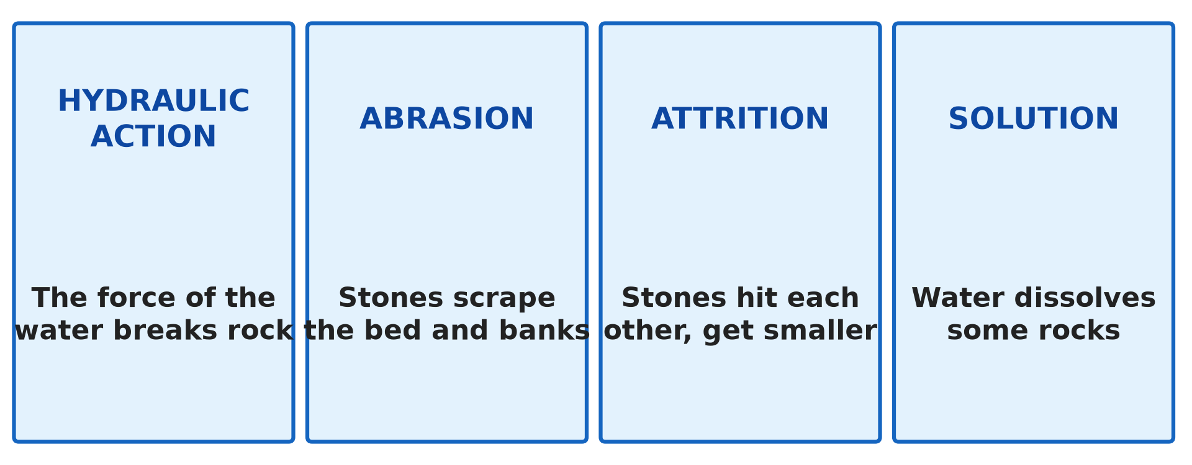
2. EROSION
Activity 2
The four processes of erosion.
Notes:
Activity 2. Look carefully at this diagram: the four processes of erosion. Observe every detail before I ask the question.

Slide 24
2. EROSION
Activity 2: Question
Distinguish abrasion from attrition.
Notes:
Here is the question for Activity 2: Distinguish abrasion from attrition. Take one minute to think and write your answer in your rough notebook.

Slide 25
2. EROSION
Activity 2: Answer
Abrasion: the load scrapes the bed and banks; attrition: stones hit each other and become smaller and rounder.
Notes:
Let us check the answer together. Abrasion: the load scrapes the bed and banks; attrition: stones hit each other and become smaller and rounder.

Slide 26
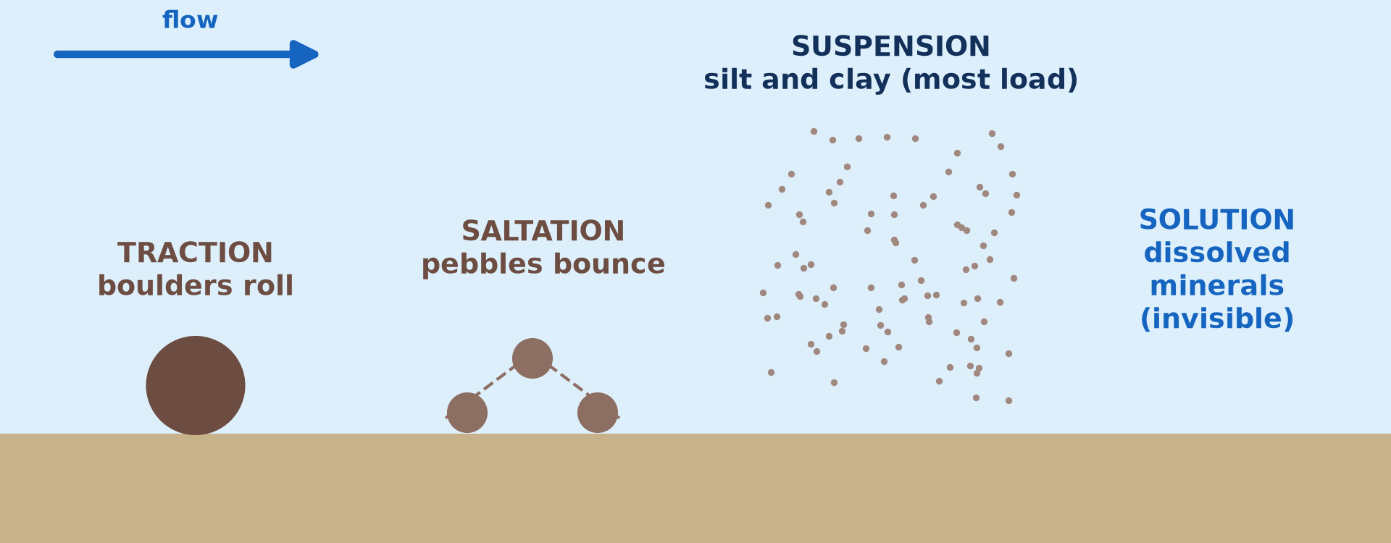
3. TRANSPORTATION
Activity 3
Four ways of carrying the load.
Notes:
Activity 3. Look carefully at this picture: four ways of carrying the load. Observe every detail before I ask the question.

Slide 27
3. TRANSPORTATION
Activity 3: Question
Which method carries the largest amount of load?
Notes:
Here is the question for Activity 3: Which method carries the largest amount of load? Take one minute to think and write your answer in your rough notebook.

Slide 28
3. TRANSPORTATION
Activity 3: Answer
Suspension.
Notes:
Let us check the answer together. Suspension.

Slide 29

3. TRANSPORTATION
Activity 4
A muddy river.
Notes:
Activity 4. Look carefully at this picture: a muddy river. Observe every detail before I ask the question.

Slide 30
3. TRANSPORTATION
Activity 4: Question
Why is the Benue brown in the rainy season?
Notes:
Here is the question for Activity 4: Why is the Benue brown in the rainy season? Take one minute to think and write your answer in your rough notebook.

Slide 31
3. TRANSPORTATION
Activity 4: Answer
It carries a lot of silt and clay in suspension.
Notes:
Let us check the answer together. It carries a lot of silt and clay in suspension.

Slide 32
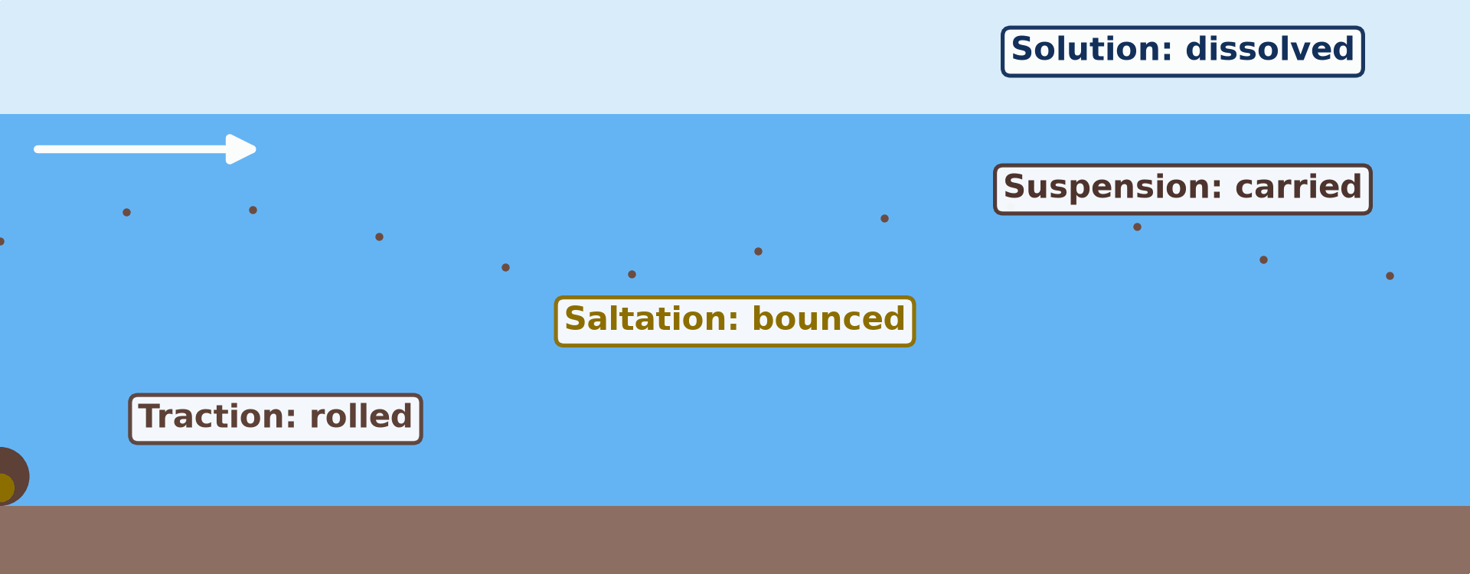
4. DEPOSITION
Activity 5
Animation: the load settles.
Notes:
Activity 5. Look carefully at this animation: animation: the load settles. Watch the animation to the end; it will play again.

Slide 33
4. DEPOSITION
Activity 5: Question
Which material is deposited first?
Notes:
Here is the question for Activity 5: Which material is deposited first? Take one minute to think and write your answer in your rough notebook.

Slide 34
4. DEPOSITION
Activity 5: Answer
The heaviest (boulders and pebbles).
Notes:
Let us check the answer together. The heaviest (boulders and pebbles).

Slide 35
BOARD SUMMARY
Board Summary
Topic: Denudational Processes on Slopes
Sub-topic: Erosion and Depositional Processes and Landforms
Lesson 14: Erosional Processes and the Fluvial System
Notes:
Now we are going to copy the board summary. Write the title and the headings neatly in your notebooks. I will give you enough time for each slide, so do not rush.

Slide 36
BOARD SUMMARY
DEFINITIONS
The key terms of this lesson are defined as follows:
River system: It is a river seen as an open system with inputs, processes and outputs.
Load: It is the material carried by a river.
Notes:
Let us copy the definitions. The key terms of this lesson are defined as follows. On this slide we have River system and Load. Write each point on a new line, with the key term first, and explain it in your own words when we revise. When you finish, we go to the next slide.

Slide 37
BOARD SUMMARY
DEFINITIONS (continued)
Deposition: It is the dropping of the load when a river loses energy.
Notes:
We continue with the definitions. On this slide we have Deposition. Write each point on a new line, with the key term first, and explain it in your own words when we revise.

Slide 38
BOARD SUMMARY
1. The River as a System
The river works as a system as follows:
Inputs: Rainwater, springs and sediments from the valley slopes enter the river.
Illustration: an open system
Notes:
Let us copy The River as a System. The river works as a system as follows. Copy the point on Inputs on the left, then draw the diagram on the right: an open system. Give it a title and label it clearly.

Slide 39
BOARD SUMMARY
1. The River as a System
Processes: The river erodes, transports and deposits.
Outputs: Water and sediments flow out into a larger river, a lake or the sea; the Benue flows into the Niger.
Notes:
We continue with The River as a System. On this slide we have Processes and Outputs. Write each point on a new line, with the key term first, and explain it in your own words when we revise.

Slide 40
BOARD SUMMARY
2. River Erosion
A river erodes its bed and banks by the following processes:
Hydraulic action: The force of the water hits the bed and banks and compresses air in cracks, breaking pieces off.
Illustration: the four processes
Notes:
Let us copy River Erosion. A river erodes its bed and banks by the following processes. Copy the point on Hydraulic action on the left, then draw the diagram on the right: the four processes. Give it a title and label it clearly.

Slide 41
BOARD SUMMARY
2. River Erosion
Abrasion (corrasion): The load scrapes and grinds the bed and banks like sandpaper.
Attrition: Stones carried by the river knock against each other and become smaller and rounder.
Solution (corrosion): The water dissolves soluble rocks such as limestone.
Notes:
We continue with River Erosion. On this slide we have Abrasion (corrasion), Attrition and Solution (corrosion). Write each point on a new line, with the key term first, and explain it in your own words when we revise.

Slide 42
BOARD SUMMARY
3. River Transportation
A river carries its load by the following methods:
Traction: The largest boulders roll along the bed.
Illustration: four ways of carrying the load
Notes:
Let us copy River Transportation. A river carries its load by the following methods. Copy the point on Traction on the left, then draw the diagram on the right: four ways of carrying the load. Give it a title and label it clearly.

Slide 43
BOARD SUMMARY
3. River Transportation
Saltation: Small pebbles and sand bounce along the bed.
Notes:
We continue with River Transportation. On this slide we have Saltation. Write each point on a new line, with the key term first, and explain it in your own words when we revise.

Slide 44
BOARD SUMMARY
3. River Transportation
Suspension: Silt and clay are carried within the water, making it brown; this is the largest part of the load.
Illustration: a muddy river
Notes:
Copy the point on Suspension on the left, then draw the diagram on the right: a muddy river. Give it a title and label it clearly.

Slide 45
BOARD SUMMARY
3. River Transportation
Solution: Dissolved minerals are carried invisibly.
Notes:
We continue with River Transportation. On this slide we have Solution. Write each point on a new line, with the key term first, and explain it in your own words when we revise.

Slide 46
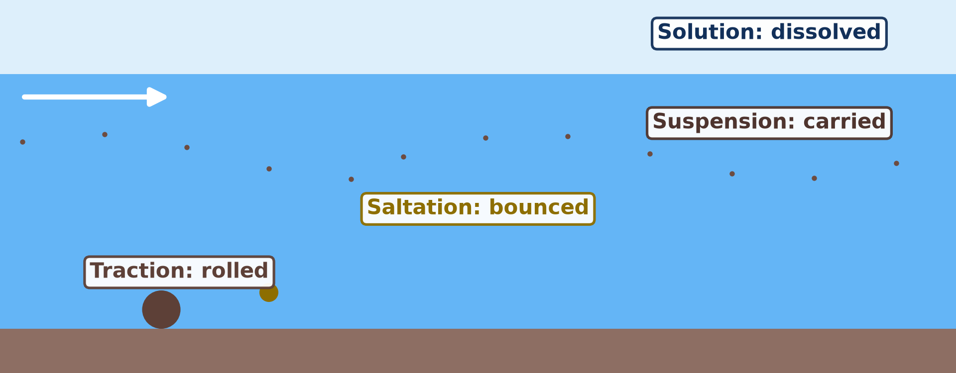
BOARD SUMMARY
4. River Deposition
A river deposits its load in the following conditions:
Loss of energy: Deposition happens when velocity falls, and the heaviest material is dropped first.
Illustration: the load settles
Notes:
Let us copy River Deposition. A river deposits its load in the following conditions. Copy the point on Loss of energy on the left, then draw the diagram on the right: the load settles. Give it a title and label it clearly.

Slide 47
BOARD SUMMARY
4. River Deposition
Less water: The volume falls in the dry season, so the Benue leaves sandbanks.
Flat land: The river enters a gentle plain and slows down.
Lakes and seas: The river enters still water, as the Benue enters the Lagdo reservoir.
Notes:
We continue with River Deposition. On this slide we have Less water, Flat land and Lakes and seas. Write each point on a new line, with the key term first, and explain it in your own words when we revise.

Slide 48
FORMATIVE EVALUATION
Evaluation 1
Distinguish abrasion from attrition.
Notes:
Now let us check what you have understood. Question 1: Distinguish abrasion from attrition. Answer in your exercise book.

Slide 49
FORMATIVE EVALUATION
Expected Answer
Abrasion is the scraping of the bed and banks by the load; attrition is the collision of stones that makes them smaller and rounder.
Notes:
The expected answer is: abrasion is the scraping of the bed and banks by the load; attrition is the collision of stones that makes them smaller and rounder. If you got it right, well done.

Slide 50
FORMATIVE EVALUATION
Evaluation 2
Give two conditions for river deposition.
Notes:
Now let us check what you have understood. Question 2: Give two conditions for river deposition. Answer in your exercise book.

Slide 51
FORMATIVE EVALUATION
Expected Answer
Fall in water volume, entry into flat land, entry into a lake or the sea (any two).
Notes:
The expected answer is: fall in water volume, entry into flat land, entry into a lake or the sea (any two). If you got it right, well done.

Slide 52
REMEDIATION
Remediation
Fill in the blanks:
The rolling of boulders is ______.
Silt carried in the water moves by ______.
The Benue leaves ______ in the dry season.
Notes:
For those who need more practice, fill in the blanks in your exercise book. The answers are: number 1, traction; number 2, suspension; number 3, sandbanks.

Slide 53
HOMEWORK
Homework
Name the three courses of a river.
Notes:
For your homework: Name the three courses of a river. We shall correct it at the beginning of our next lesson.

Slide 54
NEXT LESSON
Next Lesson
Our next lesson will be on:
Lesson 15: River Action on its Long Profile
Notes:
Our next lesson will be on Lesson 15: River Action on its Long Profile. Thank you for your attention, and see you next time.

Slide 55
BILINGUAL GAME
Bilingual Game (Jeu Bilingue)
English | Français
Erosion | L'érosion
Transportation | Le transport
Deposition | Le dépôt
River load | La charge du fleuve
River bank | La berge
Sandbank | Le banc de sable
Notes:
Let us play the bilingual game. I say a word in English, and you give me the French word. Then we do the reverse.

Slide 56
LOGBOOK
Official Logbook (1/2)
Module / Topic | Denudational Processes on Slopes
Lesson Title | Lesson 14: Erosional Processes and the Fluvial System
Expected Learning Outcomes | Describe the river as an open system. Explain the four processes of river erosion. Explain the four methods of transportation. Explain why and where a river deposits its load.
Competence | Learners are able to explain how a river erodes, carries and deposits material, using the Benue as an example.
Notes:
I record this information in the official logbook of the class after the lesson.

Slide 57
LOGBOOK
Official Logbook (2/2)
Matter Taught | DEFINITIONS; The River as a System; River Erosion; River Transportation; River Deposition.
Evaluation | Formative evaluation and remediation exercise.
Homework | Name the three courses of a river.
Enrolment / Present / Absent | ____ / ____ / ____
Achievement | To be completed after the lesson.
Notes:
I complete the second page of the logbook: the matter taught, the evaluation, the homework and the attendance.

Slide 58
TEACHER'S NOTE
Teacher's Note
Timing: Homework correction, plan, objectives 8 min | Recall, situation, action 10 min | 5 activities 30 min | Board summary (copying) 30 min | Evaluation, remediation 10 min | Homework, next lesson 5 min | Logbook 7 min
Activity 5 is an animation (GIF): it plays automatically in slide-show mode.
Without the projector (Activity 1): draw inputs, stores and outputs.
Without the projector (Activity 2): rub two stones together.
Without the projector (Activity 3): shake a bottle with water, sand and soil.
Without the projector (Activity 4): compare rainy and dry seasons.
Without the projector (Activity 5): let the shaken bottle settle.
Notes:
This slide is for me, the teacher: it gives the timing of the lesson and what to do if the projector is not available.

Slide 59
REFERENCES
References
Geography Syllabus for Sixth Forms (Lower and Upper Sixth), MINESEC, 2019 — Module 2 (Geomorphology).
Teacher's course notes: Mr KAMDEM E., Geomorphology (LSA), GBHS Garoua, 2026.
Photo, Activity 4: “Parana River Floodplain, Northern Argentina (NASA, International Space” by NASA's Marshall Space Flight Center, CC BY-NC 2.0, via nasa (https://www.flickr.com/photos/28634332@N05/5684050889)
Diagrams and animations: drawn for this lesson (Geography Department).
Notes:
These are the references and picture credits used to prepare this lesson.

