Slide 1
LOWER SIXTH ARTS
GEOGRAPHY
Lesson 1
Origin of the Earth
Notes:
Good morning, class, and welcome to our geography lesson. I am your geography teacher, Mr Kamdem. Today we are starting Lesson 1: Origin of the Earth.

Slide 2
CLASS INFO
Class, Chapter and Duration
Class | Lower Sixth Arts
Chapter | Module 2: Understanding and managing physical landscapes, geomorphological processes and hazards across the world in general and Cameroon in particular
Duration | 2 periods (2 × 50 minutes)
Notes:
This lesson is for Lower Sixth Arts. It belongs to Module 2: Understanding and managing physical landscapes, geomorphological processes and hazards across the world in general and Cameroon in particular. We shall need 2 periods to cover it.

Slide 3
IDENTIFICATION
Lesson Identification
Topic | The Development of the Earth's Structure
Sub-topic | The Origin and Earth's Structure
Lesson | Lesson 1: Origin of the Earth
Notions / Concepts | Geomorphology, structural and dynamic geomorphology, endogenic and exogenic processes, Big Bang, geologic time scale, era.
Syllabus focus | Introduction to geomorphology (meaning, branches, processes); the Big Bang theory; the geologic time scale and the characteristics of the four eras.
Competence | Learners are able to explain the origin of the Earth and place the major events of its history on the geologic time scale.
Notes:
Our topic is The Development of the Earth's Structure, and the sub-topic is The Origin and Earth's Structure. The key notions we shall use today are: geomorphology, structural and dynamic geomorphology, endogenic and exogenic processes, Big Bang, geologic time scale, era. At the end, you should be able to do this: learners are able to explain the origin of the Earth and place the major events of its history on the geologic time scale.

Slide 4

HOMEWORK CORRECTION
Correction of the Homework
Question (Further Study 4: The Drainage of Cameroon):
Draw the map of Cameroon with the four basins and two rivers in each.
Notes:
Before we start the new lesson, let us correct the homework I gave you at the end of Further Study 4: The Drainage of Cameroon. The question was: Draw the map of Cameroon with the four basins and two rivers in each. Take out your exercise books.

Slide 5
HOMEWORK CORRECTION
Correction: Possible Answer
Atlantic basin: Sanaga, Wouri. Niger basin: Benue, Faro. Lake Chad basin: Logone, Chari. Congo basin: Sangha, Dja.
Notes:
Here is a good answer. Atlantic basin: Sanaga, Wouri. Niger basin: Benue, Faro. Lake Chad basin: Logone, Chari. Congo basin: Sangha, Dja. Compare it with your own answer and correct your work in red.

Slide 6
LESSON PLAN
Lesson Plan
Correction of the homework
Objectives and recall
Real-life situation and action to take
Learning activities
Board summary
Evaluation, remediation and homework
Notes:
Here is the plan of our lesson today. First, we shall correct the homework. Then we shall look at the objectives and recall what you already know. After that, we shall study a situation from real life and the action to take, and do the learning activities. Finally, we shall copy the board summary, do the evaluation and the remediation, and I will give you the homework.

Slide 7
OBJECTIVES
Objectives
By the end of this lesson, you should be able to:
Define geomorphology and distinguish its two branches.
Distinguish endogenic and exogenic processes.
Notes:
Take your time to copy this part; we will continue together.

Slide 8
OBJECTIVES
Objectives (continued)
Explain the Big Bang theory.
Describe the four eras of the geologic time scale.
Appreciate the vastness of geologic time.
Notes:
By the end of this lesson, you should be able to do five things. Number 1: define geomorphology and distinguish its two branches. Number 2: distinguish endogenic and exogenic processes. Number 3: explain the Big Bang theory. Number 4: describe the four eras of the geologic time scale. Number 5: appreciate the vastness of geologic time.

Slide 9
PREVIOUS KNOWLEDGE
Previous Knowledge
The Earth is one of the eight planets of the solar system.
Fossils are remains of ancient living things in rocks.
The Mandara Mountains are near Mokolo.
Notes:
Let us first remember what you already know. The Earth is one of the eight planets of the solar system. Fossils are remains of ancient living things in rocks. The Mandara Mountains are near Mokolo. Keep this in mind, because we shall build on it today.

Slide 10
REAL-LIFE SITUATION
Situation in Real Life
You are with your grandfather near the Mandara Mountains.
He points to the rocks and says: "These rocks are older than any human story, older than the Benue, older than Cameroon itself."
You look at the old, weathered stone and wonder what was there before the mountains.
Notes:
Take your time to copy this part; we will continue together.

Slide 11
REAL-LIFE SITUATION
Situation in Real Life (continued)
You ask: "How did the Earth begin, and how do scientists tell the long story of its history?"
Notes:
Listen carefully to this situation from real life. You are with your grandfather near the Mandara Mountains. He points to the rocks and says: "These rocks are older than any human story, older than the Benue, older than Cameroon itself." You look at the old, weathered stone and wonder what was there before the mountains. You ask: "How did the Earth begin, and how do scientists tell the long story of its history?" Think about it, because I am going to ask you some questions.

Slide 12
REAL-LIFE SITUATION
Situation: Question 1
What is the problem in the situation?
Notes:
Question 1: What is the problem in the situation? Think for a moment, then raise your hand to answer.

Slide 13
REAL-LIFE SITUATION
Answer
The learner does not know the origin of the Earth and how its history is organised.
Notes:
Good. The learner does not know the origin of the Earth and how its history is organised.

Slide 14
REAL-LIFE SITUATION
Situation: Question 2
How do scientists think the universe began?
Notes:
Question 2: How do scientists think the universe began? Think for a moment, then raise your hand to answer.

Slide 15
REAL-LIFE SITUATION
Answer
With the Big Bang, the sudden expansion of a single, very hot and dense point.
Notes:
Good. With the Big Bang, the sudden expansion of a single, very hot and dense point.

Slide 16
REAL-LIFE SITUATION
Situation: Question 3
How is the long history of the Earth organised?
Notes:
Question 3: How is the long history of the Earth organised? Think for a moment, then raise your hand to answer.

Slide 17
REAL-LIFE SITUATION
Possible Answer
In the geologic time scale, divided into eras.
Notes:
Good. In the geologic time scale, divided into eras.

Slide 18
ACTION TO TAKE
Action to Take
Protect rocks, fossils and landscapes as records of the history of the Earth.
Notes:
From this situation, the action we are working towards in this lesson is the following: protect rocks, fossils and landscapes as records of the history of the Earth.

Slide 19
JUSTIFICATION
Justification of the Lesson
This lesson introduces geomorphology and helps us to understand the age and history of the landforms around us.
Notes:
Why is this lesson important for you? This lesson introduces geomorphology and helps us to understand the age and history of the landforms around us.

Slide 20
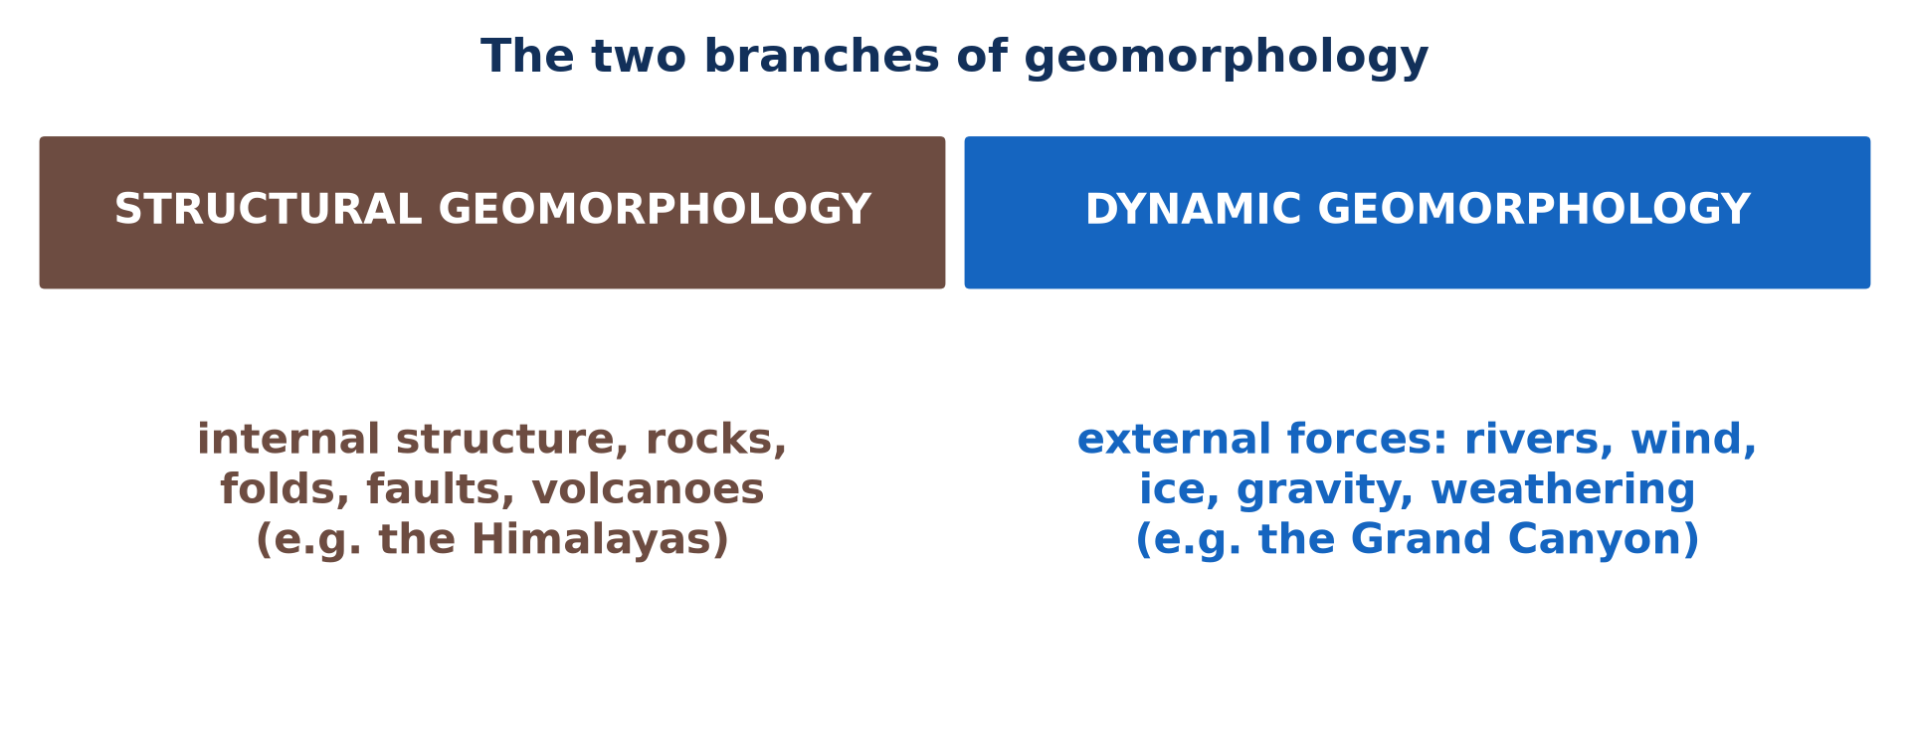
1. GEOMORPHOLOGY
Activity 1
The two branches of geomorphology.
Notes:
Activity 1. Look carefully at this picture: the two branches of geomorphology. Observe every detail before I ask the question.

Slide 21
1. GEOMORPHOLOGY
Activity 1: Question
Which branch studies landforms made by rivers and wind?
Notes:
Here is the question for Activity 1: Which branch studies landforms made by rivers and wind? Take one minute to think and write your answer in your rough notebook.

Slide 22
1. GEOMORPHOLOGY
Activity 1: Answer
Dynamic geomorphology.
Notes:
Let us check the answer together. Dynamic geomorphology.

Slide 23
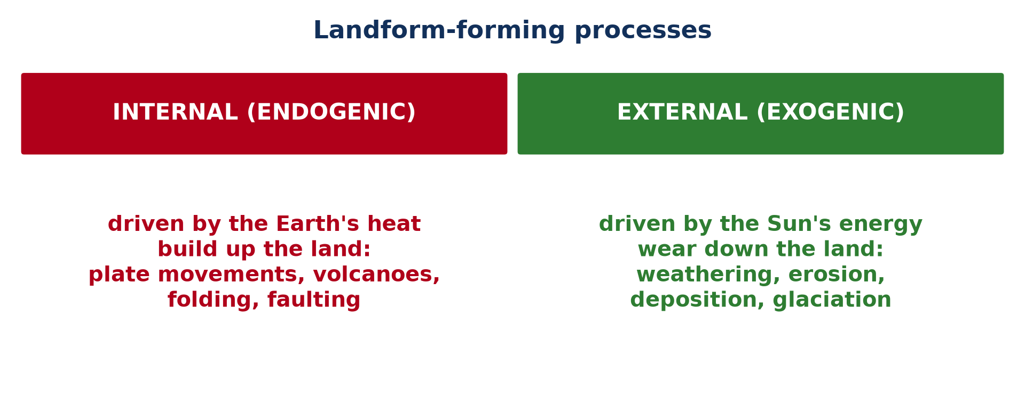
1. GEOMORPHOLOGY
Activity 2
Internal and external processes.
Notes:
Activity 2. Look carefully at this picture: internal and external processes. Observe every detail before I ask the question.

Slide 24
1. GEOMORPHOLOGY
Activity 2: Question
Is a volcanic eruption an endogenic or an exogenic process?
Notes:
Here is the question for Activity 2: Is a volcanic eruption an endogenic or an exogenic process? Take one minute to think and write your answer in your rough notebook.

Slide 25
1. GEOMORPHOLOGY
Activity 2: Answer
An endogenic (internal) process.
Notes:
Let us check the answer together. An endogenic (internal) process.

Slide 26
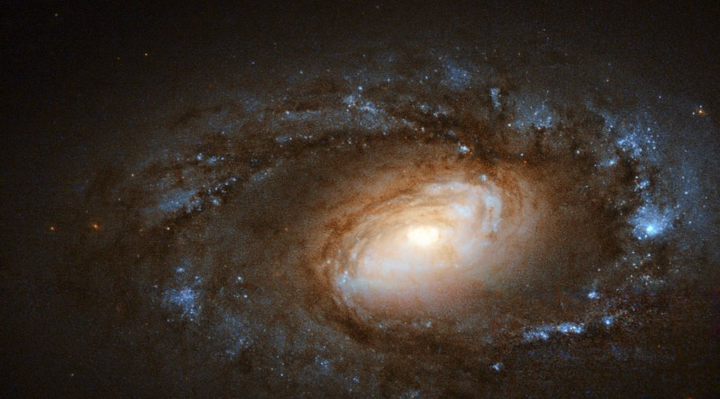
2. THE BIG BANG
Activity 3
A galaxy.
Notes:
Activity 3. Look carefully at this picture: a galaxy. Observe every detail before I ask the question.

Slide 27
2. THE BIG BANG
Activity 3: Question
When did the Big Bang take place?
Notes:
Here is the question for Activity 3: When did the Big Bang take place? Take one minute to think and write your answer in your rough notebook.

Slide 28
2. THE BIG BANG
Activity 3: Answer
About 13.8 billion years ago.
Notes:
Let us check the answer together. About 13.8 billion years ago.

Slide 29
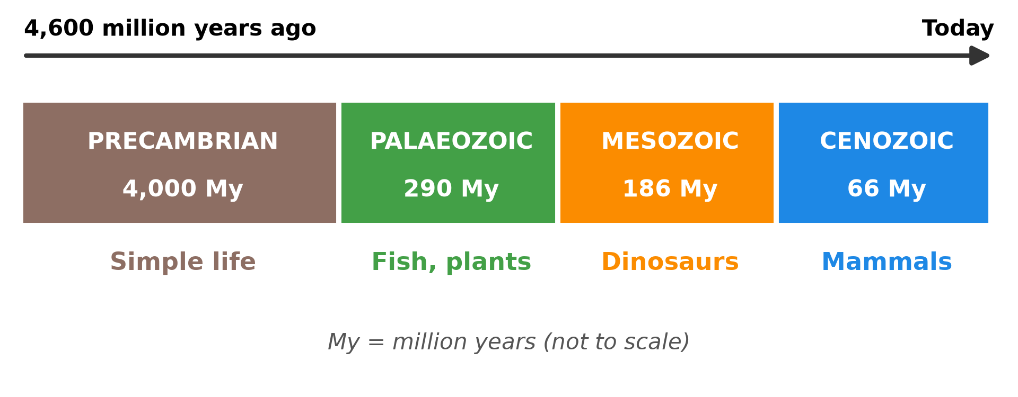
3. GEOLOGIC TIME SCALE
Activity 4
The four eras.
Notes:
Activity 4. Look carefully at this diagram: the four eras. Observe every detail before I ask the question.

Slide 30
3. GEOLOGIC TIME SCALE
Activity 4: Question
Which era is the longest?
Notes:
Here is the question for Activity 4: Which era is the longest? Take one minute to think and write your answer in your rough notebook.

Slide 31
3. GEOLOGIC TIME SCALE
Activity 4: Answer
The Precambrian (about 88 % of the history of the Earth).
Notes:
Let us check the answer together. The Precambrian (about 88 % of the history of the Earth).

Slide 32
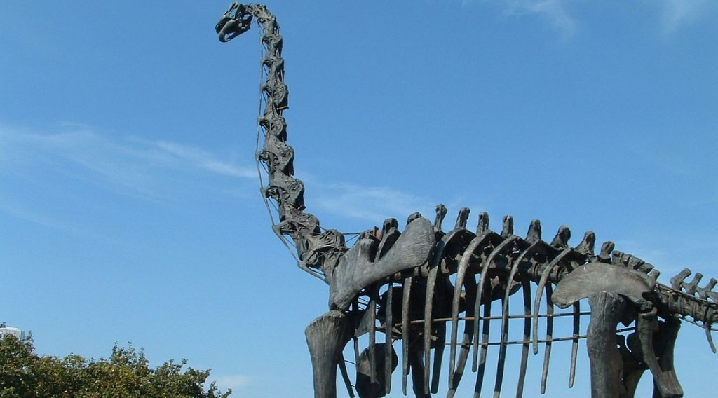
3. GEOLOGIC TIME SCALE
Activity 5
A dinosaur skeleton.
Notes:
Activity 5. Look carefully at this picture: a dinosaur skeleton. Observe every detail before I ask the question.

Slide 33
3. GEOLOGIC TIME SCALE
Activity 5: Question
In which era did dinosaurs live?
Notes:
Here is the question for Activity 5: In which era did dinosaurs live? Take one minute to think and write your answer in your rough notebook.

Slide 34
3. GEOLOGIC TIME SCALE
Activity 5: Answer
In the Mesozoic era.
Notes:
Let us check the answer together. In the Mesozoic era.

Slide 35
BOARD SUMMARY
Board Summary
Topic: The Development of the Earth's Structure
Sub-topic: The Origin and Earth's Structure
Lesson 1: Origin of the Earth
Notes:
Now we are going to copy the board summary. Write the title and the headings neatly in your notebooks. I will give you enough time for each slide, so do not rush.

Slide 36
BOARD SUMMARY
DEFINITIONS
The key terms of this lesson are defined as follows:
Geomorphology: It is the science that studies the formation, development and change of landforms.
Notes:
Let us copy the definitions. The key terms of this lesson are defined as follows. On this slide we have Geomorphology. Write each point on a new line, with the key term first, and explain it in your own words when we revise. When you finish, we go to the next slide.

Slide 37
BOARD SUMMARY
DEFINITIONS (continued)
Big Bang theory: It is the theory that the universe began about 13.8 billion years ago with the sudden expansion of a single, very hot and dense point.
Geologic time scale: It is a chart dividing the history of the Earth into eons, eras, periods and epochs.
Notes:
We continue with the definitions. On this slide we have Big Bang theory and Geologic time scale. Write each point on a new line, with the key term first, and explain it in your own words when we revise. When you finish, we go to the next slide.

Slide 38
BOARD SUMMARY
DEFINITIONS (continued)
Era: It is a very long division of geologic time marked by major geological and biological changes.
Notes:
We continue with the definitions. On this slide we have Era. Write each point on a new line, with the key term first, and explain it in your own words when we revise.

Slide 39
BOARD SUMMARY
1. Meaning of Geomorphology
Geomorphology is explained as follows:
Geomorphology: Geomorphology comes from Greek words meaning the study of the form of the Earth. It studies how landforms such as mountains, plains, valleys and coasts are formed and how they change over time.
Illustration: the branches of geomorphology
Notes:
Let us copy Meaning of Geomorphology. Geomorphology is explained as follows. Copy the point on Geomorphology on the left, then draw the diagram on the right: the branches of geomorphology. Give it a title and label it clearly.

Slide 40
BOARD SUMMARY
1. Meaning of Geomorphology
Its scope: It studies the internal forces that build the relief, such as volcanism and folding, and the external forces that wear it down, such as rivers and weathering. To understand them, it starts with the origin and long history of the Earth.
Notes:
We continue with Meaning of Geomorphology. Copy the point on Its scope: write the key term first, then its explanation.

Slide 41
BOARD SUMMARY
2. The Big Bang Theory
The Big Bang theory explains the origin of the universe and of the Earth in the following stages:
The beginning: About 13.8 billion years ago, all the matter and energy of the universe were concentrated in one extremely hot and dense point. This point expanded suddenly, creating space, time, matter and energy.
Illustration: a galaxy
Notes:
Let us copy The Big Bang Theory. The Big Bang theory explains the origin of the universe and of the Earth in the following stages. Copy the point on The beginning on the left, then draw the diagram on the right: a galaxy. Give it a title and label it clearly.

Slide 42
BOARD SUMMARY
2. The Big Bang Theory
Formation of galaxies and stars: As the universe expanded, it cooled and matter gathered under gravity into clouds of gas. These clouds formed galaxies and stars, in which heavier elements were made.
Notes:
We continue with The Big Bang Theory. Copy the point on Formation of galaxies and stars: write the key term first, then its explanation.

Slide 43
BOARD SUMMARY
2. The Big Bang Theory
Formation of the Earth: About 4.6 billion years ago, a cloud of gas and dust collapsed to form the Sun and the planets. The Earth grew by the collision of rocky fragments, then cooled and separated into layers.
Notes:
We continue with The Big Bang Theory. Copy the point on Formation of the Earth: write the key term first, then its explanation.

Slide 44
BOARD SUMMARY
2. The Big Bang Theory
Evidence for the theory: Galaxies are still moving away from each other, which shows that the universe is expanding. Scientists also detect a weak radiation left over from the early hot universe, called the cosmic microwave background.
Notes:
We continue with The Big Bang Theory. Copy the point on Evidence for the theory: write the key term first, then its explanation.

Slide 45
BOARD SUMMARY
3. The Geologic Time Scale
A) The Precambrian and the Palaeozoic
The first two eras have the following duration and characteristics:
The divisions of time: Geologists divide the 4.6 billion years of Earth history into eons, eras, periods and epochs. The four main eras are the Precambrian, the Palaeozoic, the Mesozoic and the Cenozoic.
Illustration: the geologic time scale
Notes:
Let us copy The Precambrian and the Palaeozoic. The first two eras have the following duration and characteristics. Copy the point on The divisions of time on the left, then draw the diagram on the right: the geologic time scale. Give it a title and label it clearly.

Slide 46
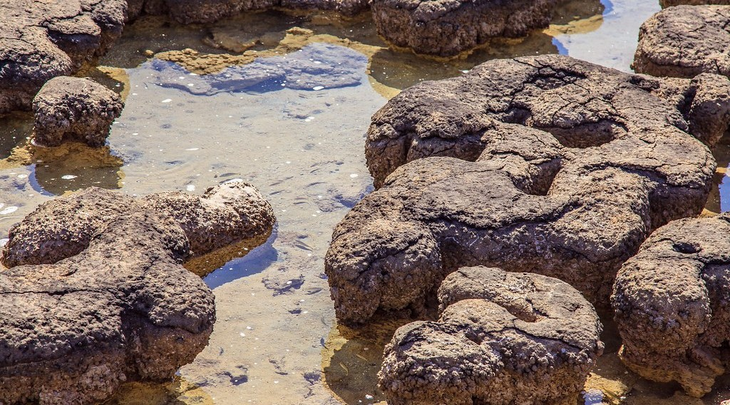
BOARD SUMMARY
3. The Geologic Time Scale
A) The Precambrian and the Palaeozoic
Precambrian (4,600 to 541 million years ago): It covers about 88 % of the history of the Earth, during which the crust, the first continents, the oceans and the atmosphere formed. Only simple, single-celled life such as bacteria and algae existed, and the old rocks of the African Shield, including those of North Cameroon, date from this era.
Illustration: stromatolites, the oldest fossils
Notes:
Copy the point on Precambrian (4,600 to 541 million years ago) on the left, then draw the diagram on the right: stromatolites, the oldest fossils. Give it a title and label it clearly.

Slide 47
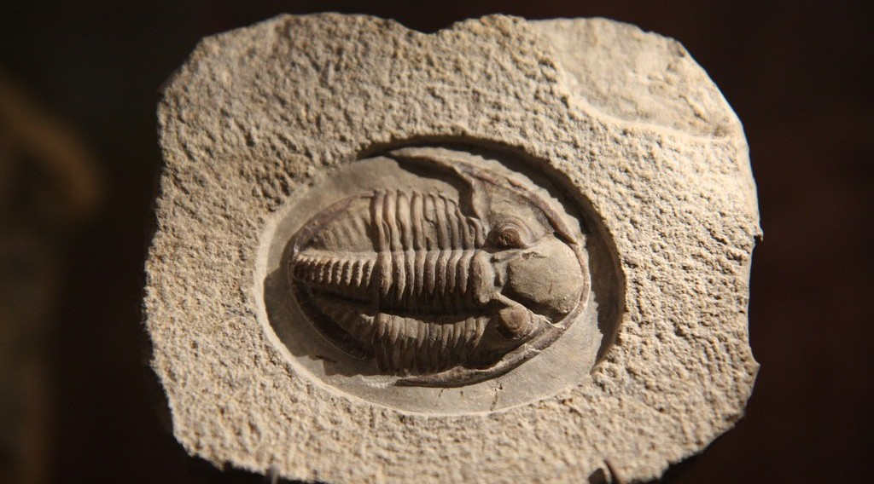
BOARD SUMMARY
3. The Geologic Time Scale
A) The Precambrian and the Palaeozoic
Palaeozoic (541 to 252 million years ago): Its name means ancient life: fish, land plants, insects, amphibians and reptiles appeared, and coal formed from great forests. The continents joined into the supercontinent Pangaea, and a mass extinction ended the era.
Illustration: a trilobite fossil
Notes:
Copy the point on Palaeozoic (541 to 252 million years ago) on the left, then draw the diagram on the right: a trilobite fossil. Give it a title and label it clearly.

Slide 48
BOARD SUMMARY
3. The Geologic Time Scale
B) The Mesozoic and the Cenozoic
The last two eras have the following duration and characteristics:
Mesozoic (252 to 66 million years ago): Its name means middle life: dinosaurs dominated the land, and birds, small mammals and flowering plants appeared. Pangaea broke up, the Atlantic Ocean opened, and a mass extinction killed the dinosaurs at its end.
Illustration: a dinosaur skeleton
Notes:
Let us copy The Mesozoic and the Cenozoic. The last two eras have the following duration and characteristics. Copy the point on Mesozoic (252 to 66 million years ago) on the left, then draw the diagram on the right: a dinosaur skeleton. Give it a title and label it clearly.

Slide 49
BOARD SUMMARY
3. The Geologic Time Scale
B) The Mesozoic and the Cenozoic
Cenozoic (66 million years ago to today): Its name means recent life: mammals became dominant, and modern humans appeared only about 300,000 years ago. The continents reached their present positions, the Alps and the Himalayas rose, and ice ages occurred.
Notes:
We continue with The Mesozoic and the Cenozoic. Copy the point on Cenozoic (66 million years ago to today): write the key term first, then its explanation.

Slide 50
BOARD SUMMARY
3. The Geologic Time Scale
B) The Mesozoic and the Cenozoic
The place of man: If the whole history of the Earth were one day of 24 hours, humans would appear only in the last few seconds. This shows how slowly most landforms have been shaped.
Notes:
We continue with The Mesozoic and the Cenozoic. Copy the point on The place of man: write the key term first, then its explanation.

Slide 51
FORMATIVE EVALUATION
Evaluation 1
Distinguish structural geomorphology from dynamic geomorphology.
Notes:
Now let us check what you have understood. Question 1: Distinguish structural geomorphology from dynamic geomorphology. Answer in your exercise book.

Slide 52
FORMATIVE EVALUATION
Expected Answer
Structural geomorphology studies landforms made by internal structure and forces; dynamic geomorphology studies landforms made by external agents.
Notes:
The expected answer is: structural geomorphology studies landforms made by internal structure and forces; dynamic geomorphology studies landforms made by external agents. If you got it right, well done.

Slide 53
FORMATIVE EVALUATION
Evaluation 2
Give one geological and one biological event of the Mesozoic.
Notes:
Now let us check what you have understood. Question 2: Give one geological and one biological event of the Mesozoic. Answer in your exercise book.

Slide 54
FORMATIVE EVALUATION
Expected Answer
Pangaea broke up; dinosaurs dominated the land.
Notes:
The expected answer is: pangaea broke up; dinosaurs dominated the land. If you got it right, well done.

Slide 55
REMEDIATION
Remediation
Fill in the blanks:
The Earth formed about ______ billion years ago.
The longest era is the ______.
The Cenozoic is the age of ______.
Notes:
For those who need more practice, fill in the blanks in your exercise book. The answers are: number 1, ; number 4, 6; number 2, Precambrian; number 3, mammals.

Slide 56
HOMEWORK
Homework
Name the three main layers of the Earth.
Notes:
For your homework: Name the three main layers of the Earth. We shall correct it at the beginning of our next lesson.

Slide 57
NEXT LESSON
Next Lesson
Our next lesson will be on:
Lesson 2: Internal Structure of the Earth
Notes:
Our next lesson will be on Lesson 2: Internal Structure of the Earth. Thank you for your attention, and see you next time.

Slide 58
BILINGUAL GAME
Bilingual Game (Jeu Bilingue)
English | Français
Big Bang | Le Big Bang
Geologic time scale | L'échelle des temps géologiques
Era | L'ère
Fossil | Le fossile
Supercontinent | Le supercontinent
Landform | La forme de relief
Notes:
Let us play the bilingual game. I say a word in English, and you give me the French word. Then we do the reverse.

Slide 59
LOGBOOK
Official Logbook (1/2)
Module / Topic | The Development of the Earth's Structure
Lesson Title | Lesson 1: Origin of the Earth
Expected Learning Outcomes | Define geomorphology and distinguish its two branches. Distinguish endogenic and exogenic processes. Explain the Big Bang theory. Describe the four eras of the geologic time scale. Appreciate the vastness of geologic time.
Competence | Learners are able to explain the origin of the Earth and place the major events of its history on the geologic time scale.
Notes:
I record this information in the official logbook of the class after the lesson.

Slide 60
LOGBOOK
Official Logbook (2/2)
Matter Taught | DEFINITIONS; Meaning of Geomorphology; The Big Bang Theory; The Precambrian and the Palaeozoic; The Mesozoic and the Cenozoic.
Evaluation | Formative evaluation and remediation exercise.
Homework | Name the three main layers of the Earth.
Enrolment / Present / Absent | ____ / ____ / ____
Achievement | To be completed after the lesson.
Notes:
I complete the second page of the logbook: the matter taught, the evaluation, the homework and the attendance.

Slide 61
TEACHER'S NOTE
Teacher's Note
Timing: Homework correction, plan, objectives 8 min | Recall, situation, action 10 min | 5 activities 30 min | Board summary (copying) 30 min | Evaluation, remediation 10 min | Homework, next lesson 5 min | Logbook 7 min
Without the projector (Activity 1): draw the two branches on the board.
Without the projector (Activity 2): list processes in two columns.
Without the projector (Activity 3): describe the night sky.
Without the projector (Activity 4): use the length of the classroom as a timeline.
Without the projector (Activity 5): name the animals of each era.
Notes:
This slide is for me, the teacher: it gives the timing of the lesson and what to do if the projector is not available.

Slide 62
REFERENCES
References
Geography Syllabus for Sixth Forms (Lower and Upper Sixth), MINESEC, 2019 — Module 2 (Geomorphology).
Teacher's course notes: Mr KAMDEM E., Geomorphology (LSA), GBHS Garoua, 2026.
Photo, Activity 3: “Hubble Spies Charming Spiral Galaxy Bursting with Stars” by NASA Goddard Photo and Video, CC BY 2.0, via nasa (https://www.flickr.com/photos/24662369@N07/15766783527)
Photo, Activity 5: “dinosaur” by ianturton, CC BY-NC-SA 2.0, via Flickr (https://www.flickr.com/photos/16041363@N00/9555513)
Photo, board summary (Precambrian (4,600 to 541 million years ago)): “Western Australia, Stromatolites Sharks Bay” by VladPix, CC BY-NC-ND 2.0, via Flickr (https://www.flickr.com/photos/62825712@N07/8766549873)
Photo, board summary (Palaeozoic (541 to 252 million years ago)): “Trilobite Fossil at NMNH” by Mr.TinDC, CC BY-ND 2.0, via Flickr (https://www.flickr.com/photos/7471115@N08/2948579998)
Diagrams and animations: drawn for this lesson (Geography Department).
Notes:
These are the references and picture credits used to prepare this lesson.

