Slide 1
LOWER SIXTH ARTS
GEOGRAPHY
Lesson 10
Intensity and Factors of Weathering
Notes:
Good morning, class, and welcome to our geography lesson. I am your geography teacher, Mr Kamdem. Today we are starting Lesson 10: Intensity and Factors of Weathering.

Slide 2
CLASS INFO
Class, Chapter and Duration
Class | Lower Sixth Arts
Chapter | Module 2: Understanding and managing physical landscapes, geomorphological processes and hazards across the world in general and Cameroon in particular
Duration | 2 periods (2 × 50 minutes)
Notes:
This lesson is for Lower Sixth Arts. It belongs to Module 2: Understanding and managing physical landscapes, geomorphological processes and hazards across the world in general and Cameroon in particular. We shall need 2 periods to cover it.

Slide 3
IDENTIFICATION
Lesson Identification
Topic | Denudational Processes on Slopes
Sub-topic | Weathering
Lesson | Lesson 10: Intensity and Factors of Weathering
Notions / Concepts | Intensity of weathering, climate, Peltier's diagram, rock hardness, joints, relief, vegetation, human activities, acid rain.
Syllabus focus | Factors of the intensity of weathering: climate (Peltier's diagram), geology, relief, vegetation and human activities.
Competence | Learners are able to explain why weathering is faster in some places and apply this to Garoua.
Notes:
Our topic is Denudational Processes on Slopes, and the sub-topic is Weathering. The key notions we shall use today are: intensity of weathering, climate, Peltier's diagram, rock hardness, joints, relief, vegetation, human activities, acid rain. At the end, you should be able to do this: learners are able to explain why weathering is faster in some places and apply this to Garoua.

Slide 4

HOMEWORK CORRECTION
Correction of the Homework
Question (Lesson 9: Denudation and Weathering):
Name the most important factor of weathering.
Notes:
Before we start the new lesson, let us correct the homework I gave you at the end of Lesson 9: Denudation and Weathering. The question was: Name the most important factor of weathering. Take out your exercise books.

Slide 5
HOMEWORK CORRECTION
Correction: Possible Answer
Climate (temperature and rainfall).
Notes:
Here is a good answer. Climate (temperature and rainfall). Compare it with your own answer and correct your work in red.

Slide 6
LESSON PLAN
Lesson Plan
Correction of the homework
Objectives and recall
Real-life situation and action to take
Learning activities
Board summary
Evaluation, remediation and homework
Notes:
Here is the plan of our lesson today. First, we shall correct the homework. Then we shall look at the objectives and recall what you already know. After that, we shall study a situation from real life and the action to take, and do the learning activities. Finally, we shall copy the board summary, do the evaluation and the remediation, and I will give you the homework.

Slide 7
OBJECTIVES
Objectives
By the end of this lesson, you should be able to:
Explain the role of climate and read Peltier's diagram.
Explain the role of rock characteristics.
Explain the role of relief.
Notes:
Take your time to copy this part; we will continue together.

Slide 8
OBJECTIVES
Objectives (continued)
Explain the roles of vegetation and human activities.
Notes:
By the end of this lesson, you should be able to do four things. Number 1: explain the role of climate and read Peltier's diagram. Number 2: explain the role of rock characteristics. Number 3: explain the role of relief. Number 4: explain the roles of vegetation and human activities.

Slide 9
PREVIOUS KNOWLEDGE
Previous Knowledge
Weathering can be mechanical, chemical or biological.
Chemical weathering is fastest where it is hot and wet.
Oxidation gives red soils.
Notes:
Let us first remember what you already know. Weathering can be mechanical, chemical or biological. Chemical weathering is fastest where it is hot and wet. Oxidation gives red soils. Keep this in mind, because we shall build on it today.

Slide 10
REAL-LIFE SITUATION
Situation in Real Life
In an old quarter of Garoua, you see two stone walls.
One was built last year: its stones are sharp and bright.
The other, about 100 years old, has rounded, cracked stones covered with green algae, and its surface is crumbly.
Notes:
Take your time to copy this part; we will continue together.

Slide 11
REAL-LIFE SITUATION
Situation in Real Life (continued)
Both are made of the same local rock.
You ask: "Why has the old wall weathered so much, and what controls the speed of weathering?"
Notes:
Listen carefully to this situation from real life. In an old quarter of Garoua, you see two stone walls. One was built last year: its stones are sharp and bright. The other, about 100 years old, has rounded, cracked stones covered with green algae, and its surface is crumbly. Both are made of the same local rock. You ask: "Why has the old wall weathered so much, and what controls the speed of weathering?" Think about it, because I am going to ask you some questions.

Slide 12
REAL-LIFE SITUATION
Situation: Question 1
What is the problem in the situation?
Notes:
Question 1: What is the problem in the situation? Think for a moment, then raise your hand to answer.

Slide 13
REAL-LIFE SITUATION
Answer
The learner does not know the factors that control the intensity of weathering.
Notes:
Good. The learner does not know the factors that control the intensity of weathering.

Slide 14
REAL-LIFE SITUATION
Situation: Question 2
Which process has worn the old wall?
Notes:
Question 2: Which process has worn the old wall? Think for a moment, then raise your hand to answer.

Slide 15
REAL-LIFE SITUATION
Answer
Weathering.
Notes:
Good. Weathering.

Slide 16
REAL-LIFE SITUATION
Situation: Question 3
What is the most important factor of weathering in Garoua?
Notes:
Question 3: What is the most important factor of weathering in Garoua? Think for a moment, then raise your hand to answer.

Slide 17
REAL-LIFE SITUATION
Possible Answer
Climate: strong heat and seasonal heavy rain.
Notes:
Good. Climate: strong heat and seasonal heavy rain.

Slide 18
ACTION TO TAKE
Action to Take
Choose resistant rocks and protect buildings from water to slow down weathering.
Notes:
From this situation, the action we are working towards in this lesson is the following: choose resistant rocks and protect buildings from water to slow down weathering.

Slide 19
JUSTIFICATION
Justification of the Lesson
This lesson helps us to understand the soils and landscapes of our region and to choose durable building materials.
Notes:
Why is this lesson important for you? This lesson helps us to understand the soils and landscapes of our region and to choose durable building materials.

Slide 20
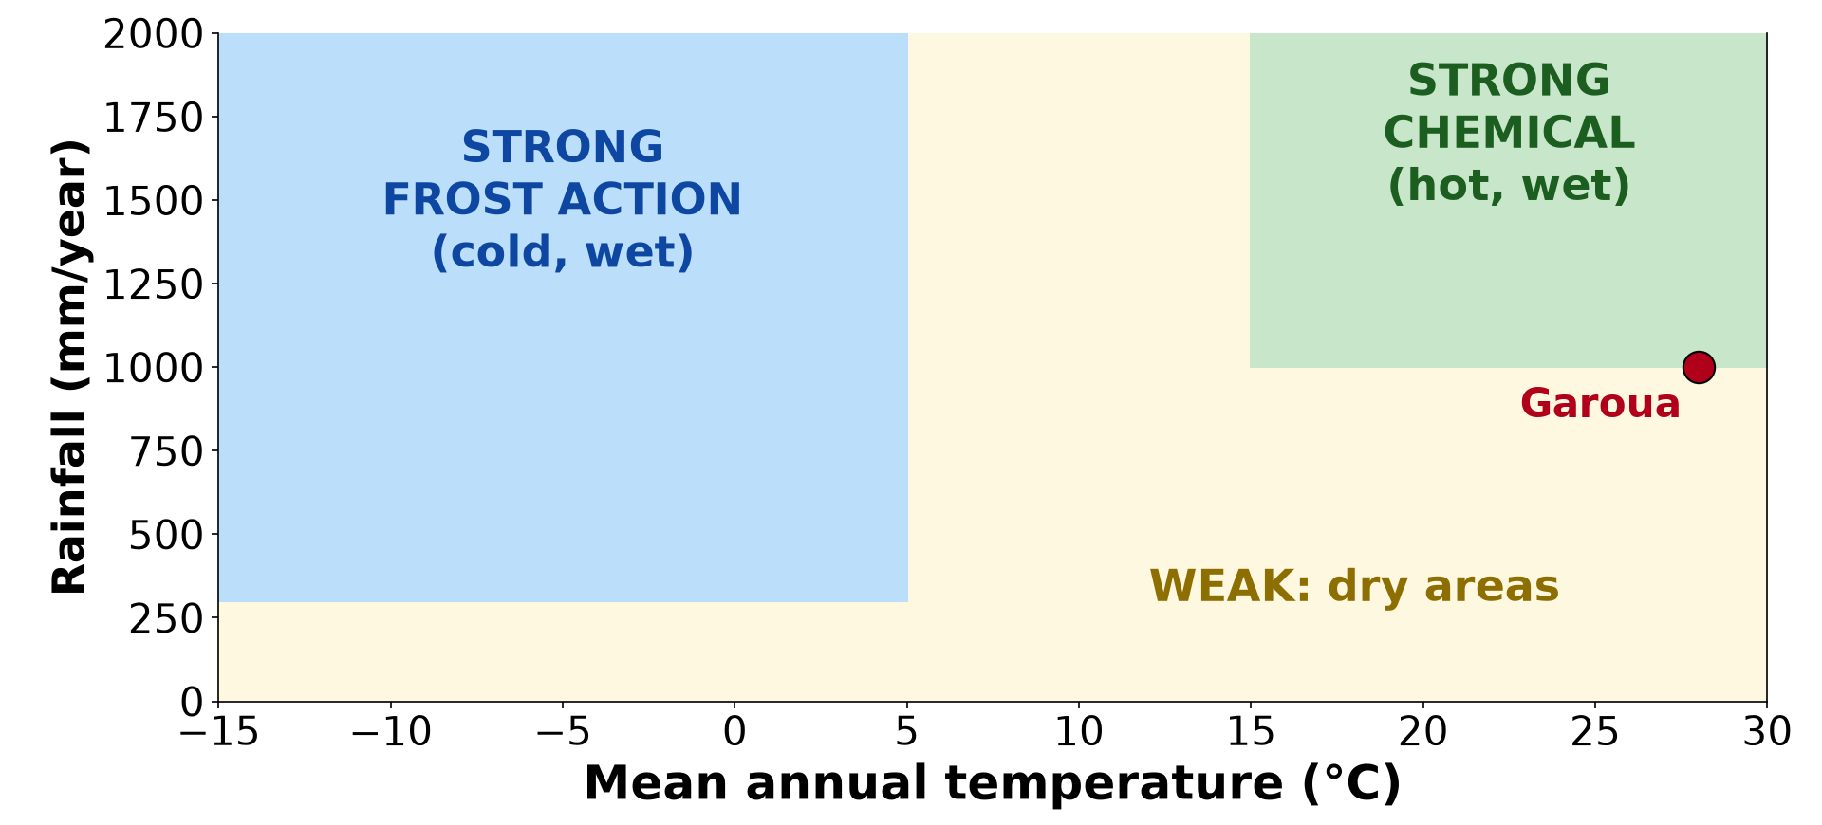
1. CLIMATE
Activity 1
Peltier's diagram.
Notes:
Activity 1. Look carefully at this diagram: peltier's diagram. Observe every detail before I ask the question.

Slide 21
1. CLIMATE
Activity 1: Question
In which climate is chemical weathering strongest?
Notes:
Here is the question for Activity 1: In which climate is chemical weathering strongest? Take one minute to think and write your answer in your rough notebook.

Slide 22
1. CLIMATE
Activity 1: Answer
In hot, wet climates.
Notes:
Let us check the answer together. In hot, wet climates.

Slide 23

1. CLIMATE
Activity 2
Red laterite.
Notes:
Activity 2. Look carefully at this picture: red laterite. Observe every detail before I ask the question.

Slide 24
1. CLIMATE
Activity 2: Question
Why are soils around Garoua red?
Notes:
Here is the question for Activity 2: Why are soils around Garoua red? Take one minute to think and write your answer in your rough notebook.

Slide 25
1. CLIMATE
Activity 2: Answer
Iron minerals are oxidised in the hot, seasonally wet climate.
Notes:
Let us check the answer together. Iron minerals are oxidised in the hot, seasonally wet climate.

Slide 26
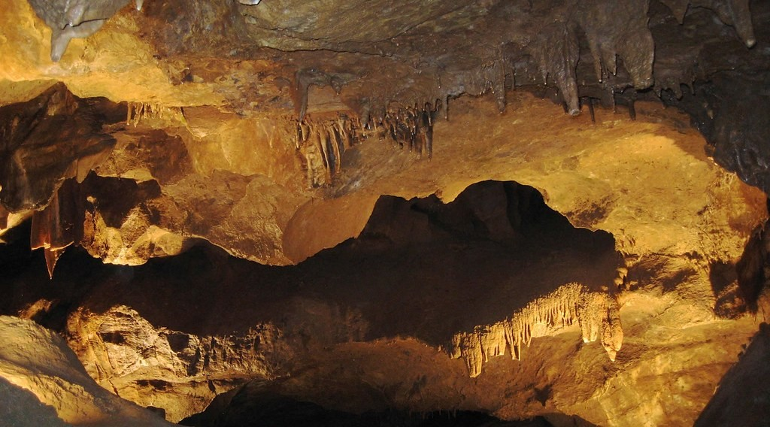
2. ROCK
Activity 3
Limestone dissolved by water.
Notes:
Activity 3. Look carefully at this picture: limestone dissolved by water. Observe every detail before I ask the question.

Slide 27
2. ROCK
Activity 3: Question
Which weathers faster: limestone or granite?
Notes:
Here is the question for Activity 3: Which weathers faster: limestone or granite? Take one minute to think and write your answer in your rough notebook.

Slide 28
2. ROCK
Activity 3: Answer
Limestone.
Notes:
Let us check the answer together. Limestone.

Slide 29

3. RELIEF
Activity 4
Scree on a steep slope.
Notes:
Activity 4. Look carefully at this picture: scree on a steep slope. Observe every detail before I ask the question.

Slide 30
3. RELIEF
Activity 4: Question
Why is fresh rock often exposed on steep slopes?
Notes:
Here is the question for Activity 4: Why is fresh rock often exposed on steep slopes? Take one minute to think and write your answer in your rough notebook.

Slide 31
3. RELIEF
Activity 4: Answer
Weathered material is quickly washed away.
Notes:
Let us check the answer together. Weathered material is quickly washed away.

Slide 32

4. HUMANS
Activity 5
A weathered stone surface.
Notes:
Activity 5. Look carefully at this picture: a weathered stone surface. Observe every detail before I ask the question.

Slide 33
4. HUMANS
Activity 5: Question
How does acid rain speed up weathering?
Notes:
Here is the question for Activity 5: How does acid rain speed up weathering? Take one minute to think and write your answer in your rough notebook.

Slide 34
4. HUMANS
Activity 5: Answer
Its acids dissolve and weaken rocks and buildings.
Notes:
Let us check the answer together. Its acids dissolve and weaken rocks and buildings.

Slide 35
BOARD SUMMARY
Board Summary
Topic: Denudational Processes on Slopes
Sub-topic: Weathering
Lesson 10: Intensity and Factors of Weathering
Notes:
Now we are going to copy the board summary. Write the title and the headings neatly in your notebooks. I will give you enough time for each slide, so do not rush.

Slide 36
BOARD SUMMARY
DEFINITIONS
The key terms of this lesson are defined as follows:
Intensity of weathering: It is the speed and depth at which rocks are broken down.
Peltier's graph: It is a graph linking mean annual temperature and rainfall to the dominant type and intensity of weathering.
Notes:
Let us copy the definitions. The key terms of this lesson are defined as follows. On this slide we have Intensity of weathering and Peltier's graph. Write each point on a new line, with the key term first, and explain it in your own words when we revise. When you finish, we go to the next slide.

Slide 37
BOARD SUMMARY
DEFINITIONS (continued)
Joints: They are natural cracks in rocks that let water in.
Notes:
We continue with the definitions. On this slide we have Joints. Write each point on a new line, with the key term first, and explain it in your own words when we revise.

Slide 38
BOARD SUMMARY
1. Climate
Climate influences weathering in the following ways:
Temperature: High temperatures speed up chemical reactions, which are about twice as fast for each rise of 10 °C. Large daily ranges of temperature, as in deserts and in Garoua in the dry season, cause exfoliation.
Illustration: Peltier's graph
Notes:
Let us copy Climate. Climate influences weathering in the following ways. Copy the point on Temperature on the left, then draw the diagram on the right: peltier's graph. Give it a title and label it clearly.

Slide 39
BOARD SUMMARY
1. Climate
Moisture: Water is needed for almost all chemical weathering and for frost action. Wet regions therefore weather faster and more deeply than dry regions.
Notes:
We continue with Climate. Copy the point on Moisture: write the key term first, then its explanation.

Slide 40
BOARD SUMMARY
1. Climate
Peltier's weathering regions: Peltier showed that chemical weathering is strongest in hot, wet climates, and frost action is strongest in cold, moist climates. In hot or cold deserts, weathering is weak and mostly mechanical, while in Garoua both types act and give deep red soils.
Illustration: red laterite
Notes:
Copy the point on Peltier's weathering regions on the left, then draw the diagram on the right: red laterite. Give it a title and label it clearly.

Slide 41
BOARD SUMMARY
2. Geology (Rock Characteristics)
Rock characteristics influence weathering in the following ways:
Mineral composition and hardness: Rocks made of soluble or weak minerals, such as limestone or rocks rich in feldspar, weather quickly. Rocks rich in quartz, such as quartzite, resist weathering.
Illustration: weathered limestone
Notes:
Let us copy Geology (Rock Characteristics). Rock characteristics influence weathering in the following ways. Copy the point on Mineral composition and hardness on the left, then draw the diagram on the right: weathered limestone. Give it a title and label it clearly.

Slide 42
BOARD SUMMARY
2. Geology (Rock Characteristics)
Structure (joints and bedding): Joints, cracks and bedding planes let water and roots enter the rock. The more jointed a rock is, the faster it weathers, and weathering follows the joints.
Notes:
We continue with Geology (Rock Characteristics). Copy the point on Structure (joints and bedding): write the key term first, then its explanation.

Slide 43
BOARD SUMMARY
2. Geology (Rock Characteristics)
Colour and grain size: Dark rocks absorb more heat and expand and contract more than light rocks. Coarse-grained rocks such as granite break apart more easily into grains than fine-grained rocks.
Notes:
We continue with Geology (Rock Characteristics). Copy the point on Colour and grain size: write the key term first, then its explanation.

Slide 44
BOARD SUMMARY
3. Relief
Relief influences weathering in the following ways:
Steep slopes: On steep slopes, as in the Mandara Mountains, weathered material is quickly removed by gravity and runoff. Fresh rock is constantly exposed, so mechanical weathering dominates and soils remain thin.
Illustration: scree on a steep slope
Notes:
Let us copy Relief. Relief influences weathering in the following ways. Copy the point on Steep slopes on the left, then draw the diagram on the right: scree on a steep slope. Give it a title and label it clearly.

Slide 45
BOARD SUMMARY
3. Relief
Gentle slopes and plains: On gentle slopes and plains, water stays longer in contact with the rock and the weathered material remains in place. Chemical weathering therefore acts deeply and forms thick soils.
Notes:
We continue with Relief. Copy the point on Gentle slopes and plains: write the key term first, then its explanation.

Slide 46
BOARD SUMMARY
4. Vegetation
Vegetation influences weathering in the following ways:
Increase of weathering: Roots split rocks, and decaying leaves release humic acids and carbon dioxide into the soil water. This makes chemical weathering faster under forests.
Notes:
Let us copy Vegetation. Vegetation influences weathering in the following ways. Copy the point on Increase of weathering: write the key term first, then its explanation.

Slide 47
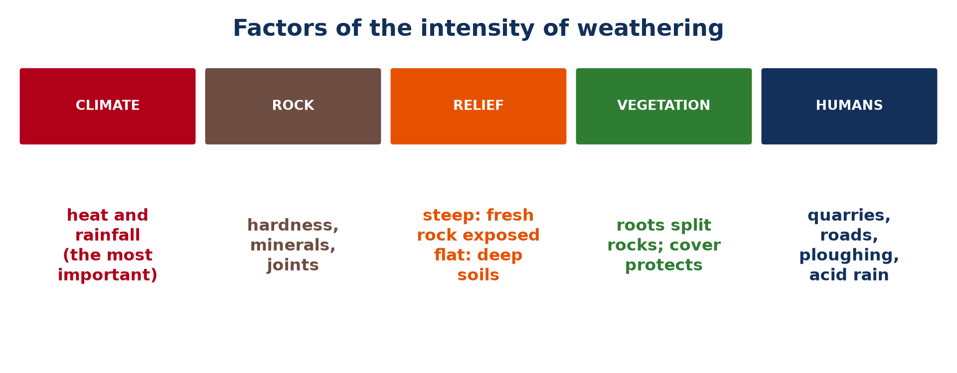
BOARD SUMMARY
4. Vegetation
Protection of rocks: A dense plant cover shades the rocks from the sun and keeps the soil moist. It therefore reduces the daily range of temperature and slows down mechanical weathering.
Illustration: the factors of weathering
Notes:
Copy the point on Protection of rocks on the left, then draw the diagram on the right: the factors of weathering. Give it a title and label it clearly.

Slide 48
BOARD SUMMARY
5. Human Activities
Human activities influence weathering in the following ways:
Quarrying and construction: Quarries, road cuts and building sites, as around Garoua, break rocks and expose fresh surfaces to the weather. They speed up weathering locally.
Notes:
Let us copy Human Activities. Human activities influence weathering in the following ways. Copy the point on Quarrying and construction: write the key term first, then its explanation.

Slide 49
BOARD SUMMARY
5. Human Activities
Agriculture and deforestation: Clearing forests and ploughing remove the protective plant cover. The bare rocks and soils are then exposed to strong heating and to rain.
Notes:
We continue with Human Activities. Copy the point on Agriculture and deforestation: write the key term first, then its explanation.

Slide 50
BOARD SUMMARY
5. Human Activities
Pollution: Smoke from vehicles, factories and power stations produces acid rain. It dissolves limestone and marble and damages buildings and monuments.
Notes:
We continue with Human Activities. Copy the point on Pollution: write the key term first, then its explanation.

Slide 51
FORMATIVE EVALUATION
Evaluation 1
Why is climate the most important factor of weathering in North Cameroon?
Notes:
Now let us check what you have understood. Question 1: Why is climate the most important factor of weathering in North Cameroon? Answer in your exercise book.

Slide 52
FORMATIVE EVALUATION
Expected Answer
Strong heat causes exfoliation and speeds up chemical reactions, while the heavy rains provide water for chemical weathering.
Notes:
The expected answer is: strong heat causes exfoliation and speeds up chemical reactions, while the heavy rains provide water for chemical weathering. If you got it right, well done.

Slide 53
FORMATIVE EVALUATION
Evaluation 2
How can vegetation both increase and reduce weathering?
Notes:
Now let us check what you have understood. Question 2: How can vegetation both increase and reduce weathering? Answer in your exercise book.

Slide 54
FORMATIVE EVALUATION
Expected Answer
Roots split rocks, but a dense cover protects rocks from sun and rain.
Notes:
The expected answer is: roots split rocks, but a dense cover protects rocks from sun and rain. If you got it right, well done.

Slide 55
REMEDIATION
Remediation
Fill in the blanks:
The diagram linking climate and weathering is by ______.
Limestone weathers faster than ______.
Acid rain speeds up ______ weathering.
Notes:
For those who need more practice, fill in the blanks in your exercise book. The answers are: number 1, Peltier; number 2, granite; number 3, chemical.

Slide 56
HOMEWORK
Homework
Define regolith.
Notes:
For your homework: Define regolith. We shall correct it at the beginning of our next lesson.

Slide 57
NEXT LESSON
Next Lesson
Our next lesson will be on:
Lesson 11: The Impact of Weathering
Notes:
Our next lesson will be on Lesson 11: The Impact of Weathering. Thank you for your attention, and see you next time.

Slide 58
BILINGUAL GAME
Bilingual Game (Jeu Bilingue)
English | Français
Weathering | L'altération
Climate | Le climat
Rock | La roche
Relief | Le relief
Vegetation | La végétation
Acid rain | Les pluies acides
Notes:
Let us play the bilingual game. I say a word in English, and you give me the French word. Then we do the reverse.

Slide 59
LOGBOOK
Official Logbook (1/2)
Module / Topic | Denudational Processes on Slopes
Lesson Title | Lesson 10: Intensity and Factors of Weathering
Expected Learning Outcomes | Explain the role of climate and read Peltier's diagram. Explain the role of rock characteristics. Explain the role of relief. Explain the roles of vegetation and human activities.
Competence | Learners are able to explain why weathering is faster in some places and apply this to Garoua.
Notes:
I record this information in the official logbook of the class after the lesson.

Slide 60
LOGBOOK
Official Logbook (2/2)
Matter Taught | DEFINITIONS; Climate; Geology (Rock Characteristics); Relief; Vegetation; Human Activities.
Evaluation | Formative evaluation and remediation exercise.
Homework | Define regolith.
Enrolment / Present / Absent | ____ / ____ / ____
Achievement | To be completed after the lesson.
Notes:
I complete the second page of the logbook: the matter taught, the evaluation, the homework and the attendance.

Slide 61
TEACHER'S NOTE
Teacher's Note
Timing: Homework correction, plan, objectives 8 min | Recall, situation, action 10 min | 5 activities 30 min | Board summary (copying) 30 min | Evaluation, remediation 10 min | Homework, next lesson 5 min | Logbook 7 min
Without the projector (Activity 1): draw the two axes of the diagram.
Without the projector (Activity 2): show a handful of red soil.
Without the projector (Activity 3): drop vinegar on chalk.
Without the projector (Activity 4): compare a hill and a plain.
Without the projector (Activity 5): list human activities that expose rock.
Notes:
This slide is for me, the teacher: it gives the timing of the lesson and what to do if the projector is not available.

Slide 62
REFERENCES
References
Geography Syllabus for Sixth Forms (Lower and Upper Sixth), MINESEC, 2019 — Module 2 (Geomorphology).
Teacher's course notes: Mr KAMDEM E., Geomorphology (LSA), GBHS Garoua, 2026.
Photo, Activity 2: “Laterite soil bricks in Richard Rebello's farm” by India Water Portal, CC BY-NC-SA 2.0, via Flickr (https://www.flickr.com/photos/21623815@N03/10720461943)
Photo, Activity 3: “Songam Cave” by D-Stanley, CC BY 2.0, via Flickr (https://www.flickr.com/photos/79721788@N00/5063216873)
Photo, Activity 4: “Full Screen Plate Tectonics” by subarcticmike, CC BY 2.0, via Flickr (https://www.flickr.com/photos/31856336@N03/3109980958)
Photo, Activity 5: “Moisturise Daily (Statue at Palladio's Teatro Olimpico), Vicenza” by flatworldsedge, CC BY-SA 2.0, via Flickr (https://www.flickr.com/photos/53196512@N07/5624073650)
Diagrams and animations: drawn for this lesson (Geography Department).
Notes:
These are the references and picture credits used to prepare this lesson.

