Slide 1
LOWER SIXTH ARTS
GEOGRAPHY
Lesson 16
Coastal Processes and Features
Notes:
Good morning, class, and welcome to our geography lesson. I am your geography teacher, Mr Kamdem. Today we are starting Lesson 16: Coastal Processes and Features.

Slide 2
CLASS INFO
Class, Chapter and Duration
Class | Lower Sixth Arts
Chapter | Module 2: Understanding and managing physical landscapes, geomorphological processes and hazards across the world in general and Cameroon in particular
Duration | 2 periods (2 × 50 minutes)
Notes:
This lesson is for Lower Sixth Arts. It belongs to Module 2: Understanding and managing physical landscapes, geomorphological processes and hazards across the world in general and Cameroon in particular. We shall need 2 periods to cover it.

Slide 3
IDENTIFICATION
Lesson Identification
Topic | Denudational Processes on Slopes
Sub-topic | Erosion and Depositional Processes and Landforms
Lesson | Lesson 16: Coastal Processes and Features
Notions / Concepts | Coast, wave, fetch, tide, storm surge, hydraulic action, abrasion, attrition, solution, longshore drift, swash, backwash, cliff, wave-cut platform, cave, arch, stack, stump, beach, spit, bar.
Syllabus focus | The coastal system and wave action; coastal processes (erosion, transportation, deposition); landforms of erosion and deposition; threats to coasts in Cameroon.
Competence | Learners are able to explain coastal processes and landforms and the problems of the coast of Cameroon.
Notes:
Our topic is Denudational Processes on Slopes, and the sub-topic is Erosion and Depositional Processes and Landforms. The key notions we shall use today are: coast, wave, fetch, tide, storm surge, hydraulic action, abrasion, attrition, solution, longshore drift, swash, backwash, cliff, wave-cut platform, cave, arch, stack, stump, beach, spit, bar. At the end, you should be able to do this: learners are able to explain coastal processes and landforms and the problems of the coast of Cameroon.

Slide 4

HOMEWORK CORRECTION
Correction of the Homework
Question (Lesson 15: River Action on its Long Profile):
Define longshore drift.
Notes:
Before we start the new lesson, let us correct the homework I gave you at the end of Lesson 15: River Action on its Long Profile. The question was: Define longshore drift. Take out your exercise books.

Slide 5
HOMEWORK CORRECTION
Correction: Possible Answer
Longshore drift is the movement of sand and pebbles along a coast by waves that reach the shore at an angle.
Notes:
Here is a good answer. Longshore drift is the movement of sand and pebbles along a coast by waves that reach the shore at an angle. Compare it with your own answer and correct your work in red.

Slide 6
LESSON PLAN
Lesson Plan
Correction of the homework
Objectives and recall
Real-life situation and action to take
Learning activities
Board summary
Evaluation, remediation and homework
Notes:
Here is the plan of our lesson today. First, we shall correct the homework. Then we shall look at the objectives and recall what you already know. After that, we shall study a situation from real life and the action to take, and do the learning activities. Finally, we shall copy the board summary, do the evaluation and the remediation, and I will give you the homework.

Slide 7
OBJECTIVES
Objectives
By the end of this lesson, you should be able to:
Describe waves, tides and storm surges.
Explain the processes of wave erosion.
Explain longshore drift.
Notes:
Take your time to copy this part; we will continue together.

Slide 8
OBJECTIVES
Objectives (continued)
Describe landforms of coastal erosion and deposition.
Explain the threats to coasts.
Notes:
By the end of this lesson, you should be able to do five things. Number 1: describe waves, tides and storm surges. Number 2: explain the processes of wave erosion. Number 3: explain longshore drift. Number 4: describe landforms of coastal erosion and deposition. Number 5: explain the threats to coasts.

Slide 9
PREVIOUS KNOWLEDGE
Previous Knowledge
Rivers erode by hydraulic action, abrasion, attrition and solution.
Deposition happens when energy falls.
Kribi and Limbe are on the coast of Cameroon.
Notes:
Let us first remember what you already know. Rivers erode by hydraulic action, abrasion, attrition and solution. Deposition happens when energy falls. Kribi and Limbe are on the coast of Cameroon. Keep this in mind, because we shall build on it today.

Slide 10
REAL-LIFE SITUATION
Situation in Real Life
You travel from Garoua to Kribi for the holidays and see the sea for the first time.
Unlike the Benue, which flows in one direction, the sea moves constantly, with waves crashing on the shore.
You build a sandcastle, but a few hours later the rising water washes it away.
Notes:
Take your time to copy this part; we will continue together.

Slide 11
REAL-LIFE SITUATION
Situation in Real Life (continued)
In some places the shore is sandy and wide; in others, tall rocks are being worn away.
You ask: "What forces shape and change the land where it meets the sea?"
Notes:
Listen carefully to this situation from real life. You travel from Garoua to Kribi for the holidays and see the sea for the first time. Unlike the Benue, which flows in one direction, the sea moves constantly, with waves crashing on the shore. You build a sandcastle, but a few hours later the rising water washes it away. In some places the shore is sandy and wide; in others, tall rocks are being worn away. You ask: "What forces shape and change the land where it meets the sea?" Think about it, because I am going to ask you some questions.

Slide 12
REAL-LIFE SITUATION
Situation: Question 1
What is the problem in the situation?
Notes:
Question 1: What is the problem in the situation? Think for a moment, then raise your hand to answer.

Slide 13
REAL-LIFE SITUATION
Answer
The learner does not know the processes and landforms of the coast.
Notes:
Good. The learner does not know the processes and landforms of the coast.

Slide 14
REAL-LIFE SITUATION
Situation: Question 2
What gives waves their energy?
Notes:
Question 2: What gives waves their energy? Think for a moment, then raise your hand to answer.

Slide 15
REAL-LIFE SITUATION
Answer
The wind blowing over the sea.
Notes:
Good. The wind blowing over the sea.

Slide 16
REAL-LIFE SITUATION
Situation: Question 3
Why was the sandcastle washed away?
Notes:
Question 3: Why was the sandcastle washed away? Think for a moment, then raise your hand to answer.

Slide 17
REAL-LIFE SITUATION
Possible Answer
The tide rose and brought the water further up the shore.
Notes:
Good. The tide rose and brought the water further up the shore.

Slide 18
ACTION TO TAKE
Action to Take
Protect mangroves and beaches and avoid dumping waste on the coast.
Notes:
From this situation, the action we are working towards in this lesson is the following: protect mangroves and beaches and avoid dumping waste on the coast.

Slide 19
JUSTIFICATION
Justification of the Lesson
This lesson helps us to understand the coast of Cameroon, its landforms and the dangers faced by coastal towns.
Notes:
Why is this lesson important for you? This lesson helps us to understand the coast of Cameroon, its landforms and the dangers faced by coastal towns.

Slide 20

1. WAVES AND TIDES
Activity 1
Large waves.
Notes:
Activity 1. Look carefully at this picture: large waves. Observe every detail before I ask the question.

Slide 21
1. WAVES AND TIDES
Activity 1: Question
Name one factor of the size of waves.
Notes:
Here is the question for Activity 1: Name one factor of the size of waves. Take one minute to think and write your answer in your rough notebook.

Slide 22
1. WAVES AND TIDES
Activity 1: Answer
Wind speed, wind duration or the fetch.
Notes:
Let us check the answer together. Wind speed, wind duration or the fetch.

Slide 23
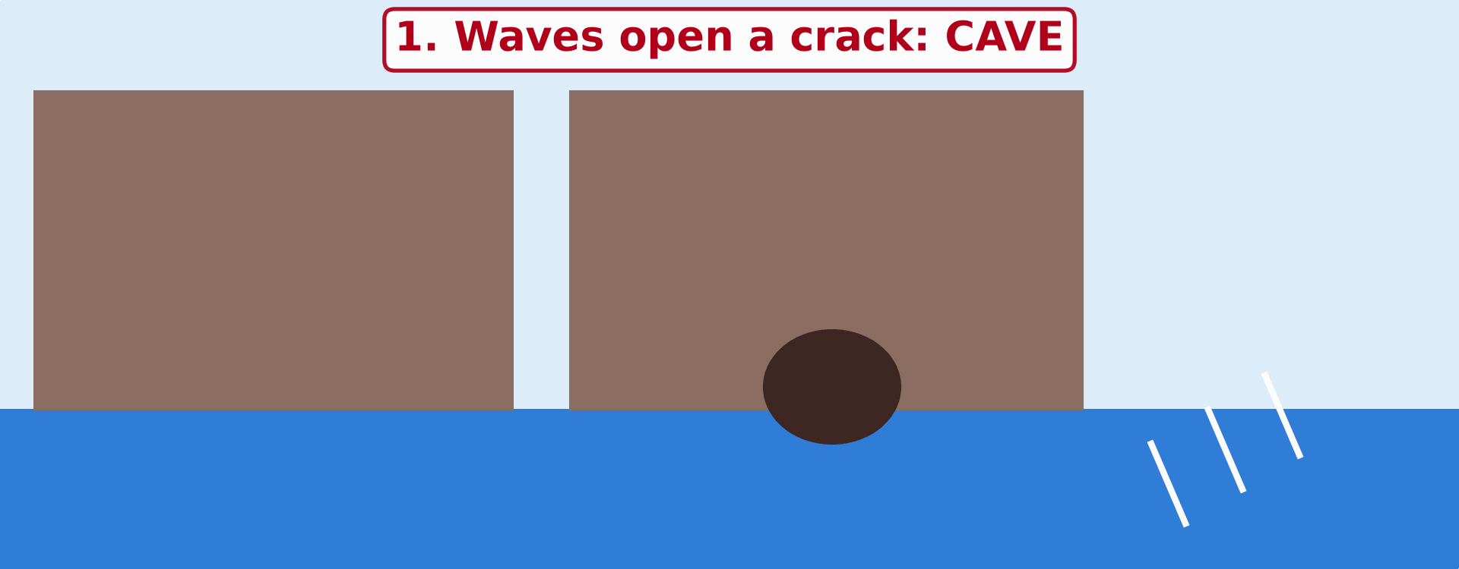
2. EROSION
Activity 2
Animation: erosion of a headland.
Notes:
Activity 2. Look carefully at this animation: animation: erosion of a headland. Watch the animation to the end; it will play again.

Slide 24
2. EROSION
Activity 2: Question
Put in order: arch, cave, stack, stump.
Notes:
Here is the question for Activity 2: Put in order: arch, cave, stack, stump. Take one minute to think and write your answer in your rough notebook.

Slide 25
2. EROSION
Activity 2: Answer
Cave, arch, stack, stump.
Notes:
Let us check the answer together. Cave, arch, stack, stump.

Slide 26
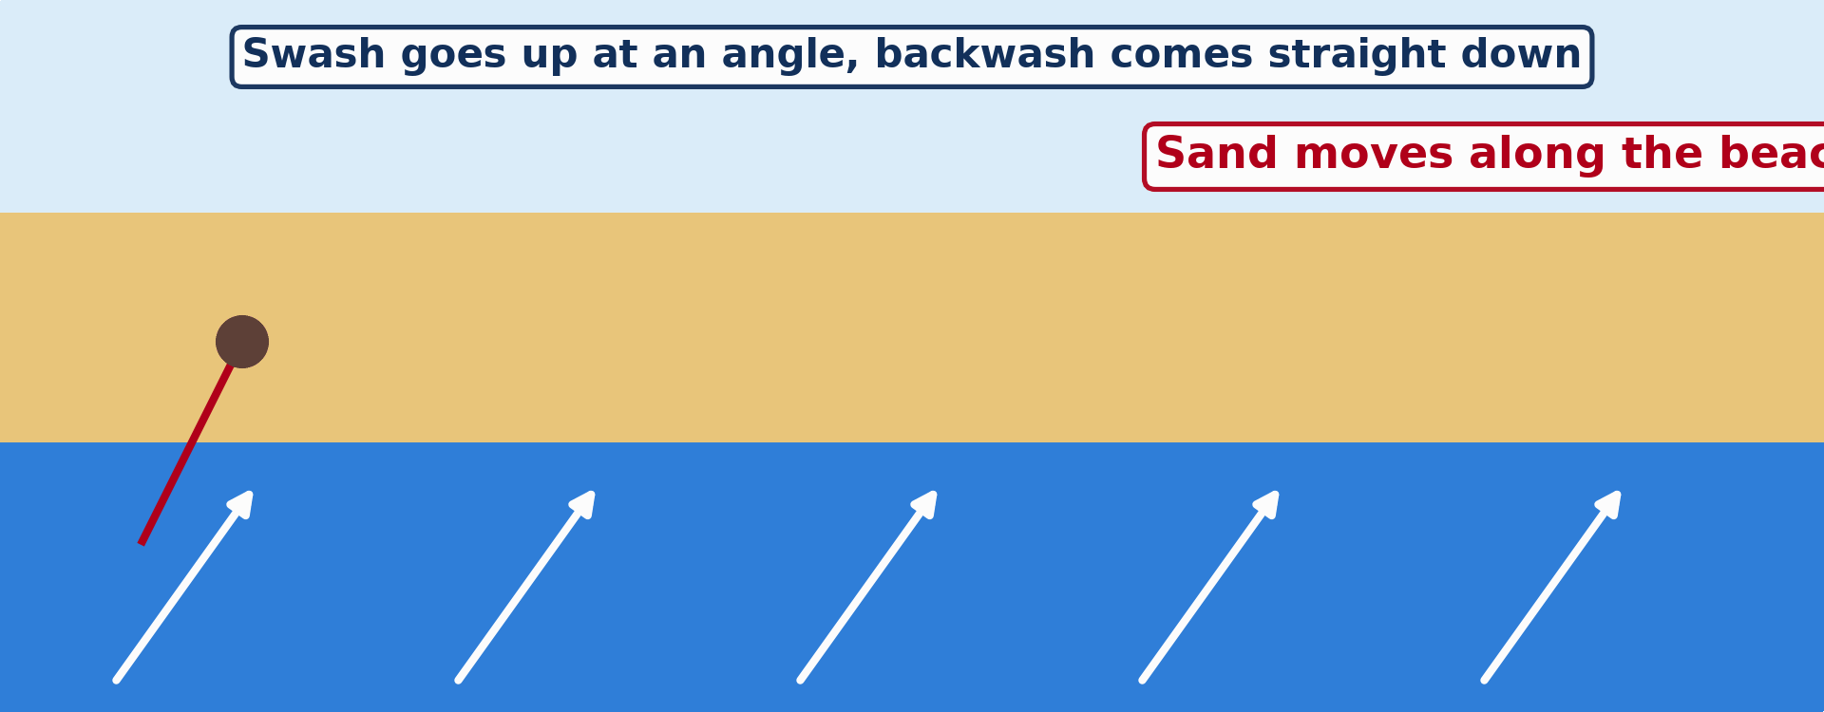
2. TRANSPORTATION
Activity 3
Animation: longshore drift.
Notes:
Activity 3. Look carefully at this animation: animation: longshore drift. Watch the animation to the end; it will play again.

Slide 27
2. TRANSPORTATION
Activity 3: Question
Why does longshore drift move sand along the beach?
Notes:
Here is the question for Activity 3: Why does longshore drift move sand along the beach? Take one minute to think and write your answer in your rough notebook.

Slide 28
2. TRANSPORTATION
Activity 3: Answer
The swash comes up at an angle and the backwash goes straight down, so sand zig-zags along.
Notes:
Let us check the answer together. The swash comes up at an angle and the backwash goes straight down, so sand zig-zags along.

Slide 29

3. DEPOSITION
Activity 4
A spit.
Notes:
Activity 4. Look carefully at this picture: a spit. Observe every detail before I ask the question.

Slide 30
3. DEPOSITION
Activity 4: Question
What is a spit?
Notes:
Here is the question for Activity 4: What is a spit? Take one minute to think and write your answer in your rough notebook.

Slide 31
3. DEPOSITION
Activity 4: Answer
A long ridge of sand or shingle joined to the land and projecting into the sea.
Notes:
Let us check the answer together. A long ridge of sand or shingle joined to the land and projecting into the sea.

Slide 32
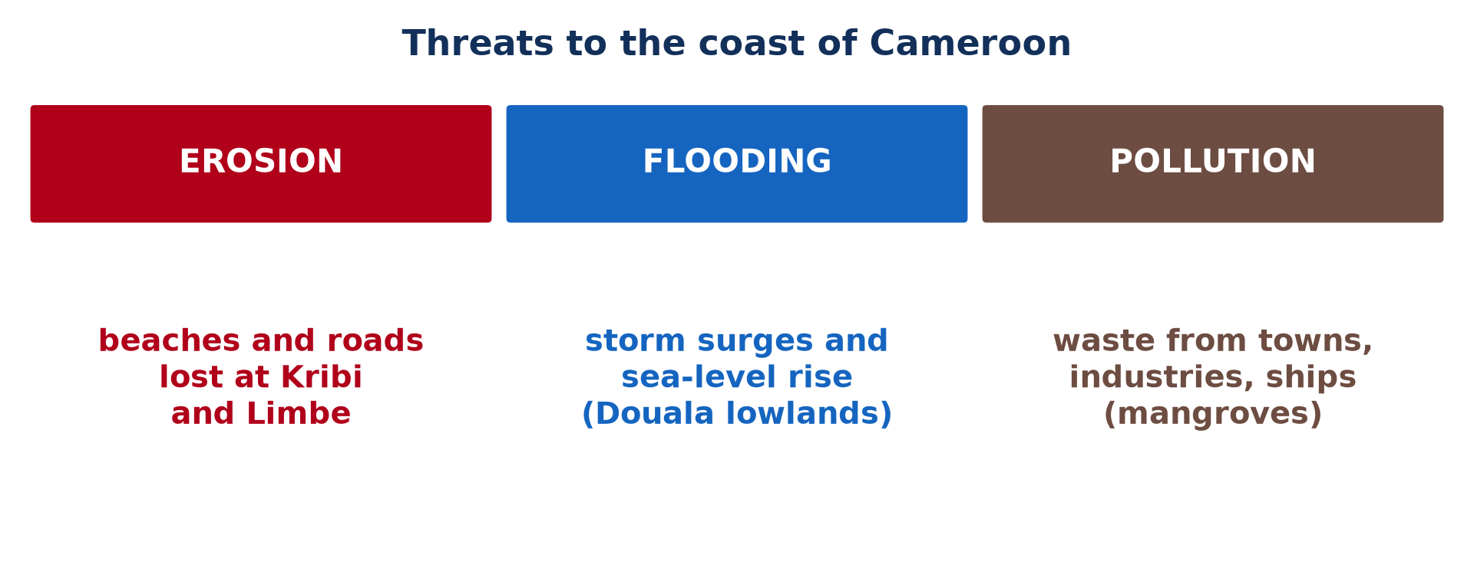
4. THREATS
Activity 5
Threats to the coast.
Notes:
Activity 5. Look carefully at this picture: threats to the coast. Observe every detail before I ask the question.

Slide 33
4. THREATS
Activity 5: Question
Give one threat faced by Kribi or Limbe.
Notes:
Here is the question for Activity 5: Give one threat faced by Kribi or Limbe. Take one minute to think and write your answer in your rough notebook.

Slide 34
4. THREATS
Activity 5: Answer
Coastal erosion, flooding or pollution.
Notes:
Let us check the answer together. Coastal erosion, flooding or pollution.

Slide 35
BOARD SUMMARY
Board Summary
Topic: Denudational Processes on Slopes
Sub-topic: Erosion and Depositional Processes and Landforms
Lesson 16: Coastal Processes and Features
Notes:
Now we are going to copy the board summary. Write the title and the headings neatly in your notebooks. I will give you enough time for each slide, so do not rush.

Slide 36
BOARD SUMMARY
DEFINITIONS
The key terms of this lesson are defined as follows:
Coast: It is the narrow zone where the land meets the sea.
Fetch: It is the distance of open water over which the wind blows.
Notes:
Let us copy the definitions. The key terms of this lesson are defined as follows. On this slide we have Coast and Fetch. Write each point on a new line, with the key term first, and explain it in your own words when we revise. When you finish, we go to the next slide.

Slide 37
BOARD SUMMARY
DEFINITIONS (continued)
Wave refraction: It is the bending of waves as they approach an irregular coastline.
Longshore drift: It is the movement of sediment along the coast by waves reaching the shore at an angle.
Storm surge: It is an abnormal rise of the sea level caused by a storm.
Notes:
We continue with the definitions. On this slide we have Wave refraction, Longshore drift and Storm surge. Write each point on a new line, with the key term first, and explain it in your own words when we revise.

Slide 38

BOARD SUMMARY
1. The Coast and the Coastal System
The coast and the coastal system are explained as follows:
The coast: The coast is the zone where the land meets the sea, from the highest level reached by storm waves to the lowest level of the tides. It is always changing because of waves, tides and currents.
Illustration: a beach
Notes:
Let us copy The Coast and the Coastal System. The coast and the coastal system are explained as follows. Copy the point on The coast on the left, then draw the diagram on the right: a beach. Give it a title and label it clearly.

Slide 39
BOARD SUMMARY
1. The Coast and the Coastal System
The coastal system: Energy from waves, tides and winds and sediments from rivers and cliffs are the inputs of the system. Erosion, transport and deposition are its processes, and landforms and sediments carried out to sea are its outputs.
Notes:
We continue with The Coast and the Coastal System. Copy the point on The coastal system: write the key term first, then its explanation.

Slide 40
BOARD SUMMARY
2. Factors Influencing Coasts
The form of a coast depends on the following factors:
Wave energy: Strong waves, driven by strong winds over a long fetch, erode the coast quickly. Sheltered coasts with weak waves favour deposition.
Notes:
Let us copy Factors Influencing Coasts. The form of a coast depends on the following factors. Copy the point on Wave energy: write the key term first, then its explanation.

Slide 41
BOARD SUMMARY
2. Factors Influencing Coasts
Geology: Hard rocks such as granite form headlands and high cliffs, while soft rocks such as clay are eroded into bays. The structure of the rocks, their joints and dip, also controls the shape of cliffs.
Notes:
We continue with Factors Influencing Coasts. Copy the point on Geology: write the key term first, then its explanation.

Slide 42
BOARD SUMMARY
2. Factors Influencing Coasts
Changes of sea level: A rise of sea level drowns valleys and forms estuaries and rias, while a fall leaves raised beaches. The present rise of sea level increases erosion on many coasts.
Notes:
We continue with Factors Influencing Coasts. Copy the point on Changes of sea level: write the key term first, then its explanation.

Slide 43
BOARD SUMMARY
2. Factors Influencing Coasts
Human activities and vegetation: Ports, sea walls and the removal of sand change the movement of sediments. Mangroves and dune vegetation protect coasts, and their destruction increases erosion.
Notes:
We continue with Factors Influencing Coasts. Copy the point on Human activities and vegetation: write the key term first, then its explanation.

Slide 44
BOARD SUMMARY
3. Waves and Energy
Waves carry energy to the coast in the following ways:
Formation of waves: Wind blowing over the sea transfers energy to the water and forms waves. Their size depends on the wind speed, how long it blows and the fetch.
Illustration: large waves
Notes:
Let us copy Waves and Energy. Waves carry energy to the coast in the following ways. Copy the point on Formation of waves on the left, then draw the diagram on the right: large waves. Give it a title and label it clearly.

Slide 45
BOARD SUMMARY
3. Waves and Energy
Breaking waves: Near the shore, the base of the wave is slowed by the sea bed, and the top falls forward and breaks. Constructive waves have a strong swash and build beaches, while destructive waves have a strong backwash and erode them.
Notes:
We continue with Waves and Energy. Copy the point on Breaking waves: write the key term first, then its explanation.

Slide 46
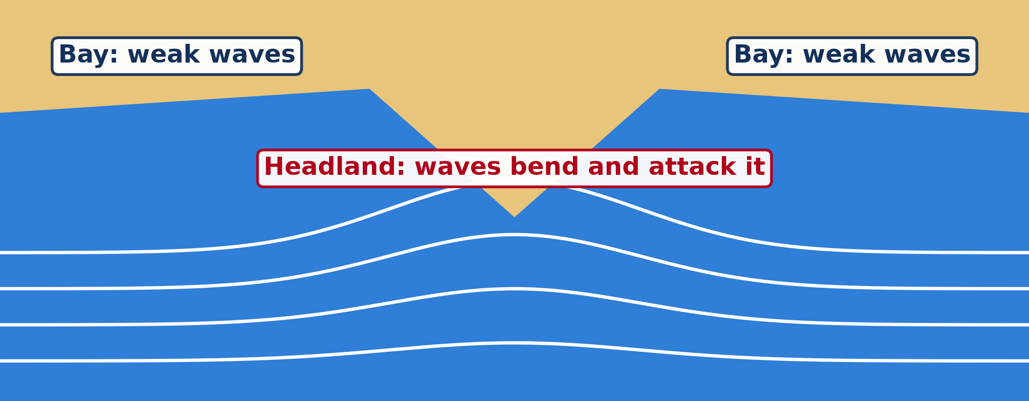
BOARD SUMMARY
3. Waves and Energy
Wave refraction: Waves slow down in shallow water off headlands and bend so that they strike the headlands on three sides. Energy is concentrated on headlands, which are eroded, and spread out in bays, where deposition takes place.
Illustration: wave refraction
Notes:
Copy the point on Wave refraction on the left, then draw the diagram on the right: wave refraction. Give it a title and label it clearly.

Slide 47
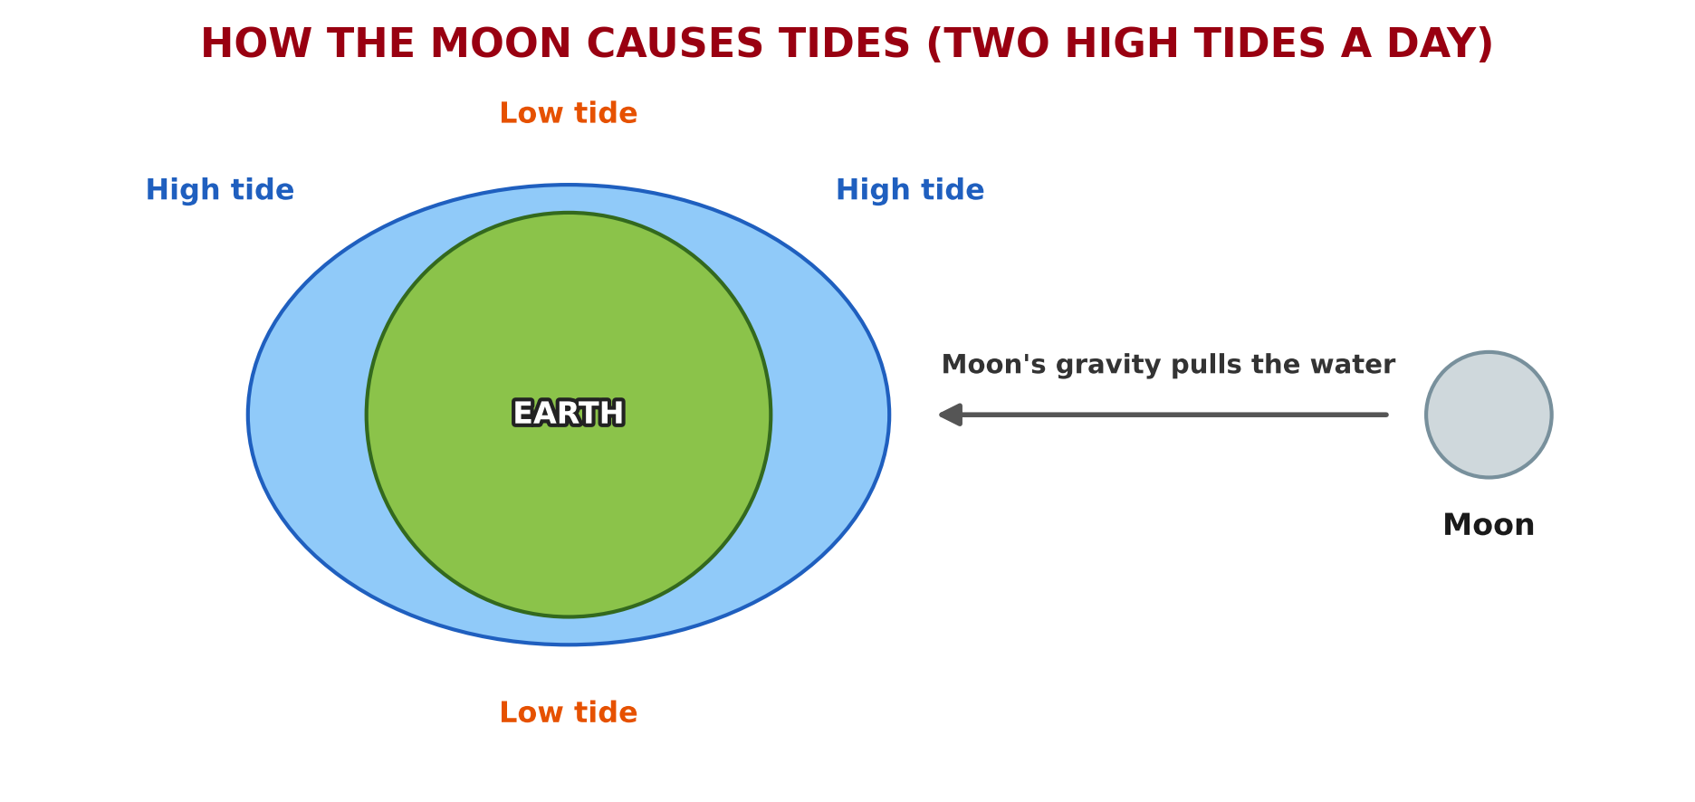
BOARD SUMMARY
4. Other Coastal Processes
Coasts are also affected by the following processes:
Tides: The sea rises and falls about twice a day because of the pull of the Moon and the Sun. The tidal range decides how much of the shore is attacked by waves.
Illustration: the tides
Notes:
Let us copy Other Coastal Processes. Coasts are also affected by the following processes. Copy the point on Tides on the left, then draw the diagram on the right: the tides. Give it a title and label it clearly.

Slide 48
BOARD SUMMARY
4. Other Coastal Processes
Storm surges: Strong winds and low pressure during a storm raise the sea level well above normal. The surge floods low coasts and causes severe erosion.
Notes:
We continue with Other Coastal Processes. Copy the point on Storm surges: write the key term first, then its explanation.

Slide 49
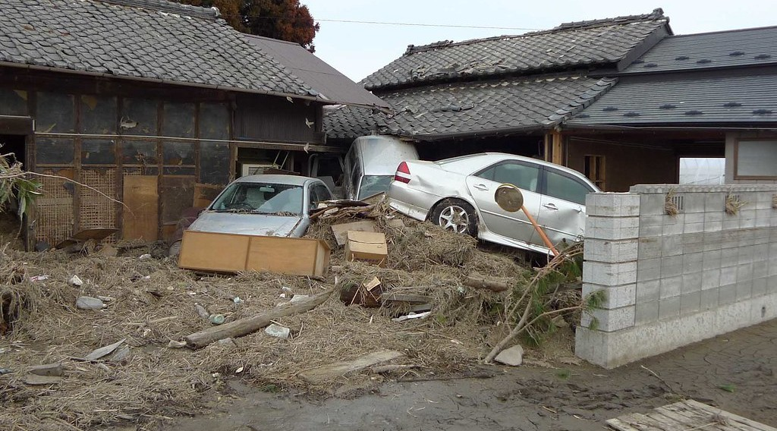
BOARD SUMMARY
4. Other Coastal Processes
Tsunamis: Undersea earthquakes, eruptions or landslides set off giant waves that can reach tens of metres high at the coast. They flood the land and destroy everything in their path.
Illustration: a tsunami
Notes:
Copy the point on Tsunamis on the left, then draw the diagram on the right: a tsunami. Give it a title and label it clearly.

Slide 50
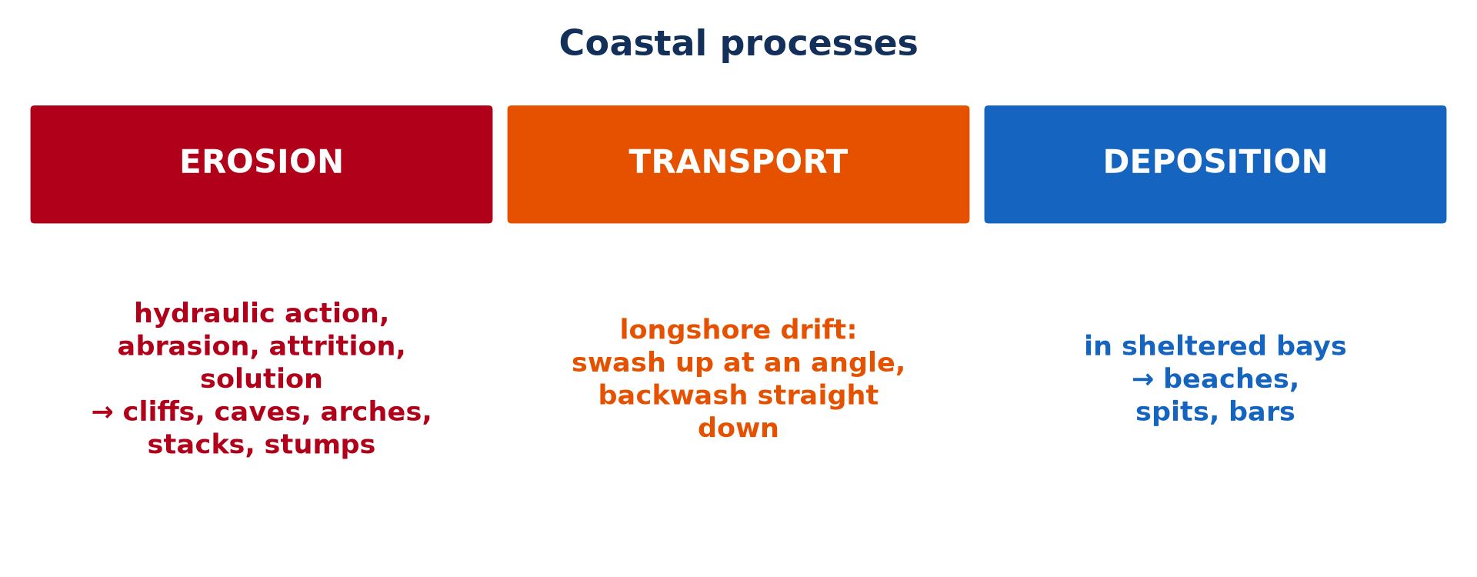
BOARD SUMMARY
5. Wave Erosion, Transport and Deposition
Waves shape the coast by the following processes:
Wave erosion: Waves erode the coast by hydraulic action, when water and compressed air break the rock, and by abrasion, when they throw sand and pebbles against cliffs. Attrition rounds the pebbles, and solution dissolves limestone.
Illustration: coastal processes
Notes:
Let us copy Wave Erosion, Transport and Deposition. Waves shape the coast by the following processes. Copy the point on Wave erosion on the left, then draw the diagram on the right: coastal processes. Give it a title and label it clearly.

Slide 51
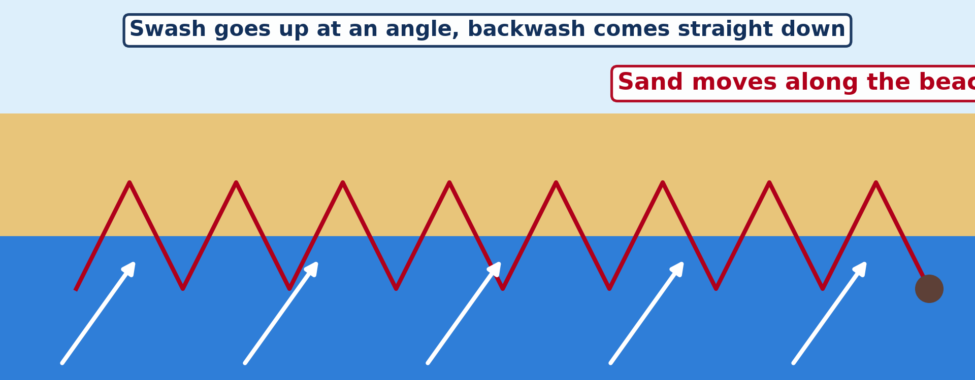
BOARD SUMMARY
5. Wave Erosion, Transport and Deposition
Longshore drift: Waves reaching the beach at an angle carry sediment up the beach in the swash, and the backwash brings it straight back down. The sediment therefore moves step by step along the coast.
Illustration: longshore drift
Notes:
Copy the point on Longshore drift on the left, then draw the diagram on the right: longshore drift. Give it a title and label it clearly.

Slide 52
BOARD SUMMARY
5. Wave Erosion, Transport and Deposition
Deposition: Waves drop their load where they lose energy, in sheltered bays, behind islands and where the coast changes direction. Constructive waves build beaches in these places.
Notes:
We continue with Wave Erosion, Transport and Deposition. Copy the point on Deposition: write the key term first, then its explanation.

Slide 53
BOARD SUMMARY
6. Features Produced
A) Features of Erosion
Wave erosion produces the following features:
Headlands and bays: Where hard and soft rocks alternate along the coast, the soft rocks are eroded into bays and the hard rocks remain as headlands. Refraction then concentrates erosion on the headlands.
Notes:
Let us copy Features of Erosion. Wave erosion produces the following features. Copy the point on Headlands and bays: write the key term first, then its explanation.

Slide 54
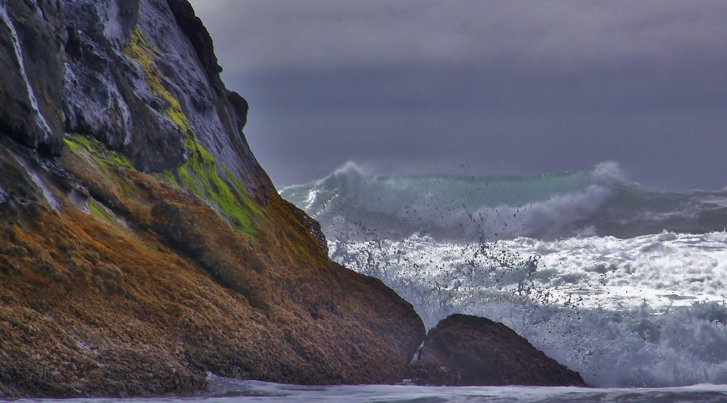
BOARD SUMMARY
6. Features Produced
A) Features of Erosion
Cliffs and wave-cut platforms: Waves cut a notch at the foot of a cliff; the rock above collapses and the cliff retreats. A flat rock platform, visible at low tide, is left in front of it.
Illustration: a cliff
Notes:
Copy the point on Cliffs and wave-cut platforms on the left, then draw the diagram on the right: a cliff. Give it a title and label it clearly.

Slide 55
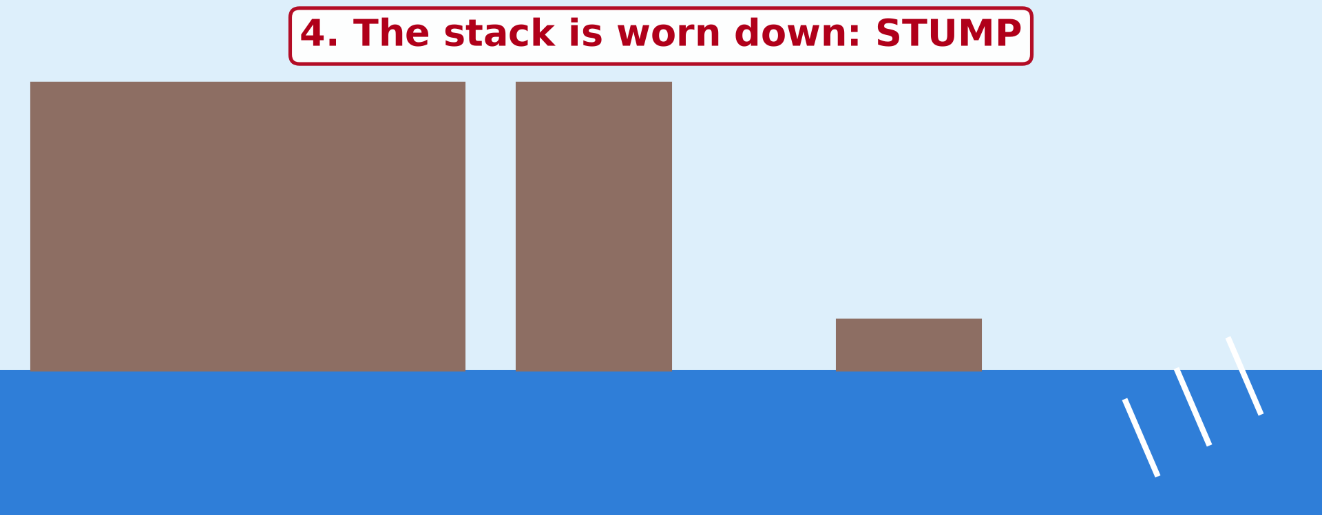
BOARD SUMMARY
6. Features Produced
A) Features of Erosion
Caves, arches, stacks and stumps: On a headland, waves widen a crack into a cave, and two caves meet to form an arch. The arch collapses and leaves a stack, which is worn down into a stump.
Illustration: the erosion of a headland
Notes:
Copy the point on Caves, arches, stacks and stumps on the left, then draw the diagram on the right: the erosion of a headland. Give it a title and label it clearly.

Slide 56
BOARD SUMMARY
6. Features Produced
B) Features of Deposition
Wave deposition produces the following features:
Beaches: Sand and shingle accumulate between the low and high tide levels, especially in bays. The beaches of Kribi and Limbe, with black volcanic sand at Limbe, are examples.
Notes:
Let us copy Features of Deposition. Wave deposition produces the following features. Copy the point on Beaches: write the key term first, then its explanation.

Slide 57
BOARD SUMMARY
6. Features Produced
B) Features of Deposition
Spits: Where the coast changes direction, longshore drift continues to deposit sand into the sea. It builds a long, narrow ridge attached to the land at one end, often with a curved tip.
Illustration: a spit
Notes:
Copy the point on Spits on the left, then draw the diagram on the right: a spit. Give it a title and label it clearly.

Slide 58
BOARD SUMMARY
6. Features Produced
B) Features of Deposition
Bars and tombolos: A spit that grows across a bay forms a bar, which traps a lagoon behind it. A ridge of sand that joins an island to the mainland is a tombolo.
Notes:
We continue with Features of Deposition. Copy the point on Bars and tombolos: write the key term first, then its explanation.

Slide 59
BOARD SUMMARY
7. Threats to Coasts
Coasts face the following threats:
Coastal erosion: Beaches, roads and houses are lost as the coast retreats, especially at Kribi and Limbe. Sand mining on beaches makes erosion worse.
Illustration: threats to coasts
Notes:
Let us copy Threats to Coasts. Coasts face the following threats. Copy the point on Coastal erosion on the left, then draw the diagram on the right: threats to coasts. Give it a title and label it clearly.

Slide 60
BOARD SUMMARY
7. Threats to Coasts
Flooding and sea-level rise: Global warming is raising the sea level, and storm surges flood low areas. Parts of Douala and the Wouri estuary are threatened.
Notes:
We continue with Threats to Coasts. Copy the point on Flooding and sea-level rise: write the key term first, then its explanation.

Slide 61
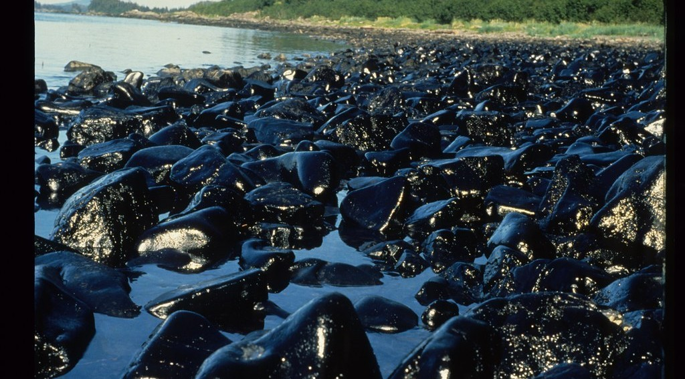
BOARD SUMMARY
7. Threats to Coasts
Pollution: Waste from towns and industries, and oil from ships and platforms, pollute the water and the beaches. They harm fishing and tourism.
Illustration: an oil spill
Notes:
Copy the point on Pollution on the left, then draw the diagram on the right: an oil spill. Give it a title and label it clearly.

Slide 62

BOARD SUMMARY
7. Threats to Coasts
Destruction of mangroves: Mangroves are cut for firewood, for smoking fish and to build houses, as around Douala. Without them, the coast loses its natural protection against waves and its fish nurseries.
Illustration: mangroves
Notes:
Copy the point on Destruction of mangroves on the left, then draw the diagram on the right: mangroves. Give it a title and label it clearly.

Slide 63
FORMATIVE EVALUATION
Evaluation 1
Explain how waves break a hard cliff.
Notes:
Now let us check what you have understood. Question 1: Explain how waves break a hard cliff. Answer in your exercise book.

Slide 64
FORMATIVE EVALUATION
Expected Answer
Hydraulic action compresses air in cracks, abrasion hurls pebbles against the rock, and solution dissolves some minerals.
Notes:
The expected answer is: hydraulic action compresses air in cracks, abrasion hurls pebbles against the rock, and solution dissolves some minerals. If you got it right, well done.

Slide 65
FORMATIVE EVALUATION
Evaluation 2
Describe the formation of a stack.
Notes:
Now let us check what you have understood. Question 2: Describe the formation of a stack. Answer in your exercise book.

Slide 66
FORMATIVE EVALUATION
Expected Answer
A crack in a headland is enlarged into a cave, then an arch; the arch collapses, leaving a stack.
Notes:
The expected answer is: a crack in a headland is enlarged into a cave, then an arch; the arch collapses, leaving a stack. If you got it right, well done.

Slide 67
REMEDIATION
Remediation
Fill in the blanks:
The distance of open water over which wind blows is the ______.
Waves going up the beach are the ______.
A ridge of sand closing a bay is a ______.
Notes:
For those who need more practice, fill in the blanks in your exercise book. The answers are: number 1, fetch; number 2, swash; number 3, bar.

Slide 68
HOMEWORK
Homework
Name the highest mountain of Cameroon.
Notes:
For your homework: Name the highest mountain of Cameroon. We shall correct it at the beginning of our next lesson.

Slide 69
NEXT LESSON
Next Lesson
Our next lesson will be on:
Further Study 3: Relief of Cameroon
Notes:
Our next lesson will be on Further Study 3: Relief of Cameroon. Thank you for your attention, and see you next time.

Slide 70
BILINGUAL GAME
Bilingual Game (Jeu Bilingue)
English | Français
Coast | La côte
Wave | La vague
Erosion | L'érosion
Beach | La plage
Tide | La marée
Cliff | La falaise
Notes:
Let us play the bilingual game. I say a word in English, and you give me the French word. Then we do the reverse.

Slide 71
LOGBOOK
Official Logbook (1/2)
Module / Topic | Denudational Processes on Slopes
Lesson Title | Lesson 16: Coastal Processes and Features
Expected Learning Outcomes | Describe waves, tides and storm surges. Explain the processes of wave erosion. Explain longshore drift. Describe landforms of coastal erosion and deposition. Explain the threats to coasts.
Competence | Learners are able to explain coastal processes and landforms and the problems of the coast of Cameroon.
Notes:
I record this information in the official logbook of the class after the lesson.

Slide 72
LOGBOOK
Official Logbook (2/2)
Matter Taught | DEFINITIONS; The Coast and the Coastal System; Factors Influencing Coasts; Waves and Energy; Other Coastal Processes; Wave Erosion, Transport and Deposition; Features of Erosion; Features of Deposition; Threats to Coasts.
Evaluation | Formative evaluation and remediation exercise.
Homework | Name the highest mountain of Cameroon.
Enrolment / Present / Absent | ____ / ____ / ____
Achievement | To be completed after the lesson.
Notes:
I complete the second page of the logbook: the matter taught, the evaluation, the homework and the attendance.

Slide 73
TEACHER'S NOTE
Teacher's Note
Timing: Homework correction, plan, objectives 8 min | Recall, situation, action 10 min | 5 activities 30 min | Board summary (copying) 30 min | Evaluation, remediation 10 min | Homework, next lesson 5 min | Logbook 7 min
Activities 2 and 3 are animations (GIF): it plays automatically in slide-show mode.
Without the projector (Activity 1): blow over a basin of water.
Without the projector (Activity 2): draw the four stages.
Without the projector (Activity 3): draw the zig-zag.
Without the projector (Activity 4): draw a spit and a bar.
Without the projector (Activity 5): discuss coastal problems.
Notes:
This slide is for me, the teacher: it gives the timing of the lesson and what to do if the projector is not available.

Slide 74
REFERENCES
References
Geography Syllabus for Sixth Forms (Lower and Upper Sixth), MINESEC, 2019 — Module 2 (Geomorphology).
Teacher's course notes: Mr KAMDEM E., Geomorphology (LSA), GBHS Garoua, 2026.
Photo, Activity 1: “Wave Explosion, Monterey Bay, California” by John William Hammond, CC BY-NC-SA 2.0, via Flickr (https://www.flickr.com/photos/8398907@N02/16328053911)
Photo, Activity 4: “Coastal defences no longer being maintained - Why? Spurn Head, Yorkshi” by Richard Allaway, CC BY 2.0, via Flickr (https://www.flickr.com/photos/16287002@N00/6605676971)
Photo, board summary (The coast): “Crowded Sunny Beach, Bulgaria” by phototouring, CC BY-NC-SA 2.0, via Flickr (https://www.flickr.com/photos/19054742@N00/1557605901)
Photo, board summary (Tsunamis): “Tsunami damage” by robertodevido, CC BY-NC-ND 2.0, via Flickr (https://www.flickr.com/photos/63082042@N00/5531541425)
Photo, board summary (Cliffs and wave-cut platforms): “Forces of Nature” by liquidcrash, CC BY-SA 2.0, via Flickr (https://www.flickr.com/photos/124320023@N06/13938903780)
Notes:
Take your time to copy this part; we will continue together.

Slide 75
REFERENCES
References (continued)
Photo, board summary (Pollution): “Exxon Valdez Oil Spill - 0038” by ARLIS Reference, CC BY-SA 2.0, via Flickr (https://www.flickr.com/photos/51606297@N07/4750613516)
Photo, board summary (Destruction of mangroves): “Pitchavaram waterway - Mangrove forest” by Balaji.B Photography, CC BY 2.0, via Flickr (https://www.flickr.com/photos/81073027@N00/1745978833)
Diagrams and animations: drawn for this lesson (Geography Department).
Notes:
These are the references and picture credits used to prepare this lesson.

