Slide 1
LOWER SIXTH ARTS
GEOGRAPHY
Lesson 5: Chemical Properties of the Soil
Chemical Properties of the Soil
Notes:
Good morning, class, and welcome to our geography lesson. I am your geography teacher, Mr Kamdem. Today we are starting Lesson 5: Chemical Properties of the Soil.

Slide 2
CLASS INFO
Class, Chapter and Duration
Class | Lower Sixth Arts
Chapter | Module 3: Understanding and managing biogeographic zones across the world in general and Cameroon in particular
Duration | 2 periods (2 × 50 minutes)
Notes:
This lesson is for Lower Sixth Arts. It belongs to Module 3: Understanding and managing biogeographic zones across the world in general and Cameroon in particular. We shall need 2 periods to cover it.

Slide 3
IDENTIFICATION
Lesson Identification
Topic | Soil and its Properties
Sub-topic | Soil Properties and their Significance
Lesson | Lesson 5: Chemical Properties of the Soil
Notions / Concepts | Soil colour, nutrients, macronutrients, pH, acidity, alkalinity, liming.
Syllabus focus | Soil colour, soil nutrients and soil pH: meaning, factors and significance.
Competence | Learners are able to explain soil colour, nutrients and pH and their effect on crops.
Notes:
Our topic is Soil and its Properties, and the sub-topic is Soil Properties and their Significance. The key notions we shall use today are: soil colour, nutrients, macronutrients, pH, acidity, alkalinity, liming. At the end, you should be able to do this: learners are able to explain soil colour, nutrients and pH and their effect on crops.

Slide 4

HOMEWORK CORRECTION
Correction of the Homework
Question (Lesson 4: Soil Depth, Organic Matter and Soil Organisms):
Make a small compost heap with leaves and observe it for two weeks.
Notes:
Before we start the new lesson, let us correct the homework I gave you at the end of Lesson 4: Soil Depth, Organic Matter and Soil Organisms. The question was: Make a small compost heap with leaves and observe it for two weeks. Take out your exercise books.

Slide 5
HOMEWORK CORRECTION
Correction: Possible Answer
After two weeks the compost heap becomes warm, smaller and darker; the leaves begin to rot because bacteria, fungi and worms decompose them into humus.
Notes:
Here is a good answer. After two weeks the compost heap becomes warm, smaller and darker; the leaves begin to rot because bacteria, fungi and worms decompose them into humus. Compare it with your own answer and correct your work in red.

Slide 6
LESSON PLAN
Lesson Plan
Correction of the homework
Objectives and recall
Real-life situation and action to take
Learning activities
Board summary
Evaluation, remediation and homework
Notes:
Here is the plan of our lesson today. First, we shall correct the homework. Then we shall look at the objectives and recall what you already know. After that, we shall study a situation from real life and the action to take, and do the learning activities. Finally, we shall copy the board summary, do the evaluation and the remediation, and I will give you the homework.

Slide 7
OBJECTIVES
Objectives
By the end of this lesson, you should be able to:
Explain what soil colour shows.
Name the main soil nutrients.
Explain soil pH, its factors and significance.
Notes:
By the end of this lesson, you should be able to do three things. Number 1: explain what soil colour shows. Number 2: name the main soil nutrients. Number 3: explain soil pH, its factors and significance.

Slide 8
PREVIOUS KNOWLEDGE
Previous Knowledge
Humus is dark.
Leaching removes minerals from the soil.
Notes:
Let us first remember what you already know. Humus is dark. Leaching removes minerals from the soil. Keep this in mind, because we shall build on it today.

Slide 9
REAL-LIFE SITUATION
Situation in Real Life
An agricultural officer in Bertoua tests a farmer's soil and says that it is "too acid" for maize. She advises the farmer to add lime and manure.
Notes:
Listen carefully to this situation from real life. An agricultural officer in Bertoua tests a farmer's soil and says that it is "too acid" for maize. She advises the farmer to add lime and manure. Think about it, because I am going to ask you some questions.

Slide 10
REAL-LIFE SITUATION
Situation: Question 1
What is the problem in the situation?
Notes:
Question 1: What is the problem in the situation? Think for a moment, then raise your hand to answer.

Slide 11
REAL-LIFE SITUATION
Answer
The soil is too acid for crops.
Notes:
Good. The soil is too acid for crops.

Slide 12
REAL-LIFE SITUATION
Situation: Question 2
What measures acidity?
Notes:
Question 2: What measures acidity? Think for a moment, then raise your hand to answer.

Slide 13
REAL-LIFE SITUATION
Answer
Soil pH.
Notes:
Good. Soil pH.

Slide 14
REAL-LIFE SITUATION
Situation: Question 3
How can acidity be reduced?
Notes:
Question 3: How can acidity be reduced? Think for a moment, then raise your hand to answer.

Slide 15
REAL-LIFE SITUATION
Possible Answer
By adding lime.
Notes:
Good. By adding lime.

Slide 16
ACTION TO TAKE
Action to Take
Test and correct soil chemistry to improve crop yields.
Notes:
From this situation, the action we are working towards in this lesson is the following: test and correct soil chemistry to improve crop yields.

Slide 17
JUSTIFICATION
Justification of the Lesson
This lesson helps us to understand the chemistry of soil, which controls fertility.
Notes:
Why is this lesson important for you? This lesson helps us to understand the chemistry of soil, which controls fertility.

Slide 18

1. SOIL COLOUR
Activity 1
A red tropical soil.
Notes:
Activity 1. Look carefully at this picture: a red tropical soil. Observe every detail before I ask the question.

Slide 19
1. SOIL COLOUR
Activity 1: Question
What gives this soil its red colour?
Notes:
Here is the question for Activity 1: What gives this soil its red colour? Take one minute to think and write your answer in your rough notebook.

Slide 20
1. SOIL COLOUR
Activity 1: Answer
Iron oxides (rust) formed by weathering in a hot, wet climate.
Notes:
Let us check the answer together. Iron oxides (rust) formed by weathering in a hot, wet climate.

Slide 21

1. SOIL COLOUR
Activity 2
A dark soil.
Notes:
Activity 2. Look carefully at this picture: a dark soil. Observe every detail before I ask the question.

Slide 22
1. SOIL COLOUR
Activity 2: Question
What does a dark colour usually show?
Notes:
Here is the question for Activity 2: What does a dark colour usually show? Take one minute to think and write your answer in your rough notebook.

Slide 23
1. SOIL COLOUR
Activity 2: Answer
Much humus (or clay rich in minerals, as in black earths).
Notes:
Let us check the answer together. Much humus (or clay rich in minerals, as in black earths).

Slide 24
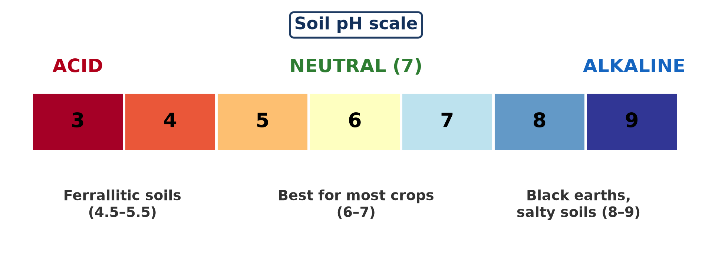
3. SOIL pH
Activity 3
The soil pH scale.
Notes:
Activity 3. Look carefully at this diagram: the soil pH scale. Observe every detail before I ask the question.

Slide 25
3. SOIL pH
Activity 3: Question
What pH is best for most crops?
Notes:
Here is the question for Activity 3: What pH is best for most crops? Take one minute to think and write your answer in your rough notebook.

Slide 26
3. SOIL pH
Activity 3: Answer
About 6 to 7 (slightly acid to neutral).
Notes:
Let us check the answer together. About 6 to 7 (slightly acid to neutral).

Slide 27
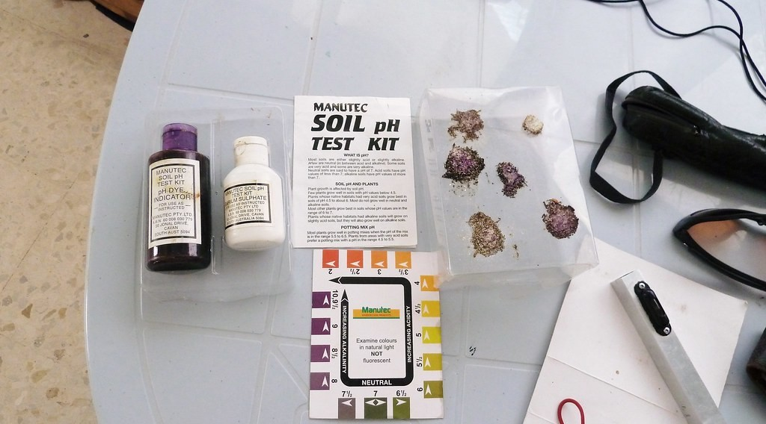
3. SOIL pH
Activity 4
A soil pH test kit.
Notes:
Activity 4. Look carefully at this picture: a soil pH test kit. Observe every detail before I ask the question.

Slide 28
3. SOIL pH
Activity 4: Question
How can a farmer measure soil pH?
Notes:
Here is the question for Activity 4: How can a farmer measure soil pH? Take one minute to think and write your answer in your rough notebook.

Slide 29
3. SOIL pH
Activity 4: Answer
With a test kit or pH paper that changes colour.
Notes:
Let us check the answer together. With a test kit or pH paper that changes colour.

Slide 30

2. SOIL NUTRIENTS
Activity 5
A farmer applying fertiliser.
Notes:
Activity 5. Look carefully at this picture: a farmer applying fertiliser. Observe every detail before I ask the question.

Slide 31
2. SOIL NUTRIENTS
Activity 5: Question
Name the three main nutrients in fertiliser.
Notes:
Here is the question for Activity 5: Name the three main nutrients in fertiliser. Take one minute to think and write your answer in your rough notebook.

Slide 32
2. SOIL NUTRIENTS
Activity 5: Answer
Nitrogen (N), phosphorus (P) and potassium (K).
Notes:
Let us check the answer together. Nitrogen (N), phosphorus (P) and potassium (K).

Slide 33
BOARD SUMMARY
Board Summary
Topic: Soil and its Properties
Sub-topic: Soil Properties and their Significance
Lesson 5: Chemical Properties of the Soil
Notes:
Now we are going to copy the board summary. Write the title and the headings neatly in your notebooks. I will give you enough time for each slide, so do not rush.

Slide 34
BOARD SUMMARY
1. Soil Colour
Soil colour can be studied as follows:
Meaning and factors: Soil colour is the shade of the soil, which depends on humus, iron compounds and drainage. Red soils contain oxidised iron, while dark soils are rich in humus.
Notes:
Let us copy Soil Colour. Soil colour can be studied as follows. On this slide we have Meaning and factors. Write each point on a new line, with the key term first, and explain it in your own words when we revise. When you finish, we go to the next slide.

Slide 35
BOARD SUMMARY
1. Soil Colour (continued)
Significance: Grey or mottled colours show poor drainage (waterlogging). Colour helps to identify horizons and soil fertility.
Notes:
We continue with Soil Colour. On this slide we have Significance. Write each point on a new line, with the key term first, and explain it in your own words when we revise.

Slide 36
BOARD SUMMARY
2. Soil Nutrients
Soil nutrients can be studied as follows:
Meaning: Nutrients are the chemical elements that plants need to grow. Macronutrients are nitrogen (N), phosphorus (P) and potassium (K), plus calcium and magnesium.
Notes:
Let us copy Soil Nutrients. Soil nutrients can be studied as follows. On this slide we have Meaning. Write each point on a new line, with the key term first, and explain it in your own words when we revise. When you finish, we go to the next slide.

Slide 37
BOARD SUMMARY
2. Soil Nutrients (continued)
Factors: Nutrients come from weathered rock, humus and fertilisers. They are lost by leaching, erosion and crop removal.
Significance: N helps leaf growth, P helps roots and flowers, and K helps fruits and resistance to disease. Lack of nutrients reduces yields.
Notes:
We continue with Soil Nutrients. On this slide we have Factors and Significance. Write each point on a new line, with the key term first, and explain it in your own words when we revise.

Slide 38
BOARD SUMMARY
3. Soil pH
Soil pH can be studied as follows:
Meaning: pH measures how acid or alkaline a soil is, on a scale from 0 to 14. A pH of 7 is neutral, below 7 is acid and above 7 is alkaline.
Notes:
Let us copy Soil pH. Soil pH can be studied as follows. On this slide we have Meaning. Write each point on a new line, with the key term first, and explain it in your own words when we revise. When you finish, we go to the next slide.

Slide 39
BOARD SUMMARY
3. Soil pH (continued)
Factors: Heavy rain and leaching make soils acid, as in the equatorial forest. Dry climates and limestone make soils alkaline.
Significance: Most crops grow best between pH 6 and 7. Farmers add lime to acid soils; pH is measured with a pH meter or indicator paper.
Notes:
We continue with Soil pH. On this slide we have Factors and Significance. Write each point on a new line, with the key term first, and explain it in your own words when we revise.

Slide 40
BOARD SUMMARY
3. Soil pH
Illustration: the pH scale
Notes:
Now draw this illustration in your notebook: the pH scale. Give it a title and label it clearly.

Slide 41
FORMATIVE EVALUATION
Evaluation 1
What does a red soil colour show?
Notes:
Now let us check what you have understood. Question 1: What does a red soil colour show? Answer in your exercise book.

Slide 42
FORMATIVE EVALUATION
Expected Answer
Iron oxides formed by weathering in a hot, wet climate.
Notes:
The expected answer is: iron oxides formed by weathering in a hot, wet climate. If you got it right, well done.

Slide 43
FORMATIVE EVALUATION
Evaluation 2
Why are soils of the rainforest often acid?
Notes:
Now let us check what you have understood. Question 2: Why are soils of the rainforest often acid? Answer in your exercise book.

Slide 44
FORMATIVE EVALUATION
Expected Answer
Heavy rain leaches the bases (calcium, magnesium) out of the soil.
Notes:
The expected answer is: heavy rain leaches the bases (calcium, magnesium) out of the soil. If you got it right, well done.

Slide 45
REMEDIATION
Remediation
Fill in the blanks:
A pH of 7 is ______.
Acid soils are corrected by adding ______.
N, P and K are plant ______.
Notes:
For those who need more practice, fill in the blanks in your exercise book. The answers are: number 1, neutral; number 2, lime; number 3, nutrients.

Slide 46
HOMEWORK
Homework
Read the label of a fertiliser bag and explain what N, P and K do.
Notes:
For your homework: Read the label of a fertiliser bag and explain what N, P and K do. We shall correct it at the beginning of our next lesson.

Slide 47
NEXT LESSON
Next Lesson
Our next lesson will be on:
Lesson 6: Soil Fertility
Notes:
Our next lesson will be on Lesson 6: Soil Fertility. Thank you for your attention, and see you next time.

Slide 48
BILINGUAL GAME
Bilingual Game (Jeu Bilingue)
English | Français
Colour | La couleur
Acid | Acide
Nutrient | L'élément nutritif
Fertiliser | L'engrais
Lime | La chaux
Iron | Le fer
Notes:
Let us play the bilingual game. I say a word in English, and you give me the French word. Then we do the reverse.

Slide 49
LOGBOOK
Official Logbook (1/2)
Module / Topic | Soil and its Properties
Lesson Title | Lesson 5: Chemical Properties of the Soil
Expected Learning Outcomes | Explain what soil colour shows. Name the main soil nutrients. Explain soil pH, its factors and significance.
Competence | Learners are able to explain soil colour, nutrients and pH and their effect on crops.
Notes:
I record this information in the official logbook of the class after the lesson.

Slide 50
LOGBOOK
Official Logbook (2/2)
Matter Taught | Soil Colour; Soil Nutrients; Soil pH.
Evaluation | Formative evaluation and remediation exercise.
Homework | Read the label of a fertiliser bag and explain what N, P and K do.
Enrolment / Present / Absent | ____ / ____ / ____
Achievement | To be completed after the lesson.
Notes:
I complete the second page of the logbook: the matter taught, the evaluation, the homework and the attendance.

Slide 51
TEACHER'S NOTE
Teacher's Note
Timing: Homework correction, plan, objectives 8 min | Recall, situation, action 10 min | 5 activities 30 min | Board summary (copying) 30 min | Evaluation, remediation 10 min | Homework, next lesson 5 min | Logbook 7 min
Without the projector (Activity 1): compare local soil colours.
Without the projector (Activity 2): compare topsoil and subsoil.
Without the projector (Activity 3): draw the scale.
Without the projector (Activity 4): describe litmus paper.
Without the projector (Activity 5): read a fertiliser bag (NPK).
Notes:
This slide is for me, the teacher: it gives the timing of the lesson and what to do if the projector is not available.

Slide 52
REFERENCES
References
National Geography Syllabus, MINESEC/IGE/IP-SS, 2019 — Module 3 (Biogeography).
Photo, Activity 1: “in the middle of nowhere, morocco” by mariusz kluzniak, CC BY-NC-ND 2.0, via Flickr (https://www.flickr.com/photos/39997856@N03/8398997251)
Photo, Activity 2: “My date palm. Cool, huh?” by Hair Squared, CC BY-SA 2.0, via Flickr (https://www.flickr.com/photos/73119211@N00/3804244479)
Photo, Activity 4: “Soil Ph Test Kit” by London Permaculture, CC BY-NC-SA 2.0, via Flickr (https://www.flickr.com/photos/7371031@N08/5211146737)
Photo, Activity 5: “Farmer applies fertilizer on his rice field” by IRRI Images, CC BY-NC-SA 2.0, via Flickr (https://www.flickr.com/photos/86712369@N00/5366605498)
Diagrams and animations: drawn for this lesson (Geography Department).
Notes:
These are the references and picture credits used to prepare this lesson.

