Slide 1
LOWER SIXTH ARTS
GEOGRAPHY
Further Study 1: Tropical Weather Disturbances
Tropical Weather Disturbances
Notes:
Good morning, class, and welcome to our geography lesson. I am your geography teacher, Mr Kamdem. Today we are starting Further Study 1: Tropical Weather Disturbances.

Slide 2
CLASS INFO
Class, Chapter and Duration
Class | Lower Sixth Arts
Chapter | Module 1: Understanding and managing atmospheric and hydrological phenomena and hazards across the world in general and Cameroon in particular
Duration | 2 periods (2 × 50 minutes)
Notes:
This lesson is for Lower Sixth Arts. It belongs to Module 1: Understanding and managing atmospheric and hydrological phenomena and hazards across the world in general and Cameroon in particular. We shall need 2 periods to cover it.

Slide 3
IDENTIFICATION
Lesson Identification
Topic | Climates
Sub-topic | Air Mass Interactions at Fronts and Convergence Zones
Lesson | Further Study 1: Tropical Weather Disturbances
Notions / Concepts | Thunderstorm, tornado, tropical cyclone, eye, storm surge, early warning.
Syllabus focus | Thunderstorms, tornadoes and tropical cyclones: meaning, distribution, causes, consequences and control measures.
Competence | Learners are able to explain tropical weather disturbances and suggest measures to reduce their dangers.
Notes:
Our topic is Climates, and the sub-topic is Air Mass Interactions at Fronts and Convergence Zones. The key notions we shall use today are: thunderstorm, tornado, tropical cyclone, eye, storm surge, early warning. At the end, you should be able to do this: learners are able to explain tropical weather disturbances and suggest measures to reduce their dangers.

Slide 4

HOMEWORK CORRECTION
Correction of the Homework
Question (Lesson 21: Mountain Climates):
Compare the climate of Buea and Douala and explain two differences.
Notes:
Before we start the new lesson, let us correct the homework I gave you at the end of Lesson 21: Mountain Climates. The question was: Compare the climate of Buea and Douala and explain two differences. Take out your exercise books.

Slide 5
HOMEWORK CORRECTION
Correction: Possible Answer
Buea (about 900 m) is cooler than Douala (sea level) because temperature falls with height. Buea is also often misty and cloudy, while Douala is hotter and more humid.
Notes:
Here is a good answer. Buea (about 900 m) is cooler than Douala (sea level) because temperature falls with height. Buea is also often misty and cloudy, while Douala is hotter and more humid. Compare it with your own answer and correct your work in red.

Slide 6
LESSON PLAN
Lesson Plan
Correction of the homework
Objectives and recall
Real-life situation and action to take
Learning activities
Board summary
Evaluation, remediation and homework
Notes:
Here is the plan of our lesson today. We shall correction of the homework; then objectives and recall; then real-life situation and action to take; then learning activities; then board summary; then evaluation, remediation and homework.

Slide 7
OBJECTIVES
Objectives
By the end of this lesson, you should be able to:
Explain the formation and effects of thunderstorms.
Explain tornadoes.
Notes:
Take your time to copy this part; we will continue together.

Slide 8
OBJECTIVES
Objectives (continued)
Explain tropical cyclones and measures against them.
Notes:
By the end of this lesson, you should be able to do three things. Number 1: explain the formation and effects of thunderstorms. Number 2: explain tornadoes. Number 3: explain tropical cyclones and measures against them.

Slide 9
PREVIOUS KNOWLEDGE
Previous Knowledge
Unstable air gives cumulonimbus clouds.
Warm seas give much water vapour.
Notes:
Let us first remember what you already know. Unstable air gives cumulonimbus clouds. Warm seas give much water vapour. Keep this in mind, because we shall build on it today.

Slide 10
REAL-LIFE SITUATION
Situation in Real Life
At the start of the rainy season in Ngaoundéré, a violent storm with strong winds tears off roofs and lightning kills cattle. Learners want to know how such storms form and how to stay safe.
Notes:
Listen carefully to this situation from real life. At the start of the rainy season in Ngaoundéré, a violent storm with strong winds tears off roofs and lightning kills cattle. Learners want to know how such storms form and how to stay safe. Think about it, because I am going to ask you some questions.

Slide 11
REAL-LIFE SITUATION
Situation: Question 1
What is the problem in the situation?
Notes:
Question 1: What is the problem in the situation? Think for a moment, then raise your hand to answer.

Slide 12
REAL-LIFE SITUATION
Answer
Violent storms destroy property and kill people and animals.
Notes:
Good. Violent storms destroy property and kill people and animals.

Slide 13
REAL-LIFE SITUATION
Situation: Question 2
What type of cloud gives such storms?
Notes:
Question 2: What type of cloud gives such storms? Think for a moment, then raise your hand to answer.

Slide 14
REAL-LIFE SITUATION
Answer
Cumulonimbus.
Notes:
Good. Cumulonimbus.

Slide 15
REAL-LIFE SITUATION
Situation: Question 3
Name two stronger tropical storms.
Notes:
Question 3: Name two stronger tropical storms. Think for a moment, then raise your hand to answer.

Slide 16
REAL-LIFE SITUATION
Possible Answer
Tornadoes and tropical cyclones (hurricanes).
Notes:
Good. Tornadoes and tropical cyclones (hurricanes).

Slide 17
ACTION TO TAKE
Action to Take
Protect lives and property from storms through warnings and safe behaviour.
Notes:
From this situation, the action we are working towards in this lesson is the following: protect lives and property from storms through warnings and safe behaviour.

Slide 18
JUSTIFICATION
Justification of the Lesson
This lesson helps us to understand violent storms and how to protect lives and property.
Notes:
Why is this lesson important for you? This lesson helps us to understand violent storms and how to protect lives and property.

Slide 19
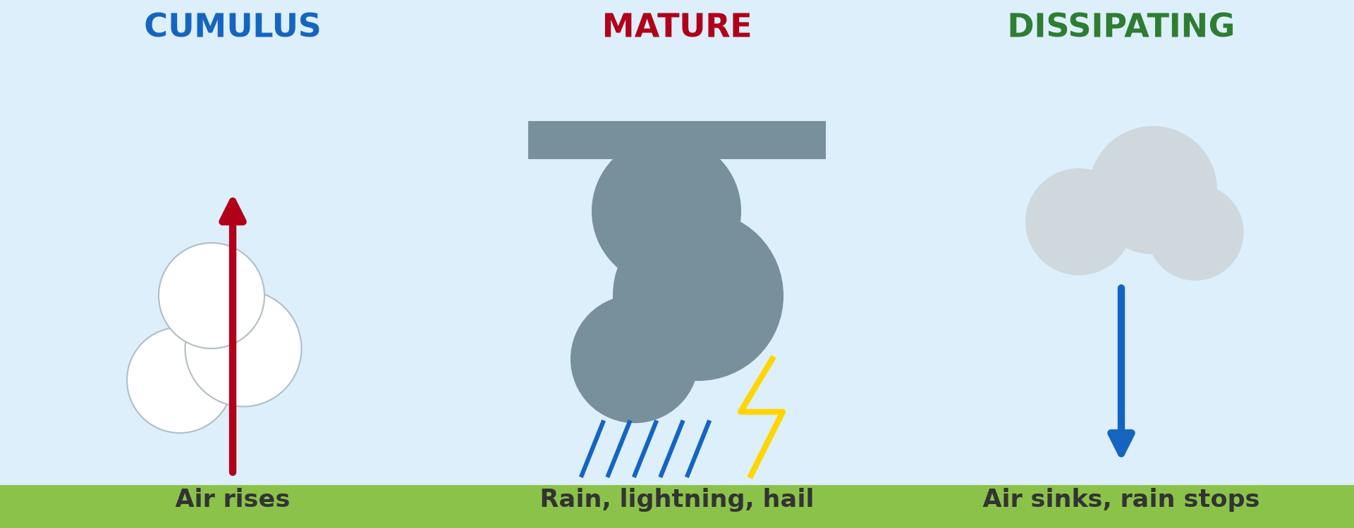
1. THUNDERSTORMS: FORMATION
Activity 1
The three stages of a thunderstorm.
Notes:
Activity 1. Look carefully at this diagram: the three stages of a thunderstorm. Observe every detail before I ask the question.

Slide 20
1. THUNDERSTORMS: FORMATION
Activity 1: Question
Name the three stages of a thunderstorm.
Notes:
Here is the question for Activity 1: Name the three stages of a thunderstorm. Take one minute to think and write your answer in your rough notebook.

Slide 21
1. THUNDERSTORMS: FORMATION
Activity 1: Answer
Cumulus (growing), mature (rain, lightning, hail), dissipating (dying).
Notes:
Let us check the answer together. Cumulus (growing), mature (rain, lightning, hail), dissipating (dying).

Slide 22

1. THUNDERSTORMS: EFFECTS
Activity 2
A cumulonimbus storm cloud.
Notes:
Activity 2. Look carefully at this picture: a cumulonimbus storm cloud. Observe every detail before I ask the question.

Slide 23
1. THUNDERSTORMS: EFFECTS
Activity 2: Question
Give two dangers of thunderstorms.
Notes:
Here is the question for Activity 2: Give two dangers of thunderstorms. Take one minute to think and write your answer in your rough notebook.

Slide 24
1. THUNDERSTORMS: EFFECTS
Activity 2: Answer
Lightning, strong winds, hail and floods.
Notes:
Let us check the answer together. Lightning, strong winds, hail and floods.

Slide 25

2. TROPICAL CYCLONES: FORMATION
Activity 3
A hurricane seen from space.
Notes:
Activity 3. Look carefully at this picture: a hurricane seen from space. Observe every detail before I ask the question.

Slide 26
2. TROPICAL CYCLONES: FORMATION
Activity 3: Question
Over what surface do tropical cyclones form?
Notes:
Here is the question for Activity 3: Over what surface do tropical cyclones form? Take one minute to think and write your answer in your rough notebook.

Slide 27
2. TROPICAL CYCLONES: FORMATION
Activity 3: Answer
Over warm seas above 27 °C, between 5° and 20° of latitude.
Notes:
Let us check the answer together. Over warm seas above 27 °C, between 5° and 20° of latitude.

Slide 28
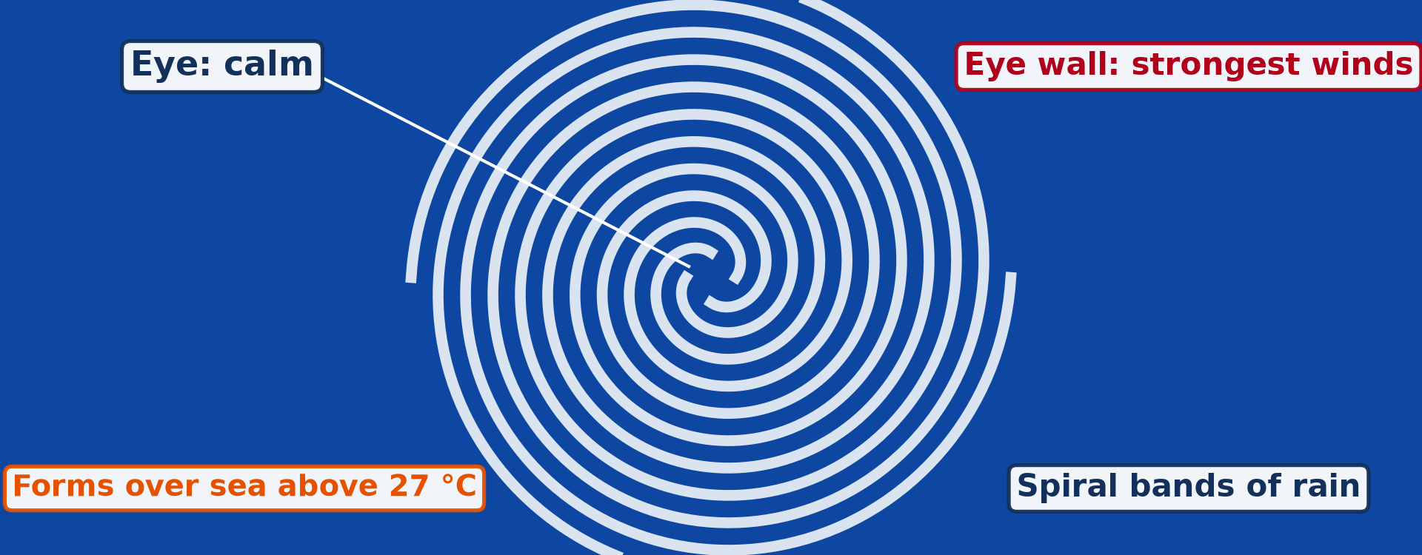
2. TROPICAL CYCLONES: STRUCTURE
Activity 4
The structure of a tropical cyclone.
Notes:
Activity 4. Look carefully at this diagram: the structure of a tropical cyclone. Observe every detail before I ask the question.

Slide 29
2. TROPICAL CYCLONES: STRUCTURE
Activity 4: Question
Where are the winds strongest? Where is it calm?
Notes:
Here is the question for Activity 4: Where are the winds strongest? Where is it calm? Take one minute to think and write your answer in your rough notebook.

Slide 30
2. TROPICAL CYCLONES: STRUCTURE
Activity 4: Answer
Strongest in the eye wall; calm in the eye.
Notes:
Let us check the answer together. Strongest in the eye wall; calm in the eye.

Slide 31
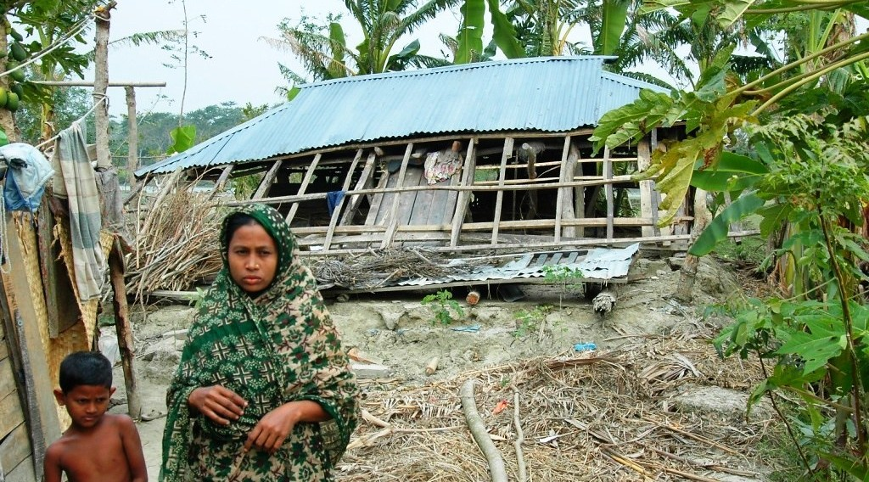
3. EFFECTS AND CONTROL
Activity 5
A damaged home in Bangladesh, a country often hit by cyclones.
Notes:
Activity 5. Look carefully at this picture: a damaged home in Bangladesh, a country often hit by cyclones. Observe every detail before I ask the question.

Slide 32
3. EFFECTS AND CONTROL
Activity 5: Question
How can people reduce the damage of cyclones?
Notes:
Here is the question for Activity 5: How can people reduce the damage of cyclones? Take one minute to think and write your answer in your rough notebook.

Slide 33
3. EFFECTS AND CONTROL
Activity 5: Answer
Early warning, evacuation, cyclone shelters and strong buildings.
Notes:
Let us check the answer together. Early warning, evacuation, cyclone shelters and strong buildings.

Slide 34
BOARD SUMMARY
Board Summary
Topic: Climates
Sub-topic: Air Mass Interactions at Fronts and Convergence Zones
Further Study 1: Tropical Weather Disturbances
Notes:
Now we are going to copy the board summary. Write the title and the headings neatly in your notebooks. I will give you enough time for each slide, so do not rush.

Slide 35
BOARD SUMMARY
DEFINITIONS
The key terms of this lesson are defined as follows:
Thunderstorm: It is a storm with a cumulonimbus cloud, heavy rain, thunder and lightning.
Notes:
Let us copy DEFINITIONS. The key terms of this lesson are defined as follows. Write each point on a new line, with the key term first. When you finish, we go to the next slide.

Slide 36
BOARD SUMMARY
DEFINITIONS (continued)
Tropical cyclone: It is a violent low-pressure storm that forms over warm tropical oceans, with winds above 119 km/h.
Notes:
We continue with the same part. Write each point on a new line, with the key term first.

Slide 37
BOARD SUMMARY
1. Thunderstorms
Thunderstorms can be studied under the following points:
Formation: They form in hot, humid and unstable air, when strong up-currents build a cumulonimbus cloud. They are very common in Cameroon at the start and end of the rainy season.
Notes:
Let us copy Thunderstorms. Thunderstorms can be studied under the following points. Write each point on a new line, with the key term first. When you finish, we go to the next slide.

Slide 38
BOARD SUMMARY
1. Thunderstorms (continued)
Stages: In the cumulus stage, the cloud grows upwards. In the mature stage, there is heavy rain, thunder, lightning and hail; in the dissipating stage, down-currents weaken it.
Notes:
We continue with the same part. Write each point on a new line, with the key term first. When you finish, we go to the next slide.

Slide 39
BOARD SUMMARY
1. Thunderstorms (continued)
Effects: Lightning kills people and animals and starts fires. Heavy rain and strong winds cause floods and destroy roofs and crops.
Notes:
We continue with the same part. Write each point on a new line, with the key term first.

Slide 40
BOARD SUMMARY
1. Thunderstorms
Illustration: stages of a thunderstorm
Notes:
Now draw this illustration in your notebook: stages of a thunderstorm. Give it a title and label it clearly.

Slide 41
BOARD SUMMARY
2. Tropical Cyclones
Tropical cyclones can be studied as follows:
Conditions of formation: They form over oceans warmer than 26.5 °C, between 5° and 20° of latitude, where the Coriolis force can make the air spin. They lose strength over land.
Notes:
Let us copy Tropical Cyclones. Tropical cyclones can be studied as follows. Write each point on a new line, with the key term first. When you finish, we go to the next slide.

Slide 42
BOARD SUMMARY
2. Tropical Cyclones (continued)
Structure: The calm, clear eye is surrounded by the eye wall with the strongest winds and rain. Spiral rain bands turn around the centre.
Notes:
We continue with the same part. Write each point on a new line, with the key term first. When you finish, we go to the next slide.

Slide 43
BOARD SUMMARY
2. Tropical Cyclones (continued)
Names and areas: They are called hurricanes in the Caribbean, typhoons in East Asia and cyclones in the Indian Ocean. They are rare in the Gulf of Guinea.
Notes:
We continue with the same part. Write each point on a new line, with the key term first.

Slide 44
BOARD SUMMARY
2. Tropical Cyclones
Illustration: structure of a tropical cyclone
Notes:
Now draw this illustration in your notebook: structure of a tropical cyclone. Give it a title and label it clearly.

Slide 45
BOARD SUMMARY
3. Effects and Control
The effects and control of tropical disturbances are:
Effects: Cyclones cause destructive winds, storm surges and floods that kill thousands of people. They destroy houses, crops, roads and power lines.
Notes:
Let us copy Effects and Control. The effects and control of tropical disturbances are. Write each point on a new line, with the key term first. When you finish, we go to the next slide.

Slide 46
BOARD SUMMARY
3. Effects and Control (continued)
Control and prevention: Satellites and radar give early warnings, and people are evacuated to shelters. Strong buildings, lightning conductors and mangrove protection reduce damage.
Notes:
We continue with the same part. Write each point on a new line, with the key term first.

Slide 47
FORMATIVE EVALUATION
Evaluation 1
Give two conditions for a tropical cyclone to form.
Notes:
Now let us check what you have understood. Question 1: Give two conditions for a tropical cyclone to form. Answer in your exercise book.

Slide 48
FORMATIVE EVALUATION
Expected Answer
A sea warmer than 27 °C and a latitude away from the Equator (5°–20°).
Notes:
The expected answer is: a sea warmer than 27 °C and a latitude away from the Equator (5°–20°). If you got it right, well done.

Slide 49
FORMATIVE EVALUATION
Evaluation 2
Give two measures against cyclone damage.
Notes:
Now let us check what you have understood. Question 2: Give two measures against cyclone damage. Answer in your exercise book.

Slide 50
FORMATIVE EVALUATION
Expected Answer
Early warning and evacuation (also shelters, strong buildings).
Notes:
The expected answer is: early warning and evacuation (also shelters, strong buildings). If you got it right, well done.

Slide 51
REMEDIATION
Remediation
Fill in the blanks:
Thunderstorms come from ______ clouds.
The calm centre of a cyclone is the ______.
In the Caribbean, cyclones are called ______.
Notes:
For those who need more practice, fill in the blanks in your exercise book. The answers are: number 1, cumulonimbus; number 2, eye; number 3, hurricanes.

Slide 52
HOMEWORK
Homework
Write five safety rules for a thunderstorm in your area.
Notes:
For your homework: Write five safety rules for a thunderstorm in your area. We shall correct it at the beginning of our next lesson.

Slide 53
NEXT LESSON
Next Lesson
Our next lesson will be on:
Further Study 2: Weather Observation, Prediction, Modification and Mapping
Notes:
Our next lesson will be on Further Study 2: Weather Observation, Prediction, Modification and Mapping. Thank you for your attention, and see you next time.

Slide 54
BILINGUAL GAME
Bilingual Game (Jeu Bilingue)
English | Français
Thunderstorm | L'orage
Lightning | La foudre
Tornado | La tornade
Cyclone | Le cyclone
Eye | L'œil
Warning | L'alerte
Notes:
Let us play the bilingual game. I say a word in English, and you give me the French word. Then we do the reverse.

Slide 55
LOGBOOK
Official Logbook (1/2)
Module / Topic | Climates
Lesson Title | Further Study 1: Tropical Weather Disturbances
Expected Learning Outcomes | Explain the formation and effects of thunderstorms. Explain tornadoes. Explain tropical cyclones and measures against them.
Competence | Learners are able to explain tropical weather disturbances and suggest measures to reduce their dangers.
Notes:
I record this information in the official logbook of the class after the lesson.

Slide 56
LOGBOOK
Official Logbook (2/2)
Matter Taught | DEFINITIONS; Thunderstorms; Tropical Cyclones; Effects and Control.
Evaluation | Formative evaluation and remediation exercise.
Homework | Write five safety rules for a thunderstorm in your area.
Enrolment / Present / Absent | ____ / ____ / ____
Achievement | To be completed after the lesson.
Notes:
I complete the second page of the logbook: the matter taught, the evaluation, the homework and the attendance.

Slide 57
TEACHER'S NOTE
Teacher's Note
Timing: Homework correction, plan, objectives 8 min | Recall, situation, action 10 min | 5 activities 30 min | Board summary (copying) 30 min | Evaluation, remediation 10 min | Homework, next lesson 5 min | Logbook 7 min
Without the projector (Activity 1): draw the three clouds.
Without the projector (Activity 2): give safety rules for lightning.
Without the projector (Activity 3): find the Caribbean and the Bay of Bengal.
Without the projector (Activity 4): draw the spiral.
Without the projector (Activity 5): list the measures on the board.
Notes:
This slide is for me, the teacher: it gives the timing of the lesson and what to do if the projector is not available.

Slide 58
REFERENCES
References
National Geography Syllabus, MINESEC/IGE/IP-SS, 2019 — Module 1 (Meteorology, Climatology & Hydrology).
Photo, Activity 2: “06172012 Sunday evening pulse storms/cumulonimbi” by StormRider93 | Into the Storm, CC BY-NC-ND 2.0, via Flickr (https://www.flickr.com/photos/65232104@N04/7395715628)
Photo, Activity 3: “NASA's Aqua Satellite Captures Hurricane Danielle” by NASA Goddard Photo and Video, CC BY 2.0, via nasa (https://www.flickr.com/photos/24662369@N07/4931591817)
Photo, Activity 5: “Nazma Begum” by IRRI Images, CC BY-NC-SA 2.0, via Flickr (https://www.flickr.com/photos/86712369@N00/2247242477)
Diagrams and animations: drawn for this lesson (Geography Department).
Notes:
These are the references and picture credits used to prepare this lesson.

