Slide 1
LOWER SIXTH ARTS
GEOGRAPHY
Lesson 15: Planetary Winds
Planetary Winds
Notes:
Good morning, class, and welcome to our geography lesson. I am your geography teacher, Mr Kamdem. Today we are starting Lesson 15: Planetary Winds.

Slide 2
CLASS INFO
Class, Chapter and Duration
Class | Lower Sixth Arts
Chapter | Module 1: Understanding and managing atmospheric and hydrological phenomena and hazards across the world in general and Cameroon in particular
Duration | 2 periods (2 × 50 minutes)
Notes:
This lesson is for Lower Sixth Arts. It belongs to Module 1: Understanding and managing atmospheric and hydrological phenomena and hazards across the world in general and Cameroon in particular. We shall need 2 periods to cover it.

Slide 3
IDENTIFICATION
Lesson Identification
Topic | Global and Local Atmospheric Circulation
Sub-topic | Macroscale or Global Scale Winds
Lesson | Lesson 15: Planetary Winds
Notions / Concepts | Wind, pressure gradient, Coriolis force, trade winds, westerlies, polar easterlies, doldrums.
Syllabus focus | Meaning, illustration, types and characteristics of planetary winds.
Competence | Learners are able to describe the planetary winds and explain their direction.
Notes:
Our topic is Global and Local Atmospheric Circulation, and the sub-topic is Macroscale or Global Scale Winds. The key notions we shall use today are: wind, pressure gradient, Coriolis force, trade winds, westerlies, polar easterlies, doldrums. At the end, you should be able to do this: learners are able to describe the planetary winds and explain their direction.

Slide 4

HOMEWORK CORRECTION
Correction of the Homework
Question (Lesson 14: Vertical Motions: Stability and Instability):
For one week, note whether the afternoon is stormy or calm and link it to stability.
Notes:
Before we start the new lesson, let us correct the homework I gave you at the end of Lesson 14: Vertical Motions: Stability and Instability. The question was: For one week, note whether the afternoon is stormy or calm and link it to stability. Take out your exercise books.

Slide 5
HOMEWORK CORRECTION
Correction: Possible Answer
Stormy afternoons show unstable air: the ground is hot and the air rises to form cumulonimbus clouds. Calm, clear or hazy afternoons show stable air, for example during the Harmattan.
Notes:
Here is a good answer. Stormy afternoons show unstable air: the ground is hot and the air rises to form cumulonimbus clouds. Calm, clear or hazy afternoons show stable air, for example during the Harmattan. Compare it with your own answer and correct your work in red.

Slide 6
LESSON PLAN
Lesson Plan
Correction of the homework
Objectives and recall
Real-life situation and action to take
Learning activities
Board summary
Evaluation, remediation and homework
Notes:
Here is the plan of our lesson today. We shall correction of the homework; then objectives and recall; then real-life situation and action to take; then learning activities; then board summary; then evaluation, remediation and homework.

Slide 7
OBJECTIVES
Objectives
By the end of this lesson, you should be able to:
Define wind and explain its cause.
Explain the Coriolis force.
Describe the trades, westerlies and polar easterlies.
Notes:
By the end of this lesson, you should be able to do three things. Number 1: define wind and explain its cause. Number 2: explain the Coriolis force. Number 3: describe the trades, westerlies and polar easterlies.

Slide 8
PREVIOUS KNOWLEDGE
Previous Knowledge
Air moves from high to low pressure.
There are four pressure belts in each hemisphere.
Notes:
Let us first remember what you already know. Air moves from high to low pressure. There are four pressure belts in each hemisphere. Keep this in mind, because we shall build on it today.

Slide 9
REAL-LIFE SITUATION
Situation in Real Life
In the past, sailing ships crossed the Atlantic from Europe to America by going south first to catch steady winds. Sailors called these winds the "trade winds".
Notes:
Listen carefully to this situation from real life. In the past, sailing ships crossed the Atlantic from Europe to America by going south first to catch steady winds. Sailors called these winds the "trade winds". Think about it, because I am going to ask you some questions.

Slide 10
REAL-LIFE SITUATION
Situation: Question 1
What is the problem in the situation?
Notes:
Question 1: What is the problem in the situation? Think for a moment, then raise your hand to answer.

Slide 11
REAL-LIFE SITUATION
Answer
Sailors needed to know the direction of the great winds.
Notes:
Good. Sailors needed to know the direction of the great winds.

Slide 12
REAL-LIFE SITUATION
Situation: Question 2
Why are the trade winds steady?
Notes:
Question 2: Why are the trade winds steady? Think for a moment, then raise your hand to answer.

Slide 13
REAL-LIFE SITUATION
Answer
They blow all year from the subtropical highs to the Equator.
Notes:
Good. They blow all year from the subtropical highs to the Equator.

Slide 14
REAL-LIFE SITUATION
Situation: Question 3
Why do winds not blow straight?
Notes:
Question 3: Why do winds not blow straight? Think for a moment, then raise your hand to answer.

Slide 15
REAL-LIFE SITUATION
Possible Answer
The rotation of the Earth deflects them.
Notes:
Good. The rotation of the Earth deflects them.

Slide 16
ACTION TO TAKE
Action to Take
Understand the planetary winds that bring rain and dry seasons.
Notes:
From this situation, the action we are working towards in this lesson is the following: understand the planetary winds that bring rain and dry seasons.

Slide 17
JUSTIFICATION
Justification of the Lesson
This lesson helps us to understand the great wind systems that carry heat and moisture around the Earth.
Notes:
Why is this lesson important for you? This lesson helps us to understand the great wind systems that carry heat and moisture around the Earth.

Slide 18

1. MEANING
Activity 1
A windsock shows wind direction.
Notes:
Activity 1. Look carefully at this picture: a windsock shows wind direction. Observe every detail before I ask the question.

Slide 19
1. MEANING
Activity 1: Question
What is wind? What causes it?
Notes:
Here is the question for Activity 1: What is wind? What causes it? Take one minute to think and write your answer in your rough notebook.

Slide 20
1. MEANING
Activity 1: Answer
Moving air; it blows from high to low pressure.
Notes:
Let us check the answer together. Moving air; it blows from high to low pressure.

Slide 21
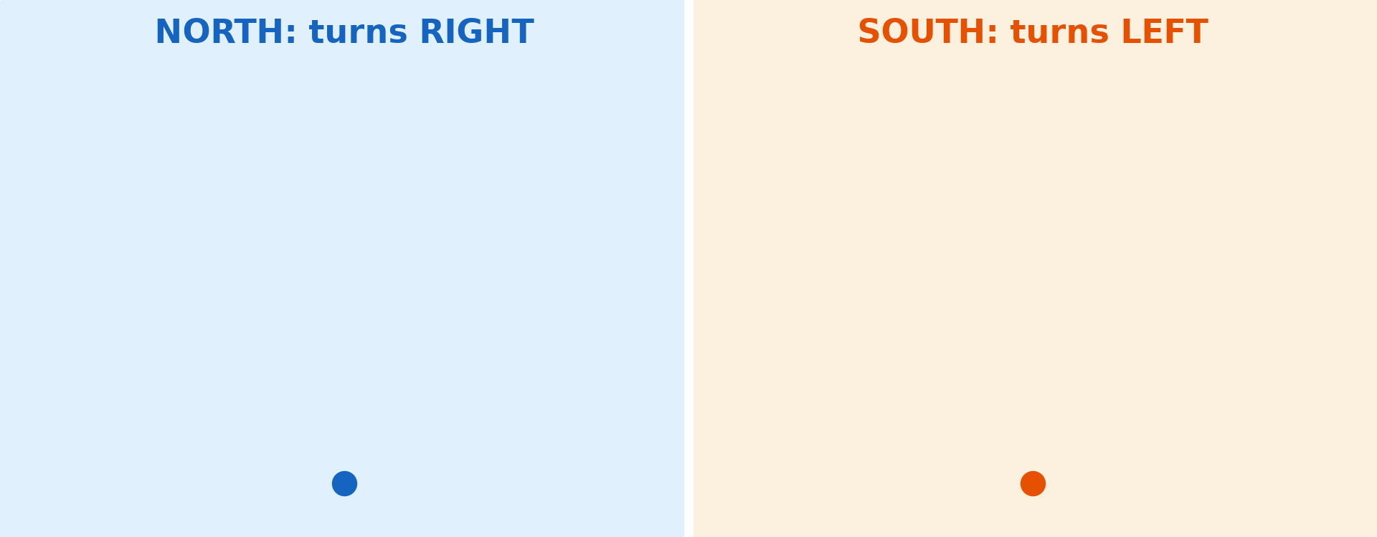
1. ILLUSTRATION: CORIOLIS EFFECT
Activity 2
Animation: winds turn right in the north and left in the south.
Notes:
Activity 2. Look carefully at this animation: animation: winds turn right in the north and left in the south. Watch the animation to the end; it will play again.

Slide 22
1. ILLUSTRATION: CORIOLIS EFFECT
Activity 2: Question
Why do winds turn instead of blowing straight?
Notes:
Here is the question for Activity 2: Why do winds turn instead of blowing straight? Take one minute to think and write your answer in your rough notebook.

Slide 23
1. ILLUSTRATION: CORIOLIS EFFECT
Activity 2: Answer
The rotation of the Earth (Coriolis force).
Notes:
Let us check the answer together. The rotation of the Earth (Coriolis force).

Slide 24
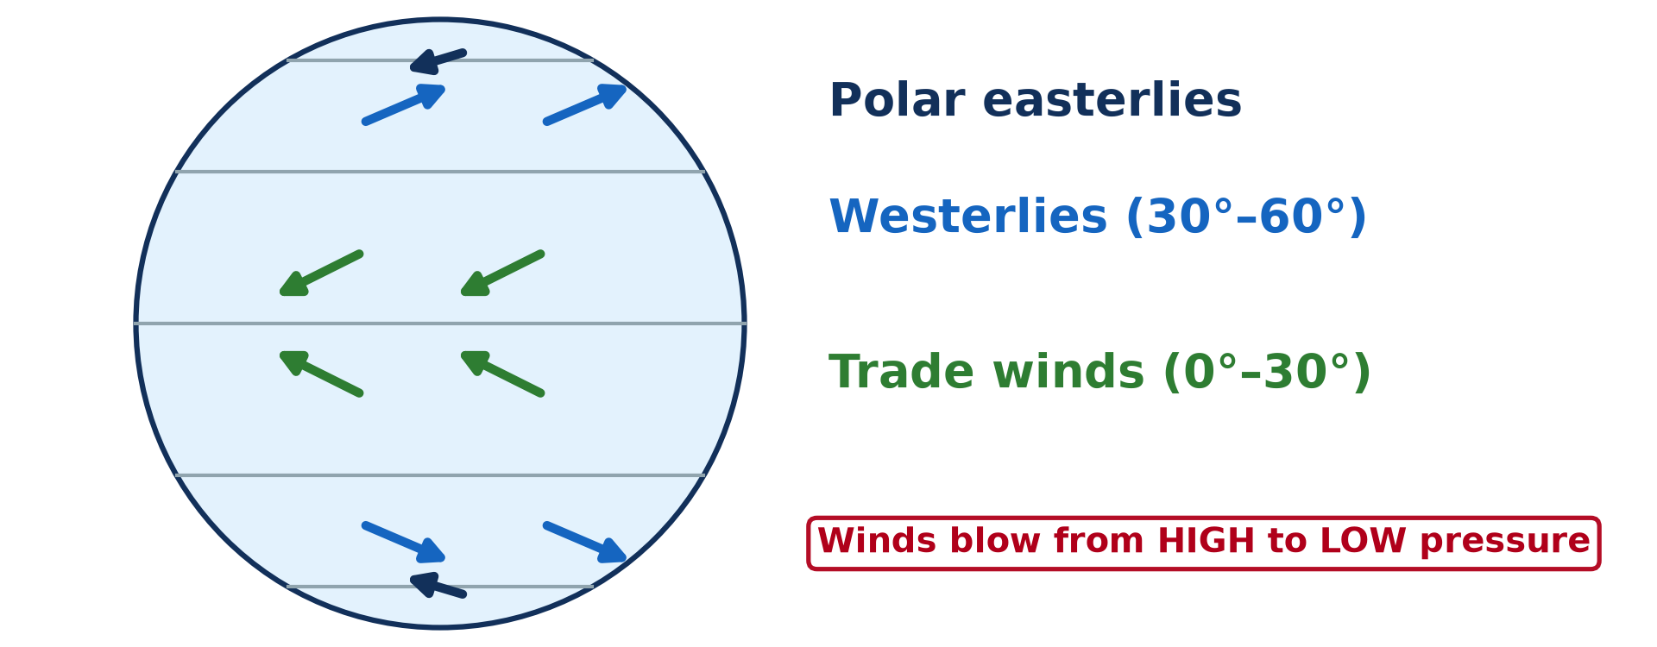
2. A) TRADE WINDS AND WESTERLIES
Activity 3
The planetary winds.
Notes:
Activity 3. Look carefully at this diagram: the planetary winds. Observe every detail before I ask the question.

Slide 25
2. A) TRADE WINDS AND WESTERLIES
Activity 3: Question
Which winds blow between 30° and 60°? From which direction in the north?
Notes:
Here is the question for Activity 3: Which winds blow between 30° and 60°? From which direction in the north? Take one minute to think and write your answer in your rough notebook.

Slide 26
2. A) TRADE WINDS AND WESTERLIES
Activity 3: Answer
The westerlies; from the south-west.
Notes:
Let us check the answer together. The westerlies; from the south-west.

Slide 27
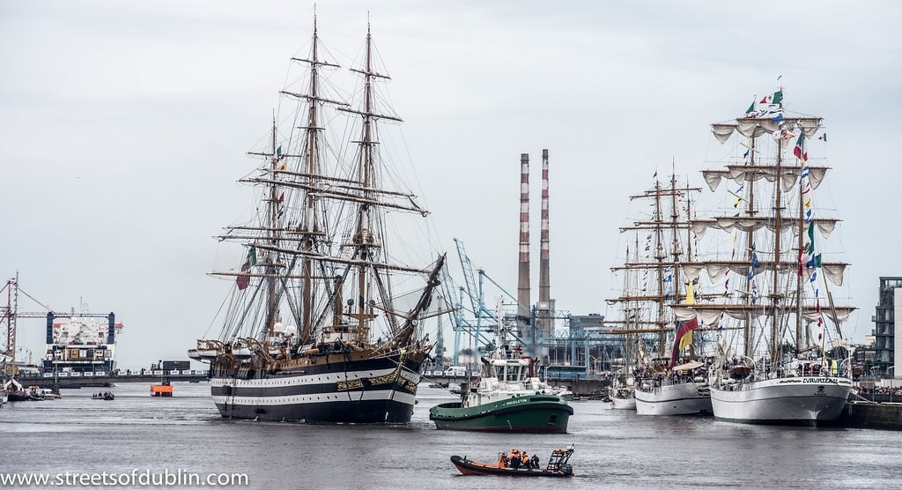
2. A) TRADE WINDS
Activity 4
Tall sailing ships.
Notes:
Activity 4. Look carefully at this picture: tall sailing ships. Observe every detail before I ask the question.

Slide 28
2. A) TRADE WINDS
Activity 4: Question
Why did sailing ships follow the trade winds?
Notes:
Here is the question for Activity 4: Why did sailing ships follow the trade winds? Take one minute to think and write your answer in your rough notebook.

Slide 29
2. A) TRADE WINDS
Activity 4: Answer
They are steady winds that blow in the same direction all year.
Notes:
Let us check the answer together. They are steady winds that blow in the same direction all year.

Slide 30

2. B) WESTERLIES
Activity 5
Big waves in a stormy ocean.
Notes:
Activity 5. Look carefully at this picture: big waves in a stormy ocean. Observe every detail before I ask the question.

Slide 31
2. B) WESTERLIES
Activity 5: Question
The westerlies of the southern ocean are very strong. What are they called by sailors?
Notes:
Here is the question for Activity 5: The westerlies of the southern ocean are very strong. What are they called by sailors? Take one minute to think and write your answer in your rough notebook.

Slide 32
2. B) WESTERLIES
Activity 5: Answer
The Roaring Forties.
Notes:
Let us check the answer together. The Roaring Forties.

Slide 33
BOARD SUMMARY
Board Summary
Topic: Global and Local Atmospheric Circulation
Sub-topic: Macroscale or Global Scale Winds
Lesson 15: Planetary Winds
Notes:
Now we are going to copy the board summary. Write the title and the headings neatly in your notebooks. I will give you enough time for each slide, so do not rush.

Slide 34
BOARD SUMMARY
1. Meaning and Illustration
The main terms are defined as follows:
Wind: It is the horizontal movement of air from high-pressure areas to low-pressure areas.
Notes:
Let us copy Meaning and Illustration. The main terms are defined as follows. Write each point on a new line, with the key term first. When you finish, we go to the next slide.

Slide 35
BOARD SUMMARY
1. Meaning and Illustration (continued)
Planetary (permanent) winds: They are large-scale winds that blow in a fixed direction over particular latitudes throughout the year. Their direction is bent by the rotation of the Earth, an effect called the Coriolis force.
Notes:
We continue with the same part. Write each point on a new line, with the key term first.

Slide 36
BOARD SUMMARY
1. Meaning and Illustration
Illustration
The planetary winds blow between the pressure belts:
Coriolis force: Winds are deflected to the right in the Northern Hemisphere and to the left in the Southern Hemisphere. This is Ferrel's law.
Notes:
Let us copy Illustration. The planetary winds blow between the pressure belts. Write each point on a new line, with the key term first.

Slide 37
BOARD SUMMARY
1. Meaning and Illustration
Illustration: global pressure belts and planetary winds
Notes:
Now draw this illustration in your notebook: global pressure belts and planetary winds. Give it a title and label it clearly.

Slide 38
BOARD SUMMARY
2. Types and Characteristics
There are three types of planetary winds:
Trade winds: They blow from the subtropical highs (30°) towards the equatorial low. They come from the north-east in the Northern Hemisphere and from the south-east in the Southern Hemisphere.
Notes:
Let us copy Types and Characteristics. There are three types of planetary winds. Write each point on a new line, with the key term first. When you finish, we go to the next slide.

Slide 39
BOARD SUMMARY
2. Types and Characteristics (continued)
Westerlies: They blow from the subtropical highs towards the subpolar lows, between 30° and 60°. They blow from the south-west in the north and from the north-west in the south.
Notes:
We continue with the same part. Write each point on a new line, with the key term first. When you finish, we go to the next slide.

Slide 40
BOARD SUMMARY
2. Types and Characteristics (continued)
Polar easterlies: They blow from the polar highs towards the subpolar lows. They are very cold and dry.
Notes:
We continue with the same part. Write each point on a new line, with the key term first.

Slide 41
BOARD SUMMARY
2. Types and Characteristics
Characteristics
The characteristics of each type are:
Trade winds: They are steady and regular, and they are dry over land but bring rain to east coasts. They meet at the ITCZ.
Notes:
Let us copy Characteristics. The characteristics of each type are. Write each point on a new line, with the key term first. When you finish, we go to the next slide.

Slide 42
BOARD SUMMARY
2. Types and Characteristics
Characteristics (continued)
Westerlies: They are variable and stormy, stronger in the Southern Hemisphere (Roaring Forties). They bring depressions and rain to west coasts such as Western Europe.
Notes:
We continue with the same part. Write each point on a new line, with the key term first. When you finish, we go to the next slide.

Slide 43
BOARD SUMMARY
2. Types and Characteristics
Characteristics (continued)
Polar easterlies: They are cold, dry and irregular. They meet the westerlies at the polar front, where depressions form.
Notes:
We continue with the same part. Write each point on a new line, with the key term first.

Slide 44
FORMATIVE EVALUATION
Evaluation 1
What is the Coriolis force?
Notes:
Now let us check what you have understood. Question 1: What is the Coriolis force? Answer in your exercise book.

Slide 45
FORMATIVE EVALUATION
Expected Answer
The effect of the Earth's rotation that deflects winds.
Notes:
The expected answer is: the effect of the Earth's rotation that deflects winds. If you got it right, well done.

Slide 46
FORMATIVE EVALUATION
Evaluation 2
Name the three planetary winds.
Notes:
Now let us check what you have understood. Question 2: Name the three planetary winds. Answer in your exercise book.

Slide 47
FORMATIVE EVALUATION
Expected Answer
Trade winds, westerlies and polar easterlies.
Notes:
The expected answer is: trade winds, westerlies and polar easterlies. If you got it right, well done.

Slide 48
REMEDIATION
Remediation
Fill in the blanks:
Winds blow from ______ to low pressure.
In the north, winds turn to the ______.
Winds from the subtropical highs to the Equator are the ______ winds.
Notes:
For those who need more practice, fill in the blanks in your exercise book. The answers are: number 1, high; number 2, right; number 3, trade.

Slide 49
HOMEWORK
Homework
Draw the planetary winds and pressure belts on one diagram.
Notes:
For your homework: Draw the planetary winds and pressure belts on one diagram. We shall correct it at the beginning of our next lesson.

Slide 50
NEXT LESSON
Next Lesson
Our next lesson will be on:
Lesson 16: Tropical Seasonal Winds: Monsoon and Harmattan
Notes:
Our next lesson will be on Lesson 16: Tropical Seasonal Winds: Monsoon and Harmattan. Thank you for your attention, and see you next time.

Slide 51
BILINGUAL GAME
Bilingual Game (Jeu Bilingue)
English | Français
Wind | Le vent
Trade winds | Les alizés
Westerlies | Les vents d'ouest
Deflection | La déviation
Rotation | La rotation
Windsock | La manche à air
Notes:
Let us play the bilingual game. I say a word in English, and you give me the French word. Then we do the reverse.

Slide 52
LOGBOOK
Official Logbook (1/2)
Module / Topic | Global and Local Atmospheric Circulation
Lesson Title | Lesson 15: Planetary Winds
Expected Learning Outcomes | Define wind and explain its cause. Explain the Coriolis force. Describe the trades, westerlies and polar easterlies.
Competence | Learners are able to describe the planetary winds and explain their direction.
Notes:
I record this information in the official logbook of the class after the lesson.

Slide 53
LOGBOOK
Official Logbook (2/2)
Matter Taught | Meaning and Illustration; Illustration; Types and Characteristics; Characteristics.
Evaluation | Formative evaluation and remediation exercise.
Homework | Draw the planetary winds and pressure belts on one diagram.
Enrolment / Present / Absent | ____ / ____ / ____
Achievement | To be completed after the lesson.
Notes:
I complete the second page of the logbook: the matter taught, the evaluation, the homework and the attendance.

Slide 54
TEACHER'S NOTE
Teacher's Note
Timing: Homework correction, plan, objectives 8 min | Recall, situation, action 10 min | 5 activities 30 min | Board summary (copying) 30 min | Evaluation, remediation 10 min | Homework, next lesson 5 min | Logbook 7 min
Activity 2 is an animation (GIF): it plays automatically in slide-show mode.
Without the projector (Activity 1): let air out of a balloon.
Without the projector (Activity 2): draw a line on a spinning plate.
Without the projector (Activity 3): draw the winds on a circle.
Without the projector (Activity 4): describe a sailing canoe.
Without the projector (Activity 5): explain that there is little land to slow them.
Notes:
This slide is for me, the teacher: it gives the timing of the lesson and what to do if the projector is not available.

Slide 55
REFERENCES
References
National Geography Syllabus, MINESEC/IGE/IP-SS, 2019 — Module 1 (Meteorology, Climatology & Hydrology).
Photo, Activity 1: “Windsock” by Wajahat Mahmood, CC BY-SA 2.0, via Flickr (https://www.flickr.com/photos/26116471@N03/6613272897)
Photo, Activity 4: “The Amerigo Vespucci Arrives In Dublin (Tall Ships Race Dublin - 2012)” by infomatique, CC BY-SA 2.0, via Flickr (https://www.flickr.com/photos/80824546@N00/7846937046)
Photo, Activity 5: “Wave Explosion, Monterey Bay, California” by John William Hammond, CC BY-NC-SA 2.0, via Flickr (https://www.flickr.com/photos/8398907@N02/16328053911)
Diagrams and animations: drawn for this lesson (Geography Department).
Notes:
These are the references and picture credits used to prepare this lesson.

