Slide 1
LOWER SIXTH ARTS
GEOGRAPHY
Lesson 2: Internal Structure of the Earth
Internal Structure of the Earth
Notes:
Good morning, class, and welcome to our geography lesson. I am your geography teacher, Mr Kamdem. Today we are starting Lesson 2: Internal Structure of the Earth.

Slide 2
CLASS INFO
Class, Chapter and Duration
Class | Lower Sixth Arts
Chapter | Module 2: Understanding and managing physical landscapes, geomorphological processes and hazards across the world in general and Cameroon in particular
Duration | 2 periods (2 × 50 minutes)
Notes:
This lesson is for Lower Sixth Arts. It belongs to Module 2: Understanding and managing physical landscapes, geomorphological processes and hazards across the world in general and Cameroon in particular. We shall need 2 periods to cover it.

Slide 3
IDENTIFICATION
Lesson Identification
Topic | The Development of the Earth's Structure
Sub-topic | The Origin and Earth's Structure
Lesson | Lesson 2: Internal Structure of the Earth
Notions / Concepts | Endogenesis, exogenesis, discontinuity, lithosphere, rock cycle.
Syllabus focus | Layers of the Earth; the rock cycle; internal and external forces; categories of landforms.
Competence | Learners are able to describe the layers of the Earth and explain how internal and external forces shape the landscape.
Notes:
Our topic is The Development of the Earth's Structure, and the sub-topic is The Origin and Earth's Structure. The key notions we shall use today are: endogenesis, exogenesis, discontinuity, lithosphere, rock cycle. At the end, you should be able to do this: learners are able to describe the layers of the Earth and explain how internal and external forces shape the landscape.

Slide 4

HOMEWORK CORRECTION
Correction of the Homework
Question (Lesson 1: Origin of the Earth):
Draw the geologic time scale in your exercise book and write one event for each era.
Notes:
Before we start the new lesson, let us correct the homework I gave you at the end of Lesson 1: Origin of the Earth. The question was: Draw the geologic time scale in your exercise book and write one event for each era. Take out your exercise books.

Slide 5
HOMEWORK CORRECTION
Correction: Possible Answer
Precambrian: first bacteria and oldest rocks. Palaeozoic: trilobites and first forests. Mesozoic: dinosaurs and break-up of Pangaea. Cenozoic: mammals, man and the Himalayas.
Notes:
Here is a good answer. Precambrian: first bacteria and oldest rocks. Palaeozoic: trilobites and first forests. Mesozoic: dinosaurs and break-up of Pangaea. Cenozoic: mammals, man and the Himalayas. Compare it with your own answer and correct your work in red.

Slide 6
LESSON PLAN
Lesson Plan
Correction of the homework
Objectives and recall
Real-life situation and action to take
Learning activities
Board summary
Evaluation, remediation and homework
Notes:
Here is the plan of our lesson today. First, we shall correct the homework. Then we shall look at the objectives and recall what you already know. After that, we shall study a situation from real life and the action to take, and do the learning activities. Finally, we shall copy the board summary, do the evaluation and the remediation, and I will give you the homework.

Slide 7
OBJECTIVES
Objectives
By the end of this lesson, you should be able to:
Describe the layers of the Earth and the main discontinuities.
Explain the rock cycle.
Notes:
Take your time to copy this part; we will continue together.

Slide 8
OBJECTIVES
Objectives (continued)
Distinguish internal (endogenic) and external (exogenic) forces.
Notes:
By the end of this lesson, you should be able to do three things. Number 1: describe the layers of the Earth and the main discontinuities. Number 2: explain the rock cycle. Number 3: distinguish internal (endogenic) and external (exogenic) forces.

Slide 9
PREVIOUS KNOWLEDGE
Previous Knowledge
The Earth formed about 4.6 billion years ago.
Rocks are igneous, sedimentary or metamorphic.
Notes:
Let us first remember what you already know. The Earth formed about 4.6 billion years ago. Rocks are igneous, sedimentary or metamorphic. Keep this in mind, because we shall build on it today.

Slide 10
REAL-LIFE SITUATION
Situation in Real Life
After an earthquake is felt in the South-West Region, a student asks why the ground can shake and why Mount Cameroon erupts. Another student says that the inside of the Earth is empty.
Notes:
Listen carefully to this situation from real life. After an earthquake is felt in the South-West Region, a student asks why the ground can shake and why Mount Cameroon erupts. Another student says that the inside of the Earth is empty. Think about it, because I am going to ask you some questions.

Slide 11
REAL-LIFE SITUATION
Situation: Question 1
What is the problem in the situation?
Notes:
Question 1: What is the problem in the situation? Think for a moment, then raise your hand to answer.

Slide 12
REAL-LIFE SITUATION
Answer
Students do not know what the inside of the Earth is like.
Notes:
Good. Students do not know what the inside of the Earth is like.

Slide 13
REAL-LIFE SITUATION
Situation: Question 2
Is the inside of the Earth empty?
Notes:
Question 2: Is the inside of the Earth empty? Think for a moment, then raise your hand to answer.

Slide 14
REAL-LIFE SITUATION
Answer
No. It is made of solid and liquid layers.
Notes:
Good. No. It is made of solid and liquid layers.

Slide 15
REAL-LIFE SITUATION
Situation: Question 3
How do scientists know this?
Notes:
Question 3: How do scientists know this? Think for a moment, then raise your hand to answer.

Slide 16
REAL-LIFE SITUATION
Possible Answer
They study earthquake waves that pass through the Earth.
Notes:
Good. They study earthquake waves that pass through the Earth.

Slide 17
ACTION TO TAKE
Action to Take
Understand the forces that shape our landscape and the rocks we use.
Notes:
From this situation, the action we are working towards in this lesson is the following: understand the forces that shape our landscape and the rocks we use.

Slide 18
JUSTIFICATION
Justification of the Lesson
This lesson helps us to understand the structure of the Earth and the forces that build and wear down the landscape.
Notes:
Why is this lesson important for you? This lesson helps us to understand the structure of the Earth and the forces that build and wear down the landscape.

Slide 19

1. LAYERS OF THE EARTH
Activity 1
The layers of the Earth.
Notes:
Activity 1. Look carefully at this diagram: the layers of the Earth. Observe every detail before I ask the question.

Slide 20
1. LAYERS OF THE EARTH
Activity 1: Question
Name the layers from the surface to the centre.
Notes:
Here is the question for Activity 1: Name the layers from the surface to the centre. Take one minute to think and write your answer in your rough notebook.

Slide 21
1. LAYERS OF THE EARTH
Activity 1: Answer
Crust, mantle, outer core and inner core.
Notes:
Let us check the answer together. Crust, mantle, outer core and inner core.

Slide 22
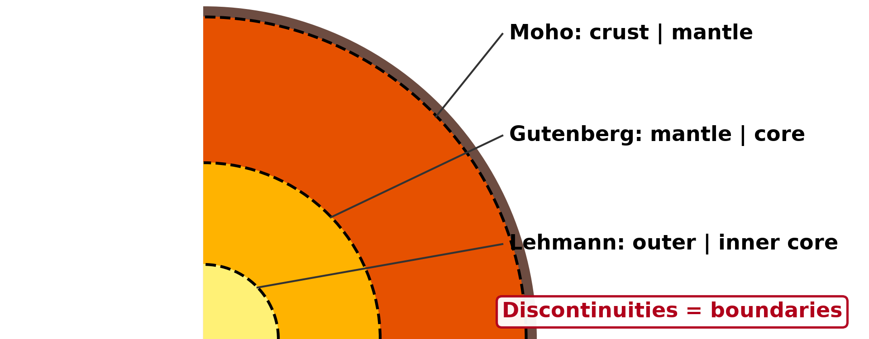
1. LAYERS OF THE EARTH
Activity 2
Discontinuities: the boundaries between the layers.
Notes:
Activity 2. Look carefully at this diagram: discontinuities: the boundaries between the layers. Observe every detail before I ask the question.

Slide 23
1. LAYERS OF THE EARTH
Activity 2: Question
What is the name of the boundary between the crust and the mantle?
Notes:
Here is the question for Activity 2: What is the name of the boundary between the crust and the mantle? Take one minute to think and write your answer in your rough notebook.

Slide 24
1. LAYERS OF THE EARTH
Activity 2: Answer
The Mohorovičić discontinuity (Moho).
Notes:
Let us check the answer together. The Mohorovičić discontinuity (Moho).

Slide 25
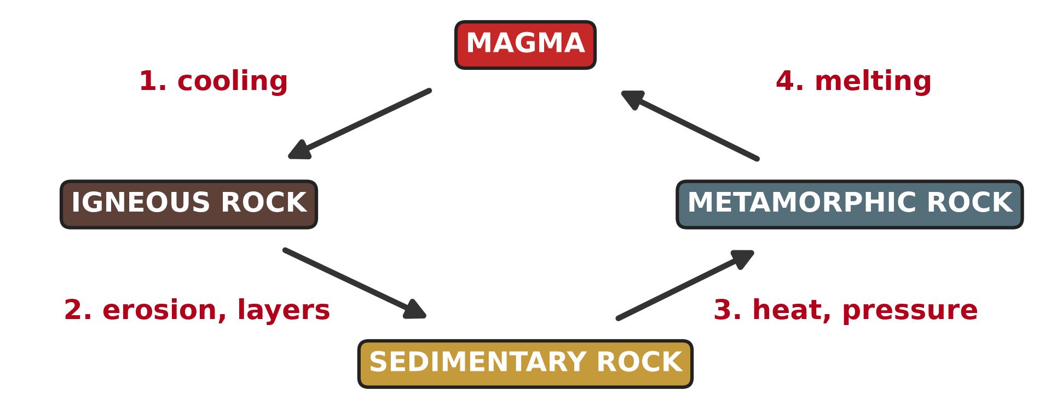
2. THE ROCK CYCLE
Activity 3
The rock cycle.
Notes:
Activity 3. Look carefully at this diagram: the rock cycle. Observe every detail before I ask the question.

Slide 26
2. THE ROCK CYCLE
Activity 3: Question
How can an igneous rock become a sedimentary rock?
Notes:
Here is the question for Activity 3: How can an igneous rock become a sedimentary rock? Take one minute to think and write your answer in your rough notebook.

Slide 27
2. THE ROCK CYCLE
Activity 3: Answer
It is weathered and eroded; the pieces form layers that harden.
Notes:
Let us check the answer together. It is weathered and eroded; the pieces form layers that harden.

Slide 28

3. INTERNAL FORCES
Activity 4
A volcanic eruption.
Notes:
Activity 4. Look carefully at this picture: a volcanic eruption. Observe every detail before I ask the question.

Slide 29
3. INTERNAL FORCES
Activity 4: Question
This force comes from inside the Earth. Is it an internal or an external force?
Notes:
Here is the question for Activity 4: This force comes from inside the Earth. Is it an internal or an external force? Take one minute to think and write your answer in your rough notebook.

Slide 30
3. INTERNAL FORCES
Activity 4: Answer
An internal (endogenic) force. It builds up the relief.
Notes:
Let us check the answer together. An internal (endogenic) force. It builds up the relief.

Slide 31

3. EXTERNAL FORCES
Activity 5
A gully cut by rain water.
Notes:
Activity 5. Look carefully at this picture: a gully cut by rain water. Observe every detail before I ask the question.

Slide 32
3. EXTERNAL FORCES
Activity 5: Question
Rain water wears the land down. Is this an internal or an external force?
Notes:
Here is the question for Activity 5: Rain water wears the land down. Is this an internal or an external force? Take one minute to think and write your answer in your rough notebook.

Slide 33
3. EXTERNAL FORCES
Activity 5: Answer
An external (exogenic) force. It wears down the relief.
Notes:
Let us check the answer together. An external (exogenic) force. It wears down the relief.

Slide 34
BOARD SUMMARY
Board Summary
Topic: The Development of the Earth's Structure
Sub-topic: The Origin and Earth's Structure
Lesson 2: Internal Structure of the Earth
Notes:
Now we are going to copy the board summary. Write the title and the headings neatly in your notebooks. I will give you enough time for each slide, so do not rush.

Slide 35
BOARD SUMMARY
DEFINITIONS
The key terms of this lesson are defined as follows:
Lithosphere: It is the rigid outer shell of the Earth, made of the crust and the upper mantle.
Rock cycle: It is the continuous change of rocks from one type to another.
Notes:
Let us copy the definitions. The key terms of this lesson are defined as follows. On this slide we have Lithosphere and Rock cycle. Write each point on a new line, with the key term first, and explain it in your own words when we revise. When you finish, we go to the next slide.

Slide 36
BOARD SUMMARY
DEFINITIONS (continued)
Landform: It is a natural shape of the Earth's surface, such as a mountain or a valley.
Notes:
We continue with the definitions. On this slide we have Landform. Write each point on a new line, with the key term first, and explain it in your own words when we revise.

Slide 37
BOARD SUMMARY
1. Layers of the Earth and their Properties
The Earth is made up of the following layers:
Crust: It is the thin outer layer, 5–10 km thick under the oceans (sima, basalt) and 30–70 km under continents (sial, granite). It is separated from the mantle by the Moho.
Notes:
Let us copy Layers of the Earth and their Properties. The Earth is made up of the following layers. On this slide we have Crust. Write each point on a new line, with the key term first, and explain it in your own words when we revise. When you finish, we go to the next slide.

Slide 38
BOARD SUMMARY
1. Layers of the Earth and their Properties (continued)
Mantle: It is about 2,900 km thick and made of hot, dense rock. Its upper part (asthenosphere) is partly molten and flows slowly, carrying the plates.
Notes:
We continue with Layers of the Earth and their Properties. On this slide we have Mantle. Write each point on a new line, with the key term first, and explain it in your own words when we revise. When you finish, we go to the next slide.

Slide 39
BOARD SUMMARY
1. Layers of the Earth and their Properties (continued)
Core: It is made of iron and nickel. The outer core is liquid and creates the Earth's magnetic field, while the inner core is solid.
Notes:
We continue with Layers of the Earth and their Properties. On this slide we have Core. Write each point on a new line, with the key term first, and explain it in your own words when we revise.

Slide 40
BOARD SUMMARY
1. Layers of the Earth and their Properties
Illustration: the layers of the Earth
Notes:
Now draw this illustration in your notebook: the layers of the Earth. Give it a title and label it clearly.

Slide 41
BOARD SUMMARY
2. The Rock Material Cycle
Rocks change from one type to another as follows:
Igneous rocks: They form when magma cools, like granite and basalt. Weathering breaks them into sediments.
Notes:
Let us copy The Rock Material Cycle. Rocks change from one type to another as follows. On this slide we have Igneous rocks. Write each point on a new line, with the key term first, and explain it in your own words when we revise. When you finish, we go to the next slide.

Slide 42
BOARD SUMMARY
2. The Rock Material Cycle (continued)
Sedimentary rocks: They form when sediments are deposited, compacted and cemented, like sandstone and limestone. Heat and pressure can change them.
Notes:
We continue with The Rock Material Cycle. On this slide we have Sedimentary rocks. Write each point on a new line, with the key term first, and explain it in your own words when we revise. When you finish, we go to the next slide.

Slide 43
BOARD SUMMARY
2. The Rock Material Cycle (continued)
Metamorphic rocks: They form when rocks are changed by heat and pressure, like marble and gneiss. If they melt, they become magma again.
Notes:
We continue with The Rock Material Cycle. On this slide we have Metamorphic rocks. Write each point on a new line, with the key term first, and explain it in your own words when we revise.

Slide 44
BOARD SUMMARY
2. The Rock Material Cycle
Illustration: the rock cycle
Notes:
Now draw this illustration in your notebook: the rock cycle. Give it a title and label it clearly.

Slide 45
BOARD SUMMARY
3. Forces and Categories of Landforms
The landscape is shaped by two groups of forces:
Internal (endogenic) forces: They come from inside the Earth: plate movements, folding, faulting, volcanism and earthquakes. They build up the relief.
Notes:
Let us copy Forces and Categories of Landforms. The landscape is shaped by two groups of forces. On this slide we have Internal (endogenic) forces. Write each point on a new line, with the key term first, and explain it in your own words when we revise. When you finish, we go to the next slide.

Slide 46
BOARD SUMMARY
3. Forces and Categories of Landforms (continued)
External (exogenic) forces: They come from the sun and gravity: weathering, mass wasting and erosion by rivers, wind, waves and ice. They wear the relief down.
Notes:
We continue with Forces and Categories of Landforms. On this slide we have External (exogenic) forces. Write each point on a new line, with the key term first, and explain it in your own words when we revise. When you finish, we go to the next slide.

Slide 47
BOARD SUMMARY
3. Forces and Categories of Landforms (continued)
Categories of landforms: Major landforms are continents, ocean basins, mountain ranges and plains. Minor landforms are small features such as valleys, waterfalls and dunes.
Notes:
We continue with Forces and Categories of Landforms. On this slide we have Categories of landforms. Write each point on a new line, with the key term first, and explain it in your own words when we revise.

Slide 48
FORMATIVE EVALUATION
Evaluation 1
Define a discontinuity and name one.
Notes:
Now let us check what you have understood. Question 1: Define a discontinuity and name one. Answer in your exercise book.

Slide 49
FORMATIVE EVALUATION
Expected Answer
A boundary between two layers of the Earth, for example the Moho.
Notes:
The expected answer is: a boundary between two layers of the Earth, for example the Moho. If you got it right, well done.

Slide 50
FORMATIVE EVALUATION
Evaluation 2
Give one internal and one external force.
Notes:
Now let us check what you have understood. Question 2: Give one internal and one external force. Answer in your exercise book.

Slide 51
FORMATIVE EVALUATION
Expected Answer
Volcanism (internal); erosion by rivers (external).
Notes:
The expected answer is: volcanism (internal); erosion by rivers (external). If you got it right, well done.

Slide 52
REMEDIATION
Remediation
Fill in the blanks:
The boundary between crust and mantle is the ______.
Forces from inside the Earth are ______ forces.
Notes:
Take your time to copy this part; we will continue together.

Slide 53
REMEDIATION
Remediation (continued)
The inner core is solid because of great ______.
Notes:
For those who need more practice, fill in the blanks in your exercise book. The answers are: number 1, Moho; number 2, endogenic (internal); number 3, pressure.

Slide 54
HOMEWORK
Homework
Look at a map of the world. Why do the coasts of Africa and South America look like pieces of a puzzle? Write two sentences.
Notes:
For your homework: Look at a map of the world. Why do the coasts of Africa and South America look like pieces of a puzzle? Write two sentences. We shall correct it at the beginning of our next lesson.

Slide 55
NEXT LESSON
Next Lesson
Our next lesson will be on:
Further Study 1: Early Theories of Crustal Movements
Notes:
Our next lesson will be on Further Study 1: Early Theories of Crustal Movements. Thank you for your attention, and see you next time.

Slide 56
BILINGUAL GAME
Bilingual Game (Jeu Bilingue)
English | Français
Crust | L'écorce terrestre
Mantle | Le manteau
Core | Le noyau
Discontinuity | La discontinuité
Rock cycle | Le cycle des roches
Landform | Le modelé
Notes:
Let us play the bilingual game. I say a word in English, and you give me the French word. Then we do the reverse.

Slide 57
LOGBOOK
Official Logbook (1/2)
Module / Topic | The Development of the Earth's Structure
Lesson Title | Lesson 2: Internal Structure of the Earth
Expected Learning Outcomes | Describe the layers of the Earth and the main discontinuities. Explain the rock cycle. Distinguish internal (endogenic) and external (exogenic) forces.
Competence | Learners are able to describe the layers of the Earth and explain how internal and external forces shape the landscape.
Notes:
I record this information in the official logbook of the class after the lesson.

Slide 58
LOGBOOK
Official Logbook (2/2)
Matter Taught | DEFINITIONS; Layers of the Earth and their Properties; The Rock Material Cycle; Forces and Categories of Landforms.
Evaluation | Formative evaluation and remediation exercise.
Homework | Look at a map of the world. Why do the coasts of Africa and South America look like pieces of a puzzle? Write two sentences.
Enrolment / Present / Absent | ____ / ____ / ____
Achievement | To be completed after the lesson.
Notes:
I complete the second page of the logbook: the matter taught, the evaluation, the homework and the attendance.

Slide 59
TEACHER'S NOTE
Teacher's Note
Timing: Homework correction, plan, objectives 8 min | Recall, situation, action 10 min | 5 activities 30 min | Board summary (copying) 30 min | Evaluation, remediation 10 min | Homework, next lesson 5 min | Logbook 7 min
Without the projector (Activity 1): draw four circles on the board.
Without the projector (Activity 2): write the three discontinuities on the board.
Without the projector (Activity 3): draw the four boxes of the rock cycle.
Without the projector (Activity 4): mention Mount Cameroon.
Without the projector (Activity 5): describe the gullies beside the roads after a storm.
Notes:
This slide is for me, the teacher: it gives the timing of the lesson and what to do if the projector is not available.

Slide 60
REFERENCES
References
National Geography Syllabus, MINESEC/IGE/IP-SS, 2019 — Module 2 (Geomorphology).
Photo, Activity 4: “Happy Anniversary Hawaii” by U.S. Geological Survey, CC0 1.0, via Flickr (https://www.flickr.com/photos/27784370@N05/14802198589)
Photo, Activity 5: “Soil erosion in the central Mexican Highlands” by CIMMYT, CC BY-NC-SA 2.0, via Flickr (https://www.flickr.com/photos/44760652@N05/6244930288)
Diagrams and animations: drawn for this lesson (Geography Department).
Notes:
These are the references and picture credits used to prepare this lesson.

