Slide 1
LOWER SIXTH ARTS
GEOGRAPHY
Lesson 4: Landforms at Constructive or Divergent Margins
Landforms at Constructive or Divergent Margins
Notes:
Good morning, class, and welcome to our geography lesson. I am your geography teacher, Mr Kamdem. Today we are starting Lesson 4: Landforms at Constructive or Divergent Margins.

Slide 2
CLASS INFO
Class, Chapter and Duration
Class | Lower Sixth Arts
Chapter | Module 2: Understanding and managing physical landscapes, geomorphological processes and hazards across the world in general and Cameroon in particular
Duration | 2 periods (2 × 50 minutes)
Notes:
This lesson is for Lower Sixth Arts. It belongs to Module 2: Understanding and managing physical landscapes, geomorphological processes and hazards across the world in general and Cameroon in particular. We shall need 2 periods to cover it.

Slide 3
IDENTIFICATION
Lesson Identification
Topic | The Development of the Earth's Structure
Sub-topic | Theories of Earth Structure and Resultant Landforms
Lesson | Lesson 4: Landforms at Constructive or Divergent Margins
Notions / Concepts | Constructive margin, faulting, rift valley, horst, graben, shield volcano.
Syllabus focus | Mid-ocean ridges, rift valleys, shield volcanoes, block mountains, escarpments; faulting; gentle eruptions and earthquakes.
Competence | Learners are able to explain the formation of landforms where plates move apart.
Notes:
Our topic is The Development of the Earth's Structure, and the sub-topic is Theories of Earth Structure and Resultant Landforms. The key notions we shall use today are: constructive margin, faulting, rift valley, horst, graben, shield volcano. At the end, you should be able to do this: learners are able to explain the formation of landforms where plates move apart.

Slide 4

HOMEWORK CORRECTION
Correction of the Homework
Question (Lesson 3: Theory of Plate Tectonics):
Look at a picture of the East African Rift Valley. Describe its shape in two sentences.
Notes:
Before we start the new lesson, let us correct the homework I gave you at the end of Lesson 3: Theory of Plate Tectonics. The question was: Look at a picture of the East African Rift Valley. Describe its shape in two sentences. Take out your exercise books.

Slide 5
HOMEWORK CORRECTION
Correction: Possible Answer
The East African Rift Valley is a long, narrow valley with steep sides (escarpments) and a flat floor. It is formed where the African plate is splitting apart.
Notes:
Here is a good answer. The East African Rift Valley is a long, narrow valley with steep sides (escarpments) and a flat floor. It is formed where the African plate is splitting apart. Compare it with your own answer and correct your work in red.

Slide 6
LESSON PLAN
Lesson Plan
Correction of the homework
Objectives and recall
Real-life situation and action to take
Learning activities
Board summary
Evaluation, remediation and homework
Notes:
Here is the plan of our lesson today. First, we shall correct the homework. Then we shall look at the objectives and recall what you already know. After that, we shall study a situation from real life and the action to take, and do the learning activities. Finally, we shall copy the board summary, do the evaluation and the remediation, and I will give you the homework.

Slide 7
OBJECTIVES
Objectives
By the end of this lesson, you should be able to:
Explain faulting.
Describe the formation of rift valleys and block mountains.
Notes:
Take your time to copy this part; we will continue together.

Slide 8
OBJECTIVES
Objectives (continued)
Describe shield volcanoes and gentle eruptions.
Notes:
By the end of this lesson, you should be able to do three things. Number 1: explain faulting. Number 2: describe the formation of rift valleys and block mountains. Number 3: describe shield volcanoes and gentle eruptions.

Slide 9
PREVIOUS KNOWLEDGE
Previous Knowledge
At constructive margins, plates move apart.
New crust forms at mid-ocean ridges.
Notes:
Let us first remember what you already know. At constructive margins, plates move apart. New crust forms at mid-ocean ridges. Keep this in mind, because we shall build on it today.

Slide 10
REAL-LIFE SITUATION
Situation in Real Life
Paul travels in Kenya and sees a very long, deep valley with steep walls, lakes and volcanoes. His guide says the valley is getting wider every year.
Notes:
Listen carefully to this situation from real life. Paul travels in Kenya and sees a very long, deep valley with steep walls, lakes and volcanoes. His guide says the valley is getting wider every year. Think about it, because I am going to ask you some questions.

Slide 11
REAL-LIFE SITUATION
Situation: Question 1
What is the problem in the situation?
Notes:
Question 1: What is the problem in the situation? Think for a moment, then raise your hand to answer.

Slide 12
REAL-LIFE SITUATION
Answer
Paul does not know how the long valley was formed.
Notes:
Good. Paul does not know how the long valley was formed.

Slide 13
REAL-LIFE SITUATION
Situation: Question 2
What is the name of this valley?
Notes:
Question 2: What is the name of this valley? Think for a moment, then raise your hand to answer.

Slide 14
REAL-LIFE SITUATION
Answer
The Great Rift Valley.
Notes:
Good. The Great Rift Valley.

Slide 15
REAL-LIFE SITUATION
Situation: Question 3
Why is it getting wider?
Notes:
Question 3: Why is it getting wider? Think for a moment, then raise your hand to answer.

Slide 16
REAL-LIFE SITUATION
Possible Answer
The plates on each side are moving apart.
Notes:
Good. The plates on each side are moving apart.

Slide 17
ACTION TO TAKE
Action to Take
Understand landforms at divergent margins such as the East African Rift.
Notes:
From this situation, the action we are working towards in this lesson is the following: understand landforms at divergent margins such as the East African Rift.

Slide 18
JUSTIFICATION
Justification of the Lesson
This lesson helps us to understand the landforms formed where the crust is pulled apart.
Notes:
Why is this lesson important for you? This lesson helps us to understand the landforms formed where the crust is pulled apart.

Slide 19
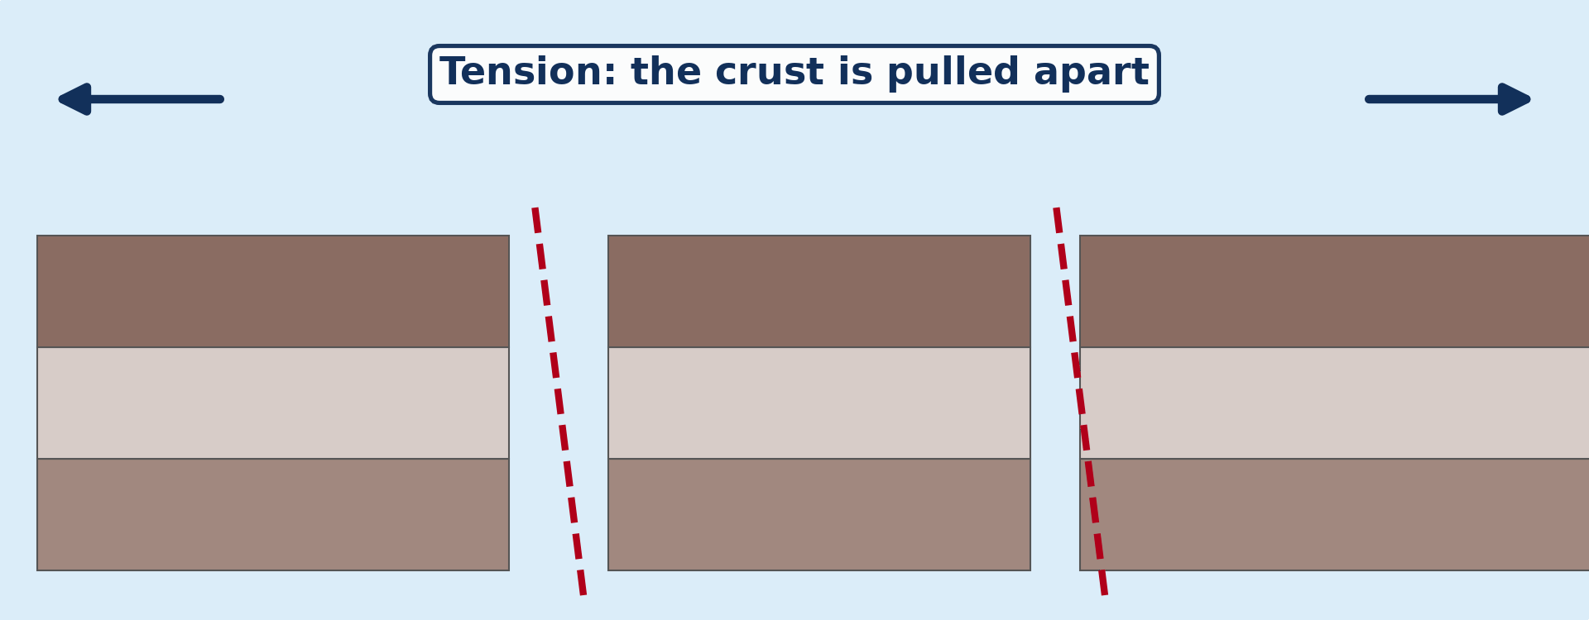
1. FAULTING
Activity 1
Animation: the crust is pulled apart and a block sinks.
Notes:
Activity 1. Look carefully at this animation: animation: the crust is pulled apart and a block sinks. Watch the animation to the end; it will play again.

Slide 20
1. FAULTING
Activity 1: Question
What happens to the middle block when the crust is pulled apart?
Notes:
Here is the question for Activity 1: What happens to the middle block when the crust is pulled apart? Take one minute to think and write your answer in your rough notebook.

Slide 21
1. FAULTING
Activity 1: Answer
It sinks between two faults and forms a rift valley (graben).
Notes:
Let us check the answer together. It sinks between two faults and forms a rift valley (graben).

Slide 22
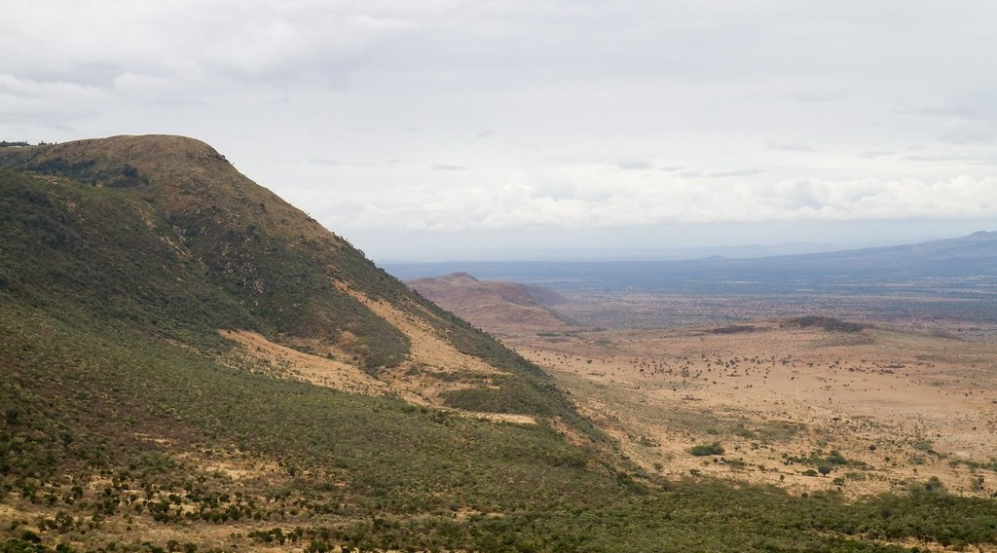
2. RIFT VALLEYS
Activity 2
The Great Rift Valley in Kenya.
Notes:
Activity 2. Look carefully at this picture: the Great Rift Valley in Kenya. Observe every detail before I ask the question.

Slide 23
2. RIFT VALLEYS
Activity 2: Question
Describe the sides of the valley. How were they formed?
Notes:
Here is the question for Activity 2: Describe the sides of the valley. How were they formed? Take one minute to think and write your answer in your rough notebook.

Slide 24
2. RIFT VALLEYS
Activity 2: Answer
They are steep escarpments formed by faults.
Notes:
Let us check the answer together. They are steep escarpments formed by faults.

Slide 25
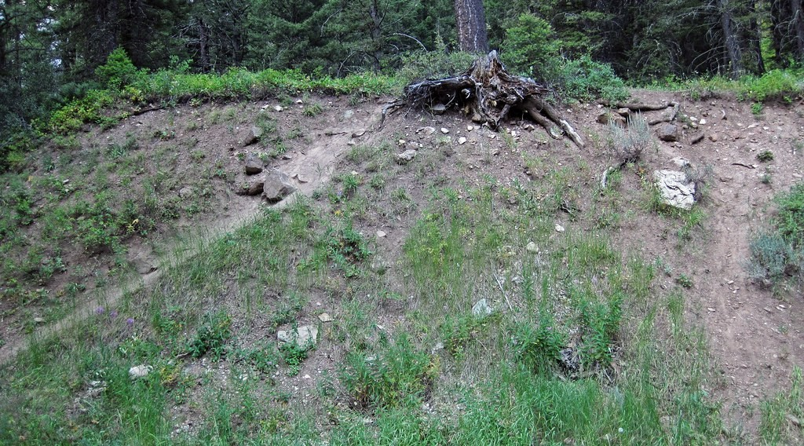
2. BLOCK MOUNTAINS AND ESCARPMENTS
Activity 3
A fault scarp made by the 1959 Hebgen Lake earthquake (USA).
Notes:
Activity 3. Look carefully at this picture: a fault scarp made by the 1959 Hebgen Lake earthquake (USA). Observe every detail before I ask the question.

Slide 26
2. BLOCK MOUNTAINS AND ESCARPMENTS
Activity 3: Question
A block of land is pushed up between two faults. What is it called?
Notes:
Here is the question for Activity 3: A block of land is pushed up between two faults. What is it called? Take one minute to think and write your answer in your rough notebook.

Slide 27
2. BLOCK MOUNTAINS AND ESCARPMENTS
Activity 3: Answer
A block mountain (horst).
Notes:
Let us check the answer together. A block mountain (horst).

Slide 28
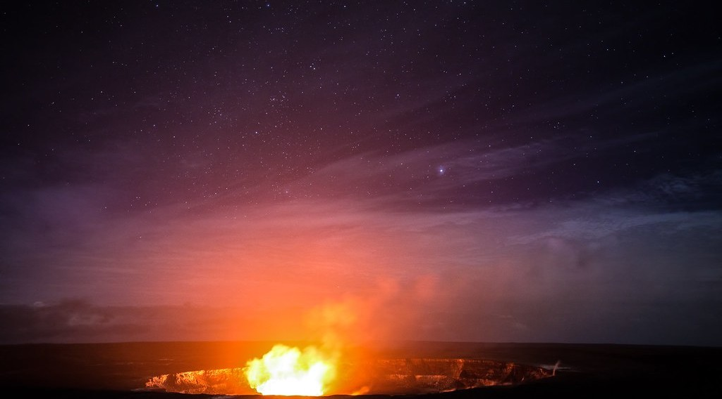
3. SHIELD VOLCANOES
Activity 4
Lava glowing in the crater of Kilauea, a wide shield volcano in Hawaii.
Notes:
Activity 4. Look carefully at this picture: lava glowing in the crater of Kilauea, a wide shield volcano in Hawaii. Observe every detail before I ask the question.

Slide 29
3. SHIELD VOLCANOES
Activity 4: Question
Why does this volcano have gentle slopes?
Notes:
Here is the question for Activity 4: Why does this volcano have gentle slopes? Take one minute to think and write your answer in your rough notebook.

Slide 30
3. SHIELD VOLCANOES
Activity 4: Answer
Its runny basic lava flows far before it cools.
Notes:
Let us check the answer together. Its runny basic lava flows far before it cools.

Slide 31

4. ERUPTIONS AND EARTHQUAKES
Activity 5
Iceland: a ridge above the sea.
Notes:
Activity 5. Look carefully at this picture: iceland: a ridge above the sea. Observe every detail before I ask the question.

Slide 32
4. ERUPTIONS AND EARTHQUAKES
Activity 5: Question
Are eruptions and earthquakes violent or gentle at constructive margins?
Notes:
Here is the question for Activity 5: Are eruptions and earthquakes violent or gentle at constructive margins? Take one minute to think and write your answer in your rough notebook.

Slide 33
4. ERUPTIONS AND EARTHQUAKES
Activity 5: Answer
Usually gentle: runny lava and shallow earthquakes.
Notes:
Let us check the answer together. Usually gentle: runny lava and shallow earthquakes.

Slide 34
BOARD SUMMARY
Board Summary
Topic: The Development of the Earth's Structure
Sub-topic: Theories of Earth Structure and Resultant Landforms
Lesson 4: Landforms at Constructive or Divergent Margins
Notes:
Now we are going to copy the board summary. Write the title and the headings neatly in your notebooks. I will give you enough time for each slide, so do not rush.

Slide 35
BOARD SUMMARY
DEFINITIONS
The key terms of this lesson are defined as follows:
Divergent (constructive) margin: It is a boundary where two plates move apart.
Fault: It is a crack in the crust along which rocks have moved.
Notes:
Let us copy the definitions. The key terms of this lesson are defined as follows. On this slide we have Divergent (constructive) margin and Fault. Write each point on a new line, with the key term first, and explain it in your own words when we revise.

Slide 36
BOARD SUMMARY
1. Faulting
Tension at divergent margins causes faulting:
Normal faults: When the crust is pulled apart, it cracks and blocks slip down along the faults. The exposed side of a fault is a fault scarp.
Notes:
Let us copy Faulting. Tension at divergent margins causes faulting. On this slide we have Normal faults. Write each point on a new line, with the key term first, and explain it in your own words when we revise. When you finish, we go to the next slide.

Slide 37
BOARD SUMMARY
1. Faulting (continued)
Horst and graben: A block pushed up between two faults is a horst, and a block that sinks is a graben. Many of them together form a basin and range landscape.
Notes:
We continue with Faulting. On this slide we have Horst and graben. Write each point on a new line, with the key term first, and explain it in your own words when we revise.

Slide 38
BOARD SUMMARY
1. Faulting
Illustration: horst and graben
Notes:
Now draw this illustration in your notebook: horst and graben. Give it a title and label it clearly.

Slide 39
BOARD SUMMARY
2. Landforms at Constructive Margins
The main landforms include:
Mid-ocean ridges: They are long underwater mountain chains where plates separate, like the Mid-Atlantic Ridge. They have a central rift valley.
Notes:
Let us copy Landforms at Constructive Margins. The main landforms include. On this slide we have Mid-ocean ridges. Write each point on a new line, with the key term first, and explain it in your own words when we revise. When you finish, we go to the next slide.

Slide 40
BOARD SUMMARY
2. Landforms at Constructive Margins (continued)
Rift valleys: They are long, narrow valleys formed when a block sinks between parallel faults. The East African Rift Valley is over 6,000 km long.
Notes:
We continue with Landforms at Constructive Margins. On this slide we have Rift valleys. Write each point on a new line, with the key term first, and explain it in your own words when we revise. When you finish, we go to the next slide.

Slide 41
BOARD SUMMARY
2. Landforms at Constructive Margins (continued)
Block mountains, plateaux and escarpments: Uplifted blocks form block mountains (Ruwenzori) and plateaux. Their steep fault sides are escarpments.
Notes:
We continue with Landforms at Constructive Margins. On this slide we have Block mountains, plateaux and escarpments. Write each point on a new line, with the key term first, and explain it in your own words when we revise. When you finish, we go to the next slide.

Slide 42
BOARD SUMMARY
2. Landforms at Constructive Margins (continued)
Shield volcanoes: Runny basalt lava spreads far and builds wide volcanoes with gentle slopes. Examples are Mauna Loa and the volcanoes of Iceland.
Notes:
We continue with Landforms at Constructive Margins. On this slide we have Shield volcanoes. Write each point on a new line, with the key term first, and explain it in your own words when we revise.

Slide 43
BOARD SUMMARY
2. Landforms at Constructive Margins
Illustration: an escarpment
Notes:
Now draw this illustration in your notebook: an escarpment. Give it a title and label it clearly.

Slide 44
BOARD SUMMARY
3. Eruptions and Earthquakes
Activity at constructive margins is characterised by:
Less violent eruptions: Basic, runny lava lets gases escape easily, so eruptions are effusive (Hawaiian or Icelandic types). Lava flows cover large areas.
Notes:
Let us copy Eruptions and Earthquakes. Activity at constructive margins is characterised by. On this slide we have Less violent eruptions. Write each point on a new line, with the key term first, and explain it in your own words when we revise. When you finish, we go to the next slide.

Slide 45
BOARD SUMMARY
3. Eruptions and Earthquakes (continued)
Shallow earthquakes: Earthquakes are frequent but shallow and usually of low magnitude. They occur along faults and transform zones of the ridges.
Notes:
We continue with Eruptions and Earthquakes. On this slide we have Shallow earthquakes. Write each point on a new line, with the key term first, and explain it in your own words when we revise.

Slide 46
FORMATIVE EVALUATION
Evaluation 1
How is a rift valley formed?
Notes:
Now let us check what you have understood. Question 1: How is a rift valley formed? Answer in your exercise book.

Slide 47
FORMATIVE EVALUATION
Expected Answer
The crust is pulled apart and a block sinks between two faults.
Notes:
The expected answer is: the crust is pulled apart and a block sinks between two faults. If you got it right, well done.

Slide 48
FORMATIVE EVALUATION
Evaluation 2
Why do shield volcanoes have gentle slopes?
Notes:
Now let us check what you have understood. Question 2: Why do shield volcanoes have gentle slopes? Answer in your exercise book.

Slide 49
FORMATIVE EVALUATION
Expected Answer
Their runny basic lava flows far before cooling.
Notes:
The expected answer is: their runny basic lava flows far before cooling. If you got it right, well done.

Slide 50
REMEDIATION
Remediation
Fill in the blanks:
A crack along which rocks move is a ______.
A raised block between faults is a ______.
A sunken block between faults is a ______.
Notes:
For those who need more practice, fill in the blanks in your exercise book. The answers are: number 1, fault; number 2, horst; number 3, graben (rift valley).

Slide 51
HOMEWORK
Homework
Find the Himalayas and the Andes on a map. Say which plates meet there.
Notes:
For your homework: Find the Himalayas and the Andes on a map. Say which plates meet there. We shall correct it at the beginning of our next lesson.

Slide 52
NEXT LESSON
Next Lesson
Our next lesson will be on:
Lesson 5: Landforms at Destructive and Conservative Margins
Notes:
Our next lesson will be on Lesson 5: Landforms at Destructive and Conservative Margins. Thank you for your attention, and see you next time.

Slide 53
BILINGUAL GAME
Bilingual Game (Jeu Bilingue)
English | Français
Rift valley | Le fossé d'effondrement (rift)
Fault | La faille
Horst | Le horst
Escarpment | L'escarpement
Shield volcano | Le volcan bouclier
Tension | La distension
Notes:
Let us play the bilingual game. I say a word in English, and you give me the French word. Then we do the reverse.

Slide 54
LOGBOOK
Official Logbook (1/2)
Module / Topic | The Development of the Earth's Structure
Lesson Title | Lesson 4: Landforms at Constructive or Divergent Margins
Expected Learning Outcomes | Explain faulting. Describe the formation of rift valleys and block mountains. Describe shield volcanoes and gentle eruptions.
Competence | Learners are able to explain the formation of landforms where plates move apart.
Notes:
I record this information in the official logbook of the class after the lesson.

Slide 55
LOGBOOK
Official Logbook (2/2)
Matter Taught | DEFINITIONS; Faulting; Landforms at Constructive Margins; Eruptions and Earthquakes.
Evaluation | Formative evaluation and remediation exercise.
Homework | Find the Himalayas and the Andes on a map. Say which plates meet there.
Enrolment / Present / Absent | ____ / ____ / ____
Achievement | To be completed after the lesson.
Notes:
I complete the second page of the logbook: the matter taught, the evaluation, the homework and the attendance.

Slide 56
TEACHER'S NOTE
Teacher's Note
Timing: Homework correction, plan, objectives 8 min | Recall, situation, action 10 min | 5 activities 30 min | Board summary (copying) 30 min | Evaluation, remediation 10 min | Homework, next lesson 5 min | Logbook 7 min
Activity 1 is an animation (GIF): it plays automatically in slide-show mode.
Without the projector (Activity 1): pull two books apart and let a third one drop between them.
Without the projector (Activity 2): draw a valley with two steep sides.
Without the projector (Activity 3): raise one book between two others.
Without the projector (Activity 4): pour honey and thick porridge: compare how far they flow.
Without the projector (Activity 5): compare with explosive volcanoes at destructive margins.
Notes:
This slide is for me, the teacher: it gives the timing of the lesson and what to do if the projector is not available.

Slide 57
REFERENCES
References
National Geography Syllabus, MINESEC/IGE/IP-SS, 2019 — Module 2 (Geomorphology).
Photo, Activity 2: “Great Rift Valley” by GSAPP_SIDL, CC BY-NC-ND 2.0, via Flickr (https://www.flickr.com/photos/77974798@N04/7341392488)
Photo, Activity 3: “1959 Hebgen Lake Earthquake fault scarp (Cabin Creek, Gallatin County,” by James St. John, CC BY 2.0, via Flickr (https://www.flickr.com/photos/47445767@N05/45610123392)
Photo, Activity 4: “Fire and Stars” by howardignatius, CC BY-NC-ND 2.0, via Flickr (https://www.flickr.com/photos/25659032@N07/39966052052)
Photo, Activity 5: “Silfra Fissure” by Daveography.ca, CC BY-NC-SA 2.0, via Flickr (https://www.flickr.com/photos/71482738@N00/32857247053)
Diagrams and animations: drawn for this lesson (Geography Department).
Notes:
These are the references and picture credits used to prepare this lesson.

