Slide 1
LOWER SIXTH ARTS
GEOGRAPHY
Lesson 5: Landforms at Destructive and Conservative Margins
Landforms at Destructive and Conservative Margins
Notes:
Good morning, class, and welcome to our geography lesson. I am your geography teacher, Mr Kamdem. Today we are starting Lesson 5: Landforms at Destructive and Conservative Margins.

Slide 2
CLASS INFO
Class, Chapter and Duration
Class | Lower Sixth Arts
Chapter | Module 2: Understanding and managing physical landscapes, geomorphological processes and hazards across the world in general and Cameroon in particular
Duration | 2 periods (2 × 50 minutes)
Notes:
This lesson is for Lower Sixth Arts. It belongs to Module 2: Understanding and managing physical landscapes, geomorphological processes and hazards across the world in general and Cameroon in particular. We shall need 2 periods to cover it.

Slide 3
IDENTIFICATION
Lesson Identification
Topic | The Development of the Earth's Structure
Sub-topic | Theories of Earth Structure and Resultant Landforms
Lesson | Lesson 5: Landforms at Destructive and Conservative Margins
Notions / Concepts | Destructive margin, conservative margin, folding, subduction, Benioff zone, island arc.
Syllabus focus | Fold mountains and folding; trenches and Benioff zones; island arcs and explosive volcanoes; tear faults.
Competence | Learners are able to explain the formation of fold mountains, trenches and island arcs.
Notes:
Our topic is The Development of the Earth's Structure, and the sub-topic is Theories of Earth Structure and Resultant Landforms. The key notions we shall use today are: destructive margin, conservative margin, folding, subduction, Benioff zone, island arc. At the end, you should be able to do this: learners are able to explain the formation of fold mountains, trenches and island arcs.

Slide 4

HOMEWORK CORRECTION
Correction of the Homework
Question (Lesson 4: Landforms at Constructive or Divergent Margins):
Find the Himalayas and the Andes on a map. Say which plates meet there.
Notes:
Before we start the new lesson, let us correct the homework I gave you at the end of Lesson 4: Landforms at Constructive or Divergent Margins. The question was: Find the Himalayas and the Andes on a map. Say which plates meet there. Take out your exercise books.

Slide 5
HOMEWORK CORRECTION
Correction: Possible Answer
The Himalayas are formed where the Indian plate collides with the Eurasian plate. The Andes are formed where the Nazca plate sinks under the South American plate.
Notes:
Here is a good answer. The Himalayas are formed where the Indian plate collides with the Eurasian plate. The Andes are formed where the Nazca plate sinks under the South American plate. Compare it with your own answer and correct your work in red.

Slide 6
LESSON PLAN
Lesson Plan
Correction of the homework
Objectives and recall
Real-life situation and action to take
Learning activities
Board summary
Evaluation, remediation and homework
Notes:
Here is the plan of our lesson today. First, we shall correct the homework. Then we shall look at the objectives and recall what you already know. After that, we shall study a situation from real life and the action to take, and do the learning activities. Finally, we shall copy the board summary, do the evaluation and the remediation, and I will give you the homework.

Slide 7
OBJECTIVES
Objectives
By the end of this lesson, you should be able to:
Explain folding and the formation of fold mountains.
Explain subduction, trenches and island arcs.
Notes:
Take your time to copy this part; we will continue together.

Slide 8
OBJECTIVES
Objectives (continued)
Describe processes at conservative margins.
Notes:
By the end of this lesson, you should be able to do three things. Number 1: explain folding and the formation of fold mountains. Number 2: explain subduction, trenches and island arcs. Number 3: describe processes at conservative margins.

Slide 9
PREVIOUS KNOWLEDGE
Previous Knowledge
At destructive margins, plates move together.
At conservative margins, plates slide past each other.
Notes:
Let us first remember what you already know. At destructive margins, plates move together. At conservative margins, plates slide past each other. Keep this in mind, because we shall build on it today.

Slide 10
REAL-LIFE SITUATION
Situation in Real Life
Aminatou reads that the Himalayas are still rising by a few millimetres each year and that Japan often has strong earthquakes and volcanic eruptions.
Notes:
Listen carefully to this situation from real life. Aminatou reads that the Himalayas are still rising by a few millimetres each year and that Japan often has strong earthquakes and volcanic eruptions. Think about it, because I am going to ask you some questions.

Slide 11
REAL-LIFE SITUATION
Situation: Question 1
What is the problem in the situation?
Notes:
Question 1: What is the problem in the situation? Think for a moment, then raise your hand to answer.

Slide 12
REAL-LIFE SITUATION
Answer
Aminatou does not know why mountains rise and why Japan is so active.
Notes:
Good. Aminatou does not know why mountains rise and why Japan is so active.

Slide 13
REAL-LIFE SITUATION
Situation: Question 2
Why are the Himalayas rising?
Notes:
Question 2: Why are the Himalayas rising? Think for a moment, then raise your hand to answer.

Slide 14
REAL-LIFE SITUATION
Answer
India is pushing into Asia.
Notes:
Good. India is pushing into Asia.

Slide 15
REAL-LIFE SITUATION
Situation: Question 3
Why is Japan active?
Notes:
Question 3: Why is Japan active? Think for a moment, then raise your hand to answer.

Slide 16
REAL-LIFE SITUATION
Possible Answer
A plate sinks under it (subduction).
Notes:
Good. A plate sinks under it (subduction).

Slide 17
ACTION TO TAKE
Action to Take
Locate zones of destructive margins and understand their hazards.
Notes:
From this situation, the action we are working towards in this lesson is the following: locate zones of destructive margins and understand their hazards.

Slide 18
JUSTIFICATION
Justification of the Lesson
This lesson helps us to understand the highest mountains and the most dangerous zones of the Earth.
Notes:
Why is this lesson important for you? This lesson helps us to understand the highest mountains and the most dangerous zones of the Earth.

Slide 19
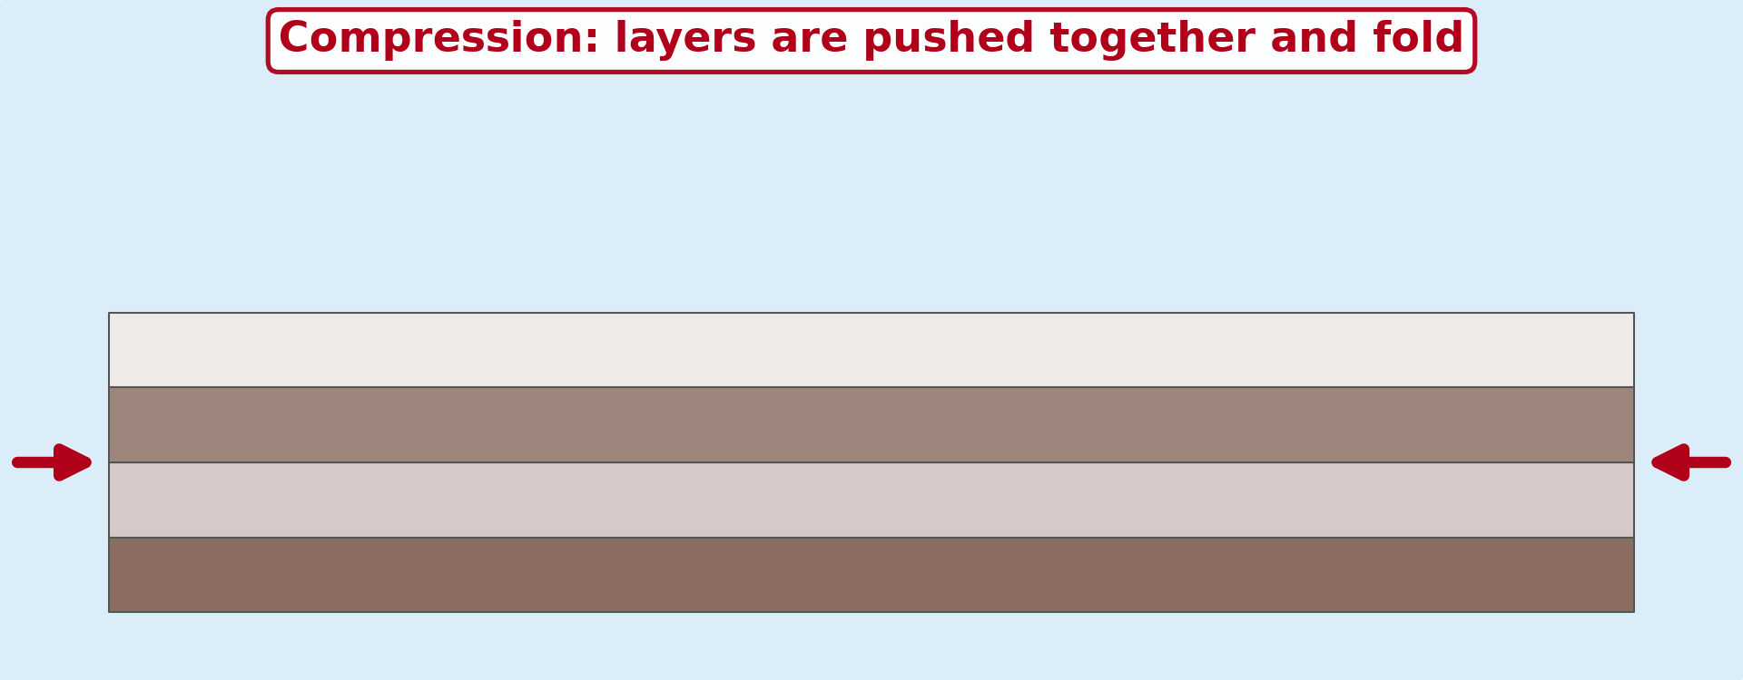
1. FOLDING
Activity 1
Animation: layers of rock are pushed together.
Notes:
Activity 1. Look carefully at this animation: animation: layers of rock are pushed together. Watch the animation to the end; it will play again.

Slide 20
1. FOLDING
Activity 1: Question
What happens to layers of rock under compression?
Notes:
Here is the question for Activity 1: What happens to layers of rock under compression? Take one minute to think and write your answer in your rough notebook.

Slide 21
1. FOLDING
Activity 1: Answer
They bend into folds: anticlines (up) and synclines (down).
Notes:
Let us check the answer together. They bend into folds: anticlines (up) and synclines (down).

Slide 22
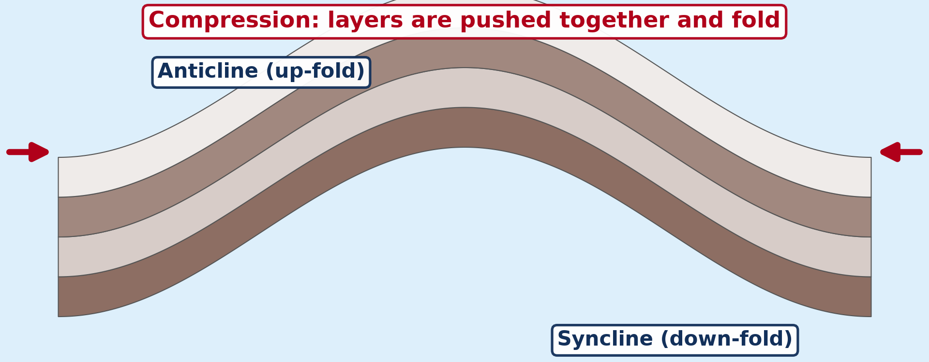
1. FOLDING
Activity 2
Diagram: layers of rock bent into folds.
Notes:
Activity 2. Look carefully at this picture: diagram: layers of rock bent into folds. Observe every detail before I ask the question.

Slide 23
1. FOLDING
Activity 2: Question
Point to an up-fold and a down-fold. What are they called?
Notes:
Here is the question for Activity 2: Point to an up-fold and a down-fold. What are they called? Take one minute to think and write your answer in your rough notebook.

Slide 24
1. FOLDING
Activity 2: Answer
The up-fold is an anticline; the down-fold is a syncline.
Notes:
Let us check the answer together. The up-fold is an anticline; the down-fold is a syncline.

Slide 25
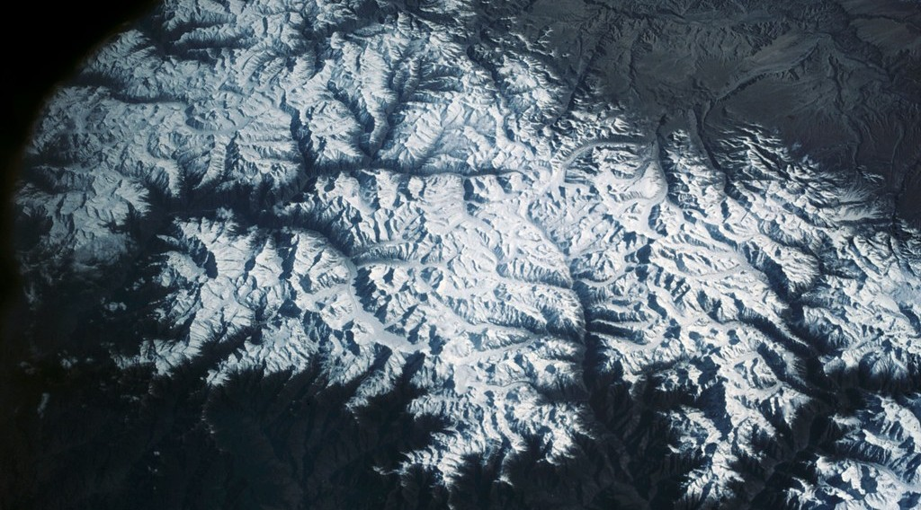
1. FOLD MOUNTAINS
Activity 3
The Himalayas.
Notes:
Activity 3. Look carefully at this picture: the Himalayas. Observe every detail before I ask the question.

Slide 26
1. FOLD MOUNTAINS
Activity 3: Question
Which two plates formed the Himalayas?
Notes:
Here is the question for Activity 3: Which two plates formed the Himalayas? Take one minute to think and write your answer in your rough notebook.

Slide 27
1. FOLD MOUNTAINS
Activity 3: Answer
The Indo-Australian (Indian) Plate and the Eurasian Plate.
Notes:
Let us check the answer together. The Indo-Australian (Indian) Plate and the Eurasian Plate.

Slide 28
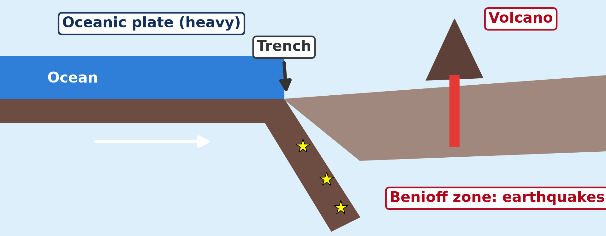
2. TRENCHES AND BENIOFF ZONES
Activity 4
An oceanic plate sinks under another plate.
Notes:
Activity 4. Look carefully at this diagram: an oceanic plate sinks under another plate. Observe every detail before I ask the question.

Slide 29
2. TRENCHES AND BENIOFF ZONES
Activity 4: Question
Where do deep earthquakes happen at a destructive margin?
Notes:
Here is the question for Activity 4: Where do deep earthquakes happen at a destructive margin? Take one minute to think and write your answer in your rough notebook.

Slide 30
2. TRENCHES AND BENIOFF ZONES
Activity 4: Answer
In the Benioff zone, along the sinking plate.
Notes:
Let us check the answer together. In the Benioff zone, along the sinking plate.

Slide 31
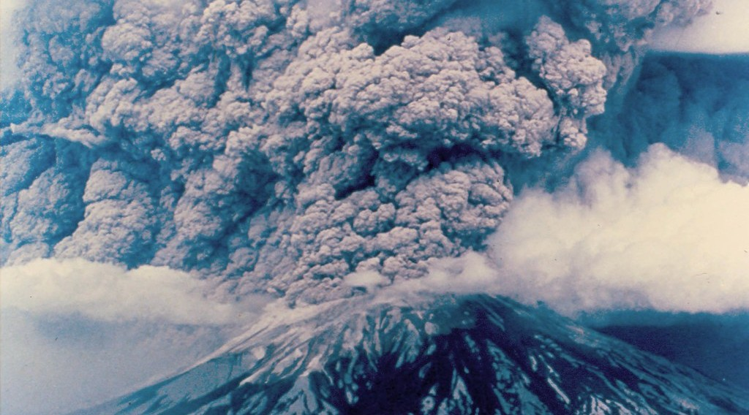
3. ISLAND ARCS AND EXPLOSIVE VOLCANOES
Activity 5
An explosive eruption.
Notes:
Activity 5. Look carefully at this picture: an explosive eruption. Observe every detail before I ask the question.

Slide 32
3. ISLAND ARCS AND EXPLOSIVE VOLCANOES
Activity 5: Question
Why are volcanoes at destructive margins explosive?
Notes:
Here is the question for Activity 5: Why are volcanoes at destructive margins explosive? Take one minute to think and write your answer in your rough notebook.

Slide 33
3. ISLAND ARCS AND EXPLOSIVE VOLCANOES
Activity 5: Answer
Their thick, acid magma traps gas, which explodes.
Notes:
Let us check the answer together. Their thick, acid magma traps gas, which explodes.

Slide 34
BOARD SUMMARY
Board Summary
Topic: The Development of the Earth's Structure
Sub-topic: Theories of Earth Structure and Resultant Landforms
Lesson 5: Landforms at Destructive and Conservative Margins
Notes:
Now we are going to copy the board summary. Write the title and the headings neatly in your notebooks. I will give you enough time for each slide, so do not rush.

Slide 35
BOARD SUMMARY
DEFINITIONS
The key terms of this lesson are defined as follows:
Convergent (destructive) margin: It is a boundary where two plates move towards each other.
Subduction: It is the sinking of one plate under another into the mantle.
Notes:
Let us copy the definitions. The key terms of this lesson are defined as follows. On this slide we have Convergent (destructive) margin and Subduction. Write each point on a new line, with the key term first, and explain it in your own words when we revise. When you finish, we go to the next slide.

Slide 36
BOARD SUMMARY
DEFINITIONS (continued)
Benioff zone: It is the sloping zone of earthquakes along a subducting plate.
Notes:
We continue with the definitions. On this slide we have Benioff zone. Write each point on a new line, with the key term first, and explain it in your own words when we revise.

Slide 37
BOARD SUMMARY
1. Fold Mountains and Folding
Compression at convergent margins causes folding:
Folding: Layers of sedimentary rock are squeezed into up-folds (anticlines) and down-folds (synclines). Strong pressure creates overfolds and nappes.
Notes:
Let us copy Fold Mountains and Folding. Compression at convergent margins causes folding. On this slide we have Folding. Write each point on a new line, with the key term first, and explain it in your own words when we revise. When you finish, we go to the next slide.

Slide 38
BOARD SUMMARY
1. Fold Mountains and Folding (continued)
Formation of fold mountains: Sediments in a sea between two plates are folded and raised when the plates collide. The Himalayas, Alps, Andes and Atlas are young fold mountains.
Notes:
We continue with Fold Mountains and Folding. On this slide we have Formation of fold mountains. Write each point on a new line, with the key term first, and explain it in your own words when we revise.

Slide 39
BOARD SUMMARY
1. Fold Mountains and Folding
Illustration: anticlines and synclines
Notes:
Now draw this illustration in your notebook: anticlines and synclines. Give it a title and label it clearly.

Slide 40
BOARD SUMMARY
2. Trenches, Island Arcs and Volcanoes
Subduction produces the following features:
Ocean trenches: Deep trenches form where the oceanic plate sinks, like the Mariana Trench (11,000 m). Earthquakes occur at increasing depth along the Benioff zone.
Notes:
Let us copy Trenches, Island Arcs and Volcanoes. Subduction produces the following features. On this slide we have Ocean trenches. Write each point on a new line, with the key term first, and explain it in your own words when we revise. When you finish, we go to the next slide.

Slide 41
BOARD SUMMARY
2. Trenches, Island Arcs and Volcanoes (continued)
Island arcs: When an oceanic plate sinks under another oceanic plate, a curved chain of volcanic islands forms. Japan and the Aleutians are examples.
Notes:
We continue with Trenches, Island Arcs and Volcanoes. On this slide we have Island arcs. Write each point on a new line, with the key term first, and explain it in your own words when we revise. When you finish, we go to the next slide.

Slide 42
BOARD SUMMARY
2. Trenches, Island Arcs and Volcanoes (continued)
Explosive volcanoes: Melting of the sinking plate forms thick, acid, gas-rich magma. It erupts violently, as at Mount St Helens and Mount Pinatubo.
Notes:
We continue with Trenches, Island Arcs and Volcanoes. On this slide we have Explosive volcanoes. Write each point on a new line, with the key term first, and explain it in your own words when we revise.

Slide 43
BOARD SUMMARY
2. Trenches, Island Arcs and Volcanoes
Illustration: subduction at a destructive margin
Notes:
Now draw this illustration in your notebook: subduction at a destructive margin. Give it a title and label it clearly.

Slide 44
BOARD SUMMARY
3. Earthquakes, Location and Conservative Margins
Other features of these margins are:
Earthquakes: Shallow, intermediate and deep earthquakes occur, often very strong. They are common around the Pacific Ring of Fire.
Notes:
Let us copy Earthquakes, Location and Conservative Margins. Other features of these margins are. On this slide we have Earthquakes. Write each point on a new line, with the key term first, and explain it in your own words when we revise. When you finish, we go to the next slide.

Slide 45
BOARD SUMMARY
3. Earthquakes, Location and Conservative Margins (continued)
Global location: Destructive margins surround the Pacific Ocean and run from the Alps to the Himalayas. These are the zones of greatest risk.
Notes:
We continue with Earthquakes, Location and Conservative Margins. On this slide we have Global location. Write each point on a new line, with the key term first, and explain it in your own words when we revise. When you finish, we go to the next slide.

Slide 46
BOARD SUMMARY
3. Earthquakes, Location and Conservative Margins (continued)
Conservative margins: Two plates by-pass each other along a tear (transform) fault. There are no volcanoes, but strong earthquakes, as in California.
Notes:
We continue with Earthquakes, Location and Conservative Margins. On this slide we have Conservative margins. Write each point on a new line, with the key term first, and explain it in your own words when we revise.

Slide 47
FORMATIVE EVALUATION
Evaluation 1
Explain how fold mountains are formed.
Notes:
Now let us check what you have understood. Question 1: Explain how fold mountains are formed. Answer in your exercise book.

Slide 48
FORMATIVE EVALUATION
Expected Answer
Two plates move together and compress sediments into folds.
Notes:
The expected answer is: two plates move together and compress sediments into folds. If you got it right, well done.

Slide 49
FORMATIVE EVALUATION
Evaluation 2
What is the Benioff zone?
Notes:
Now let us check what you have understood. Question 2: What is the Benioff zone? Answer in your exercise book.

Slide 50
FORMATIVE EVALUATION
Expected Answer
The zone of earthquakes along a sinking plate.
Notes:
The expected answer is: the zone of earthquakes along a sinking plate. If you got it right, well done.

Slide 51
REMEDIATION
Remediation
Fill in the blanks:
An up-fold is an ______.
A down-fold is a ______.
The sinking of one plate under another is ______.
Notes:
For those who need more practice, fill in the blanks in your exercise book. The answers are: number 1, anticline; number 2, syncline; number 3, subduction.

Slide 52
HOMEWORK
Homework
Collect information about Mount Cameroon: its height and the years of its recent eruptions.
Notes:
For your homework: Collect information about Mount Cameroon: its height and the years of its recent eruptions. We shall correct it at the beginning of our next lesson.

Slide 53
NEXT LESSON
Next Lesson
Our next lesson will be on:
Lesson 6: Volcanism
Notes:
Our next lesson will be on Lesson 6: Volcanism. Thank you for your attention, and see you next time.

Slide 54
BILINGUAL GAME
Bilingual Game (Jeu Bilingue)
English | Français
Fold mountain | La montagne plissée
Anticline | L'anticlinal
Syncline | Le synclinal
Subduction | La subduction
Island arc | L'arc insulaire
Compression | La compression
Notes:
Let us play the bilingual game. I say a word in English, and you give me the French word. Then we do the reverse.

Slide 55
LOGBOOK
Official Logbook (1/2)
Module / Topic | The Development of the Earth's Structure
Lesson Title | Lesson 5: Landforms at Destructive and Conservative Margins
Expected Learning Outcomes | Explain folding and the formation of fold mountains. Explain subduction, trenches and island arcs. Describe processes at conservative margins.
Competence | Learners are able to explain the formation of fold mountains, trenches and island arcs.
Notes:
I record this information in the official logbook of the class after the lesson.

Slide 56
LOGBOOK
Official Logbook (2/2)
Matter Taught | DEFINITIONS; Fold Mountains and Folding; Trenches, Island Arcs and Volcanoes; Earthquakes, Location and Conservative Margins.
Evaluation | Formative evaluation and remediation exercise.
Homework | Collect information about Mount Cameroon: its height and the years of its recent eruptions.
Enrolment / Present / Absent | ____ / ____ / ____
Achievement | To be completed after the lesson.
Notes:
I complete the second page of the logbook: the matter taught, the evaluation, the homework and the attendance.

Slide 57
TEACHER'S NOTE
Teacher's Note
Timing: Homework correction, plan, objectives 8 min | Recall, situation, action 10 min | 5 activities 30 min | Board summary (copying) 30 min | Evaluation, remediation 10 min | Homework, next lesson 5 min | Logbook 7 min
Activity 1 is an animation (GIF): it plays automatically in slide-show mode.
Without the projector (Activity 1): push a sheet of paper or a cloth from both sides.
Without the projector (Activity 2): draw an anticline and a syncline.
Without the projector (Activity 3): find the Himalayas and the Atlas on the map.
Without the projector (Activity 4): draw one plate going under another.
Without the projector (Activity 5): compare with shaking a closed bottle of soda.
Notes:
This slide is for me, the teacher: it gives the timing of the lesson and what to do if the projector is not available.

Slide 58
REFERENCES
References
National Geography Syllabus, MINESEC/IGE/IP-SS, 2019 — Module 2 (Geomorphology).
Photo, Activity 3: “View of the Himalaya Mountain Range” by NASA Johnson, CC BY-NC 2.0, via nasa (https://www.flickr.com/photos/29988733@N04/10678470543)
Photo, Activity 5: “Mount St. Helens: Eruption, May 18, 1980, from East. Photo: DNR” by Washington State Department of Natural Resources, CC BY-NC-ND 2.0, via Flickr (https://www.flickr.com/photos/35433815@N08/4607166057)
Diagrams and animations: drawn for this lesson (Geography Department).
Notes:
These are the references and picture credits used to prepare this lesson.

