Slide 1
LOWER SIXTH ARTS
GEOGRAPHY
Lesson 7: Volcanoes and Man
Volcanoes and Man
Notes:
Good morning, class, and welcome to our geography lesson. I am your geography teacher, Mr Kamdem. Today we are starting Lesson 7: Volcanoes and Man.

Slide 2
CLASS INFO
Class, Chapter and Duration
Class | Lower Sixth Arts
Chapter | Module 2: Understanding and managing physical landscapes, geomorphological processes and hazards across the world in general and Cameroon in particular
Duration | 2 periods (2 × 50 minutes)
Notes:
This lesson is for Lower Sixth Arts. It belongs to Module 2: Understanding and managing physical landscapes, geomorphological processes and hazards across the world in general and Cameroon in particular. We shall need 2 periods to cover it.

Slide 3
IDENTIFICATION
Lesson Identification
Topic | Crustal Processes and their Effect on the Land Surface and Man
Sub-topic | Volcanicity
Lesson | Lesson 7: Volcanoes and Man
Notions / Concepts | Resource, hazard, mitigation, adaptation.
Syllabus focus | Volcanoes as a resource; volcanoes as a hazard; adaptation and mitigation.
Competence | Learners are able to weigh the benefits and dangers of volcanoes and propose safety measures.
Notes:
Our topic is Crustal Processes and their Effect on the Land Surface and Man, and the sub-topic is Volcanicity. The key notions we shall use today are: resource, hazard, mitigation, adaptation. At the end, you should be able to do this: learners are able to weigh the benefits and dangers of volcanoes and propose safety measures.

Slide 4

HOMEWORK CORRECTION
Correction of the Homework
Question (Lesson 6: Volcanism):
Ask an adult what people grow around Buea and Limbe, and why the soils are good.
Notes:
Before we start the new lesson, let us correct the homework I gave you at the end of Lesson 6: Volcanism. The question was: Ask an adult what people grow around Buea and Limbe, and why the soils are good. Take out your exercise books.

Slide 5
HOMEWORK CORRECTION
Correction: Possible Answer
Around Buea and Limbe people grow bananas, tea, oil palm, cocoa and food crops. The soils are fertile because they come from weathered volcanic rocks rich in minerals.
Notes:
Here is a good answer. Around Buea and Limbe people grow bananas, tea, oil palm, cocoa and food crops. The soils are fertile because they come from weathered volcanic rocks rich in minerals. Compare it with your own answer and correct your work in red.

Slide 6
LESSON PLAN
Lesson Plan
Correction of the homework
Objectives and recall
Real-life situation and action to take
Learning activities
Board summary
Evaluation, remediation and homework
Notes:
Here is the plan of our lesson today. First, we shall correct the homework. Then we shall look at the objectives and recall what you already know. After that, we shall study a situation from real life and the action to take, and do the learning activities. Finally, we shall copy the board summary, do the evaluation and the remediation, and I will give you the homework.

Slide 7
OBJECTIVES
Objectives
By the end of this lesson, you should be able to:
Explain the importance of volcanoes as a resource.
Describe volcanic hazards.
Notes:
Take your time to copy this part; we will continue together.

Slide 8
OBJECTIVES
Objectives (continued)
Propose adaptation and mitigation strategies.
Notes:
By the end of this lesson, you should be able to do three things. Number 1: explain the importance of volcanoes as a resource. Number 2: describe volcanic hazards. Number 3: propose adaptation and mitigation strategies.

Slide 9
PREVIOUS KNOWLEDGE
Previous Knowledge
Volcanoes give lava, ash and gases.
Mount Cameroon is active.
Notes:
Let us first remember what you already know. Volcanoes give lava, ash and gases. Mount Cameroon is active. Keep this in mind, because we shall build on it today.

Slide 10
REAL-LIFE SITUATION
Situation in Real Life
A family wants to buy a farm near Buea because the soil is very fertile. A neighbour warns them that lava from Mount Cameroon destroyed farms in 1999 and 2000.
Notes:
Listen carefully to this situation from real life. A family wants to buy a farm near Buea because the soil is very fertile. A neighbour warns them that lava from Mount Cameroon destroyed farms in 1999 and 2000. Think about it, because I am going to ask you some questions.

Slide 11
REAL-LIFE SITUATION
Situation: Question 1
What is the problem in the situation?
Notes:
Question 1: What is the problem in the situation? Think for a moment, then raise your hand to answer.

Slide 12
REAL-LIFE SITUATION
Answer
The land is fertile but dangerous.
Notes:
Good. The land is fertile but dangerous.

Slide 13
REAL-LIFE SITUATION
Situation: Question 2
What is the advantage?
Notes:
Question 2: What is the advantage? Think for a moment, then raise your hand to answer.

Slide 14
REAL-LIFE SITUATION
Answer
Very fertile volcanic soil.
Notes:
Good. Very fertile volcanic soil.

Slide 15
REAL-LIFE SITUATION
Situation: Question 3
What should the family do?
Notes:
Question 3: What should the family do? Think for a moment, then raise your hand to answer.

Slide 16
REAL-LIFE SITUATION
Possible Answer
Follow warnings and have a plan to leave if there is an eruption.
Notes:
Good. Follow warnings and have a plan to leave if there is an eruption.

Slide 17
ACTION TO TAKE
Action to Take
Live safely near volcanoes by using their resources and preparing for eruptions.
Notes:
From this situation, the action we are working towards in this lesson is the following: live safely near volcanoes by using their resources and preparing for eruptions.

Slide 18
JUSTIFICATION
Justification of the Lesson
This lesson helps us to live safely near volcanoes and to use their resources.
Notes:
Why is this lesson important for you? This lesson helps us to live safely near volcanoes and to use their resources.

Slide 19
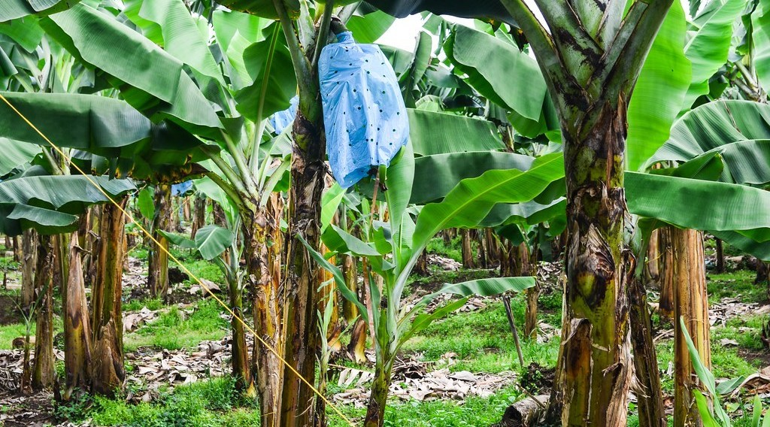
1. VOLCANOES AS A RESOURCE
Activity 1
A banana plantation.
Notes:
Activity 1. Look carefully at this picture: a banana plantation. Observe every detail before I ask the question.

Slide 20
1. VOLCANOES AS A RESOURCE
Activity 1: Question
Near Mount Cameroon, farmers grow bananas and tea. Why are the soils so fertile?
Notes:
Here is the question for Activity 1: Near Mount Cameroon, farmers grow bananas and tea. Why are the soils so fertile? Take one minute to think and write your answer in your rough notebook.

Slide 21
1. VOLCANOES AS A RESOURCE
Activity 1: Answer
Volcanic ash and lava weather into soils rich in minerals.
Notes:
Let us check the answer together. Volcanic ash and lava weather into soils rich in minerals.

Slide 22

1. VOLCANOES AS A RESOURCE
Activity 2
A geothermal power station in Kenya.
Notes:
Activity 2. Look carefully at this picture: a geothermal power station in Kenya. Observe every detail before I ask the question.

Slide 23
1. VOLCANOES AS A RESOURCE
Activity 2: Question
How can volcanic areas produce electricity?
Notes:
Here is the question for Activity 2: How can volcanic areas produce electricity? Take one minute to think and write your answer in your rough notebook.

Slide 24
1. VOLCANOES AS A RESOURCE
Activity 2: Answer
Steam from hot rocks turns turbines (geothermal energy).
Notes:
Let us check the answer together. Steam from hot rocks turns turbines (geothermal energy).

Slide 25

2. VOLCANOES AS A HAZARD
Activity 3
Lava has covered a road.
Notes:
Activity 3. Look carefully at this picture: lava has covered a road. Observe every detail before I ask the question.

Slide 26
2. VOLCANOES AS A HAZARD
Activity 3: Question
What damage can lava flows cause?
Notes:
Here is the question for Activity 3: What damage can lava flows cause? Take one minute to think and write your answer in your rough notebook.

Slide 27
2. VOLCANOES AS A HAZARD
Activity 3: Answer
They burn and bury farms, roads and houses.
Notes:
Let us check the answer together. They burn and bury farms, roads and houses.

Slide 28

2. VOLCANOES AS A HAZARD
Activity 4
Lake Nyos, North-West Region.
Notes:
Activity 4. Look carefully at this picture: lake Nyos, North-West Region. Observe every detail before I ask the question.

Slide 29
2. VOLCANOES AS A HAZARD
Activity 4: Question
What happened at Lake Nyos in 1986?
Notes:
Here is the question for Activity 4: What happened at Lake Nyos in 1986? Take one minute to think and write your answer in your rough notebook.

Slide 30
2. VOLCANOES AS A HAZARD
Activity 4: Answer
A cloud of carbon dioxide killed about 1,700 people and many animals.
Notes:
Let us check the answer together. A cloud of carbon dioxide killed about 1,700 people and many animals.

Slide 31
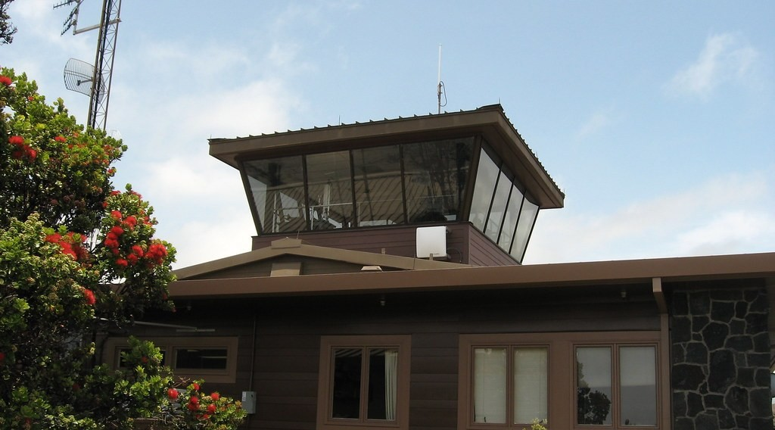
3. ADAPTATION AND MITIGATION
Activity 5
The Hawaiian Volcano Observatory, where scientists watch Kilauea.
Notes:
Activity 5. Look carefully at this picture: the Hawaiian Volcano Observatory, where scientists watch Kilauea. Observe every detail before I ask the question.

Slide 32
3. ADAPTATION AND MITIGATION
Activity 5: Question
How can scientists reduce the danger of eruptions?
Notes:
Here is the question for Activity 5: How can scientists reduce the danger of eruptions? Take one minute to think and write your answer in your rough notebook.

Slide 33
3. ADAPTATION AND MITIGATION
Activity 5: Answer
They monitor earthquakes, gases and ground swelling and give warnings.
Notes:
Let us check the answer together. They monitor earthquakes, gases and ground swelling and give warnings.

Slide 34
BOARD SUMMARY
Board Summary
Topic: Crustal Processes and their Effect on the Land Surface and Man
Sub-topic: Volcanicity
Lesson 7: Volcanoes and Man
Notes:
Now we are going to copy the board summary. Write the title and the headings neatly in your notebooks. I will give you enough time for each slide, so do not rush.

Slide 35
BOARD SUMMARY
DEFINITIONS
The key terms of this lesson are defined as follows:
Volcanic hazard: It is a volcanic event that can cause loss of life and property.
Mitigation: It is the reduction of the effects of a hazard.
Notes:
Let us copy the definitions. The key terms of this lesson are defined as follows. On this slide we have Volcanic hazard and Mitigation. Write each point on a new line, with the key term first, and explain it in your own words when we revise.

Slide 36
BOARD SUMMARY
1. Volcanoes as a Resource
Volcanoes are important in the following ways:
Fertile soils: Weathered volcanic rocks give rich soils for farming. Plantations of bananas, tea and rubber cover the slopes of Mount Cameroon.
Notes:
Let us copy Volcanoes as a Resource. Volcanoes are important in the following ways. On this slide we have Fertile soils. Write each point on a new line, with the key term first, and explain it in your own words when we revise. When you finish, we go to the next slide.

Slide 37
BOARD SUMMARY
1. Volcanoes as a Resource (continued)
Minerals and building materials: Volcanoes provide sulphur, pumice, basalt and gravel. Basalt is used for roads and buildings.
Notes:
We continue with Volcanoes as a Resource. On this slide we have Minerals and building materials. Write each point on a new line, with the key term first, and explain it in your own words when we revise. When you finish, we go to the next slide.

Slide 38
BOARD SUMMARY
1. Volcanoes as a Resource (continued)
Geothermal energy and tourism: Hot underground water produces electricity in Iceland and Kenya. Volcanoes and crater lakes attract tourists, like the Mount Cameroon Race of Hope.
Notes:
We continue with Volcanoes as a Resource. On this slide we have Geothermal energy and tourism. Write each point on a new line, with the key term first, and explain it in your own words when we revise.

Slide 39
BOARD SUMMARY
2. Volcanoes as a Hazard
Volcanoes can cause the following hazards:
Lava flows and pyroclastic flows: Lava destroys houses, roads and farms, as in 1999 near Bakingili. Pyroclastic flows of hot gas and ash move fast and kill everything.
Notes:
Let us copy Volcanoes as a Hazard. Volcanoes can cause the following hazards. On this slide we have Lava flows and pyroclastic flows. Write each point on a new line, with the key term first, and explain it in your own words when we revise. When you finish, we go to the next slide.

Slide 40
BOARD SUMMARY
2. Volcanoes as a Hazard (continued)
Ash falls and lahars: Ash destroys crops and roofs and harms breathing. Lahars are mudflows of ash and water that bury villages.
Notes:
We continue with Volcanoes as a Hazard. On this slide we have Ash falls and lahars. Write each point on a new line, with the key term first, and explain it in your own words when we revise. When you finish, we go to the next slide.

Slide 41
BOARD SUMMARY
2. Volcanoes as a Hazard (continued)
Toxic gases: Carbon dioxide released from Lake Nyos in 1986 killed about 1,700 people and many animals. Lake Monoun killed 37 people in 1984.
Notes:
We continue with Volcanoes as a Hazard. On this slide we have Toxic gases. Write each point on a new line, with the key term first, and explain it in your own words when we revise.

Slide 42
BOARD SUMMARY
3. Adaptation and Mitigation Strategies
People reduce volcanic risks through:
Monitoring and warning: Seismographs, tiltmeters and gas sensors detect signs of eruptions. Early warnings allow people to evacuate.
Notes:
Let us copy Adaptation and Mitigation Strategies. People reduce volcanic risks through. On this slide we have Monitoring and warning. Write each point on a new line, with the key term first, and explain it in your own words when we revise. When you finish, we go to the next slide.

Slide 43
BOARD SUMMARY
3. Adaptation and Mitigation Strategies (continued)
Land-use planning and preparedness: Hazard maps show where not to build, and evacuation plans are prepared. Degassing pipes now remove carbon dioxide from Lake Nyos.
Protection works: Barriers and channels can divert lava flows. Strong roofs resist ash falls.
Notes:
We continue with Adaptation and Mitigation Strategies. On this slide we have Land-use planning and preparedness and Protection works. Write each point on a new line, with the key term first, and explain it in your own words when we revise.

Slide 44
FORMATIVE EVALUATION
Evaluation 1
Give two benefits of volcanoes.
Notes:
Now let us check what you have understood. Question 1: Give two benefits of volcanoes. Answer in your exercise book.

Slide 45
FORMATIVE EVALUATION
Expected Answer
Fertile soils and geothermal energy.
Notes:
The expected answer is: fertile soils and geothermal energy. If you got it right, well done.

Slide 46
FORMATIVE EVALUATION
Evaluation 2
Give two measures to reduce volcanic hazards.
Notes:
Now let us check what you have understood. Question 2: Give two measures to reduce volcanic hazards. Answer in your exercise book.

Slide 47
FORMATIVE EVALUATION
Expected Answer
Monitoring and warnings; degassing Lake Nyos.
Notes:
The expected answer is: monitoring and warnings; degassing Lake Nyos. If you got it right, well done.

Slide 48
REMEDIATION
Remediation
Fill in the blanks:
Energy from the heat of the Earth is ______ energy.
The gas disaster of 1986 was at Lake ______.
Notes:
Take your time to copy this part; we will continue together.

Slide 49
REMEDIATION
Remediation (continued)
Reducing the effects of a hazard is ______.
Notes:
For those who need more practice, fill in the blanks in your exercise book. The answers are: number 1, geothermal; number 2, Nyos; number 3, mitigation.

Slide 50
HOMEWORK
Homework
Find out if an earthquake has ever been felt in your region. Ask an elder.
Notes:
For your homework: Find out if an earthquake has ever been felt in your region. Ask an elder. We shall correct it at the beginning of our next lesson.

Slide 51
NEXT LESSON
Next Lesson
Our next lesson will be on:
Lesson 8: Earthquakes and Man
Notes:
Our next lesson will be on Lesson 8: Earthquakes and Man. Thank you for your attention, and see you next time.

Slide 52
BILINGUAL GAME
Bilingual Game (Jeu Bilingue)
English | Français
Hazard | L'aléa / le risque
Resource | La ressource
Mitigation | L'atténuation
Evacuation | L'évacuation
Monitoring | La surveillance
Fertile soil | Le sol fertile
Notes:
Let us play the bilingual game. I say a word in English, and you give me the French word. Then we do the reverse.

Slide 53
LOGBOOK
Official Logbook (1/2)
Module / Topic | Crustal Processes and their Effect on the Land Surface and Man
Lesson Title | Lesson 7: Volcanoes and Man
Expected Learning Outcomes | Explain the importance of volcanoes as a resource. Describe volcanic hazards. Propose adaptation and mitigation strategies.
Competence | Learners are able to weigh the benefits and dangers of volcanoes and propose safety measures.
Notes:
I record this information in the official logbook of the class after the lesson.

Slide 54
LOGBOOK
Official Logbook (2/2)
Matter Taught | DEFINITIONS; Volcanoes as a Resource; Volcanoes as a Hazard; Adaptation and Mitigation Strategies.
Evaluation | Formative evaluation and remediation exercise.
Homework | Find out if an earthquake has ever been felt in your region. Ask an elder.
Enrolment / Present / Absent | ____ / ____ / ____
Achievement | To be completed after the lesson.
Notes:
I complete the second page of the logbook: the matter taught, the evaluation, the homework and the attendance.

Slide 55
TEACHER'S NOTE
Teacher's Note
Timing: Homework correction, plan, objectives 8 min | Recall, situation, action 10 min | 5 activities 30 min | Board summary (copying) 30 min | Evaluation, remediation 10 min | Homework, next lesson 5 min | Logbook 7 min
Without the projector (Activity 1): mention the CDC plantations.
Without the projector (Activity 2): compare with steam from a boiling pot.
Without the projector (Activity 3): describe the 1999 lava flow near Bakingili.
Without the projector (Activity 4): tell the story of Lake Nyos.
Without the projector (Activity 5): list warning signs of an eruption.
Notes:
This slide is for me, the teacher: it gives the timing of the lesson and what to do if the projector is not available.

Slide 56
REFERENCES
References
National Geography Syllabus, MINESEC/IGE/IP-SS, 2019 — Module 2 (Geomorphology).
Photo, Activity 1: “20131110-DSC_4372” by jbdodane, CC BY-NC 2.0, via Flickr (https://www.flickr.com/photos/27998473@N02/11288779044)
Photo, Activity 2: “Global Geothermal Alliance Stakeholder Meeting and Site Tour, 15-16 Ju” by International Renewable Energy Agency (IRENA), CC BY-NC-SA 2.0, via Flickr (https://www.flickr.com/photos/127932406@N06/18856399410)
Photo, Activity 3: “Lava flow over road” by J. N. Stuart, CC BY-NC-ND 2.0, via Flickr (https://www.flickr.com/photos/21786539@N03/3387263273)
Photo, Activity 4: “Lake Nyos, Cameroon” by jbdodane, CC BY-NC 2.0, via Flickr (https://www.flickr.com/photos/27998473@N02/11584073056)
Photo, Activity 5: “Hawaiian Volcano Observatory, Hawaiʻi Volcanoes National Park, Hawaii” by Ken Lund, CC BY-SA 2.0, via Flickr (https://www.flickr.com/photos/75683070@N00/4528702285)
Diagrams and animations: drawn for this lesson (Geography Department).
Notes:
These are the references and picture credits used to prepare this lesson.

