Slide 1
LOWER SIXTH ARTS
GEOGRAPHY
Lesson 12: Mass Wasting (Movement)
Mass Wasting (Movement)
Notes:
Good morning, class, and welcome to our geography lesson. I am your geography teacher, Mr Kamdem. Today we are starting Lesson 12: Mass Wasting (Movement).

Slide 2
CLASS INFO
Class, Chapter and Duration
Class | Lower Sixth Arts
Chapter | Module 2: Understanding and managing physical landscapes, geomorphological processes and hazards across the world in general and Cameroon in particular
Duration | 2 periods (2 × 50 minutes)
Notes:
This lesson is for Lower Sixth Arts. It belongs to Module 2: Understanding and managing physical landscapes, geomorphological processes and hazards across the world in general and Cameroon in particular. We shall need 2 periods to cover it.

Slide 3
IDENTIFICATION
Lesson Identification
Topic | Denudational Processes on Slopes
Sub-topic | Mass Movements
Lesson | Lesson 12: Mass Wasting (Movement)
Notions / Concepts | Mass wasting, gravity, shear strength, Carson and Kirkby.
Syllabus focus | Meaning and evidence; factors; classification with the Carson and Kirkby triangle.
Competence | Learners are able to recognise mass movements and explain their causes.
Notes:
Our topic is Denudational Processes on Slopes, and the sub-topic is Mass Movements. The key notions we shall use today are: mass wasting, gravity, shear strength, Carson and Kirkby. At the end, you should be able to do this: learners are able to recognise mass movements and explain their causes.

Slide 4

HOMEWORK CORRECTION
Correction of the Homework
Question (Lesson 11: The Impact of Weathering):
Look for signs of soil moving down a slope near your home (leaning posts, cracks). Write what you see.
Notes:
Before we start the new lesson, let us correct the homework I gave you at the end of Lesson 11: The Impact of Weathering. The question was: Look for signs of soil moving down a slope near your home (leaning posts, cracks). Write what you see. Take out your exercise books.

Slide 5
HOMEWORK CORRECTION
Correction: Possible Answer
Signs of soil creep: leaning posts and trees, cracked walls, small soil steps (terracettes) and soil piled behind walls on the slope.
Notes:
Here is a good answer. Signs of soil creep: leaning posts and trees, cracked walls, small soil steps (terracettes) and soil piled behind walls on the slope. Compare it with your own answer and correct your work in red.

Slide 6
LESSON PLAN
Lesson Plan
Correction of the homework
Objectives and recall
Real-life situation and action to take
Learning activities
Board summary
Evaluation, remediation and homework
Notes:
Here is the plan of our lesson today. First, we shall correct the homework. Then we shall look at the objectives and recall what you already know. After that, we shall study a situation from real life and the action to take, and do the learning activities. Finally, we shall copy the board summary, do the evaluation and the remediation, and I will give you the homework.

Slide 7
OBJECTIVES
Objectives
By the end of this lesson, you should be able to:
Define mass wasting and give its evidence.
Explain the factors of mass wasting.
Classify mass movements with the Carson and Kirkby triangle.
Notes:
By the end of this lesson, you should be able to do three things. Number 1: define mass wasting and give its evidence. Number 2: explain the factors of mass wasting. Number 3: classify mass movements with the Carson and Kirkby triangle.

Slide 8
PREVIOUS KNOWLEDGE
Previous Knowledge
Weathering produces loose material.
Weathered slopes can slide.
Notes:
Let us first remember what you already know. Weathering produces loose material. Weathered slopes can slide. Keep this in mind, because we shall build on it today.

Slide 9
REAL-LIFE SITUATION
Situation in Real Life
After days of heavy rain in the West Region, a hillside slides down onto houses. Some weeks earlier, people had noticed cracks in the ground and leaning trees.
Notes:
Listen carefully to this situation from real life. After days of heavy rain in the West Region, a hillside slides down onto houses. Some weeks earlier, people had noticed cracks in the ground and leaning trees. Think about it, because I am going to ask you some questions.

Slide 10
REAL-LIFE SITUATION
Situation: Question 1
What is the problem in the situation?
Notes:
Question 1: What is the problem in the situation? Think for a moment, then raise your hand to answer.

Slide 11
REAL-LIFE SITUATION
Answer
A hillside slid onto houses.
Notes:
Good. A hillside slid onto houses.

Slide 12
REAL-LIFE SITUATION
Situation: Question 2
What were the warning signs?
Notes:
Question 2: What were the warning signs? Think for a moment, then raise your hand to answer.

Slide 13
REAL-LIFE SITUATION
Answer
Cracks in the ground and leaning trees.
Notes:
Good. Cracks in the ground and leaning trees.

Slide 14
REAL-LIFE SITUATION
Situation: Question 3
What force moves the material down?
Notes:
Question 3: What force moves the material down? Think for a moment, then raise your hand to answer.

Slide 15
REAL-LIFE SITUATION
Possible Answer
Gravity.
Notes:
Good. Gravity.

Slide 16
ACTION TO TAKE
Action to Take
Prevent mass movements by protecting slopes and avoiding risky building.
Notes:
From this situation, the action we are working towards in this lesson is the following: prevent mass movements by protecting slopes and avoiding risky building.

Slide 17
JUSTIFICATION
Justification of the Lesson
This lesson helps us to recognise and prevent dangerous movements of soil and rock.
Notes:
Why is this lesson important for you? This lesson helps us to recognise and prevent dangerous movements of soil and rock.

Slide 18
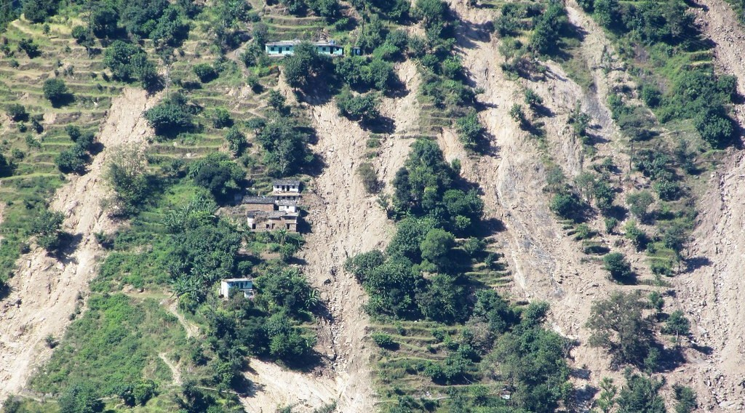
1. MEANING
Activity 1
The scar of a landslide on a hillside.
Notes:
Activity 1. Look carefully at this picture: the scar of a landslide on a hillside. Observe every detail before I ask the question.

Slide 19
1. MEANING
Activity 1: Question
What moves soil and rock down a slope without a river or the wind?
Notes:
Here is the question for Activity 1: What moves soil and rock down a slope without a river or the wind? Take one minute to think and write your answer in your rough notebook.

Slide 20
1. MEANING
Activity 1: Answer
Gravity. This is mass wasting.
Notes:
Let us check the answer together. Gravity. This is mass wasting.

Slide 21
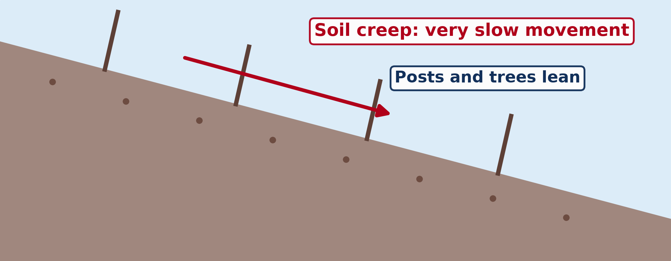
1. EVIDENCE
Activity 2
Animation: soil creep.
Notes:
Activity 2. Look carefully at this animation: animation: soil creep. Watch the animation to the end; it will play again.

Slide 22
1. EVIDENCE
Activity 2: Question
What evidence shows that soil is moving slowly?
Notes:
Here is the question for Activity 2: What evidence shows that soil is moving slowly? Take one minute to think and write your answer in your rough notebook.

Slide 23
1. EVIDENCE
Activity 2: Answer
Leaning posts, walls and trees; cracks in roads.
Notes:
Let us check the answer together. Leaning posts, walls and trees; cracks in roads.

Slide 24

2. FACTORS
Activity 3
A road cut by a landslide.
Notes:
Activity 3. Look carefully at this picture: a road cut by a landslide. Observe every detail before I ask the question.

Slide 25
2. FACTORS
Activity 3: Question
Why do most landslides happen after heavy rain?
Notes:
Here is the question for Activity 3: Why do most landslides happen after heavy rain? Take one minute to think and write your answer in your rough notebook.

Slide 26
2. FACTORS
Activity 3: Answer
Water makes the soil heavy and weak.
Notes:
Let us check the answer together. Water makes the soil heavy and weak.

Slide 27

2. FACTORS
Activity 4
Terraces on a hillside.
Notes:
Activity 4. Look carefully at this picture: terraces on a hillside. Observe every detail before I ask the question.

Slide 28
2. FACTORS
Activity 4: Question
How do people affect slope stability?
Notes:
Here is the question for Activity 4: How do people affect slope stability? Take one minute to think and write your answer in your rough notebook.

Slide 29
2. FACTORS
Activity 4: Answer
Cutting forests and roads weakens slopes; terraces and trees protect them.
Notes:
Let us check the answer together. Cutting forests and roads weakens slopes; terraces and trees protect them.

Slide 30
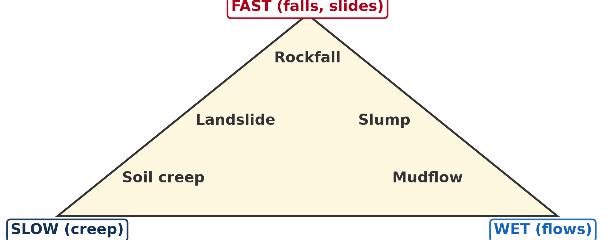
3. CLASSIFICATION
Activity 5
The Carson and Kirkby triangle.
Notes:
Activity 5. Look carefully at this diagram: the Carson and Kirkby triangle. Observe every detail before I ask the question.

Slide 31
3. CLASSIFICATION
Activity 5: Question
Which movement is fast and dry? Which is slow?
Notes:
Here is the question for Activity 5: Which movement is fast and dry? Which is slow? Take one minute to think and write your answer in your rough notebook.

Slide 32
3. CLASSIFICATION
Activity 5: Answer
Rockfall is fast and dry; soil creep is slow.
Notes:
Let us check the answer together. Rockfall is fast and dry; soil creep is slow.

Slide 33
BOARD SUMMARY
Board Summary
Topic: Denudational Processes on Slopes
Sub-topic: Mass Movements
Lesson 12: Mass Wasting (Movement)
Notes:
Now we are going to copy the board summary. Write the title and the headings neatly in your notebooks. I will give you enough time for each slide, so do not rush.

Slide 34
BOARD SUMMARY
1. Meaning and Evidence of Mass Wasting
Mass wasting can be understood as follows:
Mass wasting (movement): It is the downslope movement of soil and rock under the influence of gravity, without an agent such as a river.
Notes:
Let us copy Meaning and Evidence of Mass Wasting. Mass wasting can be understood as follows. On this slide we have Mass wasting (movement). Write each point on a new line, with the key term first, and explain it in your own words when we revise. When you finish, we go to the next slide.

Slide 35
BOARD SUMMARY
1. Meaning and Evidence of Mass Wasting (continued)
Evidence: Leaning trees, posts and walls, cracks in roads and soil steps show slow movement. Scars on hillsides and piles of debris show fast movement.
Notes:
We continue with Meaning and Evidence of Mass Wasting. On this slide we have Evidence. Write each point on a new line, with the key term first, and explain it in your own words when we revise.

Slide 36
BOARD SUMMARY
1. Meaning and Evidence of Mass Wasting
Illustration: evidence of soil creep
Notes:
Now draw this illustration in your notebook: evidence of soil creep. Give it a title and label it clearly.

Slide 37
BOARD SUMMARY
2. Factors of Mass Wasting
Mass wasting depends on the following factors:
Slope angle: Steep slopes increase the pull of gravity on material. Most landslides occur on slopes steeper than 30°.
Notes:
Let us copy Factors of Mass Wasting. Mass wasting depends on the following factors. On this slide we have Slope angle. Write each point on a new line, with the key term first, and explain it in your own words when we revise. When you finish, we go to the next slide.

Slide 38
BOARD SUMMARY
2. Factors of Mass Wasting (continued)
Water: Heavy rain adds weight and reduces friction between particles. This is why landslides happen in the rainy season, as at Bafoussam in 2019.
Notes:
We continue with Factors of Mass Wasting. On this slide we have Water. Write each point on a new line, with the key term first, and explain it in your own words when we revise. When you finish, we go to the next slide.

Slide 39
BOARD SUMMARY
2. Factors of Mass Wasting (continued)
Rock, soil and vegetation: Weak, deeply weathered or clay-rich materials move easily. Vegetation roots hold the soil, while deforestation weakens slopes.
Notes:
We continue with Factors of Mass Wasting. On this slide we have Rock, soil and vegetation. Write each point on a new line, with the key term first, and explain it in your own words when we revise. When you finish, we go to the next slide.

Slide 40
BOARD SUMMARY
2. Factors of Mass Wasting (continued)
Human activities and earthquakes: Road cuts, quarrying, farming on slopes and building increase the risk. Earthquakes can trigger sudden slides.
Notes:
We continue with Factors of Mass Wasting. On this slide we have Human activities and earthquakes. Write each point on a new line, with the key term first, and explain it in your own words when we revise.

Slide 41
BOARD SUMMARY
3. Classification
Carson and Kirkby classify mass movements on a triangular graph:
Basis: Movements are classed by speed (slow or fast) and by water content (dry or wet). The three corners are slides, flows and heaves.
Notes:
Let us copy Classification. Carson and Kirkby classify mass movements on a triangular graph. On this slide we have Basis. Write each point on a new line, with the key term first, and explain it in your own words when we revise. When you finish, we go to the next slide.

Slide 42
BOARD SUMMARY
3. Classification (continued)
Types: Slow movements are creep and solifluction; fast movements are falls, slides, slumps and flows. Wet, fast movements are mudflows.
Notes:
We continue with Classification. On this slide we have Types. Write each point on a new line, with the key term first, and explain it in your own words when we revise.

Slide 43
BOARD SUMMARY
3. Classification
Illustration: Carson and Kirkby's classification
Notes:
Now draw this illustration in your notebook: carson and Kirkby's classification. Give it a title and label it clearly.

Slide 44
FORMATIVE EVALUATION
Evaluation 1
Define mass wasting.
Notes:
Now let us check what you have understood. Question 1: Define mass wasting. Answer in your exercise book.

Slide 45
FORMATIVE EVALUATION
Expected Answer
The downslope movement of soil and rock under gravity.
Notes:
The expected answer is: the downslope movement of soil and rock under gravity. If you got it right, well done.

Slide 46
FORMATIVE EVALUATION
Evaluation 2
Give two factors of mass wasting.
Notes:
Now let us check what you have understood. Question 2: Give two factors of mass wasting. Answer in your exercise book.

Slide 47
FORMATIVE EVALUATION
Expected Answer
Heavy rain and steep slopes (also deforestation).
Notes:
The expected answer is: heavy rain and steep slopes (also deforestation). If you got it right, well done.

Slide 48
REMEDIATION
Remediation
Fill in the blanks:
The force that causes mass wasting is ______.
Leaning posts show slow soil ______.
A very fast, dry fall of rocks is a ______.
Notes:
For those who need more practice, fill in the blanks in your exercise book. The answers are: number 1, gravity; number 2, creep; number 3, rockfall.

Slide 49
HOMEWORK
Homework
Collect a news report about a landslide in Cameroon (Bafoussam 2019 or Dschang). Note the date and the effects.
Notes:
For your homework: Collect a news report about a landslide in Cameroon (Bafoussam 2019 or Dschang). Note the date and the effects. We shall correct it at the beginning of our next lesson.

Slide 50
NEXT LESSON
Next Lesson
Our next lesson will be on:
Lesson 13: Processes and Features of Mass Wasting
Notes:
Our next lesson will be on Lesson 13: Processes and Features of Mass Wasting. Thank you for your attention, and see you next time.

Slide 51
BILINGUAL GAME
Bilingual Game (Jeu Bilingue)
English | Français
Mass wasting | Les mouvements de masse
Gravity | La gravité
Landslide | Le glissement de terrain
Soil creep | La reptation du sol
Rockfall | L'éboulement
Slope | Le versant
Notes:
Let us play the bilingual game. I say a word in English, and you give me the French word. Then we do the reverse.

Slide 52
LOGBOOK
Official Logbook (1/2)
Module / Topic | Denudational Processes on Slopes
Lesson Title | Lesson 12: Mass Wasting (Movement)
Expected Learning Outcomes | Define mass wasting and give its evidence. Explain the factors of mass wasting. Classify mass movements with the Carson and Kirkby triangle.
Competence | Learners are able to recognise mass movements and explain their causes.
Notes:
I record this information in the official logbook of the class after the lesson.

Slide 53
LOGBOOK
Official Logbook (2/2)
Matter Taught | Meaning and Evidence of Mass Wasting; Factors of Mass Wasting; Classification.
Evaluation | Formative evaluation and remediation exercise.
Homework | Collect a news report about a landslide in Cameroon (Bafoussam 2019 or Dschang). Note the date and the effects.
Enrolment / Present / Absent | ____ / ____ / ____
Achievement | To be completed after the lesson.
Notes:
I complete the second page of the logbook: the matter taught, the evaluation, the homework and the attendance.

Slide 54
TEACHER'S NOTE
Teacher's Note
Timing: Homework correction, plan, objectives 8 min | Recall, situation, action 10 min | 5 activities 30 min | Board summary (copying) 30 min | Evaluation, remediation 10 min | Homework, next lesson 5 min | Logbook 7 min
Activity 2 is an animation (GIF): it plays automatically in slide-show mode.
Without the projector (Activity 1): let sand slide on a tilted board.
Without the projector (Activity 2): look for leaning fences near the school.
Without the projector (Activity 3): compare dry sand and wet sand on a slope.
Without the projector (Activity 4): describe farms on steep slopes.
Without the projector (Activity 5): draw a triangle with SLOW, FAST and WET.
Notes:
This slide is for me, the teacher: it gives the timing of the lesson and what to do if the projector is not available.

Slide 55
REFERENCES
References
National Geography Syllabus, MINESEC/IGE/IP-SS, 2019 — Module 2 (Geomorphology).
Photo, Activity 1: “Hillsides scarred by landslides caused by cloudbursts, Rudraprayag, Ut” by ICIMOD.Gallery, CC BY-NC 2.0, via Flickr (https://www.flickr.com/photos/127267759@N06/16051008426)
Photo, Activity 3: “Siuslaw National Forest, landslide, road failure.jpg” by Forest Service Pacific Northwest Region, Public domain 1.0, via Flickr (https://www.flickr.com/photos/135886671@N08/36218241110)
Photo, Activity 4: “Terraced Hillside” by AdamCohn, CC BY-NC-ND 2.0, via Flickr (https://www.flickr.com/photos/96142515@N00/6311042523)
Diagrams and animations: drawn for this lesson (Geography Department).
Notes:
These are the references and picture credits used to prepare this lesson.

