Slide 1
LOWER SIXTH ARTS
GEOGRAPHY
Lesson 33: Storm Hydrographs
Storm Hydrographs
Notes:
Good morning, class, and welcome to our geography lesson. I am your geography teacher, Mr Kamdem. Today we are starting Lesson 33: Storm Hydrographs.

Slide 2
CLASS INFO
Class, Chapter and Duration
Class | Lower Sixth Arts
Chapter | Module 1: Understanding and managing atmospheric and hydrological phenomena and hazards across the world in general and Cameroon in particular
Duration | 2 periods (2 × 50 minutes)
Notes:
This lesson is for Lower Sixth Arts. It belongs to Module 1: Understanding and managing atmospheric and hydrological phenomena and hazards across the world in general and Cameroon in particular. We shall need 2 periods to cover it.

Slide 3
IDENTIFICATION
Lesson Identification
Topic | The Drainage Basin Hydrological Cycle
Sub-topic | Components of the Drainage Basin Hydrological Cycle
Lesson | Lesson 33: Storm Hydrographs
Notions / Concepts | Storm hydrograph, peak discharge, lag time, rising limb, falling limb, flashy and subdued hydrographs.
Syllabus focus | Channel flow and discharge; storm hydrographs, their characteristics and types; factors (dynamic and static); flood prediction.
Competence | Learners are able to read a storm hydrograph and explain what controls its shape.
Notes:
Our topic is The Drainage Basin Hydrological Cycle, and the sub-topic is Components of the Drainage Basin Hydrological Cycle. The key notions we shall use today are: storm hydrograph, peak discharge, lag time, rising limb, falling limb, flashy and subdued hydrographs. At the end, you should be able to do this: learners are able to read a storm hydrograph and explain what controls its shape.

Slide 4

HOMEWORK CORRECTION
Correction of the Homework
Question (Lesson 32: Runoff):
Measure the width, depth and float speed of a stream near you and calculate its discharge.
Notes:
Before we start the new lesson, let us correct the homework I gave you at the end of Lesson 32: Runoff. The question was: Measure the width, depth and float speed of a stream near you and calculate its discharge. Take out your exercise books.

Slide 5
HOMEWORK CORRECTION
Correction: Possible Answer
Example: width 4 m, mean depth 0.5 m, so area = 2 m²; a float travels 10 m in 20 s, so velocity = 0.5 m/s. Discharge = 2 × 0.5 = 1 m³/s.
Notes:
Here is a good answer. Example: width 4 m, mean depth 0.5 m, so area = 2 m²; a float travels 10 m in 20 s, so velocity = 0.5 m/s. Discharge = 2 × 0.5 = 1 m³/s. Compare it with your own answer and correct your work in red.

Slide 6
LESSON PLAN
Lesson Plan
Correction of the homework
Objectives and recall
Real-life situation and action to take
Learning activities
Board summary
Evaluation, remediation and homework
Notes:
Here is the plan of our lesson today. First, we shall correct the homework. Then we shall look at the objectives and recall what you already know. After that, we shall study a situation from real life and the action to take, and do the learning activities. Finally, we shall copy the board summary, do the evaluation and the remediation, and I will give you the homework.

Slide 7
OBJECTIVES
Objectives
By the end of this lesson, you should be able to:
Define and label a storm hydrograph.
Distinguish flashy, subdued and double-peak hydrographs.
Notes:
Take your time to copy this part; we will continue together.

Slide 8
OBJECTIVES
Objectives (continued)
Explain the factors of hydrograph shape and lag time, and their use for flood prediction.
Notes:
By the end of this lesson, you should be able to do three things. Number 1: define and label a storm hydrograph. Number 2: distinguish flashy, subdued and double-peak hydrographs. Number 3: explain the factors of hydrograph shape and lag time, and their use for flood prediction.

Slide 9
PREVIOUS KNOWLEDGE
Previous Knowledge
Discharge = area × velocity.
Towns and bare land increase runoff.
Notes:
Let us first remember what you already know. Discharge = area × velocity. Towns and bare land increase runoff. Keep this in mind, because we shall build on it today.

Slide 10
REAL-LIFE SITUATION
Situation in Real Life
After a storm in the hills above Limbe, the river floods the town only two hours later. After a similar storm near Kribi, a forest river rises slowly over two days and does not flood.
Notes:
Listen carefully to this situation from real life. After a storm in the hills above Limbe, the river floods the town only two hours later. After a similar storm near Kribi, a forest river rises slowly over two days and does not flood. Think about it, because I am going to ask you some questions.

Slide 11
REAL-LIFE SITUATION
Situation: Question 1
What is the problem in the situation?
Notes:
Question 1: What is the problem in the situation? Think for a moment, then raise your hand to answer.

Slide 12
REAL-LIFE SITUATION
Answer
Rivers respond to storms at different speeds.
Notes:
Good. Rivers respond to storms at different speeds.

Slide 13
REAL-LIFE SITUATION
Situation: Question 2
What graph shows a river's response to a storm?
Notes:
Question 2: What graph shows a river's response to a storm? Think for a moment, then raise your hand to answer.

Slide 14
REAL-LIFE SITUATION
Answer
A storm hydrograph.
Notes:
Good. A storm hydrograph.

Slide 15
REAL-LIFE SITUATION
Situation: Question 3
Why did the forest river rise slowly?
Notes:
Question 3: Why did the forest river rise slowly? Think for a moment, then raise your hand to answer.

Slide 16
REAL-LIFE SITUATION
Possible Answer
The forest slowed the water and let it infiltrate.
Notes:
Good. The forest slowed the water and let it infiltrate.

Slide 17
ACTION TO TAKE
Action to Take
Use hydrographs to predict floods and warn people in time.
Notes:
From this situation, the action we are working towards in this lesson is the following: use hydrographs to predict floods and warn people in time.

Slide 18
JUSTIFICATION
Justification of the Lesson
This lesson helps us to understand and predict floods after storms.
Notes:
Why is this lesson important for you? This lesson helps us to understand and predict floods after storms.

Slide 19
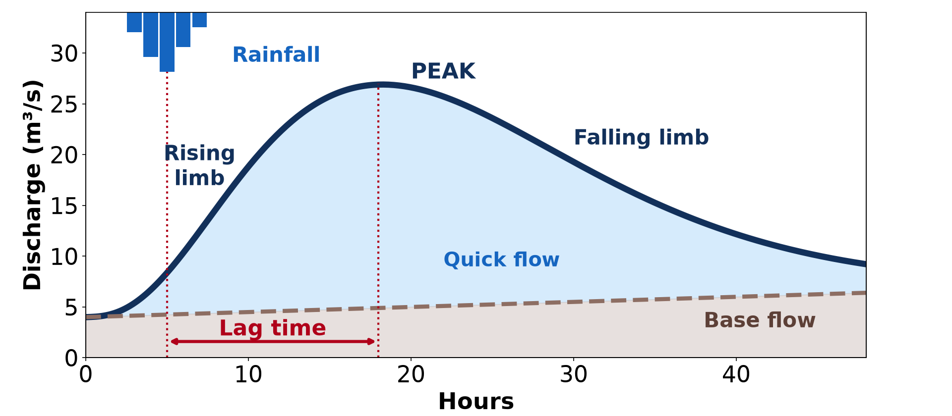
1. MEANING AND CHARACTERISTICS
Activity 1
A storm hydrograph.
Notes:
Activity 1. Look carefully at this diagram: a storm hydrograph. Observe every detail before I ask the question.

Slide 20
1. MEANING AND CHARACTERISTICS
Activity 1: Question
What is lag time?
Notes:
Here is the question for Activity 1: What is lag time? Take one minute to think and write your answer in your rough notebook.

Slide 21
1. MEANING AND CHARACTERISTICS
Activity 1: Answer
The time between the peak of the rain and the peak discharge.
Notes:
Let us check the answer together. The time between the peak of the rain and the peak discharge.

Slide 22
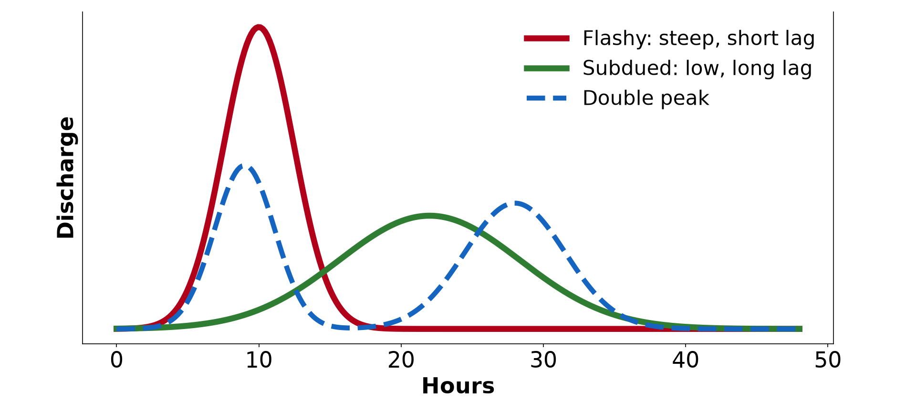
2. TYPES OF HYDROGRAPHS
Activity 2
Flashy, subdued and double-peak hydrographs.
Notes:
Activity 2. Look carefully at this diagram: flashy, subdued and double-peak hydrographs. Observe every detail before I ask the question.

Slide 23
2. TYPES OF HYDROGRAPHS
Activity 2: Question
Which hydrograph is the most dangerous for floods? Why?
Notes:
Here is the question for Activity 2: Which hydrograph is the most dangerous for floods? Why? Take one minute to think and write your answer in your rough notebook.

Slide 24
2. TYPES OF HYDROGRAPHS
Activity 2: Answer
The flashy one: a high peak comes very quickly.
Notes:
Let us check the answer together. The flashy one: a high peak comes very quickly.

Slide 25
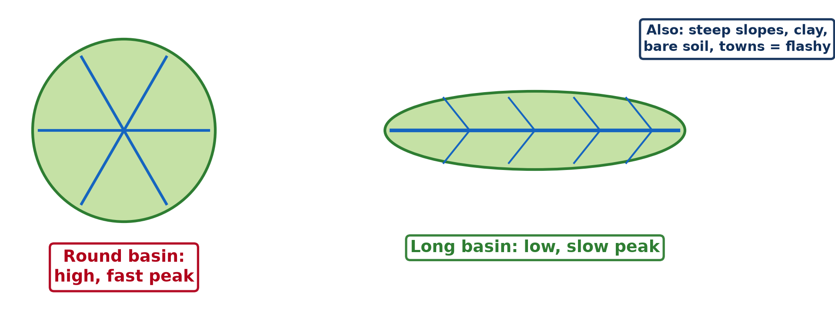
4. STATIC FACTORS
Activity 3
Basin shape and the speed of the flood.
Notes:
Activity 3. Look carefully at this diagram: basin shape and the speed of the flood. Observe every detail before I ask the question.

Slide 26
4. STATIC FACTORS
Activity 3: Question
Why does a round basin give a higher, faster peak?
Notes:
Here is the question for Activity 3: Why does a round basin give a higher, faster peak? Take one minute to think and write your answer in your rough notebook.

Slide 27
4. STATIC FACTORS
Activity 3: Answer
Water from all parts reaches the main river at about the same time.
Notes:
Let us check the answer together. Water from all parts reaches the main river at about the same time.

Slide 28
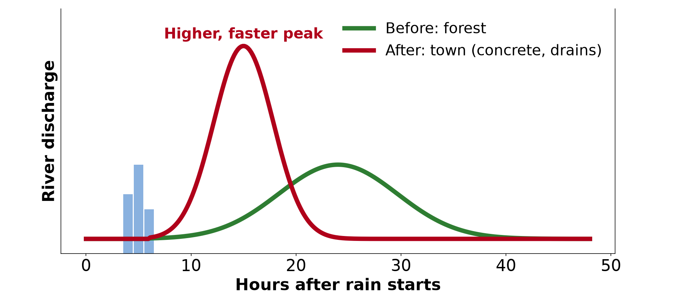
4. DYNAMIC FACTORS
Activity 4
The effect of a town on the hydrograph.
Notes:
Activity 4. Look carefully at this diagram: the effect of a town on the hydrograph. Observe every detail before I ask the question.

Slide 29
4. DYNAMIC FACTORS
Activity 4: Question
How does urbanisation change lag time and peak?
Notes:
Here is the question for Activity 4: How does urbanisation change lag time and peak? Take one minute to think and write your answer in your rough notebook.

Slide 30
4. DYNAMIC FACTORS
Activity 4: Answer
Lag time becomes shorter and the peak higher.
Notes:
Let us check the answer together. Lag time becomes shorter and the peak higher.

Slide 31

3. FLOOD PREDICTION
Activity 5
A flooded village.
Notes:
Activity 5. Look carefully at this picture: a flooded village. Observe every detail before I ask the question.

Slide 32
3. FLOOD PREDICTION
Activity 5: Question
How can hydrographs help to protect people?
Notes:
Here is the question for Activity 5: How can hydrographs help to protect people? Take one minute to think and write your answer in your rough notebook.

Slide 33
3. FLOOD PREDICTION
Activity 5: Answer
They show when and how high a flood will come, so people can be warned.
Notes:
Let us check the answer together. They show when and how high a flood will come, so people can be warned.

Slide 34
BOARD SUMMARY
Board Summary
Topic: The Drainage Basin Hydrological Cycle
Sub-topic: Components of the Drainage Basin Hydrological Cycle
Lesson 33: Storm Hydrographs
Notes:
Now we are going to copy the board summary. Write the title and the headings neatly in your notebooks. I will give you enough time for each slide, so do not rush.

Slide 35
BOARD SUMMARY
DEFINITIONS
The key terms of this lesson are defined as follows:
Channel flow: It is the water flowing in a river channel.
Discharge: It is the volume of water passing a point per second, in m³/s.
Notes:
Let us copy the definitions. The key terms of this lesson are defined as follows. On this slide we have Channel flow and Discharge. Write each point on a new line, with the key term first, and explain it in your own words when we revise. When you finish, we go to the next slide.

Slide 36
BOARD SUMMARY
DEFINITIONS (continued)
Storm hydrograph: It is a graph showing how the discharge of a river changes after a storm.
Notes:
We continue with the definitions. On this slide we have Storm hydrograph. Write each point on a new line, with the key term first, and explain it in your own words when we revise.

Slide 37
BOARD SUMMARY
1. Characteristics of a Storm Hydrograph
A storm hydrograph has the following parts:
Rising limb and peak discharge: The rising limb shows discharge increasing after the rain. The peak is the highest discharge.
Lag time: It is the time between peak rainfall and peak discharge. A short lag time means a high flood risk.
Notes:
Let us copy Characteristics of a Storm Hydrograph. A storm hydrograph has the following parts. On this slide we have Rising limb and peak discharge and Lag time. Write each point on a new line, with the key term first, and explain it in your own words when we revise. When you finish, we go to the next slide.

Slide 38
BOARD SUMMARY
1. Characteristics of a Storm Hydrograph (continued)
Falling limb and base flow: The falling limb shows discharge decreasing after the peak. Base flow is the groundwater part that continues between storms.
Notes:
We continue with Characteristics of a Storm Hydrograph. On this slide we have Falling limb and base flow. Write each point on a new line, with the key term first, and explain it in your own words when we revise.

Slide 39
BOARD SUMMARY
1. Characteristics of a Storm Hydrograph
Illustration: a storm hydrograph
Notes:
Now draw this illustration in your notebook: a storm hydrograph. Give it a title and label it clearly.

Slide 40
BOARD SUMMARY
2. Types of Hydrographs
There are three main types of hydrographs:
Flashy hydrograph: It has a steep rising limb, a high peak and a short lag time. It shows a high risk of flash floods.
Subdued hydrograph: It has a gentle rising limb, a low peak and a long lag time. The flood risk is low.
Notes:
Let us copy Types of Hydrographs. There are three main types of hydrographs. On this slide we have Flashy hydrograph and Subdued hydrograph. Write each point on a new line, with the key term first, and explain it in your own words when we revise. When you finish, we go to the next slide.

Slide 41
BOARD SUMMARY
2. Types of Hydrographs (continued)
Double-peak hydrograph: It has two peaks, from two storms or from quick flow followed by slower throughflow. It can also come from two tributaries.
Notes:
We continue with Types of Hydrographs. On this slide we have Double-peak hydrograph. Write each point on a new line, with the key term first, and explain it in your own words when we revise.

Slide 42
BOARD SUMMARY
2. Types of Hydrographs
Illustration: flashy and subdued hydrographs
Notes:
Now draw this illustration in your notebook: flashy and subdued hydrographs. Give it a title and label it clearly.

Slide 43
BOARD SUMMARY
3. Factors Affecting the Shape and Lag Time
The shape of a hydrograph depends on two groups of factors:
Dynamic factors: Precipitation type, intensity, duration and frequency, and land use, change with time. Intense storms and urbanisation shorten lag time and raise the peak.
Notes:
Let us copy Factors Affecting the Shape and Lag Time. The shape of a hydrograph depends on two groups of factors. On this slide we have Dynamic factors. Write each point on a new line, with the key term first, and explain it in your own words when we revise. When you finish, we go to the next slide.

Slide 44
BOARD SUMMARY
3. Factors Affecting the Shape and Lag Time (continued)
Static factors: Basin size, shape, relief, soil and rock stay the same. Small, round, steep basins on impermeable rock give flashy hydrographs.
Notes:
We continue with Factors Affecting the Shape and Lag Time. On this slide we have Static factors. Write each point on a new line, with the key term first, and explain it in your own words when we revise. When you finish, we go to the next slide.

Slide 45
BOARD SUMMARY
3. Factors Affecting the Shape and Lag Time (continued)
Flood prediction: By studying past hydrographs, engineers predict flood peaks and lag times. Warnings allow people to move away and protect property.
Notes:
We continue with Factors Affecting the Shape and Lag Time. On this slide we have Flood prediction. Write each point on a new line, with the key term first, and explain it in your own words when we revise.

Slide 46
BOARD SUMMARY
3. Factors Affecting the Shape and Lag Time
Illustration: basin shape and hydrograph shape
Notes:
Now draw this illustration in your notebook: basin shape and hydrograph shape. Give it a title and label it clearly.

Slide 47
FORMATIVE EVALUATION
Evaluation 1
Label the parts of a storm hydrograph.
Notes:
Now let us check what you have understood. Question 1: Label the parts of a storm hydrograph. Answer in your exercise book.

Slide 48
FORMATIVE EVALUATION
Expected Answer
Rainfall, rising limb, peak, falling limb, lag time, base flow, quick flow.
Notes:
The expected answer is: rainfall, rising limb, peak, falling limb, lag time, base flow, quick flow. If you got it right, well done.

Slide 49
FORMATIVE EVALUATION
Evaluation 2
Give two factors that give a flashy hydrograph.
Notes:
Now let us check what you have understood. Question 2: Give two factors that give a flashy hydrograph. Answer in your exercise book.

Slide 50
FORMATIVE EVALUATION
Expected Answer
Intense rain and urbanisation (also steep slopes, impermeable rock, round basin).
Notes:
The expected answer is: intense rain and urbanisation (also steep slopes, impermeable rock, round basin). If you got it right, well done.

Slide 51
REMEDIATION
Remediation
Fill in the blanks:
The time between peak rain and peak discharge is the ______.
A hydrograph with a high, quick peak is ______.
Forests make the lag time ______.
Notes:
For those who need more practice, fill in the blanks in your exercise book. The answers are: number 1, lag time; number 2, flashy; number 3, longer.

Slide 52
HOMEWORK
Homework
Draw a flashy and a subdued hydrograph and give two causes of each.
Notes:
For your homework: Draw a flashy and a subdued hydrograph and give two causes of each. We shall correct it at the beginning of our next lesson.

Slide 53
NEXT LESSON
Next Lesson
Our next lesson will be on:
Lesson 34: River Regimes
Notes:
Our next lesson will be on Lesson 34: River Regimes. Thank you for your attention, and see you next time.

Slide 54
BILINGUAL GAME
Bilingual Game (Jeu Bilingue)
English | Français
Hydrograph | L'hydrogramme
Peak | La pointe de crue
Lag time | Le temps de réponse
Flood | La crue
Rising limb | La courbe de montée
Warning | L'alerte
Notes:
Let us play the bilingual game. I say a word in English, and you give me the French word. Then we do the reverse.

Slide 55
LOGBOOK
Official Logbook (1/2)
Module / Topic | The Drainage Basin Hydrological Cycle
Lesson Title | Lesson 33: Storm Hydrographs
Expected Learning Outcomes | Define and label a storm hydrograph. Distinguish flashy, subdued and double-peak hydrographs. Explain the factors of hydrograph shape and lag time, and their use for flood prediction.
Competence | Learners are able to read a storm hydrograph and explain what controls its shape.
Notes:
I record this information in the official logbook of the class after the lesson.

Slide 56
LOGBOOK
Official Logbook (2/2)
Matter Taught | DEFINITIONS; Characteristics of a Storm Hydrograph; Types of Hydrographs; Factors Affecting the Shape and Lag Time.
Evaluation | Formative evaluation and remediation exercise.
Homework | Draw a flashy and a subdued hydrograph and give two causes of each.
Enrolment / Present / Absent | ____ / ____ / ____
Achievement | To be completed after the lesson.
Notes:
I complete the second page of the logbook: the matter taught, the evaluation, the homework and the attendance.

Slide 57
TEACHER'S NOTE
Teacher's Note
Timing: Homework correction, plan, objectives 8 min | Recall, situation, action 10 min | 5 activities 30 min | Board summary (copying) 30 min | Evaluation, remediation 10 min | Homework, next lesson 5 min | Logbook 7 min
Without the projector (Activity 1): draw and label the graph.
Without the projector (Activity 2): draw the two main types.
Without the projector (Activity 3): compare a round plate and a long ruler.
Without the projector (Activity 4): compare a roof and a forest.
Without the projector (Activity 5): discuss flood warnings on the radio.
Notes:
This slide is for me, the teacher: it gives the timing of the lesson and what to do if the projector is not available.

Slide 58
REFERENCES
References
National Geography Syllabus, MINESEC/IGE/IP-SS, 2019 — Module 1 (Meteorology, Climatology & Hydrology).
Photo, Activity 5: “Flood in Accra” by Stig Nygaard, CC BY 2.0, via Flickr (https://www.flickr.com/photos/10259776@N00/181742000)
Diagrams and animations: drawn for this lesson (Geography Department).
Notes:
These are the references and picture credits used to prepare this lesson.

