Slide 1

DIVINE GRACE COLLEGE OF ARTS, SCIENCE AND TECHNOLOGY
(DGCAST) — GAROUA | GEOGRAPHY DEPARTMENT
LOWER SIXTH ARTS — CLIMATOLOGY — FURTHER STUDY 3
The Climate of Cameroon
Mr KAMDEM EMMANUEL
Geography Teacher — PLEG
Academic Year 2026 / 2027
Notes:
Good morning, class. Today we study Further Study 3: The Climate of Cameroon.

Slide 2
GEOGRAPHY — LOWER SIXTH ARTS
CLASS INFO
Class, Chapter & Duration
Class | Lower Sixth Arts
Chapter | Module 1: Understanding and managing atmospheric and hydrological phenomena and hazards across the world in general and Cameroon in particular
Duration | 2 periods (2 × 50 minutes)
2026 / 2027
DGCAST GAROUA — GEOGRAPHY DEPARTMENT
Mr KAMDEM E. | 2

Slide 3
GEOGRAPHY — LOWER SIXTH ARTS
IDENTIFICATION
Lesson Identification
Topic | Geography of Cameroon
Sub-topic | Climate of Cameroon
Lesson | Further Study 3: The Climate of Cameroon
Notions / Concepts | Equatorial climate, Cameroon type, tropical climate, Sahelian climate, ITCZ, continentality.
Syllabus focus | Location of Cameroon; climatic domains and types; role of air masses and the ITCZ; seasons and their duration from the coast inland.
Competence | Learners are able to describe and explain the climates of Cameroon.
2026 / 2027
DGCAST GAROUA — GEOGRAPHY DEPARTMENT
Mr KAMDEM E. | 3

Slide 4
GEOGRAPHY — LOWER SIXTH ARTS
OBJECTIVES
Learning Objectives
By the end of the lesson, the learner should be able to:
Locate Cameroon and name its climatic domains.
Describe the characteristics of each climate type.
Explain the role of air masses, the ITCZ and continentality.
2026 / 2027
DGCAST GAROUA — GEOGRAPHY DEPARTMENT
Mr KAMDEM E. | 4

Slide 5
GEOGRAPHY — LOWER SIXTH ARTS
RECALL
Recall
The mT brings rain and the cT brings the Harmattan.
Temperature falls with altitude.
2026 / 2027
DGCAST GAROUA — GEOGRAPHY DEPARTMENT
Mr KAMDEM E. | 5

Slide 6
GEOGRAPHY — LOWER SIXTH ARTS
REAL-LIFE SITUATION
Real-Life Situation
A student from Kousseri moves to Douala for school. She is surprised that it rains almost all year in Douala, while at home the rainy season lasts only three months.
2026 / 2027
DGCAST GAROUA — GEOGRAPHY DEPARTMENT
Mr KAMDEM E. | 6
Notes:
Read the situation slowly, twice.

Slide 7
GEOGRAPHY — LOWER SIXTH ARTS
REAL-LIFE SITUATION
Situation — Question 1
What is the problem in the situation?
2026 / 2027
DGCAST GAROUA — GEOGRAPHY DEPARTMENT
Mr KAMDEM E. | 7

Slide 8
GEOGRAPHY — LOWER SIXTH ARTS
REAL-LIFE SITUATION
Answer
The seasons differ greatly between the south and the north of Cameroon.
2026 / 2027
DGCAST GAROUA — GEOGRAPHY DEPARTMENT
Mr KAMDEM E. | 8

Slide 9
GEOGRAPHY — LOWER SIXTH ARTS
REAL-LIFE SITUATION
Situation — Question 2
Why does it rain longer in Douala?
2026 / 2027
DGCAST GAROUA — GEOGRAPHY DEPARTMENT
Mr KAMDEM E. | 9

Slide 10
GEOGRAPHY — LOWER SIXTH ARTS
REAL-LIFE SITUATION
Answer
It is near the sea and the ITCZ stays over the south for longer.
2026 / 2027
DGCAST GAROUA — GEOGRAPHY DEPARTMENT
Mr KAMDEM E. | 10

Slide 11
GEOGRAPHY — LOWER SIXTH ARTS
REAL-LIFE SITUATION
Situation — Question 3
What type of climate does Kousseri have?
2026 / 2027
DGCAST GAROUA — GEOGRAPHY DEPARTMENT
Mr KAMDEM E. | 11

Slide 12
GEOGRAPHY — LOWER SIXTH ARTS
REAL-LIFE SITUATION
Possible Answer
A dry tropical (Sahelian) climate.
2026 / 2027
DGCAST GAROUA — GEOGRAPHY DEPARTMENT
Mr KAMDEM E. | 12

Slide 13
GEOGRAPHY — LOWER SIXTH ARTS
JUSTIFICATION
Justification of the Lesson
This lesson helps us to know the climates of our country and their effects on life and farming.
2026 / 2027
DGCAST GAROUA — GEOGRAPHY DEPARTMENT
Mr KAMDEM E. | 13

Slide 14

GEOGRAPHY — LOWER SIXTH ARTS
I. LOCATION
Activity 1
Cameroon in Africa.
2026 / 2027
DGCAST GAROUA — GEOGRAPHY DEPARTMENT
Mr KAMDEM E. | 14
Notes:
Without the projector: find Cameroon on the atlas.

Slide 15
GEOGRAPHY — LOWER SIXTH ARTS
I. LOCATION
Activity 1: Question
Between which latitudes does Cameroon lie?
2026 / 2027
DGCAST GAROUA — GEOGRAPHY DEPARTMENT
Mr KAMDEM E. | 15

Slide 16
GEOGRAPHY — LOWER SIXTH ARTS
I. LOCATION
Answer
Between about 2°N and 13°N.
2026 / 2027
DGCAST GAROUA — GEOGRAPHY DEPARTMENT
Mr KAMDEM E. | 16

Slide 17

GEOGRAPHY — LOWER SIXTH ARTS
II. CLIMATIC DOMAINS
Activity 2
The climate types of Cameroon (simplified).
2026 / 2027
DGCAST GAROUA — GEOGRAPHY DEPARTMENT
Mr KAMDEM E. | 17
Notes:
Without the projector: draw Cameroon and divide it.

Slide 18
GEOGRAPHY — LOWER SIXTH ARTS
II. CLIMATIC DOMAINS
Activity 2: Question
Name the two main climatic domains of Cameroon.
2026 / 2027
DGCAST GAROUA — GEOGRAPHY DEPARTMENT
Mr KAMDEM E. | 18

Slide 19
GEOGRAPHY — LOWER SIXTH ARTS
II. CLIMATIC DOMAINS
Answer
The equatorial domain in the south and the tropical domain in the north.
2026 / 2027
DGCAST GAROUA — GEOGRAPHY DEPARTMENT
Mr KAMDEM E. | 19

Slide 20

GEOGRAPHY — LOWER SIXTH ARTS
II. CLIMATIC DOMAINS
Activity 3
Climate graph of Douala.
2026 / 2027
DGCAST GAROUA — GEOGRAPHY DEPARTMENT
Mr KAMDEM E. | 20
Notes:
Without the projector: read the graph.

Slide 21
GEOGRAPHY — LOWER SIXTH ARTS
II. CLIMATIC DOMAINS
Activity 3: Question
Describe the climate of Douala.
2026 / 2027
DGCAST GAROUA — GEOGRAPHY DEPARTMENT
Mr KAMDEM E. | 21

Slide 22
GEOGRAPHY — LOWER SIXTH ARTS
II. CLIMATIC DOMAINS
Answer
Hot all year (about 26 °C) with very heavy rain (about 4,000 mm): Cameroon type.
2026 / 2027
DGCAST GAROUA — GEOGRAPHY DEPARTMENT
Mr KAMDEM E. | 22

Slide 23
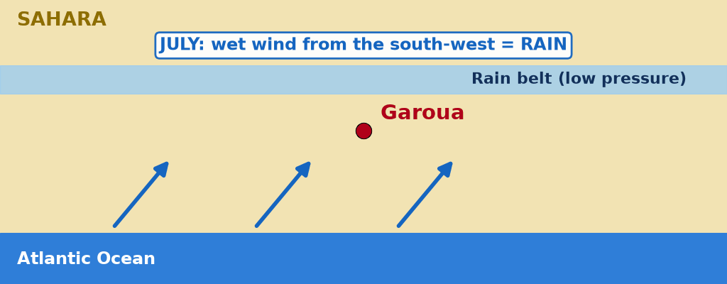
GEOGRAPHY — LOWER SIXTH ARTS
III. AIR MASSES AND ITCZ
Activity 4
Animation: the rain belt moves with the seasons.
2026 / 2027
DGCAST GAROUA — GEOGRAPHY DEPARTMENT
Mr KAMDEM E. | 23
Notes:
Without the projector: move a paper band on the map.

Slide 24
GEOGRAPHY — LOWER SIXTH ARTS
III. AIR MASSES AND ITCZ
Activity 4: Question
Why does the north have only one short rainy season?
2026 / 2027
DGCAST GAROUA — GEOGRAPHY DEPARTMENT
Mr KAMDEM E. | 24

Slide 25
GEOGRAPHY — LOWER SIXTH ARTS
III. AIR MASSES AND ITCZ
Answer
The ITCZ reaches the north only for a short time in July–August.
2026 / 2027
DGCAST GAROUA — GEOGRAPHY DEPARTMENT
Mr KAMDEM E. | 25

Slide 26
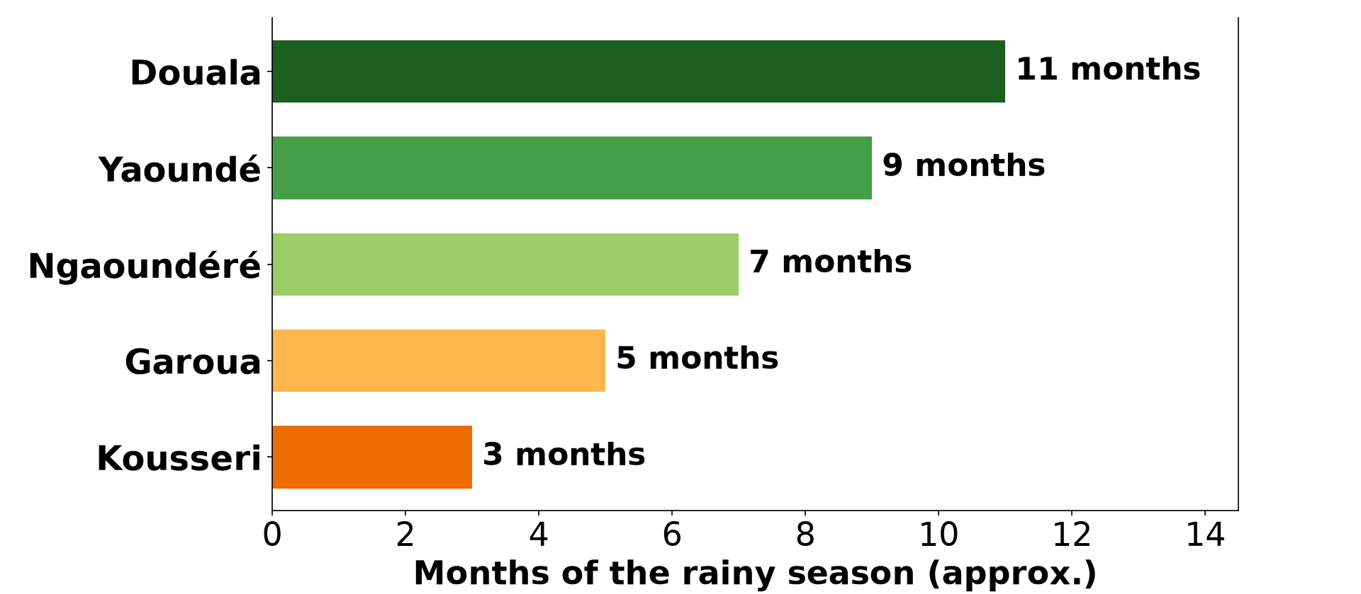
GEOGRAPHY — LOWER SIXTH ARTS
IV. SEASONS
Activity 5
Length of the rainy season from south to north.
2026 / 2027
DGCAST GAROUA — GEOGRAPHY DEPARTMENT
Mr KAMDEM E. | 26
Notes:
Without the projector: list towns from south to north.

Slide 27
GEOGRAPHY — LOWER SIXTH ARTS
IV. SEASONS
Activity 5: Question
How does the length of the rainy season change from Douala to Kousseri?
2026 / 2027
DGCAST GAROUA — GEOGRAPHY DEPARTMENT
Mr KAMDEM E. | 27

Slide 28
GEOGRAPHY — LOWER SIXTH ARTS
IV. SEASONS
Answer
It becomes shorter inland, from about 11 to about 3 months.
2026 / 2027
DGCAST GAROUA — GEOGRAPHY DEPARTMENT
Mr KAMDEM E. | 28

Slide 29
GEOGRAPHY — LOWER SIXTH ARTS
BOARD SUMMARY
The Climate of Cameroon
Topic: Geography of Cameroon
Sub-topic: Climate of Cameroon
Further Study 3: The Climate of Cameroon
2026 / 2027
DGCAST GAROUA — GEOGRAPHY DEPARTMENT
Mr KAMDEM E. | 29
Notes:
Learners copy the board summary now. Give them enough time for each slide.

Slide 30
GEOGRAPHY — LOWER SIXTH ARTS
BOARD SUMMARY
I. Definitions
Equatorial climate: It is a hot, wet climate with rain in most months.
Tropical climate: It is a hot climate with one rainy season and one dry season.
Continentality: It is the effect of distance from the sea on climate.
2026 / 2027
DGCAST GAROUA — GEOGRAPHY DEPARTMENT
Mr KAMDEM E. | 30

Slide 31
GEOGRAPHY — LOWER SIXTH ARTS
BOARD SUMMARY
II. Climatic Domains (1/2)
A. Equatorial domain (south): The Guinea type has four seasons, two wet and two dry, as in Yaoundé. The Cameroon type on the coast and mountains has very heavy rain.
B. Mountain climate (west): The Western Highlands and Mount Cameroon are cool and wet. Temperature falls with height.
2026 / 2027
DGCAST GAROUA — GEOGRAPHY DEPARTMENT
Mr KAMDEM E. | 31

Slide 32
GEOGRAPHY — LOWER SIXTH ARTS
BOARD SUMMARY
II. Climatic Domains (2/2)
C. Tropical domain (north): The humid tropical (Sudan) type has a long rainy season, as in Ngaoundéré. The dry tropical (Sahel) type has a short rainy season, as in Kousseri.
2026 / 2027
DGCAST GAROUA — GEOGRAPHY DEPARTMENT
Mr KAMDEM E. | 32

Slide 33
GEOGRAPHY — LOWER SIXTH ARTS
BOARD SUMMARY
III. Controls and Seasons (1/3)
A. Air masses and the ITCZ: The mT brings rain and the cT brings the Harmattan. The ITCZ moves north in July and south in January.
B. Continentality: Rain and the length of the rainy season fall from the coast inland. The temperature range increases towards the north.
2026 / 2027
DGCAST GAROUA — GEOGRAPHY DEPARTMENT
Mr KAMDEM E. | 33

Slide 34
GEOGRAPHY — LOWER SIXTH ARTS
BOARD SUMMARY
III. Controls and Seasons (2/3)
C. Relief: Highlands are cooler and wetter. Debundscha, at the foot of Mount Cameroon, is one of the wettest places in the world.
2026 / 2027
DGCAST GAROUA — GEOGRAPHY DEPARTMENT
Mr KAMDEM E. | 34

Slide 35
GEOGRAPHY — LOWER SIXTH ARTS
BOARD SUMMARY
III. Controls and Seasons (3/3)
Copy the map.
2026 / 2027
DGCAST GAROUA — GEOGRAPHY DEPARTMENT
Mr KAMDEM E. | 35

Slide 36
GEOGRAPHY — LOWER SIXTH ARTS
FORMATIVE EVALUATION
Formative Evaluation 1
Name the climate types of Cameroon.
2026 / 2027
DGCAST GAROUA — GEOGRAPHY DEPARTMENT
Mr KAMDEM E. | 36

Slide 37
GEOGRAPHY — LOWER SIXTH ARTS
FORMATIVE EVALUATION
Expected Answer
Equatorial (Guinea), Cameroon type, mountain, humid tropical (Sudan), dry tropical (Sahel).
2026 / 2027
DGCAST GAROUA — GEOGRAPHY DEPARTMENT
Mr KAMDEM E. | 37

Slide 38
GEOGRAPHY — LOWER SIXTH ARTS
FORMATIVE EVALUATION
Formative Evaluation 2
Why is the rainy season shorter in the north?
2026 / 2027
DGCAST GAROUA — GEOGRAPHY DEPARTMENT
Mr KAMDEM E. | 38

Slide 39
GEOGRAPHY — LOWER SIXTH ARTS
FORMATIVE EVALUATION
Expected Answer
It is far from the sea and the ITCZ reaches it only for a short time.
2026 / 2027
DGCAST GAROUA — GEOGRAPHY DEPARTMENT
Mr KAMDEM E. | 39

Slide 40
GEOGRAPHY — LOWER SIXTH ARTS
REMEDIATION
Remediation
Fill in the blanks:
Yaoundé has four seasons: it has a ______ climate.
The dry wind of the north is the ______.
The length of the rainy season ______ inland.
2026 / 2027
DGCAST GAROUA — GEOGRAPHY DEPARTMENT
Mr KAMDEM E. | 40
Notes:
Answers: 1. equatorial (Guinea) 2. Harmattan 3. decreases

Slide 41
GEOGRAPHY — LOWER SIXTH ARTS
HOMEWORK
Homework
Draw the climate map of Cameroon and write one town for each climate type.
This prepares Lesson 22: Introduction to Hydrology.
2026 / 2027
DGCAST GAROUA — GEOGRAPHY DEPARTMENT
Mr KAMDEM E. | 41
Notes:
This homework prepares the next lesson.

Slide 42
GEOGRAPHY — LOWER SIXTH ARTS
BILINGUAL GAME
Bilingual Game (Jeu Bilingue)
English | Français
Climate type | Le type de climat
Rainy season | La saison des pluies
Dry season | La saison sèche
Coast | La côte
Highlands | Les hautes terres
Inland | L'intérieur
2026 / 2027
DGCAST GAROUA — GEOGRAPHY DEPARTMENT
Mr KAMDEM E. | 42
Notes:
Say the English word; learners give the French word, then the reverse.

Slide 43
GEOGRAPHY — LOWER SIXTH ARTS
LOGBOOK
Official Logbook (1/2)
Module / Topic | Geography of Cameroon
Lesson Title | Further Study 3: The Climate of Cameroon
Expected Learning Outcomes | Locate Cameroon and name its climatic domains. Describe the characteristics of each climate type. Explain the role of air masses, the ITCZ and continentality.
Competence | Learners are able to describe and explain the climates of Cameroon.
2026 / 2027
DGCAST GAROUA — GEOGRAPHY DEPARTMENT
Mr KAMDEM E. | 43

Slide 44
GEOGRAPHY — LOWER SIXTH ARTS
LOGBOOK
Official Logbook (2/2)
Matter Taught | I. Definitions: Equatorial climate, Tropical climate, Continentality; II. Climatic Domains: Equatorial domain (south), Mountain climate (west), Tropical domain (north); III. Controls and Seasons: Air masses and the ITCZ, Continentality, Relief.
Evaluation | Formative evaluation (3 questions) and remediation exercise.
Homework | Draw the climate map of Cameroon and write one town for each climate type.
Enrolment / Present / Absent | ____ / ____ / ____
Achievement | To be completed by the teacher after the lesson.
2026 / 2027
DGCAST GAROUA — GEOGRAPHY DEPARTMENT
Mr KAMDEM E. | 44

Slide 45
GEOGRAPHY — LOWER SIXTH ARTS
TEACHER'S NOTE
Teacher's Note
Timing: Set-up, recall 8 min | Situation 8 min | 5 activities 30 min | Board summary (copying) 30 min | Evaluation, remediation 10 min | Homework, logbook 9 min | Spare 5 min
Activity 4 is an animation (GIF): it plays automatically in slide-show mode.
2026 / 2027
DGCAST GAROUA — GEOGRAPHY DEPARTMENT
Mr KAMDEM E. | 45

Slide 46
GEOGRAPHY — LOWER SIXTH ARTS
REFERENCES
References
National Geography Syllabus, Sixth Forms (Lower & Upper Sixth), MINESEC/IGE/IP-SS, August 2019 — Module 1 (Meteorology, Climatology & Hydrology).
Diagrams and animations: drawn for this lesson (DGCAST Geography Department).
2026 / 2027
DGCAST GAROUA — GEOGRAPHY DEPARTMENT
Mr KAMDEM E. | 46

