Slide 1

DIVINE GRACE COLLEGE OF ARTS, SCIENCE AND TECHNOLOGY
(DGCAST) — GAROUA | GEOGRAPHY DEPARTMENT
LOWER SIXTH ARTS — CLIMATOLOGY — LESSON 9
Temperature Inversion
Mr KAMDEM EMMANUEL
Geography Teacher — PLEG
Academic Year 2026 / 2027
Notes:
Good morning, class. Today we study Lesson 9: Temperature Inversion.

Slide 2
GEOGRAPHY — LOWER SIXTH ARTS
CLASS INFO
Class, Chapter & Duration
Class | Lower Sixth Arts
Chapter | Module 1: Understanding and managing atmospheric and hydrological phenomena and hazards across the world in general and Cameroon in particular
Duration | 2 periods (2 × 50 minutes)
2026 / 2027
DGCAST GAROUA — GEOGRAPHY DEPARTMENT
Mr KAMDEM E. | 2

Slide 3
GEOGRAPHY — LOWER SIXTH ARTS
IDENTIFICATION
Lesson Identification
Topic | Energy in the Atmosphere
Sub-topic | Vertical Distribution of Heat in the Atmosphere
Lesson | Lesson 9: Temperature Inversion
Notions / Concepts | Temperature inversion, surface inversion, upper-air inversion, frost hollow, radiation fog, smog.
Syllabus focus | Meaning, types, causes and effects of temperature inversion; fog formation.
Competence | Learners are able to explain temperature inversion and its effects on weather and people.
2026 / 2027
DGCAST GAROUA — GEOGRAPHY DEPARTMENT
Mr KAMDEM E. | 3

Slide 4
GEOGRAPHY — LOWER SIXTH ARTS
OBJECTIVES
Learning Objectives
By the end of the lesson, the learner should be able to:
Define temperature inversion.
Explain the types and causes of inversion.
Explain the effects of inversion, including fog and smog.
2026 / 2027
DGCAST GAROUA — GEOGRAPHY DEPARTMENT
Mr KAMDEM E. | 4

Slide 5
GEOGRAPHY — LOWER SIXTH ARTS
RECALL
Recall
Normally temperature falls with height.
Cold air is heavy and sinks.
2026 / 2027
DGCAST GAROUA — GEOGRAPHY DEPARTMENT
Mr KAMDEM E. | 5

Slide 6
GEOGRAPHY — LOWER SIXTH ARTS
REAL-LIFE SITUATION
Real-Life Situation
On cold mornings in the Bamenda Highlands, the valleys are full of thick fog while the hilltops are clear and sunny. Drivers must go slowly in the valleys.
2026 / 2027
DGCAST GAROUA — GEOGRAPHY DEPARTMENT
Mr KAMDEM E. | 6
Notes:
Read the situation slowly, twice.

Slide 7
GEOGRAPHY — LOWER SIXTH ARTS
REAL-LIFE SITUATION
Situation — Question 1
What is the problem in the situation?
2026 / 2027
DGCAST GAROUA — GEOGRAPHY DEPARTMENT
Mr KAMDEM E. | 7

Slide 8
GEOGRAPHY — LOWER SIXTH ARTS
REAL-LIFE SITUATION
Answer
Fog in the valleys makes driving dangerous.
2026 / 2027
DGCAST GAROUA — GEOGRAPHY DEPARTMENT
Mr KAMDEM E. | 8

Slide 9
GEOGRAPHY — LOWER SIXTH ARTS
REAL-LIFE SITUATION
Situation — Question 2
Why is the fog in the valleys and not on the hills?
2026 / 2027
DGCAST GAROUA — GEOGRAPHY DEPARTMENT
Mr KAMDEM E. | 9

Slide 10
GEOGRAPHY — LOWER SIXTH ARTS
REAL-LIFE SITUATION
Answer
Cold air has sunk into the valleys and is trapped below warmer air.
2026 / 2027
DGCAST GAROUA — GEOGRAPHY DEPARTMENT
Mr KAMDEM E. | 10

Slide 11
GEOGRAPHY — LOWER SIXTH ARTS
REAL-LIFE SITUATION
Situation — Question 3
What is this situation called?
2026 / 2027
DGCAST GAROUA — GEOGRAPHY DEPARTMENT
Mr KAMDEM E. | 11

Slide 12
GEOGRAPHY — LOWER SIXTH ARTS
REAL-LIFE SITUATION
Possible Answer
A temperature inversion.
2026 / 2027
DGCAST GAROUA — GEOGRAPHY DEPARTMENT
Mr KAMDEM E. | 12

Slide 13
GEOGRAPHY — LOWER SIXTH ARTS
JUSTIFICATION
Justification of the Lesson
This lesson helps us to understand fog, frost and air pollution in valleys and towns.
2026 / 2027
DGCAST GAROUA — GEOGRAPHY DEPARTMENT
Mr KAMDEM E. | 13

Slide 14
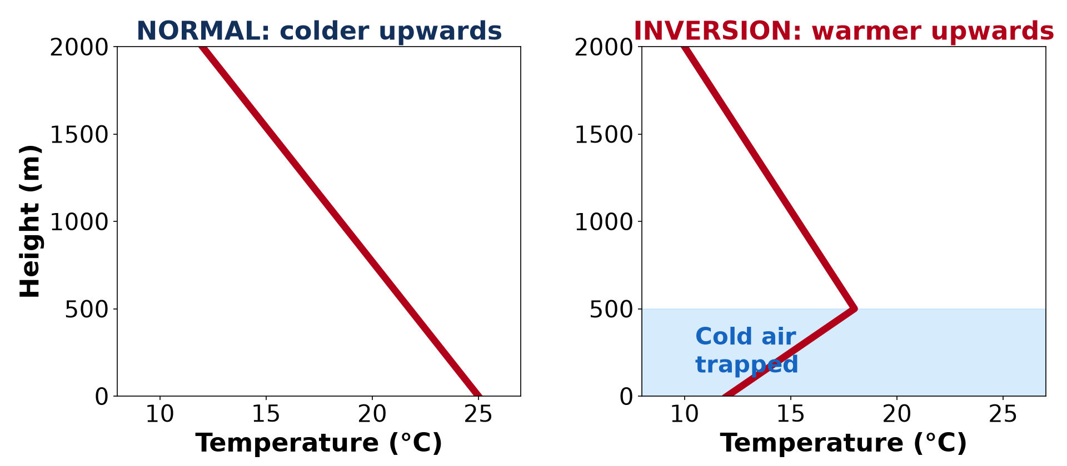
GEOGRAPHY — LOWER SIXTH ARTS
I. MEANING
Activity 1
Normal temperature and an inversion.
2026 / 2027
DGCAST GAROUA — GEOGRAPHY DEPARTMENT
Mr KAMDEM E. | 14
Notes:
Without the projector: draw the two graphs.

Slide 15
GEOGRAPHY — LOWER SIXTH ARTS
I. MEANING
Activity 1: Question
In an inversion, how does temperature change with height?
2026 / 2027
DGCAST GAROUA — GEOGRAPHY DEPARTMENT
Mr KAMDEM E. | 15

Slide 16
GEOGRAPHY — LOWER SIXTH ARTS
I. MEANING
Answer
It rises with height instead of falling.
2026 / 2027
DGCAST GAROUA — GEOGRAPHY DEPARTMENT
Mr KAMDEM E. | 16

Slide 17
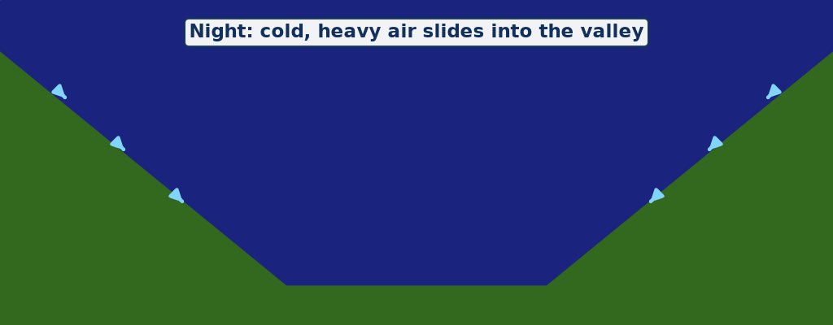
GEOGRAPHY — LOWER SIXTH ARTS
II. CAUSES
Activity 2
Animation: cold air slides into a valley at night.
2026 / 2027
DGCAST GAROUA — GEOGRAPHY DEPARTMENT
Mr KAMDEM E. | 17
Notes:
Without the projector: pour water down a slope into a bowl.

Slide 18
GEOGRAPHY — LOWER SIXTH ARTS
II. CAUSES
Activity 2: Question
Why does cold air collect in valleys at night?
2026 / 2027
DGCAST GAROUA — GEOGRAPHY DEPARTMENT
Mr KAMDEM E. | 18

Slide 19
GEOGRAPHY — LOWER SIXTH ARTS
II. CAUSES
Answer
The ground cools fast on clear nights; cold, heavy air slides down into the valley.
2026 / 2027
DGCAST GAROUA — GEOGRAPHY DEPARTMENT
Mr KAMDEM E. | 19

Slide 20
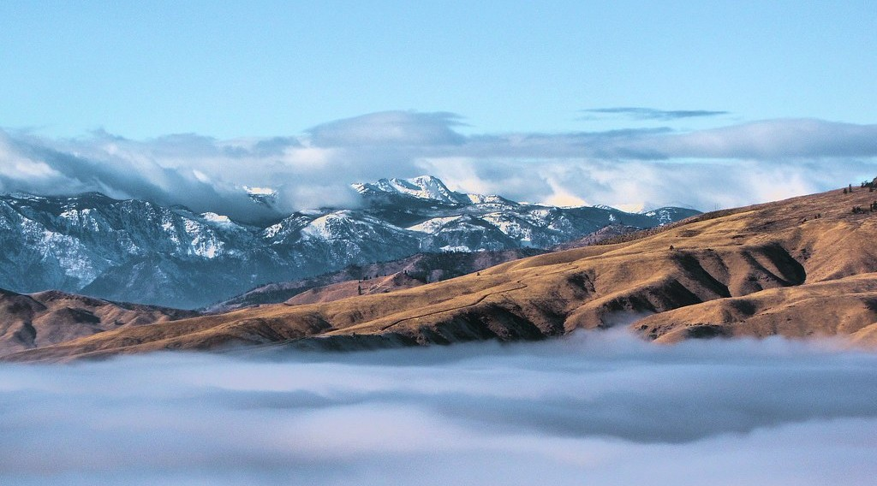
GEOGRAPHY — LOWER SIXTH ARTS
III. EFFECTS
Activity 3
Hilltops above a sea of cloud trapped by an inversion.
2026 / 2027
DGCAST GAROUA — GEOGRAPHY DEPARTMENT
Mr KAMDEM E. | 20
Notes:
Without the projector: describe morning fog in a valley.

Slide 21
GEOGRAPHY — LOWER SIXTH ARTS
III. EFFECTS
Activity 3: Question
Why is the fog trapped in the valley?
2026 / 2027
DGCAST GAROUA — GEOGRAPHY DEPARTMENT
Mr KAMDEM E. | 21

Slide 22
GEOGRAPHY — LOWER SIXTH ARTS
III. EFFECTS
Answer
The warm air above acts like a lid and stops the cold air from rising.
2026 / 2027
DGCAST GAROUA — GEOGRAPHY DEPARTMENT
Mr KAMDEM E. | 22

Slide 23
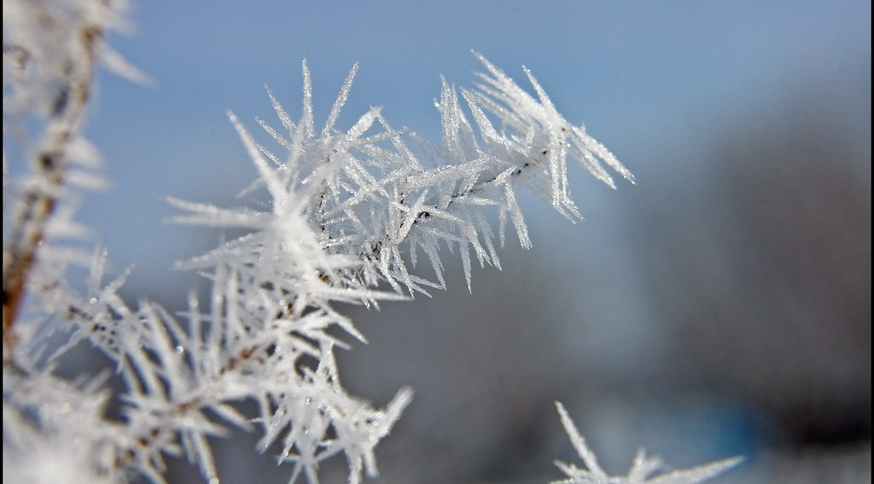
GEOGRAPHY — LOWER SIXTH ARTS
III. EFFECTS
Activity 4
Frost on plants on a cold morning.
2026 / 2027
DGCAST GAROUA — GEOGRAPHY DEPARTMENT
Mr KAMDEM E. | 23
Notes:
Without the projector: mention cold mornings in the highlands.

Slide 24
GEOGRAPHY — LOWER SIXTH ARTS
III. EFFECTS
Activity 4: Question
Why do crops in valley bottoms suffer from frost?
2026 / 2027
DGCAST GAROUA — GEOGRAPHY DEPARTMENT
Mr KAMDEM E. | 24

Slide 25
GEOGRAPHY — LOWER SIXTH ARTS
III. EFFECTS
Answer
The coldest air collects in the valley bottom (frost hollow).
2026 / 2027
DGCAST GAROUA — GEOGRAPHY DEPARTMENT
Mr KAMDEM E. | 25

Slide 26

GEOGRAPHY — LOWER SIXTH ARTS
III. EFFECTS
Activity 5
Smog in a big city (Beijing).
2026 / 2027
DGCAST GAROUA — GEOGRAPHY DEPARTMENT
Mr KAMDEM E. | 26
Notes:
Without the projector: describe smoke lying low in the morning.

Slide 27
GEOGRAPHY — LOWER SIXTH ARTS
III. EFFECTS
Activity 5: Question
Why is air pollution worse during an inversion?
2026 / 2027
DGCAST GAROUA — GEOGRAPHY DEPARTMENT
Mr KAMDEM E. | 27

Slide 28
GEOGRAPHY — LOWER SIXTH ARTS
III. EFFECTS
Answer
Smoke cannot rise, so it is trapped near the ground as smog.
2026 / 2027
DGCAST GAROUA — GEOGRAPHY DEPARTMENT
Mr KAMDEM E. | 28

Slide 29
GEOGRAPHY — LOWER SIXTH ARTS
BOARD SUMMARY
Temperature Inversion
Topic: Energy in the Atmosphere
Sub-topic: Vertical Distribution of Heat in the Atmosphere
Lesson 9: Temperature Inversion
2026 / 2027
DGCAST GAROUA — GEOGRAPHY DEPARTMENT
Mr KAMDEM E. | 29
Notes:
Learners copy the board summary now. Give them enough time for each slide.

Slide 30
GEOGRAPHY — LOWER SIXTH ARTS
BOARD SUMMARY
I. Definitions
Temperature inversion: It is a layer of air where temperature rises with height.
Frost hollow: It is a valley bottom where cold air collects and frost forms.
Smog: It is smoke and fog mixed and trapped near the ground.
2026 / 2027
DGCAST GAROUA — GEOGRAPHY DEPARTMENT
Mr KAMDEM E. | 30

Slide 31
GEOGRAPHY — LOWER SIXTH ARTS
BOARD SUMMARY
II. Types and Causes (1/2)
A. Surface inversion: On clear, calm nights the ground loses heat fast. The air near the ground becomes colder than the air above.
B. Valley inversion: Cold, heavy air slides down slopes into valleys at night. Warmer air stays above it.
2026 / 2027
DGCAST GAROUA — GEOGRAPHY DEPARTMENT
Mr KAMDEM E. | 31

Slide 32
GEOGRAPHY — LOWER SIXTH ARTS
BOARD SUMMARY
II. Types and Causes (2/2)
C. Upper-air inversion: Air sinks and warms in high-pressure areas. A warm layer forms above cooler air, as in the subtropical highs.
2026 / 2027
DGCAST GAROUA — GEOGRAPHY DEPARTMENT
Mr KAMDEM E. | 32

Slide 33
GEOGRAPHY — LOWER SIXTH ARTS
BOARD SUMMARY
III. Effects (1/3)
A. Weather: Inversions make the air stable, so clouds and rain do not form. Fog and mist form in the cold air.
B. Man: Fog makes roads and airports dangerous. Frost damages crops in valley bottoms.
2026 / 2027
DGCAST GAROUA — GEOGRAPHY DEPARTMENT
Mr KAMDEM E. | 33

Slide 34
GEOGRAPHY — LOWER SIXTH ARTS
BOARD SUMMARY
III. Effects (2/3)
C. Pollution: Smoke is trapped under the warm layer and forms smog. It causes breathing problems in cities.
2026 / 2027
DGCAST GAROUA — GEOGRAPHY DEPARTMENT
Mr KAMDEM E. | 34

Slide 35
GEOGRAPHY — LOWER SIXTH ARTS
BOARD SUMMARY
III. Effects (3/3)
Copy the graphs.
2026 / 2027
DGCAST GAROUA — GEOGRAPHY DEPARTMENT
Mr KAMDEM E. | 35

Slide 36
GEOGRAPHY — LOWER SIXTH ARTS
FORMATIVE EVALUATION
Formative Evaluation 1
What is a temperature inversion?
2026 / 2027
DGCAST GAROUA — GEOGRAPHY DEPARTMENT
Mr KAMDEM E. | 36

Slide 37
GEOGRAPHY — LOWER SIXTH ARTS
FORMATIVE EVALUATION
Expected Answer
A layer of air where temperature rises with height.
2026 / 2027
DGCAST GAROUA — GEOGRAPHY DEPARTMENT
Mr KAMDEM E. | 37

Slide 38
GEOGRAPHY — LOWER SIXTH ARTS
FORMATIVE EVALUATION
Formative Evaluation 2
Give two effects of inversion on man.
2026 / 2027
DGCAST GAROUA — GEOGRAPHY DEPARTMENT
Mr KAMDEM E. | 38

Slide 39
GEOGRAPHY — LOWER SIXTH ARTS
FORMATIVE EVALUATION
Expected Answer
Fog makes transport dangerous; smog harms health (frost damages crops).
2026 / 2027
DGCAST GAROUA — GEOGRAPHY DEPARTMENT
Mr KAMDEM E. | 39

Slide 40
GEOGRAPHY — LOWER SIXTH ARTS
REMEDIATION
Remediation
Fill in the blanks:
In an inversion, temperature ______ with height.
Valley bottoms where frost forms are frost ______.
Smoke and fog trapped together form ______.
2026 / 2027
DGCAST GAROUA — GEOGRAPHY DEPARTMENT
Mr KAMDEM E. | 40
Notes:
Answers: 1. rises 2. hollows 3. smog

Slide 41
GEOGRAPHY — LOWER SIXTH ARTS
HOMEWORK
Homework
Observe the morning sky for three days and note whether smoke rises or lies low.
This prepares Lesson 10: Nature of Moisture.
2026 / 2027
DGCAST GAROUA — GEOGRAPHY DEPARTMENT
Mr KAMDEM E. | 41
Notes:
This homework prepares the next lesson.

Slide 42
GEOGRAPHY — LOWER SIXTH ARTS
BILINGUAL GAME
Bilingual Game (Jeu Bilingue)
English | Français
Inversion | L'inversion
Fog | Le brouillard
Frost | Le gel
Smog | Le smog
Valley | La vallée
Stable air | L'air stable
2026 / 2027
DGCAST GAROUA — GEOGRAPHY DEPARTMENT
Mr KAMDEM E. | 42
Notes:
Say the English word; learners give the French word, then the reverse.

Slide 43
GEOGRAPHY — LOWER SIXTH ARTS
LOGBOOK
Official Logbook (1/2)
Module / Topic | Energy in the Atmosphere
Lesson Title | Lesson 9: Temperature Inversion
Expected Learning Outcomes | Define temperature inversion. Explain the types and causes of inversion. Explain the effects of inversion, including fog and smog.
Competence | Learners are able to explain temperature inversion and its effects on weather and people.
2026 / 2027
DGCAST GAROUA — GEOGRAPHY DEPARTMENT
Mr KAMDEM E. | 43

Slide 44
GEOGRAPHY — LOWER SIXTH ARTS
LOGBOOK
Official Logbook (2/2)
Matter Taught | I. Definitions: Temperature inversion, Frost hollow, Smog; II. Types and Causes: Surface inversion, Valley inversion, Upper-air inversion; III. Effects: Weather, Man, Pollution.
Evaluation | Formative evaluation (3 questions) and remediation exercise.
Homework | Observe the morning sky for three days and note whether smoke rises or lies low.
Enrolment / Present / Absent | ____ / ____ / ____
Achievement | To be completed by the teacher after the lesson.
2026 / 2027
DGCAST GAROUA — GEOGRAPHY DEPARTMENT
Mr KAMDEM E. | 44

Slide 45
GEOGRAPHY — LOWER SIXTH ARTS
TEACHER'S NOTE
Teacher's Note
Timing: Set-up, recall 8 min | Situation 8 min | 5 activities 30 min | Board summary (copying) 30 min | Evaluation, remediation 10 min | Homework, logbook 9 min | Spare 5 min
Activity 2 is an animation (GIF): it plays automatically in slide-show mode.
2026 / 2027
DGCAST GAROUA — GEOGRAPHY DEPARTMENT
Mr KAMDEM E. | 45

Slide 46
GEOGRAPHY — LOWER SIXTH ARTS
REFERENCES
References
National Geography Syllabus, Sixth Forms (Lower & Upper Sixth), MINESEC/IGE/IP-SS, August 2019 — Module 1 (Meteorology, Climatology & Hydrology).
Photo, Activity 3: “Rising above the Inversion” by Pictoscribe -, CC BY-NC-ND 2.0, via Flickr (https://www.flickr.com/photos/70414856@N00/6535713585)
Photo, Activity 4: “Frosty Morning” by Tom Gill., CC BY-NC-ND 2.0, via Flickr (https://www.flickr.com/photos/10199807@N00/4283143427)
Photo, Activity 5: “Beijing smog” by kevin dooley, CC BY 2.0, via Flickr (https://www.flickr.com/photos/12836528@N00/386198516)
Diagrams and animations: drawn for this lesson (DGCAST Geography Department).
2026 / 2027
DGCAST GAROUA — GEOGRAPHY DEPARTMENT
Mr KAMDEM E. | 46

