Slide 1

DIVINE GRACE COLLEGE OF ARTS, SCIENCE AND TECHNOLOGY
(DGCAST) — GAROUA | GEOGRAPHY DEPARTMENT
LOWER SIXTH ARTS — CLIMATOLOGY — LESSON 10
Nature of Moisture
Mr KAMDEM EMMANUEL
Geography Teacher — PLEG
Academic Year 2026 / 2027
Notes:
Good morning, class. Today we study Lesson 10: Nature of Moisture.

Slide 2
GEOGRAPHY — LOWER SIXTH ARTS
CLASS INFO
Class, Chapter & Duration
Class | Lower Sixth Arts
Chapter | Module 1: Understanding and managing atmospheric and hydrological phenomena and hazards across the world in general and Cameroon in particular
Duration | 2 periods (2 × 50 minutes)
2026 / 2027
DGCAST GAROUA — GEOGRAPHY DEPARTMENT
Mr KAMDEM E. | 2

Slide 3
GEOGRAPHY — LOWER SIXTH ARTS
IDENTIFICATION
Lesson Identification
Topic | Moisture in the Atmosphere
Sub-topic | Atmospheric Humidity
Lesson | Lesson 10: Nature of Moisture
Notions / Concepts | Humidity, absolute humidity, relative humidity, saturation, dew point, hygrometer.
Syllabus focus | Sources and states of moisture; absolute and relative humidity; distribution and factors; relevance.
Competence | Learners are able to measure and explain humidity and its effects on weather and people.
2026 / 2027
DGCAST GAROUA — GEOGRAPHY DEPARTMENT
Mr KAMDEM E. | 3

Slide 4
GEOGRAPHY — LOWER SIXTH ARTS
OBJECTIVES
Learning Objectives
By the end of the lesson, the learner should be able to:
Explain the sources and the three states of moisture.
Distinguish absolute and relative humidity.
Explain the factors and importance of humidity.
2026 / 2027
DGCAST GAROUA — GEOGRAPHY DEPARTMENT
Mr KAMDEM E. | 4

Slide 5
GEOGRAPHY — LOWER SIXTH ARTS
RECALL
Recall
Water vapour is a variable gas.
Evaporation takes in latent heat.
2026 / 2027
DGCAST GAROUA — GEOGRAPHY DEPARTMENT
Mr KAMDEM E. | 5

Slide 6
GEOGRAPHY — LOWER SIXTH ARTS
REAL-LIFE SITUATION
Real-Life Situation
In Douala, clothes take a long time to dry and people sweat a lot. In Maroua during the dry season, clothes dry in one hour and the lips crack. Both towns can be very hot.
2026 / 2027
DGCAST GAROUA — GEOGRAPHY DEPARTMENT
Mr KAMDEM E. | 6
Notes:
Read the situation slowly, twice.

Slide 7
GEOGRAPHY — LOWER SIXTH ARTS
REAL-LIFE SITUATION
Situation — Question 1
What is the problem in the situation?
2026 / 2027
DGCAST GAROUA — GEOGRAPHY DEPARTMENT
Mr KAMDEM E. | 7

Slide 8
GEOGRAPHY — LOWER SIXTH ARTS
REAL-LIFE SITUATION
Answer
People feel different conditions in hot places.
2026 / 2027
DGCAST GAROUA — GEOGRAPHY DEPARTMENT
Mr KAMDEM E. | 8

Slide 9
GEOGRAPHY — LOWER SIXTH ARTS
REAL-LIFE SITUATION
Situation — Question 2
What is different between the two towns?
2026 / 2027
DGCAST GAROUA — GEOGRAPHY DEPARTMENT
Mr KAMDEM E. | 9

Slide 10
GEOGRAPHY — LOWER SIXTH ARTS
REAL-LIFE SITUATION
Answer
The amount of water vapour in the air (humidity).
2026 / 2027
DGCAST GAROUA — GEOGRAPHY DEPARTMENT
Mr KAMDEM E. | 10

Slide 11
GEOGRAPHY — LOWER SIXTH ARTS
REAL-LIFE SITUATION
Situation — Question 3
Why do clothes dry slowly in Douala?
2026 / 2027
DGCAST GAROUA — GEOGRAPHY DEPARTMENT
Mr KAMDEM E. | 11

Slide 12
GEOGRAPHY — LOWER SIXTH ARTS
REAL-LIFE SITUATION
Possible Answer
The air is almost saturated, so evaporation is slow.
2026 / 2027
DGCAST GAROUA — GEOGRAPHY DEPARTMENT
Mr KAMDEM E. | 12

Slide 13
GEOGRAPHY — LOWER SIXTH ARTS
JUSTIFICATION
Justification of the Lesson
This lesson helps us to understand humidity, which controls clouds, rain and our comfort.
2026 / 2027
DGCAST GAROUA — GEOGRAPHY DEPARTMENT
Mr KAMDEM E. | 13

Slide 14

GEOGRAPHY — LOWER SIXTH ARTS
I. SOURCES
Activity 1
Animation: water evaporates and returns as rain.
2026 / 2027
DGCAST GAROUA — GEOGRAPHY DEPARTMENT
Mr KAMDEM E. | 14
Notes:
Without the projector: draw the water cycle.

Slide 15
GEOGRAPHY — LOWER SIXTH ARTS
I. SOURCES
Activity 1: Question
Where does the water vapour in the air come from?
2026 / 2027
DGCAST GAROUA — GEOGRAPHY DEPARTMENT
Mr KAMDEM E. | 15

Slide 16
GEOGRAPHY — LOWER SIXTH ARTS
I. SOURCES
Answer
Evaporation from seas, lakes, rivers and soil, and transpiration from plants.
2026 / 2027
DGCAST GAROUA — GEOGRAPHY DEPARTMENT
Mr KAMDEM E. | 16

Slide 17
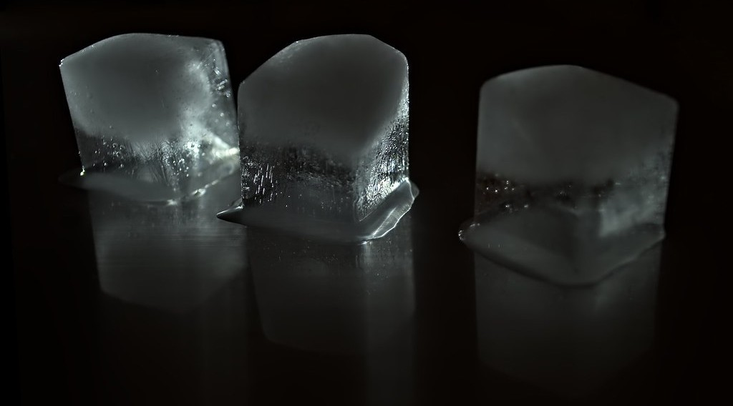
GEOGRAPHY — LOWER SIXTH ARTS
I. STATES
Activity 2
Ice cubes melting into water.
2026 / 2027
DGCAST GAROUA — GEOGRAPHY DEPARTMENT
Mr KAMDEM E. | 17
Notes:
Without the projector: show ice, water and steam from a kettle.

Slide 18
GEOGRAPHY — LOWER SIXTH ARTS
I. STATES
Activity 2: Question
Name the three states of water. Which one is invisible?
2026 / 2027
DGCAST GAROUA — GEOGRAPHY DEPARTMENT
Mr KAMDEM E. | 18

Slide 19
GEOGRAPHY — LOWER SIXTH ARTS
I. STATES
Answer
Solid (ice), liquid (water), gas (water vapour). Water vapour is invisible.
2026 / 2027
DGCAST GAROUA — GEOGRAPHY DEPARTMENT
Mr KAMDEM E. | 19

Slide 20
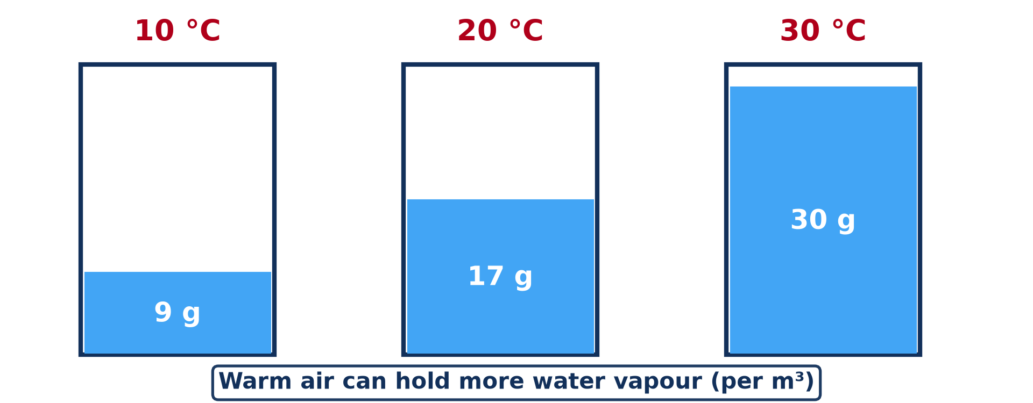
GEOGRAPHY — LOWER SIXTH ARTS
II. HUMIDITY
Activity 3
Maximum water vapour a cubic metre of air can hold.
2026 / 2027
DGCAST GAROUA — GEOGRAPHY DEPARTMENT
Mr KAMDEM E. | 20
Notes:
Without the projector: do the calculation on the board.

Slide 21
GEOGRAPHY — LOWER SIXTH ARTS
II. HUMIDITY
Activity 3: Question
Air at 30 °C holds 15 g of vapour. What is its relative humidity?
2026 / 2027
DGCAST GAROUA — GEOGRAPHY DEPARTMENT
Mr KAMDEM E. | 21

Slide 22
GEOGRAPHY — LOWER SIXTH ARTS
II. HUMIDITY
Answer
15 ÷ 30 × 100 = 50 %.
2026 / 2027
DGCAST GAROUA — GEOGRAPHY DEPARTMENT
Mr KAMDEM E. | 22

Slide 23
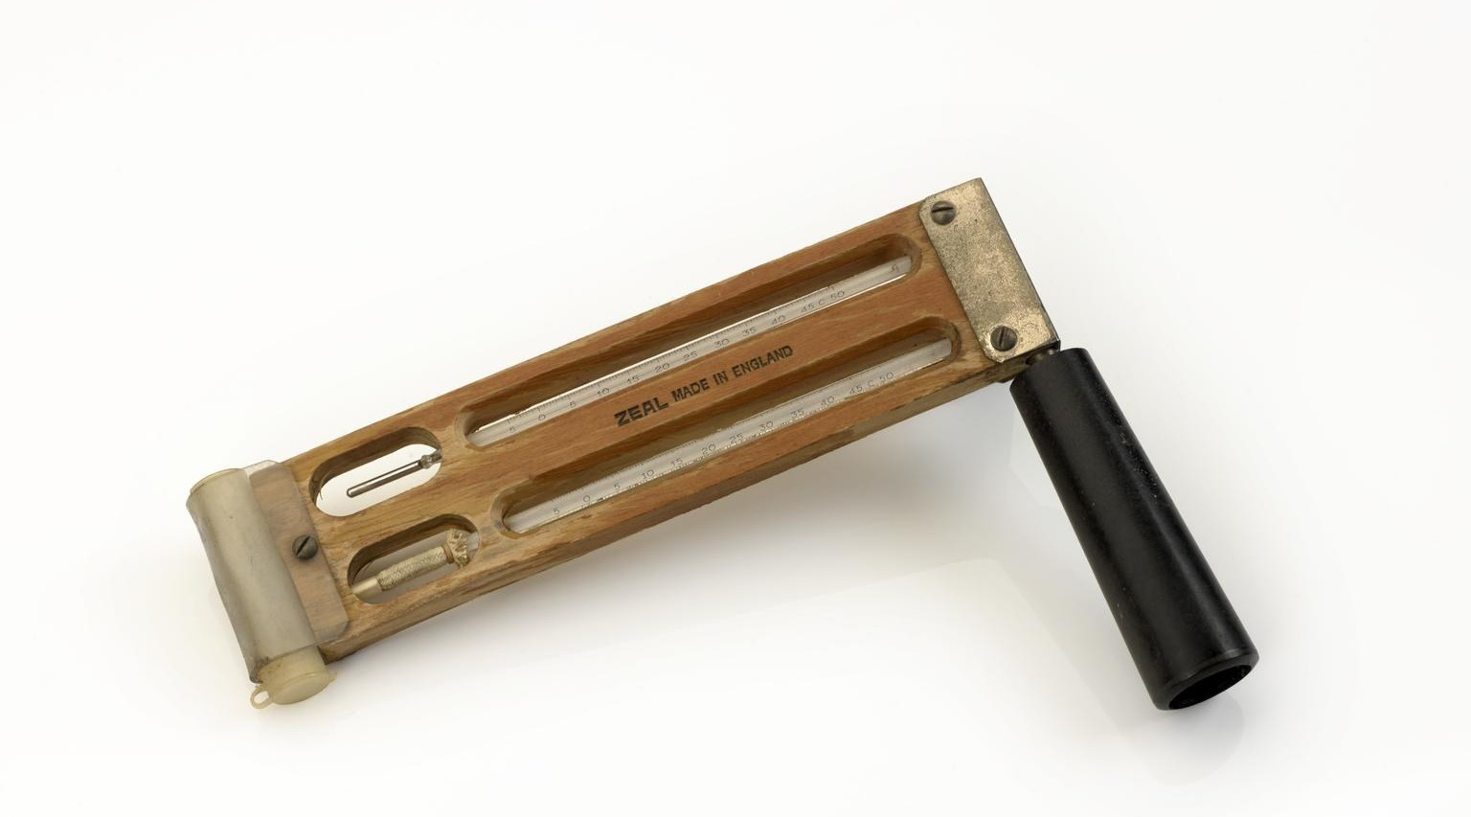
GEOGRAPHY — LOWER SIXTH ARTS
II. HUMIDITY
Activity 4
A sling hygrometer (wet and dry bulb thermometers).
2026 / 2027
DGCAST GAROUA — GEOGRAPHY DEPARTMENT
Mr KAMDEM E. | 23
Notes:
Without the projector: blow on a wet hand: it feels cold.

Slide 24
GEOGRAPHY — LOWER SIXTH ARTS
II. HUMIDITY
Activity 4: Question
Why does the wet bulb show a lower temperature than the dry bulb?
2026 / 2027
DGCAST GAROUA — GEOGRAPHY DEPARTMENT
Mr KAMDEM E. | 24

Slide 25
GEOGRAPHY — LOWER SIXTH ARTS
II. HUMIDITY
Answer
Water evaporates from the wet bulb and cools it; the drier the air, the bigger the difference.
2026 / 2027
DGCAST GAROUA — GEOGRAPHY DEPARTMENT
Mr KAMDEM E. | 25

Slide 26

GEOGRAPHY — LOWER SIXTH ARTS
III. DISTRIBUTION
Activity 5
A humid equatorial forest.
2026 / 2027
DGCAST GAROUA — GEOGRAPHY DEPARTMENT
Mr KAMDEM E. | 26
Notes:
Without the projector: compare Douala and Maroua.

Slide 27
GEOGRAPHY — LOWER SIXTH ARTS
III. DISTRIBUTION
Activity 5: Question
Why is humidity high in equatorial forests?
2026 / 2027
DGCAST GAROUA — GEOGRAPHY DEPARTMENT
Mr KAMDEM E. | 27

Slide 28
GEOGRAPHY — LOWER SIXTH ARTS
III. DISTRIBUTION
Answer
High temperature, much rain and much transpiration from plants.
2026 / 2027
DGCAST GAROUA — GEOGRAPHY DEPARTMENT
Mr KAMDEM E. | 28

Slide 29
GEOGRAPHY — LOWER SIXTH ARTS
BOARD SUMMARY
Nature of Moisture
Topic: Moisture in the Atmosphere
Sub-topic: Atmospheric Humidity
Lesson 10: Nature of Moisture
2026 / 2027
DGCAST GAROUA — GEOGRAPHY DEPARTMENT
Mr KAMDEM E. | 29
Notes:
Learners copy the board summary now. Give them enough time for each slide.

Slide 30
GEOGRAPHY — LOWER SIXTH ARTS
BOARD SUMMARY
I. Definitions (1/2)
Humidity: It is the amount of water vapour in the air.
Absolute humidity: It is the mass of water vapour in a cubic metre of air (g/m³).
Relative humidity: It is the actual vapour in the air compared with the maximum it can hold, in percent.
2026 / 2027
DGCAST GAROUA — GEOGRAPHY DEPARTMENT
Mr KAMDEM E. | 30

Slide 31
GEOGRAPHY — LOWER SIXTH ARTS
BOARD SUMMARY
I. Definitions (2/2)
Dew point: It is the temperature at which air becomes saturated.
2026 / 2027
DGCAST GAROUA — GEOGRAPHY DEPARTMENT
Mr KAMDEM E. | 31

Slide 32
GEOGRAPHY — LOWER SIXTH ARTS
BOARD SUMMARY
II. Sources and States
A. Sources: Water vapour comes from evaporation of seas, lakes and soils. Plants also give out vapour by transpiration.
B. Three states: Water exists as solid (ice), liquid (water) and gas (vapour). It changes state with temperature.
2026 / 2027
DGCAST GAROUA — GEOGRAPHY DEPARTMENT
Mr KAMDEM E. | 32

Slide 33
GEOGRAPHY — LOWER SIXTH ARTS
BOARD SUMMARY
III. Humidity and its Factors (1/2)
A. Calculation: Relative humidity = actual vapour ÷ maximum vapour × 100. At 100 % the air is saturated.
B. Factors: Warm air holds more vapour than cold air. When temperature rises, relative humidity falls.
2026 / 2027
DGCAST GAROUA — GEOGRAPHY DEPARTMENT
Mr KAMDEM E. | 33

Slide 34
GEOGRAPHY — LOWER SIXTH ARTS
BOARD SUMMARY
III. Humidity and its Factors (2/2)
C. Distribution: Humidity is high near the Equator and near the sea. It is low in deserts and in the dry season.
D. Relevance: Humid air gives clouds and rain but makes people uncomfortable. Very dry air cracks lips and spreads meningitis in the Sahel.
2026 / 2027
DGCAST GAROUA — GEOGRAPHY DEPARTMENT
Mr KAMDEM E. | 34

Slide 35
GEOGRAPHY — LOWER SIXTH ARTS
FORMATIVE EVALUATION
Formative Evaluation 1
Distinguish absolute and relative humidity.
2026 / 2027
DGCAST GAROUA — GEOGRAPHY DEPARTMENT
Mr KAMDEM E. | 35

Slide 36
GEOGRAPHY — LOWER SIXTH ARTS
FORMATIVE EVALUATION
Expected Answer
Absolute: grams of vapour per m³; relative: actual vapour as a percentage of the maximum.
2026 / 2027
DGCAST GAROUA — GEOGRAPHY DEPARTMENT
Mr KAMDEM E. | 36

Slide 37
GEOGRAPHY — LOWER SIXTH ARTS
FORMATIVE EVALUATION
Formative Evaluation 2
What happens to relative humidity when air warms?
2026 / 2027
DGCAST GAROUA — GEOGRAPHY DEPARTMENT
Mr KAMDEM E. | 37

Slide 38
GEOGRAPHY — LOWER SIXTH ARTS
FORMATIVE EVALUATION
Expected Answer
It falls, because warm air can hold more vapour.
2026 / 2027
DGCAST GAROUA — GEOGRAPHY DEPARTMENT
Mr KAMDEM E. | 38

Slide 39
GEOGRAPHY — LOWER SIXTH ARTS
REMEDIATION
Remediation
Fill in the blanks:
Air holding all the vapour it can is ______.
Humidity is measured with a ______.
Warm air holds ______ vapour than cold air.
2026 / 2027
DGCAST GAROUA — GEOGRAPHY DEPARTMENT
Mr KAMDEM E. | 39
Notes:
Answers: 1. saturated 2. hygrometer 3. more

Slide 40
GEOGRAPHY — LOWER SIXTH ARTS
HOMEWORK
Homework
Wet two pieces of cloth; dry one in the sun and one in a closed room. Explain the difference.
This prepares Lesson 11: Forms of Condensation and Precipitation.
2026 / 2027
DGCAST GAROUA — GEOGRAPHY DEPARTMENT
Mr KAMDEM E. | 40
Notes:
This homework prepares the next lesson.

Slide 41
GEOGRAPHY — LOWER SIXTH ARTS
BILINGUAL GAME
Bilingual Game (Jeu Bilingue)
English | Français
Humidity | L'humidité
Saturation | La saturation
Dew point | Le point de rosée
Water vapour | La vapeur d'eau
Transpiration | La transpiration
Hygrometer | L'hygromètre
2026 / 2027
DGCAST GAROUA — GEOGRAPHY DEPARTMENT
Mr KAMDEM E. | 41
Notes:
Say the English word; learners give the French word, then the reverse.

Slide 42
GEOGRAPHY — LOWER SIXTH ARTS
LOGBOOK
Official Logbook (1/2)
Module / Topic | Moisture in the Atmosphere
Lesson Title | Lesson 10: Nature of Moisture
Expected Learning Outcomes | Explain the sources and the three states of moisture. Distinguish absolute and relative humidity. Explain the factors and importance of humidity.
Competence | Learners are able to measure and explain humidity and its effects on weather and people.
2026 / 2027
DGCAST GAROUA — GEOGRAPHY DEPARTMENT
Mr KAMDEM E. | 42

Slide 43
GEOGRAPHY — LOWER SIXTH ARTS
LOGBOOK
Official Logbook (2/2)
Matter Taught | I. Definitions: Humidity, Absolute humidity, Relative humidity, Dew point; II. Sources and States: Sources, Three states; III. Humidity and its Factors: Calculation, Factors, Distribution, Relevance.
Evaluation | Formative evaluation (3 questions) and remediation exercise.
Homework | Wet two pieces of cloth; dry one in the sun and one in a closed room. Explain the difference.
Enrolment / Present / Absent | ____ / ____ / ____
Achievement | To be completed by the teacher after the lesson.
2026 / 2027
DGCAST GAROUA — GEOGRAPHY DEPARTMENT
Mr KAMDEM E. | 43

Slide 44
GEOGRAPHY — LOWER SIXTH ARTS
TEACHER'S NOTE
Teacher's Note
Timing: Set-up, recall 8 min | Situation 8 min | 5 activities 30 min | Board summary (copying) 30 min | Evaluation, remediation 10 min | Homework, logbook 9 min | Spare 5 min
Activity 1 is an animation (GIF): it plays automatically in slide-show mode.
2026 / 2027
DGCAST GAROUA — GEOGRAPHY DEPARTMENT
Mr KAMDEM E. | 44

Slide 45
GEOGRAPHY — LOWER SIXTH ARTS
REFERENCES
References
National Geography Syllabus, Sixth Forms (Lower & Upper Sixth), MINESEC/IGE/IP-SS, August 2019 — Module 1 (Meteorology, Climatology & Hydrology).
Photo, Activity 2: “Thrice” by mpardo.photo, CC0 1.0, via Flickr (https://www.flickr.com/photos/130551911@N05/16875162129)
Photo, Activity 4: “Sling hydrometer used on 1953 Mount Everest expedition” by G H Zeal Limited, CC BY-NC-SA 4.0, via sciencemuseum (https://collection.sciencemuseumgroup.org.uk/objects/co8593941/sling-hydrometer-used-on-1953-mount-everest-expedition)
Photo, Activity 5: “Amazon 11” by CIAT International Center for Tropical Agriculture, CC BY-SA 2.0, via Flickr (https://www.flickr.com/photos/38476503@N08/5641587148)
Diagrams and animations: drawn for this lesson (DGCAST Geography Department).
2026 / 2027
DGCAST GAROUA — GEOGRAPHY DEPARTMENT
Mr KAMDEM E. | 45

