Slide 1
FORM 4
GEOGRAPHY
Practical Work 1
Locate a Place on a Map
Notes:
Good morning, class, and welcome to our geography lesson. I am your geography teacher, Mr Kamdem. Today we are starting Practical Work 1: Locate a Place on a Map.

Slide 2
CLASS INFO
Class, Chapter and Duration
Class | Form 4
Chapter | The Earth as a Planet in the Solar System — Location and Time
Duration | 50 minutes
Notes:
This lesson is for Form 4. It belongs to The Earth as a Planet in the Solar System — Location and Time. We shall need 50 minutes to cover it.

Slide 3
IDENTIFICATION
Lesson Identification
Topic | The Earth as a Planet in the Solar System
Sub-topic | Location and Time
Lesson | Practical Work 1: Locate a Place on a Map
Notions / Concepts | Grid, coordinates, latitude, longitude.
Syllabus focus | Locating a place on a map using latitudes and longitudes; reading and writing geographical coordinates.
Competence | Learners are able to find a place on a map from its coordinates, and to give the coordinates of towns such as Garoua, Maroua and Ngaoundéré.
Notes:
Our topic is The Earth as a Planet in the Solar System, and the sub-topic is Location and Time. The key notions we shall use today are: grid, coordinates, latitude, longitude. At the end, you should be able to do this: learners are able to find a place on a map from its coordinates, and to give the coordinates of towns such as Garoua, Maroua and Ngaoundéré.

Slide 4

HOMEWORK CORRECTION
Correction of the Homework
Question (Lesson 3: Great Circles and the International Date Line):
Bring an atlas, a ruler and a pencil to the next lesson. Find the map of Cameroon in your atlas.
Notes:
Before we start the new lesson, let us correct the homework I gave you at the end of Lesson 3: Great Circles and the International Date Line. The question was: Bring an atlas, a ruler and a pencil to the next lesson. Find the map of Cameroon in your atlas. Take out your exercise books.

Slide 5
HOMEWORK CORRECTION
Correction: Possible Answer
The atlas, ruler and pencil will be used to read the latitude and longitude of towns on the map of Cameroon.
Notes:
Here is a good answer. The atlas, ruler and pencil will be used to read the latitude and longitude of towns on the map of Cameroon. Compare it with your own answer and correct your work in red.

Slide 6
LESSON PLAN
Lesson Plan
Correction of the homework
Objectives and recall
Real-life situation and action to take
Learning activities
Board summary
Evaluation, remediation and homework
Notes:
Here is the plan of our lesson today. First, we shall correct the homework. Then we shall look at the objectives and recall what you already know. After that, we shall study a situation from real life and the action to take, and do the learning activities. Finally, we shall copy the board summary, do the evaluation and the remediation, and I will give you the homework.

Slide 7
OBJECTIVES
Objectives
By the end of this lesson, you should be able to:
Revise the meaning of latitude and longitude on a map.
Follow the steps to read the coordinates of a place.
Notes:
Take your time to copy this part; we will continue together.

Slide 8
OBJECTIVES
Objectives (continued)
Find a place on a map from its coordinates.
Give the coordinates of Cameroon and of some of its towns.
Notes:
By the end of this lesson, you should be able to do four things. Number 1: revise the meaning of latitude and longitude on a map. Number 2: follow the steps to read the coordinates of a place. Number 3: find a place on a map from its coordinates. Number 4: give the coordinates of Cameroon and of some of its towns.

Slide 9
PREVIOUS KNOWLEDGE
Previous Knowledge
A latitude measures the distance north or south of the Equator.
A longitude measures the distance east or west of the Prime Meridian.
We write the latitude first and the longitude second.
Notes:
Let us first remember what you already know. A latitude measures the distance north or south of the Equator. A longitude measures the distance east or west of the Prime Meridian. We write the latitude first and the longitude second. Keep this in mind, because we shall build on it today.

Slide 10
REAL-LIFE SITUATION
Situation in Real Life
A Red Cross team in Garoua must bring medicines to a small village. The office sends only two numbers: "10° N, 14° E". The driver asks: "How can we find this village on our map with only these two numbers?"
Notes:
Listen carefully to this situation from real life. A Red Cross team in Garoua must bring medicines to a small village. The office sends only two numbers: "10° N, 14° E". The driver asks: "How can we find this village on our map with only these two numbers?" Think about it, because I am going to ask you some questions.

Slide 11
REAL-LIFE SITUATION
Situation: Question 1
What is the problem in the situation?
Notes:
Question 1: What is the problem in the situation? Think for a moment, then raise your hand to answer.

Slide 12
REAL-LIFE SITUATION
Answer
The team must find a village on a map with only its coordinates.
Notes:
Good. The team must find a village on a map with only its coordinates.

Slide 13
REAL-LIFE SITUATION
Situation: Question 2
What do the two numbers show?
Notes:
Question 2: What do the two numbers show? Think for a moment, then raise your hand to answer.

Slide 14
REAL-LIFE SITUATION
Answer
The latitude (10° N) and the longitude (14° E).
Notes:
Good. The latitude (10° N) and the longitude (14° E).

Slide 15
REAL-LIFE SITUATION
Situation: Question 3
Where are these numbers written on a map?
Notes:
Question 3: Where are these numbers written on a map? Think for a moment, then raise your hand to answer.

Slide 16
REAL-LIFE SITUATION
Possible Answer
On the sides (latitude) and at the top or bottom (longitude) of the map.
Notes:
Good. On the sides (latitude) and at the top or bottom (longitude) of the map.

Slide 17
ACTION TO TAKE
Action to Take
Read and write coordinates carefully, latitude first.
Notes:
From this situation, the action we are working towards in this lesson is the following: read and write coordinates carefully, latitude first.

Slide 18
JUSTIFICATION
Justification of the Lesson
This practical work helps us to find a place on a map with its coordinates.
Notes:
Why is this lesson important for you? This practical work helps us to find a place on a map with its coordinates.

Slide 19

1. THEORETICAL BASIS
Activity 1
A map of Cameroon with a grid.
Notes:
Activity 1. Look carefully at this diagram: a map of Cameroon with a grid. Observe every detail before I ask the question.

Slide 20
1. THEORETICAL BASIS
Activity 1: Question 1
On which sides of this map are the latitudes written?
Notes:
Here is the question for Activity 1: On which sides of this map are the latitudes written? Take one minute to think and write your answer in your rough notebook.

Slide 21
1. THEORETICAL BASIS
Activity 1: Answer 1
On the left and right sides.
Notes:
Let us check the answer together. On the left and right sides.

Slide 22
1. THEORETICAL BASIS
Activity 1: Question 2
On which sides are the longitudes written?
Notes:
Here is the next question: On which sides are the longitudes written? Take one minute to think and write your answer in your rough notebook.

Slide 23
1. THEORETICAL BASIS
Activity 1: Answer 2
At the top and bottom.
Notes:
Let us check the answer together. At the top and bottom.

Slide 24
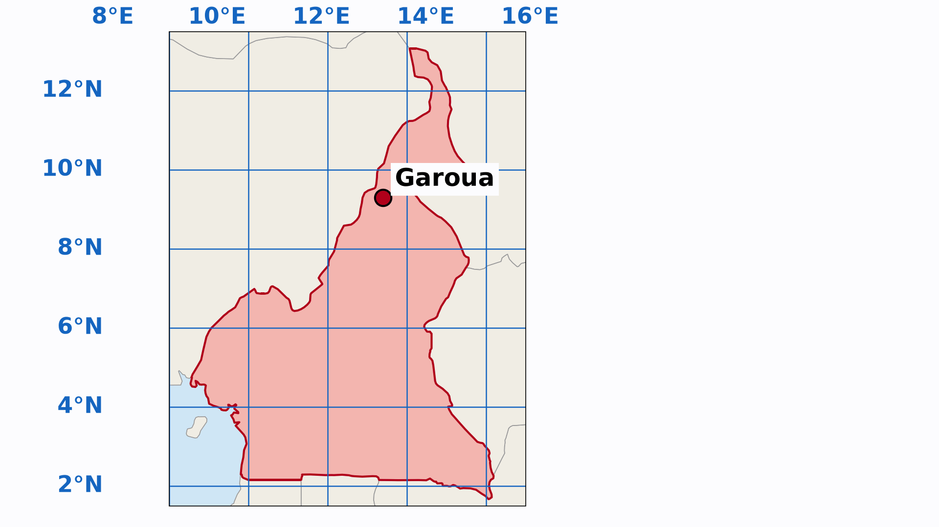
2. PRACTICAL EXERCISE
Activity 2
Animation: reading the coordinates of Garoua.
Notes:
Activity 2. Look carefully at this animation: animation: reading the coordinates of Garoua. Watch the animation to the end; it will play again.

Slide 25
2. PRACTICAL EXERCISE
Activity 2: Question
What are the coordinates of Garoua?
Notes:
Here is the question for Activity 2: What are the coordinates of Garoua? Take one minute to think and write your answer in your rough notebook.

Slide 26
2. PRACTICAL EXERCISE
Activity 2: Answer
About 9° N, 13° E.
Notes:
Let us check the answer together. About 9° N, 13° E.

Slide 27
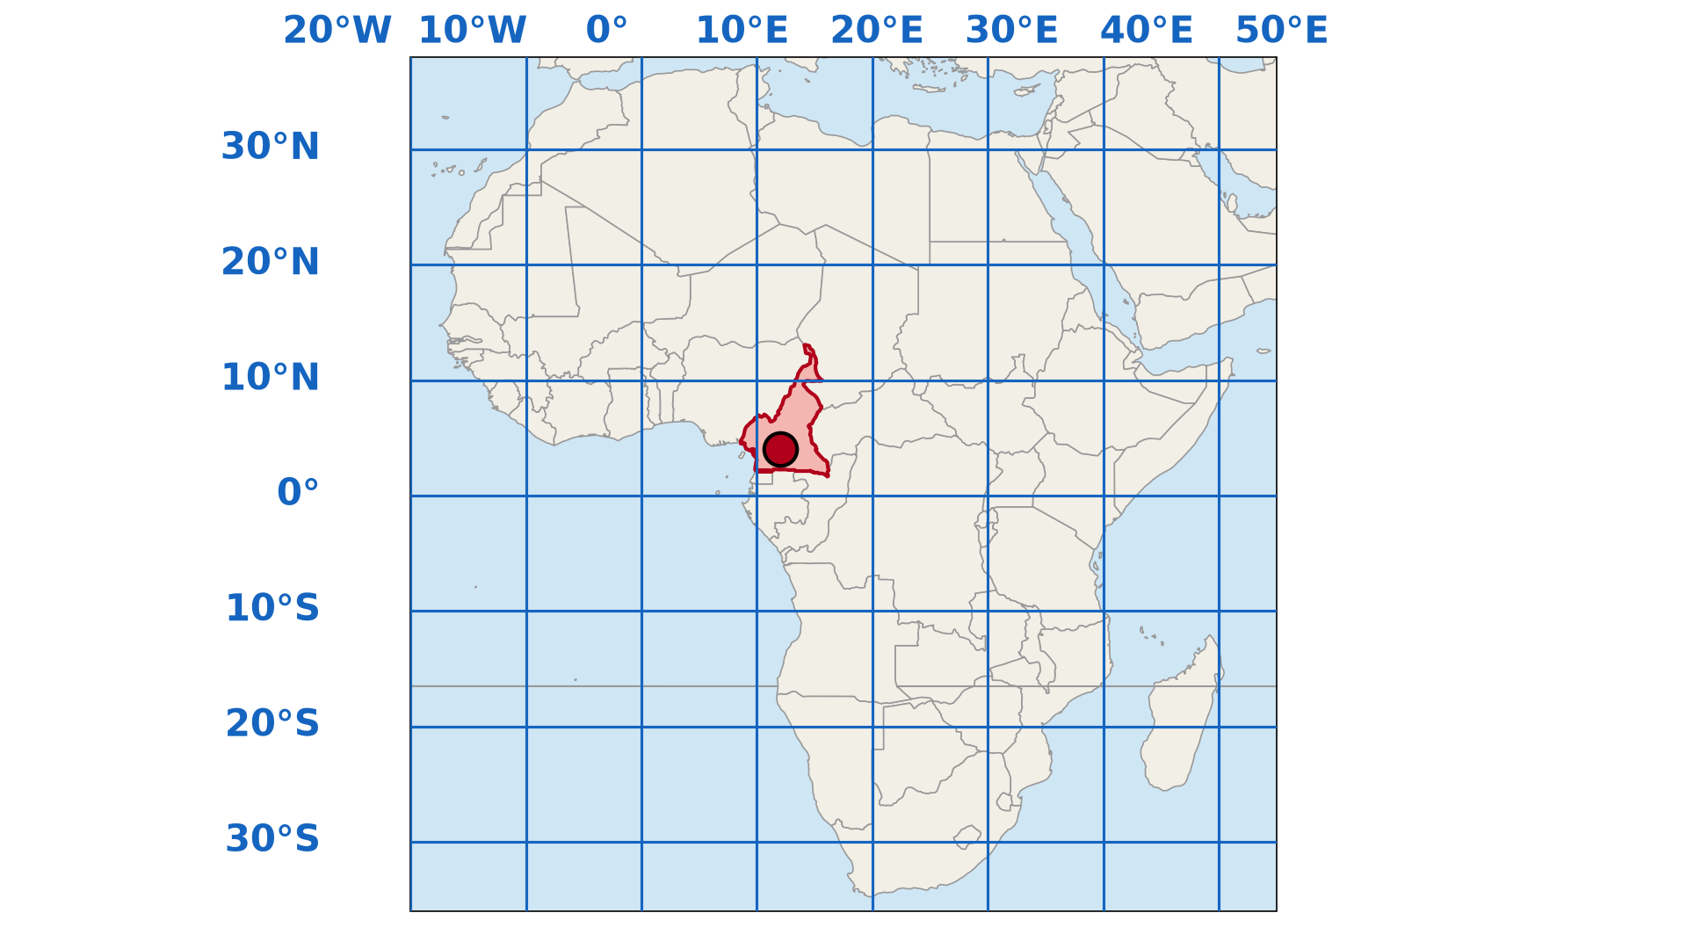
3. CONTEXTUALISATION
Activity 3
Africa with a grid of 10°.
Notes:
Activity 3. Look carefully at this diagram: africa with a grid of 10°. Observe every detail before I ask the question.

Slide 28
3. CONTEXTUALISATION
Activity 3: Question
Between which latitudes does Cameroon lie?
Notes:
Here is the question for Activity 3: Between which latitudes does Cameroon lie? Take one minute to think and write your answer in your rough notebook.

Slide 29
3. CONTEXTUALISATION
Activity 3: Answer
Between about 2° N and 13° N.
Notes:
Let us check the answer together. Between about 2° N and 13° N.

Slide 30
BOARD SUMMARY
Board Summary
Topic: The Earth as a Planet in the Solar System
Sub-topic: Location and Time
Practical Work 1: Locate a Place on a Map
Notes:
Now we are going to copy the board summary. Write the title and the headings neatly in your notebooks. I will give you enough time for each slide, so do not rush.

Slide 31
BOARD SUMMARY
DEFINITIONS
The key terms of this lesson are defined as follows:
Geographical coordinates: They are the latitude and the longitude of a place.
Grid: It is the network of lines of latitude and longitude drawn on a map.
Notes:
Let us copy the definitions. The key terms of this lesson are defined as follows. On this slide we have Geographical coordinates and Grid. Write each point on a new line, with the key term first, and explain it in your own words when we revise.

Slide 32
BOARD SUMMARY
1. Theoretical Basis
We revise the following notions:
Latitude: It is the distance north or south of the Equator, read on the left and right sides of the map.
Illustration: a map of Cameroon with a grid
Notes:
Let us copy Theoretical Basis. We revise the following notions. Copy the point on Latitude on the left, then draw the diagram on the right: a map of Cameroon with a grid. Give it a title and label it clearly.

Slide 33
BOARD SUMMARY
1. Theoretical Basis
Longitude: It is the distance east or west of Greenwich, read at the top and bottom of the map.
Order of writing: We write the latitude first and the longitude second, with N, S, E or W.
Notes:
We continue with Theoretical Basis. On this slide we have Longitude and Order of writing. Write each point on a new line, with the key term first, and explain it in your own words when we revise.

Slide 34
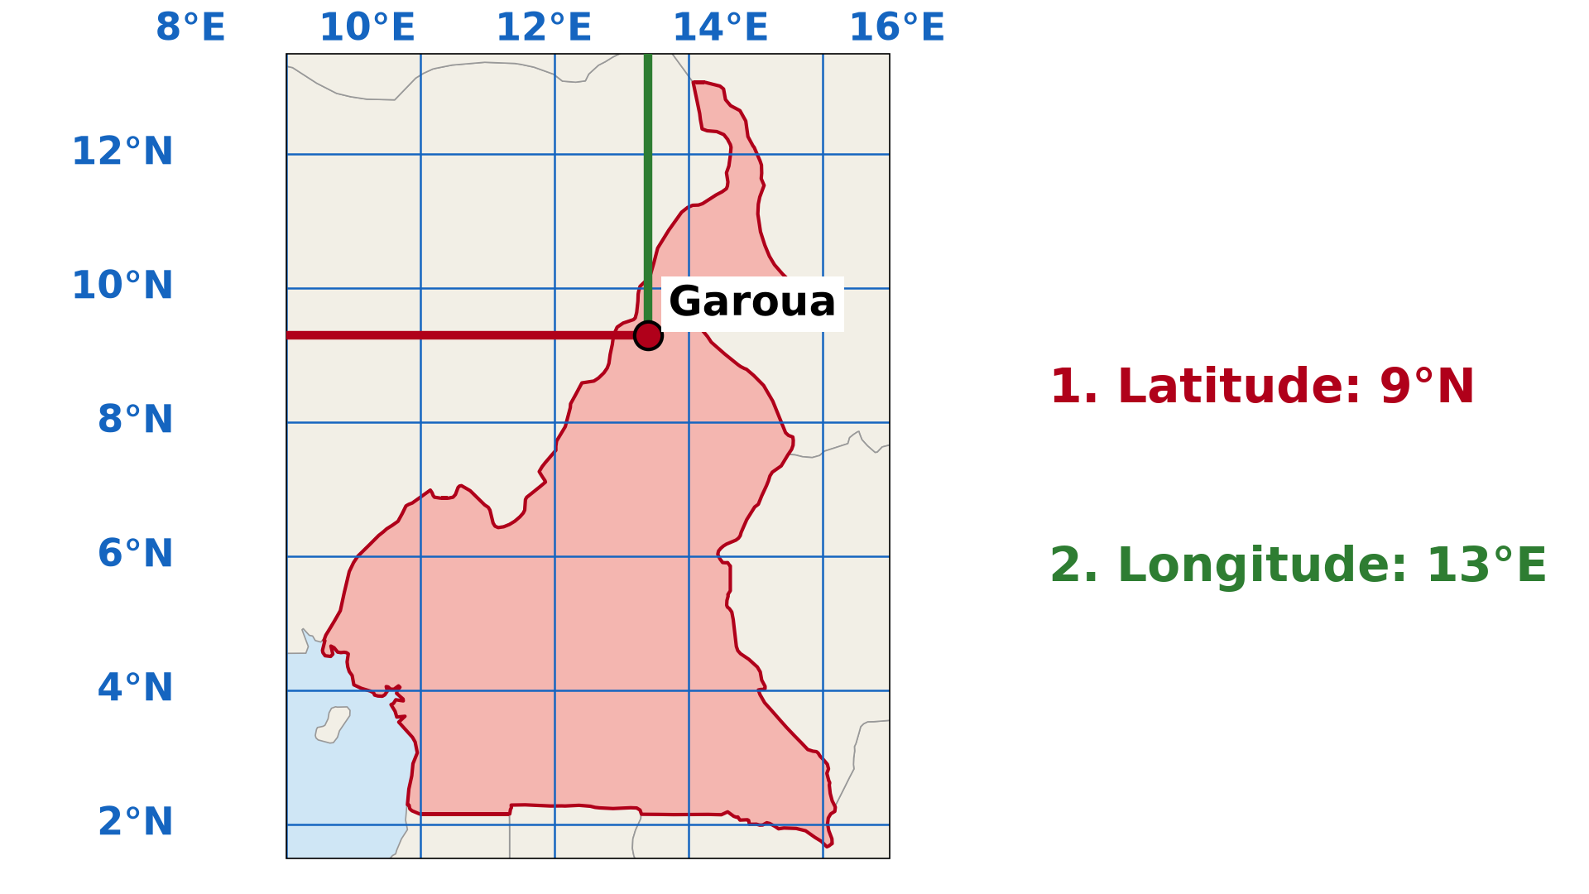
BOARD SUMMARY
2. Practical Exercise
We read the coordinates of a place on a map as follows:
Find the place: We find the town on the map.
Illustration: reading the coordinates of Garoua
Notes:
Let us copy Practical Exercise. We read the coordinates of a place on a map as follows. Copy the point on Find the place on the left, then draw the diagram on the right: reading the coordinates of Garoua. Give it a title and label it clearly.

Slide 35
BOARD SUMMARY
2. Practical Exercise
Read the latitude: We follow the parallel to the side of the map and read its value and N or S.
Read the longitude: We follow the meridian to the top or bottom of the map and read its value and E or W.
Notes:
We continue with Practical Exercise. On this slide we have Read the latitude and Read the longitude. Write each point on a new line, with the key term first, and explain it in your own words when we revise. When you finish, we go to the next slide.

Slide 36
BOARD SUMMARY
2. Practical Exercise (continued)
Write the coordinates: We write them together, for example 9° N, 13° E.
Notes:
We continue with Practical Exercise. On this slide we have Write the coordinates. Write each point on a new line, with the key term first, and explain it in your own words when we revise.

Slide 37
BOARD SUMMARY
3. Contextualisation
A) Cameroon on the Map of Africa
Cameroon is located on the map of Africa as follows:
Latitudes: Cameroon lies between about 2° N and 13° N.
Illustration: Africa with a grid
Notes:
Let us copy Cameroon on the Map of Africa. Cameroon is located on the map of Africa as follows. Copy the point on Latitudes on the left, then draw the diagram on the right: africa with a grid. Give it a title and label it clearly.

Slide 38
BOARD SUMMARY
3. Contextualisation
A) Cameroon on the Map of Africa
Longitudes: Cameroon lies between about 8° E and 16° E.
Position: It is in Central Africa, north of the Equator and east of the Greenwich Meridian.
Notes:
We continue with Cameroon on the Map of Africa. On this slide we have Longitudes and Position. Write each point on a new line, with the key term first, and explain it in your own words when we revise.

Slide 39
BOARD SUMMARY
3. Contextualisation
B) Towns of the Region on the Map of Cameroon
Some towns of our region and of Cameroon have the following coordinates:
Garoua: It is at about 9° N, 13° E.
Maroua: It is at about 11° N, 14° E.
Ngaoundéré: It is at about 7° N, 14° E.
Notes:
Let us copy Towns of the Region on the Map of Cameroon. Some towns of our region and of Cameroon have the following coordinates. On this slide we have Garoua, Maroua and Ngaoundéré. Write each point on a new line, with the key term first, and explain it in your own words when we revise. When you finish, we go to the next slide.

Slide 40
BOARD SUMMARY
3. Contextualisation
B) Towns of the Region on the Map of Cameroon (continued)
Yaoundé: It is at about 4° N, 12° E.
Notes:
We continue with Towns of the Region on the Map of Cameroon. On this slide we have Yaoundé. Write each point on a new line, with the key term first, and explain it in your own words when we revise.

Slide 41
FORMATIVE EVALUATION
Evaluation 1
What do we read first: the latitude or the longitude?
Notes:
Now let us check what you have understood. Question 1: What do we read first: the latitude or the longitude? Answer in your exercise book.

Slide 42
FORMATIVE EVALUATION
Expected Answer
The latitude.
Notes:
The expected answer is: the latitude. If you got it right, well done.

Slide 43
FORMATIVE EVALUATION
Evaluation 2
Which town is at about 4° N, 12° E?
Notes:
Now let us check what you have understood. Question 2: Which town is at about 4° N, 12° E? Answer in your exercise book.

Slide 44
FORMATIVE EVALUATION
Expected Answer
Yaoundé.
Notes:
The expected answer is: yaoundé. If you got it right, well done.

Slide 45
REMEDIATION
Remediation
Fill in the blanks:
On a map, the latitude is read on the ______ side.
The longitude is read at the ______.
Garoua is at about 9° N and ______ ° E.
Notes:
For those who need more practice, fill in the blanks in your exercise book. The answers are: number 1, left (or right); number 2, top (or bottom); number 3, 13.

Slide 46
HOMEWORK
Homework
Look at the time on a phone set to Cameroon time and on a phone or television showing the time in another country (for example Dubai or Brazil). Write both times and the difference.
Notes:
For your homework: Look at the time on a phone set to Cameroon time and on a phone or television showing the time in another country (for example Dubai or Brazil). Write both times and the difference. We shall correct it at the beginning of our next lesson.

Slide 47
NEXT LESSON
Next Lesson
Our next lesson will be on:
Lesson 4: Local Time, Standard Time and Time Zones
Notes:
Our next lesson will be on Lesson 4: Local Time, Standard Time and Time Zones. Thank you for your attention, and see you next time.

Slide 48
BILINGUAL GAME
Bilingual Game (Jeu Bilingue)
English | Français
Map | La carte
Atlas | L'atlas
Grid | La grille / le quadrillage
Edge | Le bord
Degree | Le degré
Minute (of arc) | La minute (d'angle)
Town | La ville
To locate | Localiser
Notes:
Let us play the bilingual game. I say a word in English, and you give me the French word. Then we do the reverse.

Slide 49
LOGBOOK
Official Logbook (1/2)
Module / Topic | The Earth as a Planet in the Solar System
Lesson Title | Practical Work 1: Locate a Place on a Map
Expected Learning Outcomes | Revise the meaning of latitude and longitude on a map. Follow the steps to read the coordinates of a place. Find a place on a map from its coordinates. Give the coordinates of Cameroon and of some of its towns.
Competence | Learners are able to find a place on a map from its coordinates, and to give the coordinates of towns such as Garoua, Maroua and Ngaoundéré.
Notes:
I record this information in the official logbook of the class after the lesson.

Slide 50
LOGBOOK
Official Logbook (2/2)
Matter Taught | DEFINITIONS; Theoretical Basis; Practical Exercise; Cameroon on the Map of Africa; Towns of the Region on the Map of Cameroon.
Evaluation | Formative evaluation and remediation exercise.
Homework | Look at the time on a phone set to Cameroon time and on a phone or television showing the time in another country (for example Dubai or Brazil). Write both times and the difference.
Enrolment / Present / Absent | ____ / ____ / ____
Achievement | To be completed after the lesson.
Notes:
I complete the second page of the logbook: the matter taught, the evaluation, the homework and the attendance.

Slide 51
TEACHER'S NOTE
Teacher's Note
Timing: Homework correction, plan, objectives 4 min | Recall, situation, action 6 min | 3 activities 12 min | Board summary (copying) 15 min | Evaluation, remediation 5 min | Homework, next lesson 3 min | Logbook 5 min
Activity 2 is an animation (GIF): it plays automatically in slide-show mode.
Without the projector (Activity 1): draw a grid on the board and number its sides.
Without the projector (Activity 2): show the steps with a ruler on the map of the atlas.
Without the projector (Activity 3): give learners the atlas map of Africa.
Notes:
This slide is for me, the teacher: it gives the timing of the lesson and what to do if the projector is not available.

Slide 52
REFERENCES
References
National Geography Syllabus (MINESEC), Form 4 — The Earth as a Planet in the Solar System.
Teacher's lesson notes (Form 4), checked and corrected where necessary.
Diagrams and animations: drawn for this lesson (Geography Department).
Notes:
These are the references and picture credits used to prepare this lesson.

